Slide 1
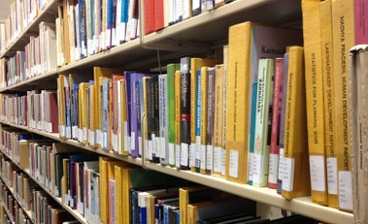
Taking it* to the Stacks:
Collection inventory methods using portable scanners
Michael Magrath
Stacks Management

Slide 2
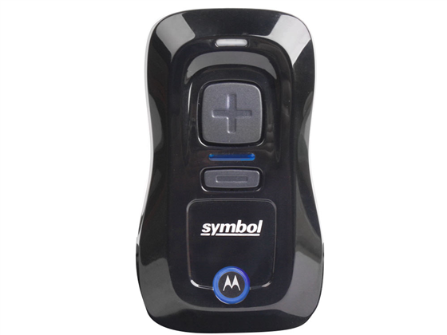
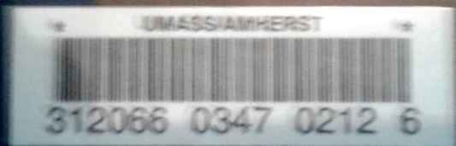
* Mini barcode Reader

Slide 3
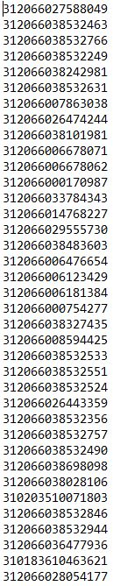
Method
Scan items in Stacks with portable scanner
Rick works his magic on the list

Slide 4
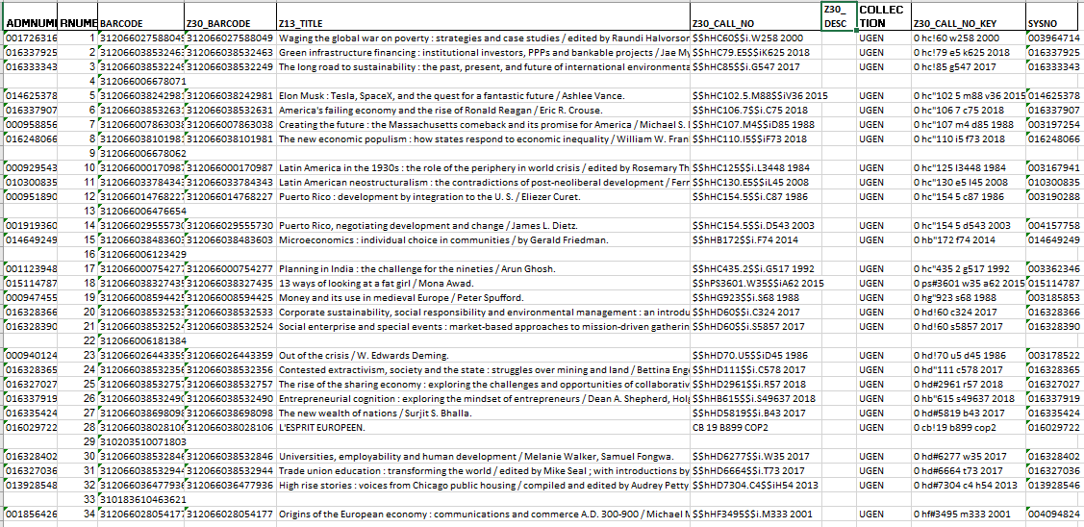
Original

Slide 5
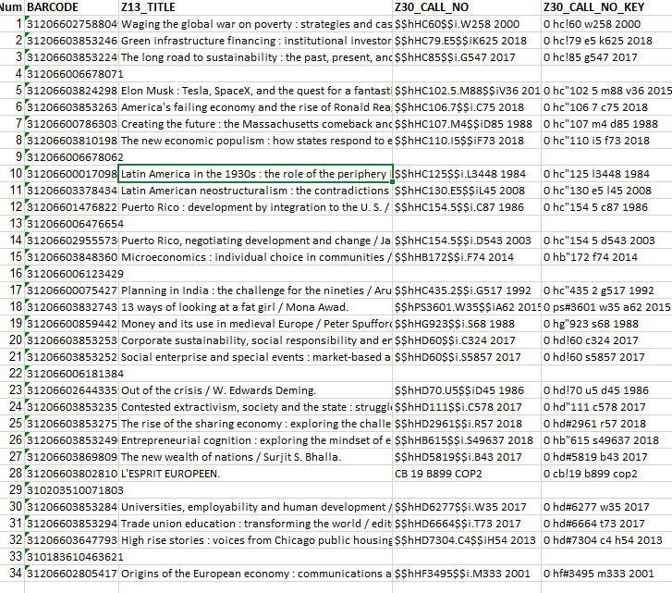
Trimmed

Slide 6
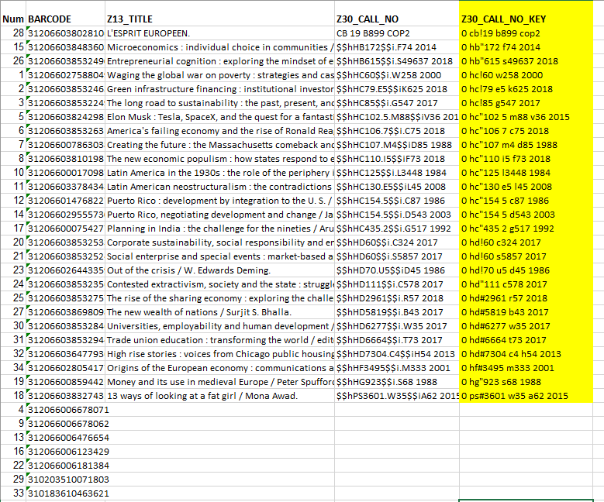
Sort by LC

Slide 7
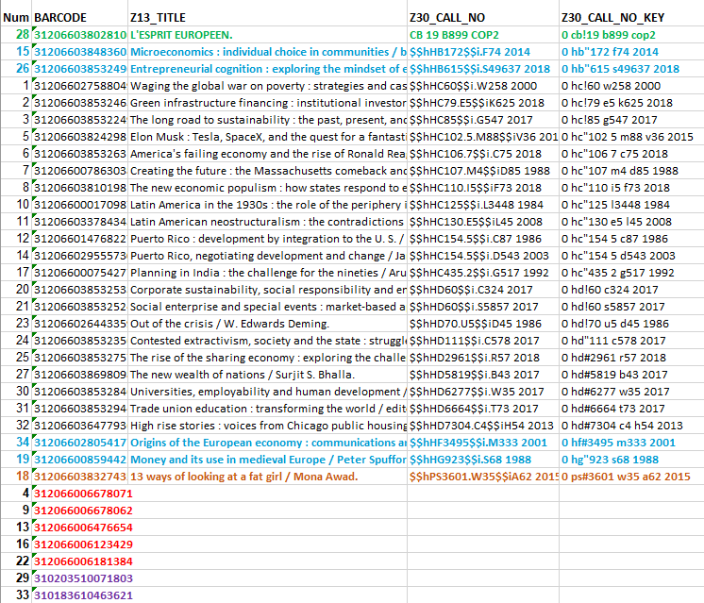
Problems

Slide 8
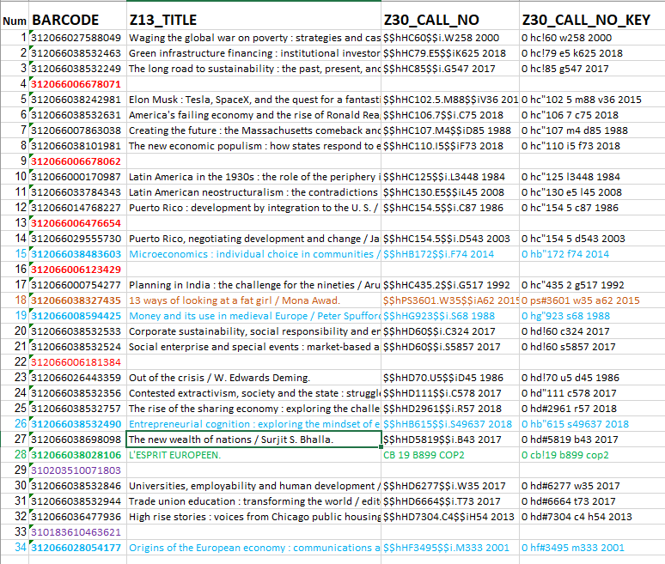
Original Order

