Slide 1



Natural Organic Matter in Water
Formation in Watersheds and Removal in Water Treatment
David A. Reckhow
University of Massachusetts
Notes:
50 min
53 slides

Slide 2
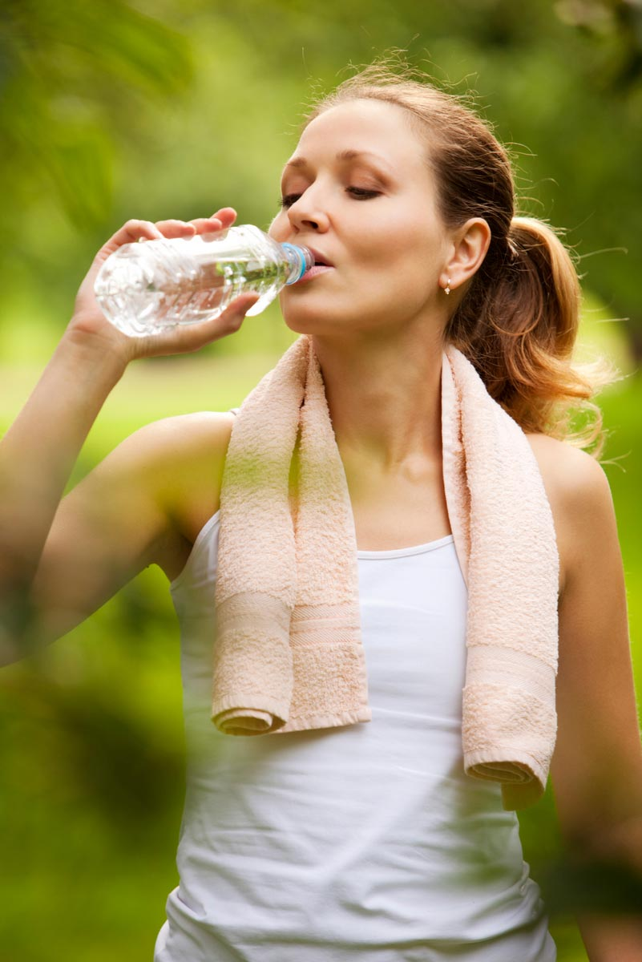
Exposure to Environmental Contaminants?
You are what you drink

Slide 3

Exposure to Environmental Contaminants?
You are what you drink?
You are what you shower with?
Or

Slide 4
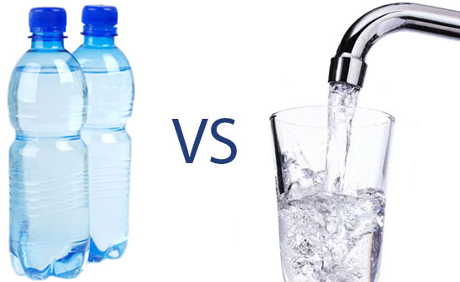
Your favorite Water ?
150 gpcd
Bottled Water
  $4 per gallon
  $220,000 per year per person
Tap Water
  5c per gallon
  $270 per year per person

Slide 5
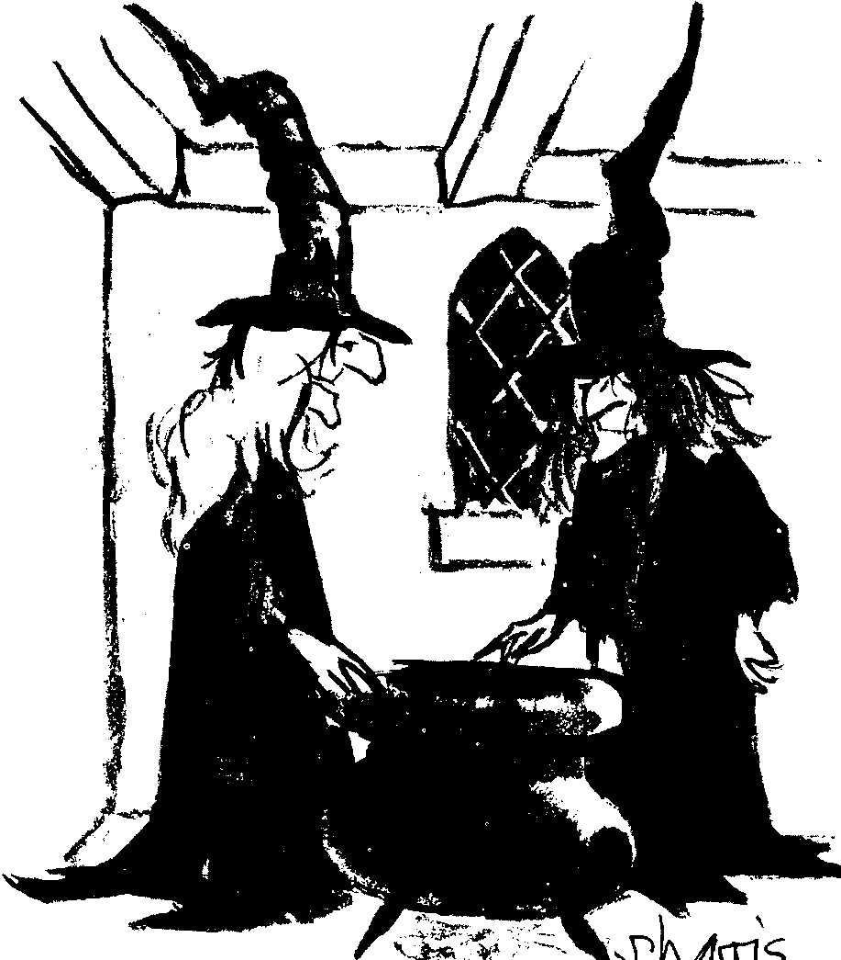
Outline
Intro & Definitions
NOM Generation
  The Hydrologic Cycle
  Land vs Water sources
  Compounds in NOM
Water Treatment
  Historical
  Types of Treatment
  Components or Processes
Some current issues & popular books
It’s one of my favorite recipes. I call it NOM
NOM = Natural Organic Matter
5

Slide 6
What’s in the Water?
Natural Substances
  Natural Organic Matter (NOM)
  Inorganic Substances (Iron, Manganese, sodium, chloride)
Anthropogenic Substances
  Pesticides
  Organic Solvents & Other Industrial Compounds
  Carcinogens
  Pharmaceuticals
  Endocrine Disrupting Compounds
  Flame Retardants
Pathogens and other microorganisms

Slide 7
NOM in Natural Waters:
Some definitions
  Groupings Based on Origin
autochthonous compounds are created within the water body
allochthonous compounds can originate from either the soil or from upstream water bodies
aquagenic, substances originating from any water body
pedogenic for substances originating from soil
7

Slide 8
Watershed Origins
Upper Soil Horizon
Lower Soil Horizon
Lake
Litter Layer
Algae
Aquifer
Sediment & Gravel in Lake Bed
8

Slide 9
Watershed Origins
Lake
Algae
Aquifer
Sediment & Gravel in Lake Bed
9

Slide 10
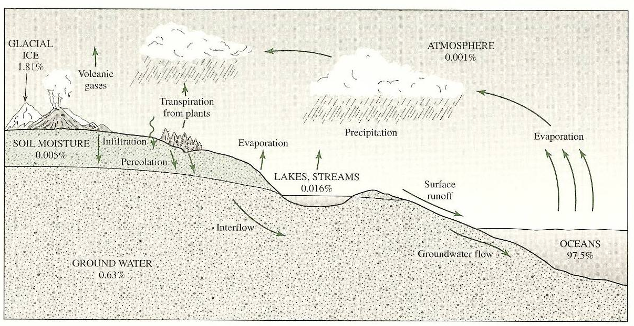
Hydrologic Cycle
D&M, Fig 6-1
Three levels
  Surface runoff, overland flow, direct runoff
  Interflow
  Infiltration, percolation, groundwater flow

Slide 11
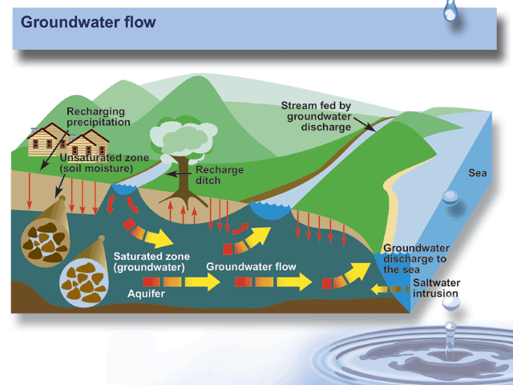
During dry periods: base flow
http://www.ec.gc.ca/water/images/nature/grdwtr/a5f2e.htm

Slide 12
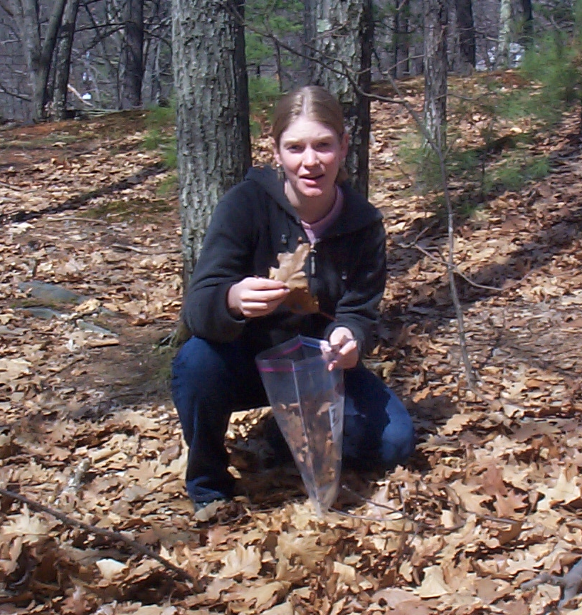
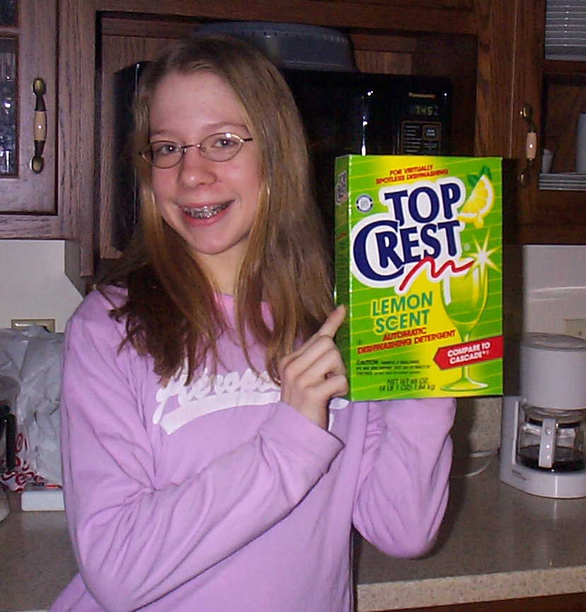
NOM: Which is the bigger source?
or
Allochthonous
  land plants
Autochthonous
  Aquatic plants

Slide 13
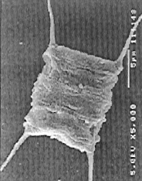
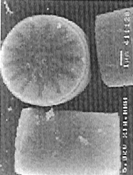
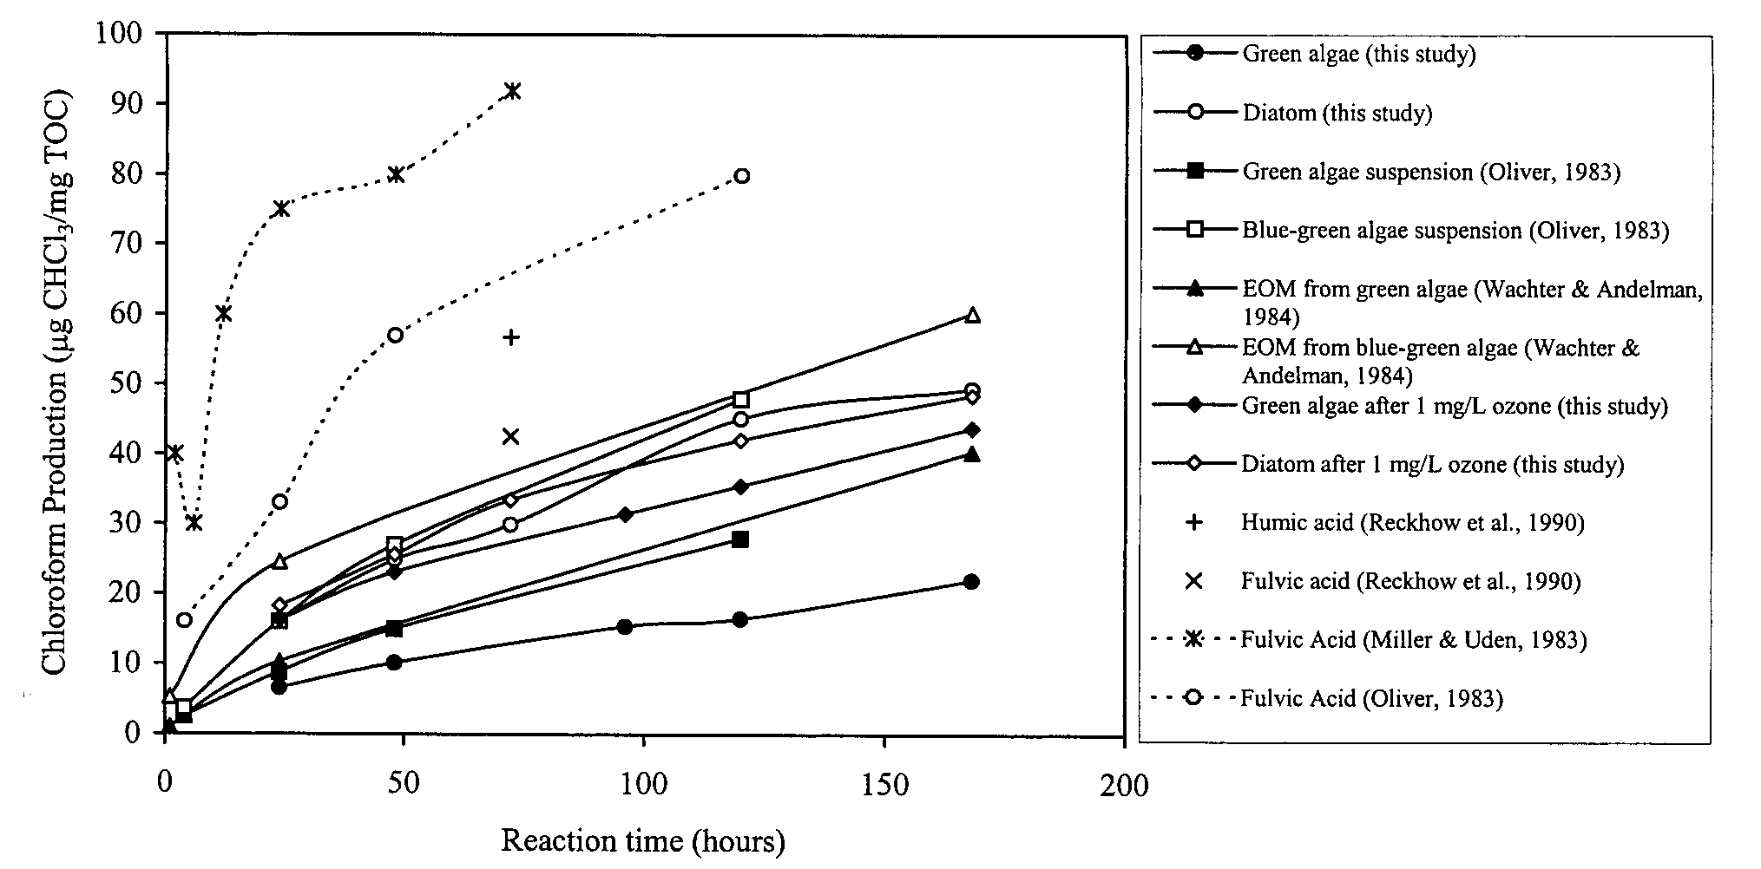
Aquatic sources: Algae
From: Plummer & Edzwald, 2001
  [ES&T:35:3661]
Scenedesmus quadricauda
~25% from EOM
Cyclotella sp.
Algae
pH 7, 20-24ºC, chlorine excess

Slide 14
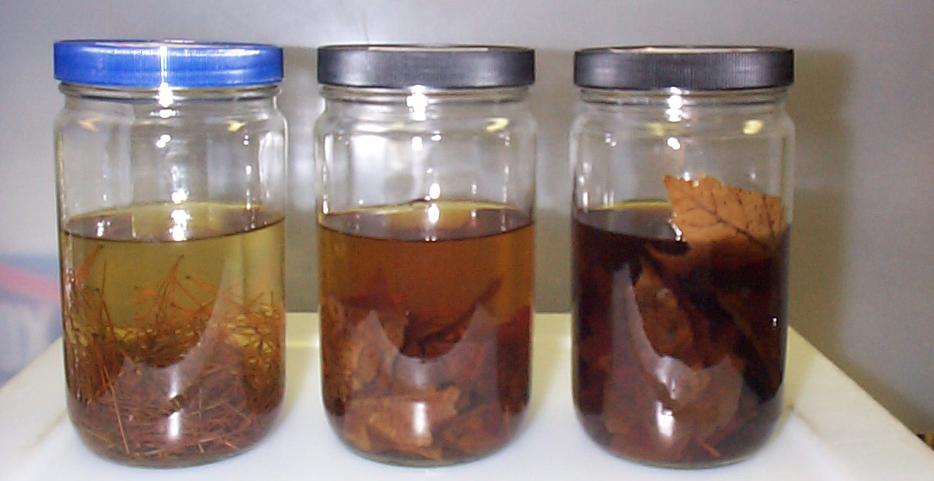
Terrestrial Sources:
Leaching Experiments
Darleen Bryan’s study
White
Pine
White
Oak
Red
Maple

Slide 15
Leaching of leaves
More organic matter released as the leaves remain submerged
Ultraviolet (UV₂₅₄) absorbance measures a certain fraction
The ratio of UV₂₅₄ to dissolved organic carbon (DOC) concentration is called SUVA and reflects organic matter reactivity

Slide 16
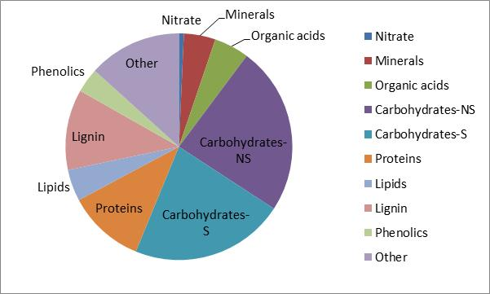
Composition of an “average” leaf
250 g/m²/yr EABP
Highly-colored
Some color

Slide 17
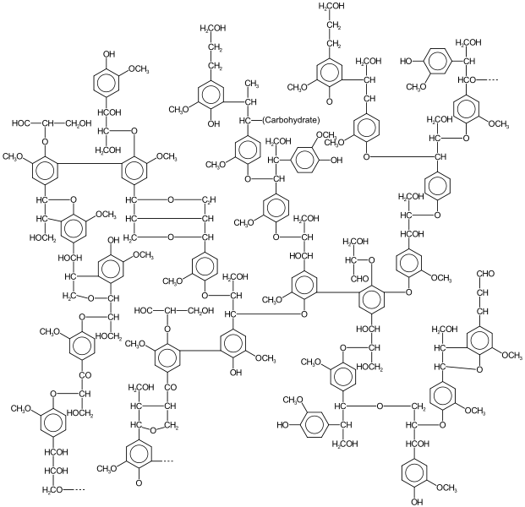
Plant biopolymers
Cellulose
Lignin
  Phenyl-propane units
  Cross-linked
  Radical polymerization
  Ill defined structure
Hemicellulose
Terpeniods
Proteins

Slide 18
Tannins, Aromatic Acids and Phenols, cont.
Lignin monomers
p-Hydroxybenzoic Acid
Vanillic Acid

Slide 19
Tannins, Aromatic Acids and Phenols
Chemical
Symbols
  About 0.5% of Total
  Plant Products
  Likely THM Precursors
  Source of Color & DBPs
Condensed Tannin
Gallic Acid monomers
Hydrolyzable Tannin
Notes:
Tannins are common plant products found in trees, coffee, cocoa, etc. They all share an ability to turn animal skins into leather, rendering non-putrescable. Some tannins have been used as an antidote to poisons. They have also been useful in the treatment of diarrhea. Some tannins may also play a role in mouth and throat cancer.

Slide 20
Carbohydrates
empirical formula: C_{x}(H₂O)_{y}
Glucose (monosaccharide) Cellulose (polysaccharide)
Glucosamine (amino sugar)

Slide 21
Fatty Acids
At neutral pH’s most lose H⁺
CH₃-COO⁻
  maybe 4% of DOC
  other mixed acids may account for 2%
H-COOH CH₃-COOH CH₃-CH₂-COOH
Formic Acid Acetic Acid Propionic Acid
CH₃-CH₂-CH₂-COOH H₃-CH₂-CH₂-CH₂-COOH
Butyric Acid Valeric Acid
Common Volatile Fatty Acids in Natural Waters

Slide 22
Amino Acids and Proteins
Simple Amino Acids
  Amine and acid groups
Alanine
Tyrosine
Polypeptides & Proteins
  Comprised of many AAs

Slide 23
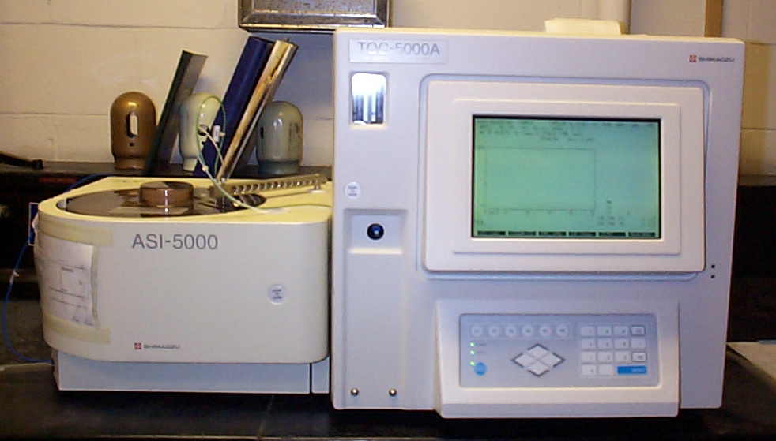
NOM Quantification: TOC & DOC
Filter
Principle: oxidize all organic matter to Carbon dioxide and water. Then measure the amount of carbon dioxide produced
      Oxidation
  High Temperature Pyrolysis
  UV Irradiation
  Heated Persulfate
  UV/Persulfate

Slide 24
Concentrations: Pedogenic
Land Sources
  From Woody & non-woody plants
  Depends on vegetation, soil, hydrology
  Most biodegradable fractions are quickly lost
Attenuated by adsorption to clay soils
  Parallel watersheds in Australia (Cotsaris et al., 1994)
    Clearwater Creek, high clay content: 2.5 mg/L TOC
    Redwater Creek, sandy soil: 31.7 mg/L TOC
Increasing?; link to global warming?
24

Slide 25
Concentrations: Aquagenic
Algal & aquatic plant Sources
  Depend on nutrient levels / trophic state
Concentrations in Lakes (mg/L) (Thurman, 1985)
Groundwater average: 0.7 mg/L
  No algae, much soil attenuation
25

Slide 26

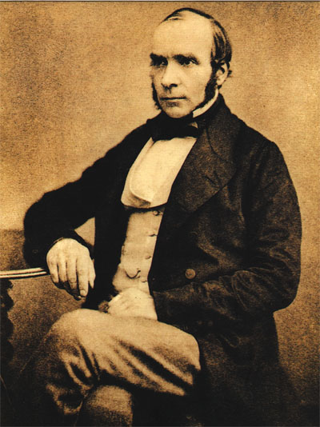
John #I: Dr. John Snow
2006
1813-1858
Characterizing “the
acute problem”
Cholera
  First emerged
  in early 1800s
  1852-1860: The third cholera pandemic
    Snow showed the role of water in disease transmission
      London’s Broad Street pump (Broadwick St)
    Miasma theory was discredited, but it took decades to fully put it to rest
Notes:
Other books:
The Strange Case of the Broadstreet Pump: John Snow and the Mystery of Cholera (2007)
The Medical Detective: John Snow, Cholera and the Mystery of the Broad Street Pump (2007)
The Blue Death: Disease, Disaster and the Water we Drink (2007)
Cholera, Chloroform and the Science of Medicine: A Life of John Snow (2003)

Slide 27
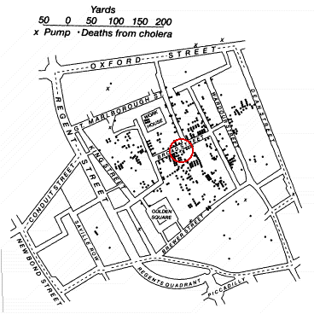
Cholera in London & Dr. John Snow
During an outbreak of cholera in London in 1854, John Snow plotted on a map the location of all the cases he learned of. Water in that part of London was pumped from wells located in the various neighborhoods. Snow's map revealed a close association between the density of cholera cases and a single well located on Broad Street.
Removing the pump handle of the Broad Street well put an end to the epidemic. This despite the fact that the infectious agent that causes cholera was not clearly recognized until 1905.
John Snow's map showing cholera deaths in London in 1854 (courtesy of The Geographical Journal). The Broad Street well is marked with an X (within the red circle).
http://www.ph.ucla.edu/epi/snow.html

Slide 28
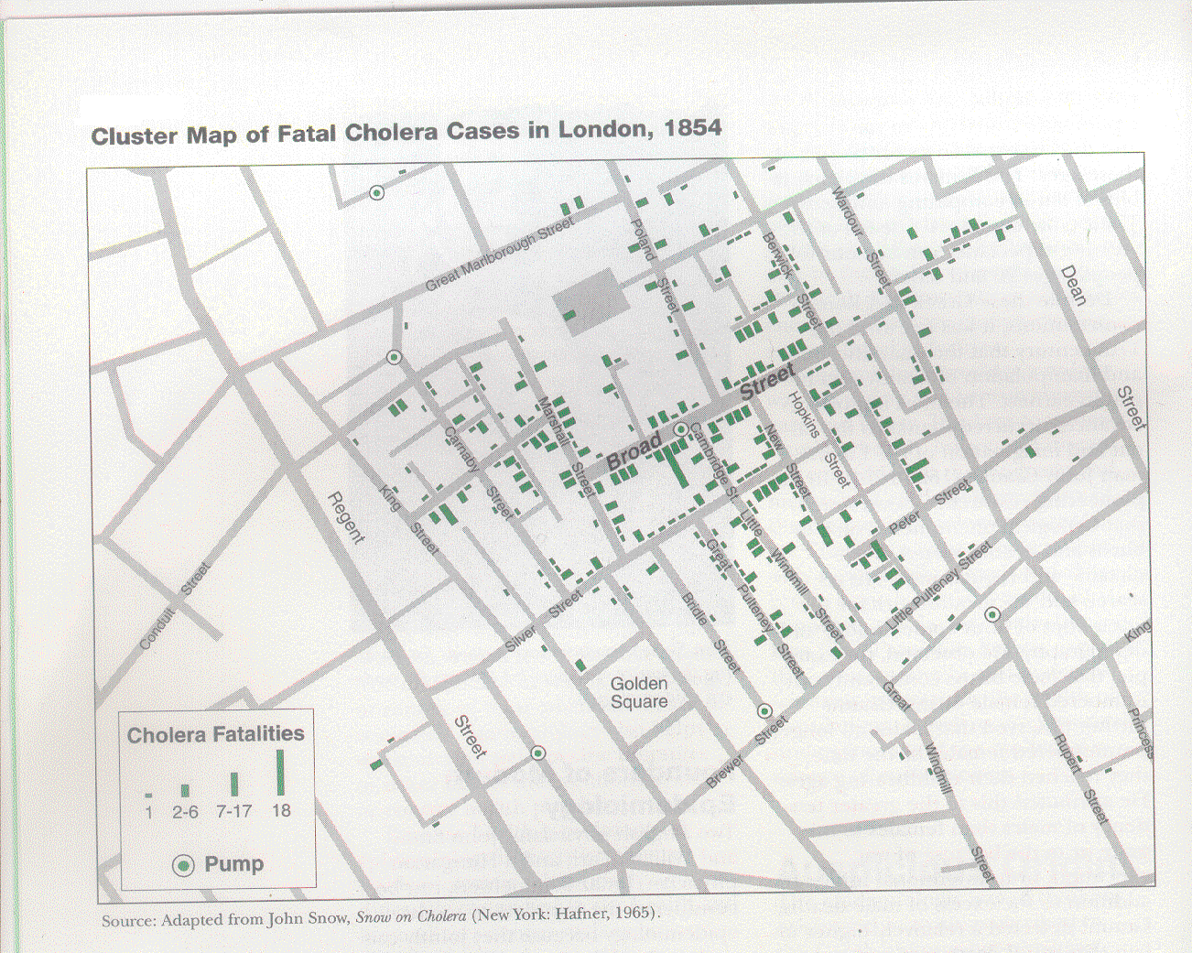
Soho, Westminster
Picadilly Circus

Slide 29
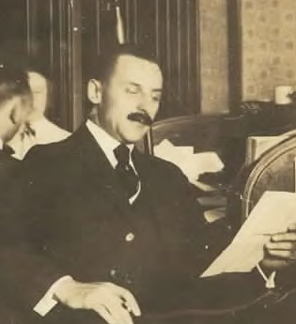
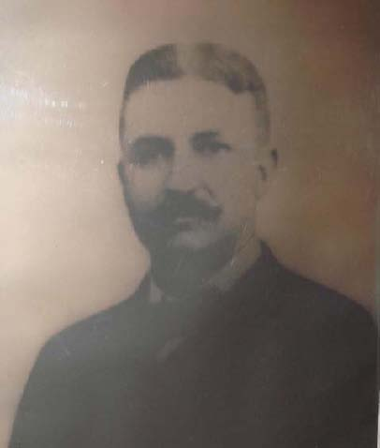
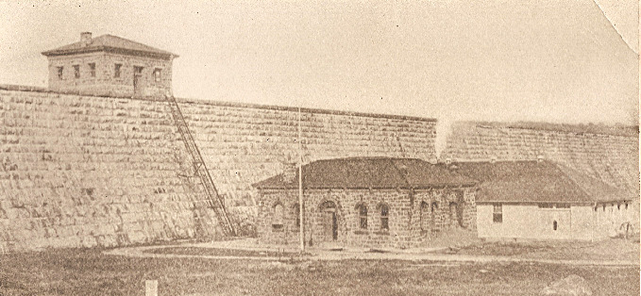
John #2: Dr. John L. Leal
Photo courtesy of the Leal family and Mike McGuire
Solutions to “the acute problem”
  Jersey City’s Boonton Reservoir
  Leal experimented with chlorine,
  its effectiveness and production
    George Johnson & George Fuller worked with Leal and designed the system (1908)
1858-1914
“Full-scale and continuous implementation of disinfection for the first time in Jersey City, NJ ignited a disinfection revolution in the United States that reverberated around the world”
M.J. McGuire, JAWWA 98(3)123

Slide 30
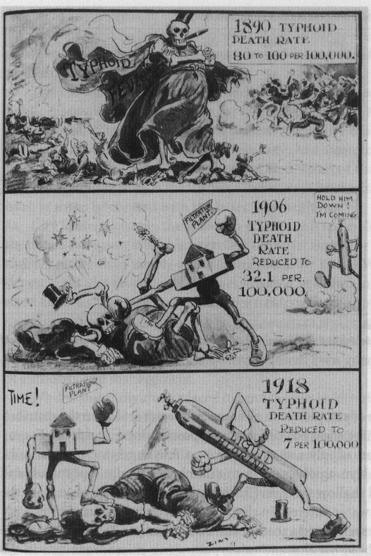
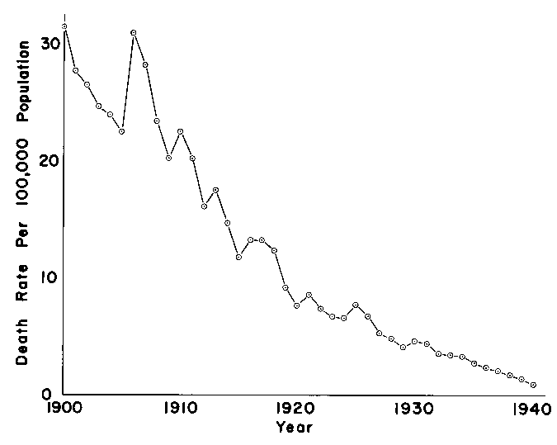
Chlorination
1-2 punch of filtration & chlorination
Greenberg, 1980, Water Chlorination, Env. Impact & Health Eff., Vol 3, pg.3, Ann Arbor Sci.
US Death Rates for Typhoid Fever
Melosi, 2000, The Sanitary City, John Hopkins Press

Slide 31
Today’s Conventional Treatment
Coagulation & solids separation
  Use of alum or another chemical coagulant
  rapid mix, flocculation, settling, filtration
Disinfection
  including clearwell for contact time
Most common sequence for surface water
Removes some of the NOM & suspended particles
Kills or inactivates pathogenic organisms
Corrosion Control
Fluoride
Dist.
Sys.
Coagulant
Disinfectant
Clear
well
raw water
rapid
mix
flocculation
Settling
Filtration

Slide 32
Coagulation chemistry
Ferric Sulfate
Alum
Mechanisms
Precipitation of metal hydroxide, then:
  Adsorption of contaminants
  Enmeshment of particles

Slide 33
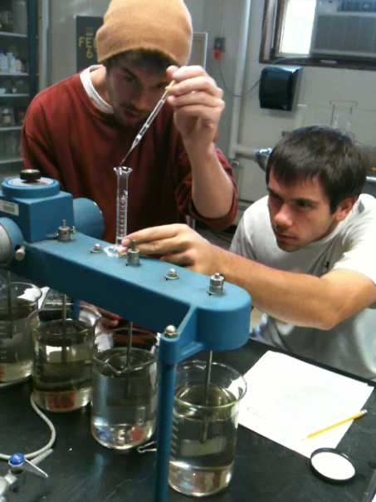
NOM removal by alum coagulation
Impacts of pH and dose
Rennes IV Raw Water
(France) 11/19/84
Reckhow & Bourbigot (unpublished data)
Mn precipitation

Slide 34
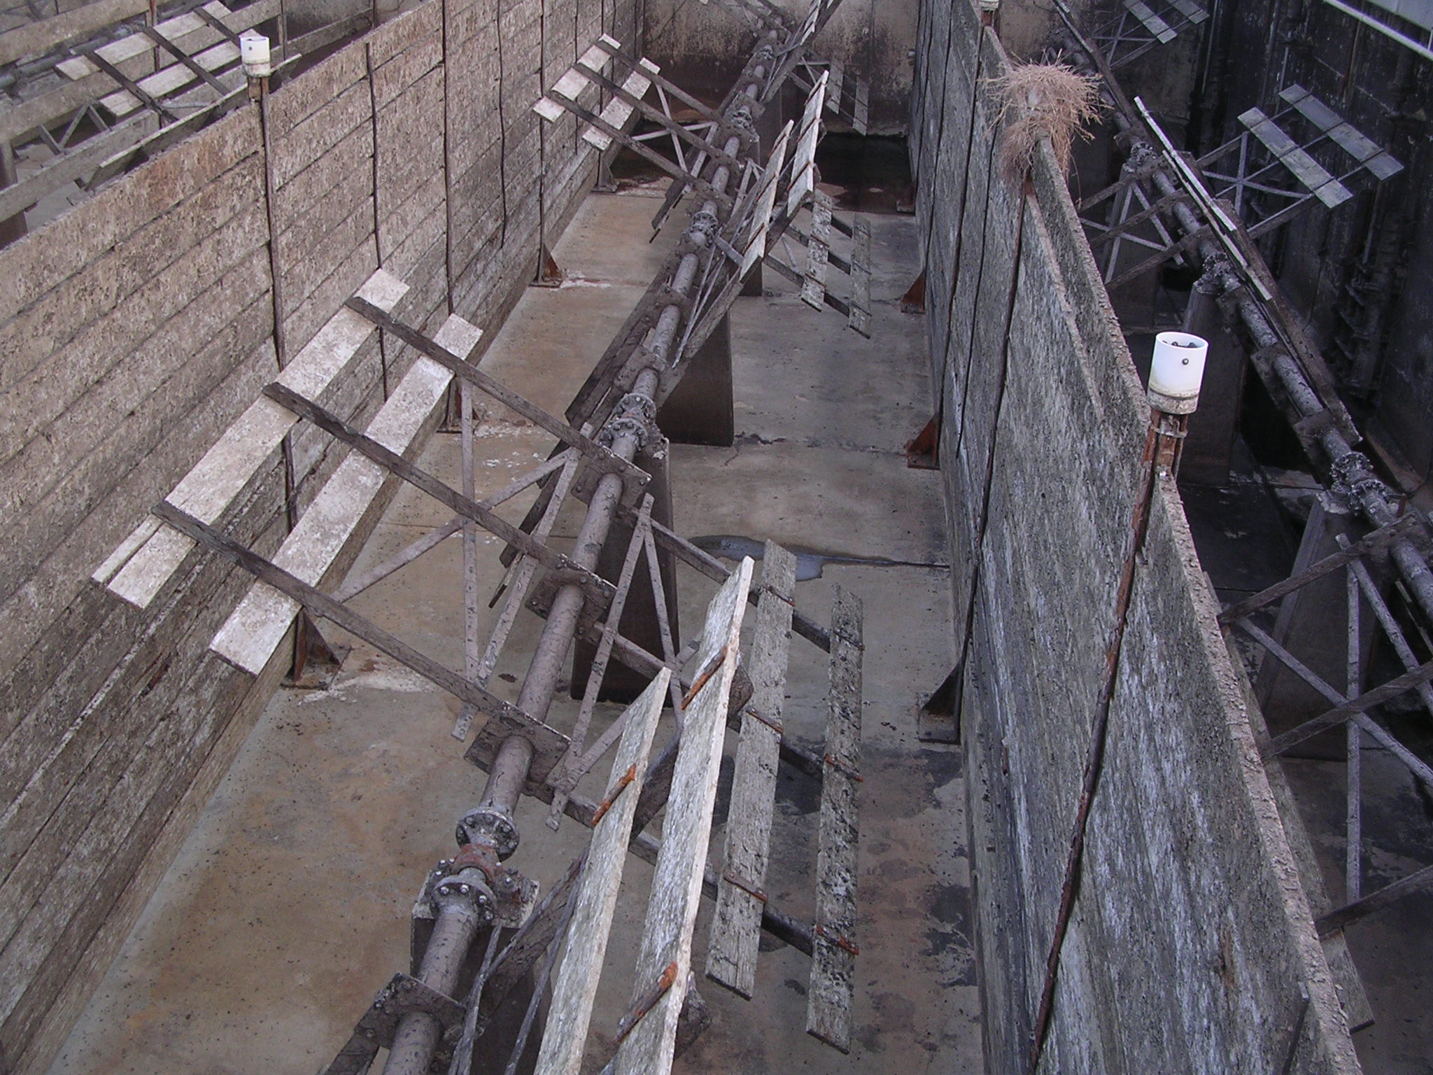
Flocculation
An Empty full-scale rectangular flocculation tank in Southern CA
Can be done in the lab by slowly mixing your sample with a stirrer or on a shaking table
MWDSC
Weymouth Plant
12 Dec 05

Slide 35
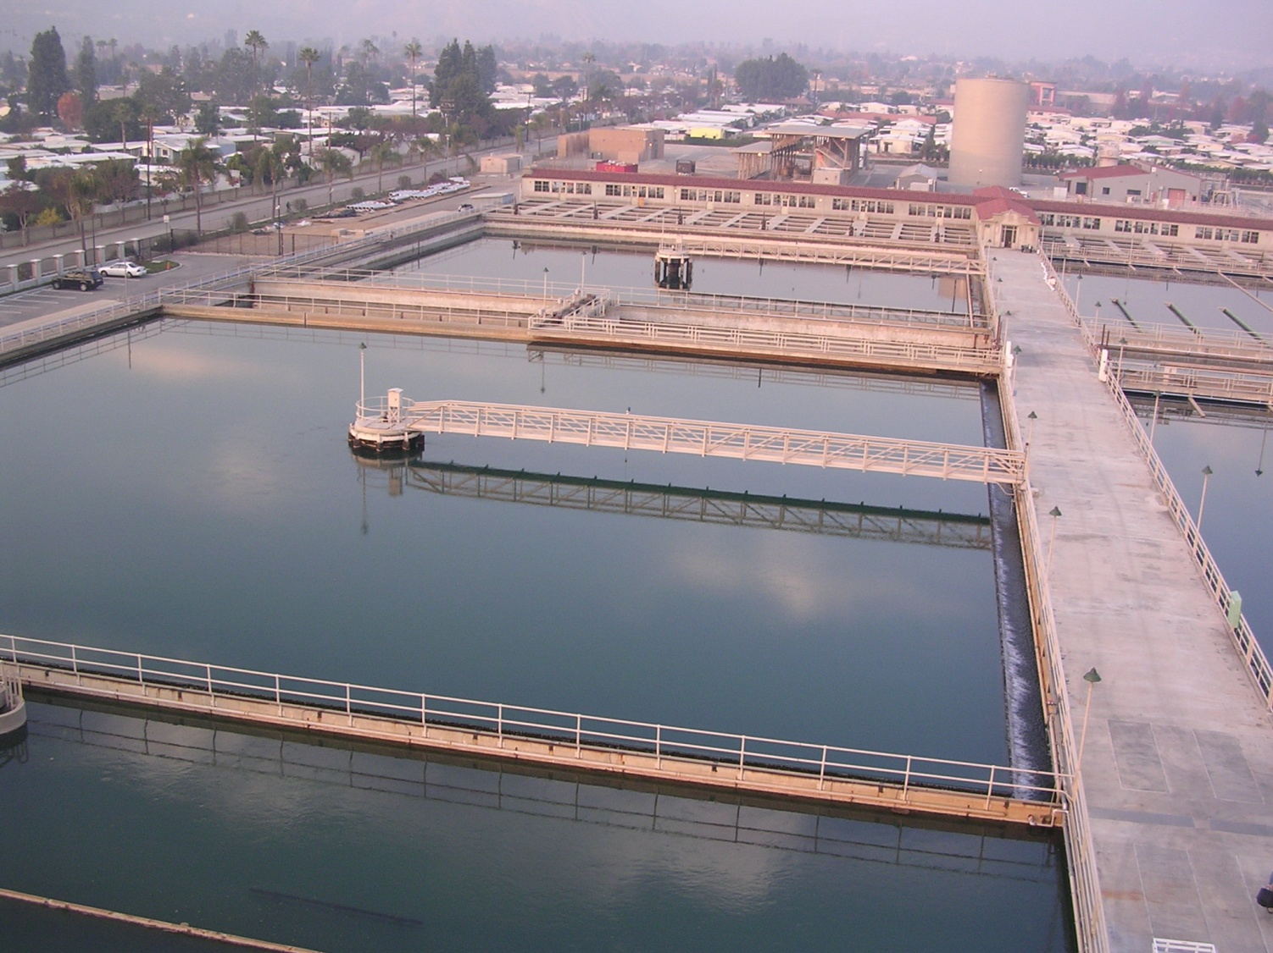
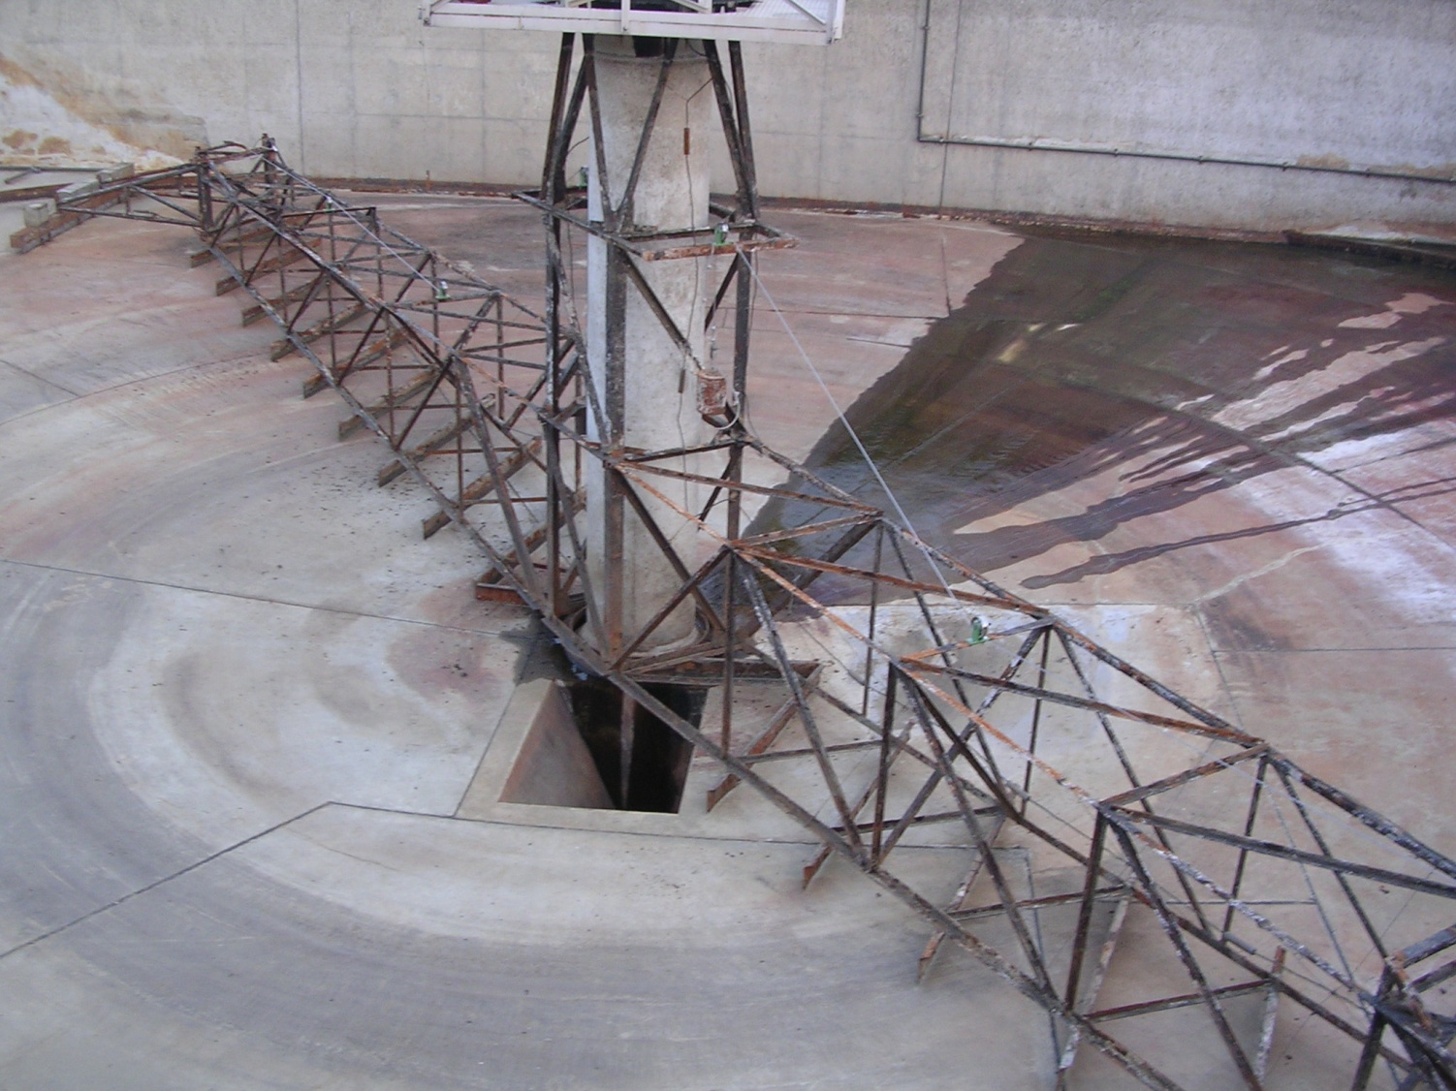
Settling
Circular and rectangular designs
Can be done in the lab by letting your sample sit in a jar quiescently
MWDSC
Weymouth Plant
12 Dec 05

Slide 36
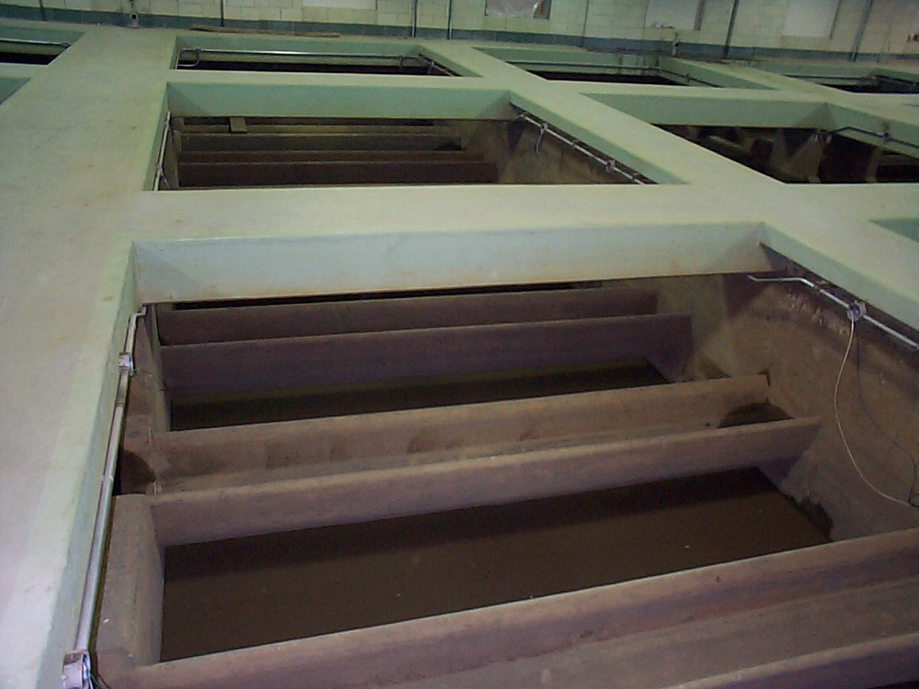
Filtration
Sand media
  Empty filter, not in service (Cincinnati)

Slide 37
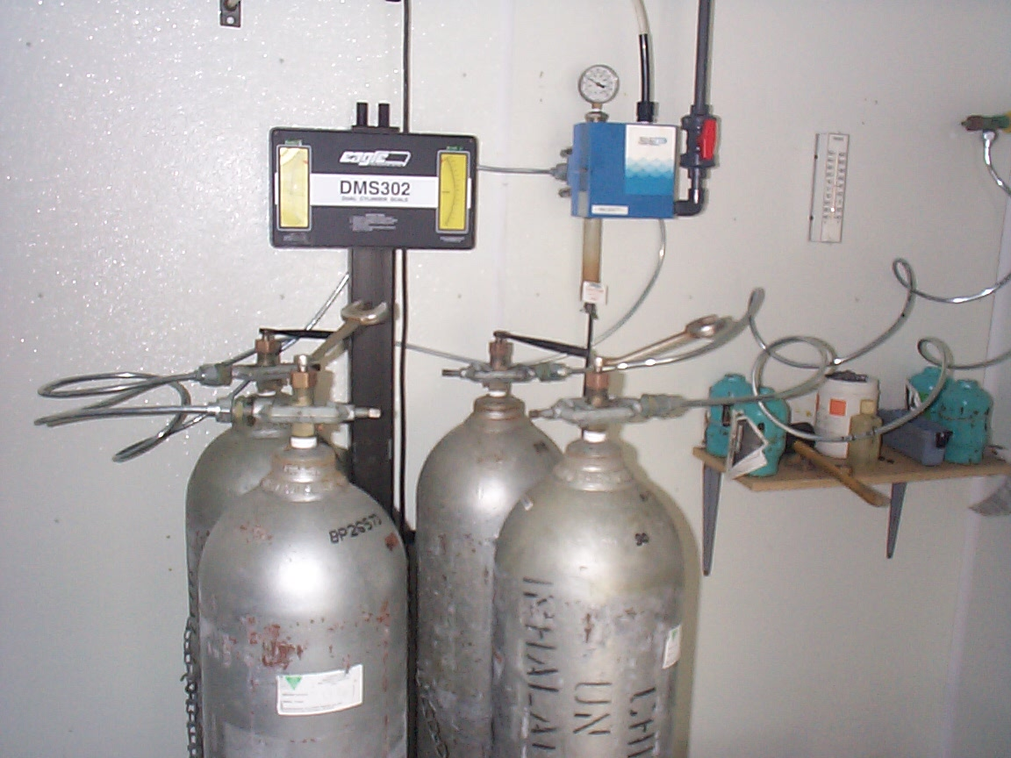
Chlorination
Chlorine tanks
  Left side is currently feeding
  Right side is on reserve

Slide 38
Other Types: Ozone Plants
Many types
  Simplest type: ozone, non-filtration shown below
    examples: MWRA (Boston), Portland ME
  More complex: including coagulation & Filtration
    examples: Andover MA, Amherst MA
  Always includes final disinfection with chlorine or chloramines
Cl₂
O₃
Dist.
Sys.
Cl₂
NH₃

Slide 39
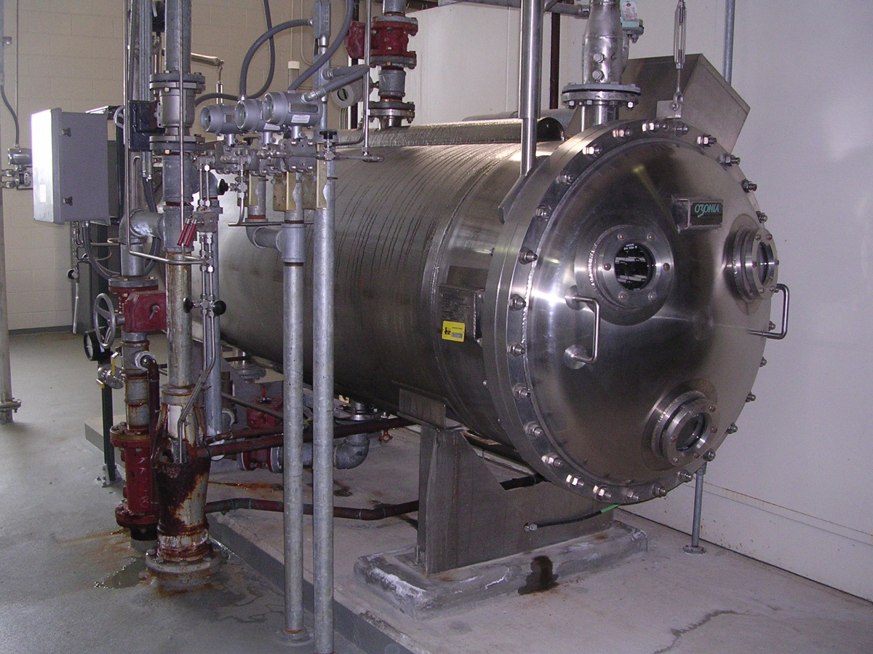
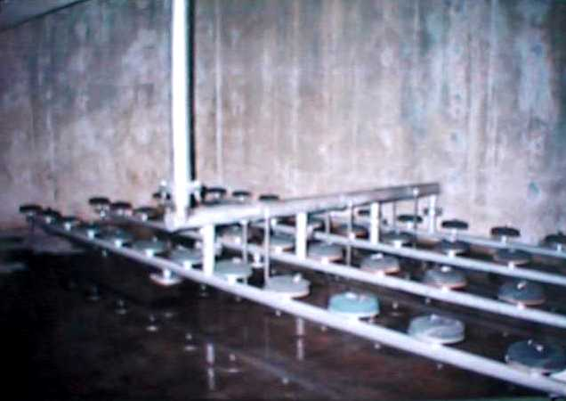
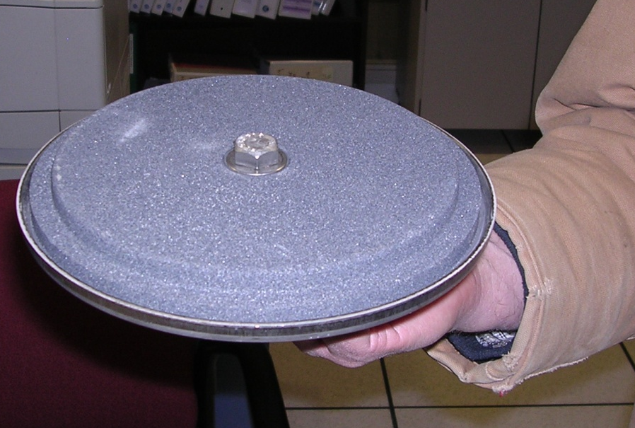
Ozone
Generator
Diffusers
Can be done in the lab with a $70 fish tank sized ozone generator

Slide 40
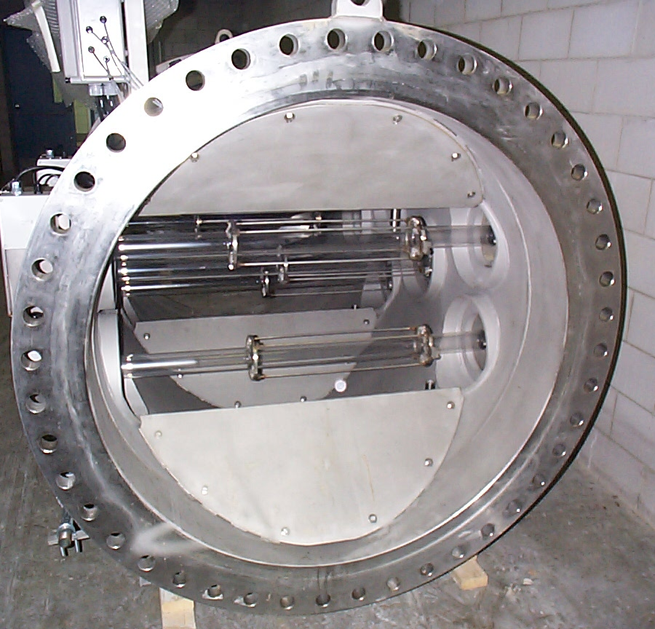
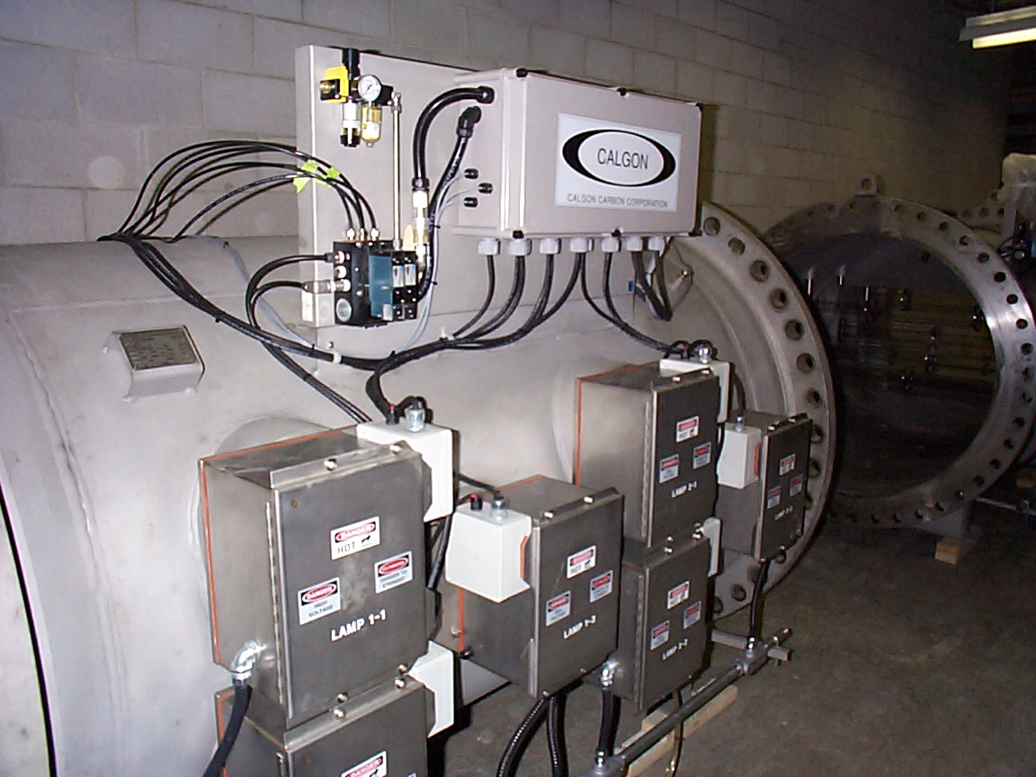
Ultraviolet Light
Waterloo, Ont

Slide 41
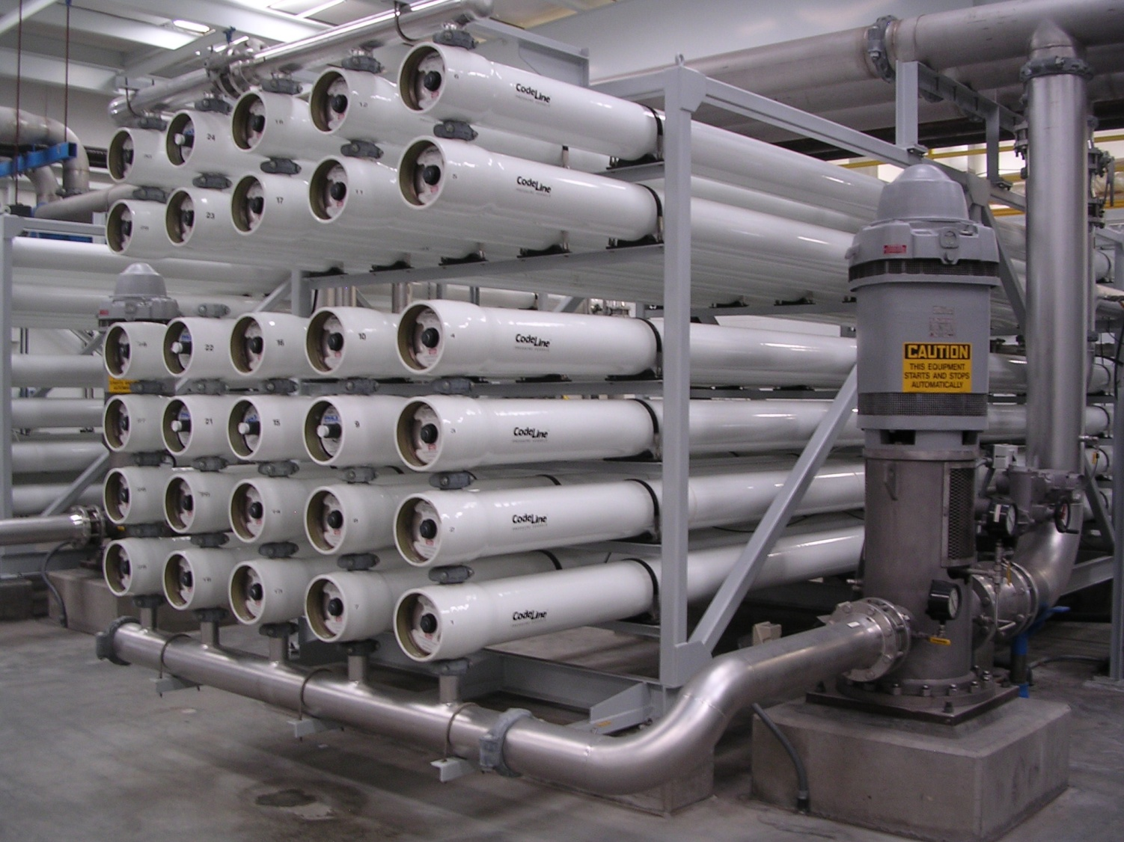
Membrane Treatment
National City, CA

Slide 42
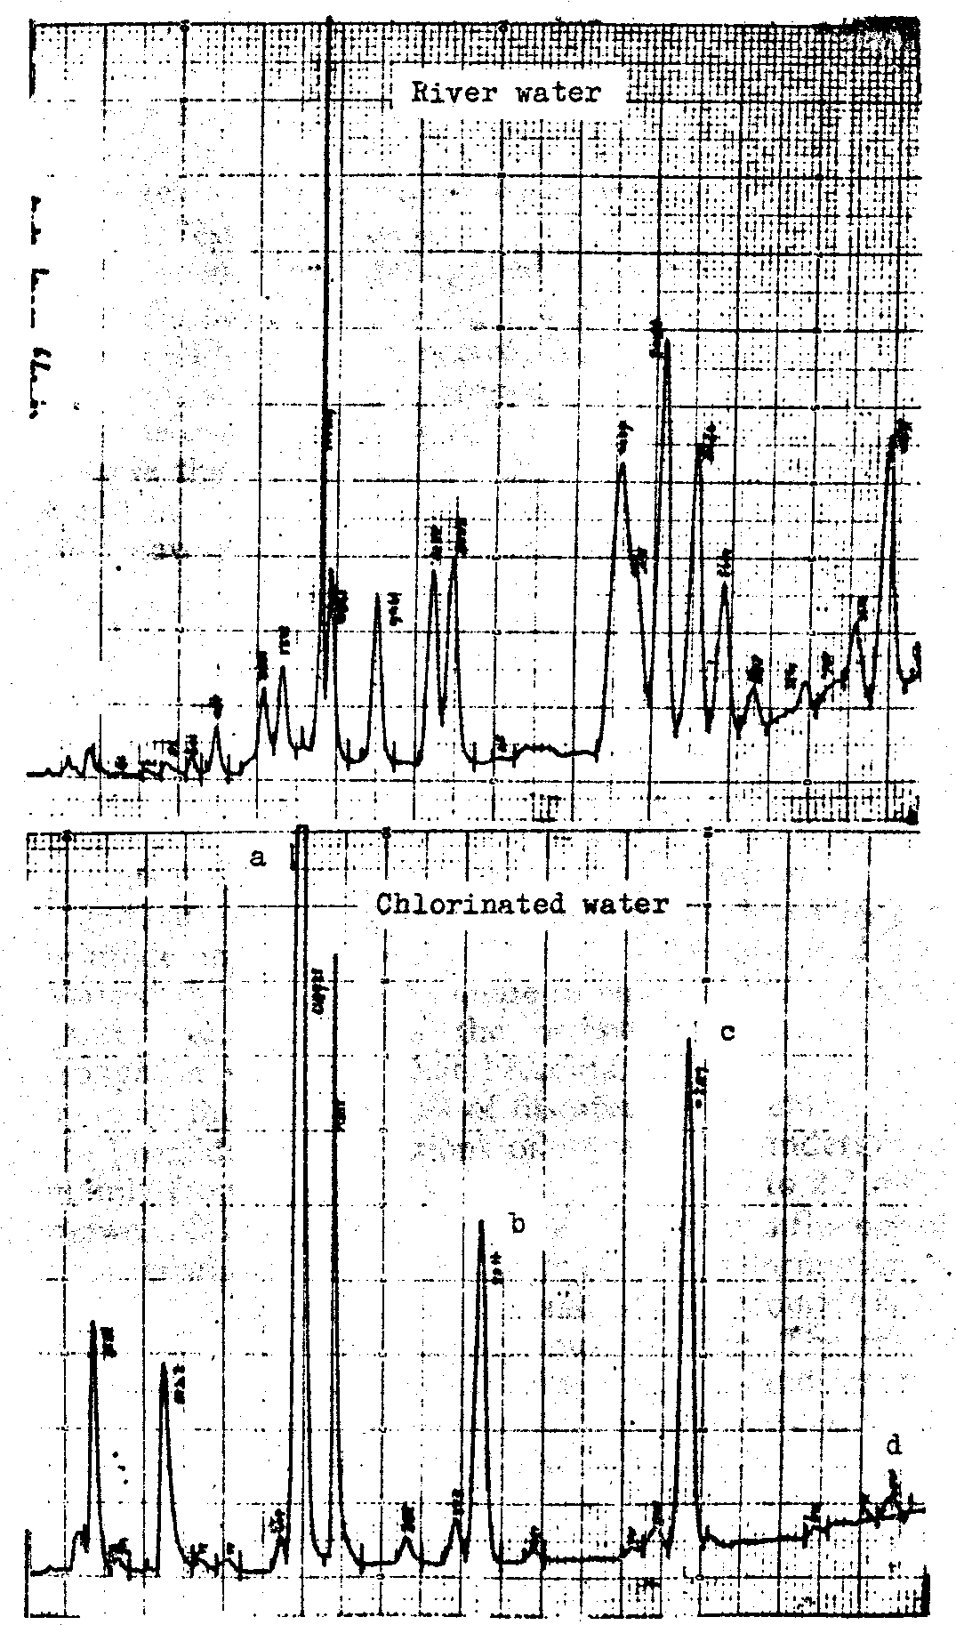
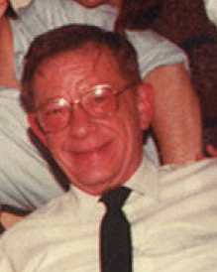

John #III: John Rook
1921-2010
Chlorine: “the chronic problem”
  Brought headspace analysis from the beer industry to drinking water
  Found trihalomethanes (THMs) in finished water
    Carcinogens !?!
  Published in Dutch journal H2O, Aug 19, 1972 issue
  Deduced that they were formed as byproducts of chlorination
  Proposed chemical pathways
Rook, 1974, Water Treat. & Exam., 23:234

Slide 43
Reactions with Disinfectants: Chlorine
The Precursors!
Oxidized NOM
and inorganic chloride
  Aldehydes
HOCl
+ natural organics
(NOM)
Chlorinated Organics
  TOX
  THMs
  HAAs
The THMs

Slide 44
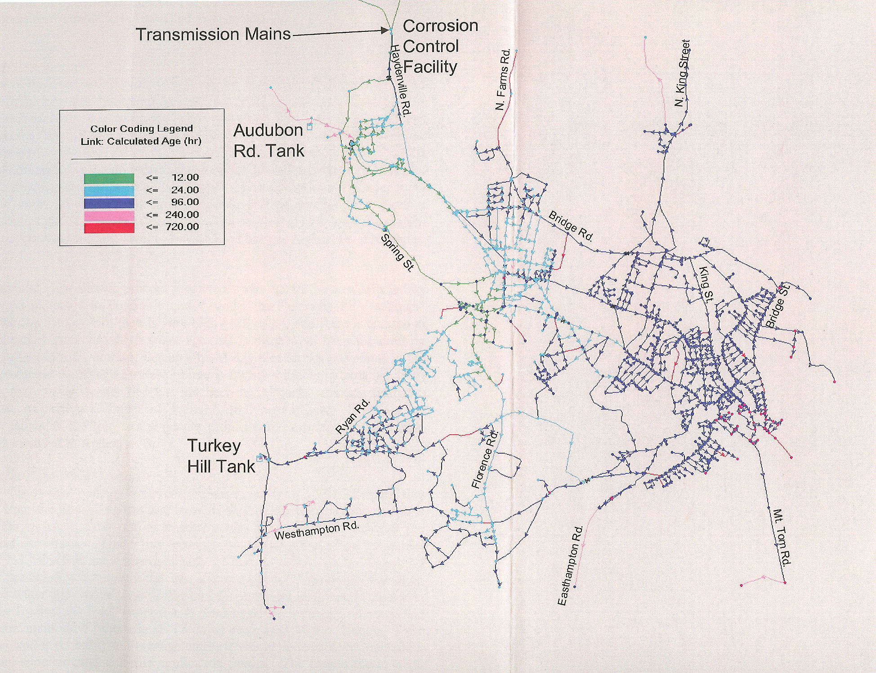
a
Hours of transit time
from the water filtration plant
to your house

Slide 45
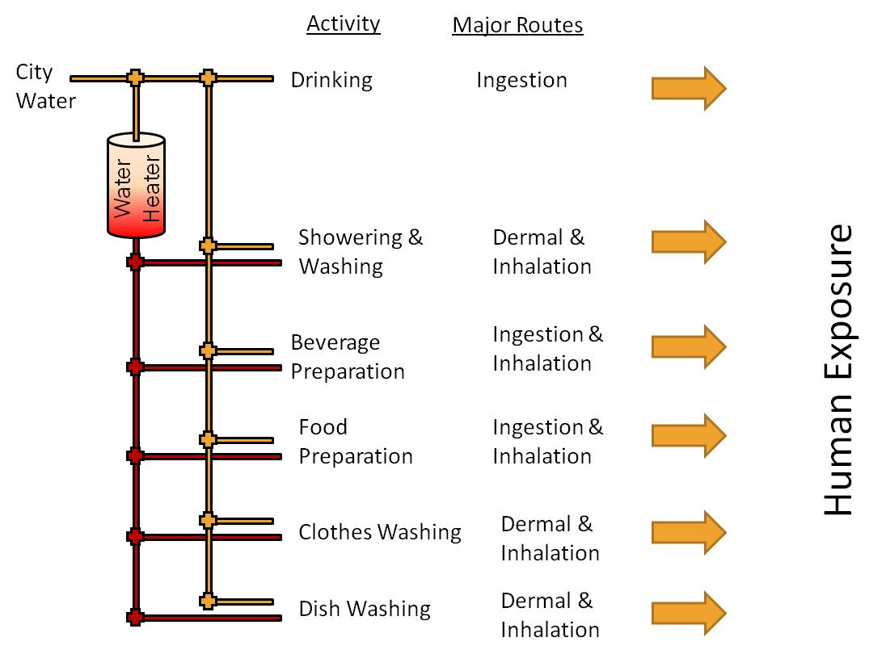

Slide 46
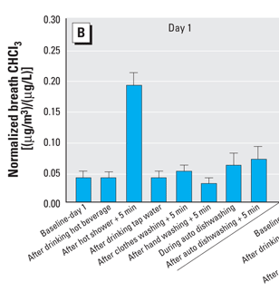
Multiple Routes of Exposure
Inhalation in the shower produces highest blood level and response is fast
Gordon et al., 2006 [Env. Health Persp.114:514-521]

Slide 47
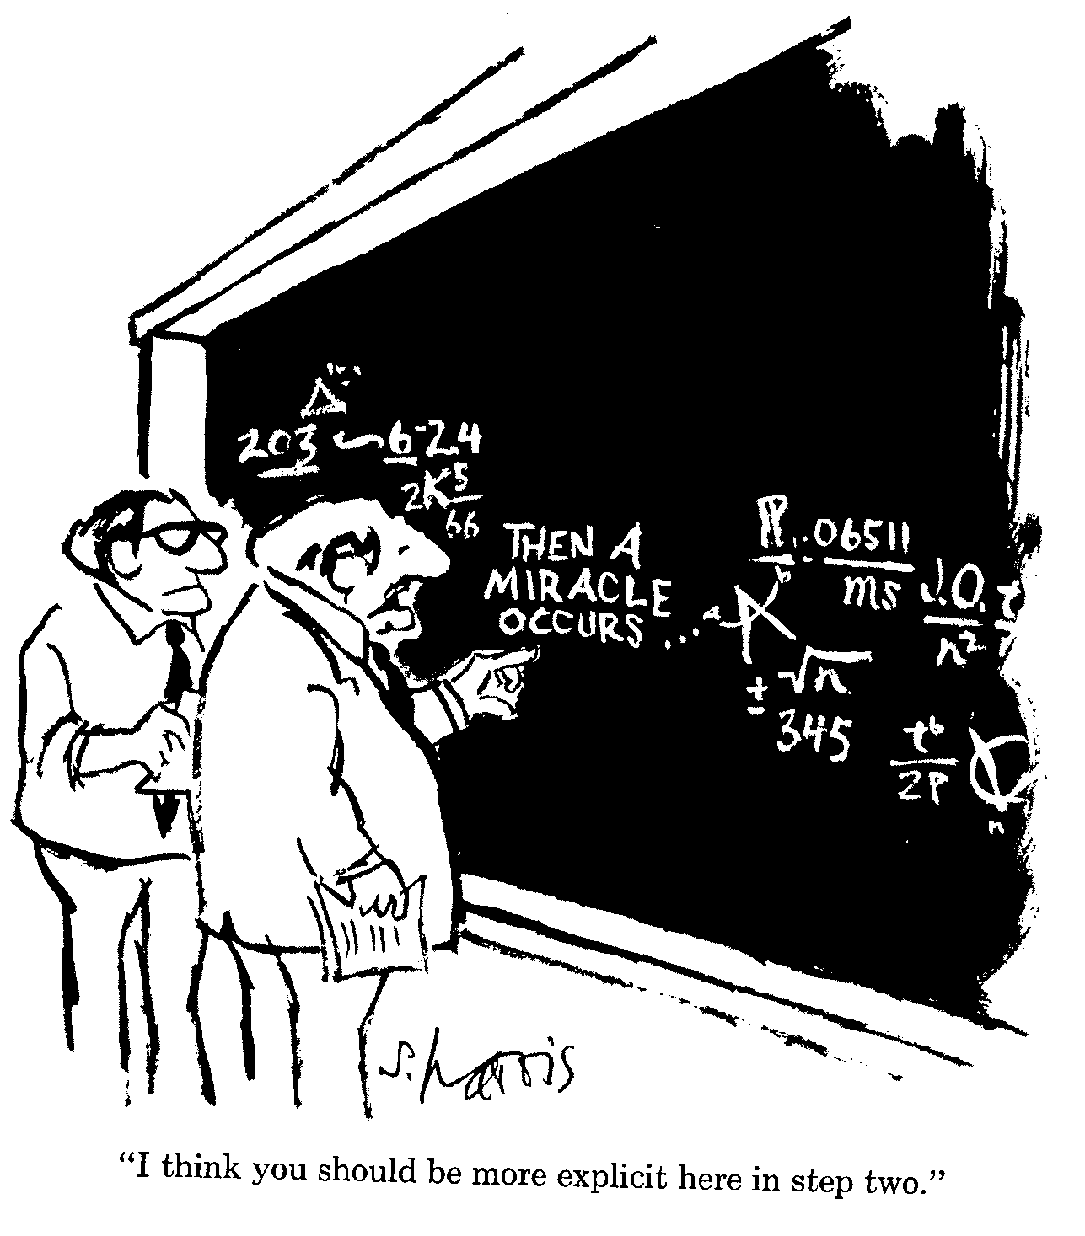
Epidemiology
Epidemiology is not supported
by Toxicology of known DBPs
Bladder Cancer
  DBPs linked to 9,300 US cases every year
Other Cancers
  Rectal, colon
Reproductive & developmental effects
  Neural tube defects
  Miscarriages & Low birth weight
  Cleft palate
Other
  Kidney & spleen disorders
  Immune system problems, neurotoxic effects
137,000 at risk in US?
“I think you should be more explicit here
in step two”

Slide 48


Observational:
The DBP Iceberg
THMs, THAAs
DHAAs
ICR Compounds
50 MWDSC DBPs
Stuart Krasner
~700 Known DBPs
Susan Richardson
Halogenated
Compounds
Non-halogenated
Compounds

Slide 49

Another
Sandra Hempel
  Journalist
2007 publication date
Similar in many ways to Johnson’s book

Slide 50
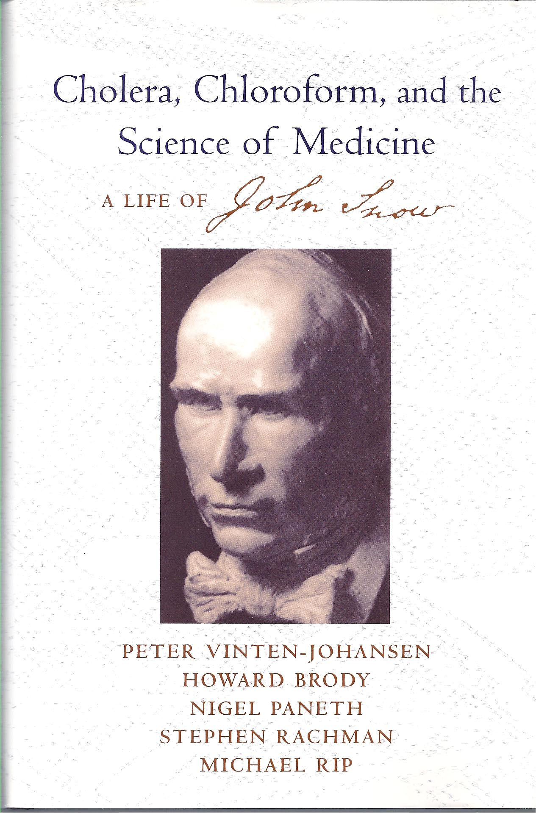
Biography
A serious biography
  2003 publication
Primarily written by MDs

Slide 51

Cholera & beyond
Robert Morris
  Environmental epidemiologist
  2007 publication date
More comprehensive
  Cholera to DBPs to Crypto

Slide 52

Lead Hazards
2006 publication date
Werner Troesken
  Professor of History
Presents many historical lessons on society’s failure to balance public health with profit

Slide 53

The End
53

