Slide 1
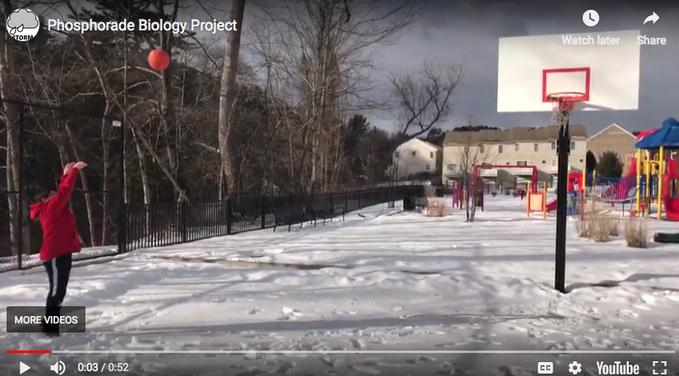
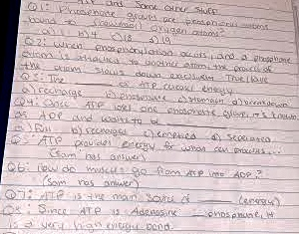
Incorporating Choice into the Classroom at a Rural High School in Western MA
Gina Chesmore, Bridges to the Future M.Ed. Candidate, B.S. in Animal Science
The Students
Seven Elements of Project Based Learning
As a high school student teacher and graduate student, I am researching educational practices with a group of male and female students in the 15 and 16-year old age range. They live in a rural, predominantly Caucasian community in Western Massachusetts, and vary in socioeconomic backgrounds. Several students are in single parent households, and one student is in foster care.
This project involves meeting as a team to help students understand more about themselves as learners and participate in a fun, collaborative, active, differentiated learning experience. I am working to include all of my classroom students because they can all benefit from this initiative.
Rather than demand that all students follow specific instructions on how to present the information they learned and demonstrate their understanding, this project gives students options in how they would prefer to be assessed. Some students might opt to take the “risk” of public speaking, while others might be more comfortable doing an interpretive dance, or an alternative presentation method.
Challenging Problem: Students are tasked with learning about ATP through their own research and then presenting that information in a creative format.
Sustained Inquiry: Students investigate all aspects of ATP and dive as deep as they want into their research.
Authenticity: This project is authentic in that students are encouraged to explore their abilities and interests and push themselves to take risks.
Student Voice & Choice: Students choose how they want to demonstrate their understanding. One group wrote & illustrated a children’s book, another group created a video, another group wrote a haiku, another group performed a rap battle, and one group designed and executed an ATP game show.
Reflection: Students reflect on their own abilities and interests to understand more about themselves.
Critique and Revision: Students were provided with a self evaluation sheet to edit their work and ensure they are meeting all the expectations of the assignment.
Public Product: Students presented their projects to their classmates. Some students allowed us to save their projects to serve as examples to our future students. Knowing that their work will be seen by many people gives the students more of a reason to publish excellent quality work.
Figure 2: Biology student’s YouTube video demonstrating the relationship between ATP and energy
Articles That Challenge My Work
The Project
Title of Article: Too Many Choices: A Problem That Can Paralyze
Source: New York Times (2010)
Link: https://www.nytimes.com/2010/02/27/your-money/27shortcuts.html
Author(s): Alina Tugend
Main Findings: People might find that having more choice can become debilitating, opposed to having less choices.
Title of Article: The Pros and Cons of Problem-Based Learning from the Teacher’s Standpoint
Source: Journal of University Teaching & Learning Practice
Link: https://ro.uow.edu.au/cgi/viewcontent.cgi?referer=https://www.google.com/&httpsredir=1&article=1149&context=jutlp
Author(s): Luis Roberto C. Ribeiro
Main Findings: Due to its unpredictable nature, Project Based Learning may increase teacher vulnerability because unfamiliar topics arise which may go beyond the class standards and the expectations laid out in the syllabus.
I am having students research the ATP “energy molecule” in small groups, and allowing them to choose how they want to present what they have learned. This project is authentic to the outside world because it allows students to explore what they are interested in and develop a better understanding of their priorities and goals as they advance throughout high school. This is designed to help students with self discovery.
The theoretical framework for this project is grounded in the seven elements of Project Based Learning, and it enables students to play to their strengths. This helps students better understand themselves because it forces them to momentarily reflect on their abilities and interests. Are they artistic and want to create an illustrated children’s book about ATP? Are they tech savvy and want to upload a PowerPoint presentation about ATP? Are they silly and want to conduct a comedy skit?
Articles That Support My Work
Title of Article: Are Choice-Making Opportunities Needed in the Classroom? Using Self-Determination Theory to Consider Student Motivation and Learner Empowerment
Source: International Journal of Teaching and Learning in Higher Education (2011)
Link: https://files.eric.ed.gov/fulltext/EJ938578.pdf
Author(s): Catherine F. Brooks and Stacy L. Young
Main Findings: People are intrinsically motivated when they have control of their own activities and can make their own decisions.
Title of Article: Creating learner-centered assessment strategies for promoting greater student retention and class participation
Source: Frontiers in Psychology (2014)
Link: https://www.ncbi.nlm.nih.gov/pmc/articles/PMC4063236/
Author(s): John D. Rich, Jr,* Arabia N. Colon, Dominique Mines, and Kimberly L. Jivers
Main Finding: Catering to the learning styles of different students by offering multiple forms of assessment helps remove barriers that uncomfortable test formats can create.
Conclusions
This implementation of PBL was very well received by the students. Their willingness to participate, their excitement over the process of creating the projects and their motivation to present an aesthetically pleasing and/or entertaining project to their peers contributes to my decision to continue to implement more PBL projects in our Biology class in the future.
Figure 1: Biology student’s ATP Jeopardy game script which they later executed with the class

