Slide 1
Materials for clean energy
Omar Abdelrahman
(Chemical Engineering)
Ashwin Ramasubramaniam
(Mechanical & Industrial Engineering)

Slide 2
Lesson Plan
Introduction:
  Examples of chemical reactions that are at the forefront of renewable/sustainable energy
  Materials challenges for catalyzing reactions
  Electrochemical approaches
  Computational modeling
Focus topic: Water Electrolysis and PEM Fuel Cell Experiment
  Hands-on experiment with hydrogen fuel cell
Wrap up

Slide 3
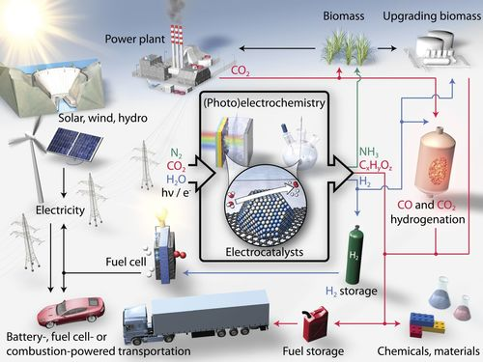
The “Green” dream
Water Electrolysis: 2H₂O _{(l)} → 2H_{2 (g)}+ O_{2 (g)}
Cathode: 4H⁺ + 4e⁻ → 2H_{2 (g)}
Anode : 2H₂O _{(l)} → O_{2 (g)}+ 4H⁺ + 4e⁻
CO₂ Reduction:
Cathode: xCO₂ + nH⁺ + ne⁻ → product + yH₂O _{(g)}
Anode: 2H₂O _{(l)} → O_{2 (g)}+ 4H⁺ + 4e⁻
Nitrogen Reduction: N₂ + 3H_{2 (g)} → 2NH_{3 (g)}
Cathode: N₂ + 6H⁺ + 6e⁻ → 2NH_{3 (g)}
Anode : 3H₂O _{(l)} → 3/2 O_{2 (g)}+ 6H⁺ + 6e⁻
Seh et al., Science 355 (2017)
DOI: 10.1126/science.aad4998
Common Theme: Electrochemical transformations to produce energy carriers and/or value-added products
Notes:
Electrochemical conversion processes that can convert molecules in the atmosphere (e.g., water, carbon dioxide, and nitrogen) into higher-value products (e.g., hydrogen, hydrocarbons, and ammonia) hold promise for a sustainable energy future
Electrocatalysts play a key role in these energy conversion technologies because they increase the rate, efficiency, and selectivity of the chemical transformations involved
Hydrogen gas, for example, is one such key value-added product that is central in chemical transformations and is highly sought after as a clean fuel. Water electrolysis – clean path to green hydrogen
Ammonia is a highly valuable chemical; also considered a good medium for hydrogen storage. Conventional Haber-Bosch energy intensive, high CO2 footprint. H2 usually comes from hydrocarbons – dirty.

Slide 4
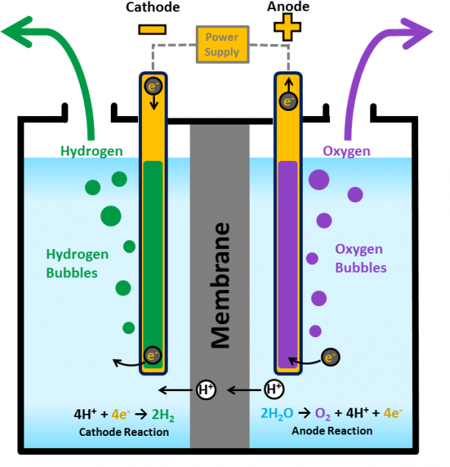
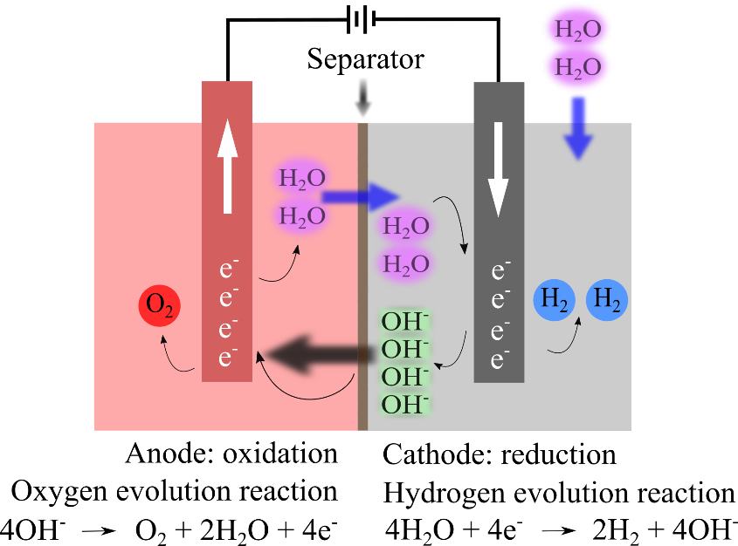
Example: H₂ as a Sustainable fuel – Production
ACIDIC (PEM)
BASIC (AEM)
Image: www.energy.gov
https://www.epfl.ch/labs/lepa/grid2mobility-demonstrator-martigny/key-technologies/alkaline-electrolyser/
Compact; higher current density and operating pressure
Less corrosive electrolytes
Pt cathode; Ir/Ir oxide anode
High-cost, short lifetime of membranes
Cheaper catalysts (Ni based)
More durable
Corrosive electrolyte
Slow dynamics, low current density

Slide 5
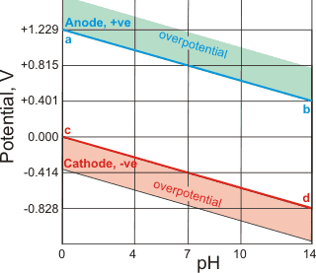
Thermodynamic Analysis
Maric and Yu
https://www.intechopen.com/chapters/62151
Need at least 1.23 V to drive electrolysis
Inefficiencies in practice lead to “overpotential” → should minimize this ~0 V

Slide 6
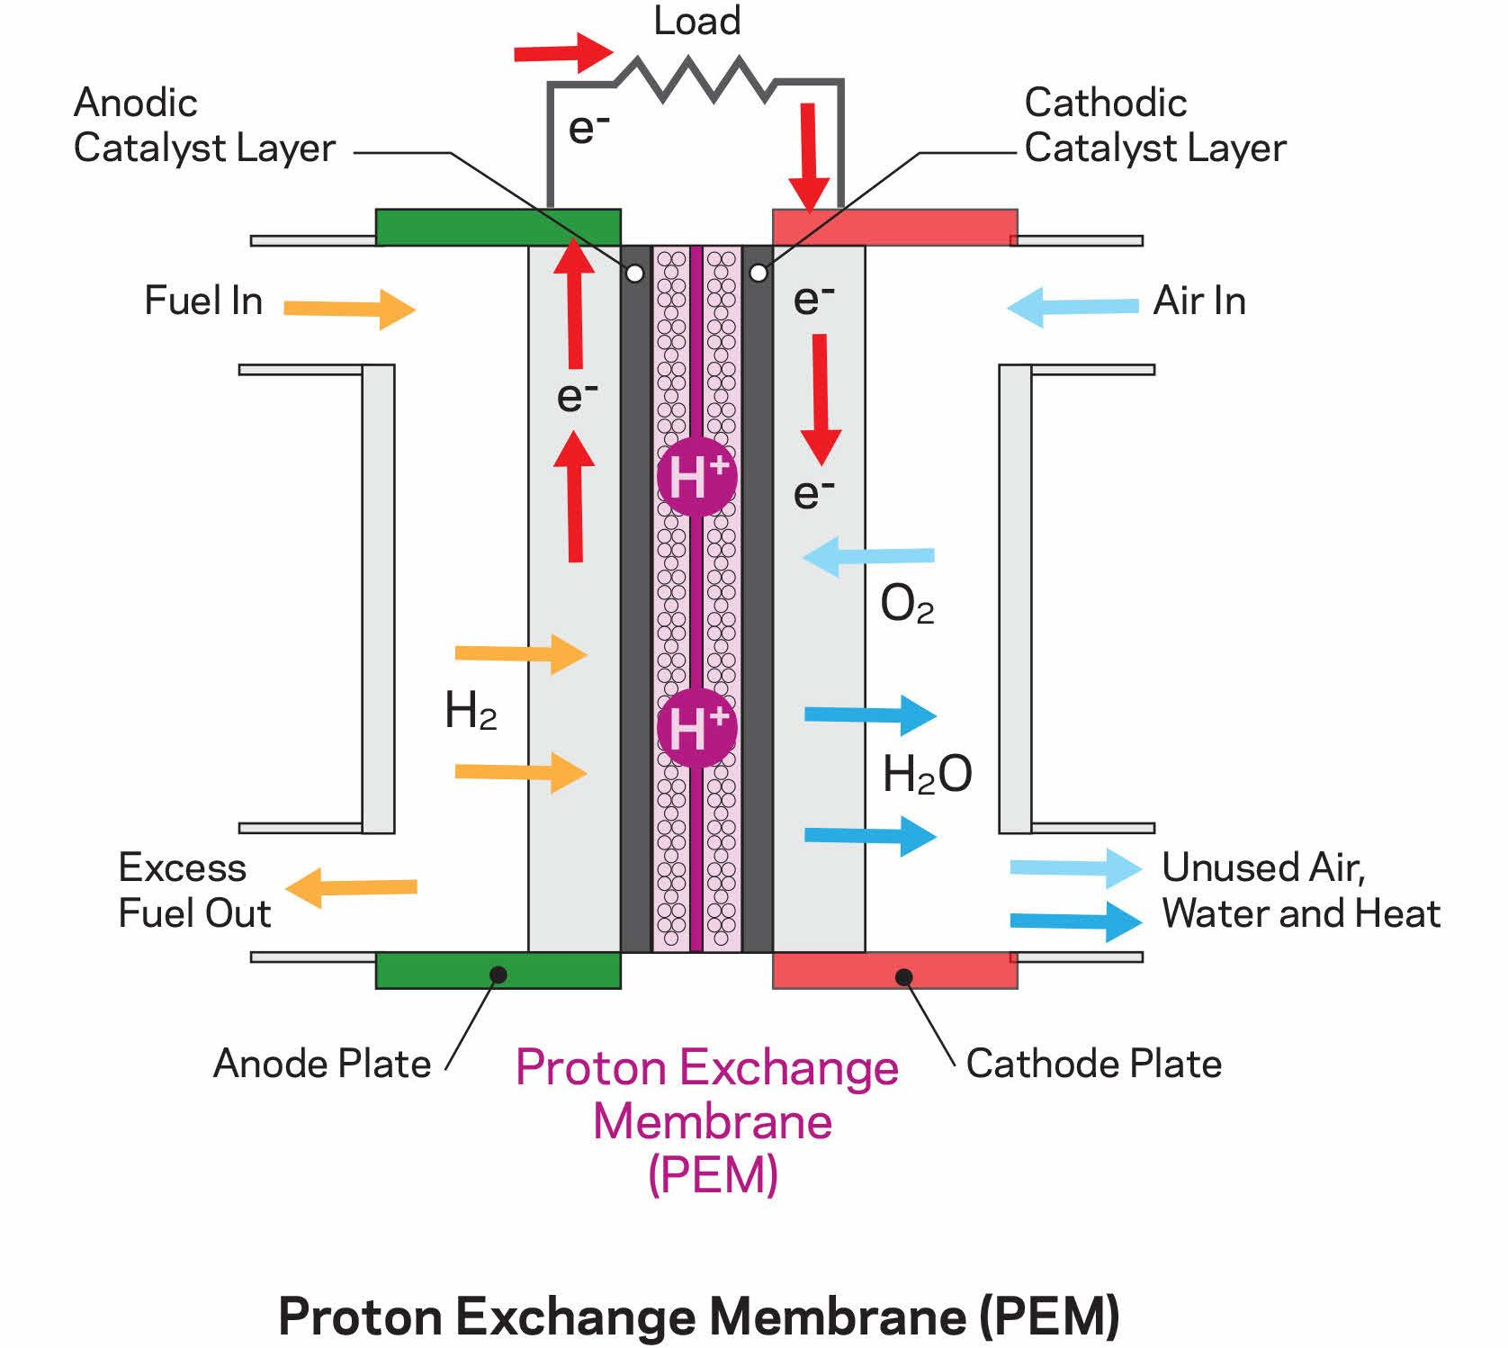
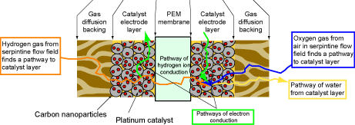
Example: H₂ as a sustainable fuel – Energy production
Recall Water Electrolysis: 2H₂O _{(l)} → 2H_{2 (g)}+ O_{2 (g)}
Cathode: 4H⁺ + 4e⁻ → 2H_{2 (g)}
Anode : 2H₂O _{(l)} → O_{2 (g)}+ 4H⁺ + 4e⁻
PEM Fuel Cell
Hydrogen Oxidation: 2H₂O _{(l)} ← 2H_{2 (g)}+ O_{2 (g)}
Anode: 4H⁺ + 4e⁻ ← 2H_{2 (g)}
Cathode : 2H₂O _{(l)} ← O_{2 (g)}+ 4H⁺ + 4e⁻
Running electrolysis in reverse
nafion.com
NIST.gov

Slide 7
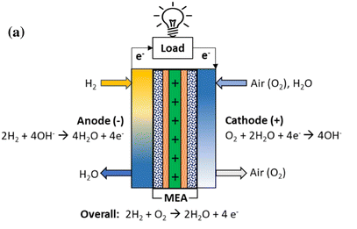
Example: H₂ as a sustainable fuel – Energy production
PEM Fuel Cell
AEM Fuel Cell
nafion.com
Pt catalyst for both anode and cathode
Pt, Pd, Ir (PGM) catalysts

Slide 8
Thermodynamic Analysis
Hydrogen Oxidation: H_{2 (g)}+ ½ O_{2 (g)} → H₂O _{(l)}
Quantity | H₂ | 0.5 O₂ | H₂O | Change
Enthalpy | 0 | 0 | -285.83 kJ | ΔH = -285.83 kJ
Entropy | 130.68 J/K | 0.5 x 205.14 J/K | 69.91 J/K | TΔS = -48.7 kJ
ΔG = ΔH - TΔS = -285.83 kJ + 48.7 kJ = -237.1 kJ (at 25 ºC)
Ideal efficiency = ΔG/ΔH = 0.83 (83%)
Cell voltage = ΔG/2F = 1.23 V; 0.7 V typical due to losses
( 2 moles of e⁻ used to produce 1 mole of H₂; F - Faraday constant)
nafion.com
http://hyperphysics.phy-astr.gsu.edu/hbase/thermo/electrol.html
Notes:
ΔG is what it takes to drive the reaction or what you can get out of the reaction
ΔH is what is stored in the fuel
So in the electrolysis/fuel cell pair where the enthalpy change is 285.8 kJ, you have to put in 237 kJ of energy to drive electrolysis and the heat from the environment will contribute TΔS=48.7 kJ to help you. Going the other way in the fuel cell, you can get out the 237 kJ as electric energy, but have to dump TΔS = 48.7 kJ to the environment.

Slide 9
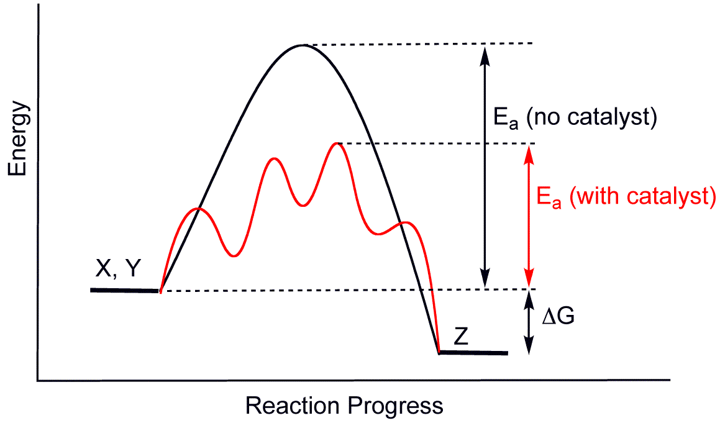
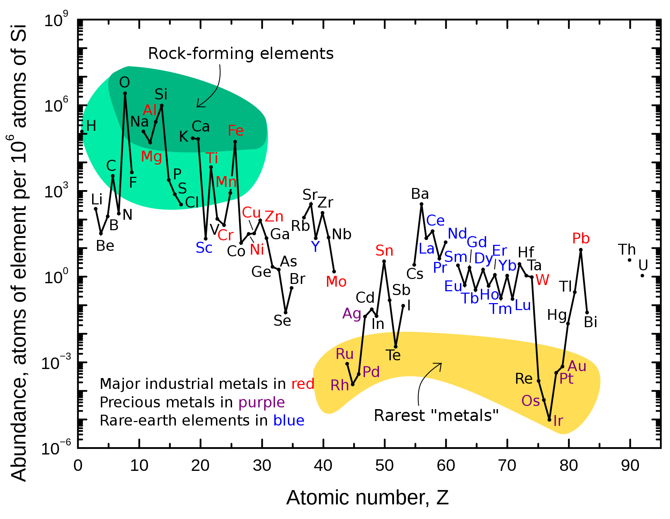
Materials Considerations
Wikipedia
Electrocatalysts
Reduce energy barriers for reactions (lower energy cost)
Enhance reaction rates – fast kinetics
Increase desired product selectivity
Good electrical conductors (low resistive losses)
Long-term stability – no degradation (leaching, sintering, etc.)
Inexpensive, earth-abundant
Electrolytes, Membrane Materials, Gas Diffusion Layers (another time…)
Wikipedia

Slide 10
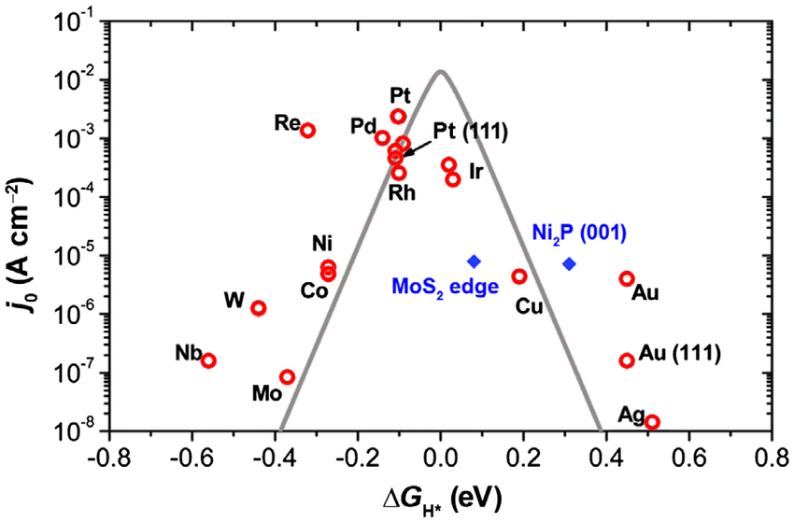
Electrocatalysts for H₂ production
Sabatier Principle: An ideal catalyst neither binds adsorbates too strongly or too weakly
Wikipedia
“Volcano” plot
H⁺ + e⁻ → ½ H₂
Catalytic activity increases
Strong binding
Weak binding
PGM catalysts, Ir-/Ru-based oxides among the best catalysts. Can they be replaced?
Chemical Society Reviews, 43(18), 6555-6569.

Slide 11
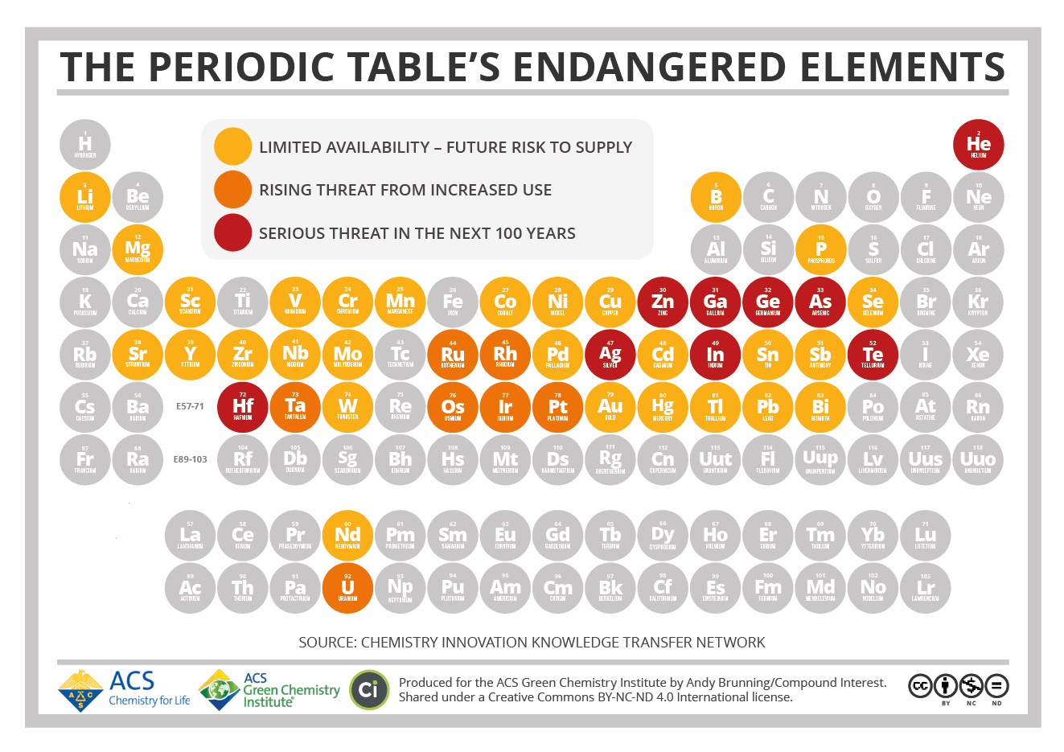
Desirable physical/chemical properties are only part of the story for materials selection
Can we move towards earth-abundant materials?
Their compounds? (Nitrides, phosphides, sulfides, carbides,…)
Can we afford to test all of these one by one?
Societal considerations?
Supply chains?
Environmental impact?

Slide 12
Computational (Electro)catalysis
Designing catalysts in silico
Explore vast space of materials efficiently (metals, oxides, nitrides, chalcogenides, ...)
Understand structure-property-function relationships
Predict reaction mechanisms and energetics/kinetics accurately
QC – corrections for complex active sites
DFT – reaction thermodynamics and barriers
MD – structure-function relationships, reaction dynamics
Continuum – microkinetic models, reactor models

Slide 13
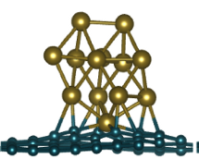
Example: Using catalysts efficiently
Key Idea: Use minimal amount of Pt with tailored “supports” to get performance comparable to bulk Pt

Slide 14
Example: Taking catalysts to the limit
Zhang et al. ACS Nano 11, 6930-6941 (2017)
Chen et al., Nature Nanotech 13, 702–707 (2018)
Yang et al., Science Advances 2 (2016)
Notes:
Ru-graphene ORR catalysts

Slide 15
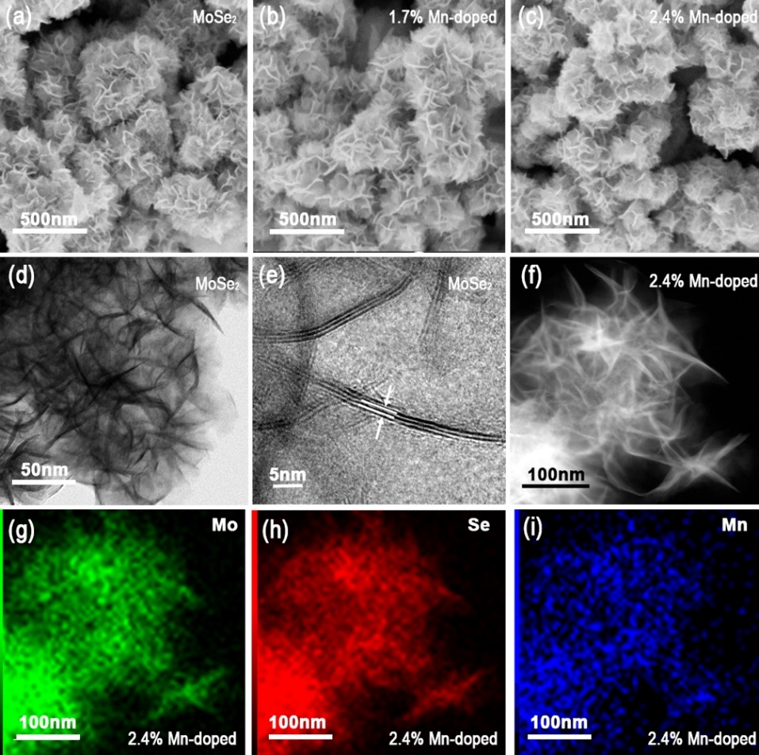
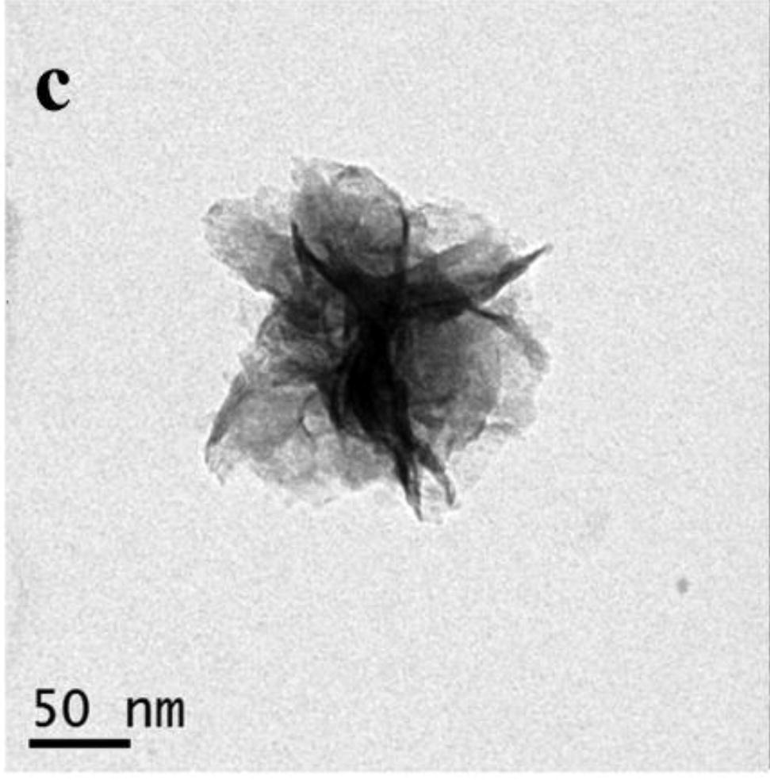
Example: Designing Earth-abundant catalysts
MoSe₂ nanoflower
Kuraganti, et al. ACS Appl. Mater. Interfaces 2019, 11, 28, 25155-25162
Ravikumar, H., et al. Materials Letters 220 (2018): 133-135
Dope edges with other transition-metal atoms

Slide 16
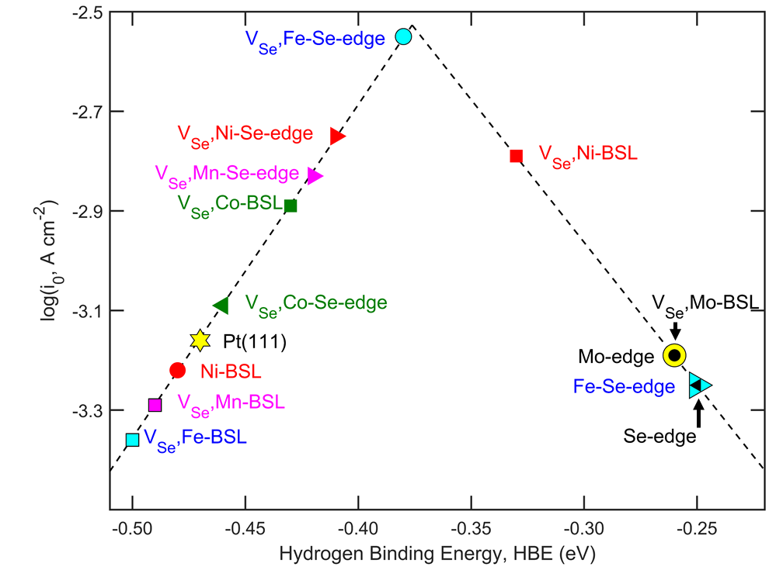
DOPED MoSe₂ ELECTROCATALYSTS
BSL: Basal Plane
V_{Se}: Se-vacancy
Doping is an effective strategy to activate MoSe₂ for hydrogen production
HER activity increases
Volcano plot (black dashed lines) from Esposito et al., J. Am. Chem. Soc., 2012, 134, 3025–3033.
Strength of H binding increases

Slide 17
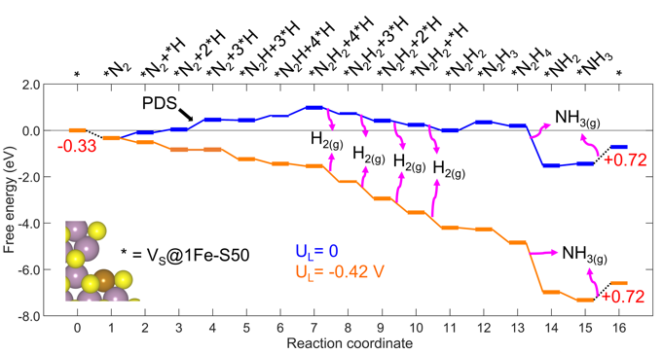
Beyond Hydrogen: Nitrogen Reduction
NRR:
N₂ + 6 (H⁺+e⁻) → 2NH_{3 (g)}
H-mediated NRR:
N₂ + 14 (H⁺+e⁻) → 2NH_{3 (g)} + 4H_{2 (g)}
Complex pathway involving coadsorbates, electrolyte effects, etc.
Plenty of ongoing research, a lot more to be done…
A. Jain, M. Bar Sadan, A. Ramasubramaniam
J. Phys. Chem. C, 125, 19980–19990 (2021)

Slide 18
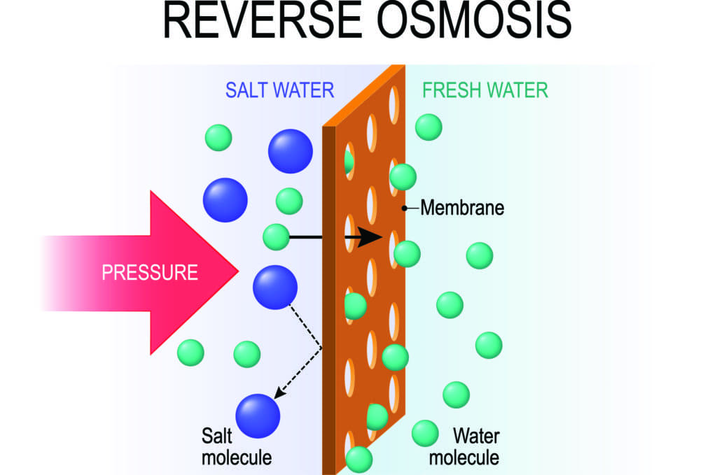
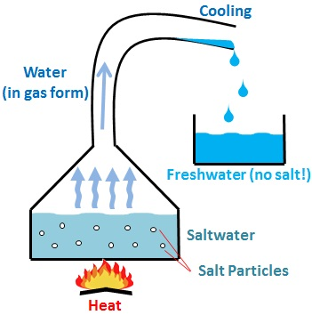
Sourcing ‘PURE’ Water
Generating pure water is energy intensive

Slide 19
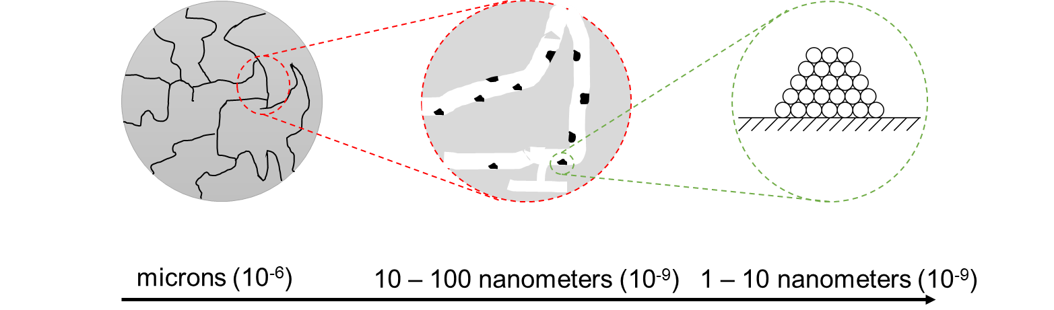
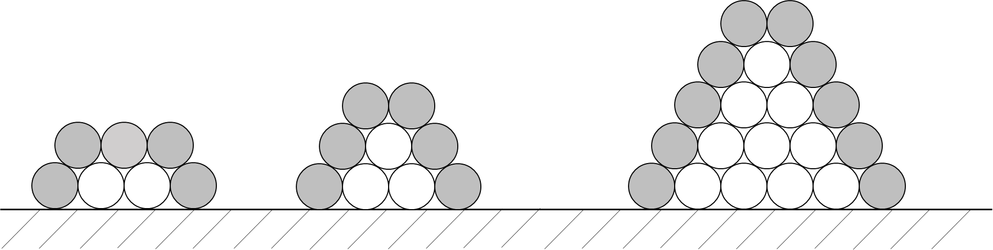
Creating a Stable Water Catalyst
Smaller particles lead to a higher fraction
of exposed metal catalyst

Slide 20
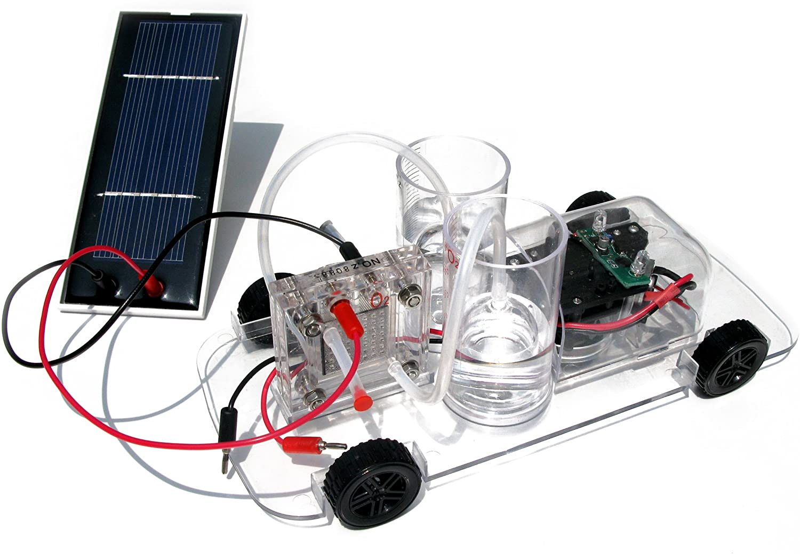
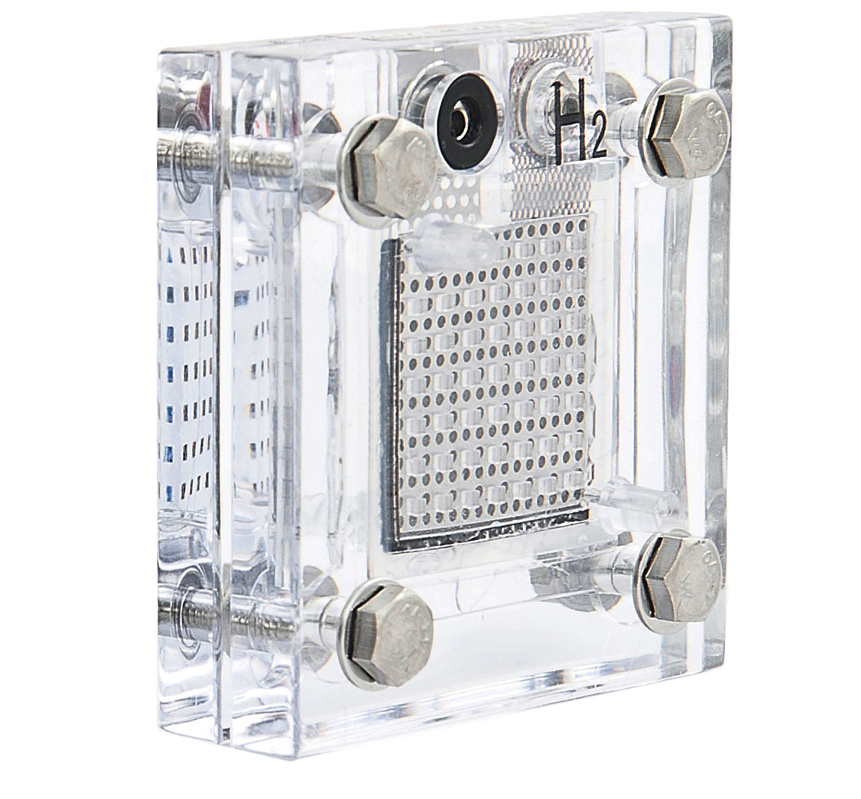
Focus topic: water electrolysis and PEM fuel cell experiment
Hydrogen Reservoir
Energy Source
Motor
Fuel Cell
Oxygen Reservoir

Slide 21
Focus topic: water electrolysis and PEM fuel cell experiment
Recall Water Electrolysis: 2H₂O _{(l)} → 2H_{2 (g)}+ O_{2 (g)}
Cathode: 4H⁺ + 4e⁻ → 2H_{2 (g)}
Anode : 2H₂O _{(l)} → O_{2 (g)}+ 4H⁺ + 4e⁻
PEM Fuel Cell
Hydrogen Oxidation: 2H₂O _{(l)} ← 2H_{2 (g)}+ O_{2 (g)}
Anode: 4H⁺ + 4e⁻ ← 2H_{2 (g)}
Cathode : 2H₂O _{(l)} ← O_{2 (g)}+ 4H⁺ + 4e⁻
Running electrolysis in reverse
nafion.com
NIST.gov

Slide 22
Thank You!

