Slide 1
Demystifying the e-resource lifecycle
By Maria Rios, Resident Librarian

Slide 2
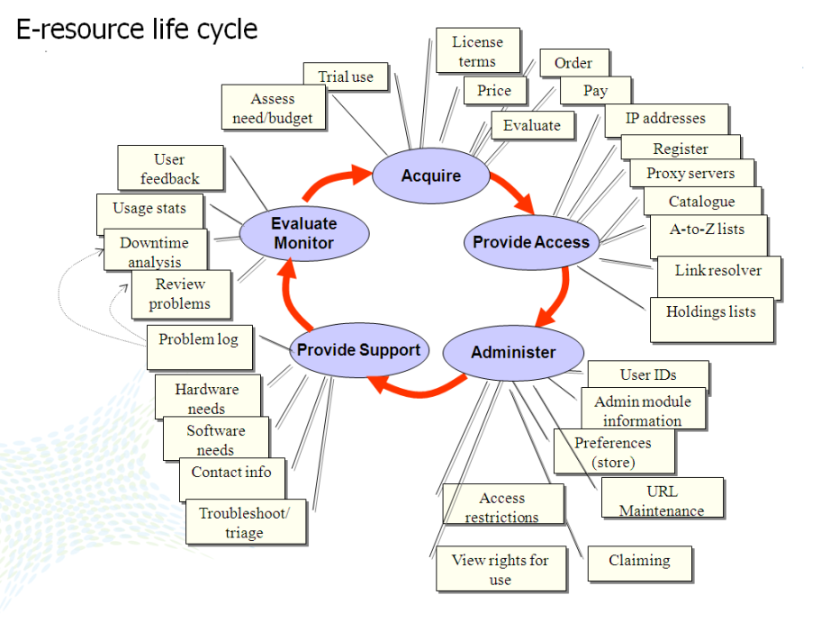
Pesch, O. (2009). ERMs and the e-resource life-cycle [Powerpoint slides]. Retrieved from http://tinyurl.com/ERLifeCycle and NASIG, E-Resources Librarians Competencies

Slide 3
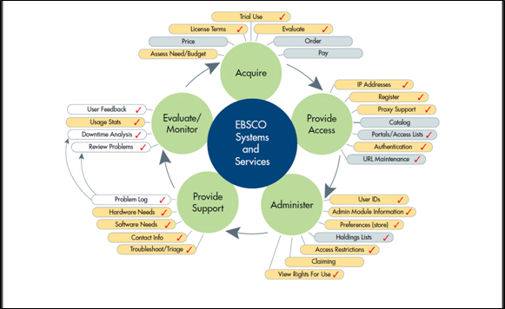
https://slideplayer.com/slide/7948949/, slide 9
Notes:
It’s important to learn the language so that you have a better technical understanding outside your area of subject specialty/expertise. Big area, so, I’m going to put this in the context of UMass specifically. /// the ERM workflows are occuring in more than just EBSCO systems. Maybe adjust that circle to make it more general?

Slide 4
Workflow
Request for e-Resource (renewal or new)
License negotiation (not all resources are licensed)
  VPAT
    Voluntary Product Accessibility Template… ADA and 508 compliance
  WCAG
    Web Content Accessibility Guidelines (WCAG) are part of a series of web accessibility guidelines published the World Wide Web Consortium (W3C)
Aleph and CORAL records created (bare bones)
*Order placed, invoice paid.
Notes:
How does the database move from the “selector”/liaison to the end-user?

Slide 5
Workflow, Part 2
License is put in R drive and CORAL
EZProxy- authentication system
  Publishers have our institutional IP addresses, so if you are in range, you are able to access the resources
    EZProxy is a proxy server that uses Shiboleth (NetIDs)
    EZProxy prompts the network authentication login for off-campus users (or else you encounter a paywall, the Silk pre-fix)
But wait, there’s more!
Notes:
R drive is departmental shared drive
to log into, it's really two forms of authentication working together.-Jack M.

Slide 6
Workflow, Part 3
SFX (Open Url Link Resolver) (backend)
  Activate resources
EDS (backend)
  Enable Metadata and CustomLinks
    Create custom link
    Create custom ranking link, that leads to full text access
HLM activation (backend)
  Select titles and packages
Notes:
SFX (Open Url Link Resolver) (backend)
Target level
Target surface
Target object portfolio level
EDS (backend)
Enable metadata
Create custom link
Create custom ranking link, that leads to full text access
(remember Aleph informs EDS)
Something that might be interesting to highlight is that all three of these systems have different terminology. You activate resources in SFX, enable Metadata and CustomLinks in EDS, and Select titles and packages in HLM.- Jack M.

Slide 7
Workflow, Part 4
Aleph record modified
Add and/or Doublecheck accuracy of URL in A-Z List
Website and LibGuide access created (end-user)
Notes:
SFX (Open Url Link Resolver) (backend)
Target level
Target surface
Target object portfolio level
EDS (backend)
Enable metadata
Create custom link
Create custom ranking link, that leads to full text access
(remember Aleph informs EDS)

Slide 8
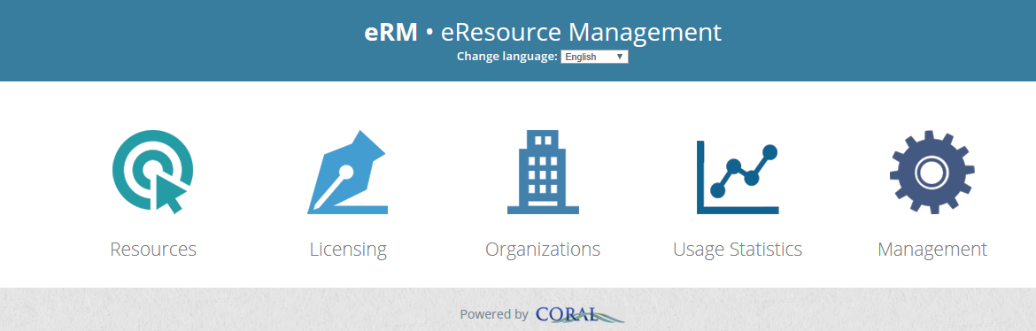


Backend: What do we use?
CORAL: eResource Management
SFX:ExLibris Open URL Link resolver
EDS: Ebsco Discovery Search (current Discovery Layer)
HLM: Holding Links Management (?)
Aleph: ILS (integrated library system) (Acquisitions and Cataloging modules)
Notes:
End-user. Aleph feeds the EDS

Slide 9
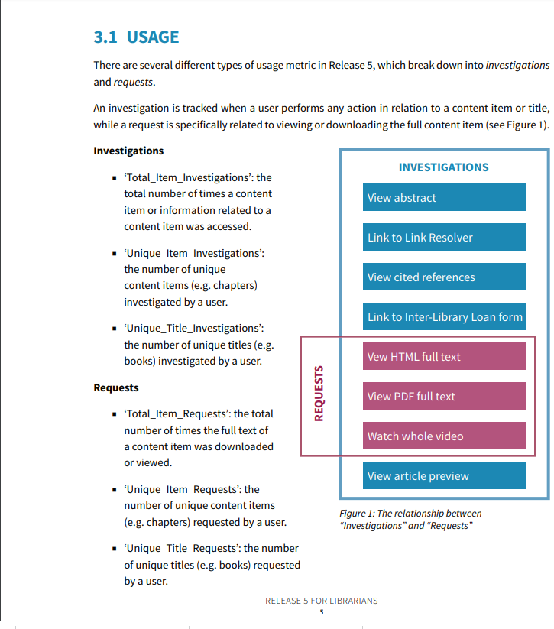
COUNTER standards Summary...
How do I access the stats?...
Regular search
Clicks
Views
Ask!
Notes:
Stats can be counter or non counter

Slide 10
Curious for more?...
Have you ever been unable to access an e-resource? Do you wish you understood why? Access and authentication of library e-resources is an increasingly complex area often only understood by a few “techy” people in the library. In this webinar, Viral Amin and Emily Singley of the BLC’s Technology COI will provide a roadmap to e-resource access designed to give librarians the vocabulary and knowledge needed to better understand patron frustrations and make more informed collection development decisions. Attendees will gain a fundamental understanding of how different authentication methods work (including EZProxy and Shibboleth) and will also learn where the access environment is heading and how current trends will impact libraries and users in the future.

Slide 11
BLC presents
Webinar
Friday, May 17th, 1-2pm
“Expanding Knowledge: De-mystifying E-resource access - What every librarian should know".

Slide 12
resources
Pesch, O. (2009). ERMs and the e-resource life-cycle [Powerpoint slides]. Retrieved from http://tinyurl.com/ERLifeCycle and NASIG, E-Resources Librarians Competencies, http://www.nasig.org/site_page.cfm?pk_association_webpage_menu=310&pk_association_webpage=1225
https://slideplayer.com/slide/7948949/, slide 9, The Changing World of Collections Syracuse University Library Scott Warren – Head of Collections March 26, 2013. Published by Samson Beasley
The Expanding Knowledge series: De-mystifying E-resource access - What every librarian should know, presented by Emily Singley (Boston College) and Viral Amin (Bentley University). The webinar will take place on Friday, May 17th, from 1:00pm-2:00pm. Register and find more information below.
Register Here: https://attendee.gotowebinar.com/register/2076173019643480845
Special thanks to Jack, Nancy, and Judy for their time and energies.

