Slide 1





Climate-Smart Gardening 2.0: Plants to Promote Climate Adaptation Coffee Talk
Feel free to adapt these slides for use in presenting this resource.
Matthew E. Fertakos
PhD Candidate, University of Massachusetts, Amherst
June 18, 2025
Coauthors: Thomas Nuhfer, Evelyn Beaury, Kabeera Singh, Matt Brincka, Suvi Birch, Bethany Bradley, Caroline Marschner, Jenica Allen

Slide 2






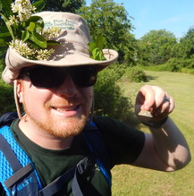


Bethany Bradley
University of Massachusetts Amherst
Caroline Marschner
Cornell University
Evelyn Beaury
New York Botanic Garden
Jenica Allen
University of Massachusetts Amherst
Kabeera Singh
University of Massachusetts Amherst
Matt Brincka
New York State Parks
Suvi Birch
University of Washington
Thomas Nuhfer
University of Massachusetts Amherst
Notes:
I want to acknowledge that I did not do all this work alone, so I’d like to introduce my coauthors on this resource here. You may see some of them participating in the discussion portion of the event later.

Slide 3
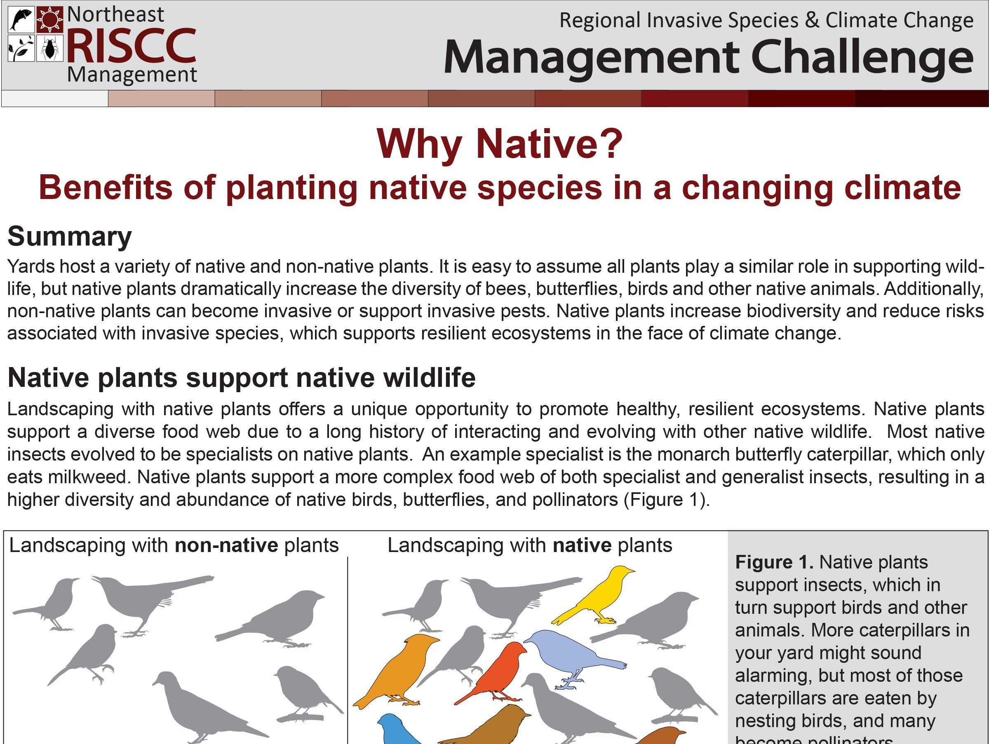
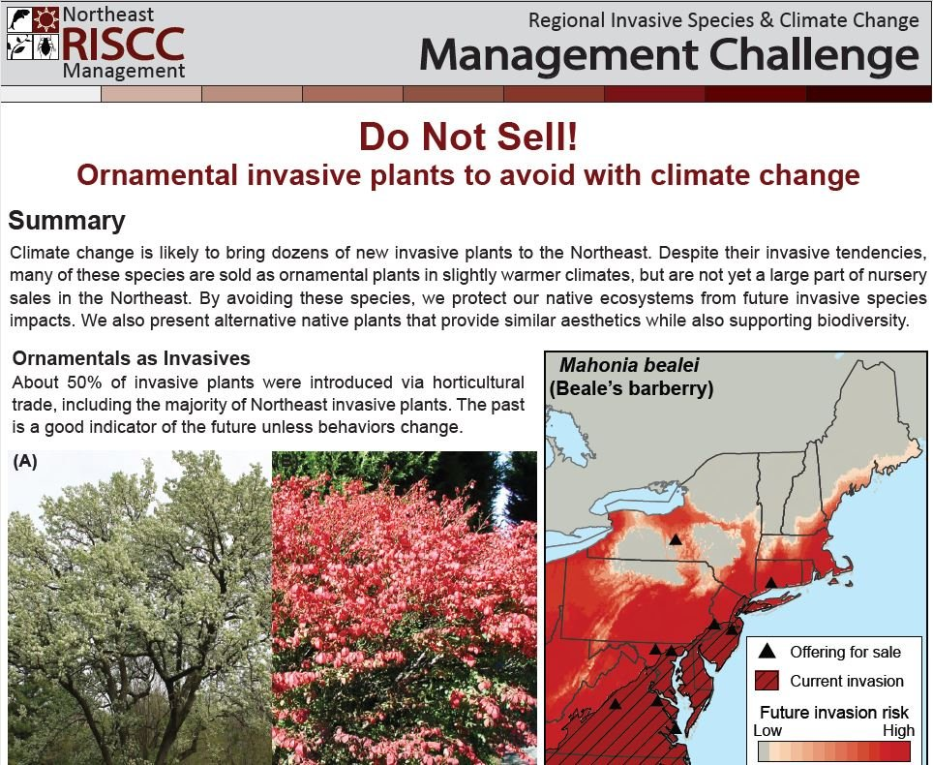
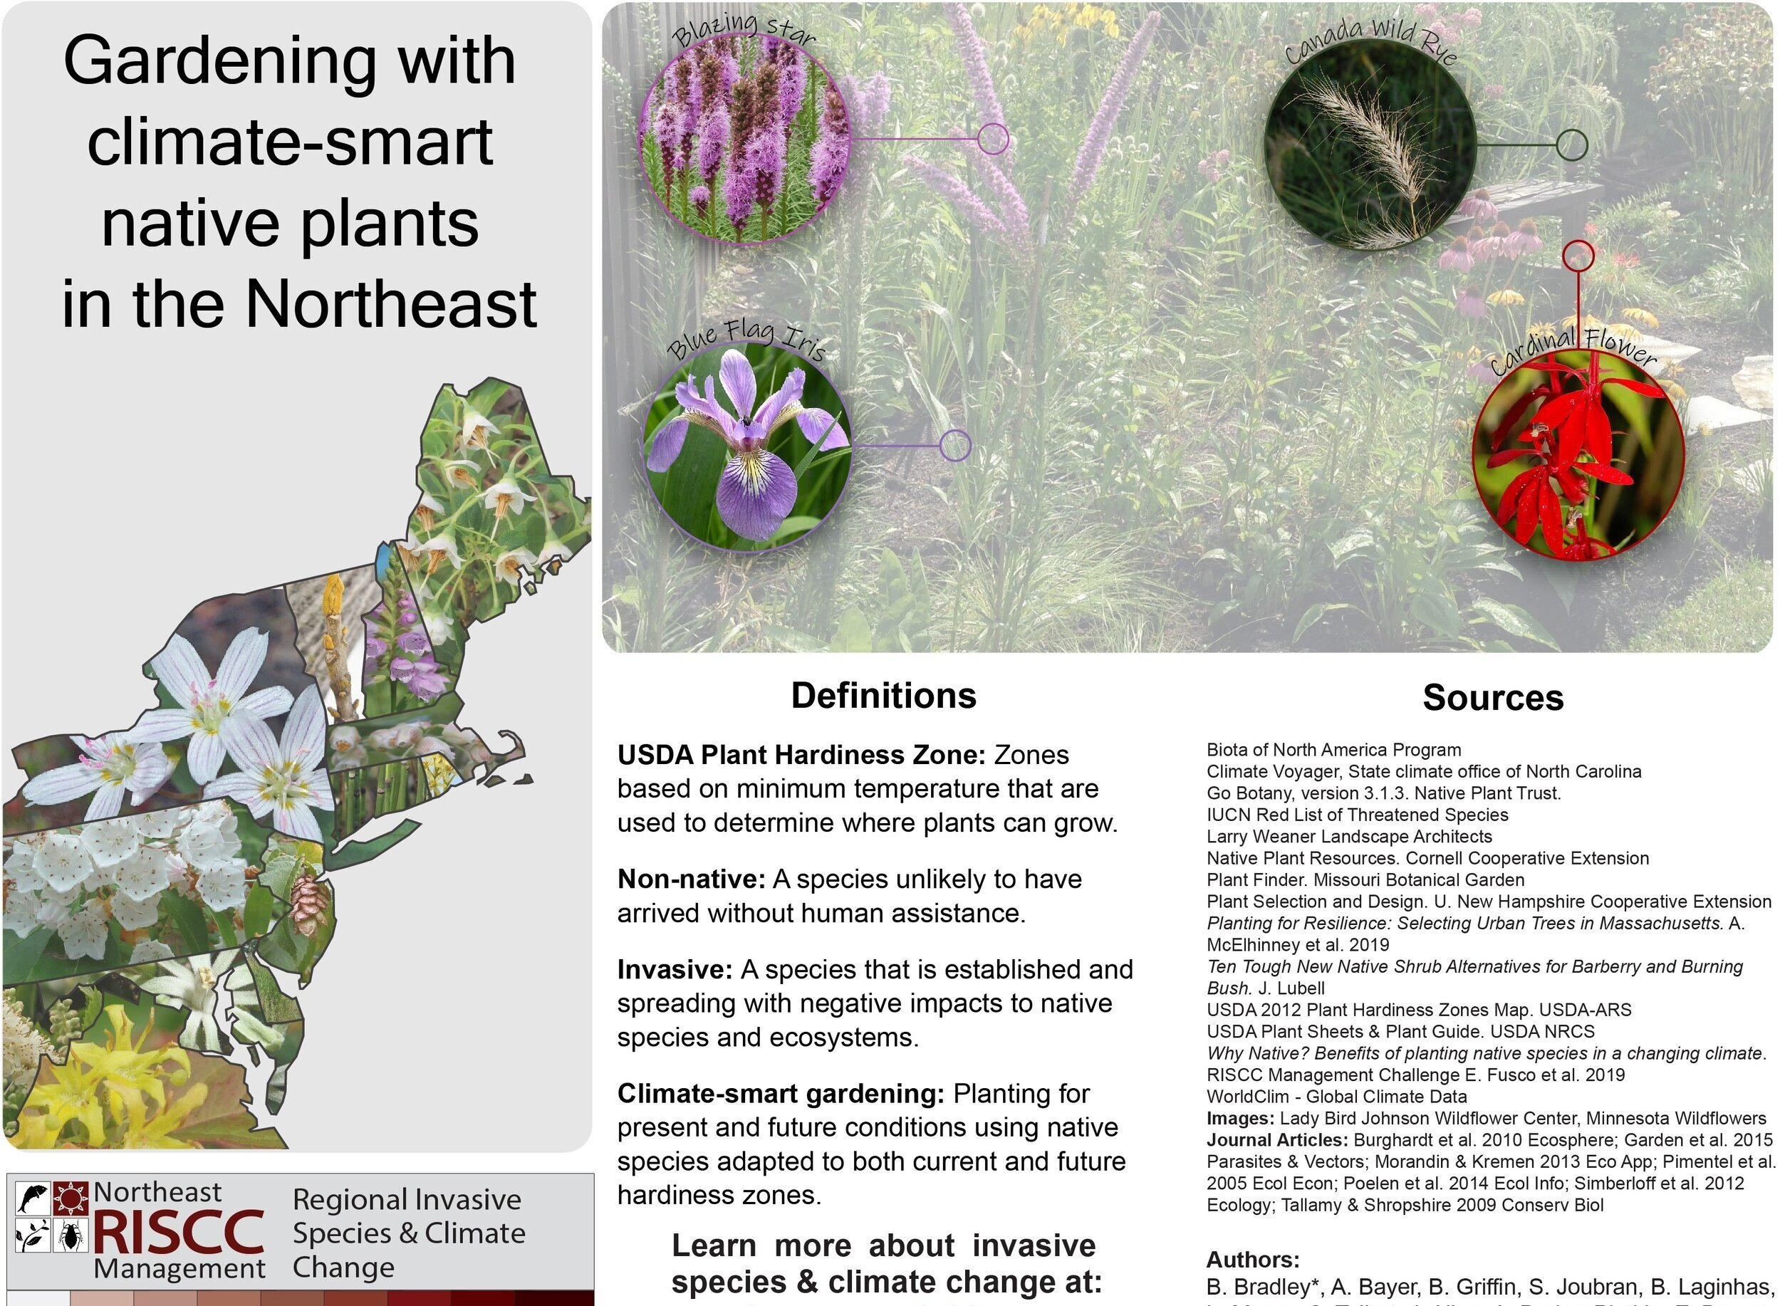
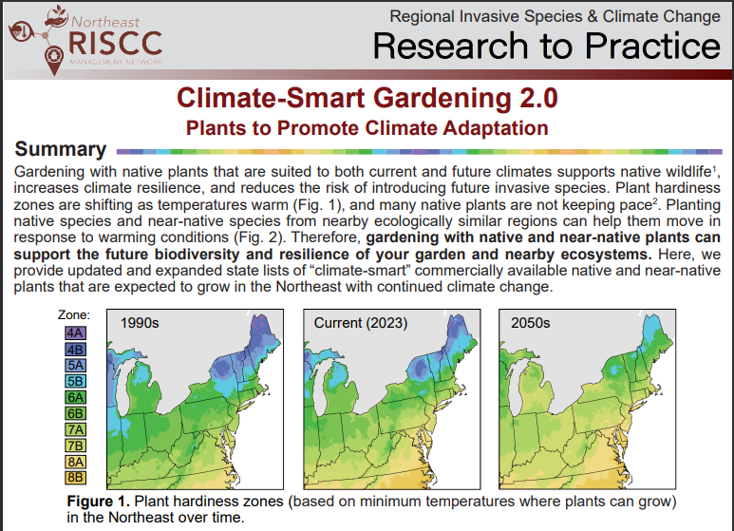
What is the Climate-Smart Gardening 2.0 resource?
Notes:
Our newest research to practice paper follows a series of previous resources created by the NE RISCC team about the relationships between the ornamental plant trade, plant invasions, climate change, and the opportunity to plant native species. We hope our previous and most recent resource enable you all to teach others about the use of native plants. Our past research to practice papers on this subject include “Why Native”, “Do Not Sell”, and our first iteration of “Climate Smart Gardening”. We have updated and expanded upon this resource in “Climate-Smart Gardening 2.0”, in which we present state specific lists of native and near-native plants expected to persist in the Northeast with continued climate change.

Slide 4
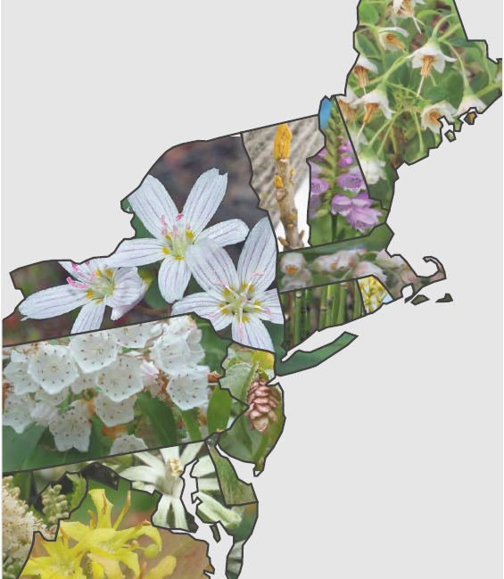
Outline
Benefits of native gardening
Barriers to native gardening
How climate change affects gardening
How we created our new resource
Demo of how to use the lists
Large group discussion

Slide 5
A garden filled with native plants provides benefits compared to a non-native garden.
Support diverse native wildlife.
Less risk of invasion.
Notes:
Native plants support a greater diversity native wildlife.
Less risk of invasion: Native plants are less likely to escape gardens and become established in the landscape and have negative consequences.

Slide 6
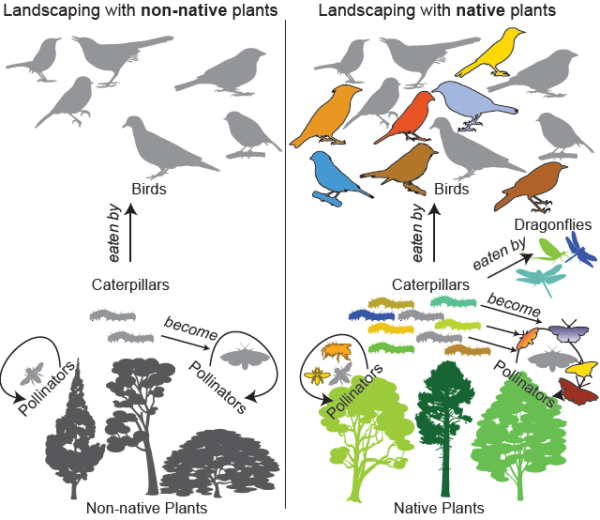
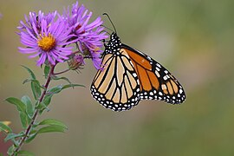
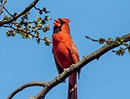
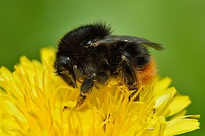
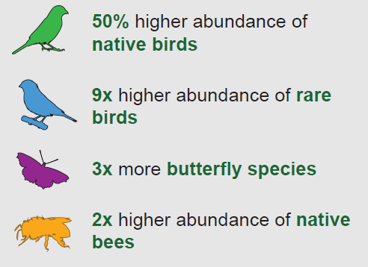
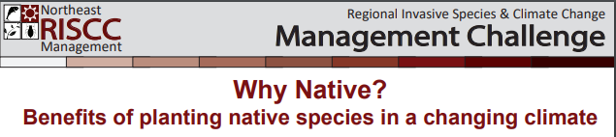
Native plants support native wildlife.
2x caterpillar diversity in native trees
Notes:
Native gardens support your local ecosystem. These benefits are emphasized here…
And this comes from the RISCC research to practice paper, “Why Native” that I mentioned earlier

Slide 7
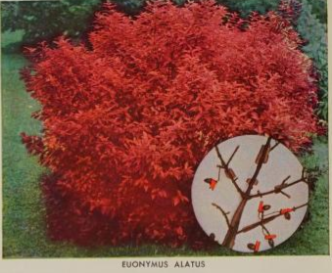
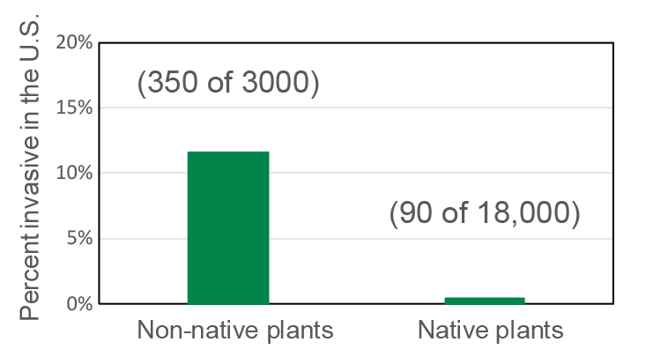
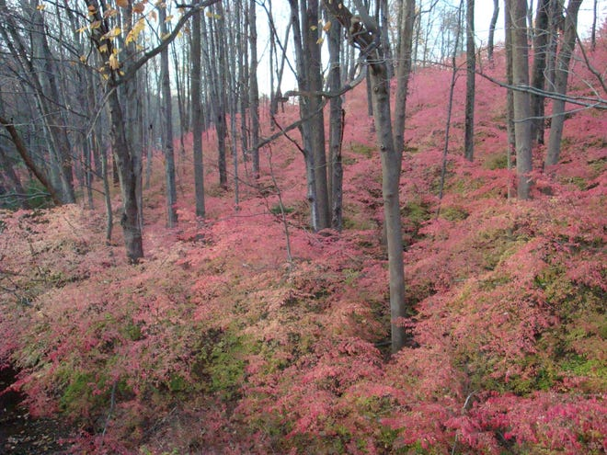
Native plants have less risk of invasion and subsequent harm.
1949
Burning bush advertised for sale in a nursery catalog in 1949 for $1.50
“Native Invaders” are rare among plants.
Invasion of burning bush in the understory of a forest.
today
Simberloff et al. 2012
Notes:
Native plants are less likely have negative consequences than non-native species if they escape from gardens and establish in the natural environment.
A study from 2012 looked at all the vascular plants present in the United States and identified how many became invasive. For plants native to North America, this was less than half a percent, but for non-native species, more than 10% become invasive.
For example, Burning Bush (Euonymus alatus) native to Eastern Asia was introduced through the ornamental plant trade in the late 19th century, and has since escaped cultivation and is now invasive in the understory of many forests in the Northeast, choking out native species. Harm like this is not nearly as common with native species.

Slide 8
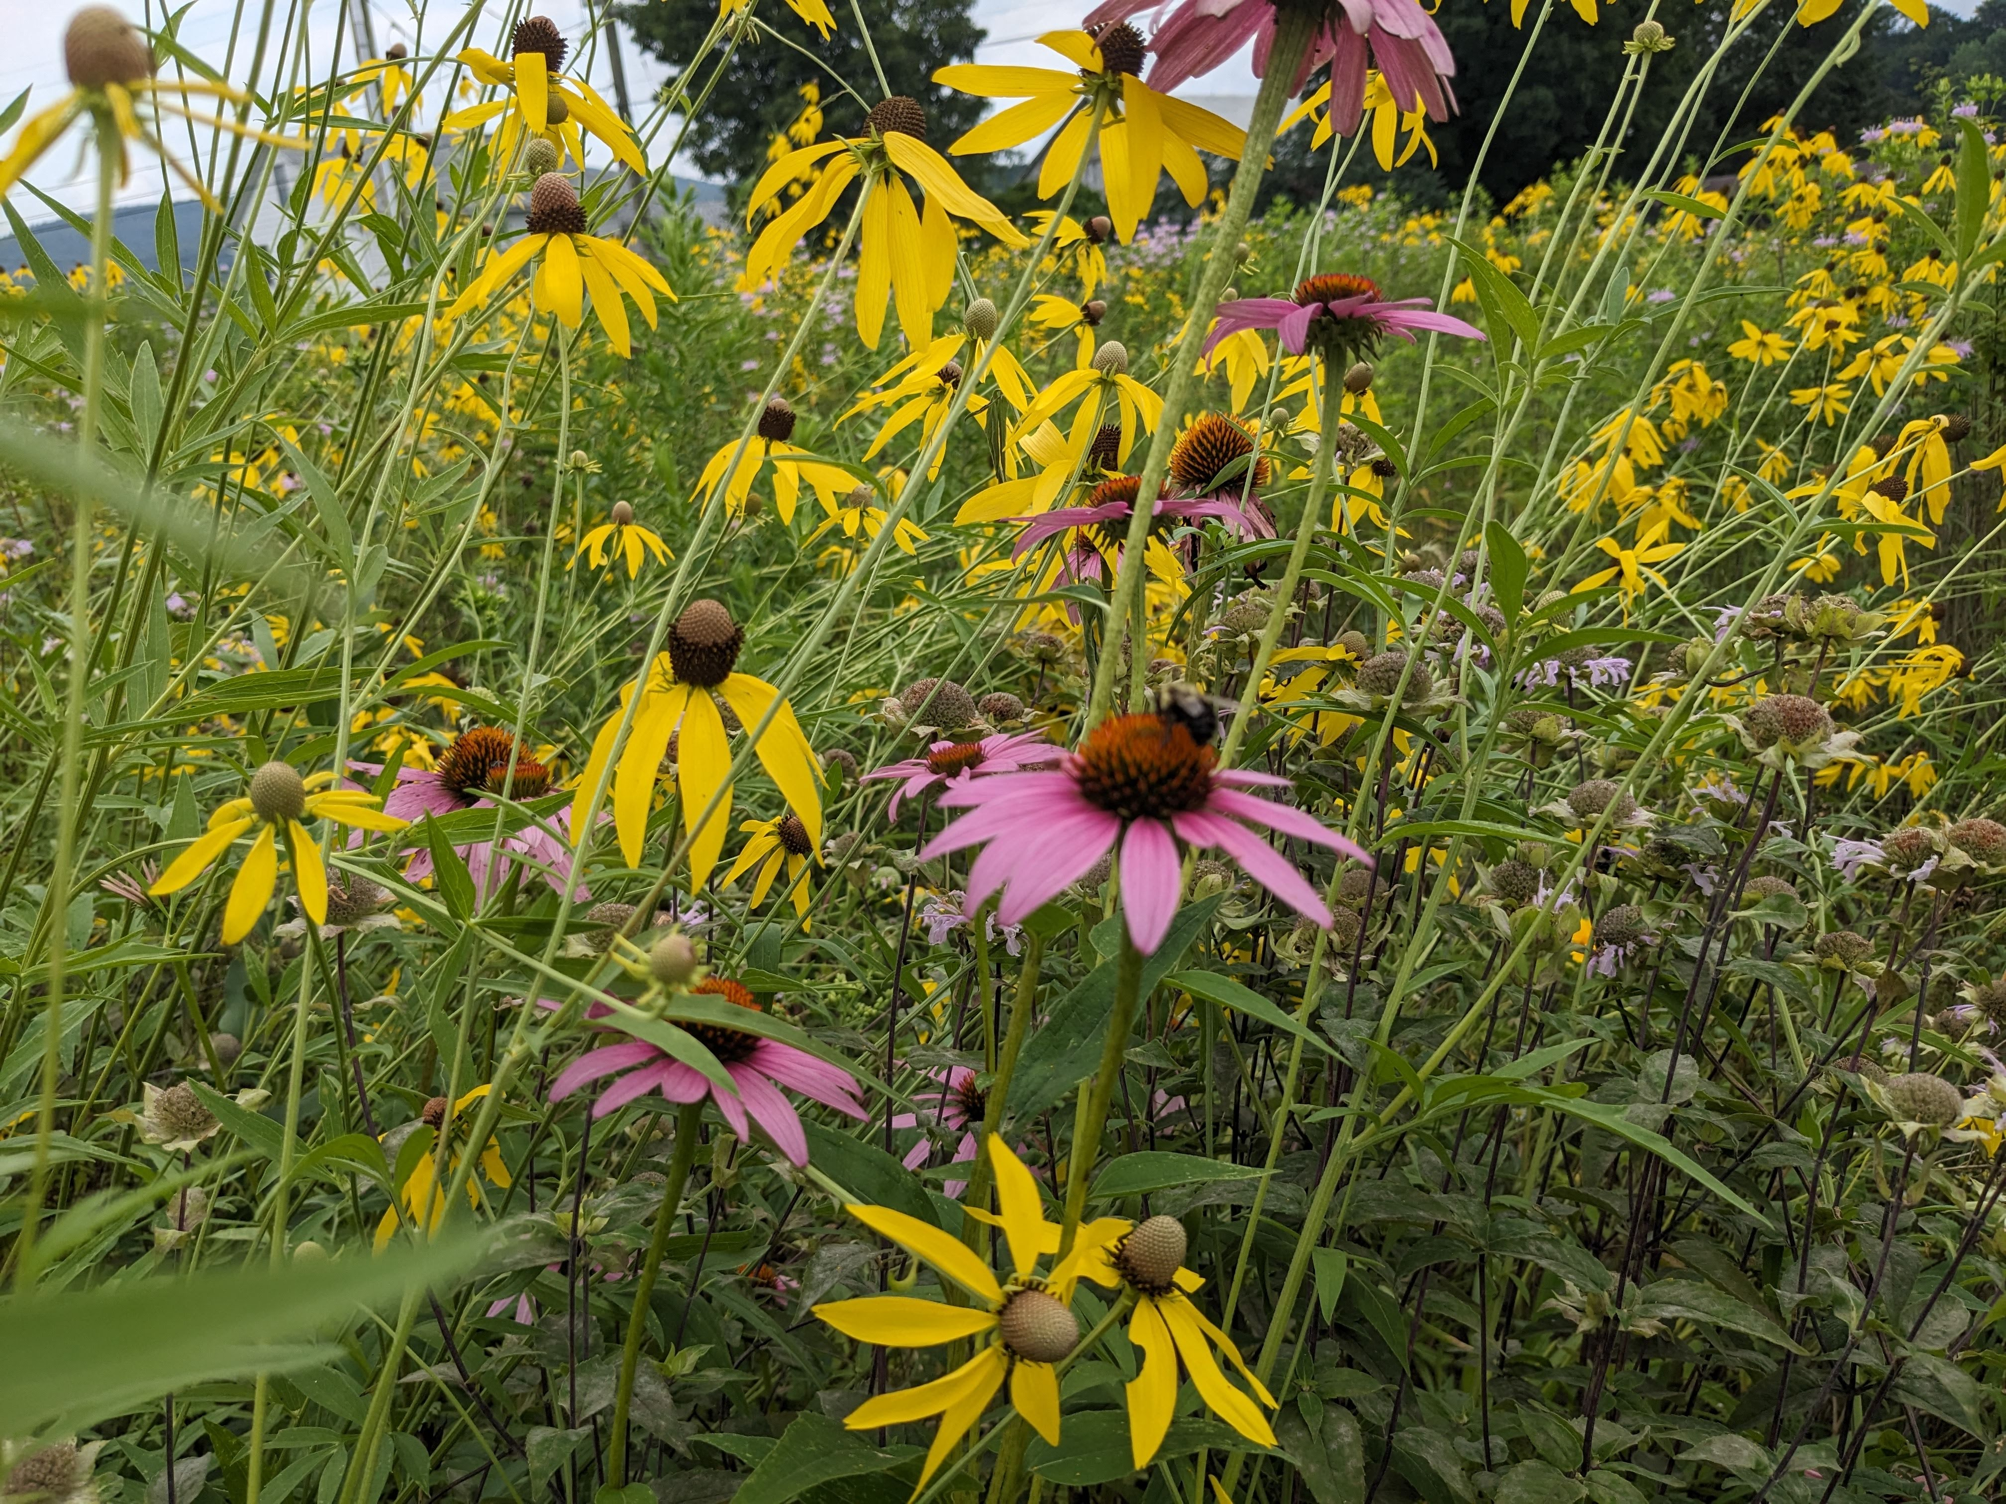
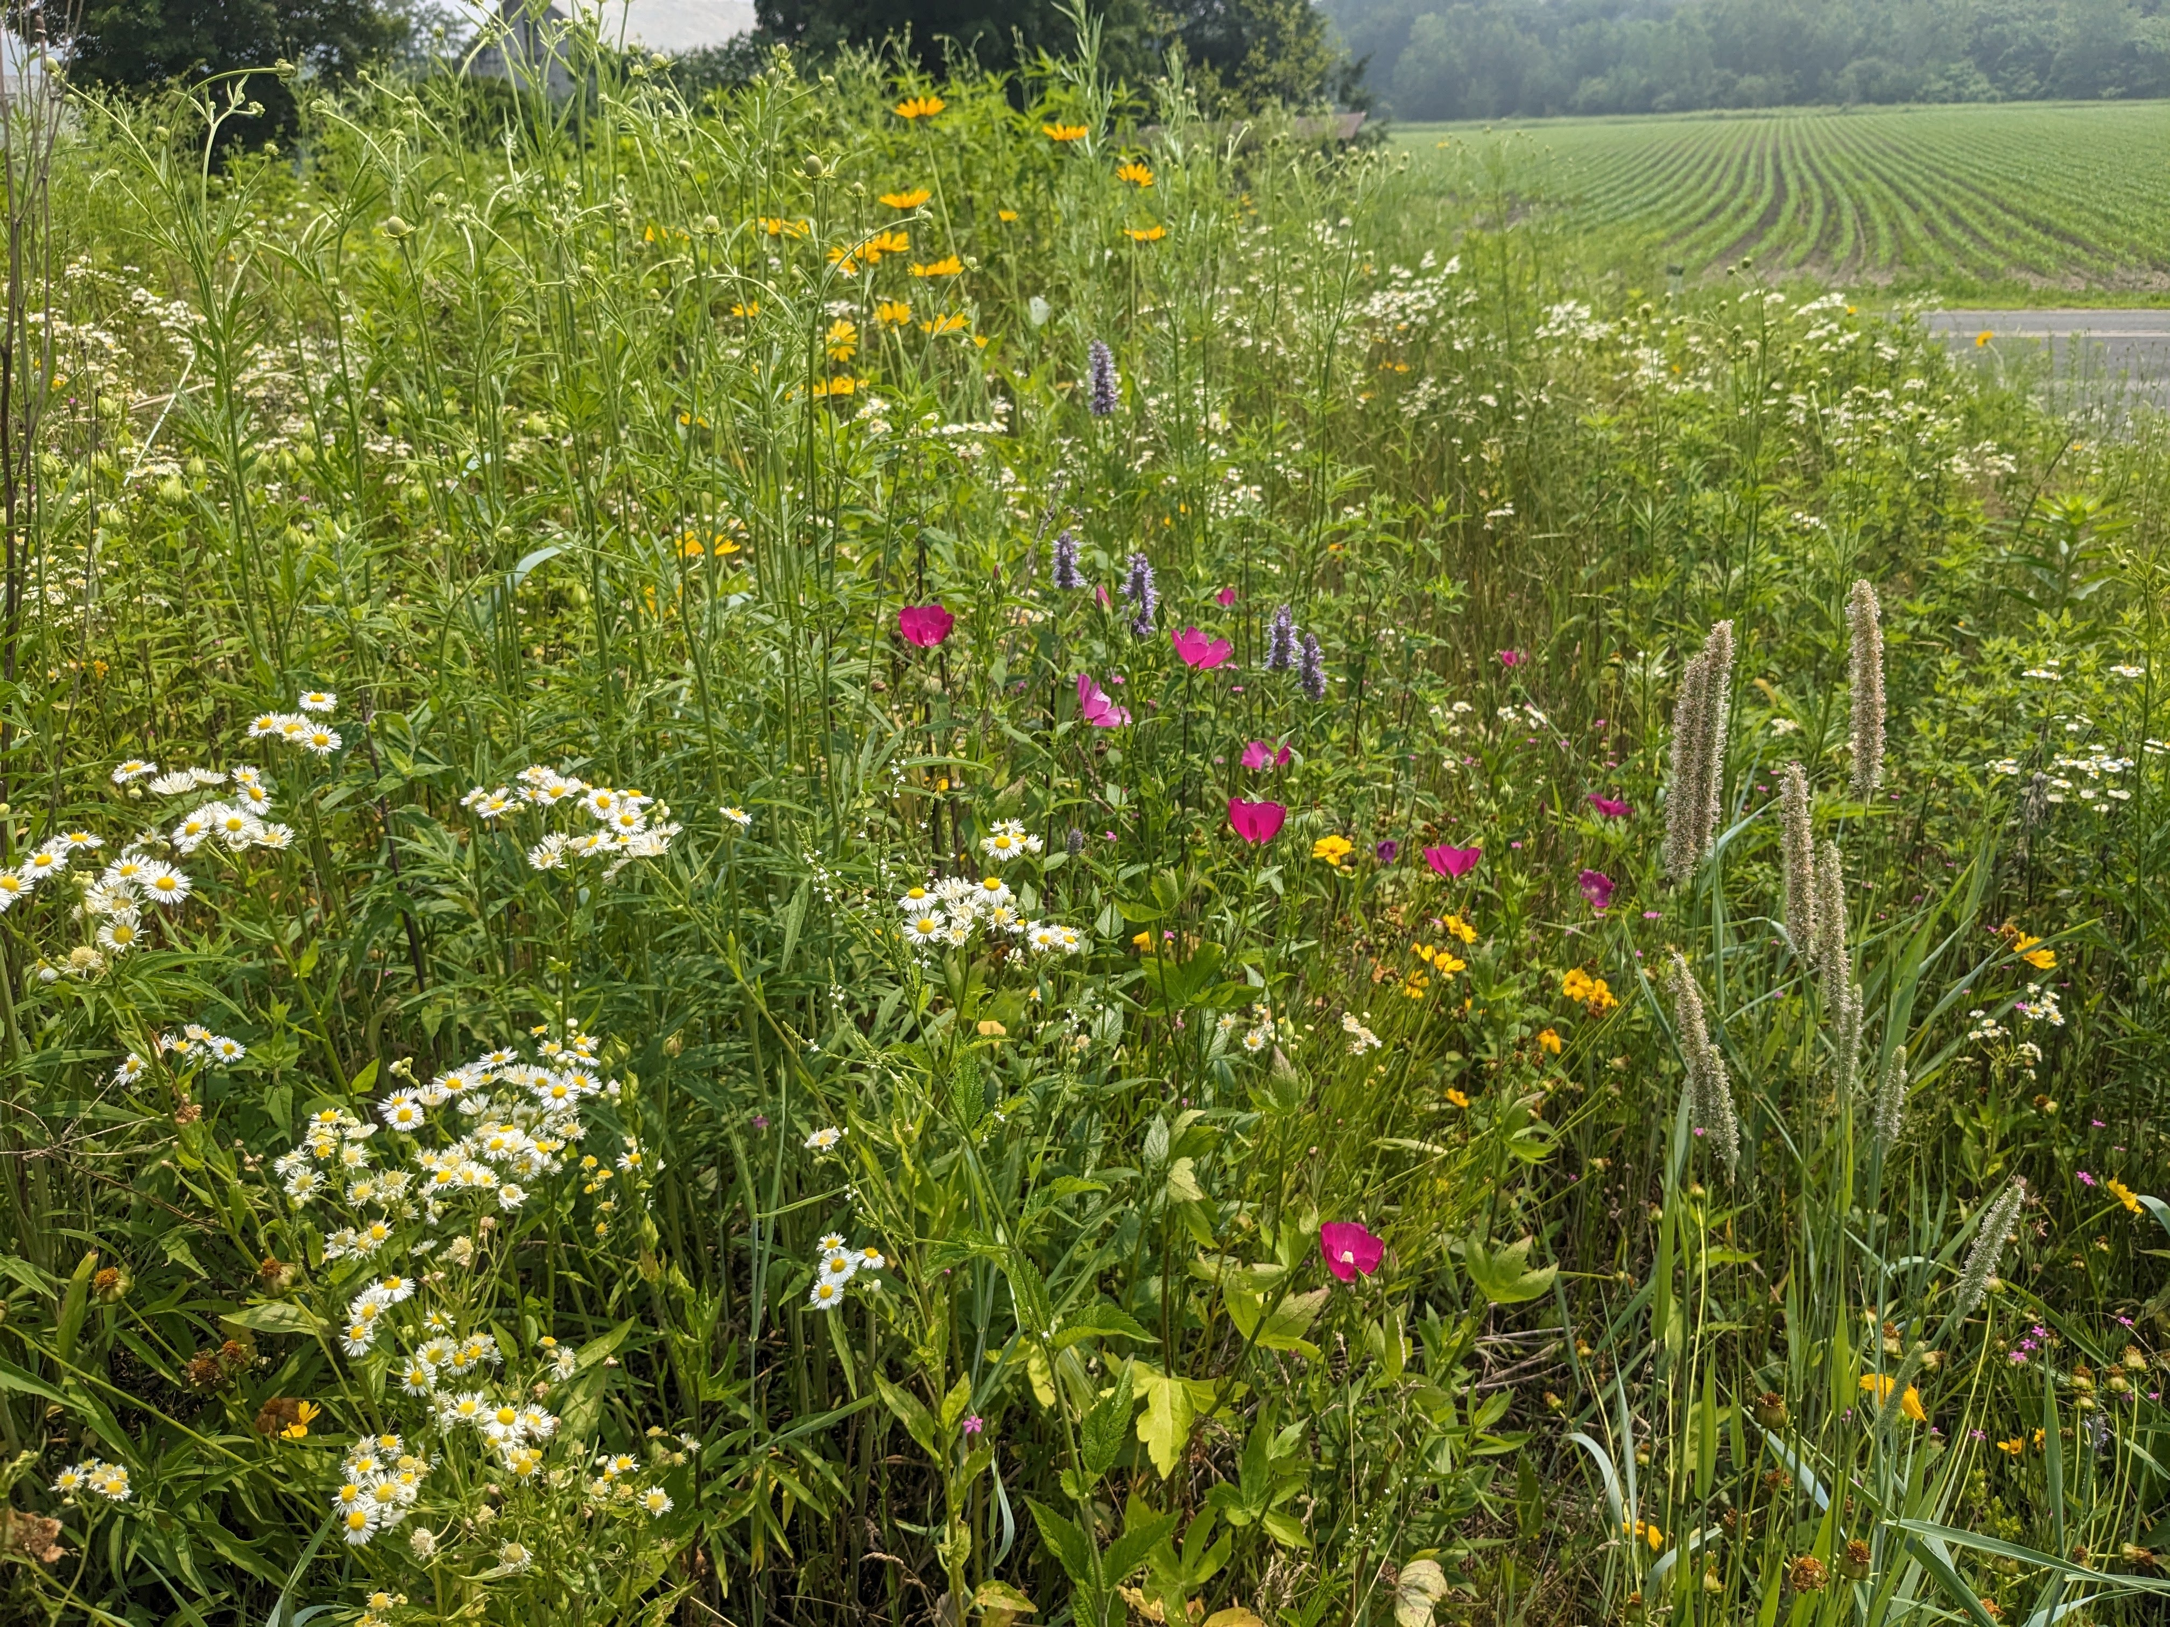
And of course, native plants are beautiful!
Photos: B. Bradley
Notes:
And of course they are beautiful!

Slide 9
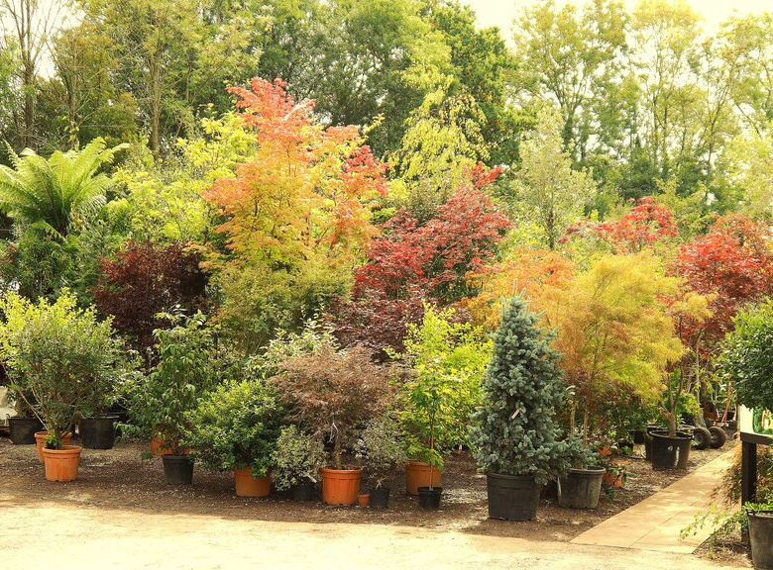
But: Most nursery stock consists of non-native species.
Notes:
Despite these benefits, the ornamental plant trade is mostly made up of non-native species which have detrimental impacts on our environment. One study found that 80% of nursery stock in the U.S. can be considered non-native. This serves as a barrier to consumers interested in planting native: It is difficult to understand what native species they should be planting, and also which native plants are actually available for sale.

Slide 10
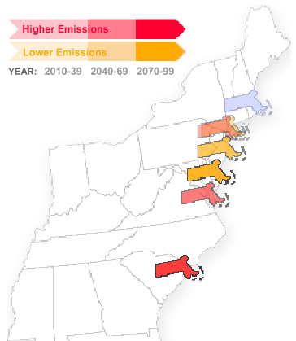
Another barrier: Climate change!
Climate change is happening fast
Plants will need to move great distances to keep up.
~800 miles
Native plant species are moving 20x slower than the pace of climate change on their own!¹
¹Bradley BA, Beaury EM, Gallardo B, et al. 2024. Observed and Potential Range Shifts of Native and Nonnative Species with Climate Change. Annual Review of Ecology, Evolution, and Systematics 55: 23–40.
Notes:
Another barrier: climate change!
Climate change is happening fast, and in less than 100 years the Massachusetts climate is expected to shift to the equivalent of about 400-800 miles South. In response to this, plants will need to move great distances to track their preferred climate, which studies show they are not doing fast enough on their own. In fact, native plants have been found to be spreading at a rate 20x slower than is needed to keep up with the pace of climate change.

Slide 11
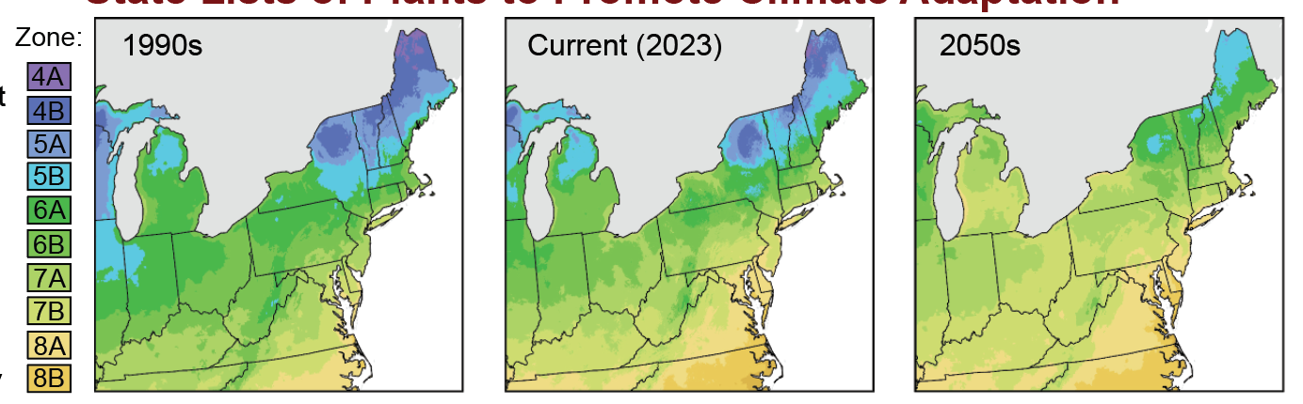
Hardiness zones are already shifting.
Plant hardiness zones are based on minimum winter temperatures, and are an estimate used by gardeners to determine what can grow at a given location.
USDA 2023
Notes:
These changes are already noticeable in the last decade as shown by shifting hardiness zones from the 1990s, to today, and projected to mid-century.
Plant hardiness zones are based on minimum winter temperatures, and are an estimate used by gardeners to determine what can grow at a given location.
We can see that since the 1990s hardiness zones have shifted by about ½ a zone corresponding to a 5 degree increase in minimum winter temperature, and by 2050 another ½ shift is expected.
These changing conditions are also changing what species can survive in gardens throughout our region.

Slide 12
Gardeners will need to consider what species will persist in their area as the climate continues to change!
Climate-smart gardening: Planting for present and future conditions using native and near-native species adapted to both current and future hardiness zones.
Notes:
Therefore, gardeners will need to consider what species will persist in their area as the climate continues to change!
This is where what we call “climate-smart” gardening comes into play: planting for present and future conditions using native and near-native species adapted to both current and future hardiness zones.

Slide 13
Gardeners will need to consider what species will persist in their area as the climate continues to change!
Climate-smart gardening: Planting for present and future conditions using native and near-native species adapted to both current and future hardiness zones.
Persistent species: Species which are suitable for both current and future hardiness zones of a given state.
Notes:
I’m going to break down and expand on these terms a bit later but for now these are some definitions of how we are going to classify species in our resource.
We define persistent species as…

Slide 14
Gardeners will need to consider what species will persist in their area as the climate continues to change!
Climate-smart gardening: Planting for present and future conditions using native and near-native species adapted to both current and future hardiness zones.
Persistent species: Species which are suitable for both current and future hardiness zones of a given state.
Native species: Species historically found growing without human intervention in a given state.
Notes:
We define native species as…

Slide 15
Gardeners will need to consider what species will persist in their area as the climate continues to change!
Climate-smart gardening: Planting for present and future conditions using native and near-native species adapted to both current and future hardiness zones.
Persistent species: Species which are suitable for both current and future hardiness zones of a given state.
Native species: Species historically found growing without human intervention in a given state.
Near-native species: Species that are not native to a given state but are native to a
nearby state with a shared Level III Ecoregion.
Notes:
We define near-native species as…

Slide 16
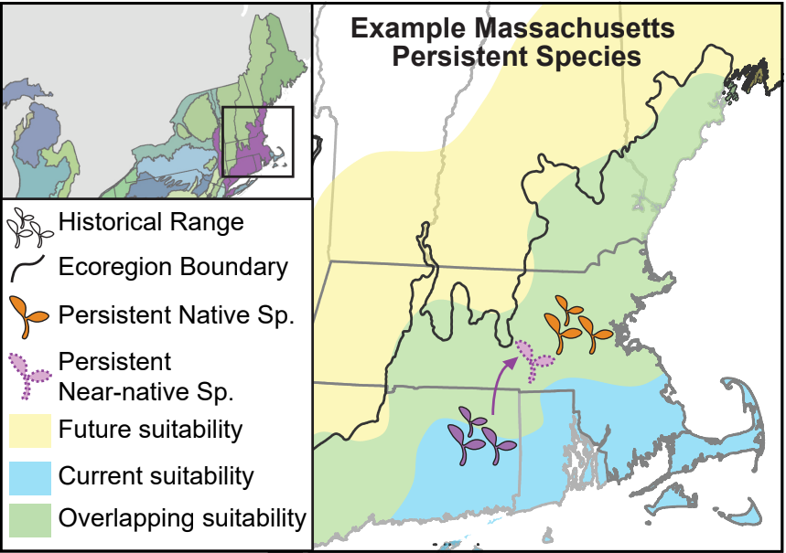
Persistent native species in MA
Current + Future suitability
sp. range
Notes:
The following slides are going to be hypothetical examples from the perspective of a gardener based in Massachusetts to better explain these concepts.
This map shows areas of environmental suitability, basically the range of USDA hardiness zones it can tolerate, of a plant species being considered for a garden.
Areas of current suitability are in blue, the future in yellow, and the overlap, so where conditions will persist, in green. You can see the historic range of this species (in orange) is native to Massachusetts and falls within the green area of persistent conditions under future climate change. We would therefore classify this species as a persistent native and it would be a good species to plant in a garden in Massachusetts.

Slide 17
Persistent near-native species in MA
Current + Future suitability
USDA Ecoregions are a way of identifying areas of ecological similarity. Areas within the same ecoregion would be expected to have similar geology, landforms, soils, vegetation, climate, land use, wildlife, and hydrology.
Notes:
Plant communities don’t often follow political boundaries though, and that is where USDA ecoregions can help us determine what species are okay to plant across state lines.
USDA Ecoregions are a way of identifying areas of ecological similarity. The black outline now on the map to the coast shows areas which fall in the “Northeastern Coastal Zone” ecoregion. Areas within the same ecoregion would be expected to have similar geology, landforms, soils, vegetation, climate, land use, wildlife, and hydrology. Therefore, you would expect similar plant communities and a shared evolutionary history across states which overlap the same ecoregion, and plants within them to be safe to plant if environmental conditions will persist across state lines.

Slide 18
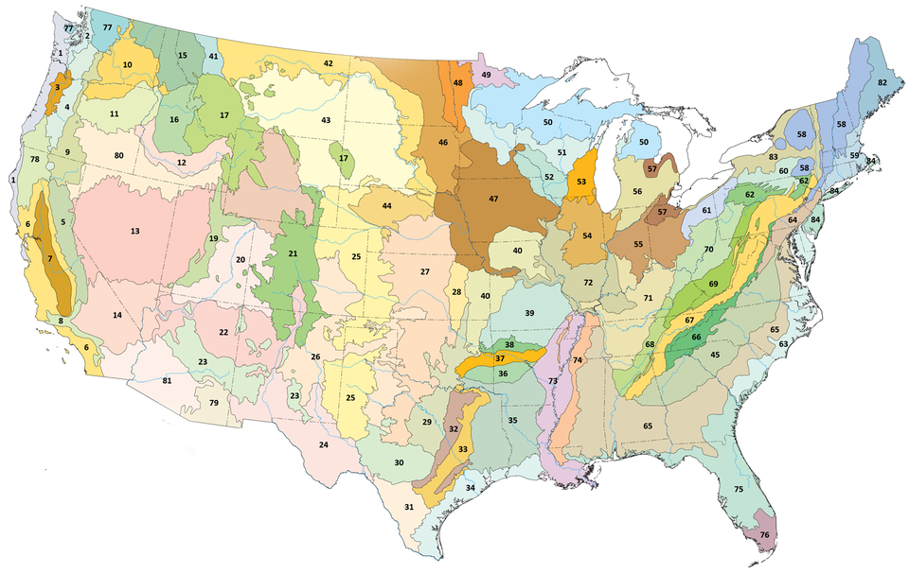
USDA Level III Ecoregions
Here is the Northeastern Coastal Zone Ecoregion used in our example!
Notes:
For context, here is what the level 3 ecoregions look like at a national scale. The ecoregion I just introduced can be seen on the right. Hopefully, this map gives you an idea of the size of the level 3 ecoregions we are making use of in our resource. We only include near native species on a state list if the focal state shares at least one level 3 ecoregion with a state in which the species is native.

Slide 19
Persistent near-native species in MA
Current + Future suitability
sp. range
Notes:
As an example, lets say we are interested in understanding whether this purple species is appropriate to plant in Massachusetts. We know its historic native range is in Connecticut, but falls within an ecoregion shared with Massachusetts.
We can also see that areas of suitability for this species are expected to persist within Massachusetts under future climate conditions. This species is therefore a persistent near-native species in Massachusetts.

Slide 20
Persistent near-native species in MA
Current + Future suitability
sp.
planting
Notes:
By planting near-native species as displayed here, you can actually help facilitate their movement tracking suitable habitat poleward in response to warming conditions, as we know the pace of climate change is much faster than native species will be able to move on their own. Because this movement is occurring within states of a shared ecoregion, the geographic distance the species is moving is not too great which reduces the risk of invasive behaviors while promoting climate adaptation.

Slide 21
The problems to planting native:
People don’t know what native species to plant.
It’s hard to know what native species are available in trade.
Climate change will alter what species will persist in an area.
Notes:
So, to summarize what I’ve gone over so far, the problems people encounter when trying to plant native gardens include:

Slide 22

To address this problem, we have created state lists of climate-smart native and near-native plants that are expected to persist under future climate conditions for use by home gardeners.
Notes:
To address this problem, our newest research to practice paper contains lists of climate-smart native and near-native plants that are expected to persist under future climate conditions for use by home gardeners. We call this ‘Climate-Smart Gardening 2.0’ because it is an expansion of our first climate-smart gardening resource that was released in 2020.

Slide 23
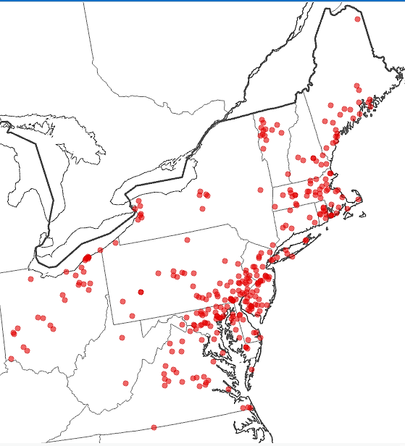
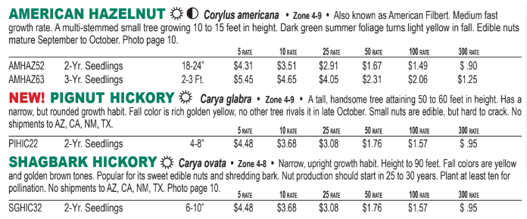
What species are available commercially?
Surveyed 339 nurseries in 15 states in the mid-Atlantic and Northeastern United States for native species currently for sale.
This resulted in the identification of 1,472 species native to the lower 48 U.S.
Notes:
To create lists of climate resilient native plant species for each state, we…
You can see a map of these nurseries displayed on the right. This is an example of a catalog from a nursery in PA we extracted data from. Through this process we identified 1,472 species native to the continental United States.
We started with what is offered for sale in nurseries in our region to ensure what we recommend is commercially available, to address this common problem encountered by users of other native plant lists.

Slide 24

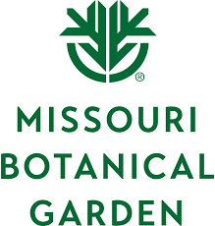
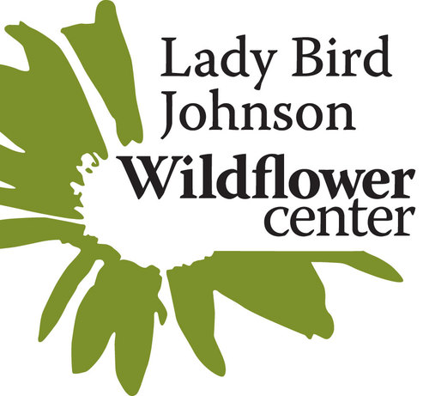
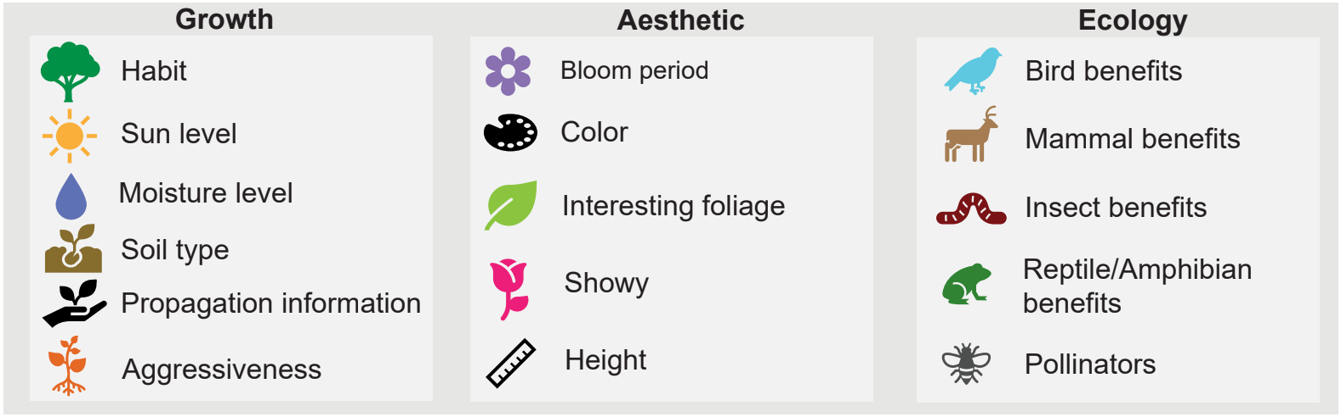

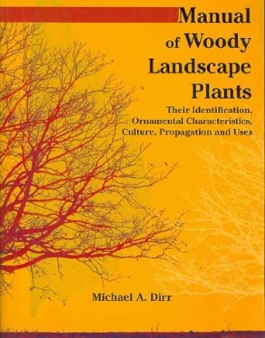
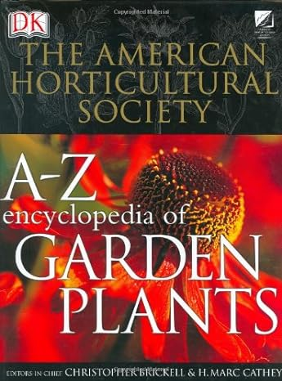
Standardization and characteristics appended
Standardized taxonomy
Appended horticultural information (including optimal hardiness zones)
The states each species is native to was appended from the World Checklist of Vascular Plants¹
Aggressiveness (weediness) of each species was indicated based on descriptions in the Missouri Botanic Garden’s Plant Finder tool.
¹Govaerts, R., Nic Lughadha, E., Black, N. et al. The World Checklist of Vascular Plants, a continuously updated resource for exploring global plant diversity. Sci Data 8, 215 (2021)
Notes:
We then standardized taxonomy to the World Flora Online taxonomic backbone to account for the fact that scientific names are changing all the time and different names can be used to mean the same species.
We then appended growth, aesthetic, and ecological information for each species to allow the user to filter species for their specific gardening project or use. This information came from resources like the Missouri botanical garden’s Plant Finder Tool, Ladybird Johnson Wildflower Center, the department of transportations ecoregional revegetation application, the Manual of Woody Landscape Plants, and A-Z Encyclopedia of garden plants.
The states each species is native to was appended from the World Checklist of Vascular Plants.
We also flagged aggressive or weedy species based on descriptions from the Missouri Botanic Garden’s Plant Finder Tool. It is important to note that species described as aggressive or weedy which are native to a state may be desirable in some cases as a ground cover, or otherwise, and are not descriptions of the species as invasive.

Slide 25
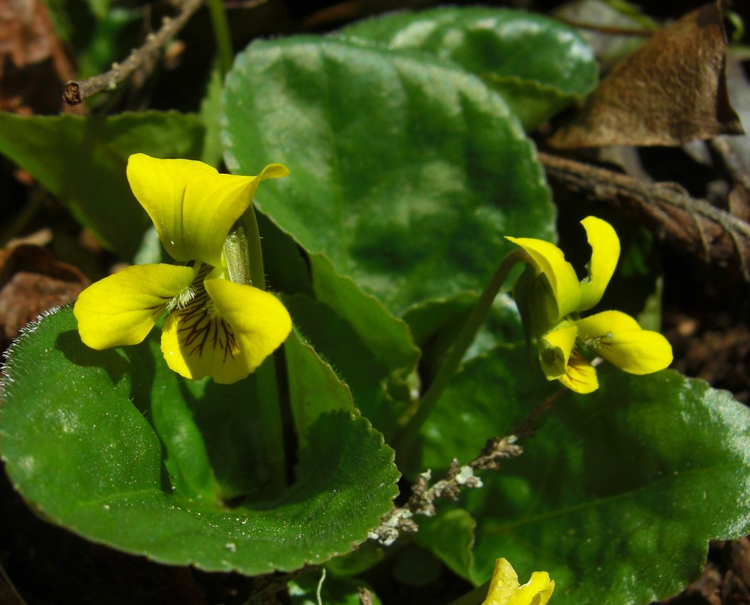
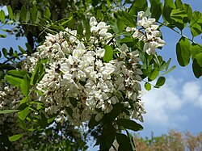
Data filters
Species for which we found no optimal hardiness zone information were removed.
We filtered out rare, threatened, or endangered species from states where they are listed.
Viola rotundifolia
Endangered in RI
Imperiled in DE
Species regulated on any official state list within the region were excluded from all state lists.
Example: Robinia pseudoacacia (Black locust)
Notes:
Species for which we found no optimal hardiness zone information were removed.
We then filter out rare, threatened, or endangered species from states where they are listed. For example, Viola rotundifolia is endangered in Rhode Island and Imperiled in Delaware, so that species would not be recommended for planting in those states to avoid the wild collection of or the introduction of inappropriate genotypes near wild populations.
We also excluded any native species regulated by any state within our region. For example, Robinia pseudoacacia, or the Black locust tree, often behaves like an invasive species, escaping gardens and taking over local ecosystems so it is not recommended for planting in home gardens.

Slide 26
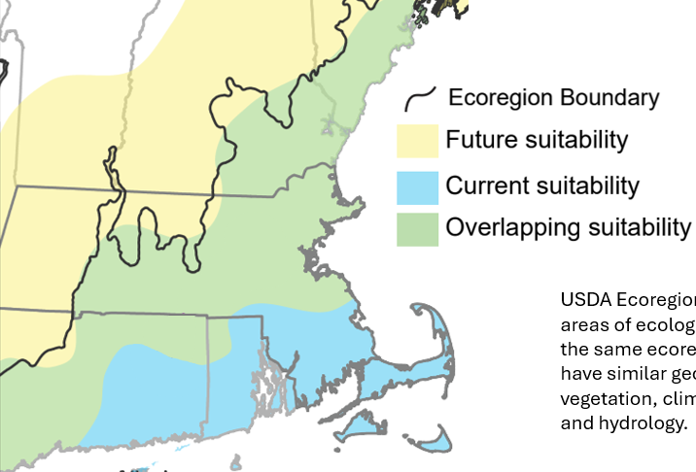
Identifying “climate smart” native plant species
To identify “climate smart” native species, we investigated if optimal hardiness zones persist in each state by mid-century under worst case future climate conditions for each species. A climate persister can survive current and future conditions within a state.
Current MA: 5 – 7
Future MA: 7 – 8
Near-native species were removed if a species was native to a state which did not share a level 3 ecoregion with the focal state.
Notes:
To identify “climate smart” native species, we investigated if optimal hardiness zones persist in each state by mid-century under worst case future climate conditions for each species. A climate persister can survive current and future conditions within a state. For example, in Massachusetts this would be a species which can persist despite the loss of hardiness zones 5 and 6 in the state by mid century. Near-native species were removed if a species was native to a state which did not share a level 3 ecoregion with the focal state. A species native to only Connecticut, and therefore near native to Massachusetts, would be included because they share the “Northeastern Coastal Zone” ecoregion, but a species native to only Virginia would not because Virginia and Massachusetts do not share a level 3 ecoregion.

Slide 27
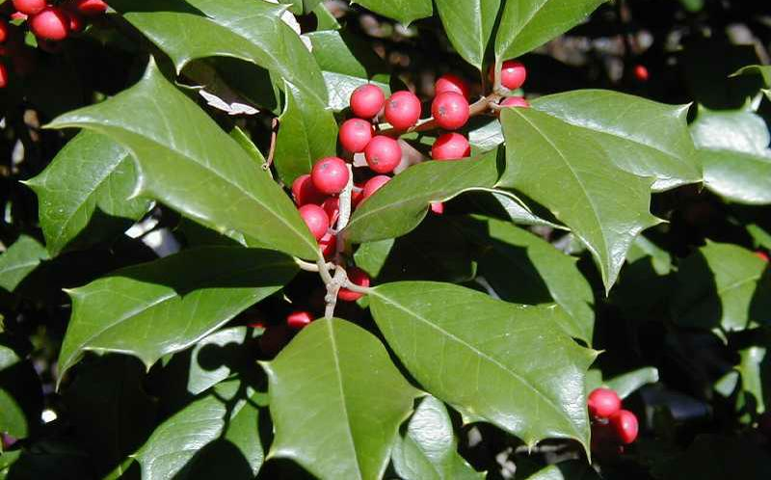

Species
Native to MA?
Survive current conditions?
Survive future conditions?
Category
Climate-smart?
Ilex opaca
Persistent native
Notes:
Here are some examples of how we classified species as climate smart relative to a gardener in MA, but these concepts were applied to any state included in our lists.
American Holly (Ilex opaca) is native to MA and has an optimal hardiness zone of 5 to 9. These hardiness zones are present currently and are predicted to persist by mid century in the state so it is classified as a persistent native and we encourage planting by home gardeners.

Slide 28
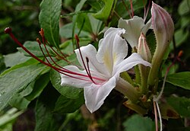

Species
Native to MA?
Survive current conditions?
Survive future conditions?
Category
Climate-smart?
Ilex opaca
Persistent native
Rhododendron arborescens
Persistent near-native
But shares a level III ecoregion with MA
Notes:
Rhododendron arborescens is not native to MA but is native to nearby Pennsylvania which shares the “Northeastern Highlands” ecoregion with MA. It’s optimal hardiness zone range is 4 to 7 which will persist under current and future climate conditions. We classify this as a near-native species which a good candidate to be planted by home gardeners in MA.

Slide 29
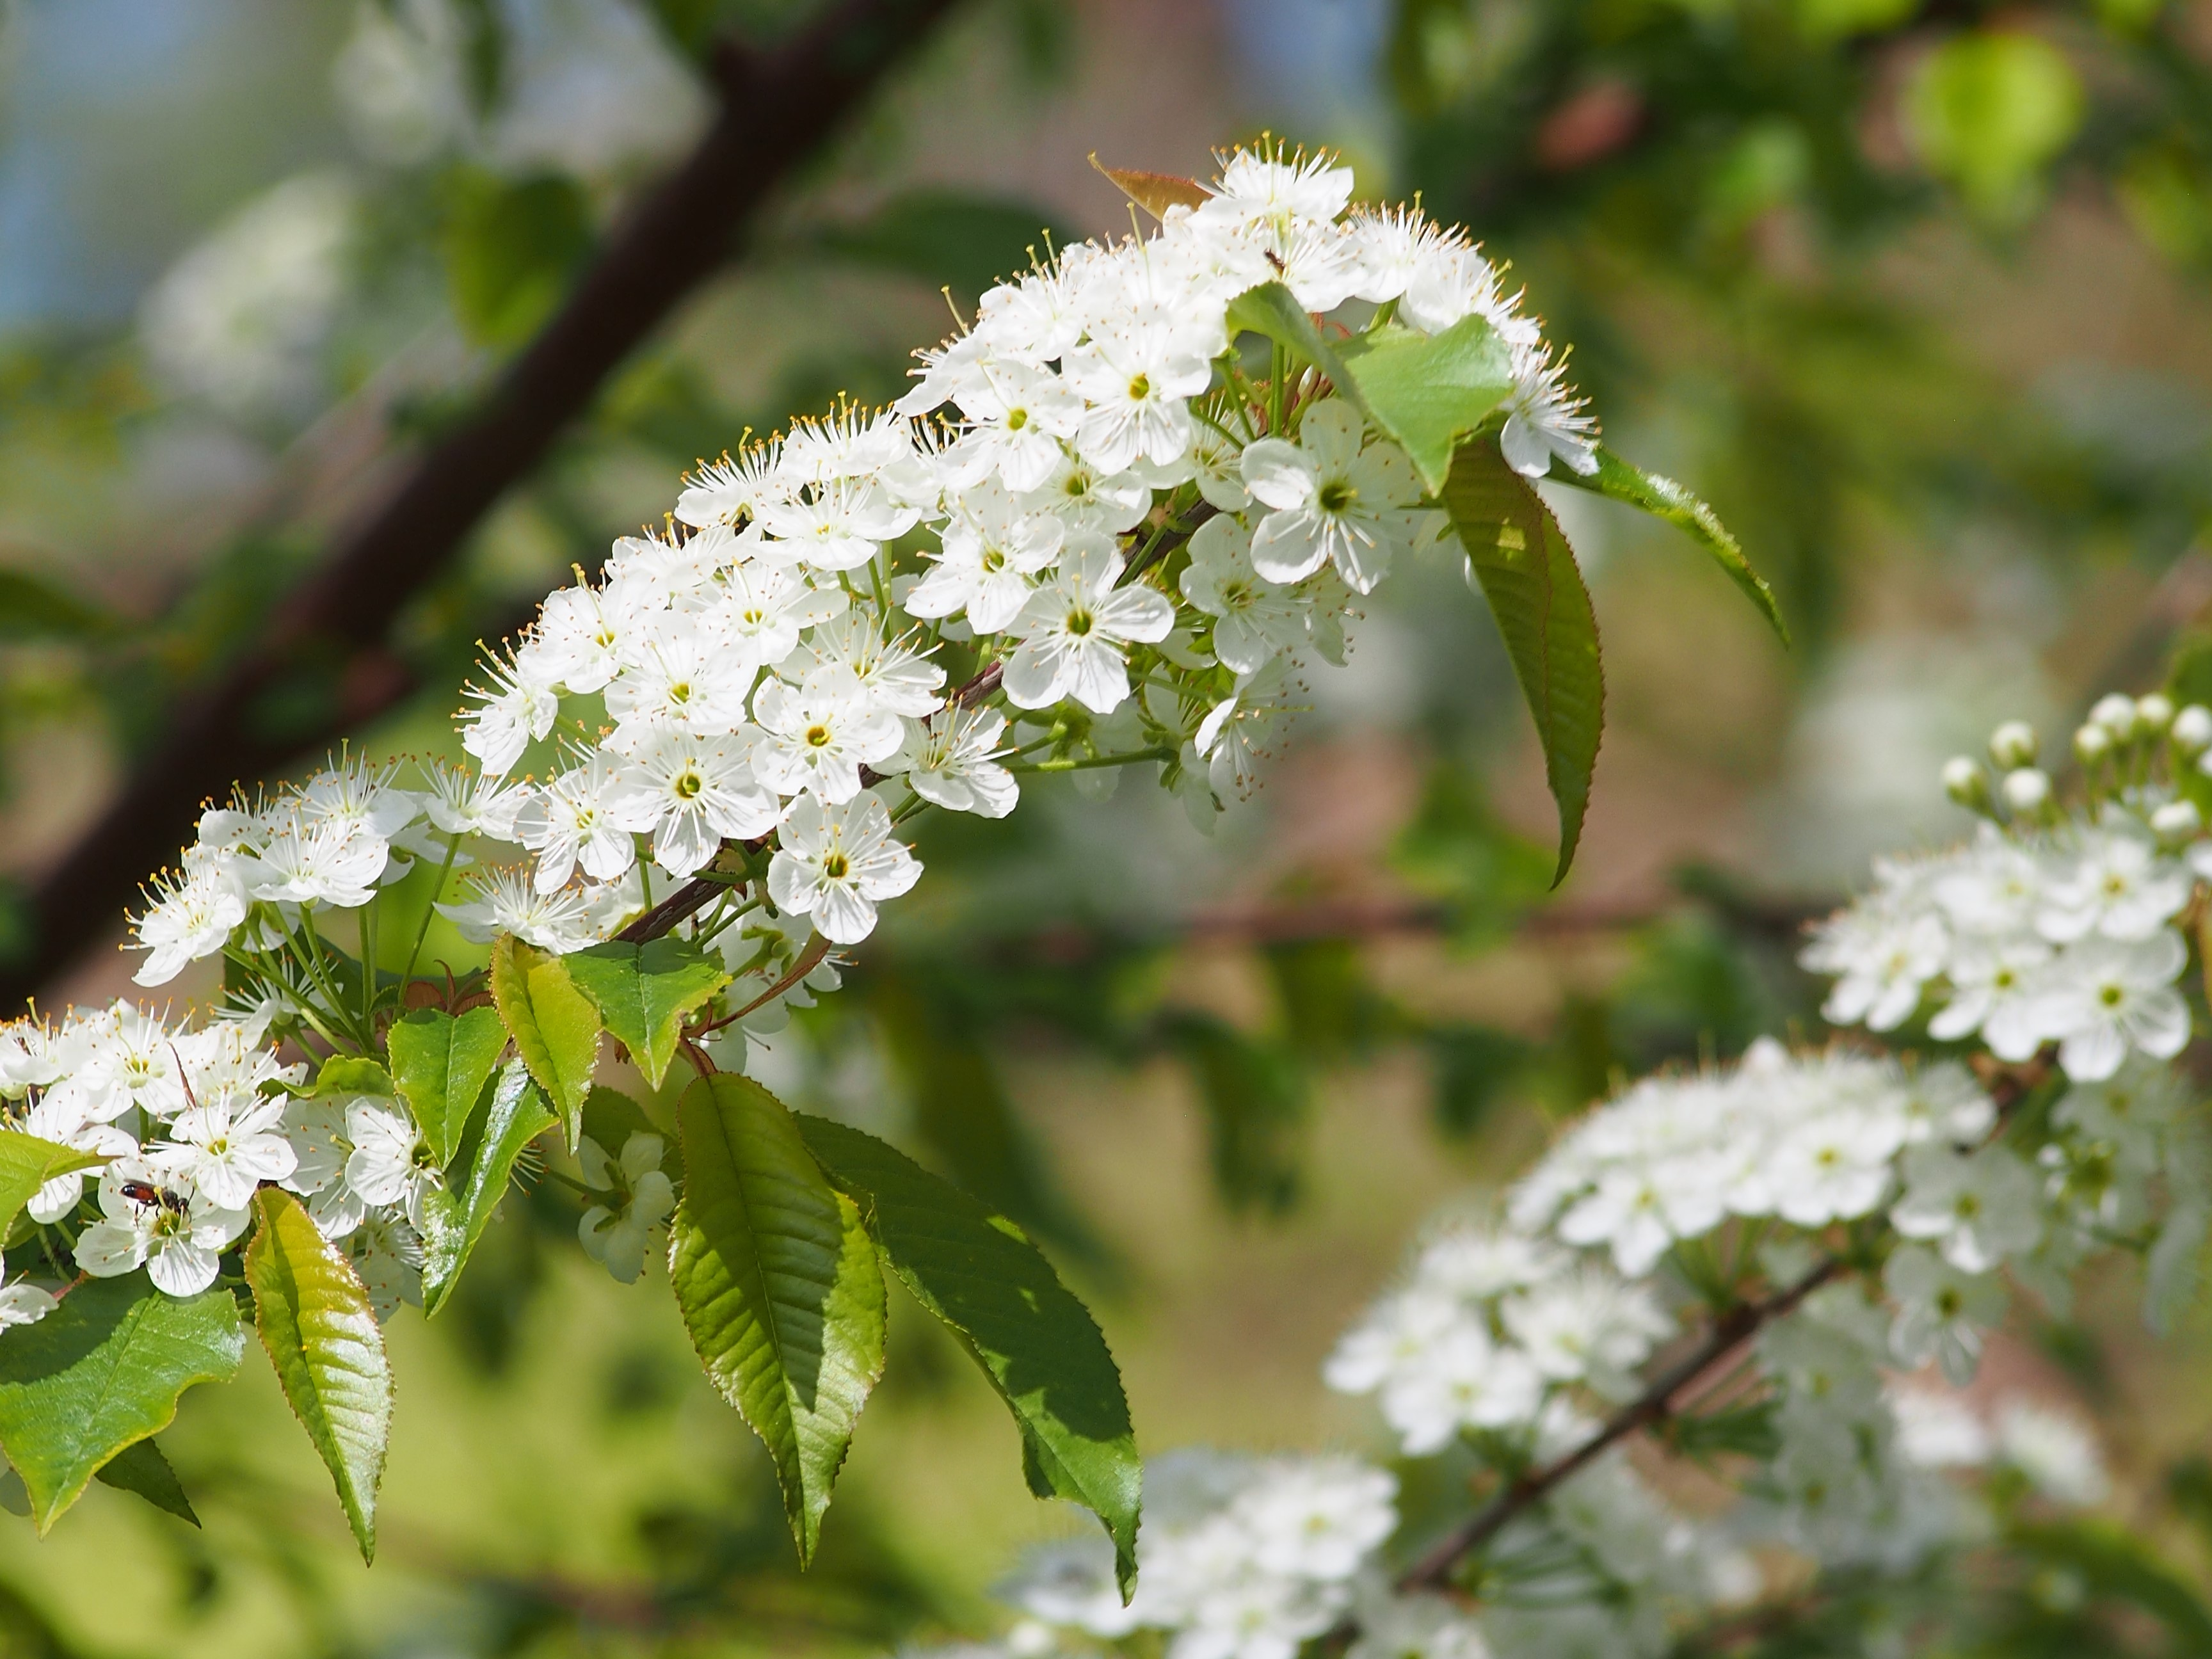
Species
Native to MA?
Survive current conditions?
Survive future conditions?
Category
Climate-smart?
Ilex opaca
Persistent native
Rhododendron arborescens
Persistent near-native
But shares a level III ecoregion with MA
Prunus pensylvanica
Native loss
Notes:
Conversely, Fire Cherry (Prunus pensylvanica), we know this species is native to MA and can survive under current hardiness zones in the state. By mid century though, the 2 to 6 optimal hardiness zones for growing Fire Cherry will be lost as the lowest zone will be 7. This is a species gardeners would not want to plant as it will not persist, and is categorized as a native loss.

Slide 30
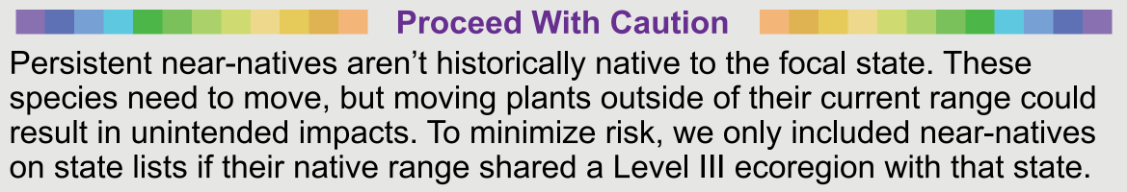
Species
Native to MA?
Survive current conditions?
Survive future conditions?
Category
Climate-smart?
Ilex opaca
Persistent native
Rhododendron arborescens
Persistent near-native
But shares a level III ecoregion with MA
Prunus pensylvanica
Native loss
Notes:
One note of caution thought on what we classify as persistent near native species. Near native species are color coded separately from native species in our resource so they are easily distinguishable. We did this because persistent near-native species aren’t historically native to the focal state
Most of the near native species on our list have a very low risk of invasion, especially because we filtered to only near native species which share a level three ecoregion with a focal state, but risk still does exist. We based this decision on an attempt to balance the minimal potential risk of invasive behaviors by some near-native species and the current available science in which we understand that native species are spreading 20 times slower than the pace of climate change and will not be able to keep up on their own making some movement of species necessary to facilitate their survival.

Slide 31
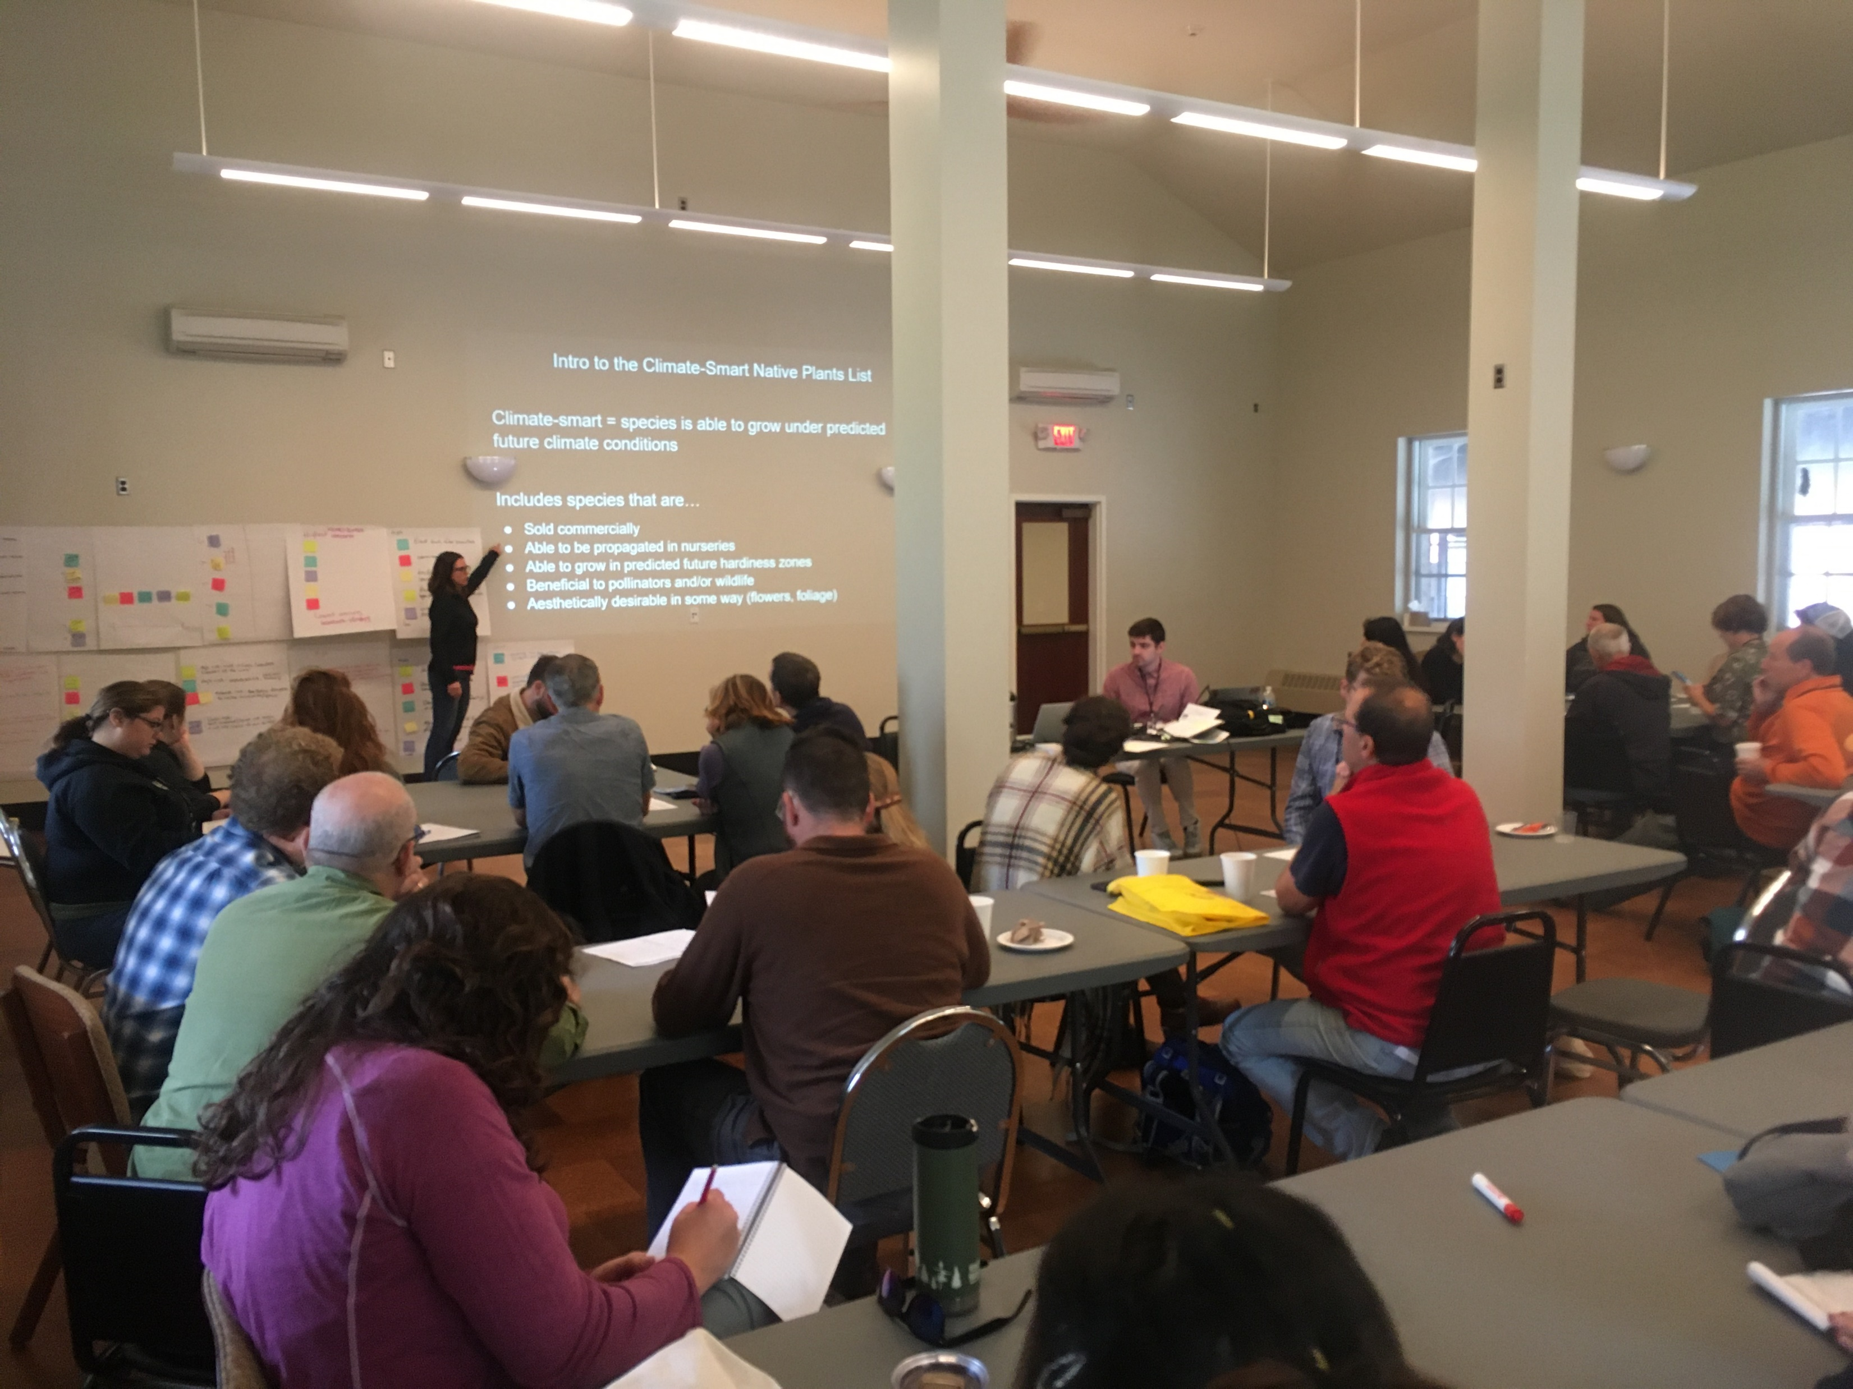
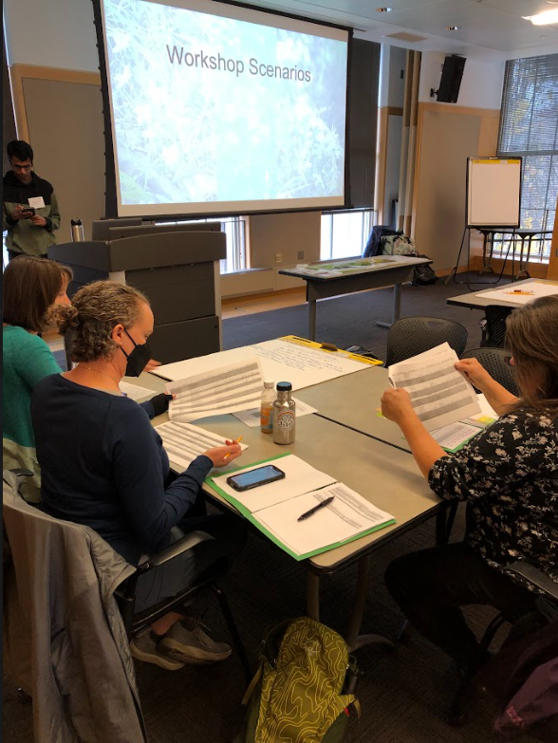
Reviewers
Finally, state lists were reviewed by experts (botanists, ecologists, horticulturalists) and additional updates were made to garden aggressiveness, common names, growth forms, taxonomy, and species were removed on a state-by-state or regional basis depending on feedback
Cornell Cooperative Extension Agriculture, Food, & Environmental Systems In-service Workshop November 2024
New York Invasive Species Expo September 2023
We are grateful for data reviews from 13 botanical, ecological, and horticultural experts, including Karen Lombard, Alyssa Siegel-Miles, and Victoria Wallace.
Notes:
Finally, lists were reviewed by botanical experts to filter out species that could be problematic in their region. We gathered feedback through two workshops with different versions of these lists and collected valuable feedback from each. We also had separate individual reviews from 13 botanical ecological and horticultural experts from states across our region including Karen Lombard, Alyssa Siegel-Miles, and Victoria Wallace. An example of helpful feedback we received was the identification of several species which are susceptible to widespread pests or pathogens (Fraxinus, Ulmus spp. [Elm]) and were subsequently removed as they would not make good persistent garden plants.

Slide 32
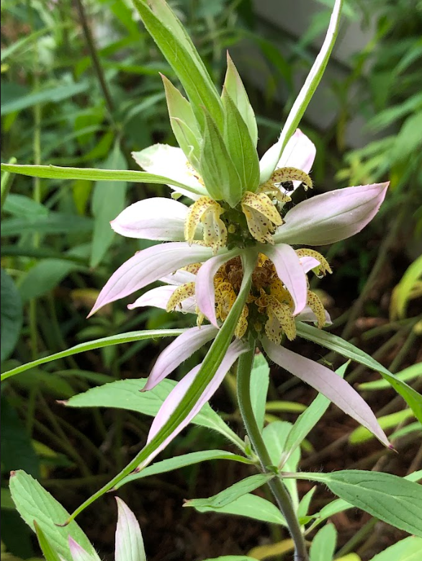
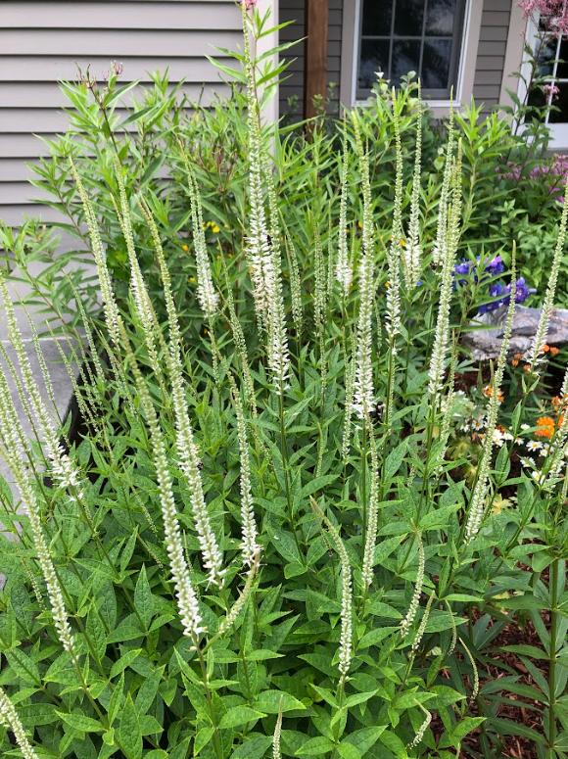
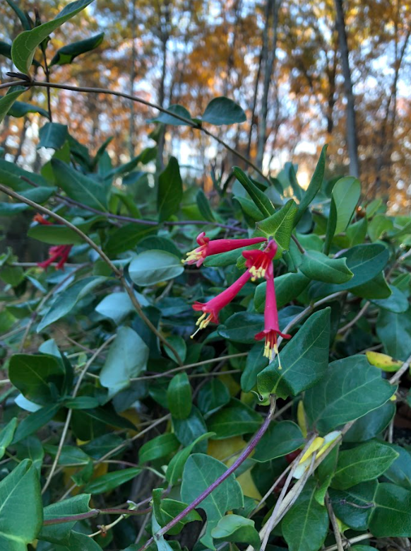
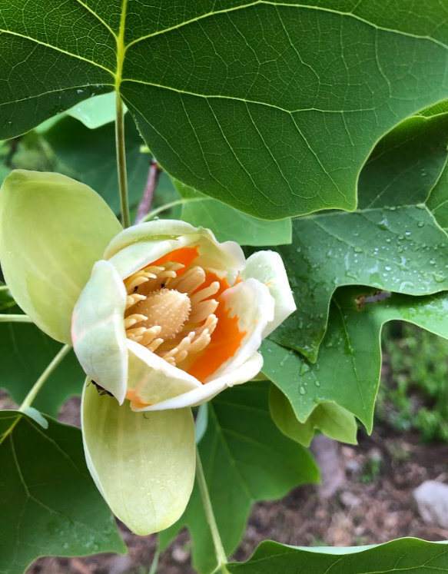
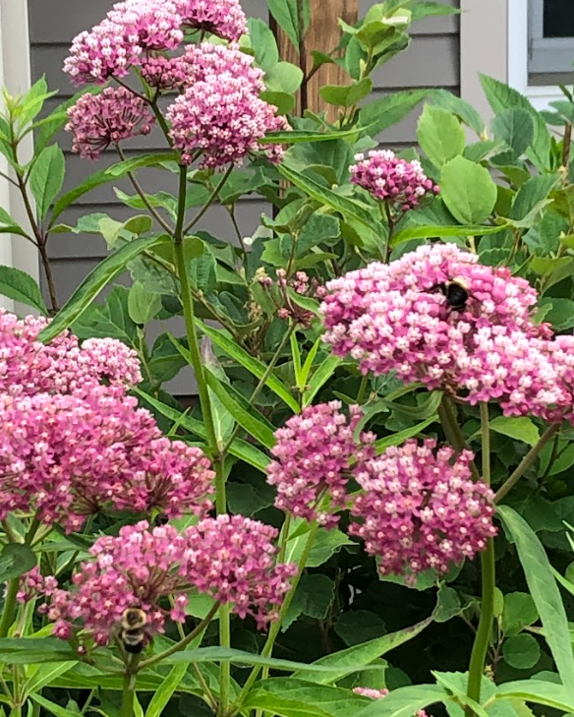
Dataset Stats
The resulting 15 state lists contain between 539 to 770 native and near-native species which are commercially available and predicted to persist under future climate conditions throughout the Northeast.
Photos: J. Allen

