Slide 1

First, a video…

Slide 2

Affordable Learning Georgia: Lessons Learned from Piloting a Statewide Initiative
Jeff Gallant
Program Manager, Affordable Learning Georgia
UNC System Workshop, May 19, 2017

Slide 3
The Road to ALG

Slide 4
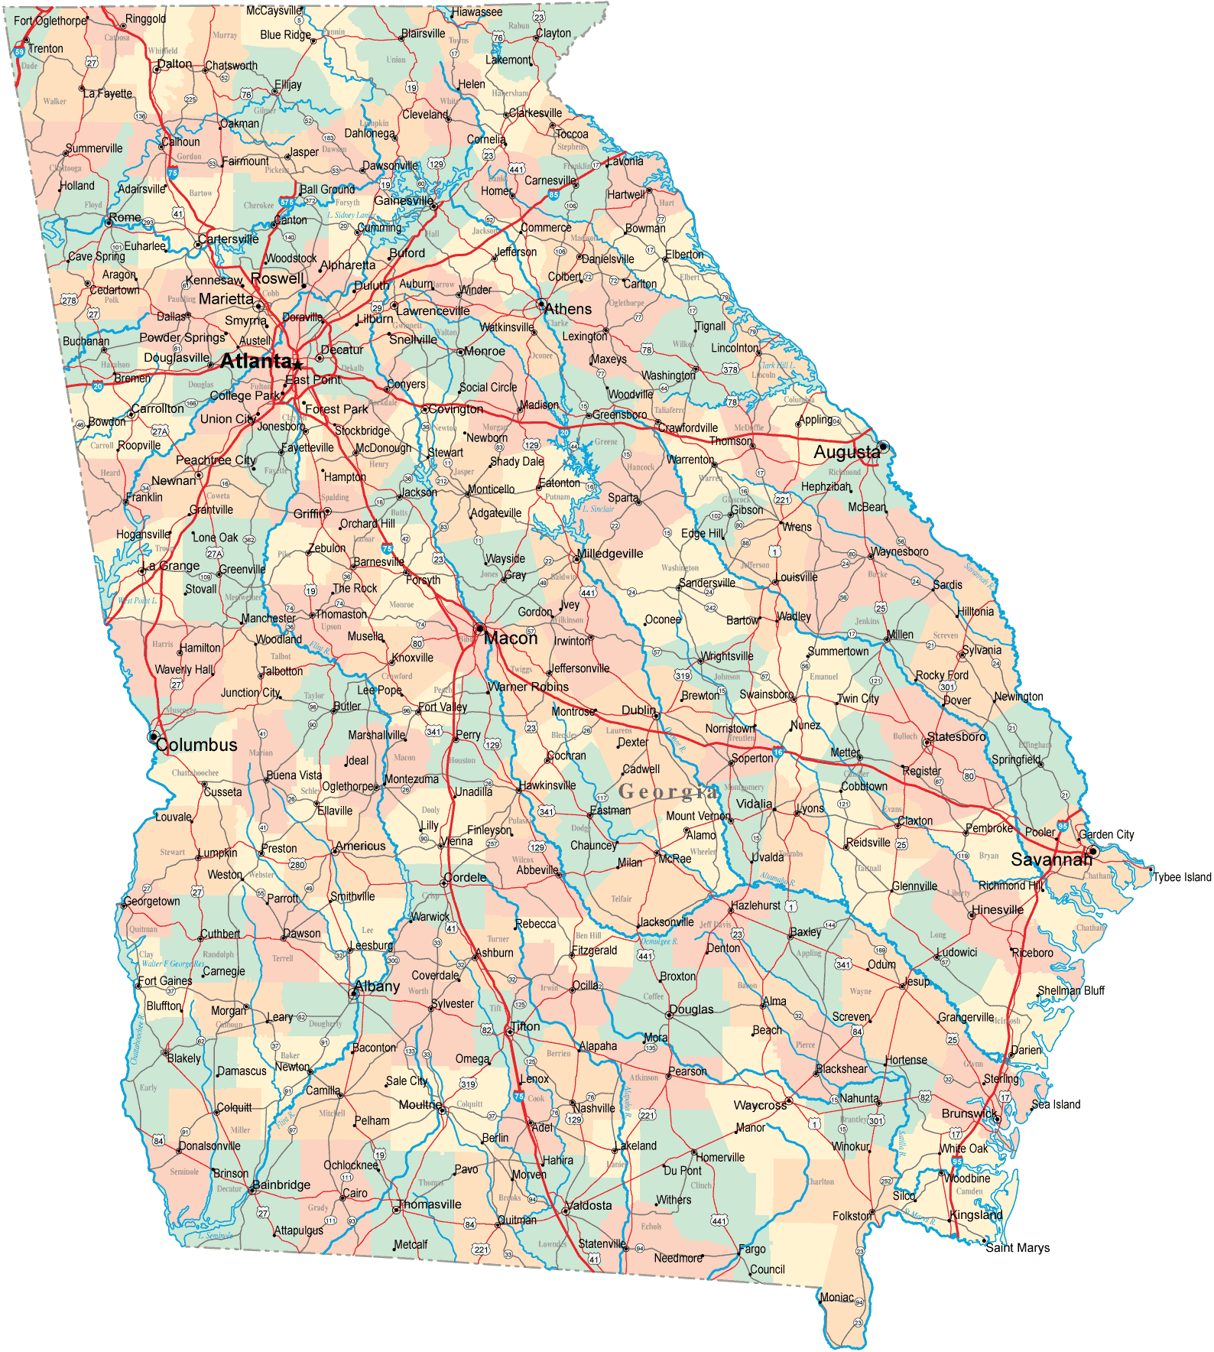
Compulsory Jargon:
What is the USG?
Georgia’s public universities and colleges – 28 institutions total
Governed by the USG Board of Regents
Administrated by a chancellor and the USG System Offices
Pioneering state institution administrative mergers for more affordable admin costs

Slide 5
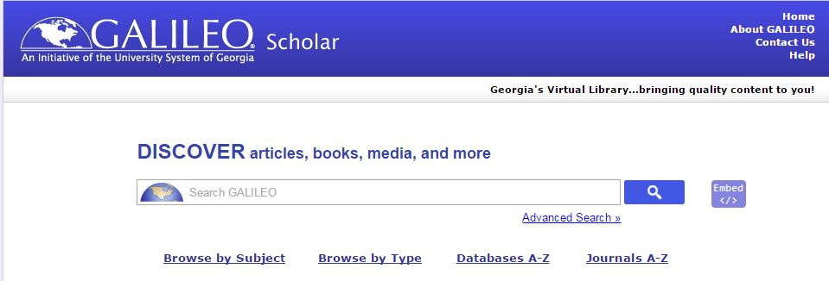
More Compulsory Jargon:
What is GALILEO?
Georgia Library Learning Online
One of the first statewide virtual libraries in the world, lasting over 20 years
Well-known and well-regarded for providing affordable and high-quality online library resources throughout GA
Serves the USG, technical colleges, public libraries, public schools, and some private institutions

Slide 6
Getting ALG Started:
Pilots and Programs

Slide 7
Affordable Learning Solutions Pilot
GALILEO Pilot Team, 2013
In partnership with California State University and MERLOT, created a website based on the CSU Affordable Learning Solutions template.
Stakeholder analyses, web page creation, testing, and improvement, presentations at state conferences, more research on OER initiatives
Affordable Learning Georgia Champions and Coordinators, Late 2013-
Affordable Learning Georgia incorporated a team of Campus Champions and Library Coordinators from each USG institution.

Slide 8

ALG Gets Funded
In 2014, the Fiscal 2015 state budget included $2.5 million in one-time funding for ALG. (This included GALILEO funding for enhanced discoverability, since library resources are also affordable.)
ALG needed to immediately get to work.
(This is when the USG borrowed me!)

Slide 9
What did we need to do?
ALG needed to make a major impact in one year. We knew that we needed to get high-quality OER in classrooms to make that impact.
In a year, we would need:
Faculty awareness of OER and ALG
Validation of OER use at scale
Support at each institution for OER implementation
Support for the time it takes to implement OER
Preservation of academic freedom (opt-in)
Partners who generate/make OER available

Slide 10
What did we need to do?
What were our answers?
Faculty awareness of OER and ALG: Champions, Website, Newsletter, Webinars, Symposia
Validation of OER use at scale: eCore Partnership
Support at each institution for OER implementation: Library Coordinators
Support for the time it takes to implement OER: Grants
Preservation of academic freedom (opt-in): Grants
Partners who generate/make OER available: CSU, OpenStax, UNG Press

Slide 11
Our Plan: Textbook Transformation Grants
Grants awarded to teams of faculty and professional staff with a plan to adopt, adapt, and create open and/or affordable educational resources to replace a commercial textbook
Grant methodology based on preserving academic freedom with incentives and support, not mandates, with a peer review selection process
Currently under 50% acceptance rate
Funding model based on providing time: average cost of course release with flexibility to institutions

Slide 12
How Do They Work?
Team proposes a project during a Request for Proposals
  Two funding categories: Standard-Scale (max $10,800) and Large-Scale (max $30,000)
  Funding depends on size of the team and impact of the project
  Always max $5000 per team member, $800 for travel to Kickoff Meeting for the round
Proposal is reviewed by administrators and three Peer Reviewers
Proposals either accepted or rejected, any rejected proposal teams receive peer review and administrative feedback

Slide 13
Incentives and Support:
Textbook Transformation Grants
First round awarded in Fall 2014
Round Nine in Summer 2017
To date:
$2,671,211.90 awarded to 159 projects
Up to R9: Annual savings (with all projects implemented): $20,450,056.60
Students affected annually (per one course enrollment): 120,693
Speaking of numbers…

Slide 14
The Numbers, So Far
In Fiscal Year 2016-2017, ALG programs have already saved students $15,812,852.30 in textbook costs, affecting 118,186 students.
Once all FY2016-2017 grant projects are fully implemented, these projects will annually save students $20.4 million dollars on textbook costs.
Since the initiative’s funded inception in Fiscal Year 2014-2015, all ALG programs have saved a total projected $26.1 million dollars on textbook costs, affecting 221,735 students.

Slide 15
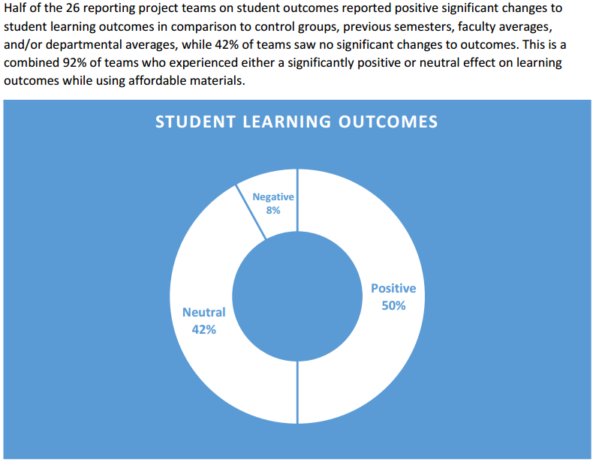
Grant Outcomes
COUP Framework: Cost, Outcomes, Usage, Perception
  Savings, # students
  Learning Outcomes
  Retention: Drop, Fail, Withdraw (DFW) rates
Summarized at completion of a round of grants
R1 & R2: Positive student satisfaction, positive or neutral student learning outcomes, positive or neutral DFW
http://affordablelearninggeorgia.org/documents/R2_Summary.pdf

Slide 16
Lessons Learned

Slide 17
Show of hands!
How many of you are responsible for tracking the impact of an OER program?

Slide 18
#1: Keep Your Data Flexible and Expandable

Slide 19
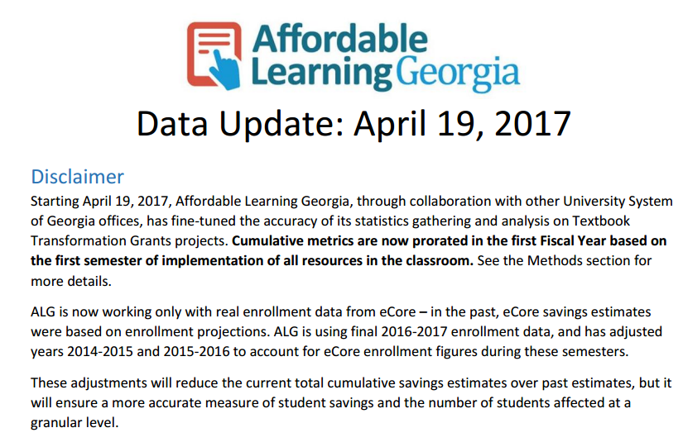
Making the Most of Urgent Report Requests
To improve our accuracy for cumulative metrics this year, we needed to take the initial semester of OER implementation in the classroom into account, not just annual statistics.

Slide 20
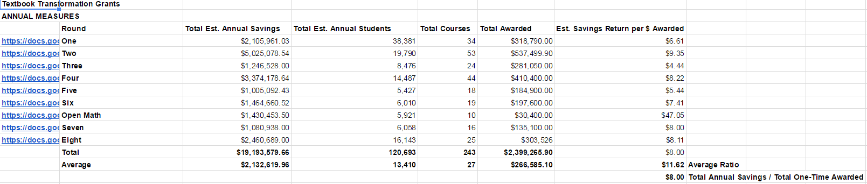
Transforming Data Analysis for Accuracy
From this:

Slide 21
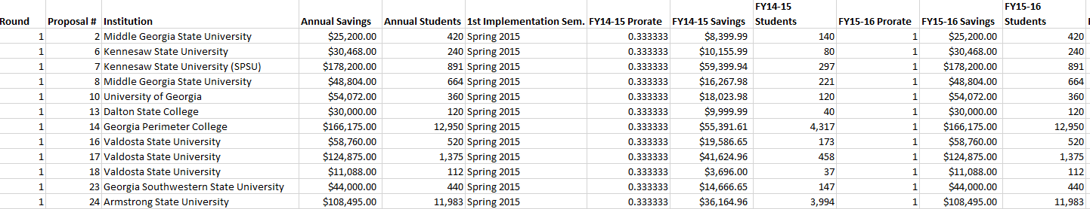
Transforming Data Analysis for Accuracy
To this:
etc. >>>>>

Slide 22
Show of hands!
How many of you have to report your data to someone who doesn’t know much about OER?

Slide 23
#2: Inform at All Times, Even When Presenting Numbers

Slide 24
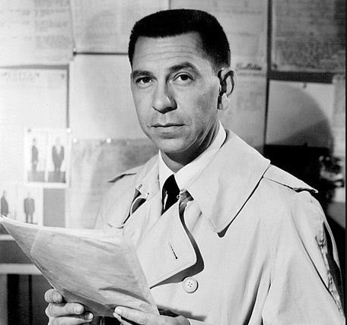
It’s Never As Easy As “Just the Facts”
Facts have context, and OER programs are no exception.
You need to teach the value of Open not only to faculty, but administrators, the media, and the public whenever possible.

Slide 25
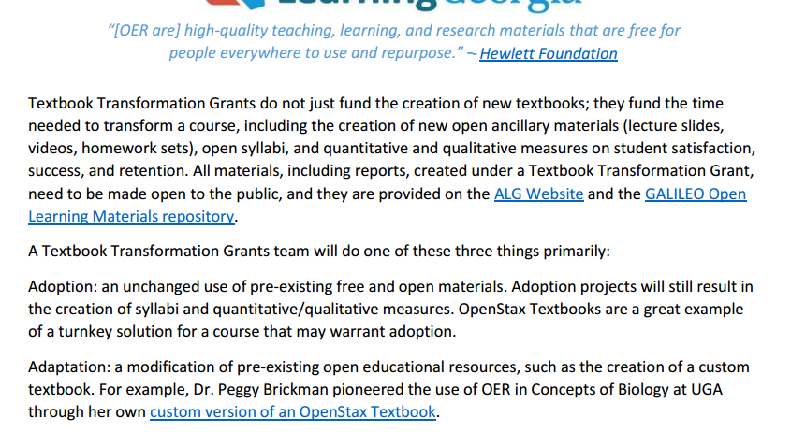
Making the Most of Urgent Report Requests
They need to know the fundamentals of OER along with your project.
Otherwise, how could they explain to people how your program helps?

Slide 26
Speak out!
Who is your favorite campus OER champion? What have they done?

Slide 27
#3: OER Champions Will Create New Champions, Given the Opportunity

Slide 28
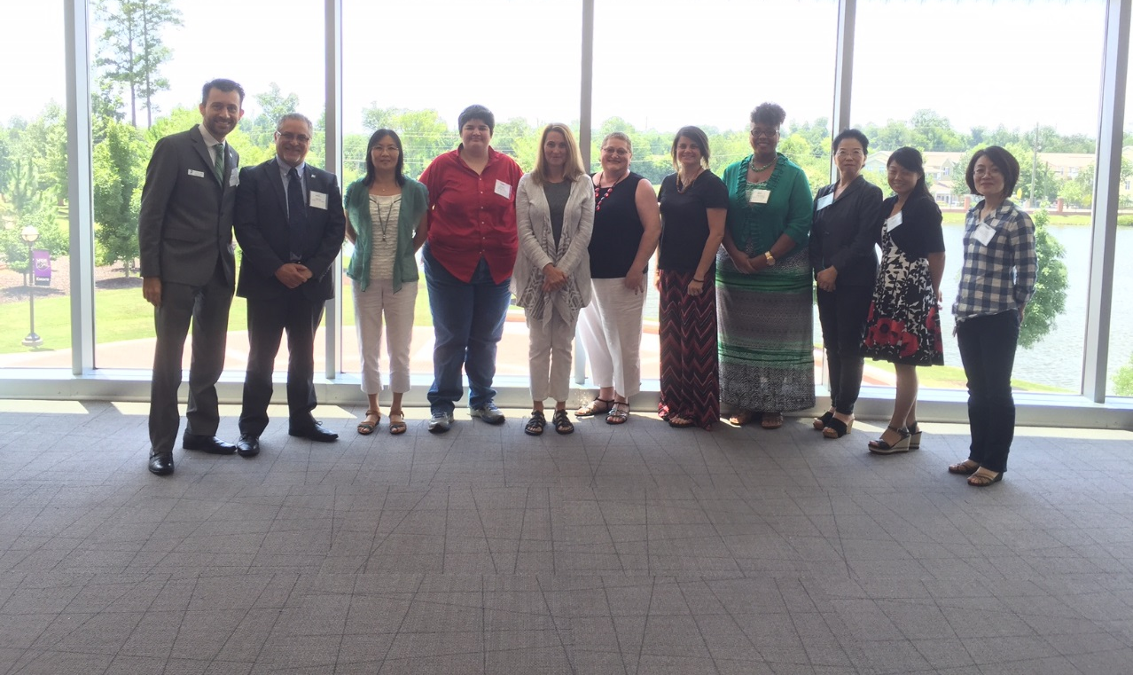
Open Mathematics in Action, Kickoff Meeting 2016

Slide 29

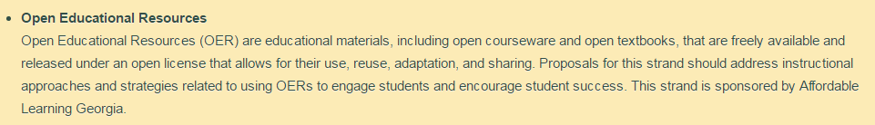
Successful OER Programs Build Communities
Work toward getting faculty and staff interested in OER. Before long, you will have an engaged community of practice which can assist and motivate others with OER use.

Slide 30
#4: Go Beyond Just Savings and Content

Slide 31
Moving Beyond Savings and Content:
ALG’s Three-Year Strategic Plan, 2017-2020
It’s time for us to look at OER-enabled pedagogical practices and assist wherever we can:
SoTL OER Research Fellows (Find the best practices)
Faculty and Staff Learning Communities (Share these practices)
Training and Development Opportunities

Slide 32
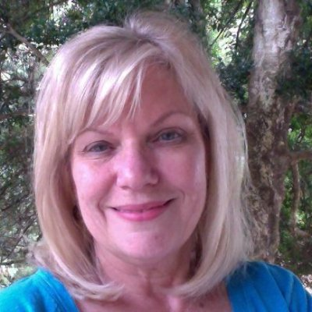
ALG’s New Full-Time Team Member:
Dr. Marie Lasseter
Joined us on May 1st
Yes, she was mentioned earlier- she pioneered OER in the USG!
Ed.D., UGA
Instructional Design and online course consultation experience
Faculty Development expertise

Slide 33
Show of hands!
How many of you have managed the revision of an open educational resource on your campus?

Slide 34
#5: Created Open Content Must Be Discoverable, Revised, Preserved

Slide 35
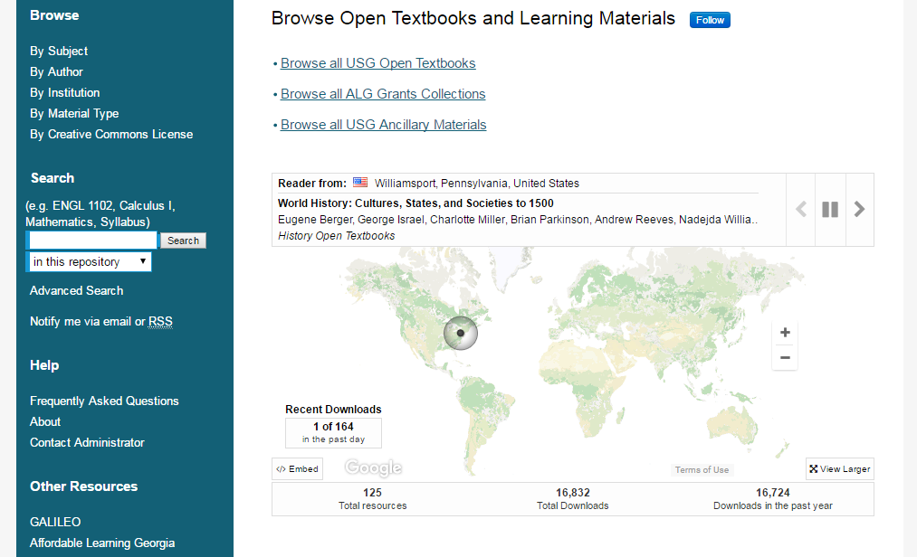
Current: GALILEO Open Learning Materials

Slide 36
Moving Beyond Hosting and Preservation
Creation of supporting ancillary materials for current textbooks
Grants to review and improve existing OER
Grants to improve a team’s current OER implementation
Formal peer review process through university presses to determine open textbook revisions
Revision management with older versions available

Slide 37
Speak Out!
If your OER initiative is funded, how does it feel to have to manage these funds?

Slide 38
#6: All Public Funding Contains an Imperative to Serve the Public

Slide 39
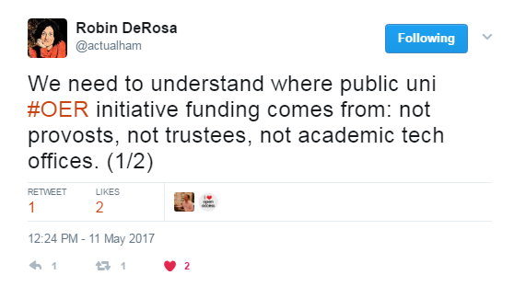
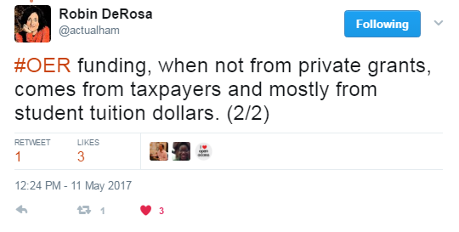

Slide 40
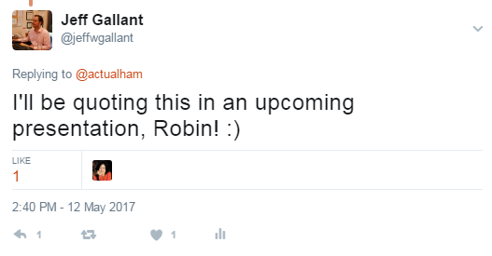
(This presentation just got meta.)

Slide 41
Let’s Discuss!
[this space was intentionally left blank for your thoughts]

Slide 42
Thank You!
Jeff.Gallant@usg.edu

