Slide 1
Adapting a New Model for Library Orientation: The Clinical Case Presentation
Nancy Bianchi, MSLIS / Dana Medical Library, UVM
Gary Atwood, MSLIS / Dana Medical Library, UVM

Slide 2
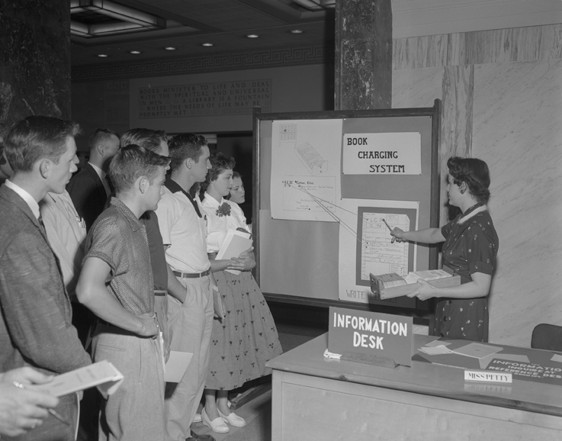
Courtesy of the Ohio State University Archives

Slide 3
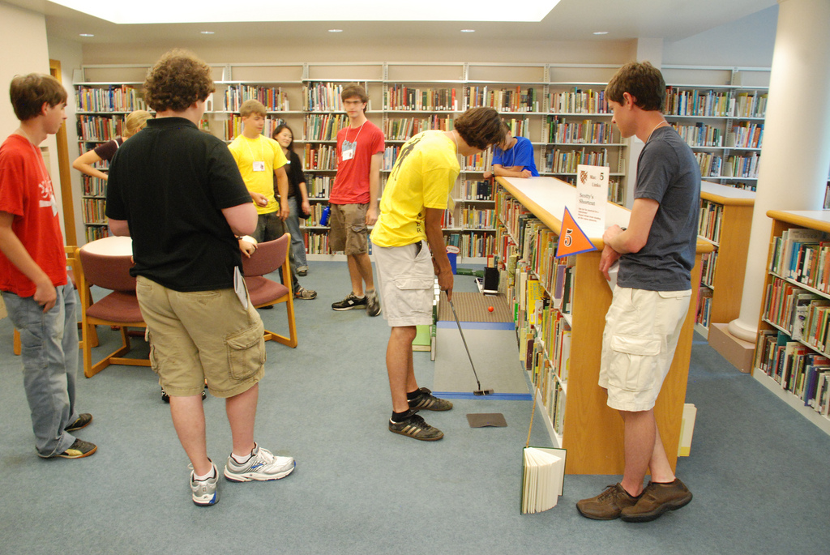

Slide 4


Slide 5
Medical Education 101

Slide 6
June

Slide 7
Educational Requirements for Physicians
4 Years
College/University
B.A. / B.S.
4 Years
Medical School
M.D.
3-7 Years
Residency
(Post-MD Training)
0-3 Years
Fellowship
(Subspecialty Training)
Undergraduate
Medical Training
Graduate
Medical Training
Source: http://www.ama-assn.org/ama/pub/education-careers/becoming-physician.page?

Slide 8
UVMMC Residency Departments
Anesthesiology
Dental
Dermatology
Family Medicine
Internal Medicine
Neurology
Neurosurgery
Obstetrics & Gynecology
Orthopedics
Otolaryngology
Pathology
Pediatrics
Pharmacy
Psychiatry
Radiology
Surgery
Urology

Slide 9
Accreditation Council for Graduate Medical Education (ACGME)
ACGME 6 Core Competencies:
Practice-Based Learning & Improvement
Patient Care & Procedural Skills
Systems-Based Practice
Medical Knowledge
Interpersonal & Communication Skills
Professionalism

Slide 10
Practice-Based Learning & Improvement
To demonstrate this core competency, physicians must be able to access and review scientific information in medical journals and published clinical studies and apply this information to each patient’s needs.

Slide 11
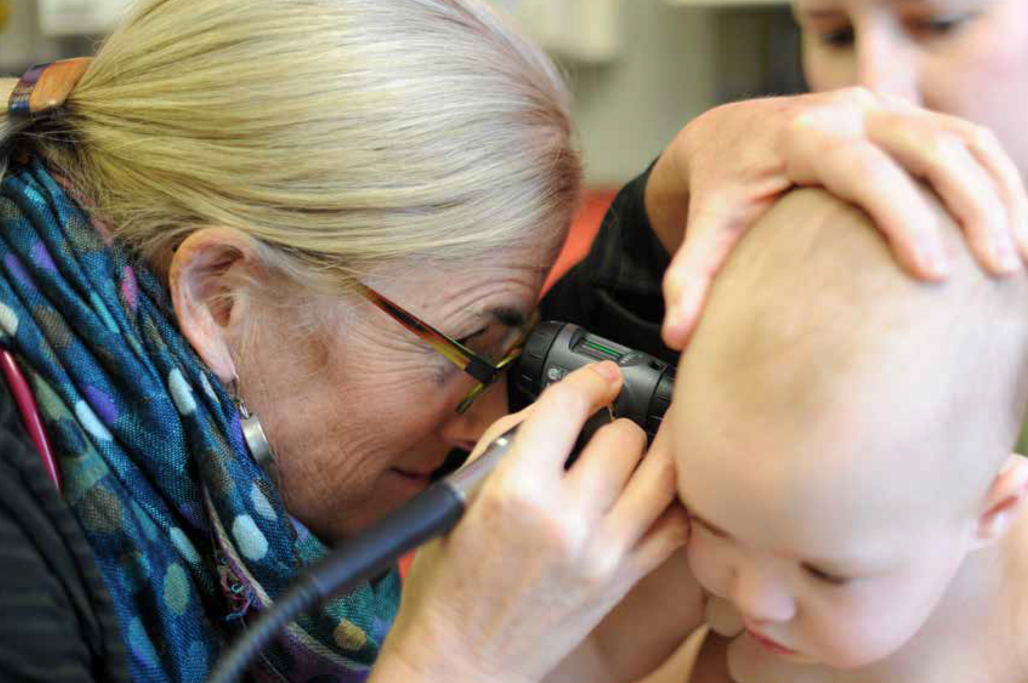

Slide 12

Traditional Orientation
Lecture
Library Tour

Slide 13
Medicaid/Medicare
Provider Access Services
Benefits Information
ID Badges
Radiology Services
Organ Donation
Credit Union
Restrooms
Dana Medical Library
Resident Call Room
Interpreter Services
Parking Security
PRISM
Information Services
Paycheck
Teaching Academy

Slide 14


(You know who these guys are)
(Like a medical version of Wikipedia)

Slide 15
Patient Case Presentation Model
CC - 62 year old man presenting b/c of fever & cough for 2 days
HPI - Well until 10 days ago, when he developed nasal congestion, sore throat, low grade fever. Reports diffuse muscle aches & mild nausea; denies chills, chest pain, headache, still neck or abdominal pain. No recent travel, no TB exposure. Chronic cough
Social – Works as banana importer & is married with 2 children. No unusual travel
PMH – MI 3 years ago w/o complications, stress test before discharge, no subsequent workup
  Meds – Diltiazem-CD 180 mg QD
  Allergies – None known
  Smoking – 1 ppd for 40 years
Family – Father: CVA age 64, Mother: Alice & well, Sister: Lyme Disease; No cancer, heart disease
ROS – General: 20 lb weight loss over 6 mo w/o dieting, no fevers, sweats; HEENT: No trauma, dizziness, headaches

Slide 16

Cancerous tumor of the retina -
most common eye tumor in children
Clinical Information Need:
Information on the genetics of retinoblastoma for use in a presentation to other physicians and residents.
Outline of New Library Orientation:
Information Case Presentation
Plan (Introduction to Library Resources)
  Dana Medical Library Website
  CATQuest (Library Catalog)
  Pediatrics Research Guide
Clinical Information Need:
Information on the genetics of retinoblastoma for Professor Rounds (an educational conference)
Definition of Retinoblastoma:
A cancerous tumor of the retina that is the most common primary tumor of the eye in children
Outline of New Library Orientation:
- Information Case Presentation
Plan (Introduction to Library Resources):
  Dana Medical Library Website
  CATQuest (Libraries’ Catalog)
  Pediatrics Research Guide

Slide 17
Cancerous tumor of the retina -
most common eye tumor in children
Clinical Information Need:
Information on the genetics of retinoblastoma for use in a presentation to other physicians and residents.
Outline of New Library Orientation:
Information Case Presentation
Plan (Introduction to Library Resources)
  Dana Medical Library Website
  CATQuest (Library Catalog)
  Pediatrics Research Guide
Clinical Information Need:
Information on the genetics of retinoblastoma for Professor Rounds (an educational conference)
Definition of Retinoblastoma:
A cancerous tumor of the retina that is the most common primary tumor of the eye in children
Outline of New Library Orientation:
- Information Case Presentation
Plan (Introduction to Library Resources):
  Dana Medical Library Website
  CATQuest (Libraries’ Catalog)
  Pediatrics Research Guide

Slide 18
Case Presentation Formats
Clinical Case Presentation
Chief Complaint (C/C)
History of Present Illness (HPI)
Past Medical History (PMHx)
Medications (MEDS)
Social History (SOC Hx)
Family History (FAM Hx)
Review of Systems (ROS)
Allergies/Reactions (All RXNS)

Slide 19
Case Presentation Formats
Clinical Case Presentation
Chief Complaint (C/C)
History of Present Illness (HPI)
Past Medical History (PMHx)
Medications (MEDS)
Social History (SOC Hx)
Family History (FAM Hx)
Review of Systems (ROS)
Allergies/Reactions (All RXNS)
Information Case Presentation
Chief Complaint (C/C)
History of Present Information Need (HPIN)
Past Information History (PIHx)
Social History (SOC Hx)
Family History (FAM Hx)
Review of Information Systems (ROIS)

Slide 20

http://www.neoncircus.com/hire/neon_sign_hire_catalogue_02.html

Slide 22
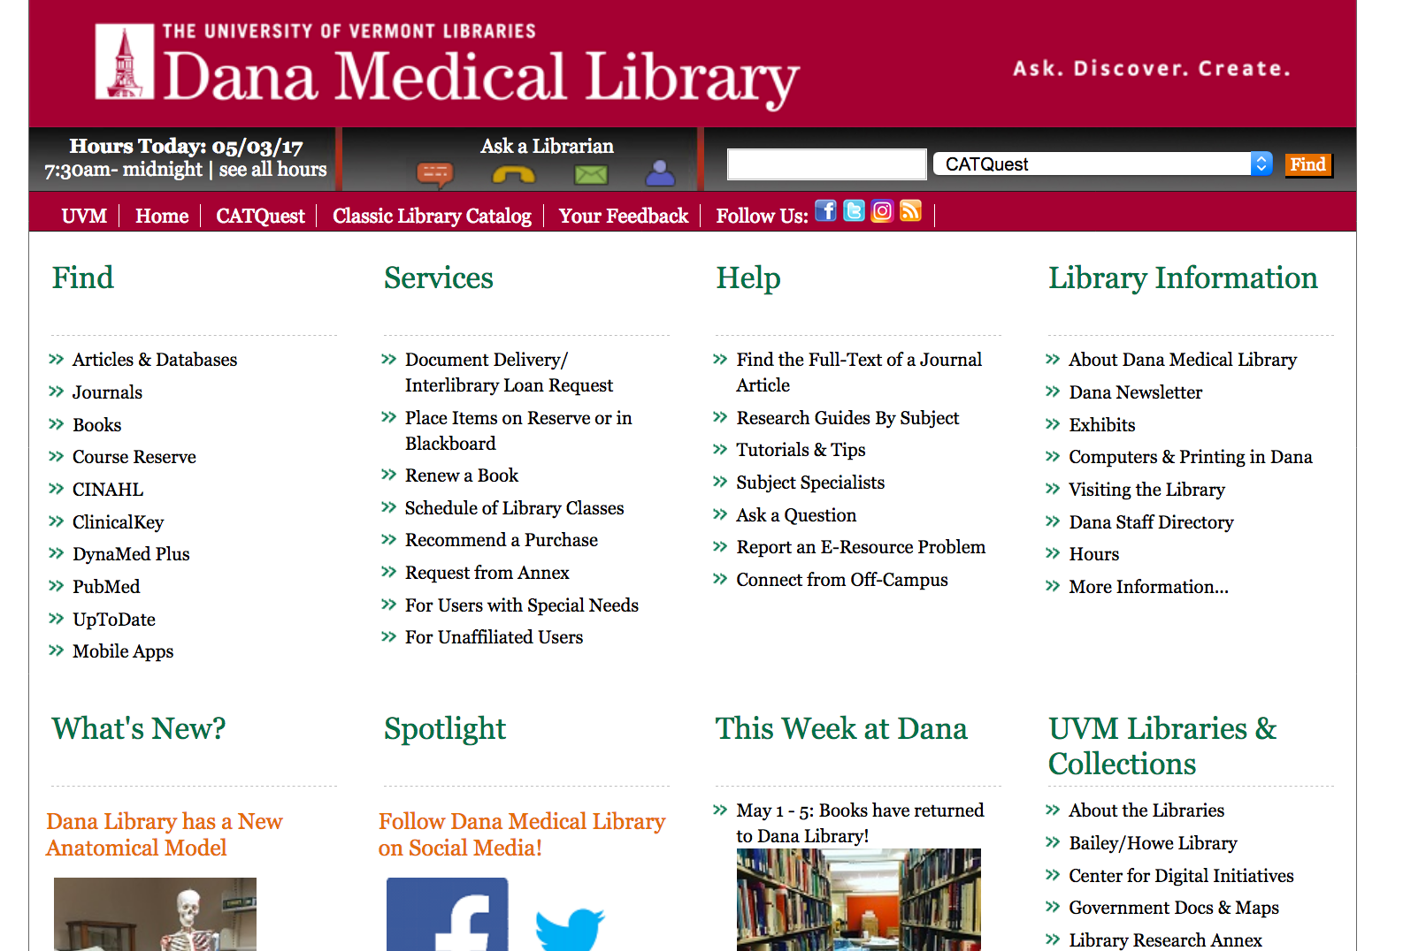

Slide 23
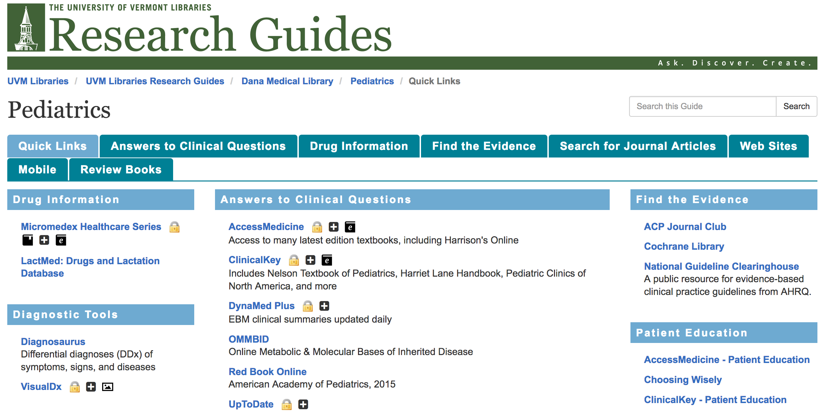

Slide 24
Final thoughts…

Slide 25


Slide 26
Any Ideas?

Slide 27
SWOT
Strengths
Weaknesses
Opportunities
Threats

Slide 28
Multidisciplinary
Large # of journals
Lots of full text
Good limits
SWOT
Strengths
Weaknesses
Opportunities
Threats
Inconsistent indexing
Lots of non-scholarly stuff
Citation export a little confusing
Doesn’t contain all journals in specific discipline
What would be an opportunity?
Key journals pulled out by publisher
What else?

Slide 29
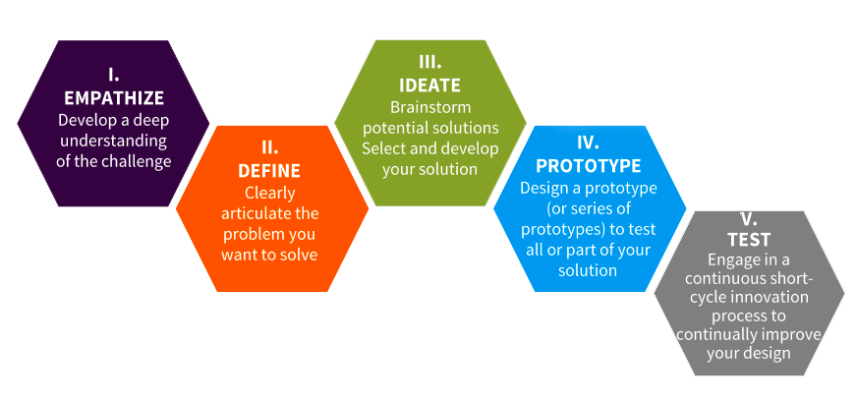
Background research?
Select resources to search?
Run searches?
Review results, revise if
necessary, repeat?
Develop research question?
http://www.blendmylearning.com/2014/05/28/using-design-thinking-to-develop-personalized-learning-pilots/

Slide 30
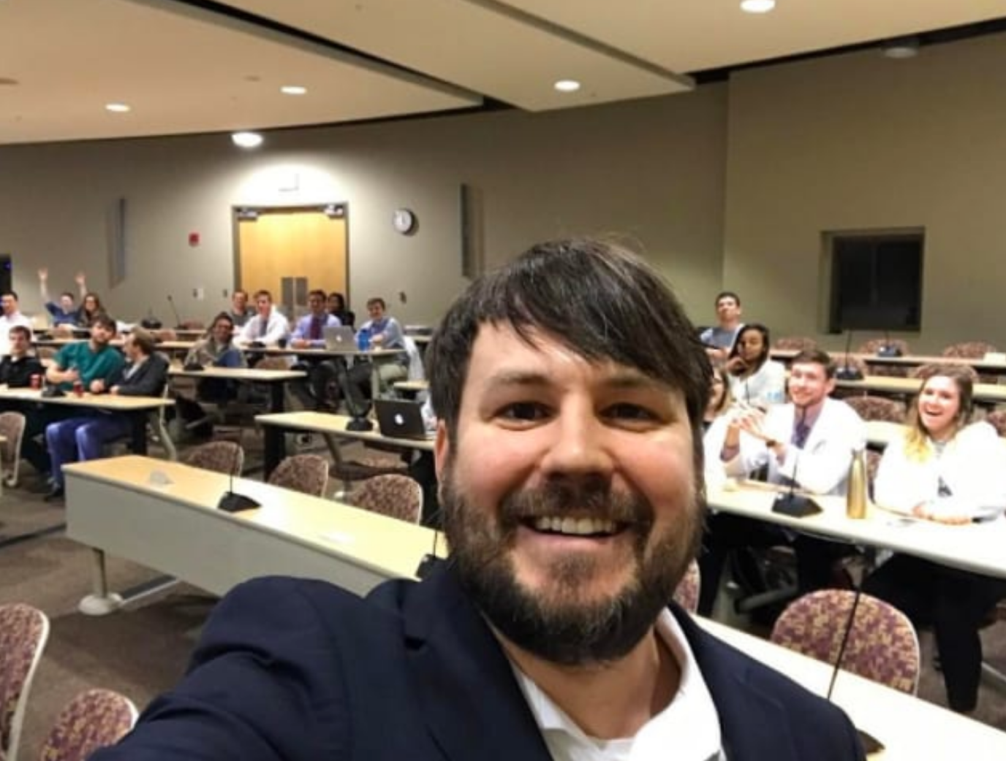

Slide 31
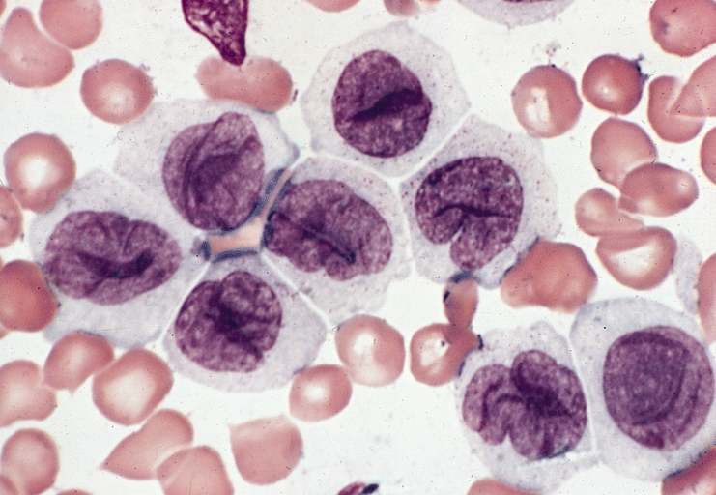
BONE MARROW: ACUTE MONOCYTIC LEUKEMIA

Slide 32
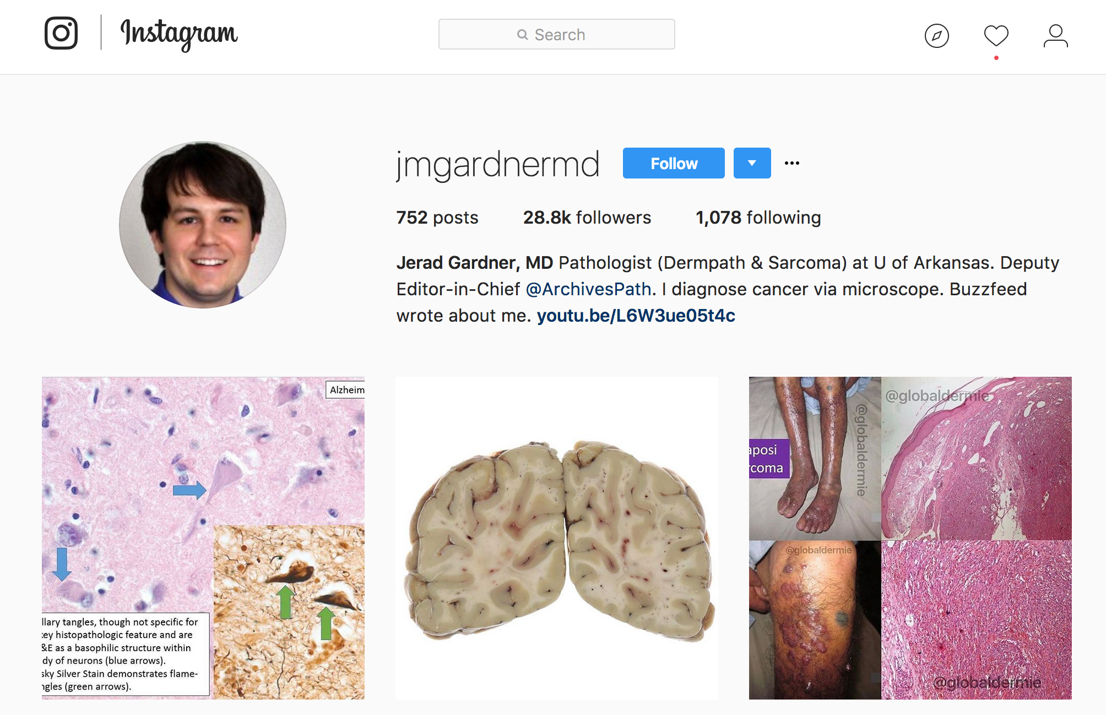

Slide 33
“My goal is to share good medical knowledge. Best way to do that is to post in the format that people like to receive info from.”
--Dr. Jered Gardner

Slide 34


