Slide 1
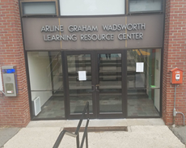
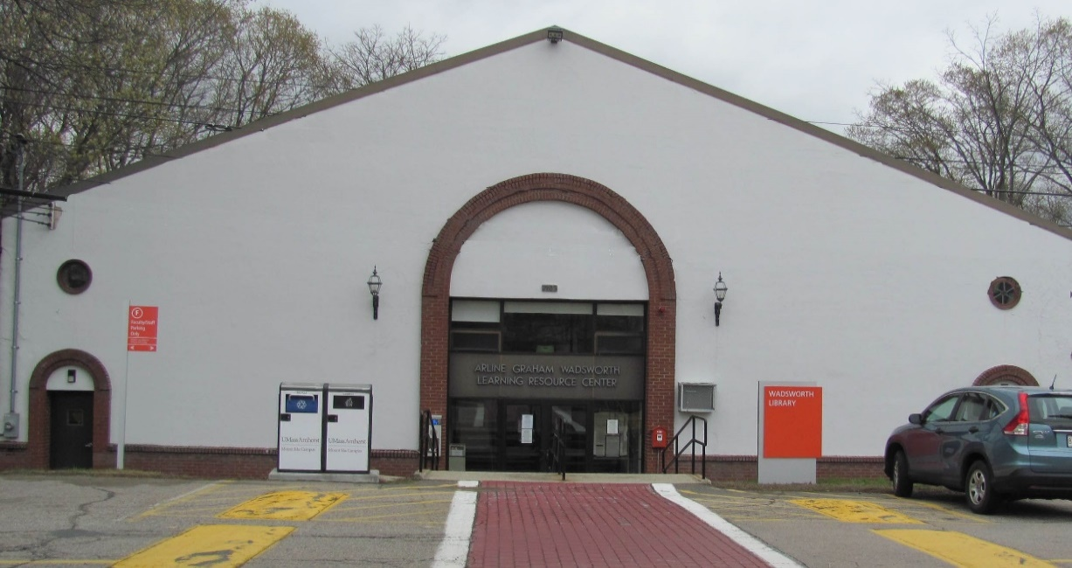
Wadsworth Learning Resource Center and Library
Mount Ida Campus, Newton
Ilse Allen Laurence Mini
Integrated Services Specialists

Slide 2
Summary of operations and services at the Wadsworth Library
In 2018-2019, we served a mixed population of:
  UMass Vet Tech, internship students
  Dental Hygiene Regis College students
  Community member groups
    Retirees
    Students from local schools
    Parents of students using practice fields
    Former Mount Ida (Minuteman) users
    Other non-UMass community members

Slide 3
Summary of operations and services at the Wadsworth Library
Typical services offered on a daily basis include:
    How to access print and online resources
    Technical support and troubleshooting
      printing
      wireless access
      Microsoft/Google docs
    Hosting online tutoring sessions
    Use of Reserve books
    Student life and academic programming
      monthly coffee hour
      Finals Fun destination

Slide 4
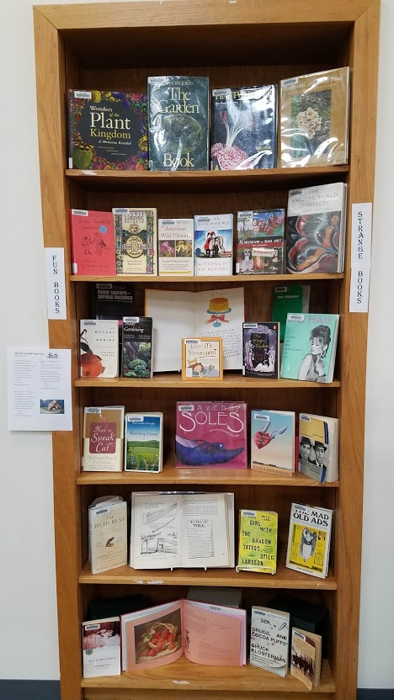
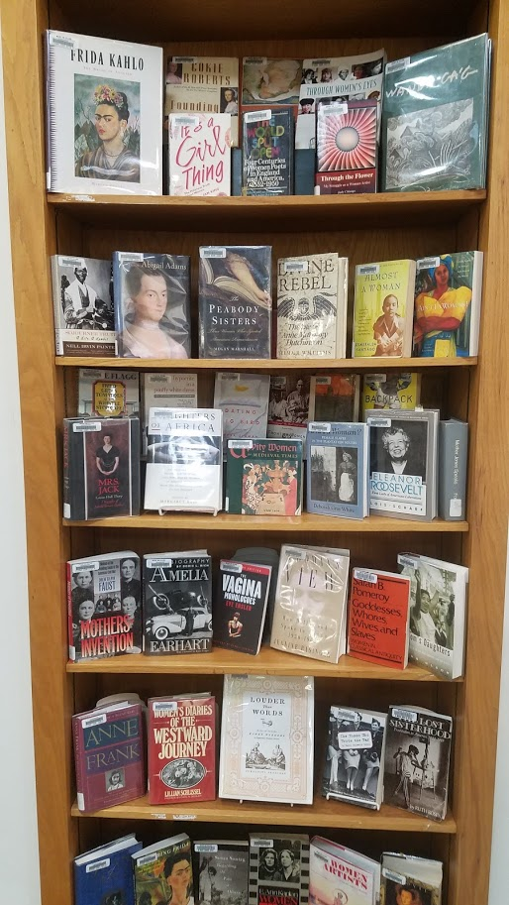
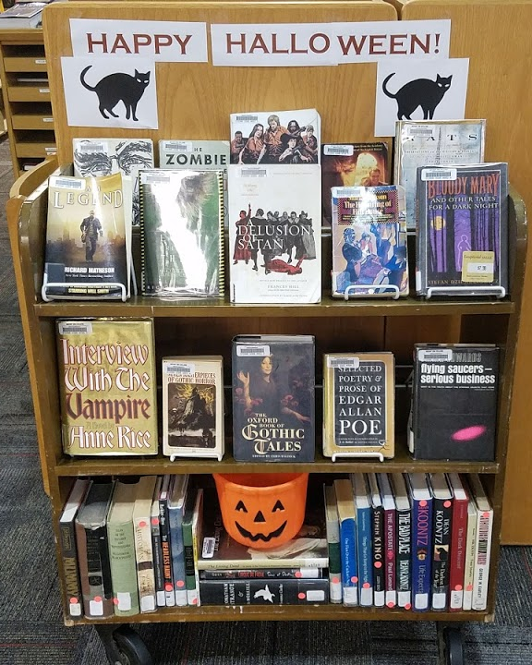
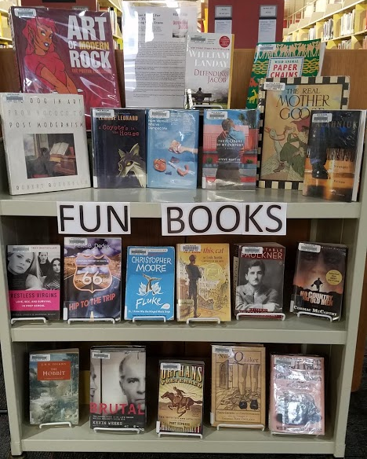
Management of the Mount Ida Collections
Linking and un-suppressing records
Creating new shelf and spine labels for easier browsing
Creating new collection categories
  Juvenile collection
  Young Adult Fiction (PZs)
  Vet Tech journal and AV Curriculum
Copy cataloging of unfound items
Mending and repairing books
Monthly thematic book displays

Slide 5

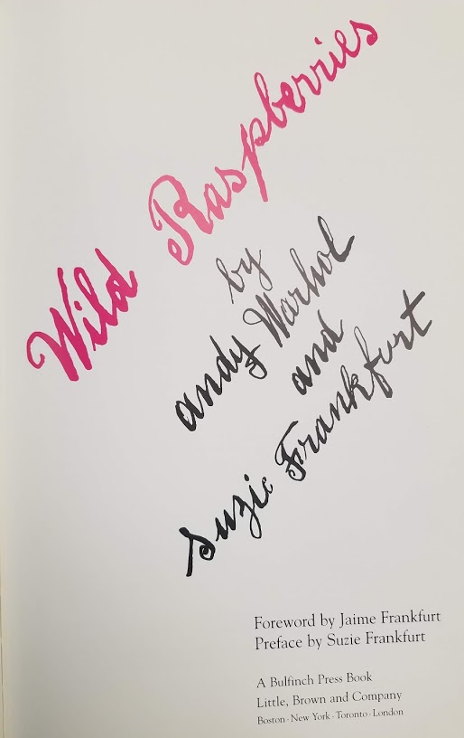
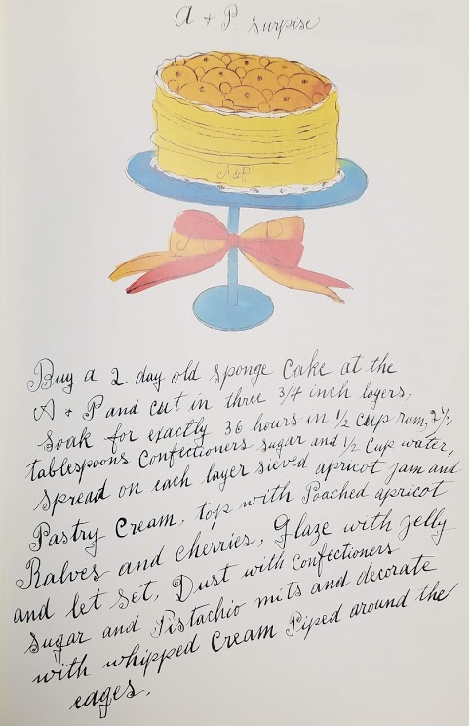
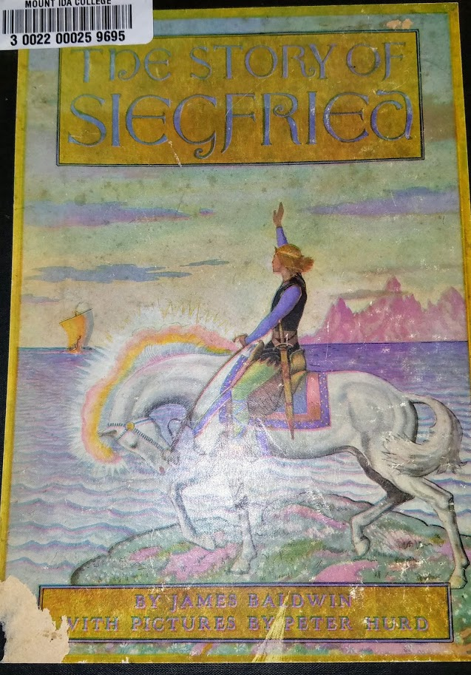
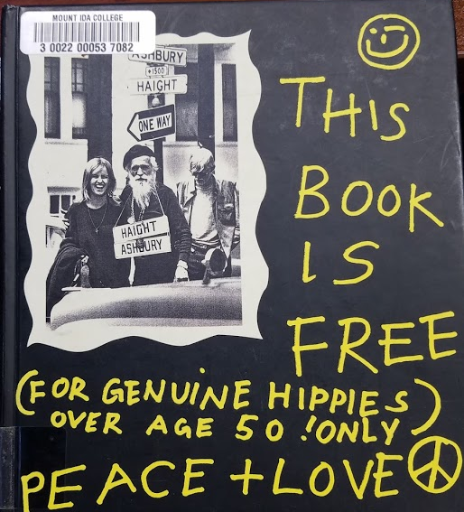
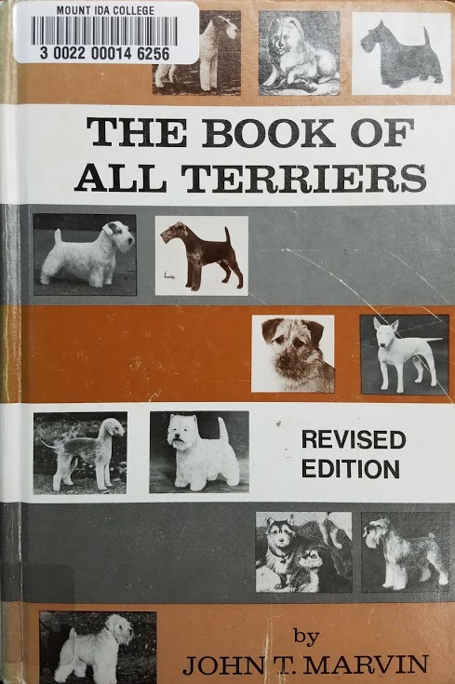
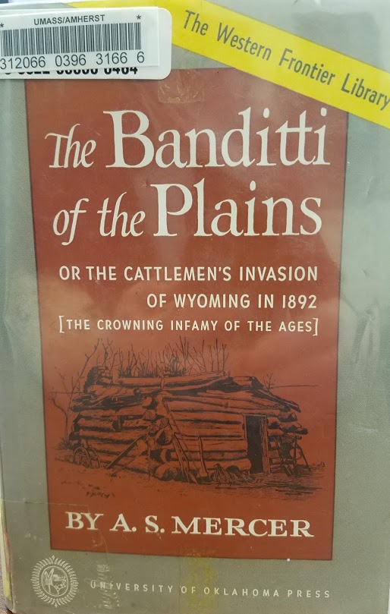
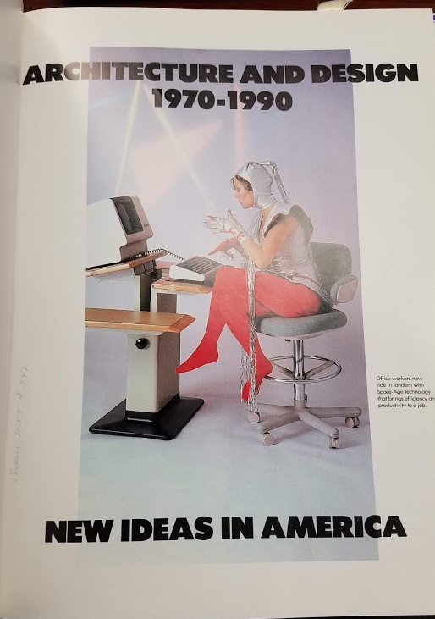
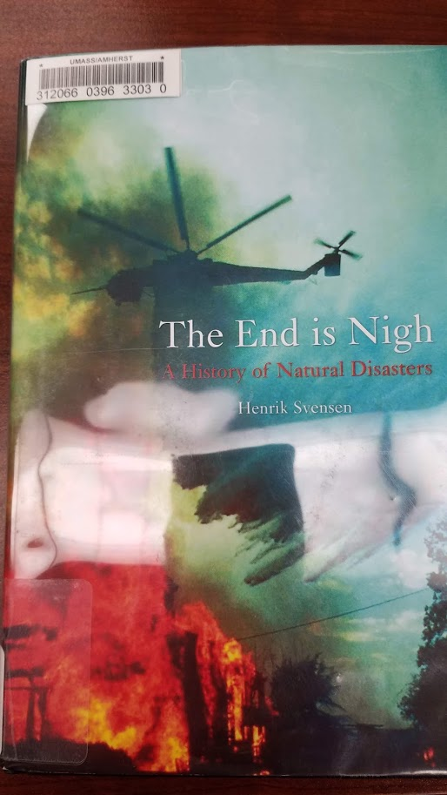
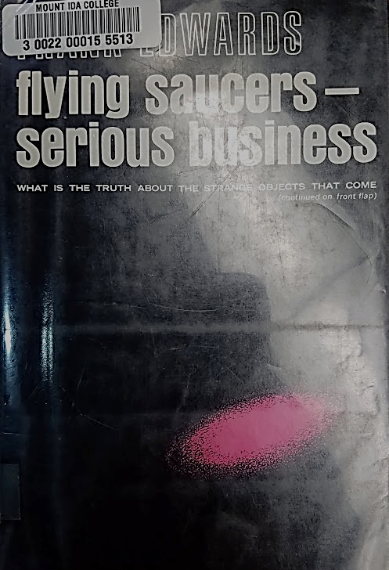
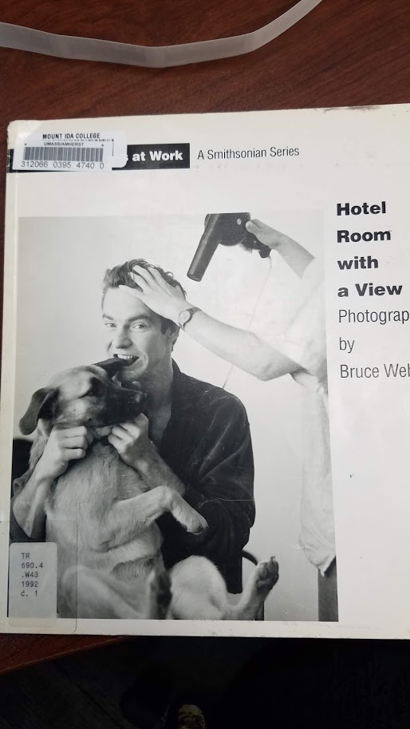
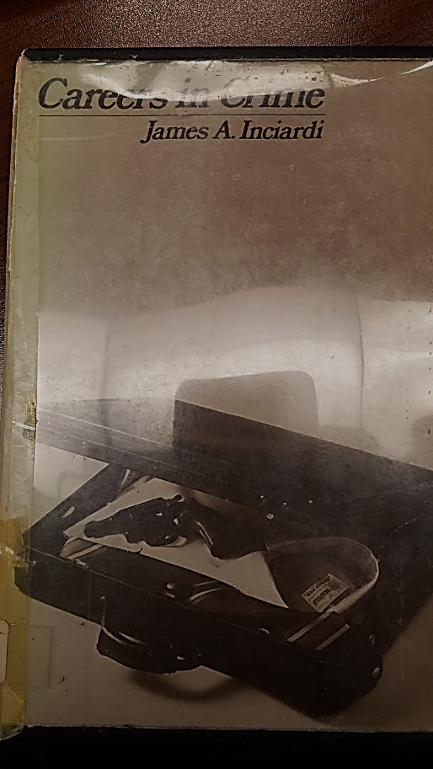
Interesting Items in Our Collections…

Slide 6
Challenges and Solutions
Improved communication about facilities and operations at MIC and between campuses
IT at both campuses working to upgrade outdated networking at Mount Ida campus
UMass/Mount Ida IT now works with library IT more consistently to upgrade and resolve issues with library work stations
Hiring graduate students here for internships and classes for library support
Library staff been a source of reassurance and information about not only library resources, but UMA in general, to many former Mount Ida students as they adjust to life at a large university
Communications between campuses
New facilities, new challenges
Wireless networking and printer issues
Software and hardware glitches
Creating a student workforce with no real student population
Helping students adjust to the difficult transition to UMass from a small, liberal arts college
Notes:
Campus-wide communications, including processes on mail service, HR paperwork, and other functions which have no “on-the-ground presence” in Newton: Work in Progress

Slide 7
2019-2020 AY @ the Wadsworth and Mount Ida Campus
New graduate programs from Isenberg School, other professional and graduate departments on campus
Internship and Co-op program growing this summer
  1 year-long Isenberg program beginning in May 2019
  3 new graduate programs in Fall 2019
  About 12 internship students at MIC in Spring 2019
  50+ students coming to MIC for summer internship program
  Expected to grow this program for fall semester
Transition of the Vet Tech program to new format in 2020-2021 AY
Campus Climate Grant awarded to the Wadsworth Library for new book-to-film series with banned books/social justice theme

Slide 8
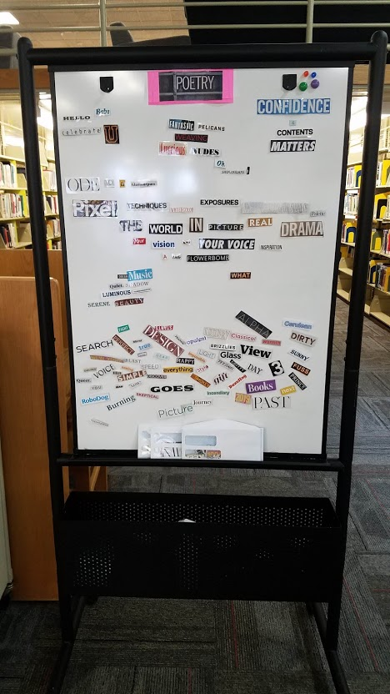
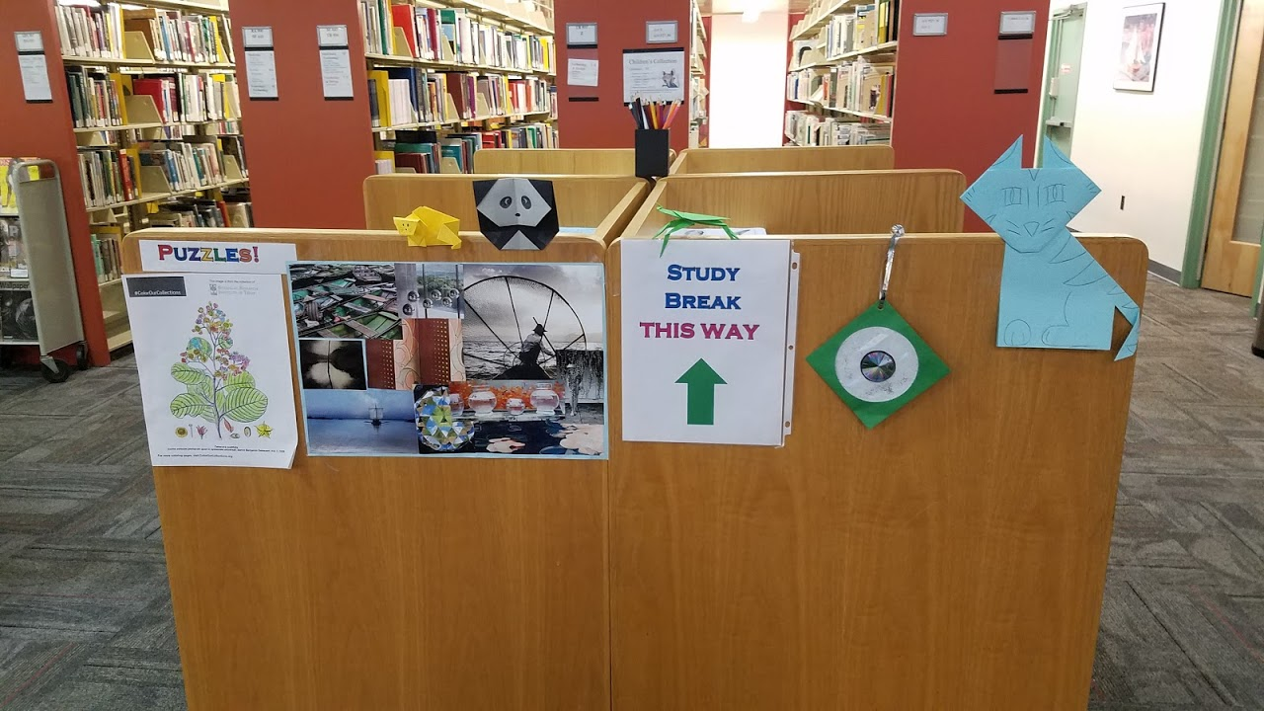
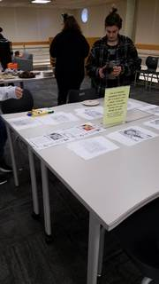
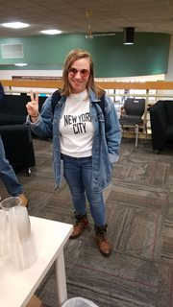
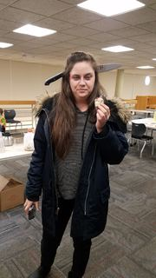
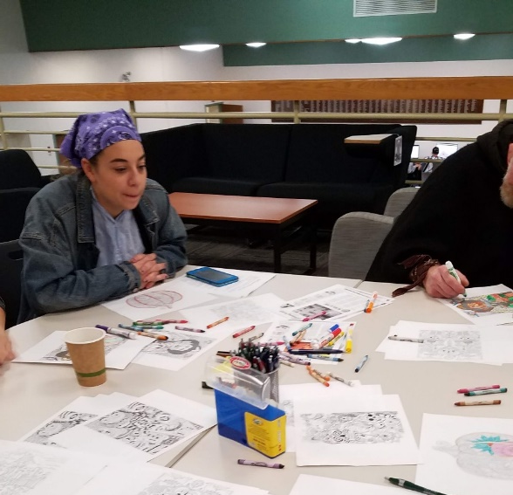
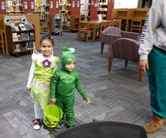
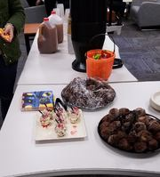
Wadsworth Student Engagement Programming-Fall 2018/Spring 2019

Slide 9
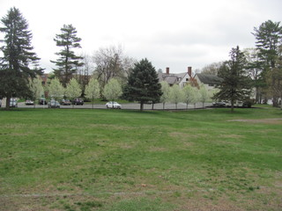
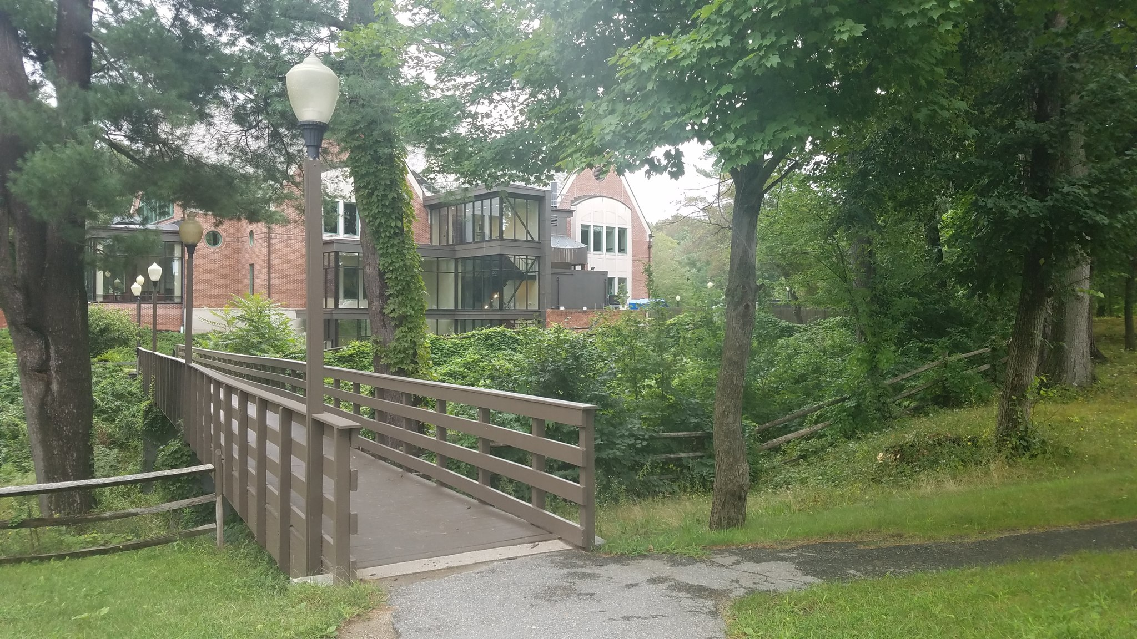
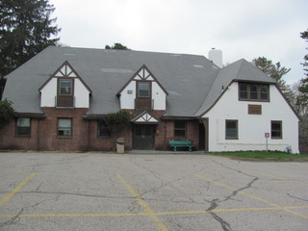
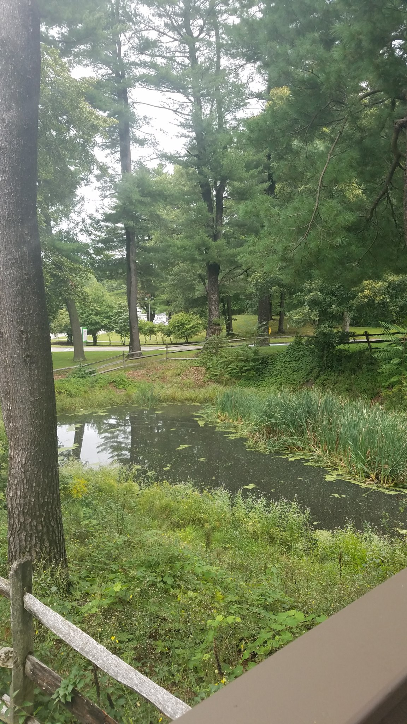
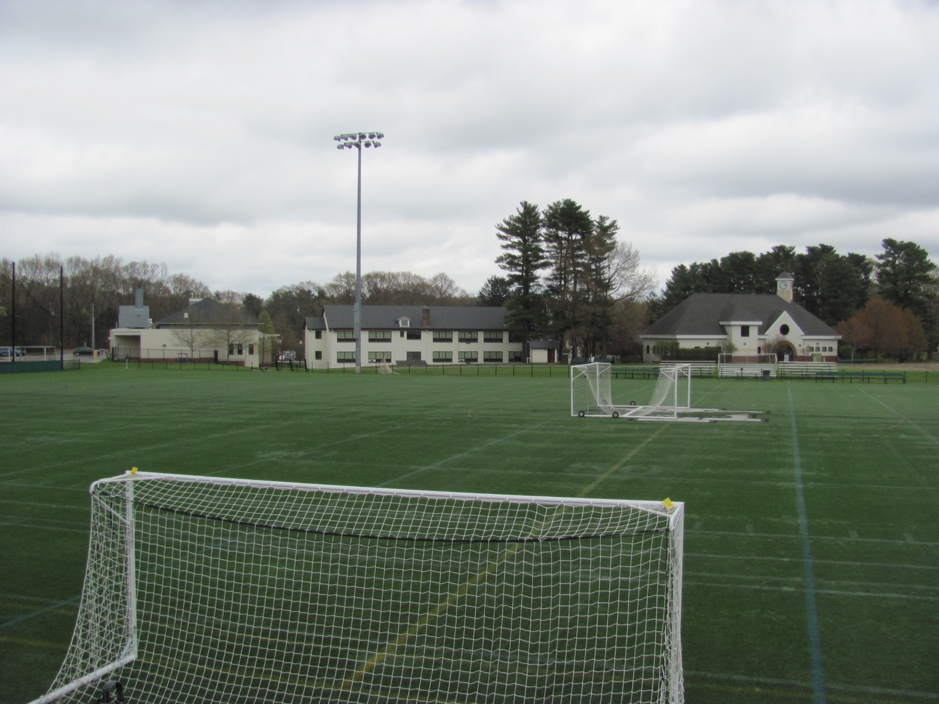
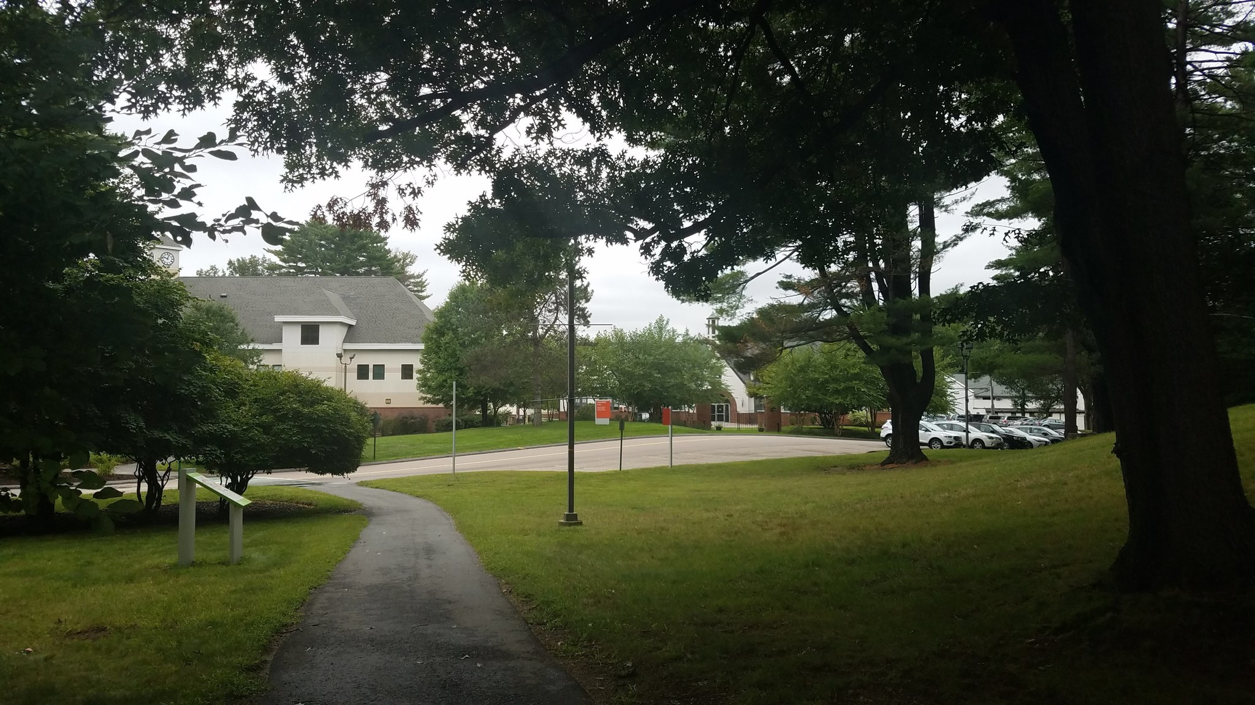
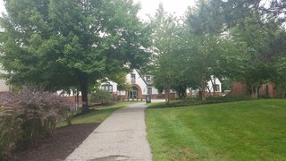
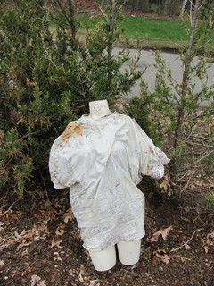
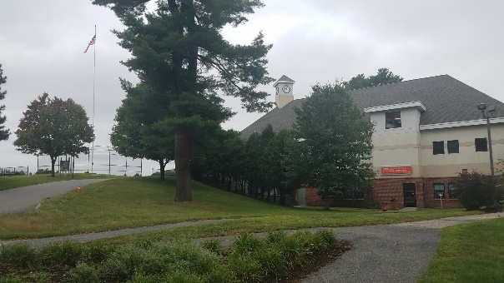
Views from the campus
View of the back side of campus
Holden Hall: one location where Paramount has been filming a TV mini series of novel “Defending Jacob”
Bridge to the campus center from residence hall
Soccer fields and mid-campus
Views of mid-campus from Carlson Street entrance

