Slide 1

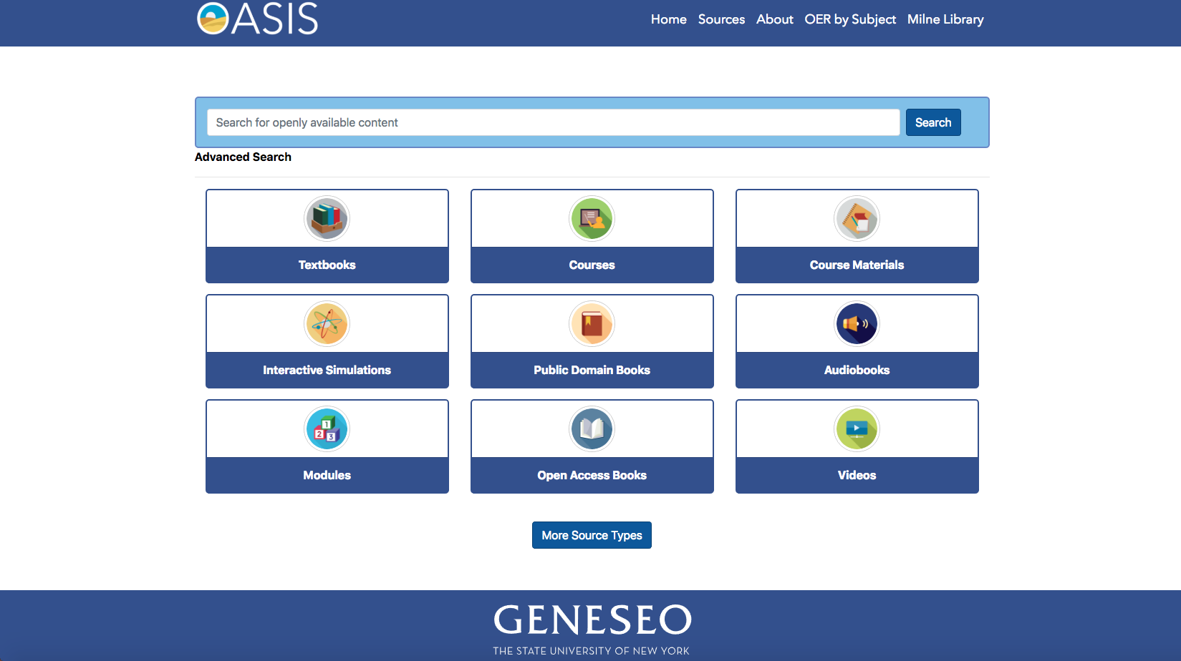
Making discovery of open content easier with oasis
Bill Jones & Ben Rawlins
SUNY Geneseo
This work is licensed under a Creative Commons Attribution 4.0 International License.

Slide 2
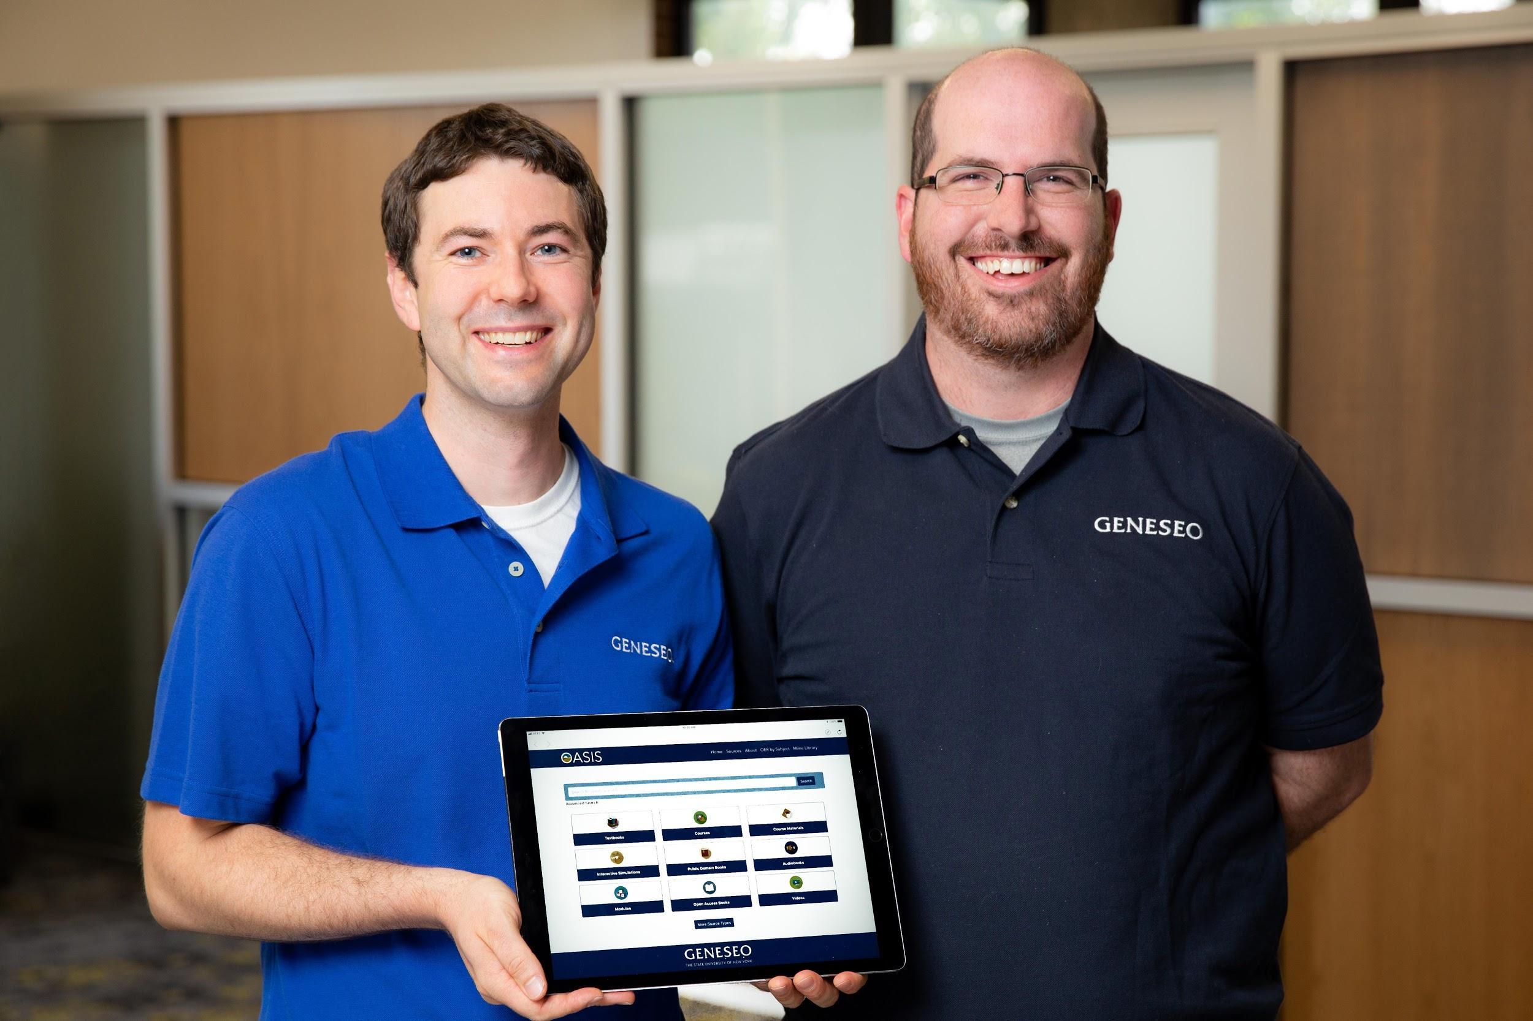
Who We Are
Bill Jones, Digital Resources and Systems Librarian, State University of New York at Geneseo
Ben Rawlins, Library Director, State University of New York at Geneseo
Photo by Keith Walters

Slide 3
OER
Discovery

Slide 4

Development Time
Openly Available Sources Integrated Search
Began April 2018
Launched September 5, 2018
  52 sources and 155,000+ records
Since then, we’ve added:
  32 sources and 170,000+ records

Slide 5
84 Sources
329,797 records

Slide 6


‘Nerding it out’
Bill
Ben

Slide 7
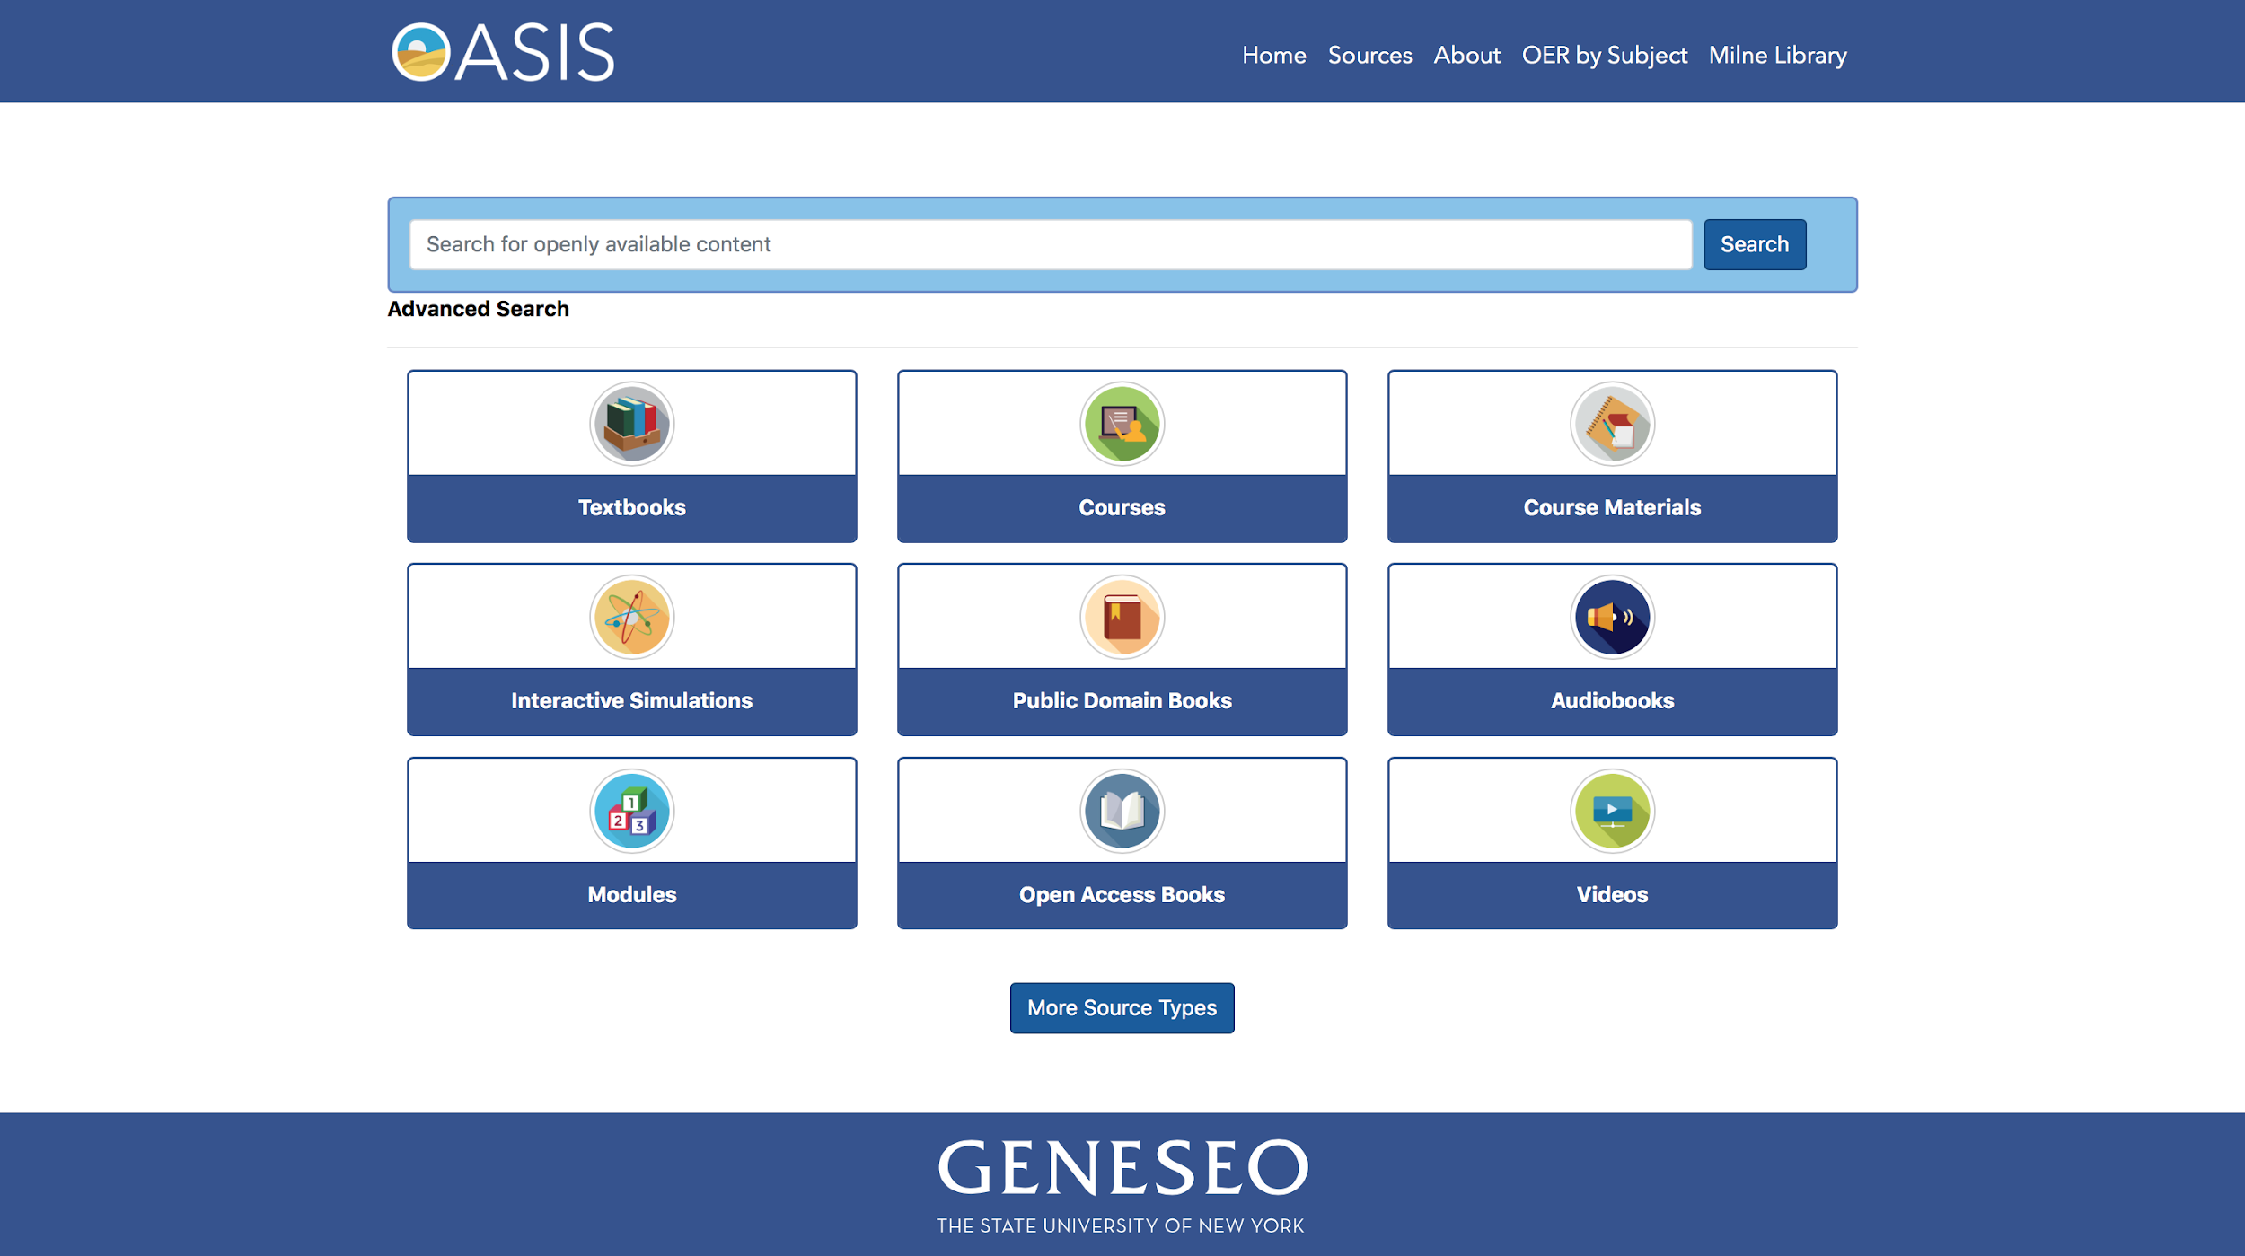
Selection of types

Slide 8

How We
built OASIS...
Photo by Jeff Eaton

Slide 9

And so the story goes...
Noun Project: Arief Sugiyanto, ID
The framework was built using PHP, MySQL, Bootstrap 4, HTML, CSS, Javascript, and Python
We host OASIS at Geneseo and we pull the content from each site with python scripts that we developed
We added Google Analytics to gather user stats

Slide 10




Tools we used
Noun Project: Vectplus
Text editors (UltraEdit, Brackets, Text Wrangler)
Terminal
GitHub
Photoshop
Flaticon
Font Awesome
@brawlins4
@Hypolymer
https://github.com

Slide 11

We get by with a little help from our friends...
Stack Overflow
Various forums and guides
Strategic Google searches
https://stackoverflow.com

Slide 12

Our development strategy
We met weekly to prioritize development and kept track of our milestones and issues in GitHub
We consulted with Allison and Alexis in Publishing and OER about additional features
We put OASIS through accessibility testing
We shared OASIS with the SUNY OER institutional leads prior to launch to gather feedback
Noun Project: Maxim Kulikov

Slide 13
Features
Search using single/multiple words and “quoted phrase”
Advanced searching by title, author, subject, source, and link
Begin search by format type
Easy filtering for type, subject, source, and license
Email someone about a resource
Sticky search bar on every page
Clean, crisp interface

Slide 14

A Few quotes from Users
“OASIS addresses the main frustration expressed by faculty—how do I know what I’m looking for? Or even what open sources are out there?...OASIS is one step closer to getting OER into the classroom, providing equal access and increasing the discoverability of texts.” (link to blog post)
“Your OER discovery tool is exceptional! Really impressive.” (personal email)
“Wow!!! This is such a wonderful tool! Thank you so much for all of your hard work on this!” (personal email)

Slide 15

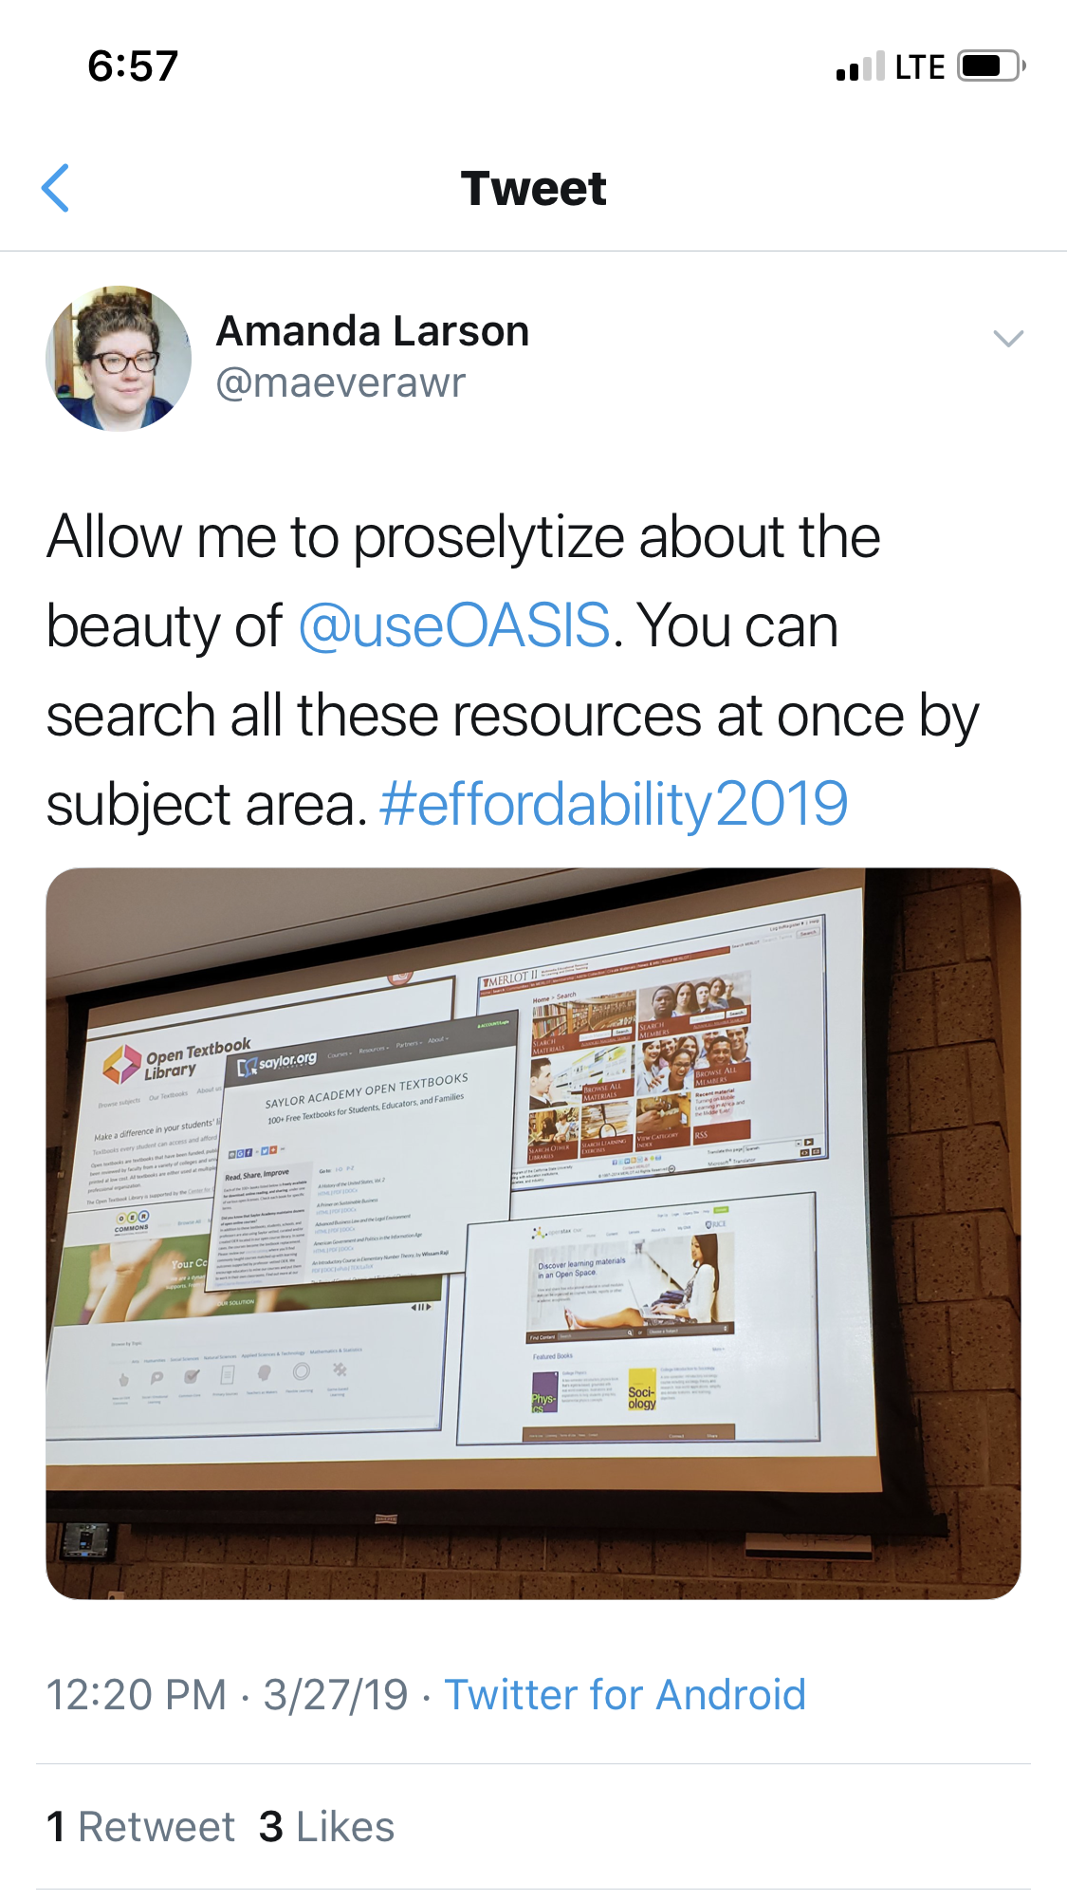
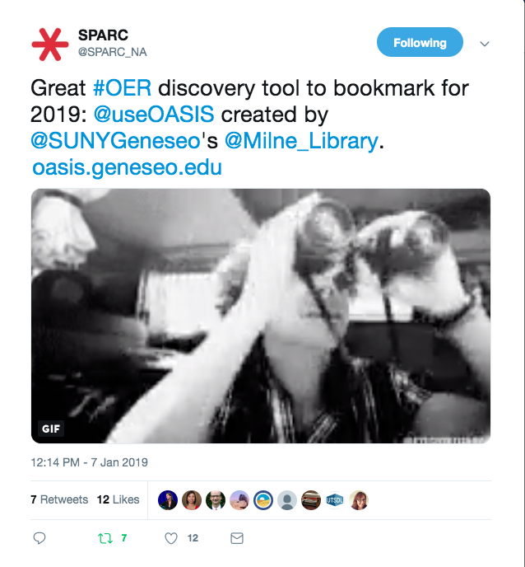
Twitter tells the story

Slide 16

Users statistics and updates
https://developers.google.com/analytics/terms/branding-policy

Slide 17
21,296
29,824
126,781
83
Sessions
Users
Statistics
(As of May 20, 2019)
Page views Average users a day

Slide 18
Who’s Using OASIS?
441 Institutions
409 United States
23 Canada
5 Australia
1 Lebanon
1 Turkey
1 United kingdom
1 Singapore

Slide 19

Updates since release
Detailed item view
Search within results
Shareable link to results
Voice Search
Added 28 sources and 170,000+ records
Noun Project:
Pundimon

Slide 20
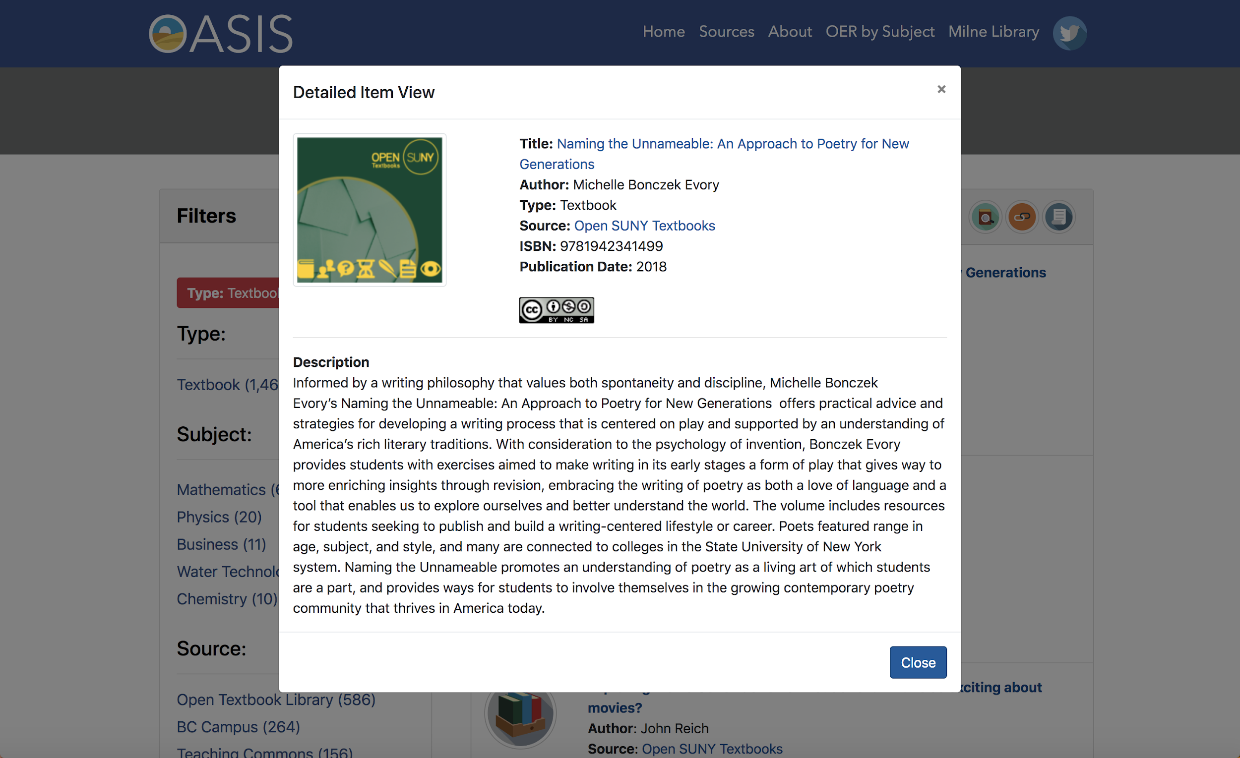
Detailed item view

Slide 21
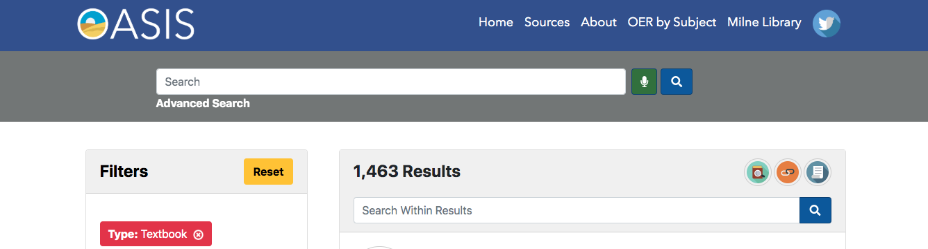
Search within Results

Slide 22
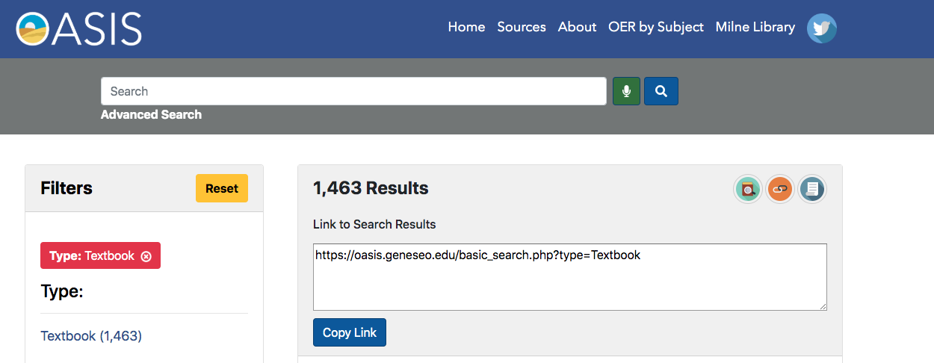
Shareable link to results

Slide 23
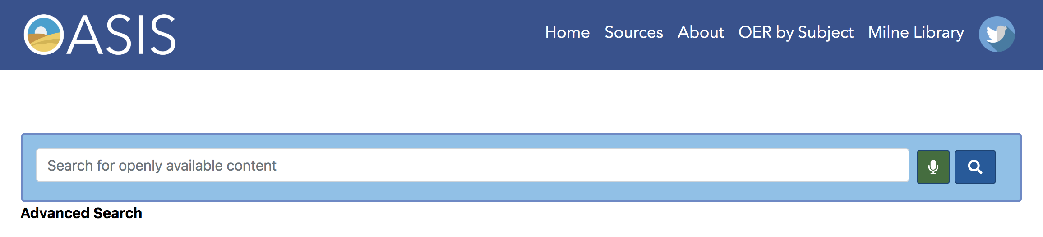
Voice Search

Slide 24


"WHOAAA" by rzrxtion (pronounced resurrection) is licensed under CC BY 2.0
Live Demo of
https://oasis.geneseo.edu

Slide 25
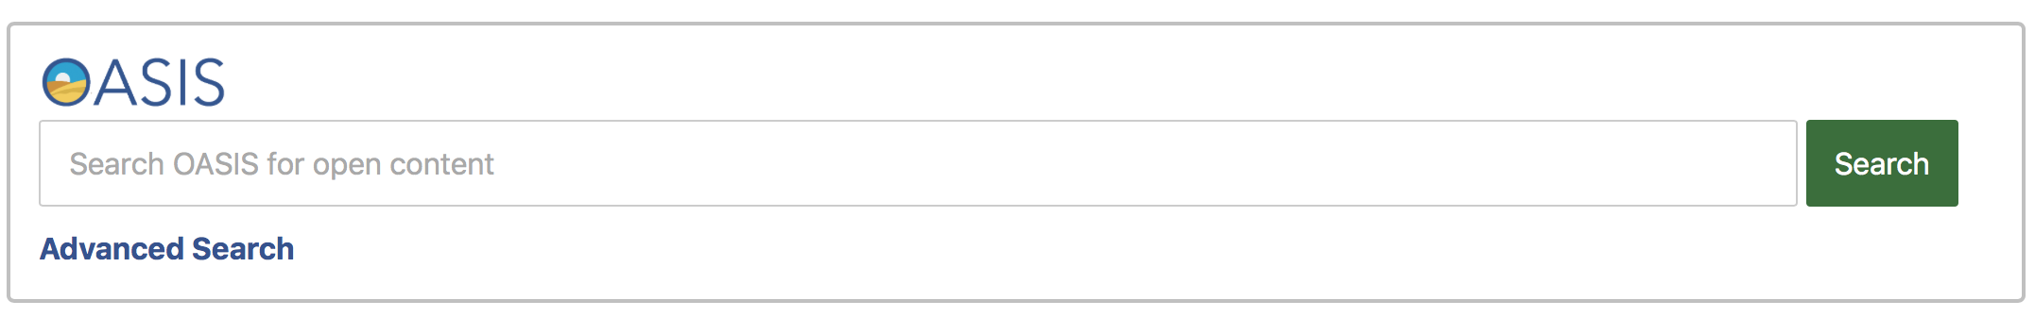
Get Started with OASIS today!
Head over to https://oasis.geneseo.edu/about to copy the embeddable widget code

Slide 26
THANKS!
Visit OASIS at https://oasis.geneseo.edu
Ben Rawlins Bill Jones OASIS
@BenRawlins6 @Polyradeo @useOASIS
rawlins@geneseo.edu jonesw@geneseo.edu oasis@geneseo.edu

Slide 27
Questions?

