Slide 1
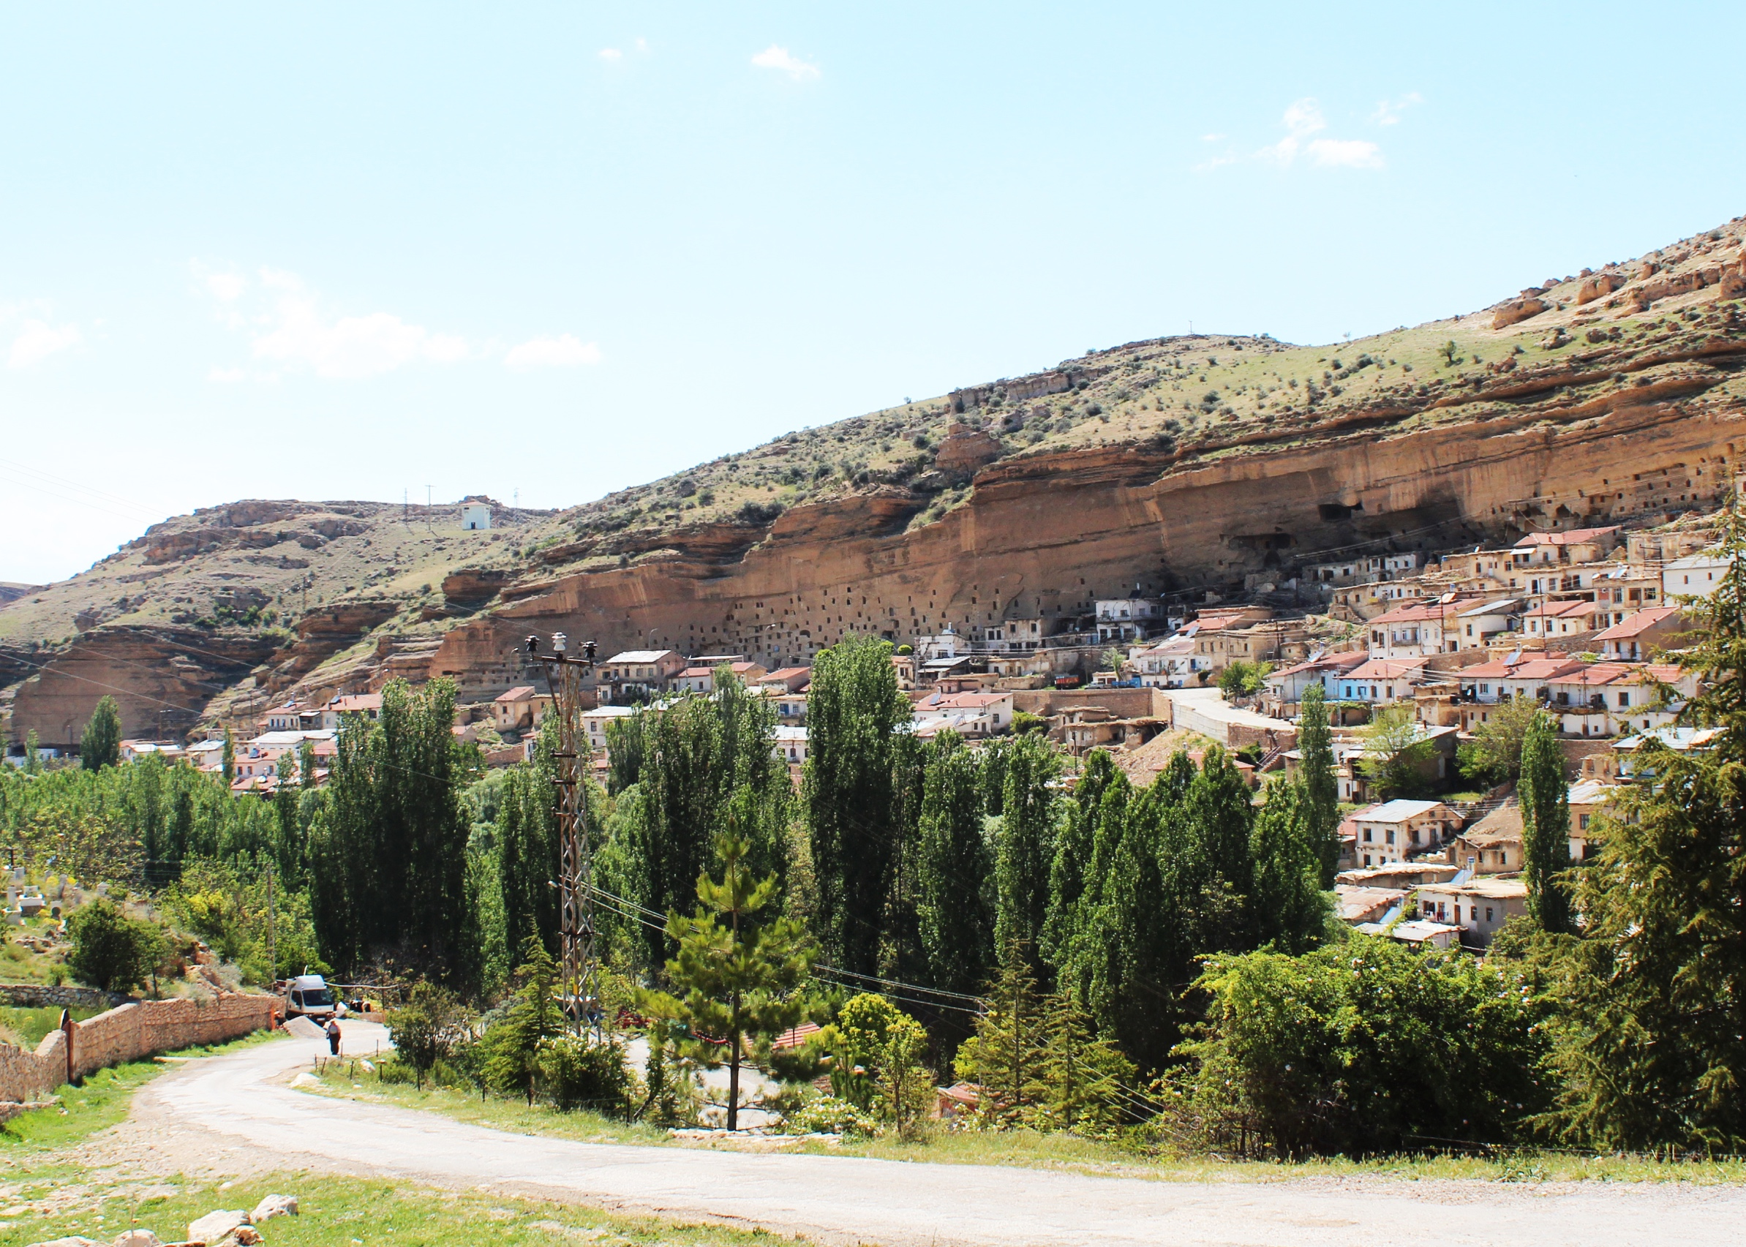
Contradictions Between Local Values And Top-down Conservation Priorities:
Taşkale, Turkey
Emine Çiğdem Asrav, A. Guliz Bilgin Altinoz
Architectural and Landscape Heritage Program, Department of Architecture and Design, Politecnico di Torino, Italy
ICOMOS Turkey | ICOMOS ISC CL
Conservation of Cultural Heritage, Department of Architecture, Middle East Technical University, Turkey
ICOMOS Turkey

Slide 2
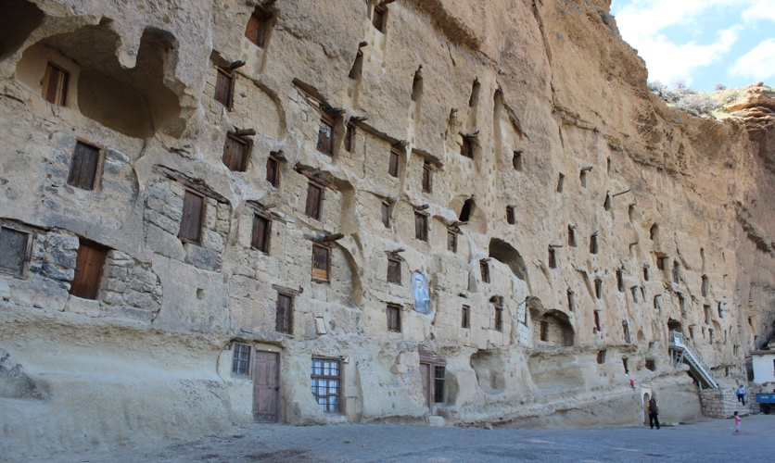
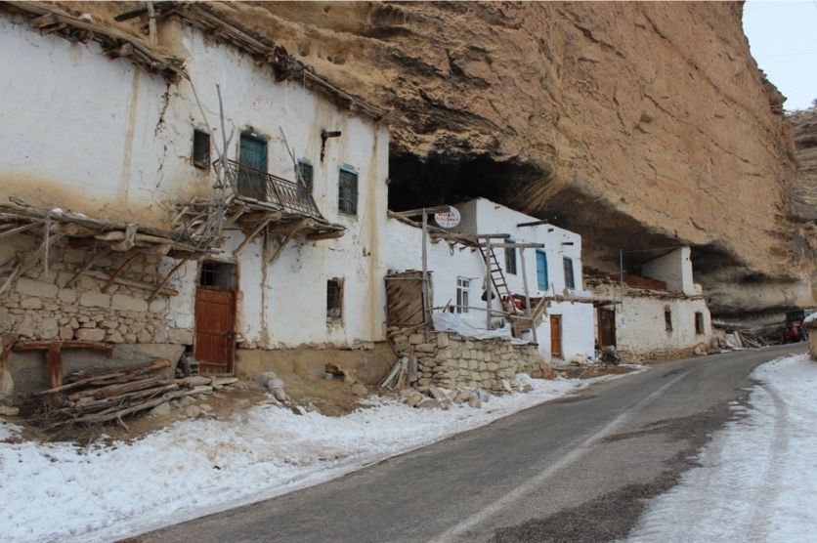
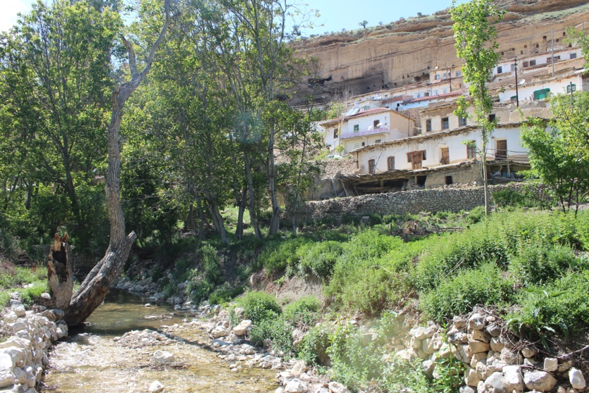
settlement characteristics
in the nature
rock-carved spaces: initial settlements
attached to the nature
rock-cut spaces closed by wall: granaries, rock-cut houses
on the nature
row and terrace houses

Slide 3
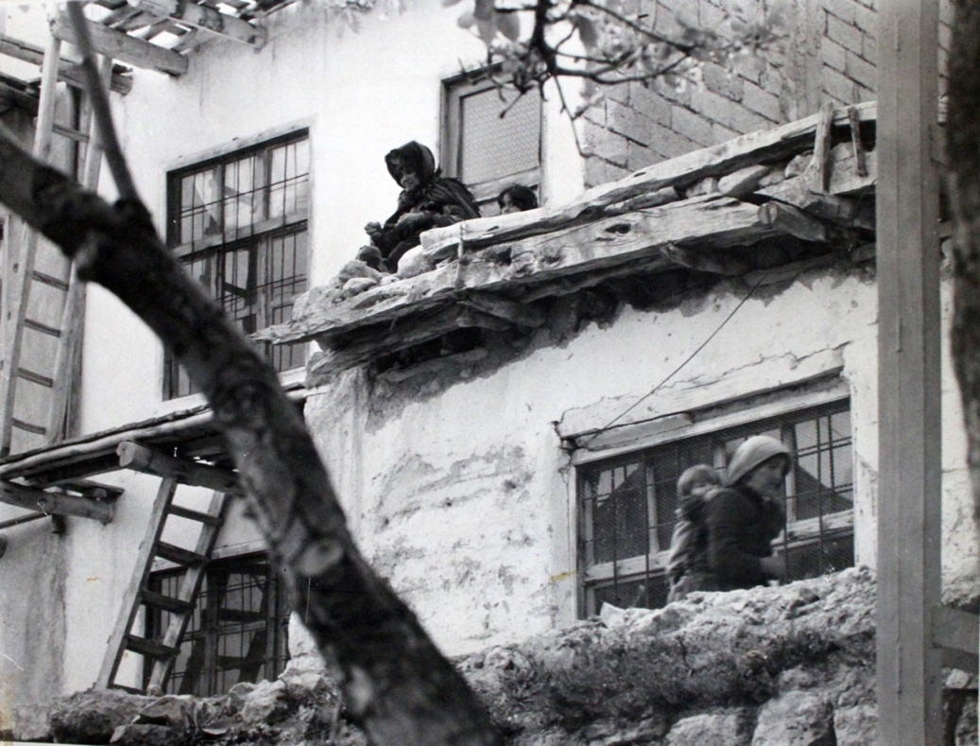
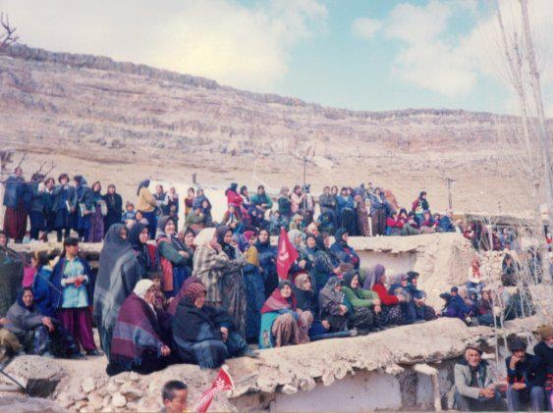
settlement characteristics & daily use
The socio-cultural and economic life activities are totally dependent on nature and living spaces. For this, there is active use of spaces in the village and in its historic landscape.

Slide 4
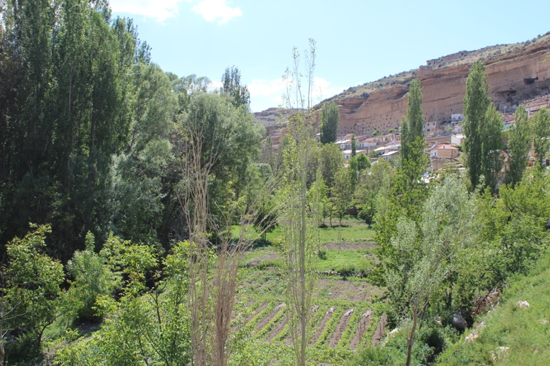
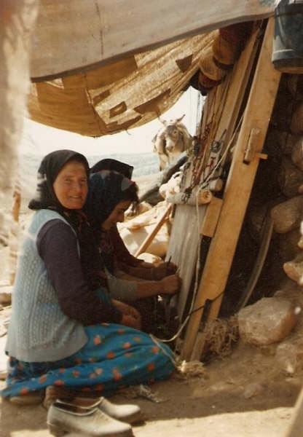
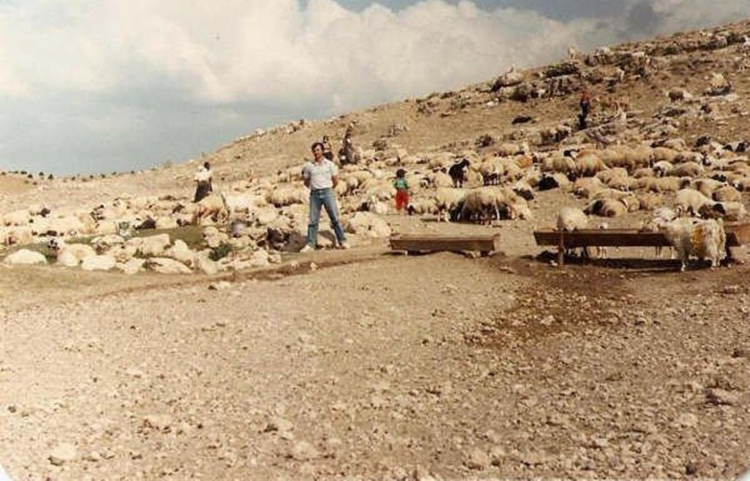
socio-economic characteristics
agriculture
animal husbandry
carpet weaving
beekeeping

Slide 5
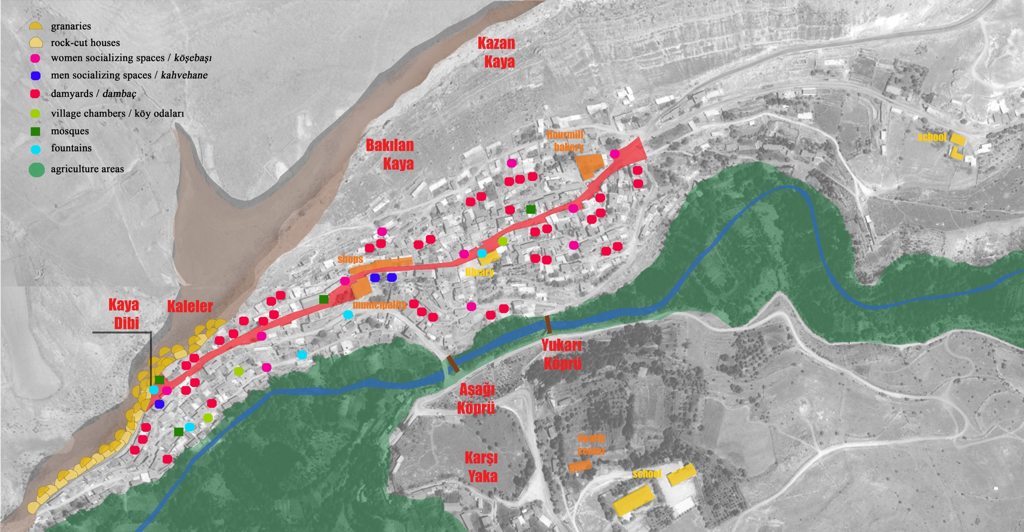
overall values of Taşkale Village
natural and man-made setting
active use of whole cultural landscape in socio-cultural and economic activities
intangible relations with living environment through memories, symbol areas, place attachments

Slide 6
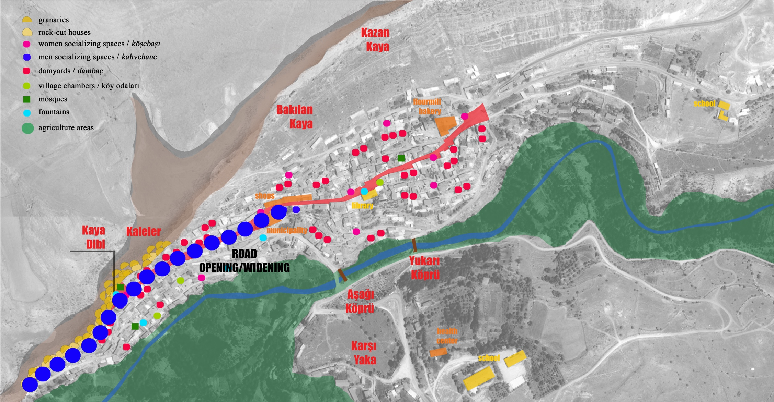
state-driven & expert-based top-down decisions disregarding local values
state ‘touches’ as top-down decisios for development:
1983 Road opening & widening

Slide 7
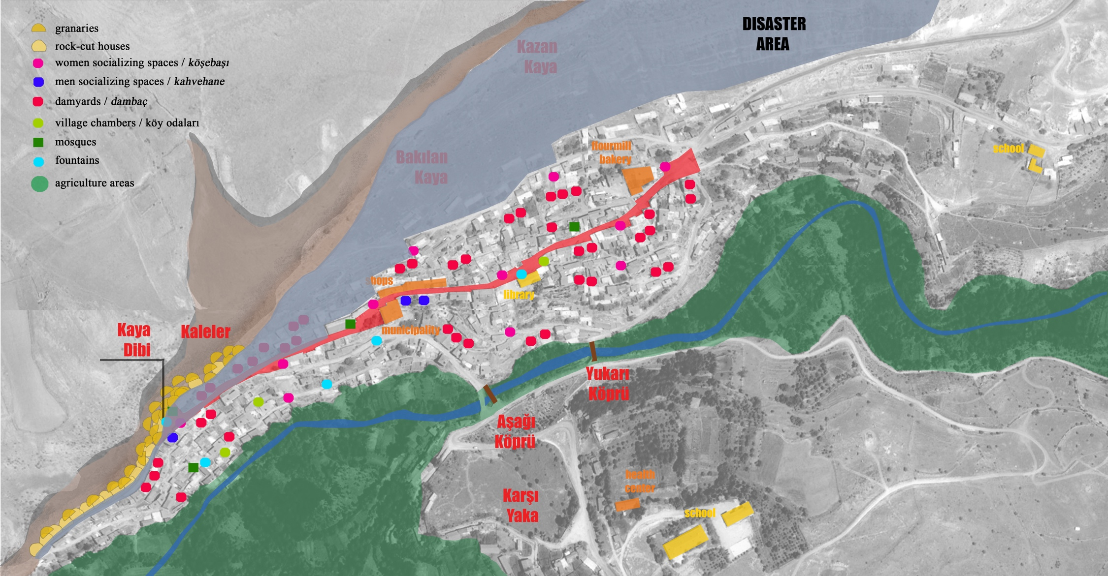
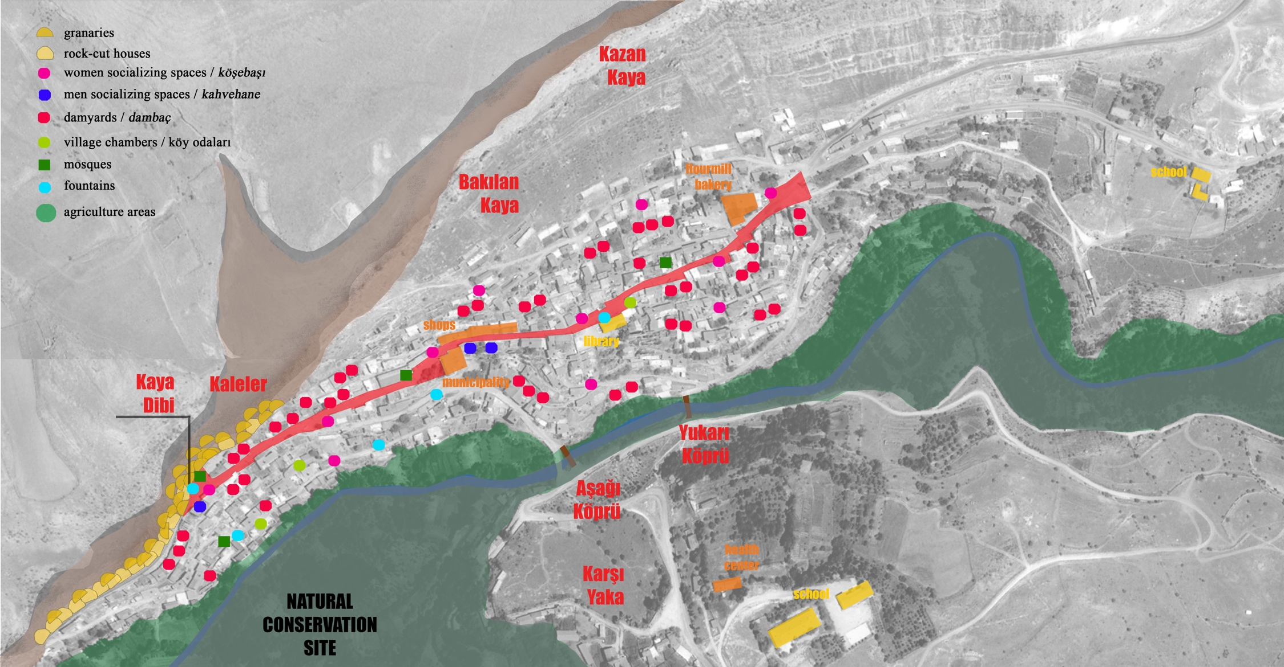
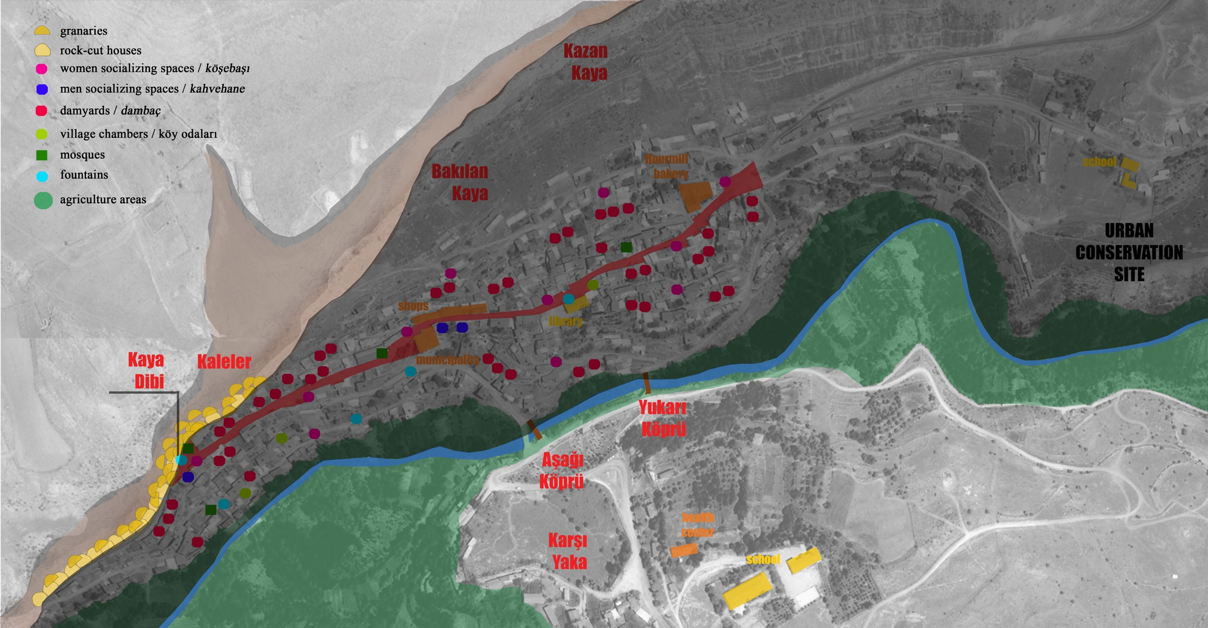
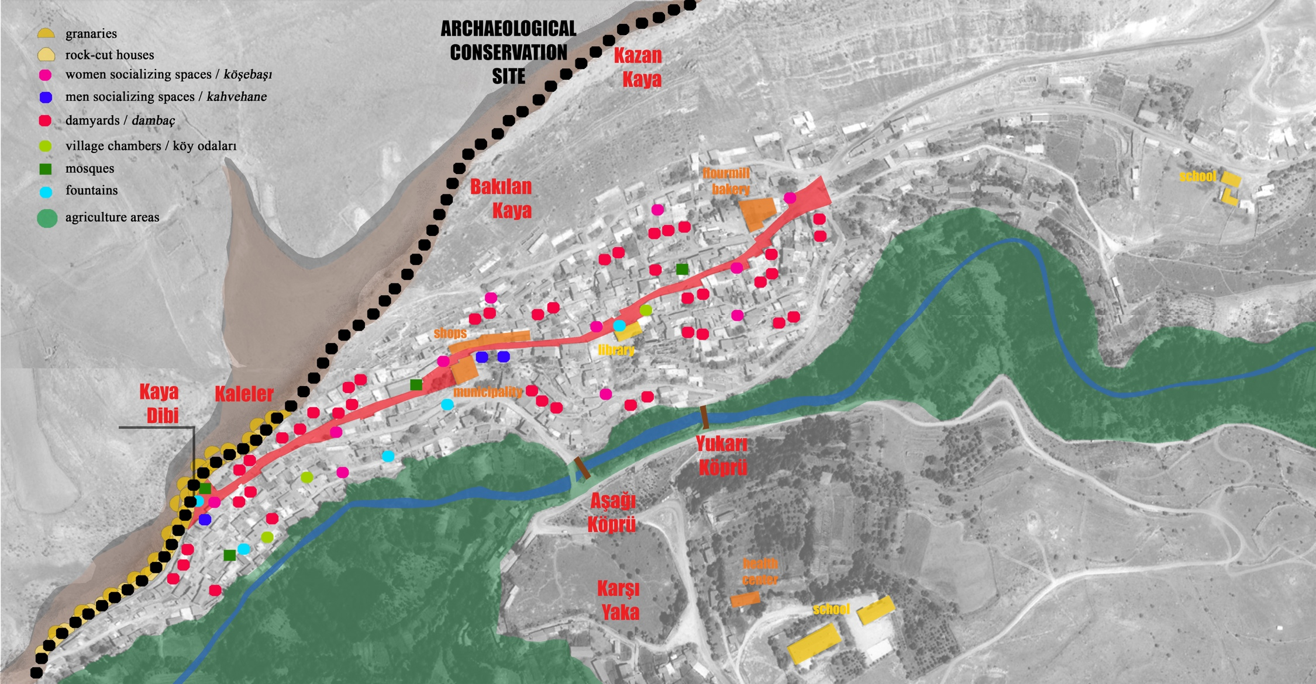
state-driven & expert-based top-down decisions disregarding local values
state ‘touches’ as top-down decisios for conservation:
  1986 1st degree Archaeological Conservation Site
  1992 Urban Conservation Site
  1992 1st degree Natural Conservation Site
state ‘touches’ as top-down decisios for protection:
  1992 Disaster Area Declaration

Slide 8
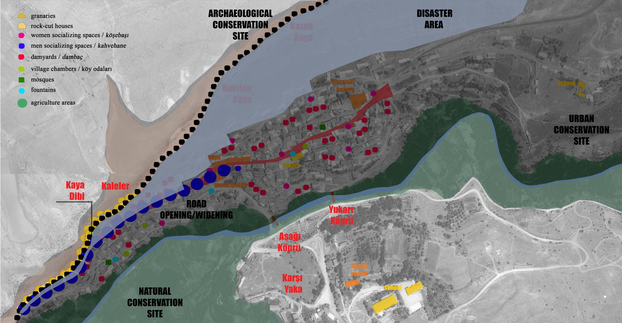
state ‘touches’ as top-down decisios
  for development
  for conservation
  for protection
  for promotion & economic advance

Slide 9
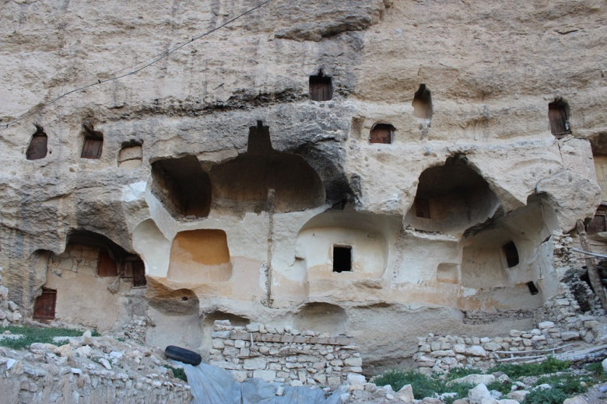
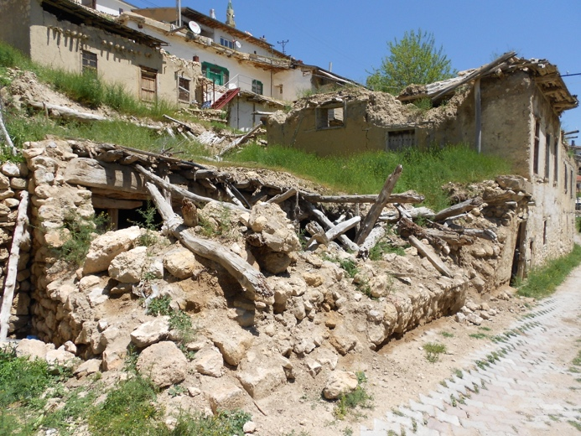
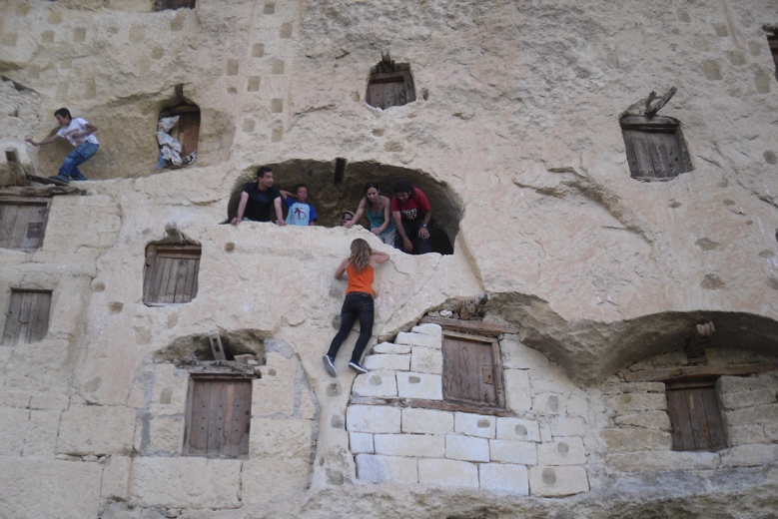
Contradictions Between Local Values and Top-Down Decisions
prevention on daily use of places
set of rules for conservation activities contradicting with the local lifecycle
abandonment
degraded physical environment
tourism development as the only future vision

Slide 10
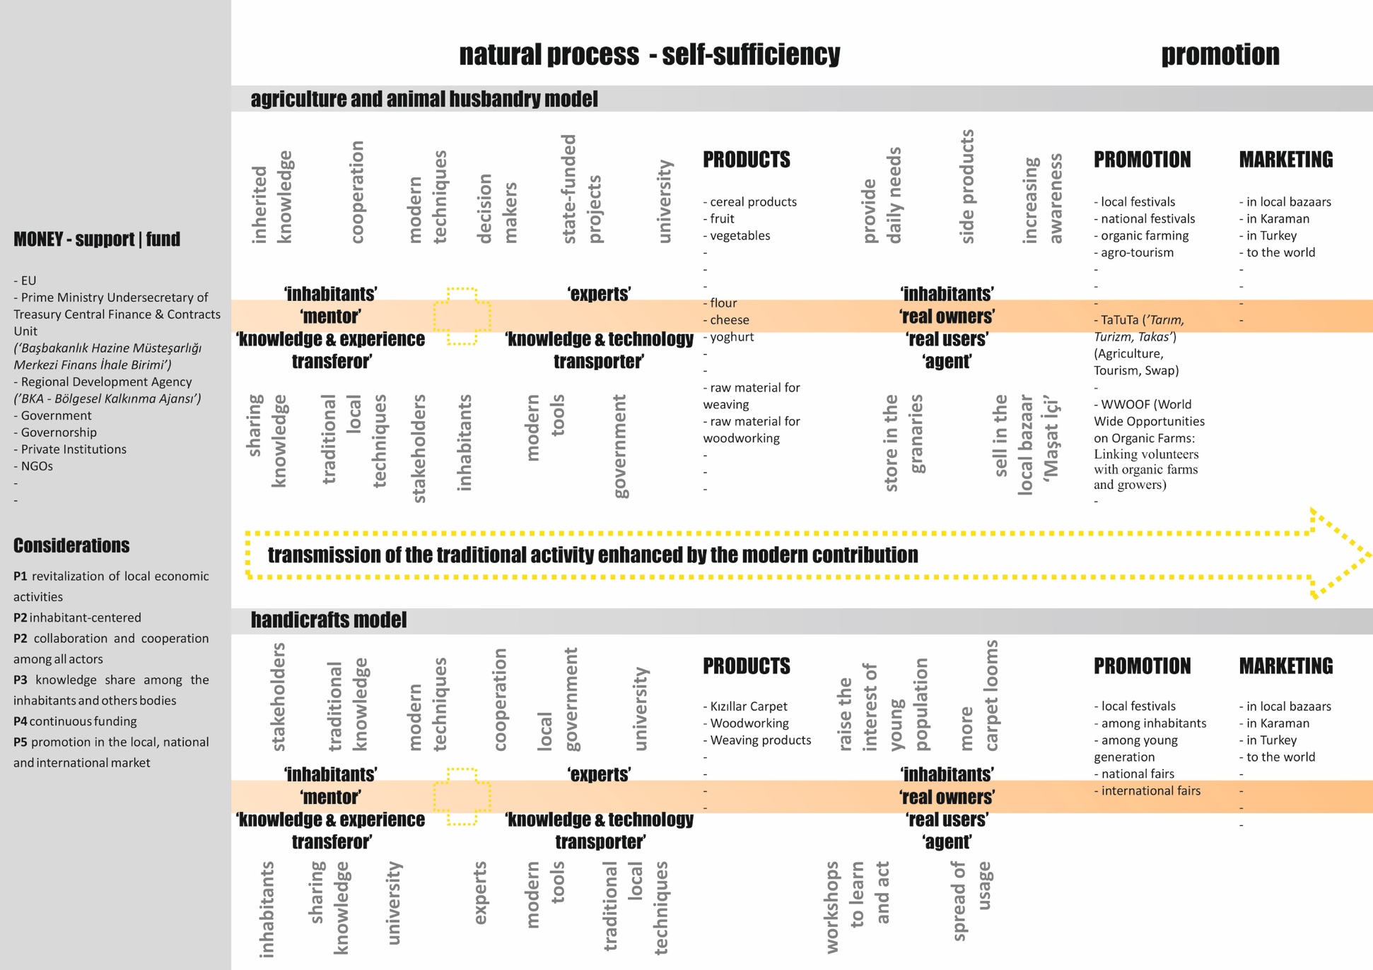
Policies & Strategies for Community-Driven Conservation and Empowerment
1 Production Model

Slide 11
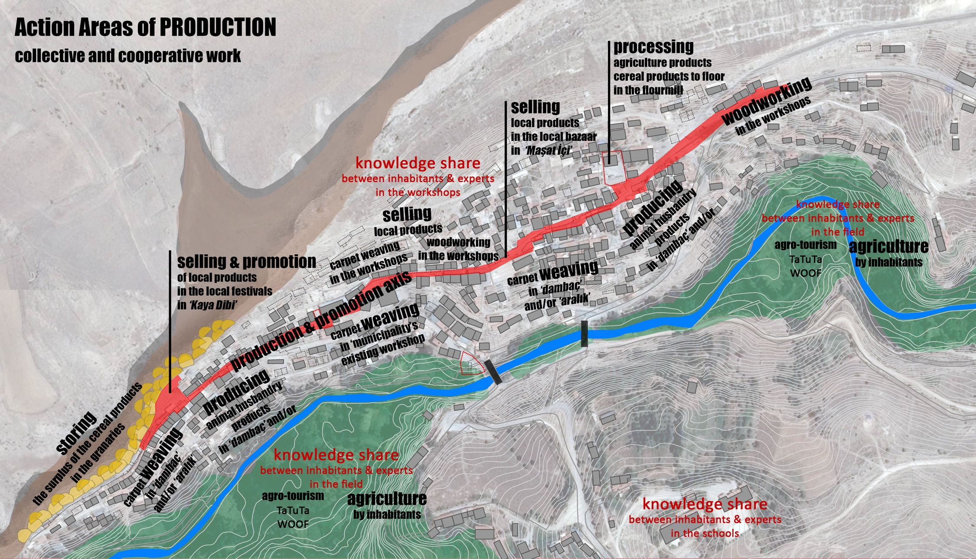
Policies & Strategies for Community-Driven Conservation and Empowerment
1 Production Model │ Action Areas

Slide 12
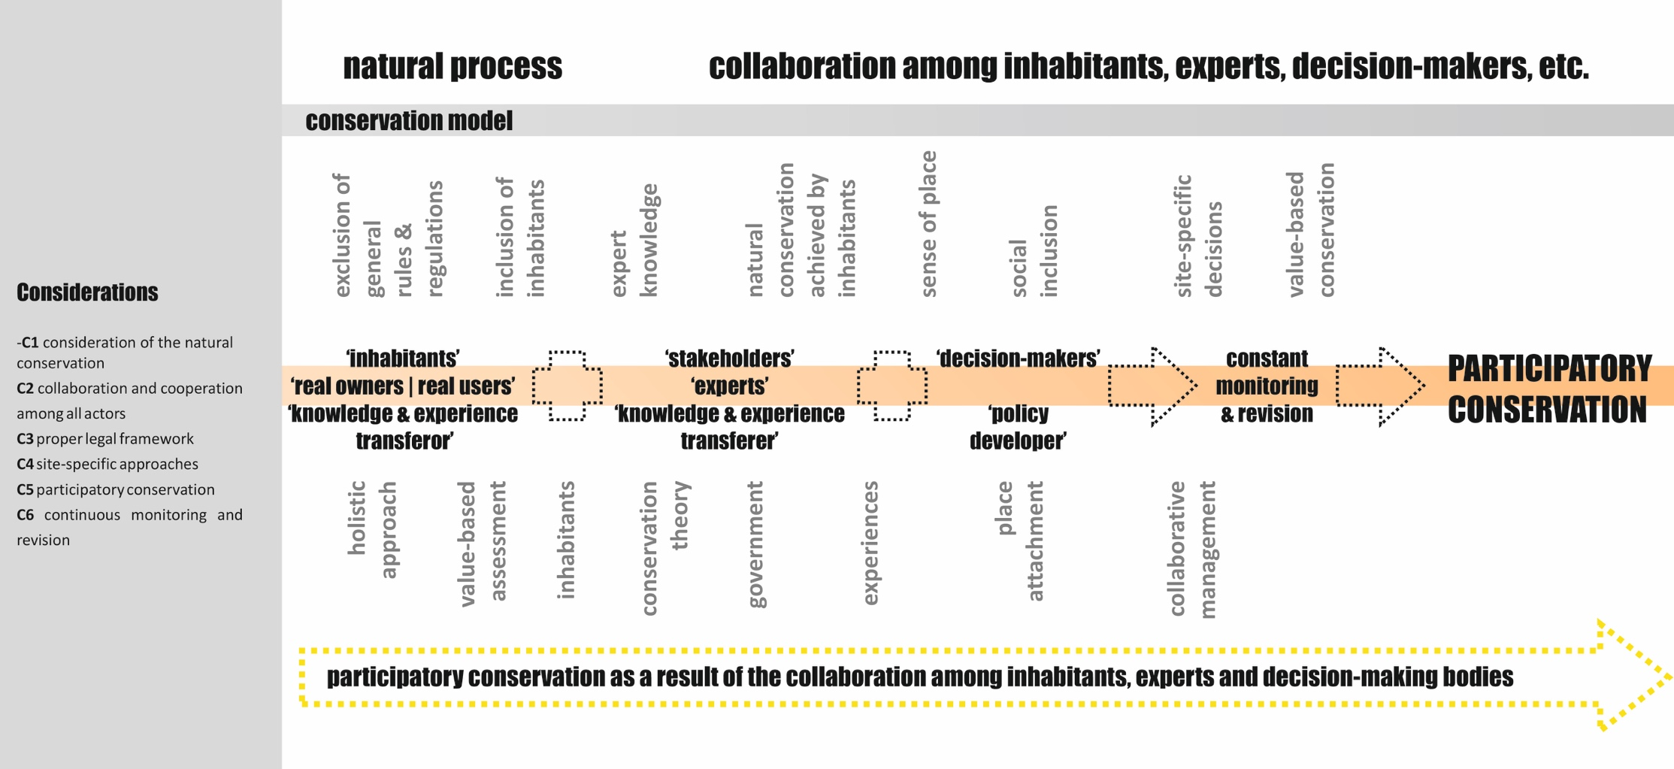
Policies & Strategies for Community-Driven Conservation and Empowerment
2 Conservation Model

Slide 13
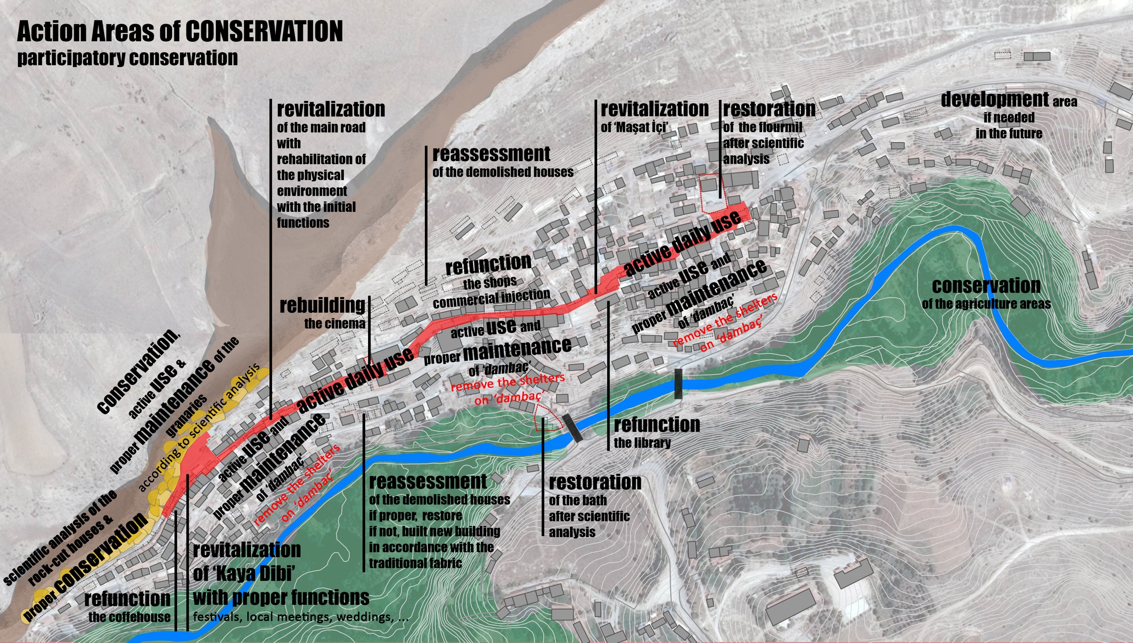
Policies & Strategies for Community-Driven Conservation and Empowerment
2 Conservation Model │ Action Areas

Slide 14
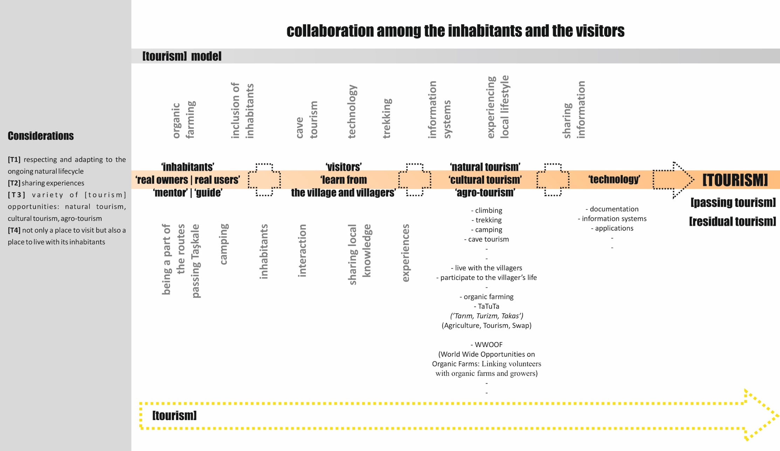
Policies & Strategies for Community-Driven Conservation and Empowerment
3 [Tourism] Model

Slide 15
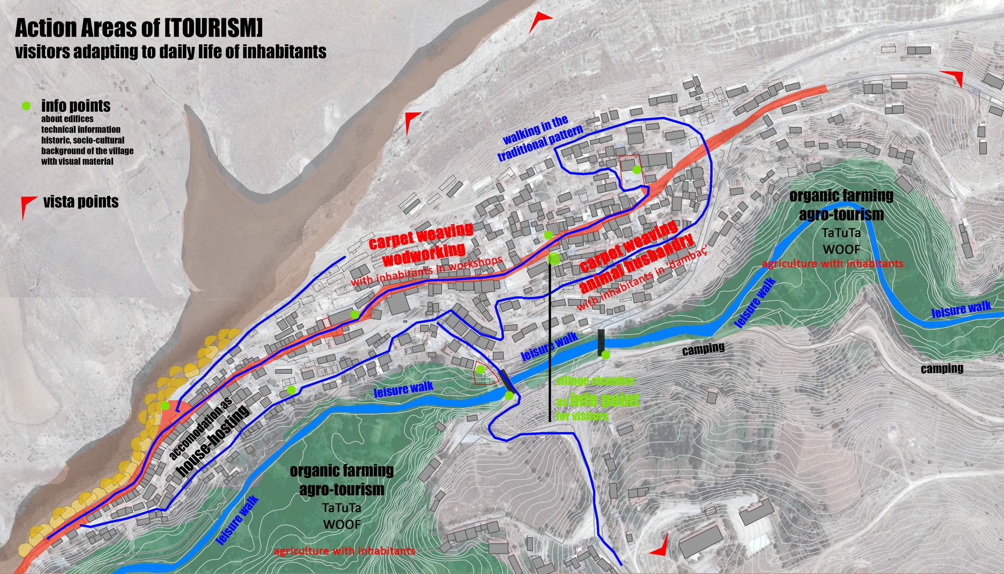
Policies & Strategies for Community-Driven Conservation and Empowerment
3 f [Tourism] Model │ Action Areas

Slide 16
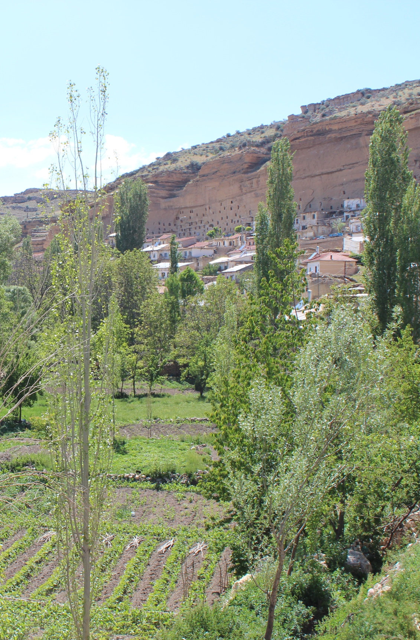
Concluding Remarks
Rural areas,
represent close relations among nature and culture
are characterized by traditional practices, traditional knowledge and inherited experiences
develop within their own tangible and intangible dynamics
Local community,
take an active role in constructing, transferring and sustaining local values
Therefore,
any decision related to rural areas should be given considering local dynamics and providing active involvement of local community, as well as diverse stakeholders to the decision-making processes.
In this way,
contradictions among local values and top-down conservation, development and economic advance priorities can be prevented.

