Slide 1
Social Class and OER
Elizabeth Siler, Associate Professor, Business Administration and Economics Department, Worcester State University
Angela Quitadamo, Assistant Dean, Academic Student Success,
Mount Wachusett Community College
Vicki Gruzynski, Teaching and Learning Librarian,
Worcester State University
Presented at the Northeast OER Summit, May 22, 2019, Amherst MA
This work is licensed under a Creative Commons Attribution 4.0 International License.

Slide 2
Session Plan
What is social class and how does it matter?
How using OER has changed our teaching
How OER can address problems at an institutional level
Problems related to social class that OER does not address
Questions and Discussion

Slide 3
What is Social Class?
Complex Construct Consisting of:
Education Level
Total Income - Earned & Unearned for Household (Total Assets/Debt)
Occupation & Industry (Level of Prestige)
Subjective Perception of One’s Social Position (Working, Middle, Upper)
Family Size & Composition
Poverty/Hardship Assessments (Food Insecurity, Economic Pressure, Unmet Needs)
Combination of Educational Attainment, Occupational Prestige, & Income
Notes:
Social class is about more than money.
In research, it’s often operationalized as socioeconomic status (SES), income, education level, parents’ education level.

Slide 4
How Does Class Matter?
“Individuals are not separate from their social contexts, people think and feel and act in culture-specific ways—ways that are shaped by particular patterns of historically derived meanings, practices, products, and institutions.” (DiMaggio & Markus, 2010: 348)
Notes:
In other words, what we do, and why we do it, and how we see the world, is all seen through the social class we were raised in.
And one very important part of this is that we ALL see the world through the lens of our own social class. Not just our students.
Further, we take our social class for granted, as the way things “just are” or “are supposed to be,” so that when our students behave in ways that are not consistent with our expectations, we tend to see them as “wrong.”

Slide 5
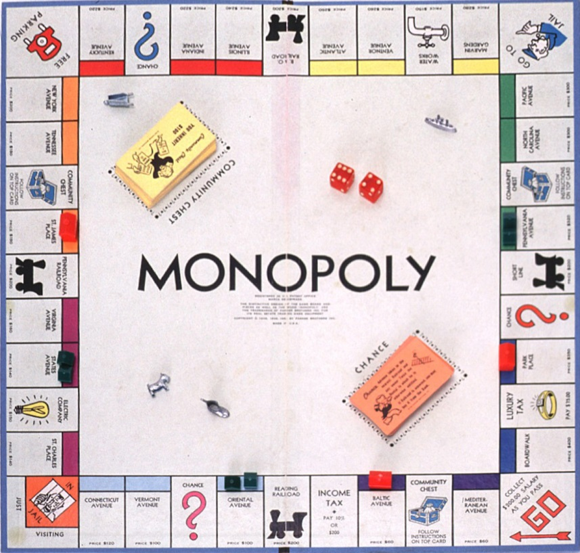
How Does Class Matter?
This is what happens:
Faculty are playing Monopoly.
We expect students to play it as well.
Notes:
This is one way that social class differences between students and faculty show up:
----------------------------------
This slide and the two that follow are a short explanation of Bourdieu’s concepts of “field” and “practice.”
Bourdieu was a French philosopher who grew up in a working-class family but then went on to be educated with people who mostly came from higher social classes.
One of his important ideas is “field” and “practice.” There are lots of different fields, and, like different games, every field has its own rules (practices).
So, different social contexts (fields), like family and school, have different ways that people are expected to behave (practices).
Similarly, different social classes have different rules.

Slide 6
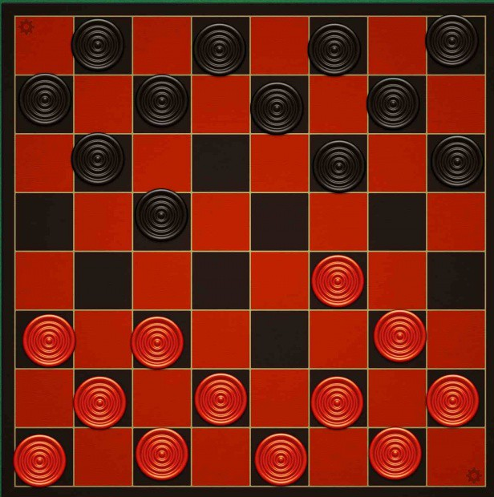
How Does Class Matter?
When students don’t follow the rules, faculty think:
“What’s wrong with you? You’re really bad at this game!”
When actually our students are playing a different game.
With different rules.
Notes:
So our students get to our classes and our offices and we think, wow! You are really bad at this game! When actually they’re playing checkers.
So, when you see student behavior through a Bourdieusian lens, these bewildering behaviors are students playing, very correctly, the rules of an entirely different game.
And to make this even more complicated, none of us know that we’re playing different games with different rules!

Slide 7

How Does Class Matter?
But neither of us realizes we are playing different games.
And we can make those practices explicit, to ourselves and our students.
Notes:
The point is to help faculty see students not as deficient but coming from a different context re: school.
This is especially true at schools like Worcester State, Westfield State, community colleges where the majority of the students are from working-class backgrounds and/or are first-generation college students.
Haven’t been taught to be good at school the way that most faculty were taught--or learned--to be.
Ex: how to look like you’re paying attention during class, even if you’re not. How to ask for help, or just that it’s OK and expected to ask for help.
Ex: Showing examples of two student emails on the same topic, and the different ways that each email may be perceived by faculty: “Did I miss anything?” vs. “I will get notes from classmates, confirming that XYZ is still due next week, if I have questions I will ask before the next class.

Slide 8
University Culture Represents Middle-Class Norms
Independent Values
Being independently motivated
Working collaboratively in groups
Conducting independent research
Paving their own innovative pathways
Challenging the norms or rules
Developing personal opinions
Interdependent Values
Being motivated by others’ high expectations
Working collaboratively in groups
Conducting collaborative research
Following in the footsteps of accomplished others
Considering the norms or rules
Appreciating the opinions of others
Source: Stephens et al 2012
Notes:
Example of working class vs. middle class values.
This is from “four studies testing the hypothesis that first-generation students underperform because interdependent norms from their mostly working-class backgrounds constitute a mismatch with middle-class independent norms prevalent in universities” (Stephens et al 2012, p. 1178 (abstract))
In a series of matched-pair items, more university administrators chose the independent value item over the interdependent item in every pair.
92% vs. 8% (top)
Down to
60% vs. 40% (bottom)
Two tables from the paper are included @ end of presentation

Slide 9
How OER Changed Our Teaching
Books on reserve: which is very difficult for the ways many students schedule classes and campus time.
Old editions: bookstore policies may prohibit the purchase; weeks’ delay in on-line ordering
Using examples from companies like those our students might work at, not Microsoft or other large companies that are typical textbook examples.
Using non-textbook sources and genres to promote the habit of reading
Choosing topics because of their relevance, ex: how to handle conflict, types of social networks
Notes:
These examples are from courses taught by Elizabeth Siler and Mim Plavin-Masterman at Worcester State University.
We have replaced a single textbook with a combination of OER materials, mainly textbook chapters, and publicly available but copyrighted materials.
Ex: We use radio stories and podcasts, so you can listen in the car if you’re commuting--about 80% of business majors at WSU commute. This also helps them to become familiar with public radio as a source of news.
Ex: Networking. In Central Massachusetts, where most of our students are from, most people don’t leave, so they have different types of social networks than there are in other places (very dense).
Ex: Conflict-handling approaches: students tend to avoid conflict, so I spend more time on that topic than on others.
Ex: In Strategy, choosing companies that students are interested in, can go to, etc.
Ex: In Organizational Behavior, choosing case examples about medium or small or family-owned organizations, because that’s where they are more likely to work--in contrast to the examples in most OB textbooks.
Reading, the habit of reading, the presence of books in the house. Learning to read a textbook does not equal learning to read anything else (journalism)

Slide 10
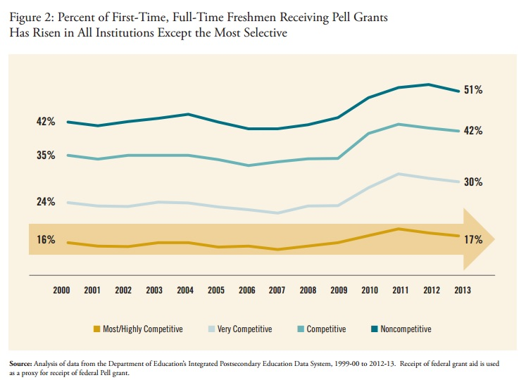
Notes:
ANGELA
Chart of % of Pell Grant recipients, by selectivity of school
The extent to which you see social class in your students will depend on your institution
(also the major/department/school; as selectivity of the institution goes down, percentage of business majors goes up.)
Your ability to see social class will depend on your institution. The more selective an institution is, the fewer working-class students there are. CC serve 49.2% of all college students. Put that together with this graphic.
"While colleges and universities raised a staggering $43.6 billion in 2017, only 1.5 percent of charitable gift dollars raised by educational institutions went to two-year institutions, despite the fact that community colleges serve 49.2 percent of the country’s college students - All Too Rare: A Gift Underscores a Persistent Lack of Support for Community Colleges by Mike Scutari
Demographics in the U.S. are shifting, so more students will be from lower social class background.
Even though social class is about more than income, money is still important! Students make many choices based on finances
Note: Link to income-equivalence calculator at the end of this presentation
SAT just added an “adversity score” which will aim to measure their socioeconomic background.
https://www.marketwatch.com/story/sat-adds-adversity-score-amid-concerns-that-privileged-students-have-an-unfair-advantage-2019-05-16

Slide 11
Administration Perspective
From an enrollment perspective, we know when there are multiple sections of the same course, OER sections typically fill first
Students sometimes choose courses based solely on book prices
Using OER can contribute to transparency in college costs
Access to materials increases GPAs. More students with good academic standing and thus avoid SAP issues and the costs associated with non-completion
Classroom climate: OER promotes an inclusive and engaging classroom climate because all students have the materials.
OER can build immediate instructor credibility with students. It’s an unspoken choice that acknowledges economic hardships being navigated by students.
Notes:
ANGELA
students choose classes based on book prices: they ignore format (choose online, don’t consider the campus, etc...it’s the driving force of the decision). Faculty don’t end up with cancelled section.
GPAs are higher means students can maintain 2.0 - hard to do without a book, Give Quick SAP intro - how it disproportionately catches low income and students already struggling with the achievement gap.
Hits most needy students hardest:If you end up with SAP issues and cannot self-pay, game over. No college credential, owe a bill, no transcripts, and if you took loans you go into repayment with
Not all students have funds left over for book vouchers. Though books are often available for purchase cheaper online, this assumes students have credit cards to undertake these transactions. Middle class assumptions for students that operate in a cash community. No one is hiding in the back because they can’t afford the readings, or have an old edition with the wrong questions.
Belonging: Zumbrunn, S., McKim, C., Buhs, E., & Hawley, L. (2014). Support, belonging, motivation, and engagement in the college classroom: a mixed method study. Instructional Science, 42(5), 661-684.
Zumbrunn et al. (2014) study on support, belonging, motivation, and engagement in the college classroom quantitatively found “a model that presents belonging as antecedent to motivational constructs/variables” (p.678).

Slide 12
Social Class Problems that OER Does Not Address
When students can’t afford the textbook, often they come to the library looking for help and alternatives
Our students still have a million jobs and limited time to do their homework
Students who live at home (or nearby) will still have expectations from their family that do not necessarily align with “school comes first”
Having OER materials available electronically still requires Internet access and a working laptop
If students don’t have internet access, they need to pay to print materials
Doesn’t solve accessibility issues
Notes:
VICKI

Slide 13
Questions and Closing Thoughts
If the first person in a family gets through college, it’s a demonstration that you can do it.
One purpose of this presentation is to raise awareness about social class, especially as the traditional student population is shrinking. When you’re facing a problem, consider if there may be a social class component that you might not be seeing.
What questions do you have?
What would you like to discuss?
Notes:
VICKI
Scenarios for discussion, should we need them:
1) It’s the third week of class. You receive an email from a student that says, in part, “I can’t do my homework because I don’t have the book yet. I ordered it online two weeks ago, but it’s not here yet.”
2) Your class includes a lot of discussion. One student never volunteers, but sometimes will answer if you ask him directly. Once, when you were talking with his group about something they did not do well, he looked at the ground the whole time and seemed ashamed and maybe scared.
3) Your class has a weekly online quiz. One week, only 4 of 25 students took it. When you ask, they say, “We didn’t know it was due. You didn’t write it on the board last week.” You say: “It’s in the syllabus! It doesn’t matter whether I write it on the board; it’s still due!”

Slide 14
References (cited in presentation)
DiMaggio, P., & Markus, H. R. (2010). Culture and Social Psychology: Converging Perspectives. Social Psychology Quarterly, 73(4), 347–352.
Stephens, N.M., Fryberg, S.A., Markus, H.R., Johnson, C.S., & Covarrubias, R. (2007). Unseen Disadvantage: How American Universities’ Focus on Independence Undermines the Academic Performance of First-Generation College Students. Interpersonal Relations and Group Processes, Journal of Personality and Social Psychology, 2012, Vol. 102, No. 6, 1178–1197.
Notes:
Additional references in notes for slides # 10 and 11.

Slide 15
Additional References
Collier, P.J., and Morgan, D.L. (2008). “Is that paper really due today?”: Differences in first- generation and traditional college students’ understandings of faculty expectations. Higher Education, 55, 425—446
Goyette, K.A. and Mullen, A. (2006). Who studies the arts and sciences? Social background and the choice and consequences of undergraduate field of study. The Journal of Higher Education, 77(3), 497—538.
Harker, R. (1984). On reproduction, habitus and education. British Journal of Sociology of Education, 5(2), 117–127
Hurst, A.L. (2010). The burden of academic success: Loyalists, renegades, and double agents. Lanham, MD: Lexington Books.
Hurst, A. L. (2013). Student types as reflection of class habitus: An application of Bourdieu’s scholastic fallacy. Theory and Research in Education, 11(1), 43–61.
King, C. S. (2012). What’s a girl like you doing in a place like this? Journal of Public Affairs Education, 18(1), 51–66.
Stephens, N., Hamedani, M. G., & Destin, M. (2014). Closing the Social-Class Achievement Gap: A Difference-Education Intervention Improves First-Generation Students’ Academic Performance and All Students’ College Transition. Psychological Science, (February 2014), 1–11.
Stephens, N., & Townsend, S. S. M. (2013). Rank Is Not Enough: Why We Need a Sociocultural Perspective to Understand Social Class. Psychological Inquiry, 24, 126–130.
Stephens, N., Townsend, S. S. M., Markus, H. R., & Phillips, L. T. (2012). A cultural mismatch: Independent cultural norms produce greater increases in cortisol and more negative emotions among first -generation college students. Journal of Experimental Social Psychology, 48, 1389–1393.

Slide 16
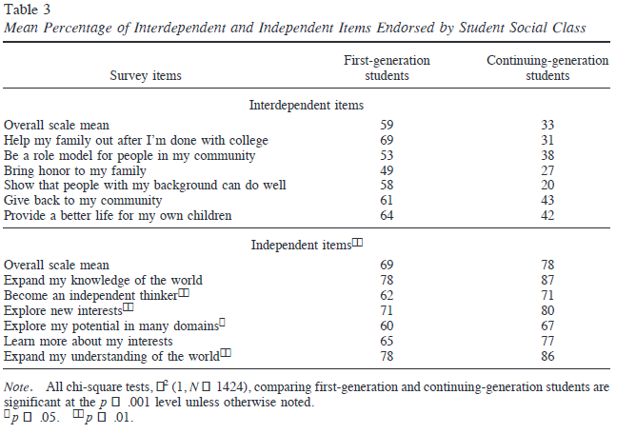
Source: Stephens et al 2012, p. 1185

Slide 17
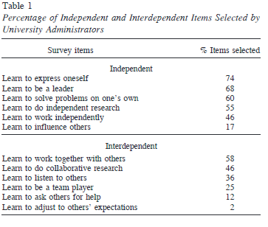
Source: Stephens et al 2012, p.1184

Slide 18
Income Comparison Calculator
https://tippingpoint.org/povertylineprices/index.html#3

Slide 19
Contact us!
Elizabeth Siler, Associate Professor, Business Administration and Economics Department, Worcester State University
esiler [@] worcester.edu
Angela Quitadamo, Assistant Dean, Academic Student Success,
Mount Wachusett Community College
aquitadamo [@] mwcc.mass.edu
Vicki Gruzynski, Teaching and Learning Librarian,
Worcester State University
vgruzynski [@] worcester.edu
Twitter: @boo_urns

