Slide 1

Balancing Work and Learning on the Job:
Building a platform for experiential learning
Kris M. Markman & Jess Rios

Slide 2

Background

Slide 3

Past Experience Quotes
“It was amazing to work on things I didn't normally work on with people I didn't normally work with -- I learned a great deal and gained so many new skills because of that. “
***
“...it was very helpful and was useful for confirming that I was interested in reference and allowed me to transition into it.”

Slide 4
Unmet Needs
There wasn’t a clear way to discover available opportunities. These were generally informal arrangements that were not widely publicized.
There weren’t any best practices for 80/20 arrangements. Such as check-ins, mid-point evaluations, or duration limits.
There weren’t enough of them. I wanted to see more of these opportunities but needed to know more about the barriers to creating and offering them.

Slide 5
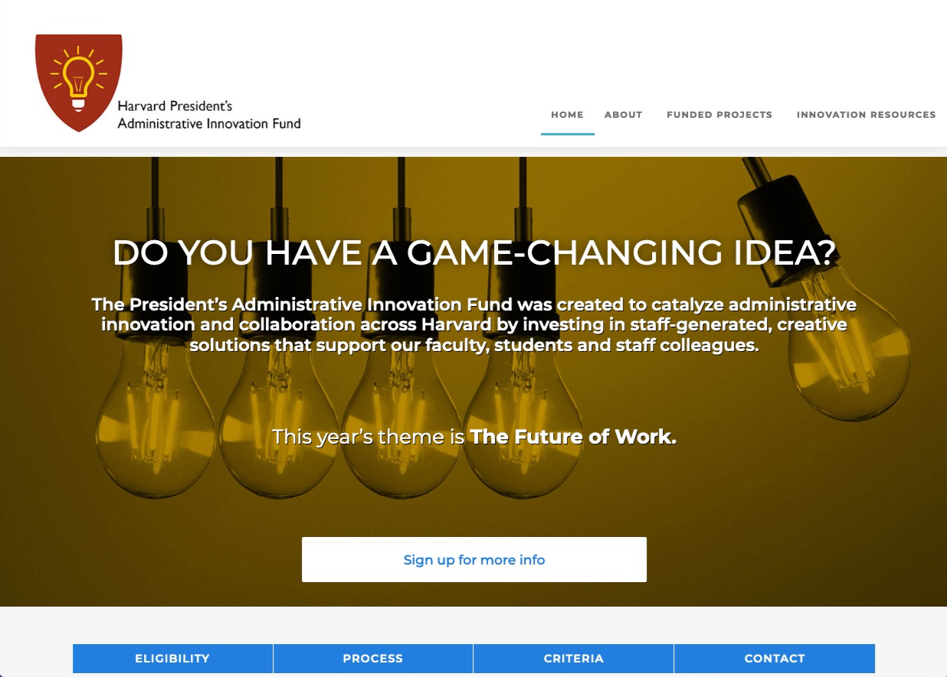
The Opportunity
Harvard PAIF

Slide 6

Getting the project started

Slide 7

Building a Team
The Team
Who are the right people to work on this project?
What kind of connections and expertise do we need?
In addition to the core team, who else will we work closely with?

Slide 8

User Research
User Research
Identify stakeholders and users
Learn about past experiences with 80/20 and other learning opportunities
Understand user needs
Co-design the solution

Slide 9
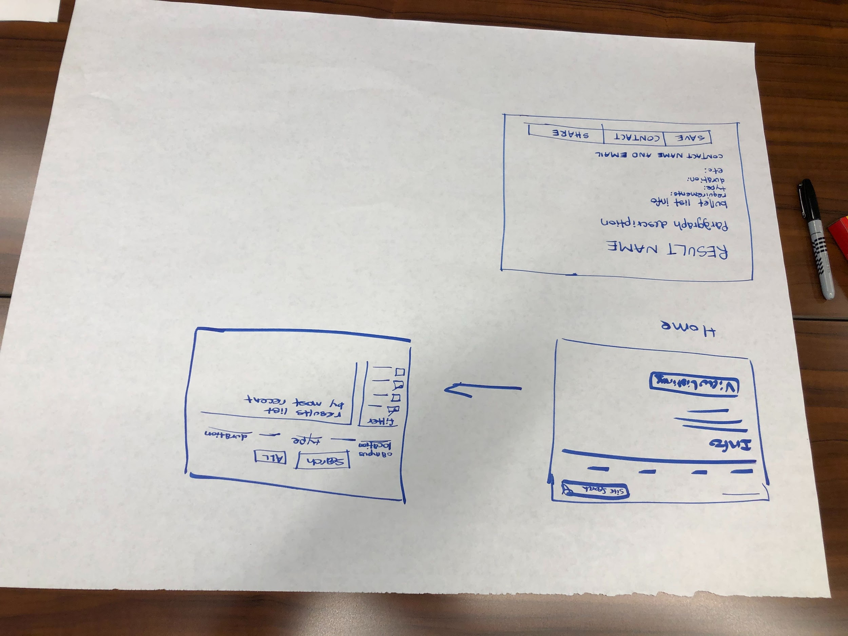
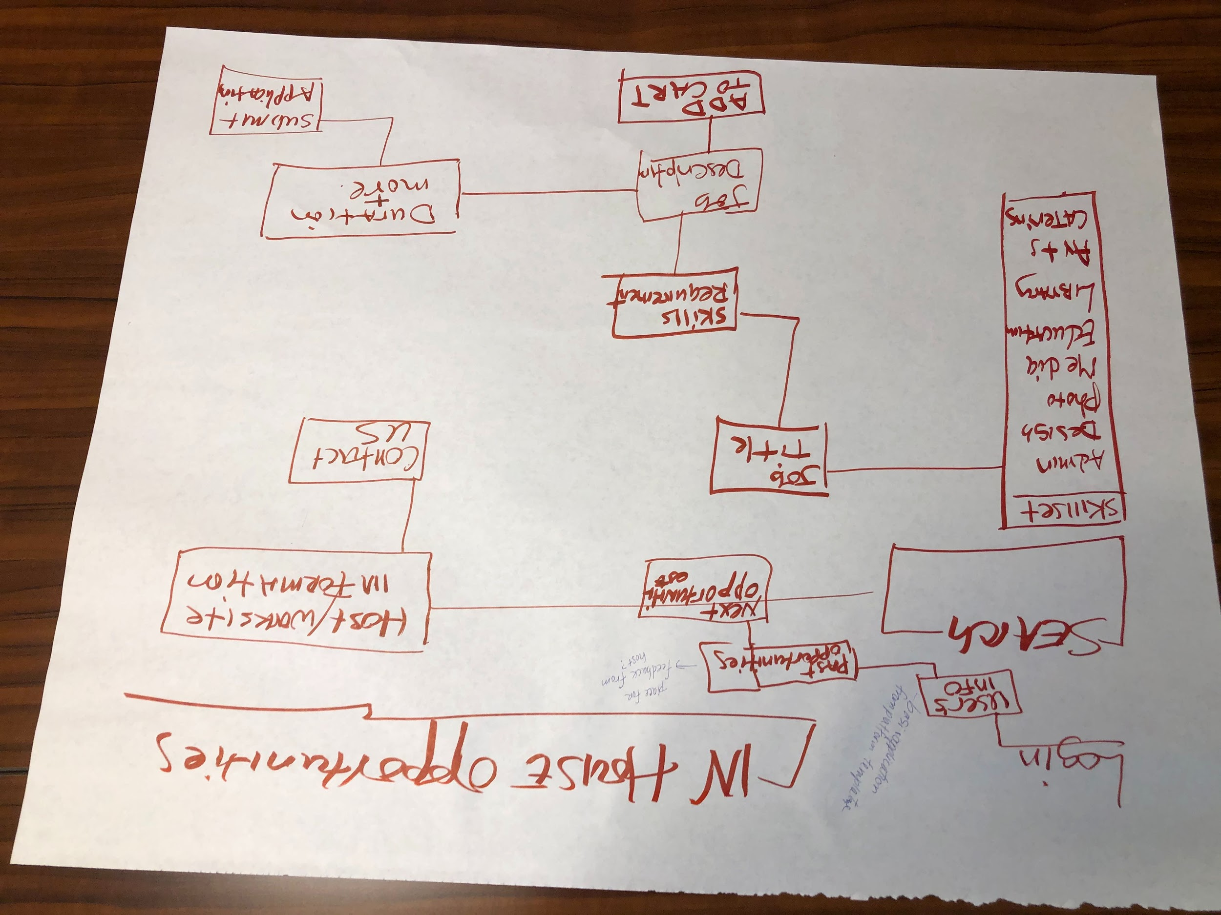
Sketching Session

Slide 10

Building the platform & the process

Slide 11


Process overview
Make use of available resources (OpenScholar)
Build from prior art
(existing 80/20 forms, flex form)
Design, test & iterate
(the site and the process)
Communicate with stakeholders

Slide 12

Deployment

Slide 13
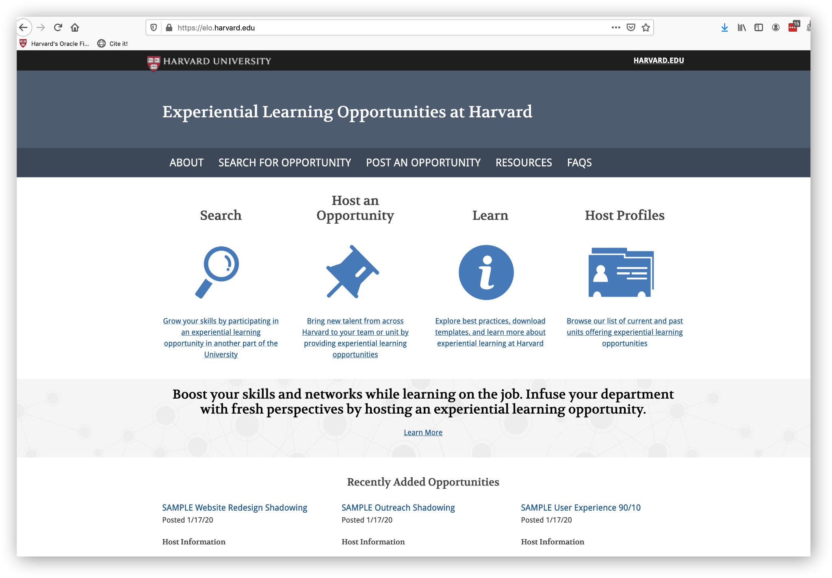
Our Site

Slide 14

Pivot
COVID pivot?

Slide 15

Experience Quote
“The ELO experience was very beneficial. Having assistance managing an online class through the pandemic was a lifesaver, and we ended up expanding the opportunity to dive into some course and data analytics not previously planned for.
However, communication and oversight were a challenge. On one hand, you want to let the participant focus on the work, but you might have to help shepherd the work along. As an inexperienced manger, this was a new opportunity for me to learn about managing a project with other people.
The opportunity to work with other Harvard Librarians has allowed participants and myself to learn new skills and work together in new ways that might not always be apparent.”
Julie Goldman, Countway Research Data Services Librarian, Harvard Library

Slide 16

Lessons learned

Slide 17




Key Takeaways
Words matter!
Value proposition is key
Champions are necessary
Know your culture (but try to change it?)

Slide 18

Contact Us
Kris M. Markman
Director of Professional Education, Tufts Clinical & Translational Science Institute
Assistant Professor, Tufts University School of Medicine
kris.markman@tufts.edu
Jess Rios
Service Designs & Assessment Librarian
Harvard Law School Library
Harvard University
jrios@law.harvard.edu

