Slide 1
The Trials & Tribulations of incorporating 3D Printing into the Health Science Curriculum
Laurel Scheinfeld, Health Science Librarian, SUNY Stony Brook
Joan Wagner, Chief Librarian, Touro College School of Health Sciences
Blanche Leeman, Occupational Therapy Professor, Touro College School of Health Sciences

Slide 2
Learning Objectives:
Participants will understand how to initiate a 3D printing program at their institution
Participants will be able to identify strategies that help promote success and avoid pitfalls
Notes:
Laurel

Slide 3
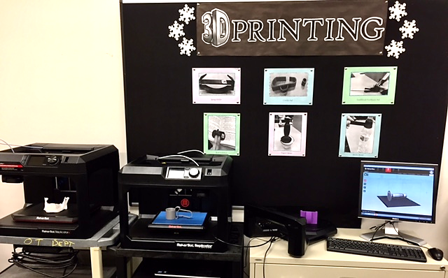
Outline:
Why we did this project
How we got started
Basics of the project
Challenges
Benefits
Q & A
Notes:
Laurel

Slide 4
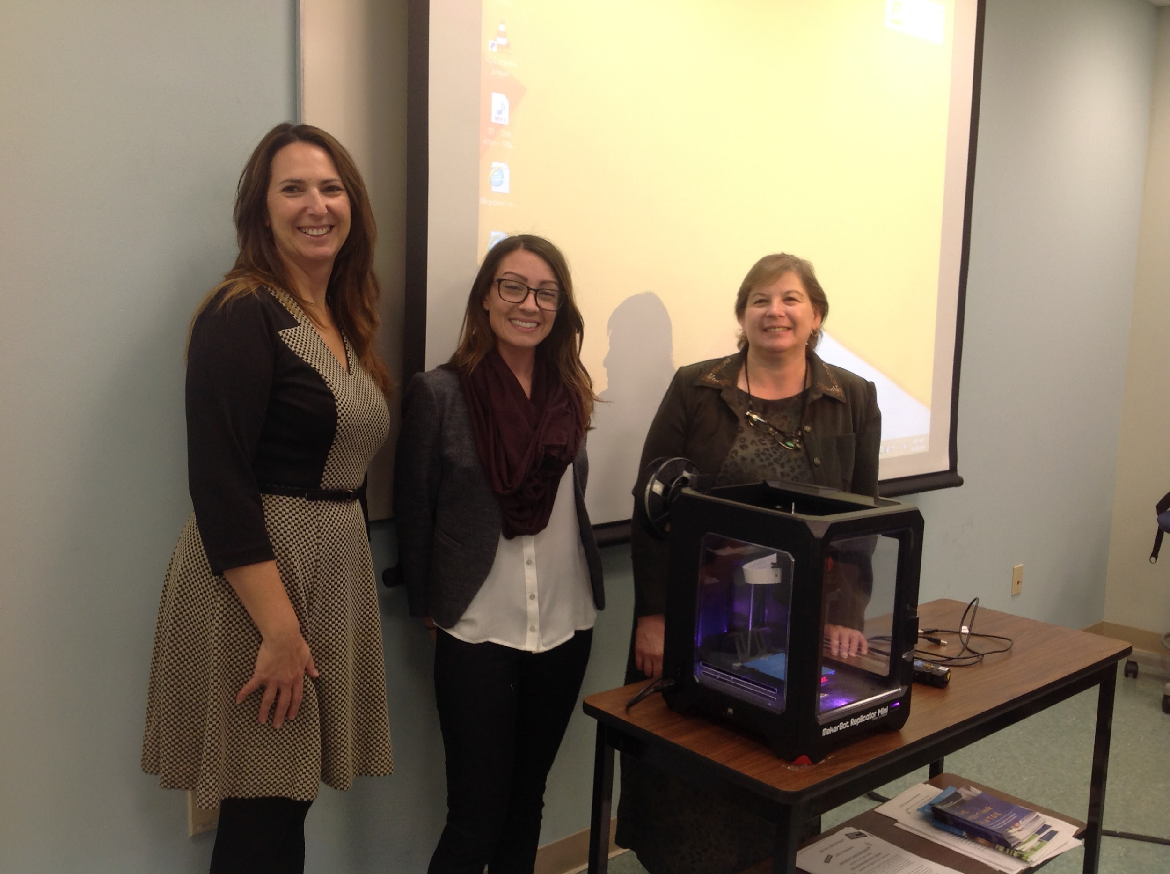
Why did we want a 3D printer?
Add a useful service
Innovate
Motivate librarians
Embed into curriculum
*Educause article
Colegrove, Patrick. 2014. Making it real: 3D printing as a library service. Educause review online
Notes:
Laurel
I was a new librarian (second career) and excited about the profession. But I found that a lot of people were questioning whether libraries were needed any longer now that so much information was available online. Well we all know that libraries are still relevant for many reasons, but I was interested in exploring how my library could possibly shift and adapt to offer new and innovative services that would continue to make it a central service to the institution.
This is the article that inspired me to pursue the project. The article citation and link is on your handout. In it Mr. Colegrove talked about how they started a makerspace and they expected engineering and art students to use their 3D printers but were surprised to find that students from almost every department were interested in it. And that was a benefit of having it in the library - it could cross all departments and benefit all. I had NO experience with 3D printing and I’m not especially ‘techie”.

Slide 5

How did we get a 3D printer?
Support from Dean and Library Administration
Notes:
Laurel
Support is Crucial - An OK from Dean of School of Health Sciences and Director of Libraries. The grant required letters from them, so make sure you have the support up front.
Grants - We looked at two grants - NNLM and IMLS. We chose NNLM because of the time frame. Both are good options to look into. Links are on the handout. We also had help from our Office of Sponsored Programs. The grant money covered the cost of the printer, the training, the warranty and initial supplies. The training and warranty were crucial and we highly recommend them both. Additional grants were later received for more printers and supplies and a 3D scanner.
The grant we applied for was for a “medical library project” so we couldn’t just propose to buy a 3D printer - we had to come up with a project. So we talked to the heads of the different departments in the school to see if there was interest in designing a 3D printing project.
Partners - We partnered with OT, PT and IT. Then we also wound up partnering with a group of engineering students who helped us with designing files

Slide 6



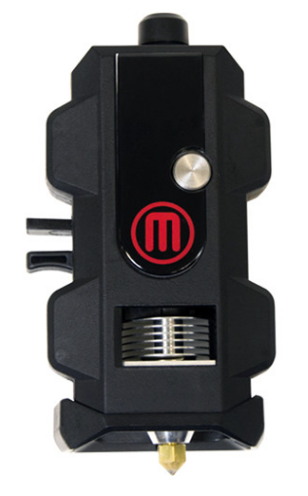
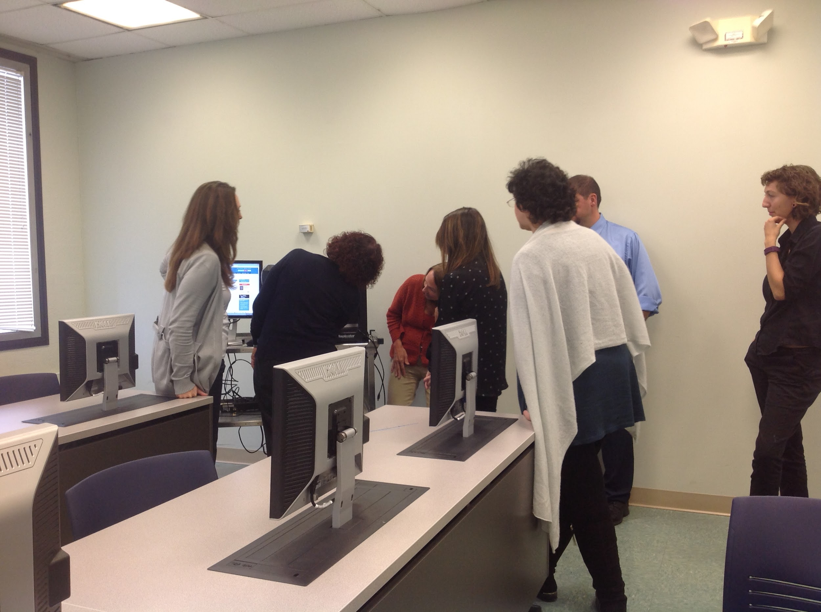
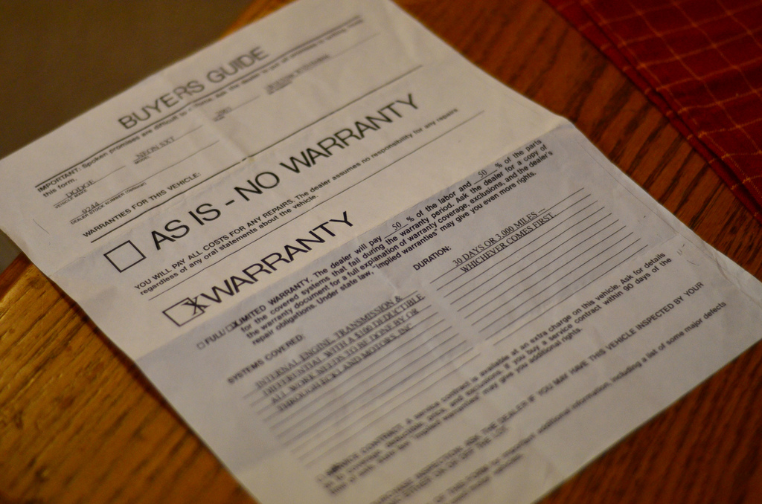
How did we get a 3D printer?
2. Grant Application:
Paid for: 3D printer, filament, extra extruder, two-day training, service contract

Slide 7



How did we get a 3D printer?
3. Partners

Slide 8
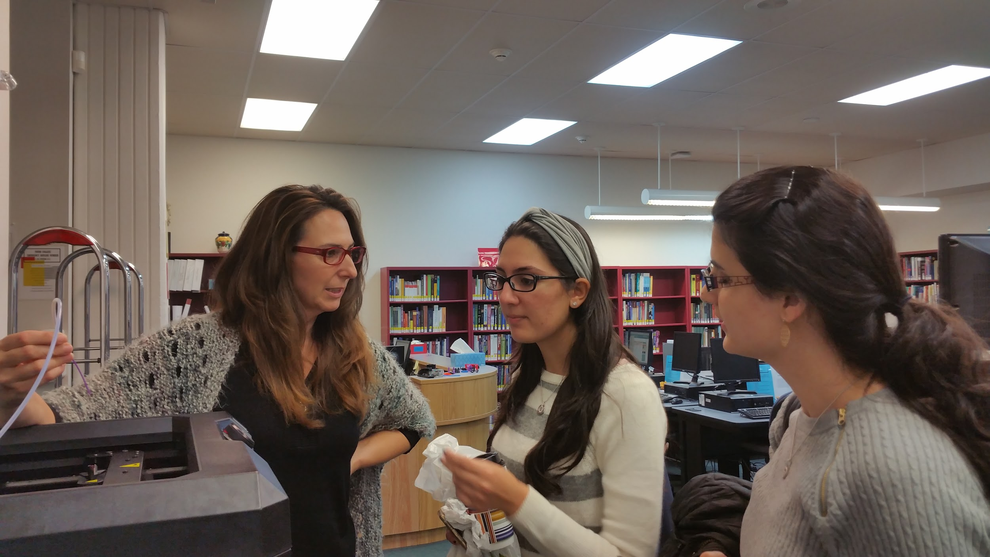
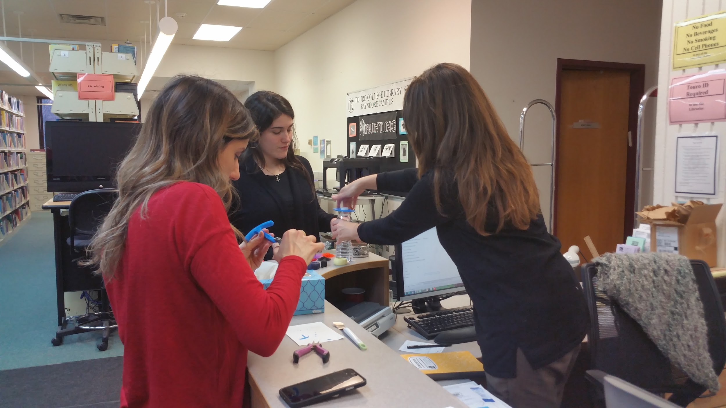
The basics of our project:
OT and PT students would learn to design and print a device for a patient
The library would provide:
  Housing and maintenance of the printer
  Instruction in 3D printing
  Supervision of printing
  Recordkeeping and coordination of all prototypes, files & prints
Notes:
Laurel
Our project is very different from most 3D printing services in libraries. We think it is pretty unique. We didn’t just offer 3D printing or a makerspace. We embedded a project into the curriculum.
Blanche will go into detail about creating the assistive device. I will tell you about the library’s role
The printer is in the library
We created video tutorials on the basics of 3D printing and design and on uploading prints to a repository to share. You can view them all from our LibGuide which is on your handout.
We use Google docs extensively to keep track of projects from beginning to end

Slide 9
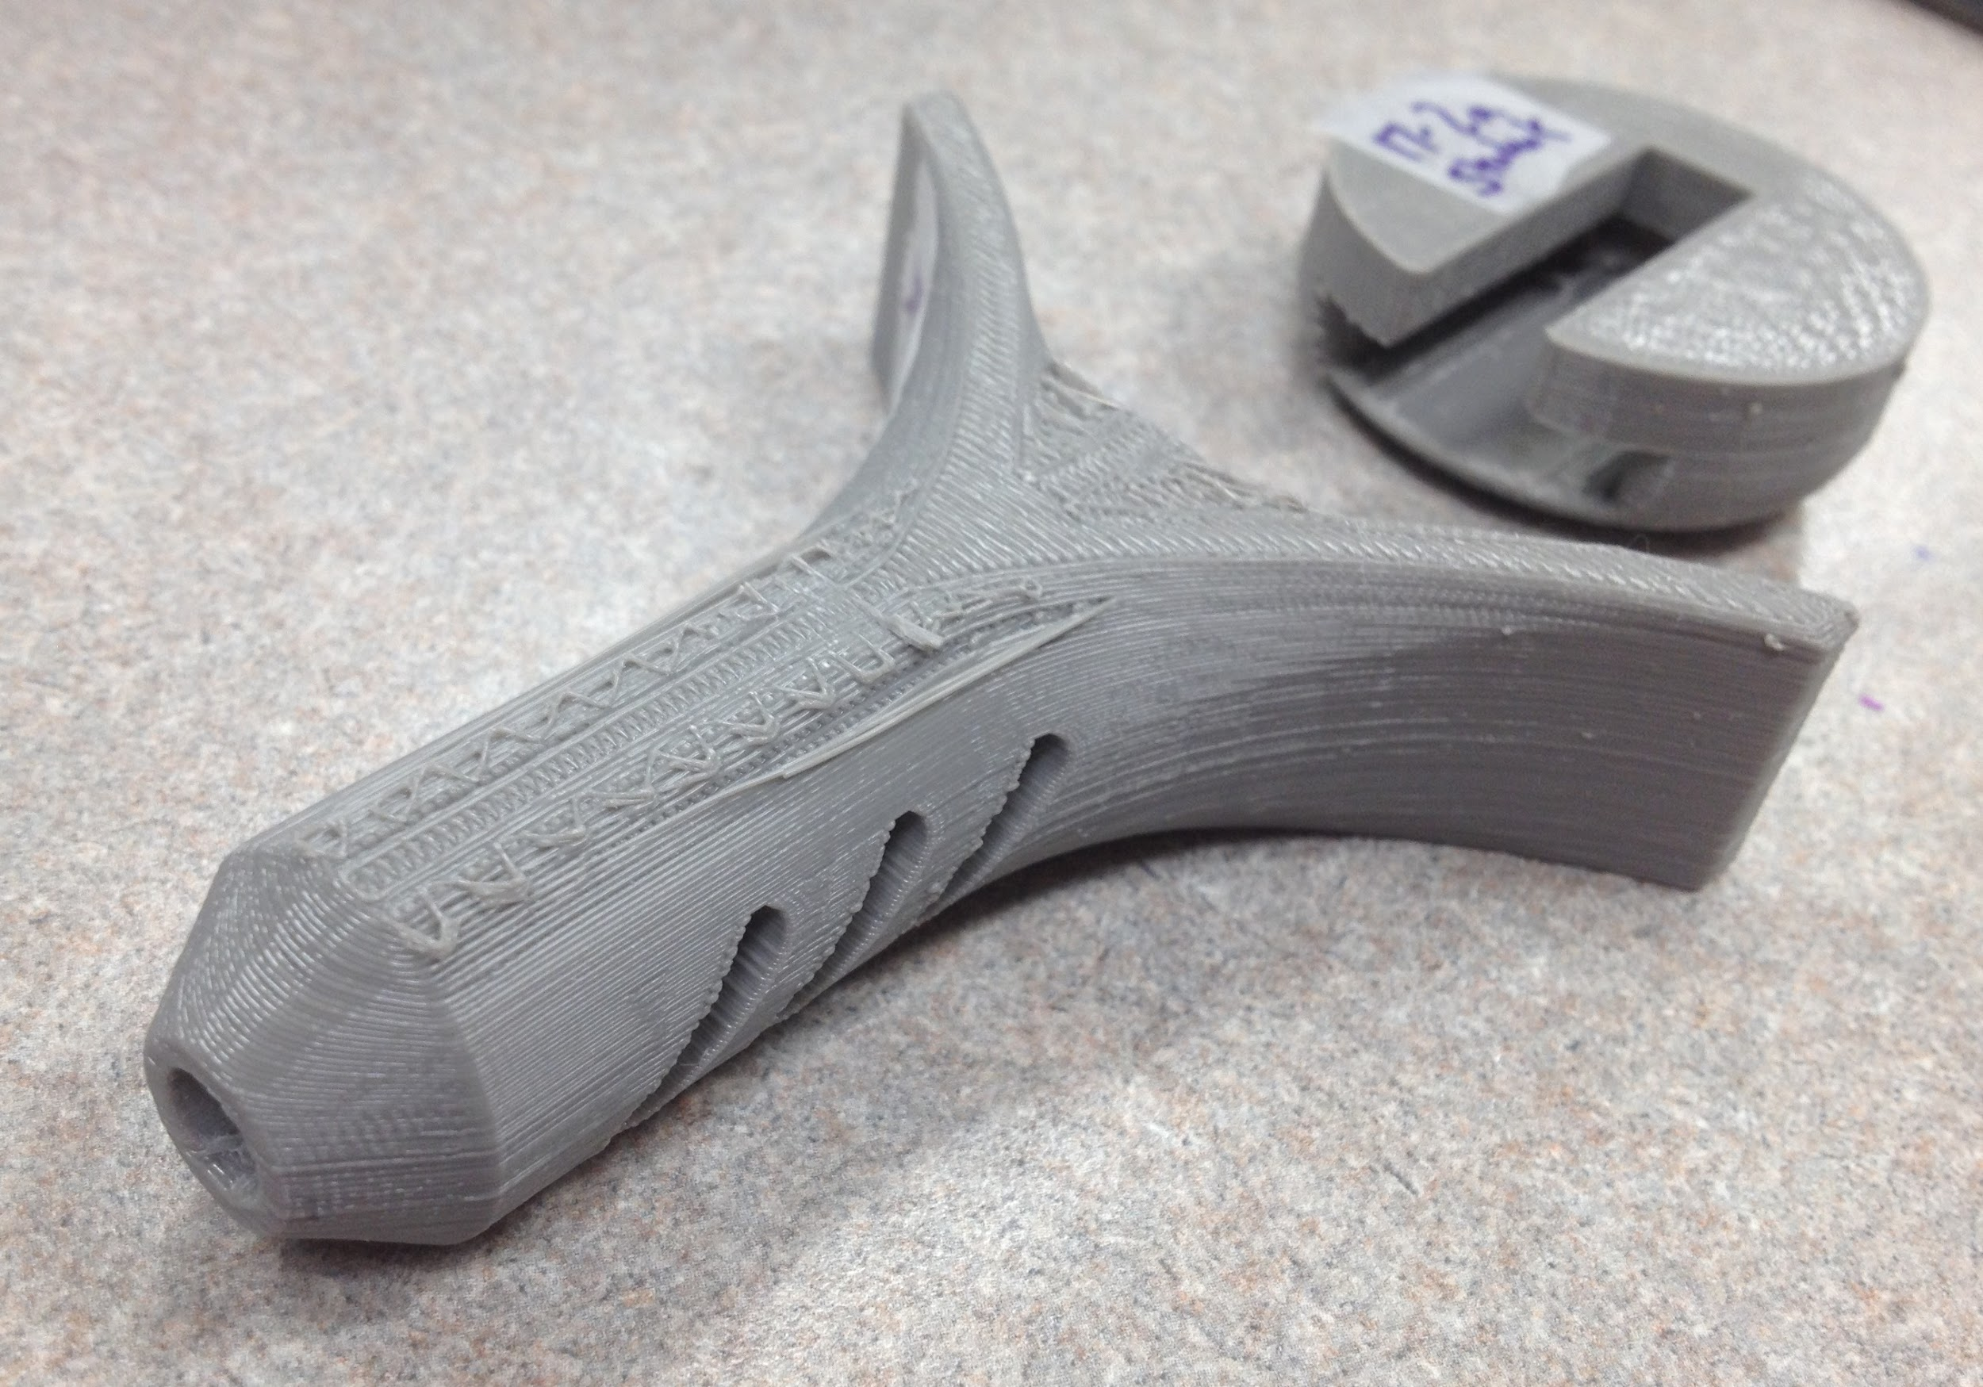
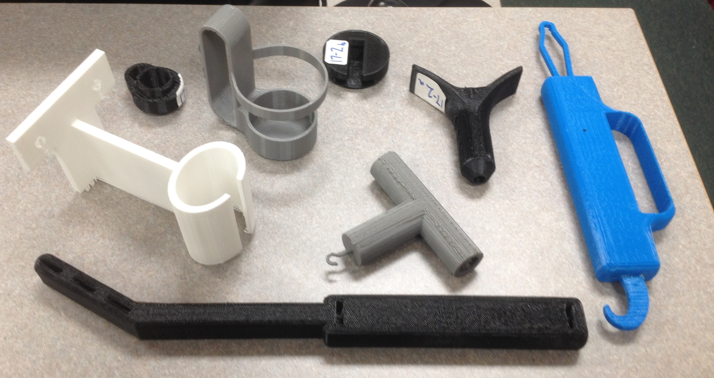
3D printing and occupational therapy:
What is occupational therapy?
What is an assistive device?
How do occupational therapy and 3D printing go together?
Examples of our creativity that facilitated function for an individual
Notes:
Blanche- define what an OT does, define the term AD and how it facilitates independence,, how 3D and OT can go hand in hand

Slide 10
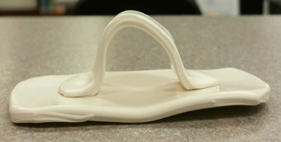
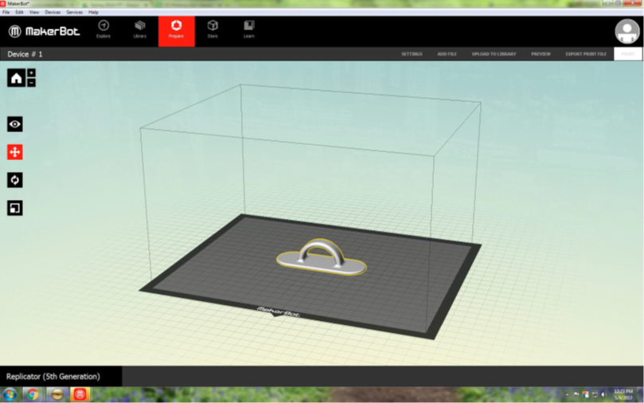
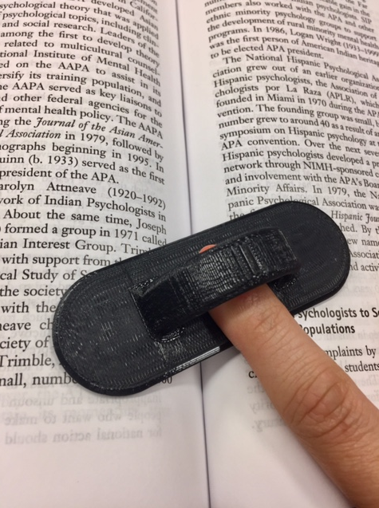
Creation Process:
Student idea for an assistive device
Prototype created
Sent to engineering students for file creation
.STL file sent to library
Item printed!
Notes:
Blanche explain the student prototype, design stage with engineering students, and completed AD

Slide 11
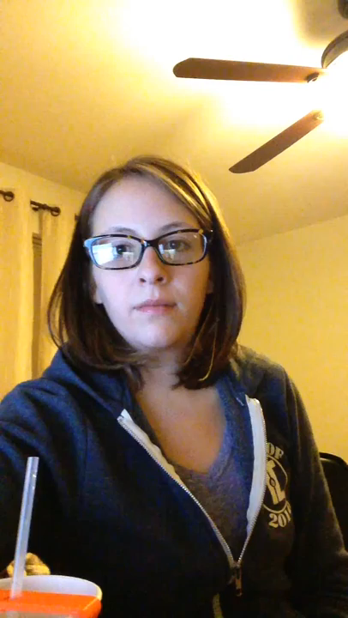
So, what did we print?

Slide 12
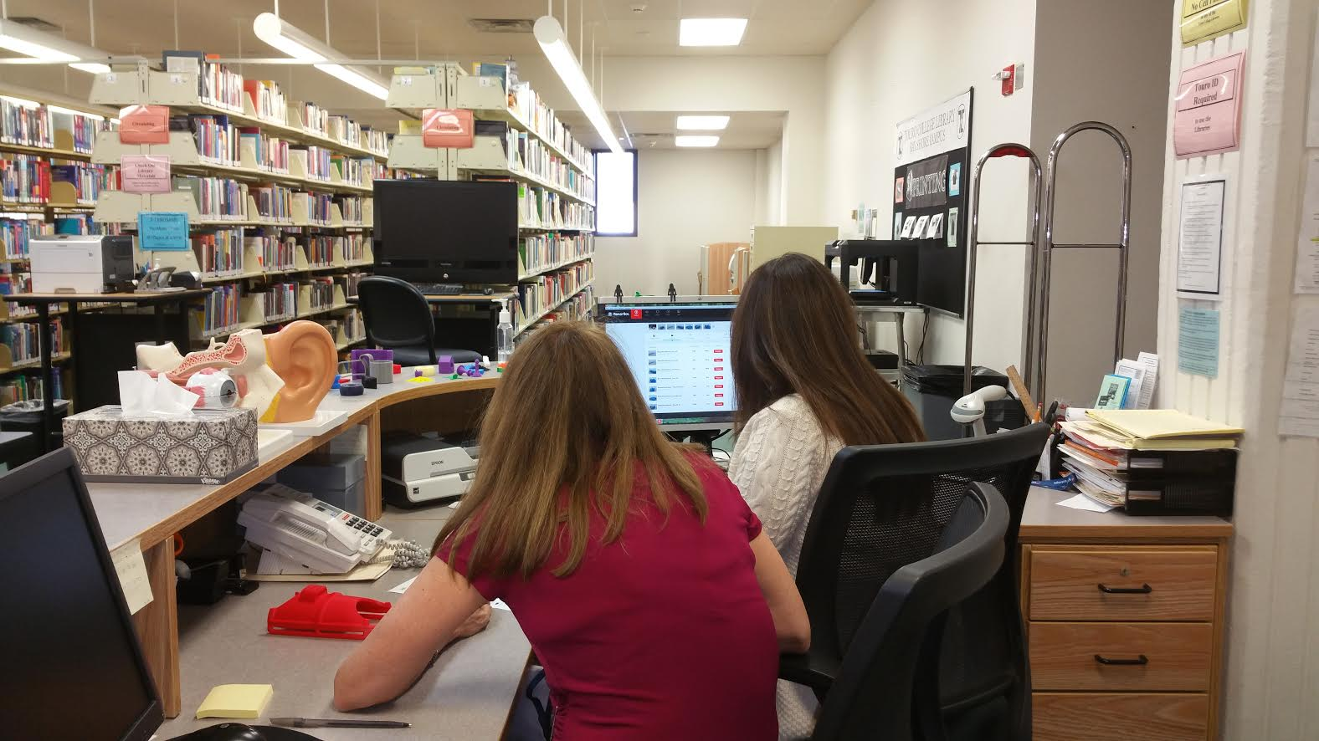
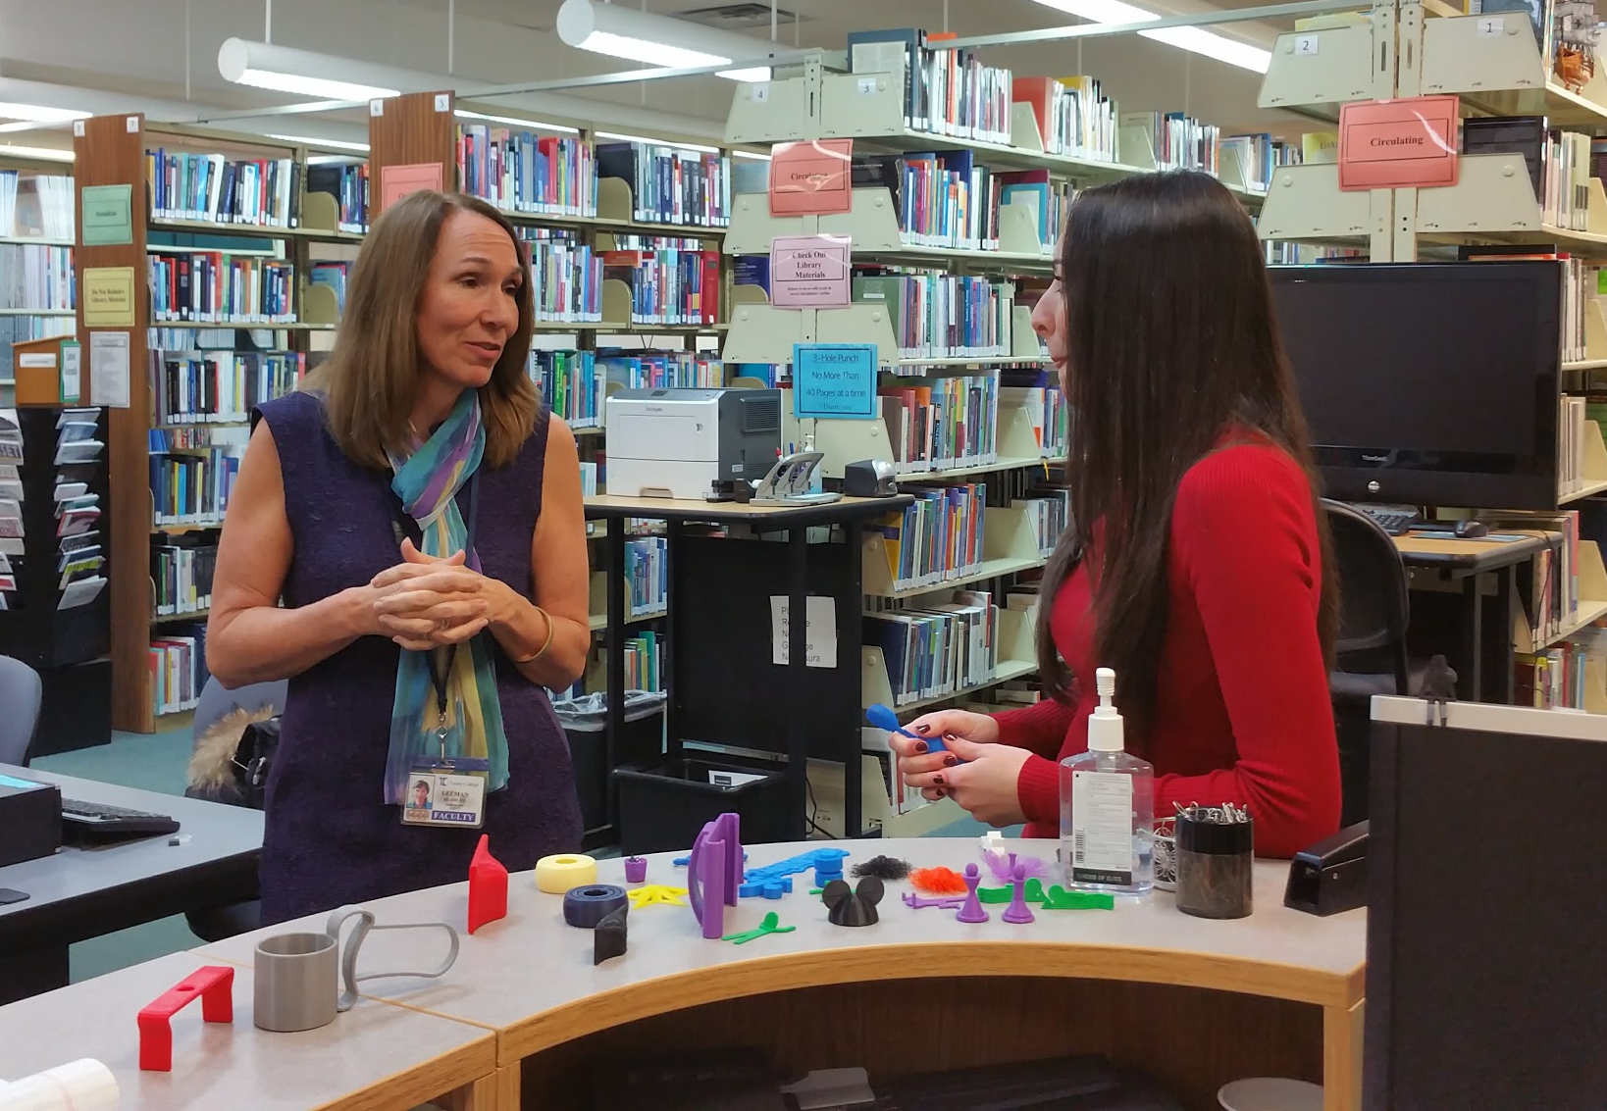
Ideas to engage faculty:
Educate self about the professional programs in your college
Propose an idea for a object that can be made to:
Demonstrate a concept to the student
Have the student learn a concept through using 3D printing
Offer to manage some aspect of the project
Make a one-and-done assignment or a short workshop as a push in the a course
Extra credit project
Make learning videos for the professor on the topic
Notes:
Blanche explain about PT, clueless about how to use 3D printing

Slide 13
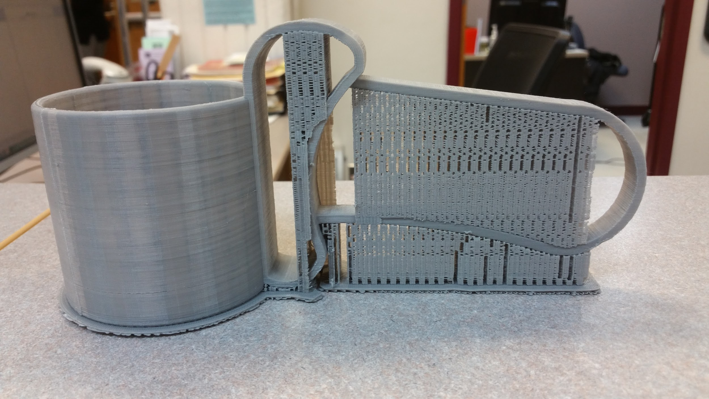
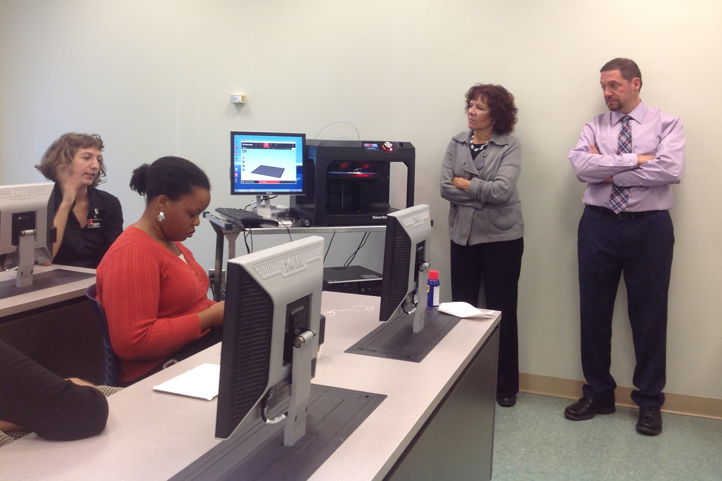
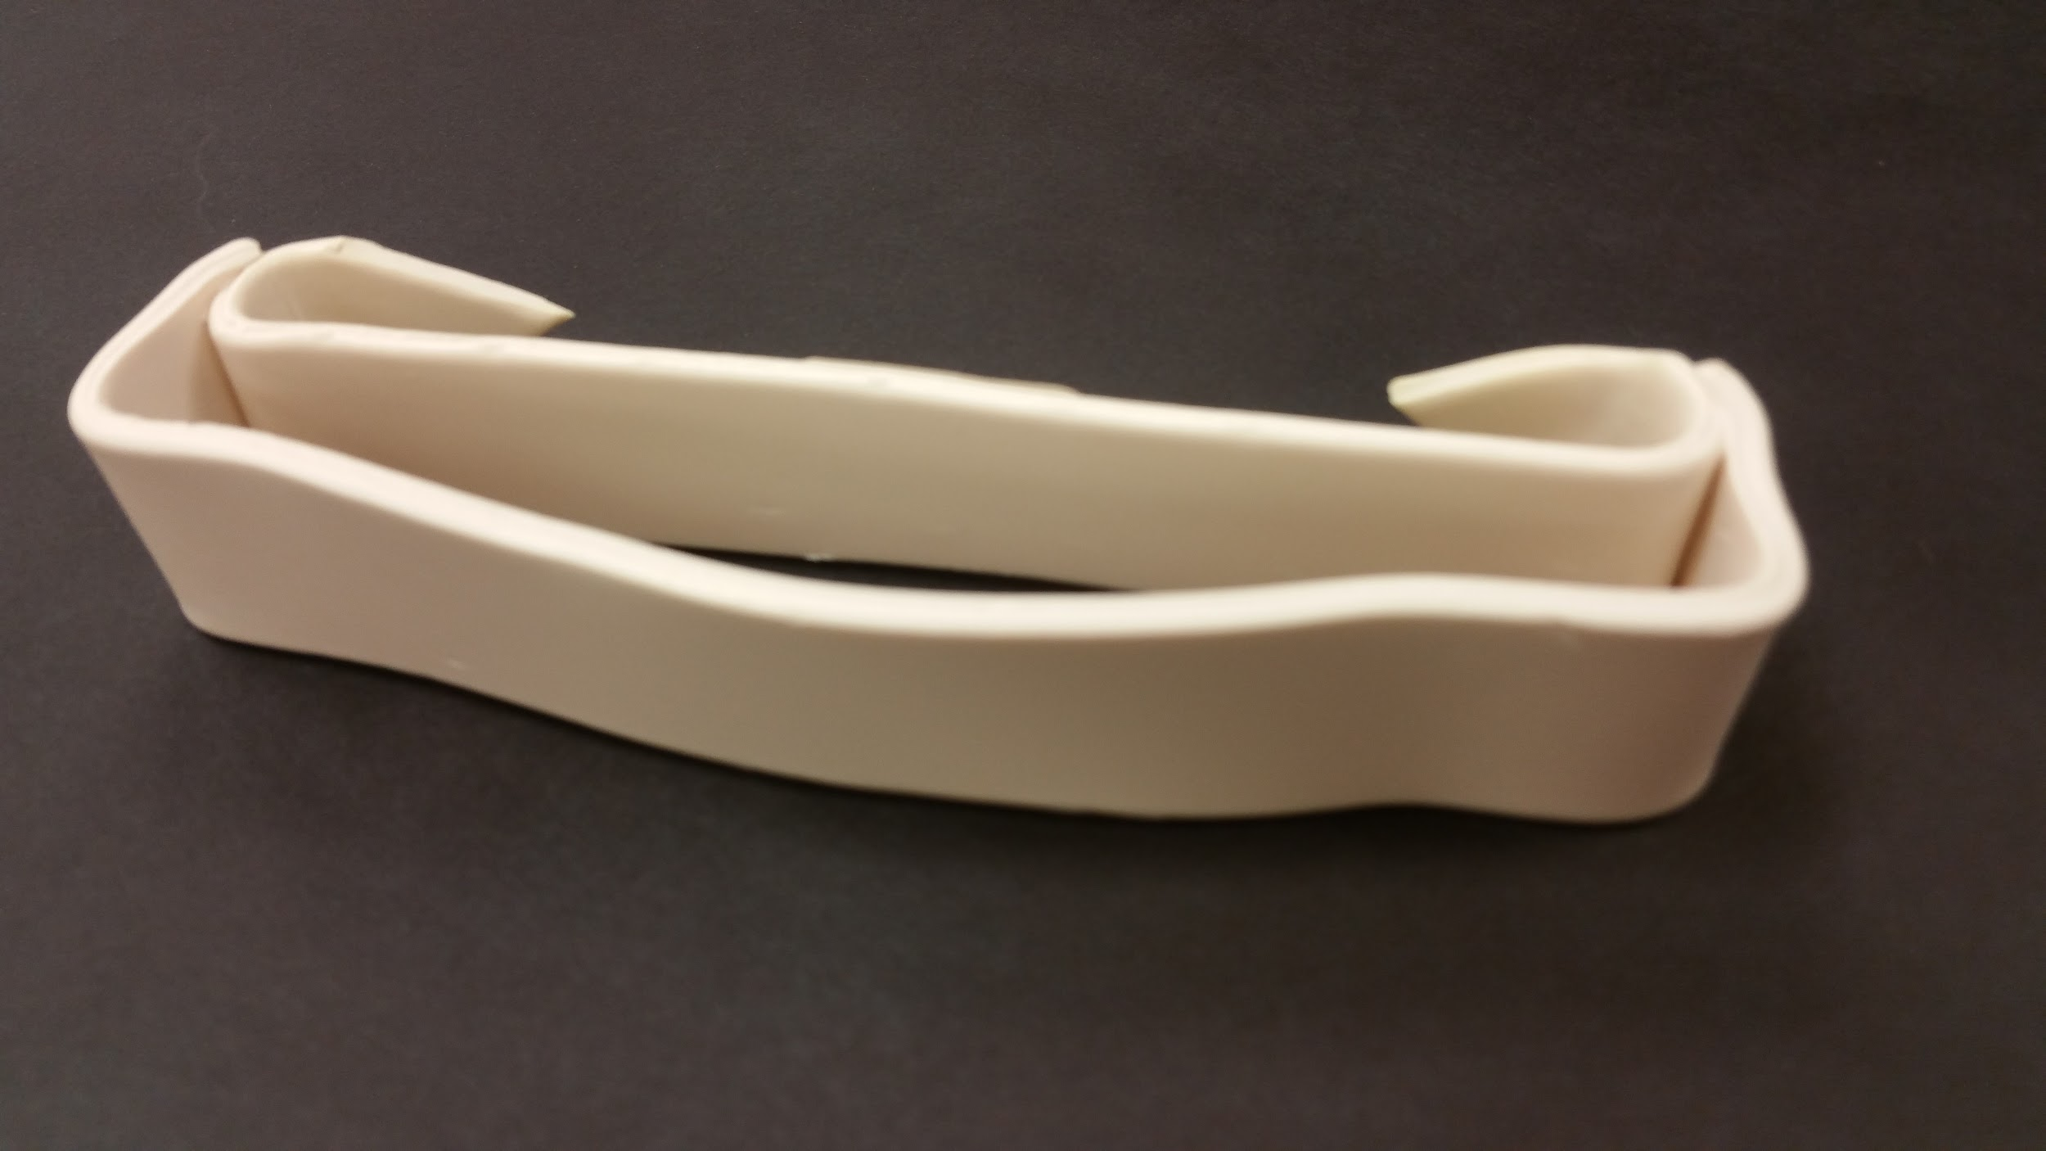
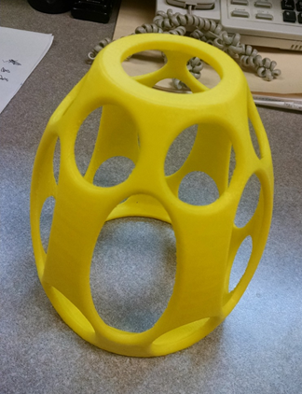
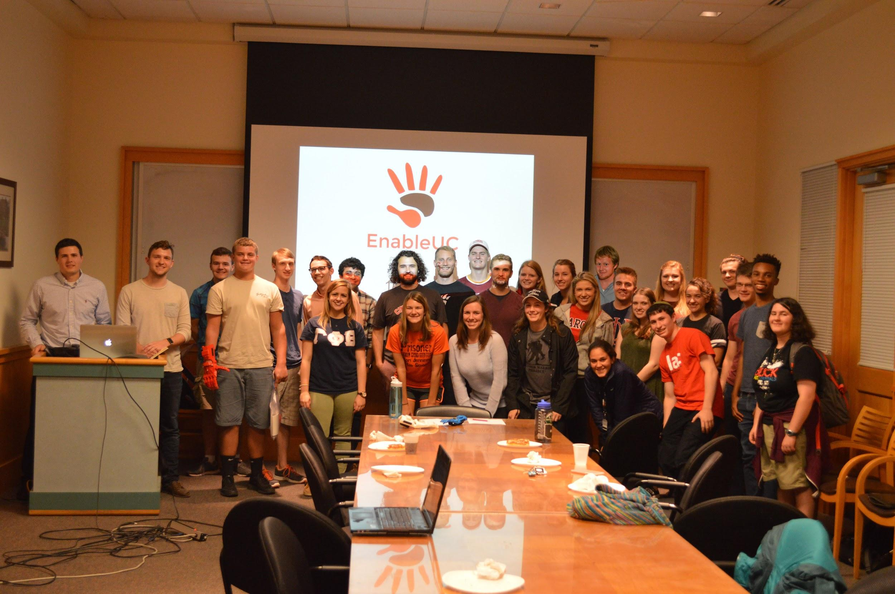
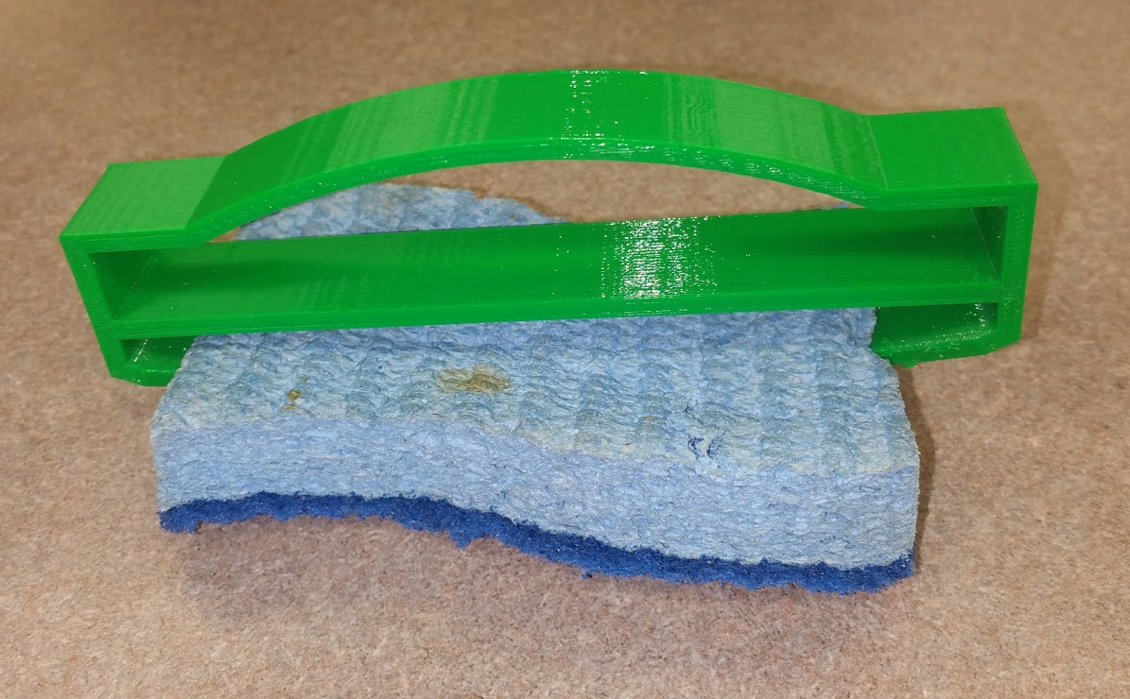
Challenges: File Design
Designing files is extremely difficult:
  Our partnership with eNable UC turned out to be crucial to the success of our project
Notes:
In the 2 day training….
We formed a parnership with enable Univ of Cin to convert the protype to a stl file.

Slide 14
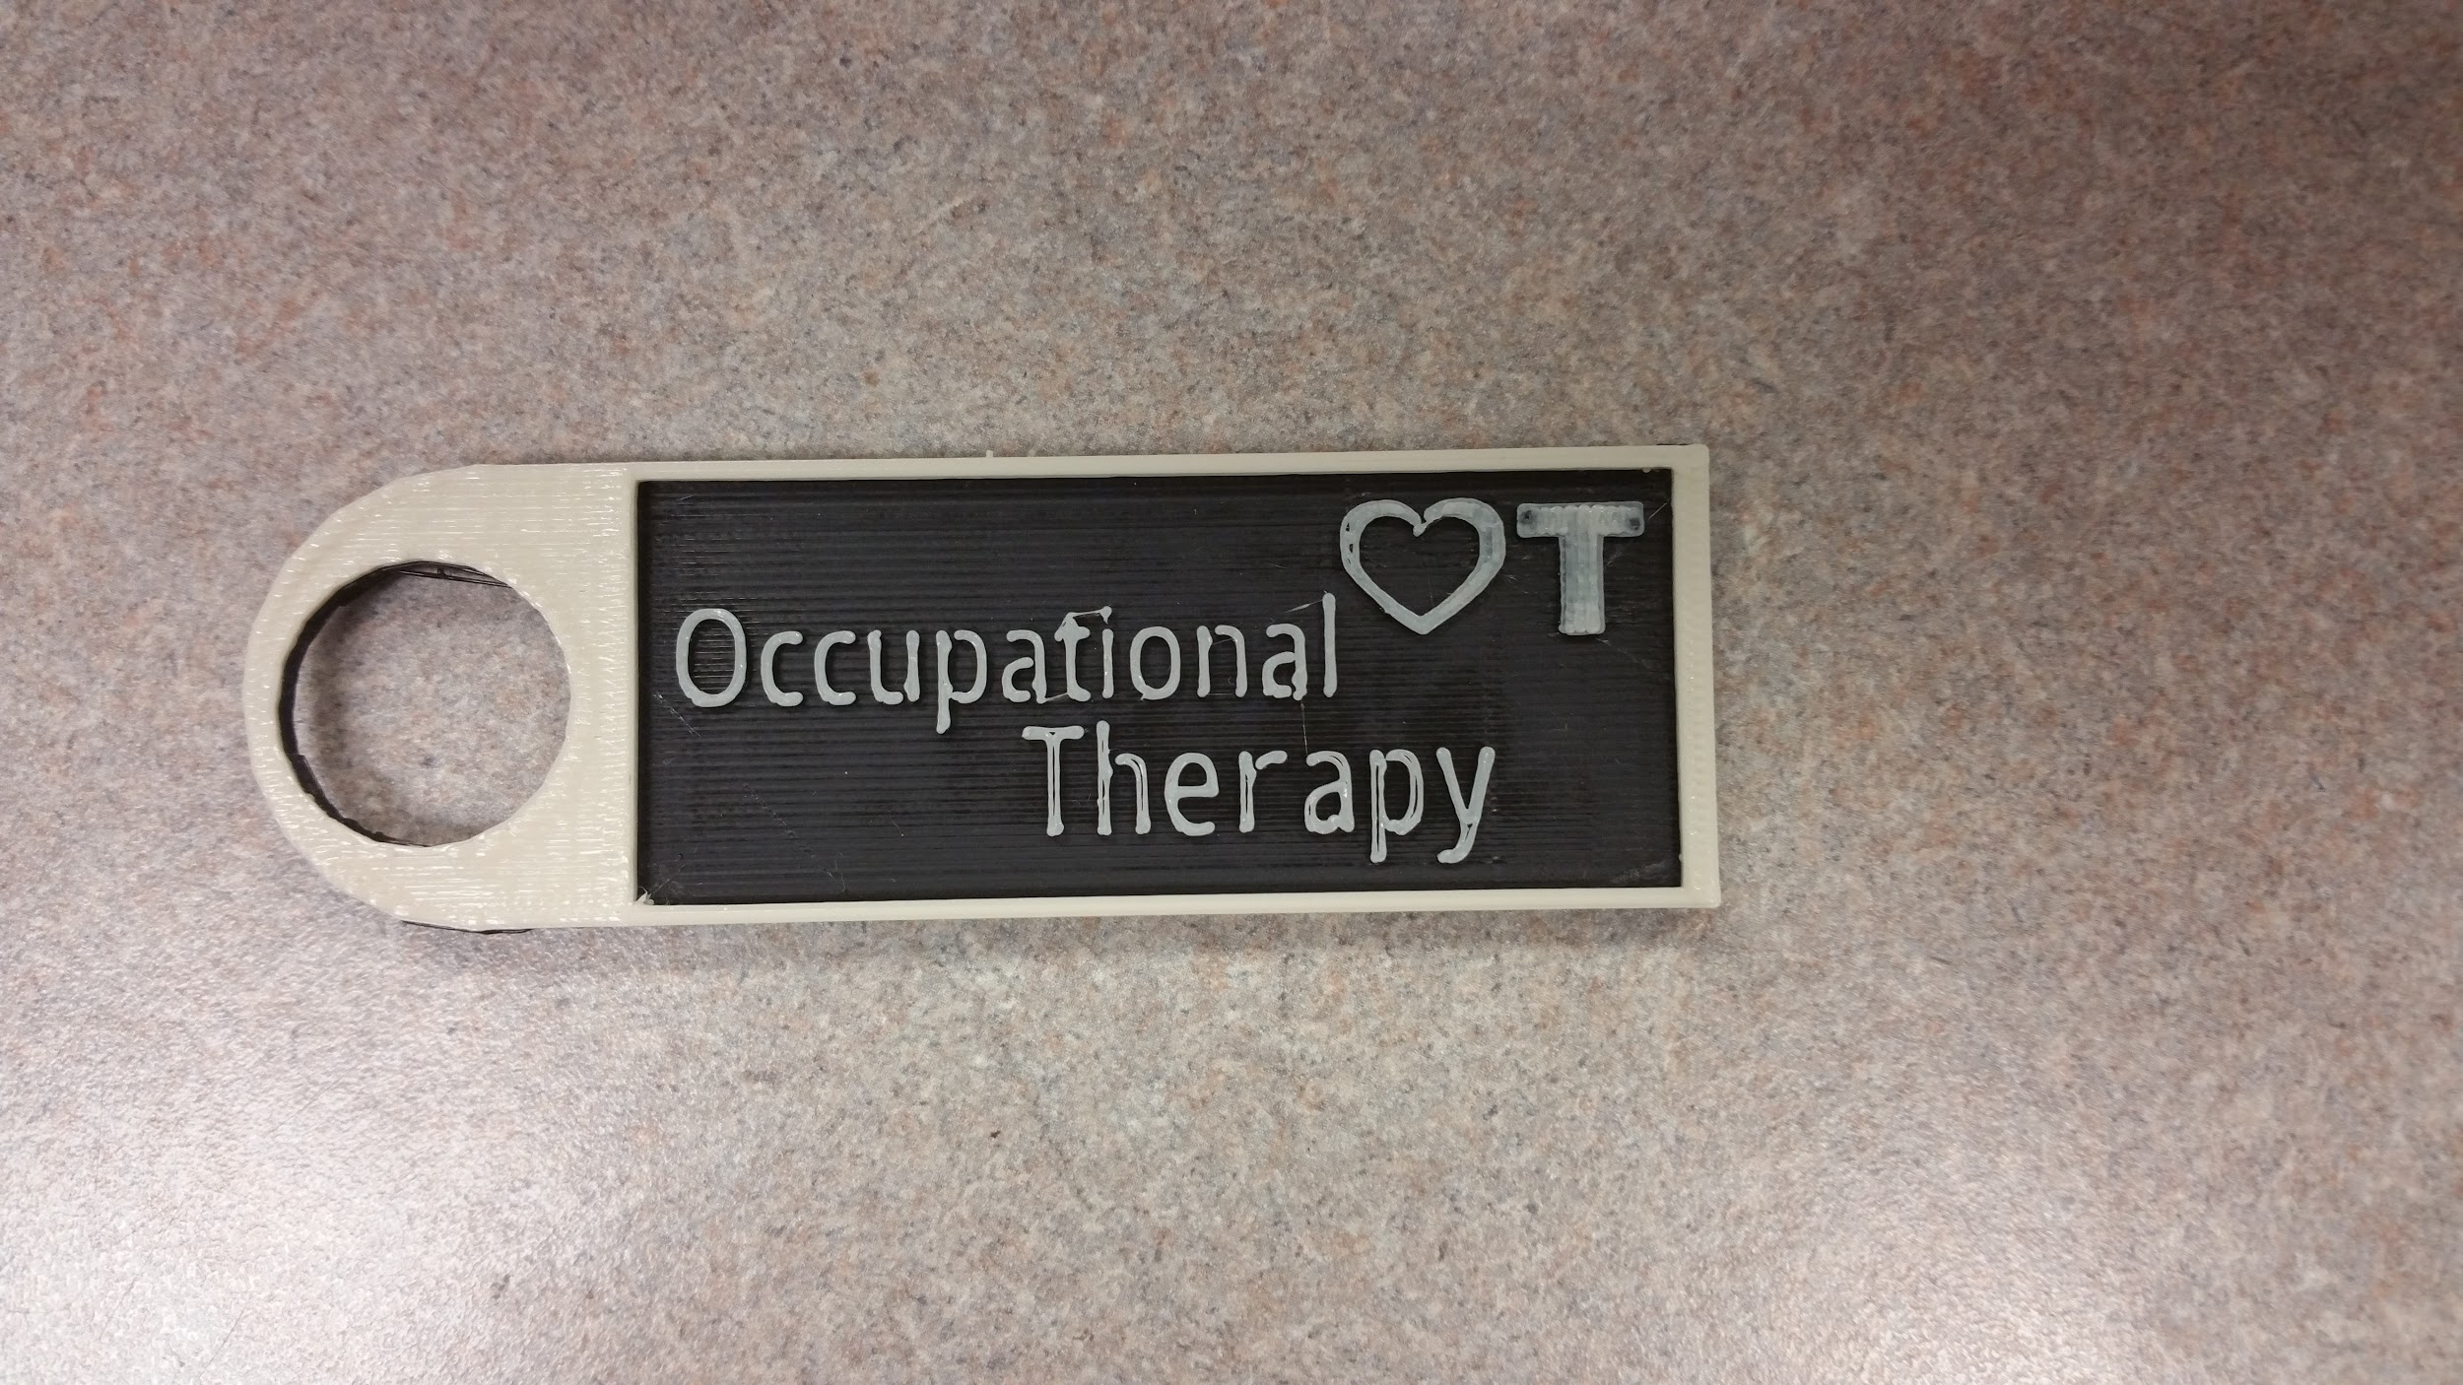
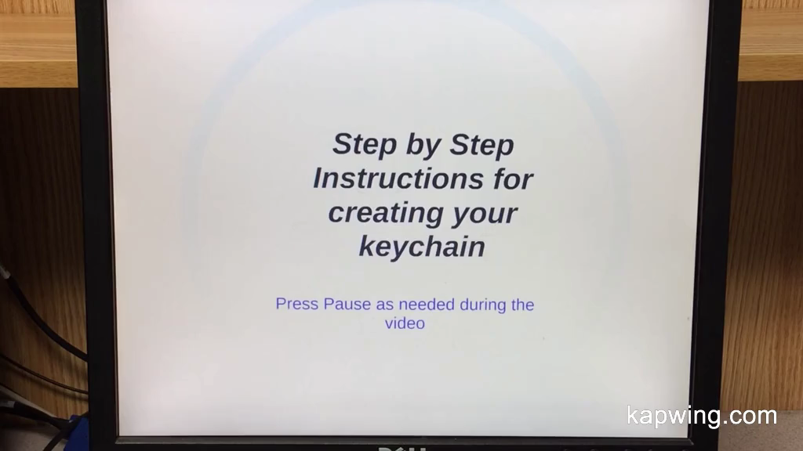
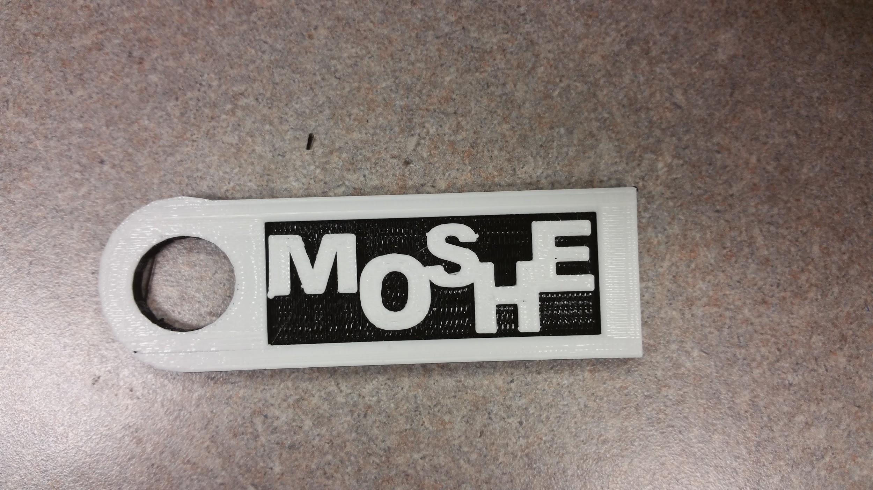
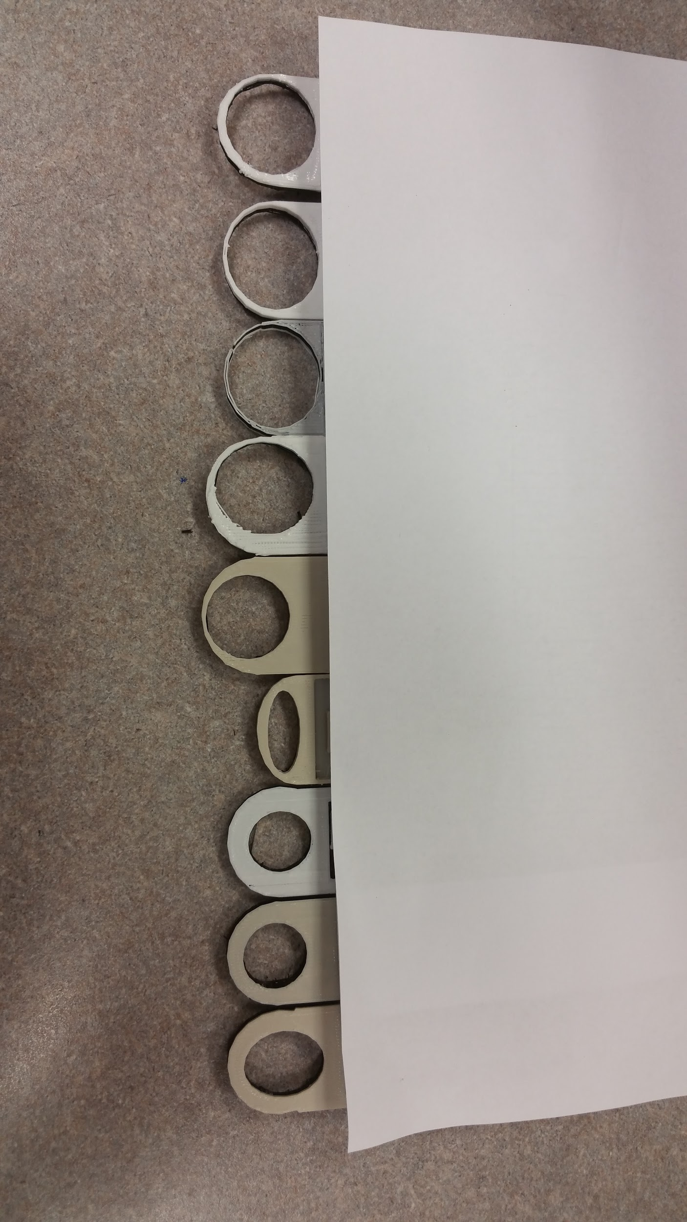
Challenges: Exploring 3D Design
Basic file creation
Notes:
Let me show you just a few minutes of a video we created ….

Slide 15
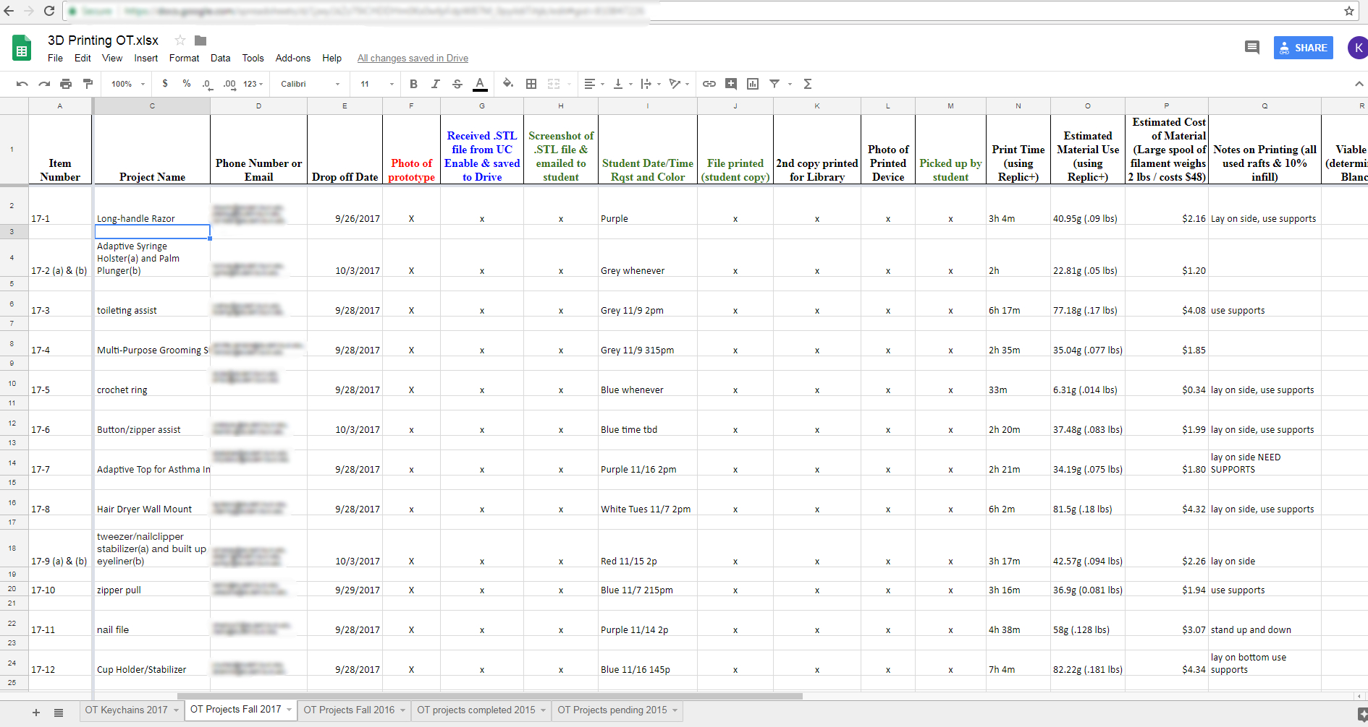
Challenges:
Organization
Interprofessional/Educational Communication
Notes:
Joan: Like we said, designing files is extremely hard. Even with the 2-day Makerbot training session, we realized the level of knowledge needed to design files for the types of objects our students were creating was beyond the realm of our knowledge. Bringing in Enable UC group addressed that but even they had difficulty with extremely detailed objects, like the PT orthotics..
To keep Communication current we started with an excel sheet that grew as we understood to keep all involved parties up to date with crucial to keep the project running on the necessary timeline. The Google Drive spreadsheet was used by the librarians, Blanche, and Enable UC in order to keep the most accurate data. This proved essential to keep the project running, especially across state borders and library shift changes.
OT proved to the be the most motivated partner - as you can see based on the success of their program. The IT department and PT department involvement fizzled out as more and more challenges arose.

Slide 16

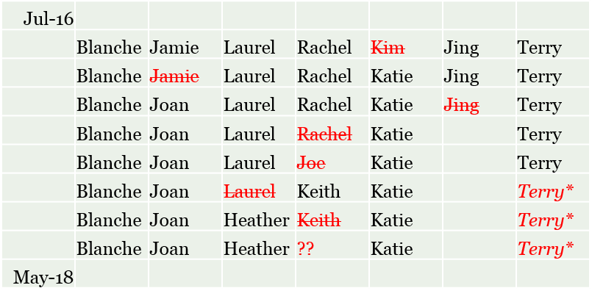
Challenges: Staff Turnover
Notes:
Joan
We have managed to keep moving foward despite the turnover rate. We went with new people came in they brought new ideas

Slide 17
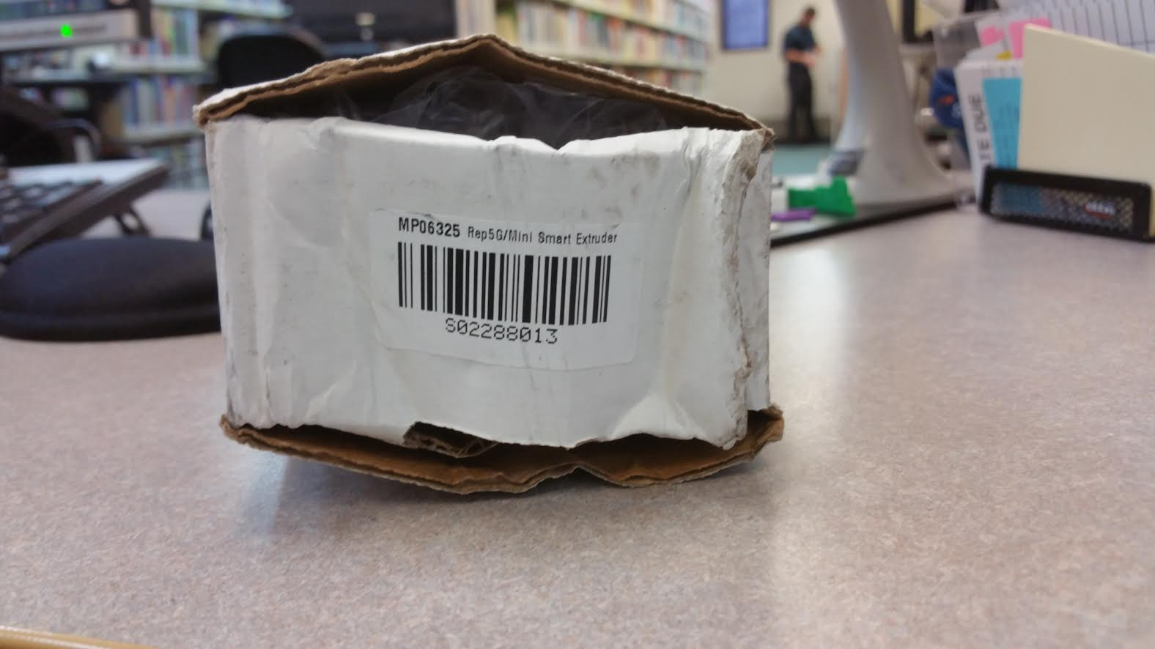
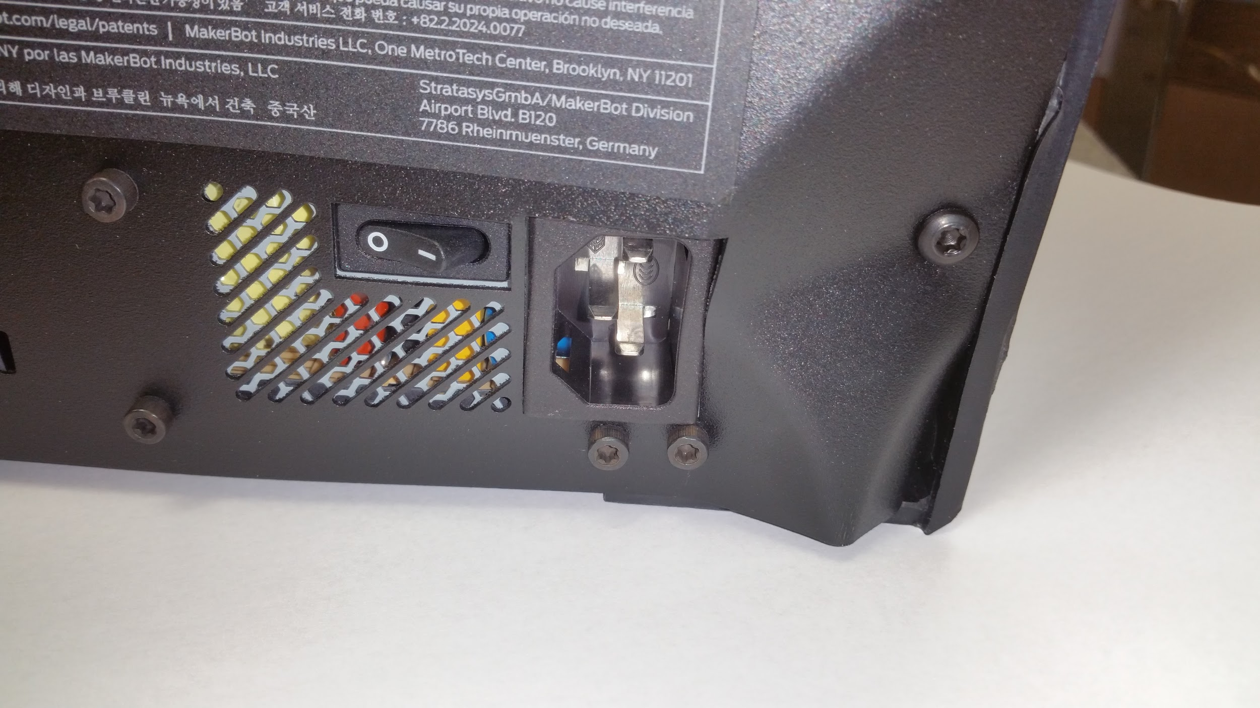
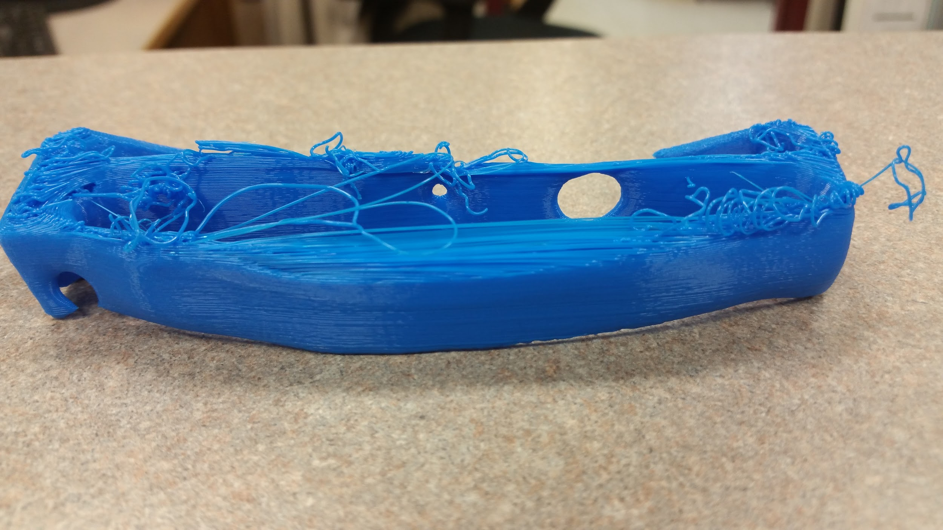
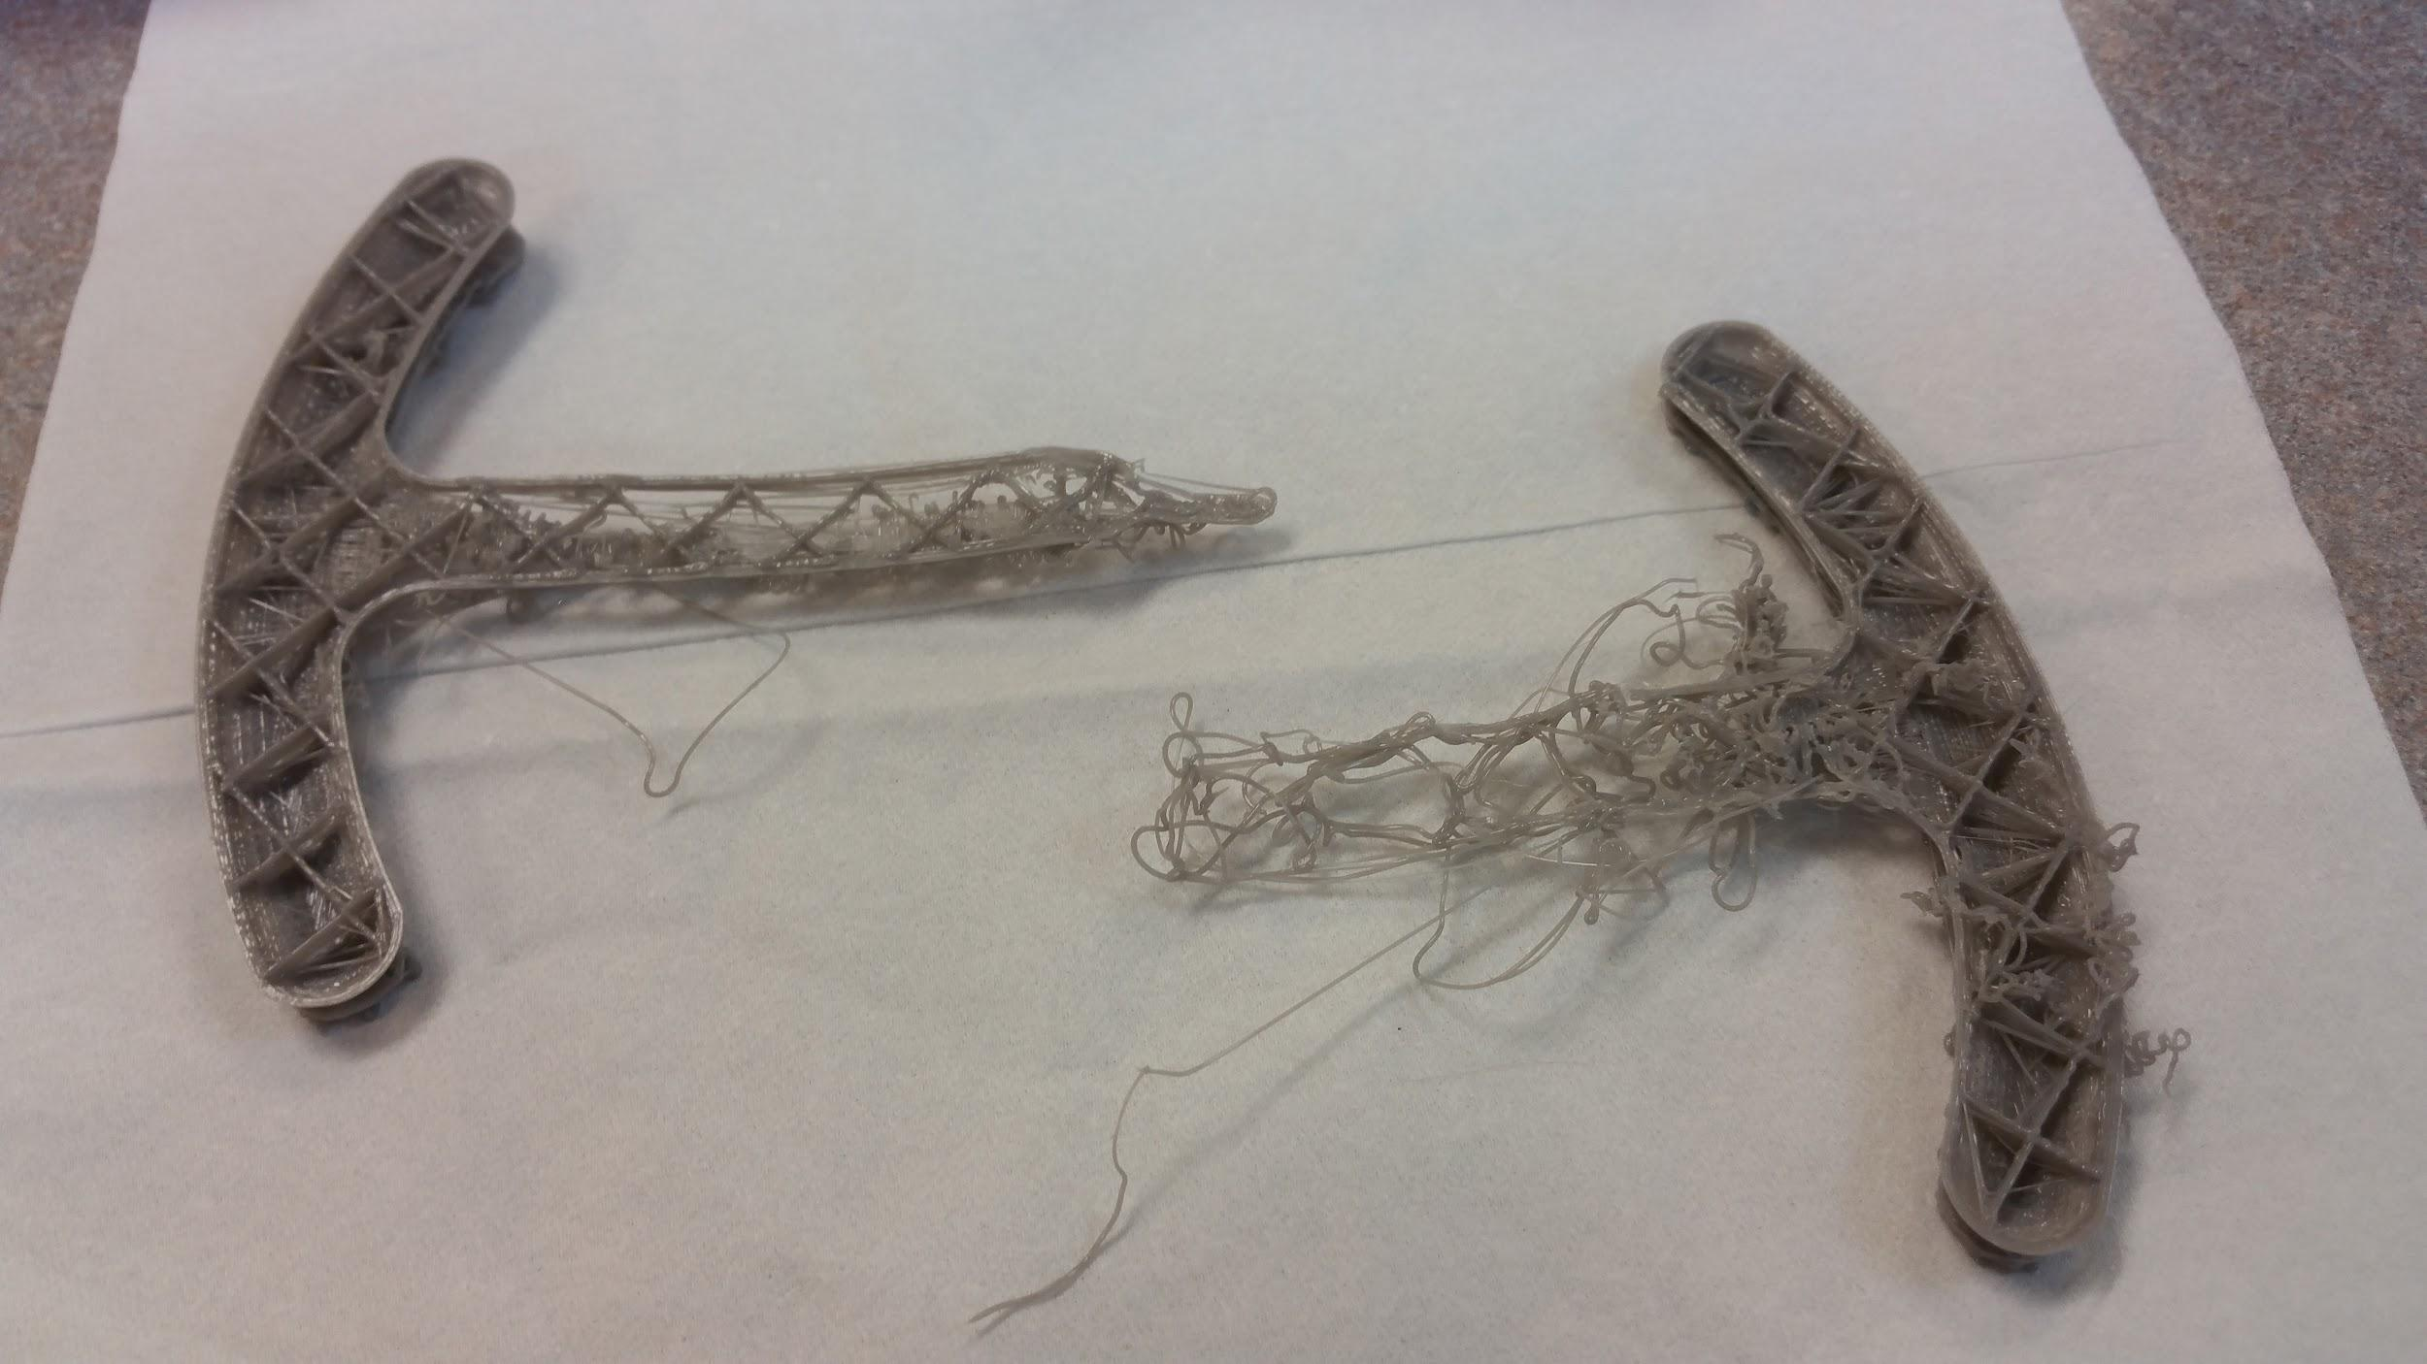
Challenges: Bloopers
Equipment failure & printer malfunctions
  Delivery problems
  Equipment replacement
Notes:
Joan: Each printer was sent back at least once due to technical problems. The extruders were replaced multiple times.
The equipment was mishandled prior to delivery.

Slide 18
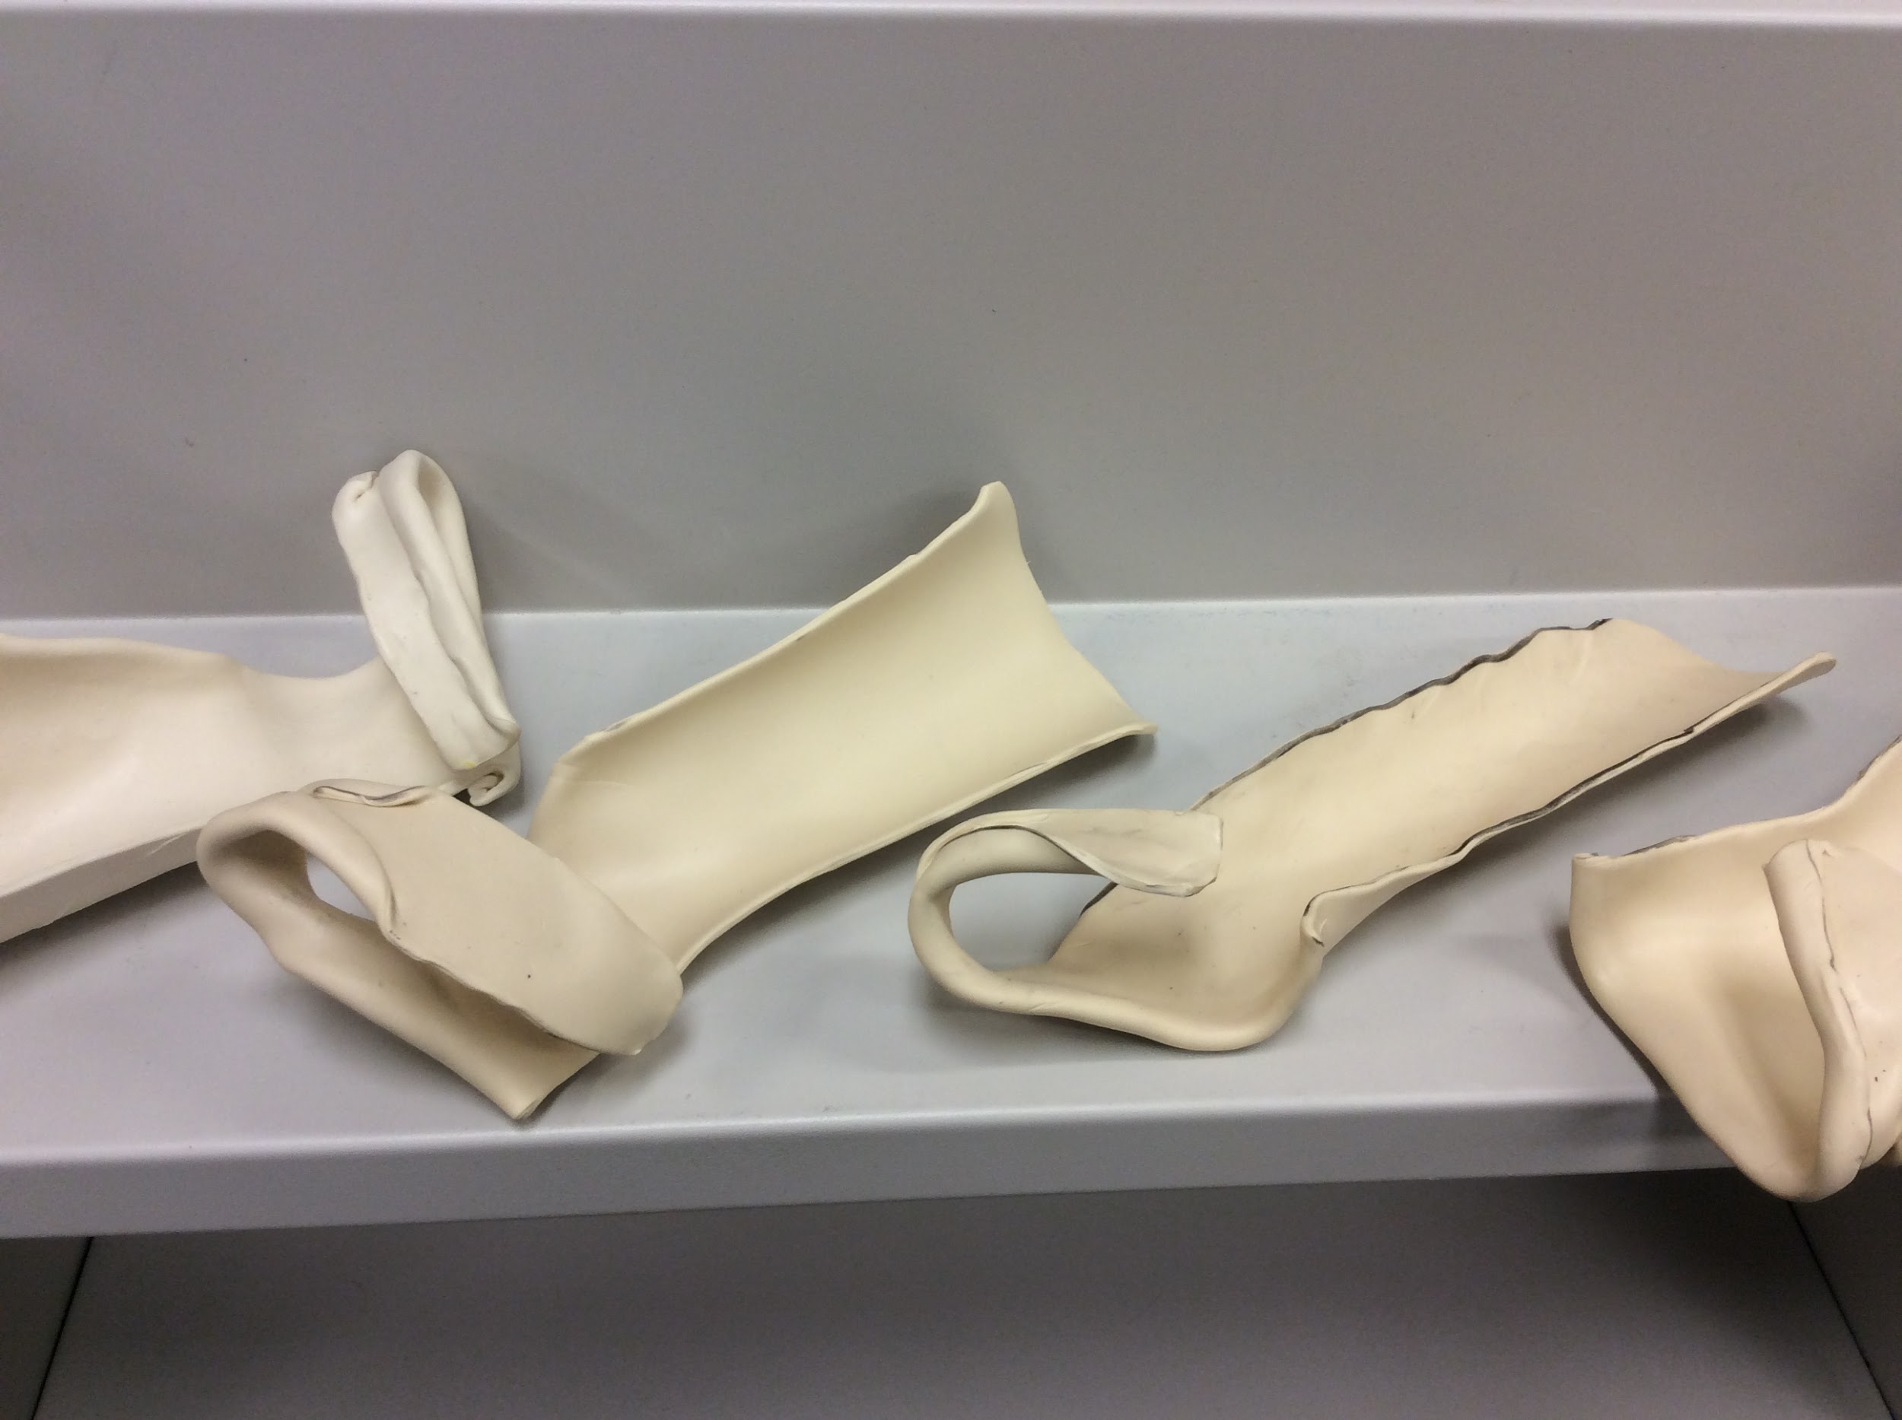
Challenges:
Physical Therapy Projects
Physical therapy projects (hand and foot orthotics) were unsuccessful
  Files were too difficult to create due to the curvature of the objects
Some partners are more motivated than others

Slide 19
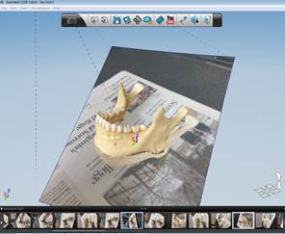
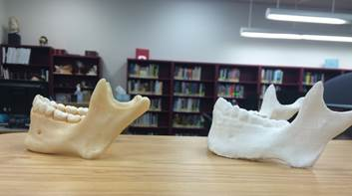
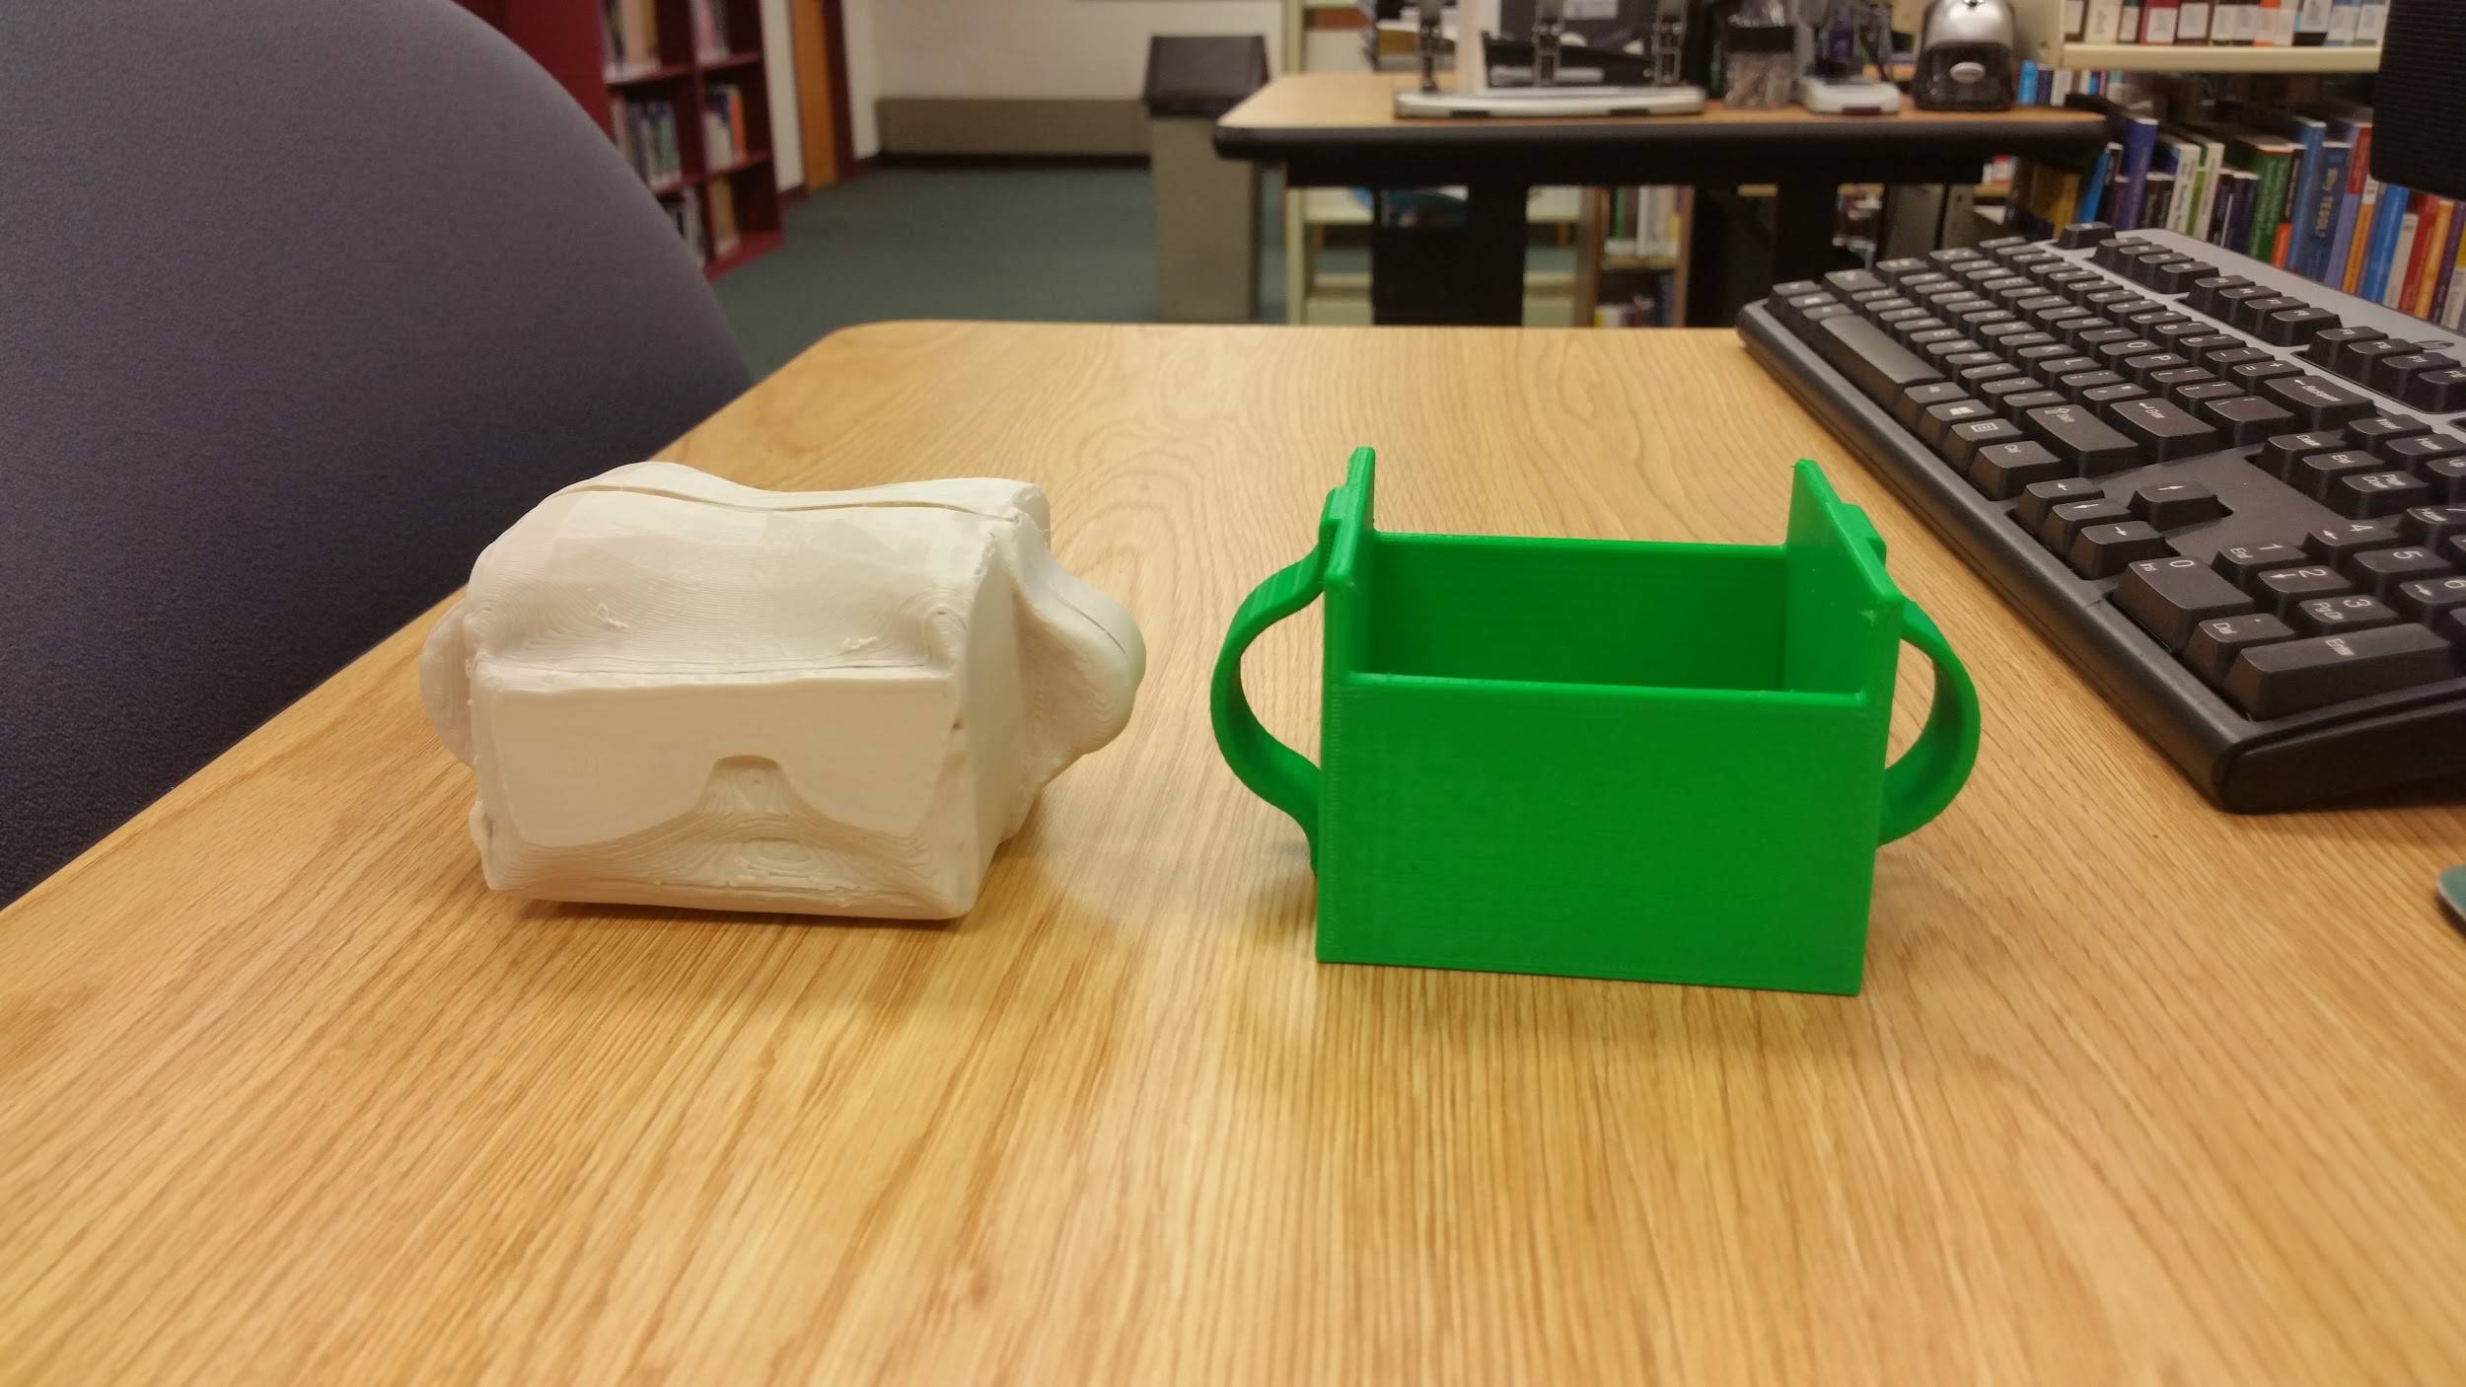
Challenges:
Scanning
MakerBot 3D scanner was unable to print successfully
Some success with iPad scanning
Notes:
3D scanner was unable to print for several reasons: glare from the splinting material, poor lighting in the library, and inability of the scanner to recognize depth perception

Slide 20
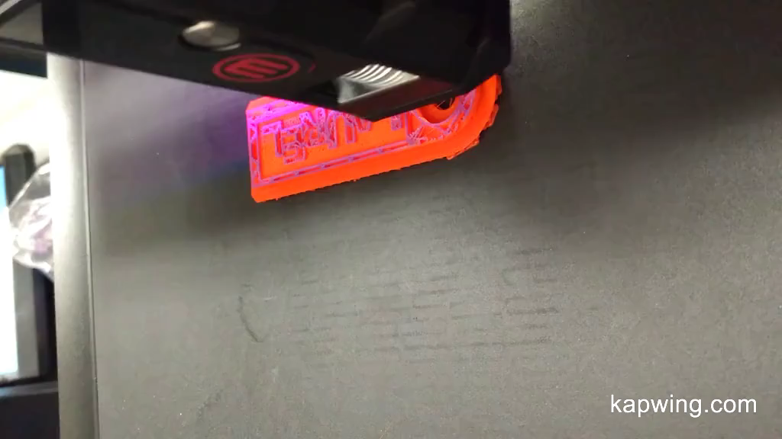
Challenges:
3D printers are noisy!
Too many projects, project mix-ups, size restrictions
New questions coming up now - Copyright? Patents? Liability? We will have to deal with these eventually
Notes:
Joan Because of the noise we have had to work around if it bothers a student
We had two surveys and didn’t measure what we expected
When each student had own it was too many and lost Also had to reduce size to have less print time
We are realizing we need to be more on top of what we are printing and copyright

Slide 21
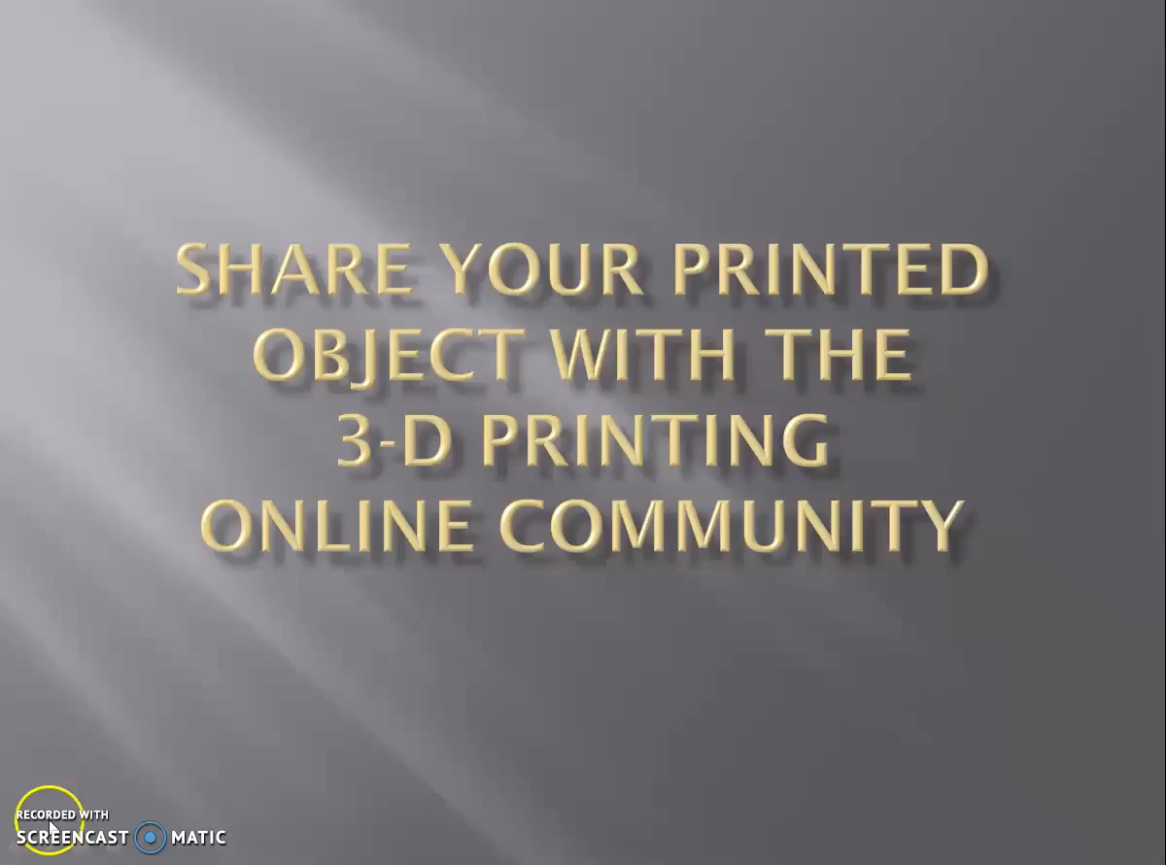
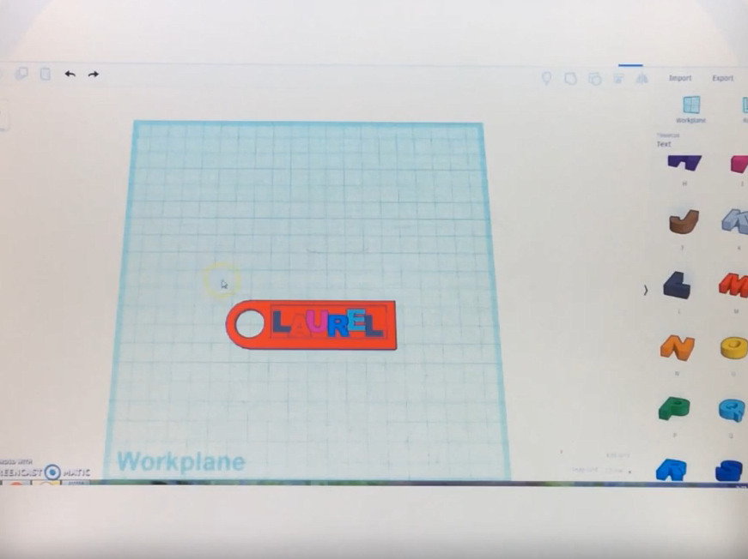
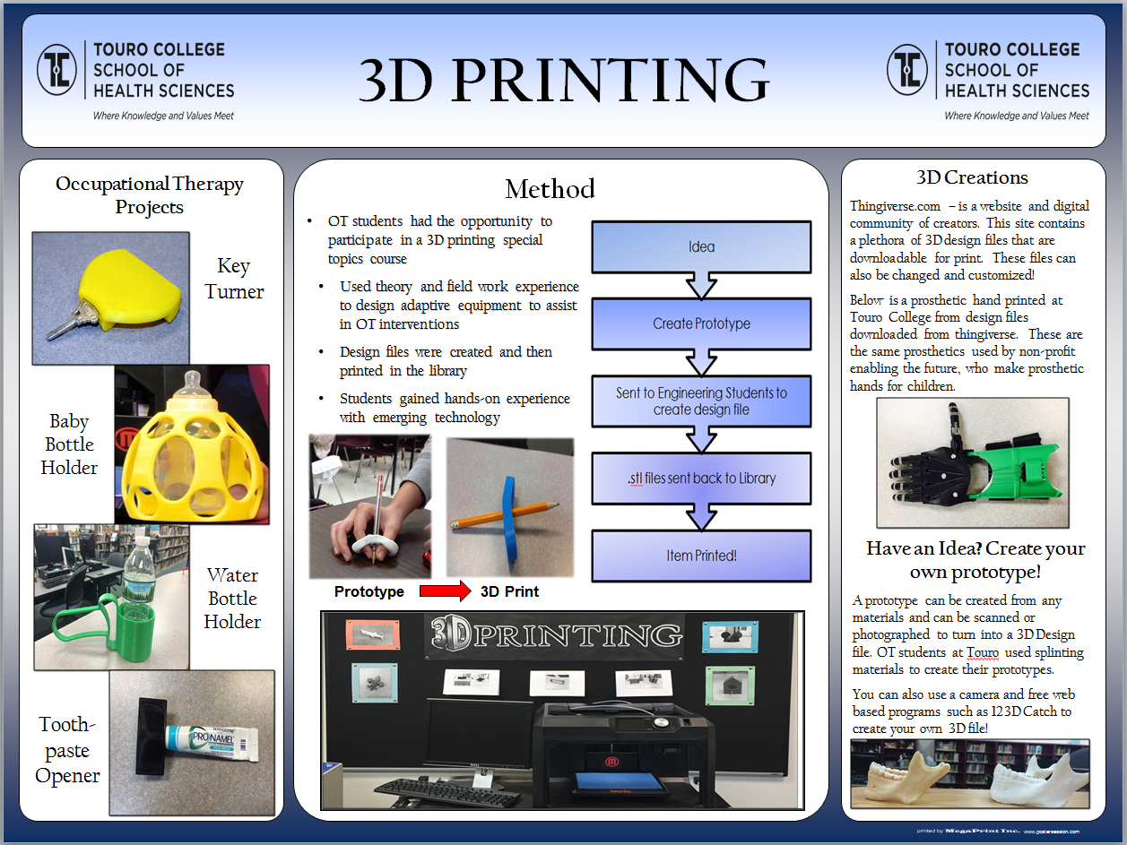
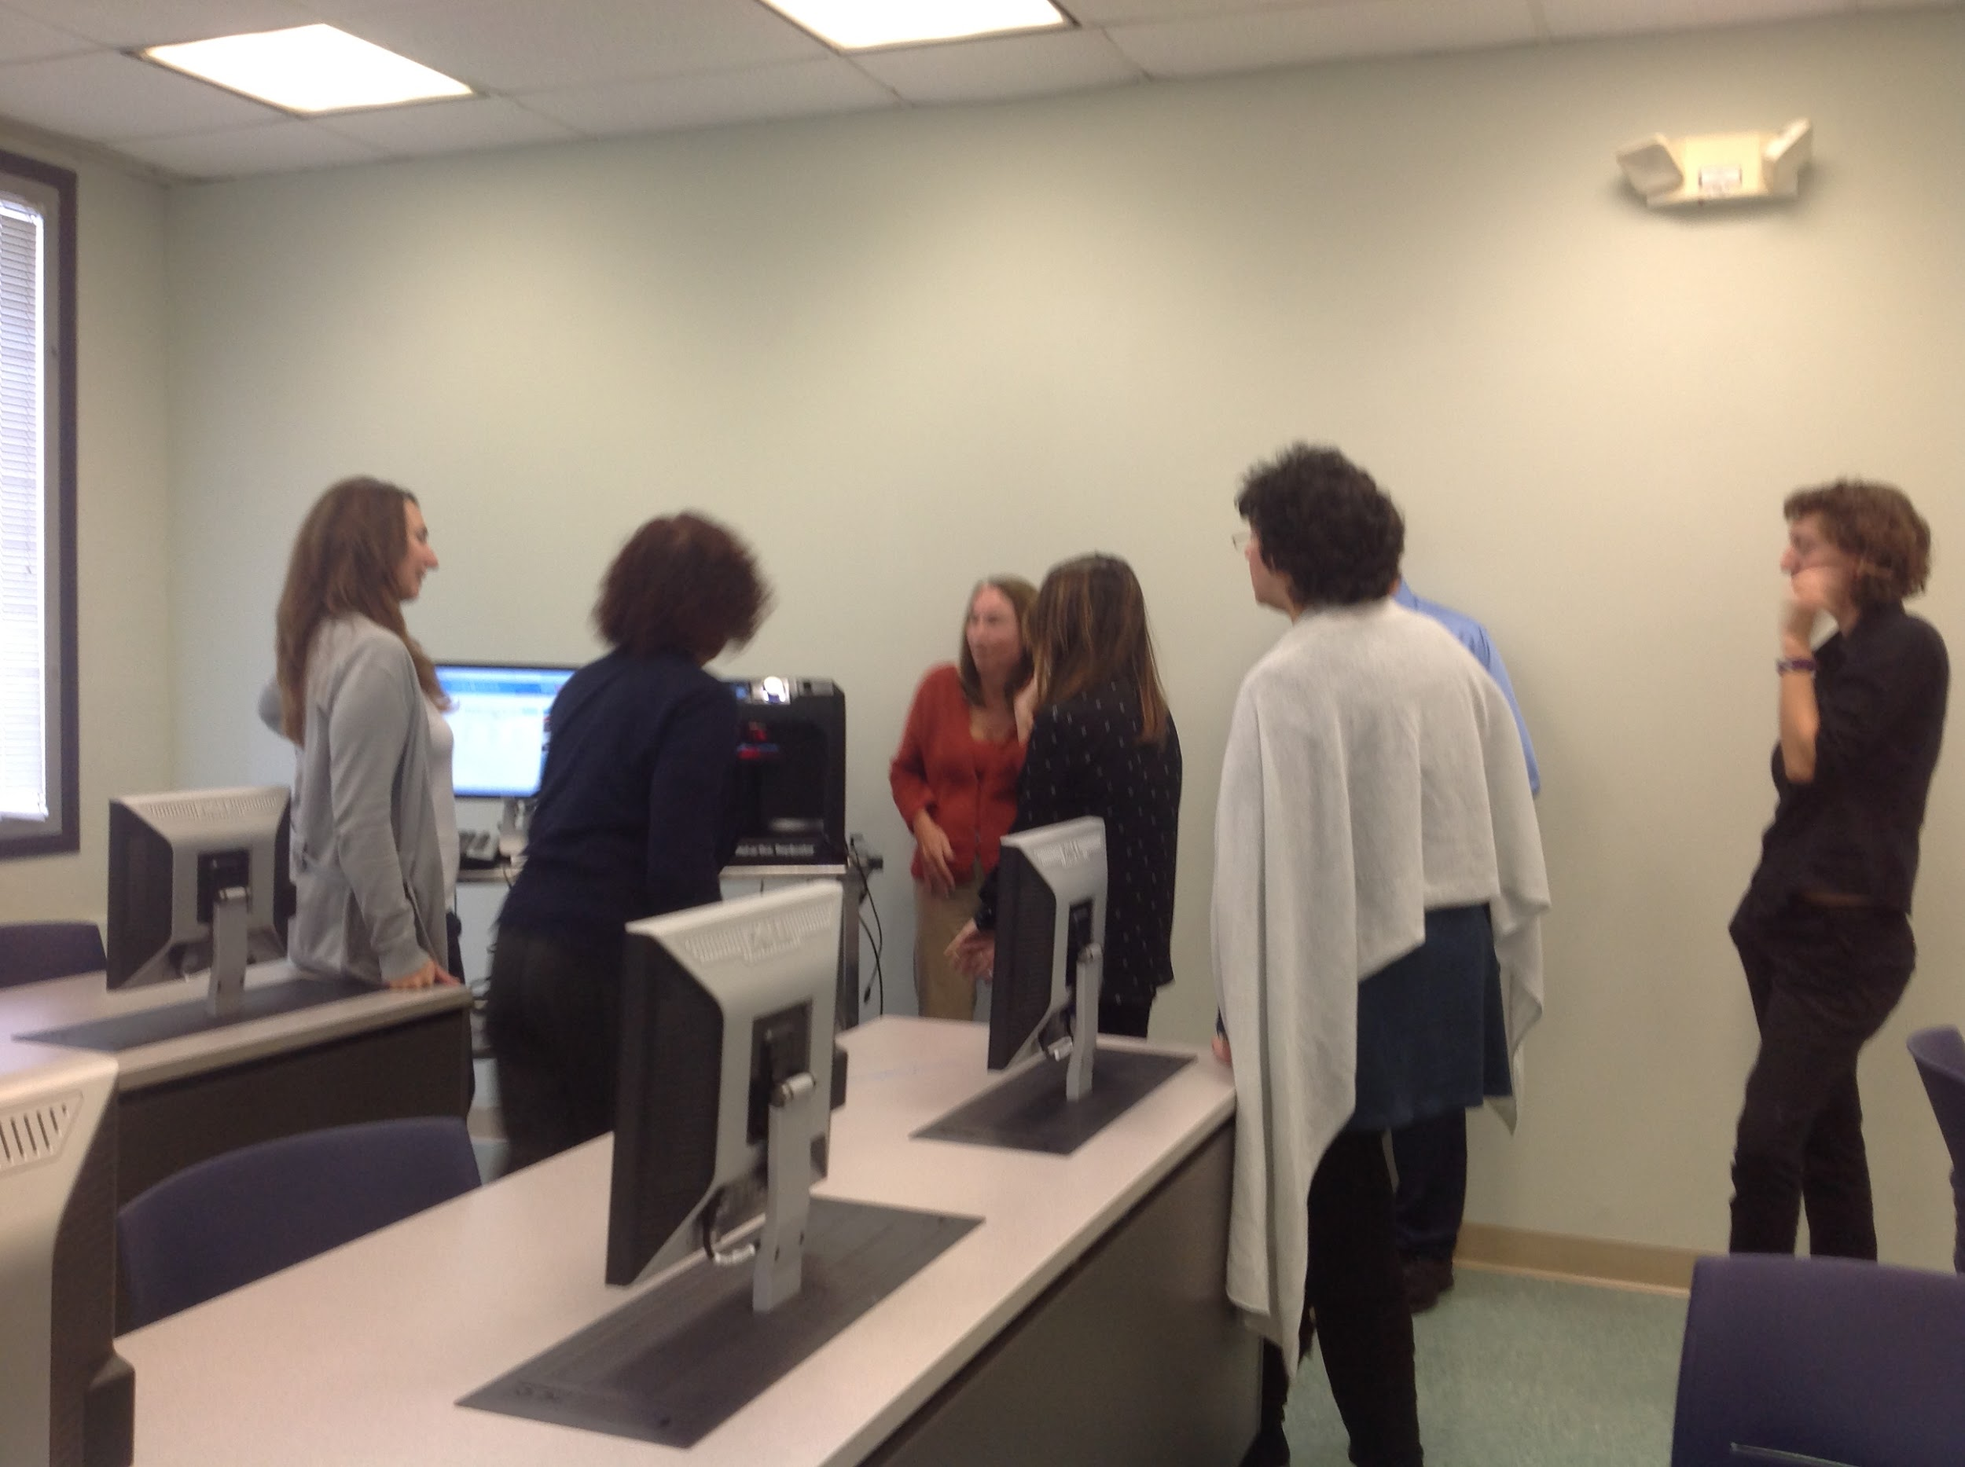
Benefits & Successes:
Skills
Growth of staff knowledge/new skills for librarians:
  Operation of 3D printers
  Basic .stl file creation with Tinkercad
  3D scanning (with MakerBot scanner & iPad scanning)
  Makerfaire
  Video tutorials and voicethreads
Notes:
Joan: Since the project’s inception, librarians have learned how to operate the 3D printers as well as create simple .STL files using Tinkercad. We’ve also experimented with new technologies and applications such as iPad scanning to create 3D printed objects. This lead to video tutorials and voicethreads

Slide 22
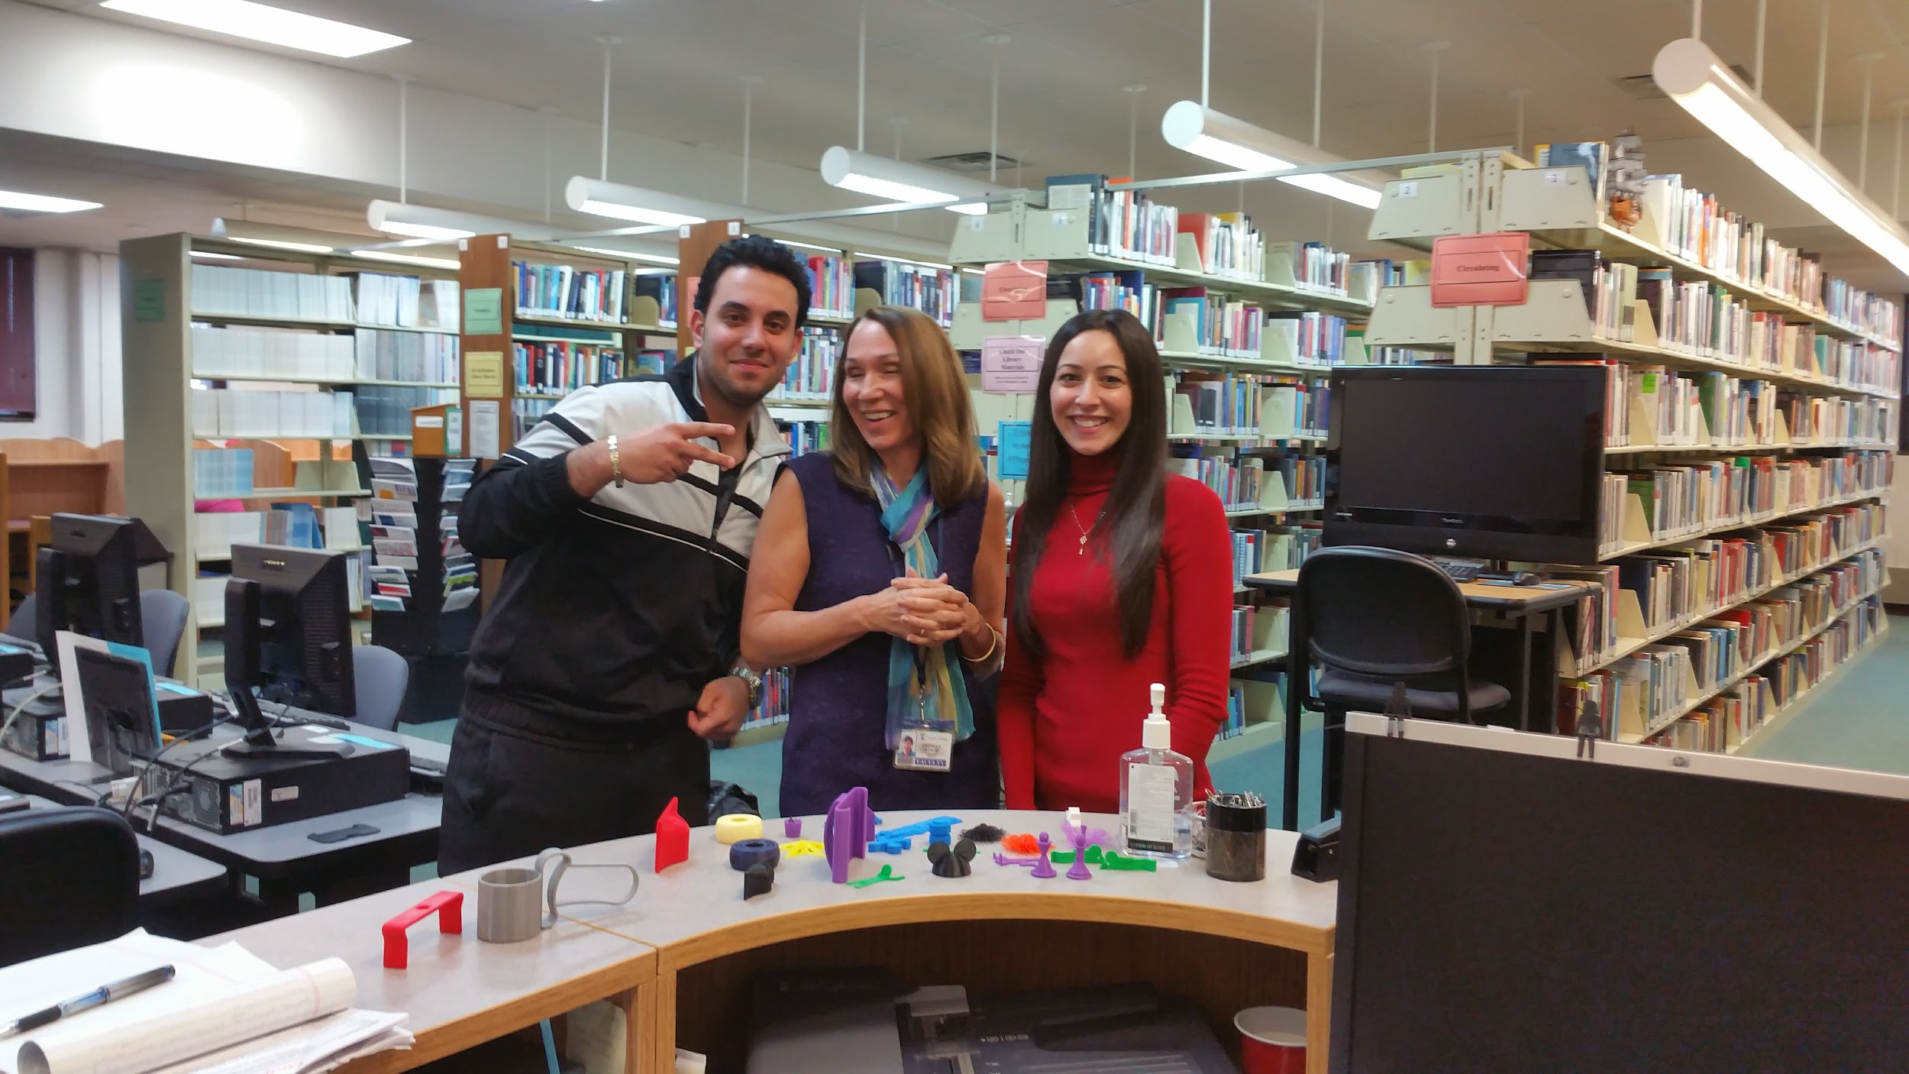
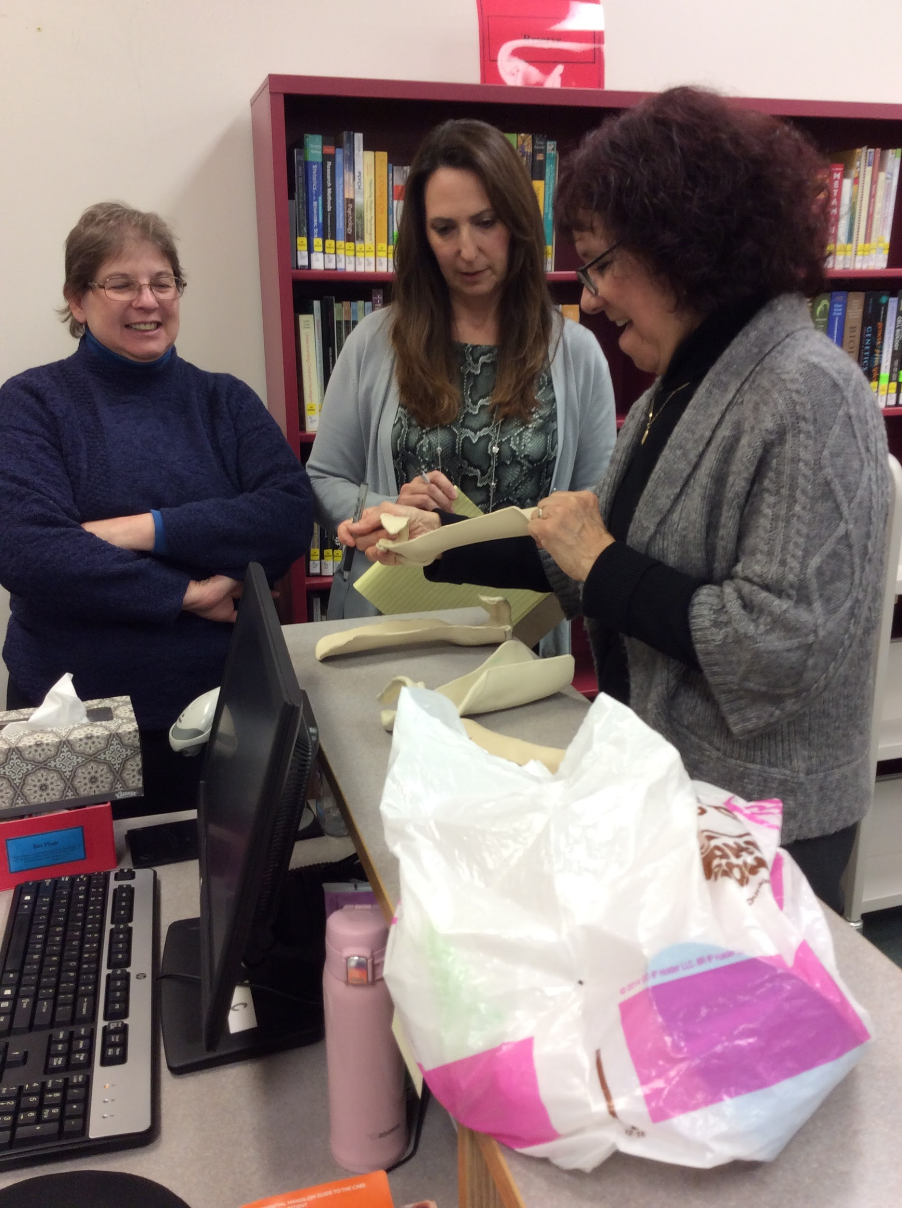
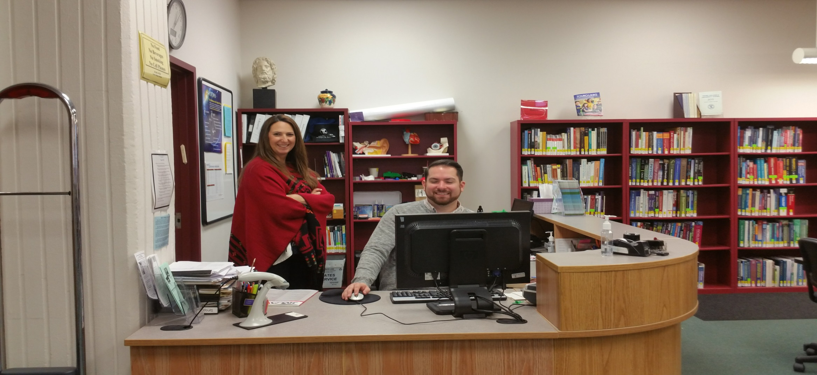
Benefits & Successes:
Communication
Collaboration among students, staff members, departments, and other institutions
Notes:
Joan
For the project to work we had to communicate among the groups involved

Slide 23
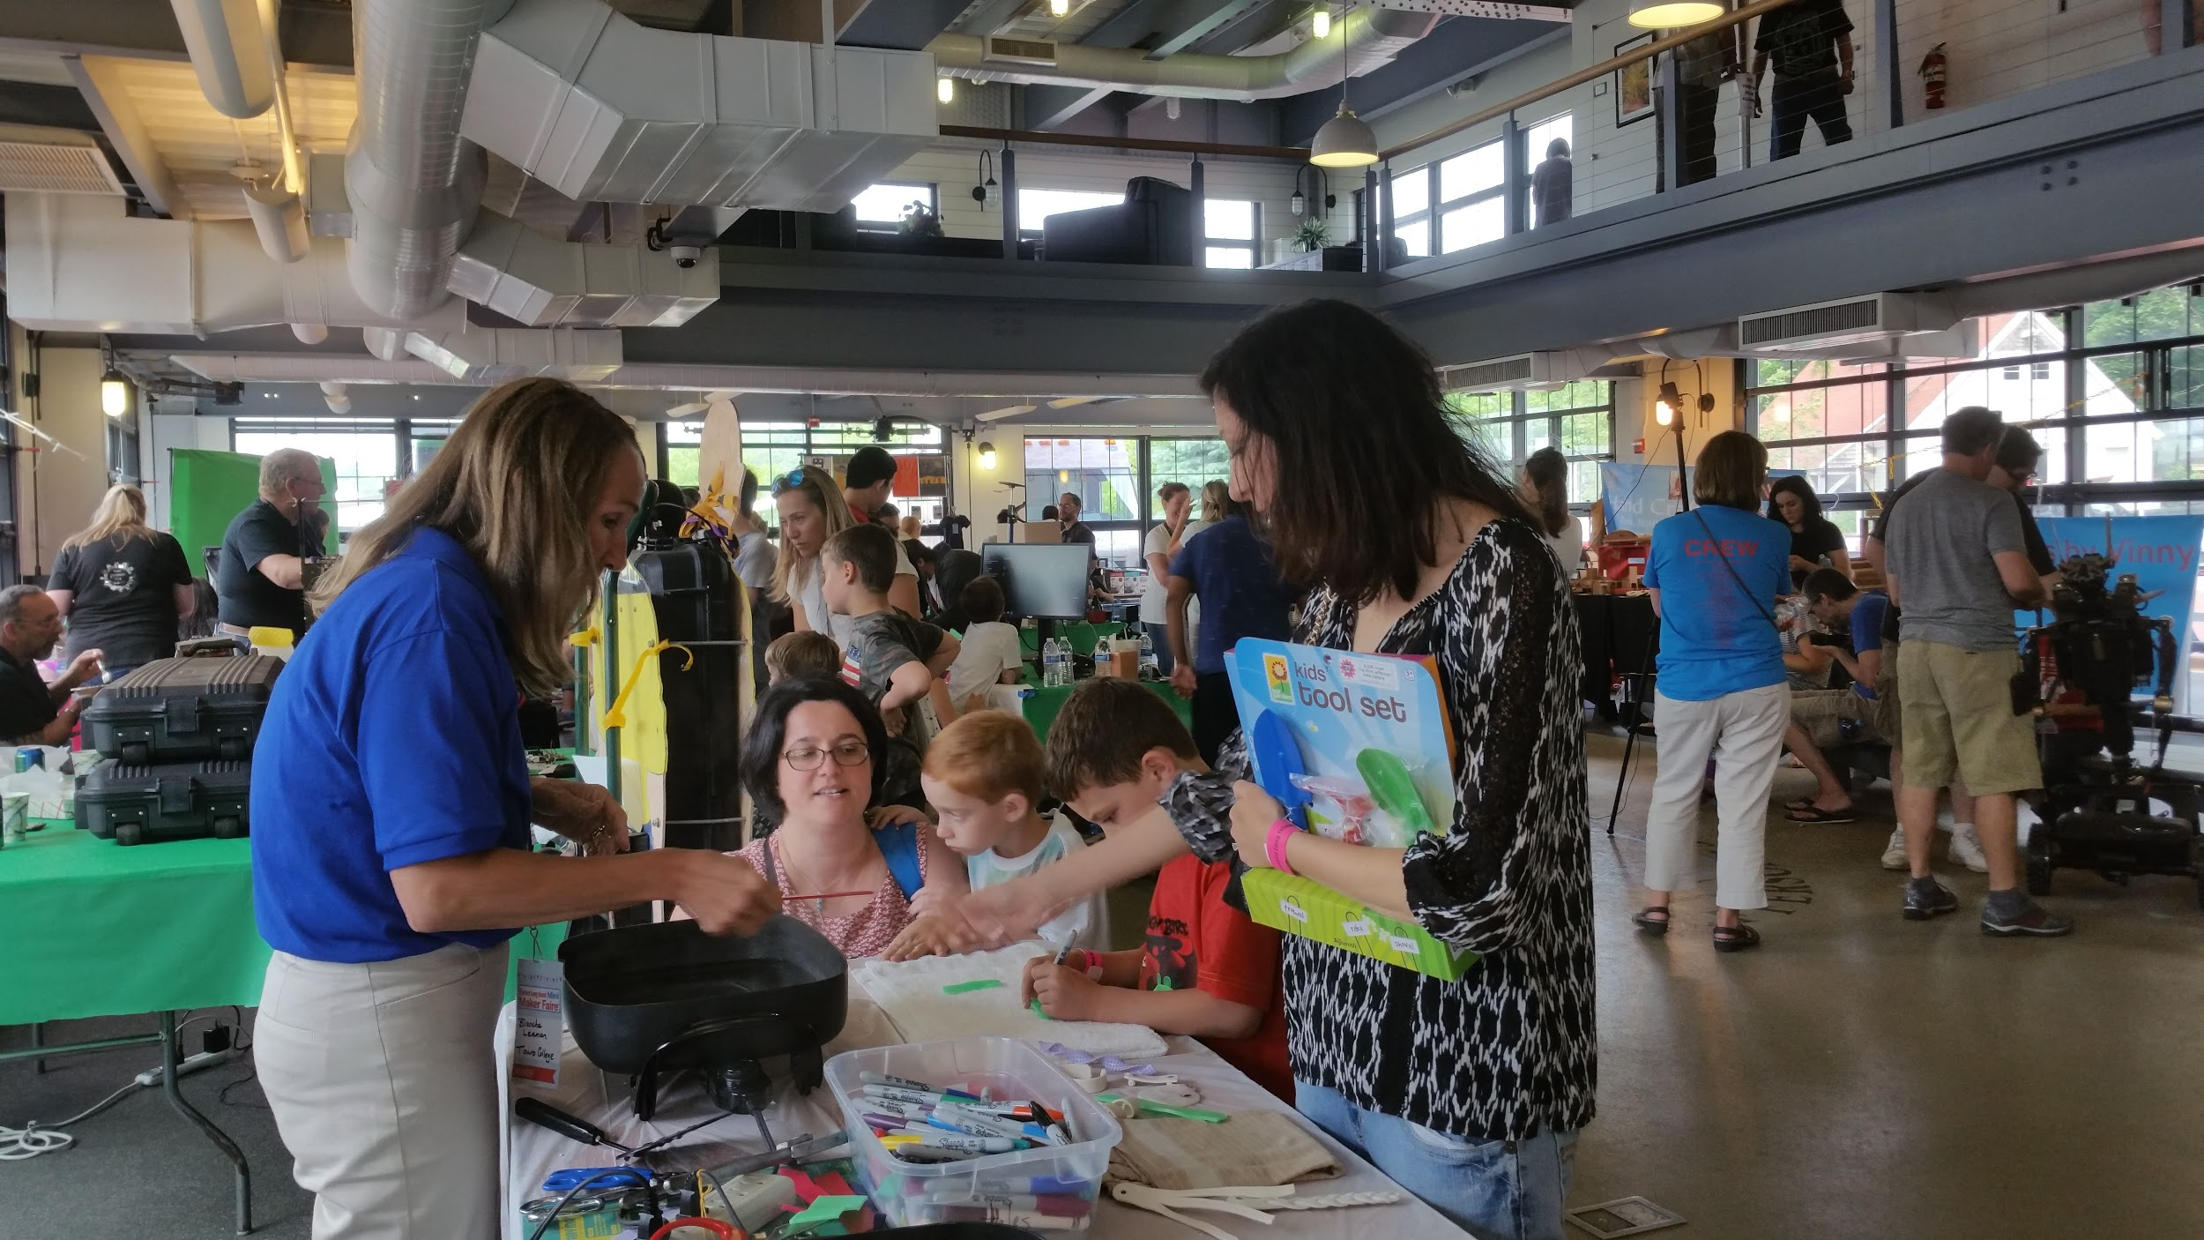
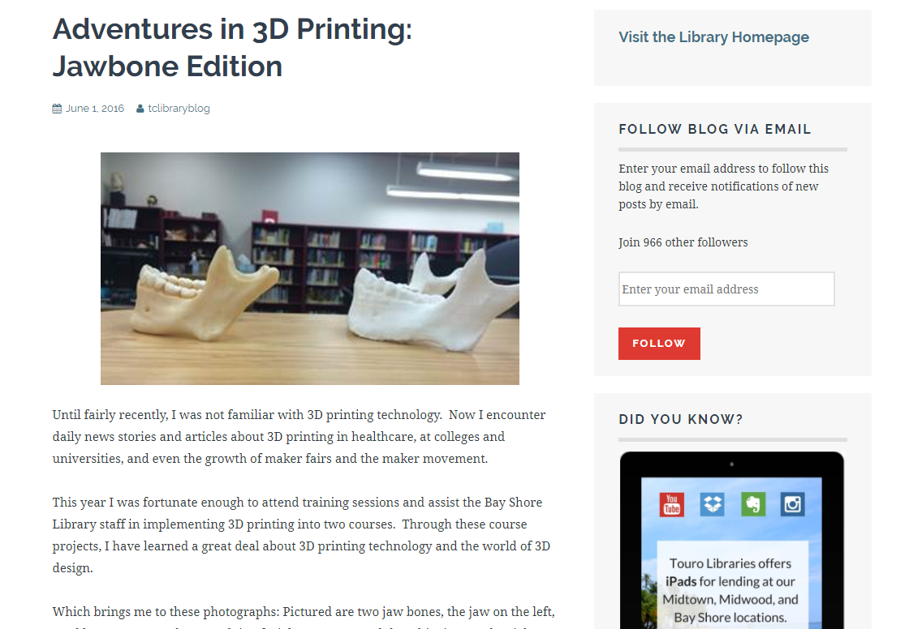
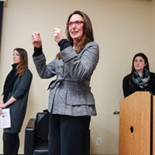
Benefits & Successes:
Sharing
Presentations at staff meetings
Local MakerFaire
Social media presence (FaceBook, Instagram,
Twitter, Library blog)
Scholarly article

Slide 24
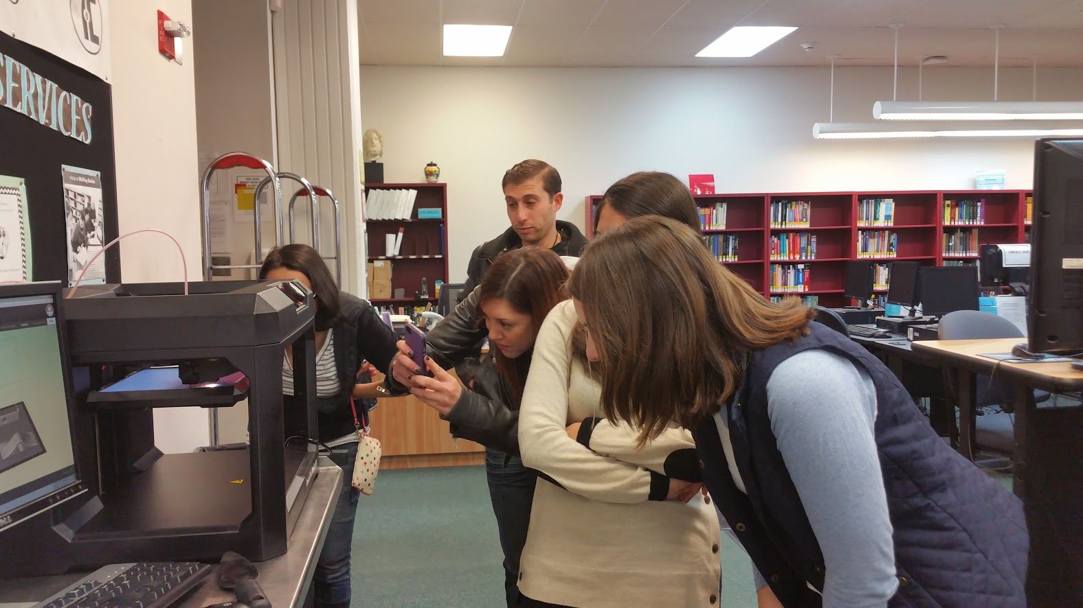
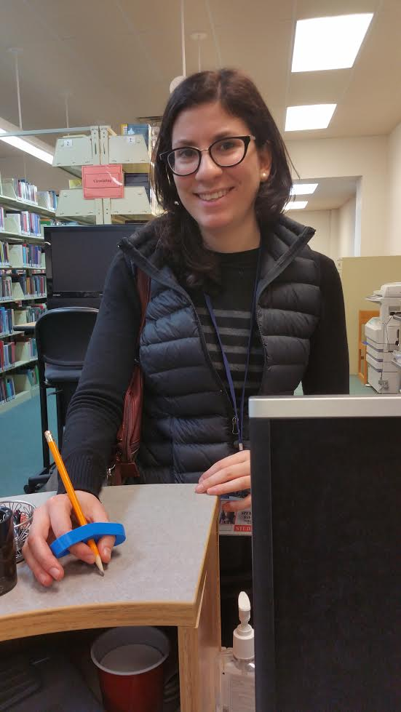
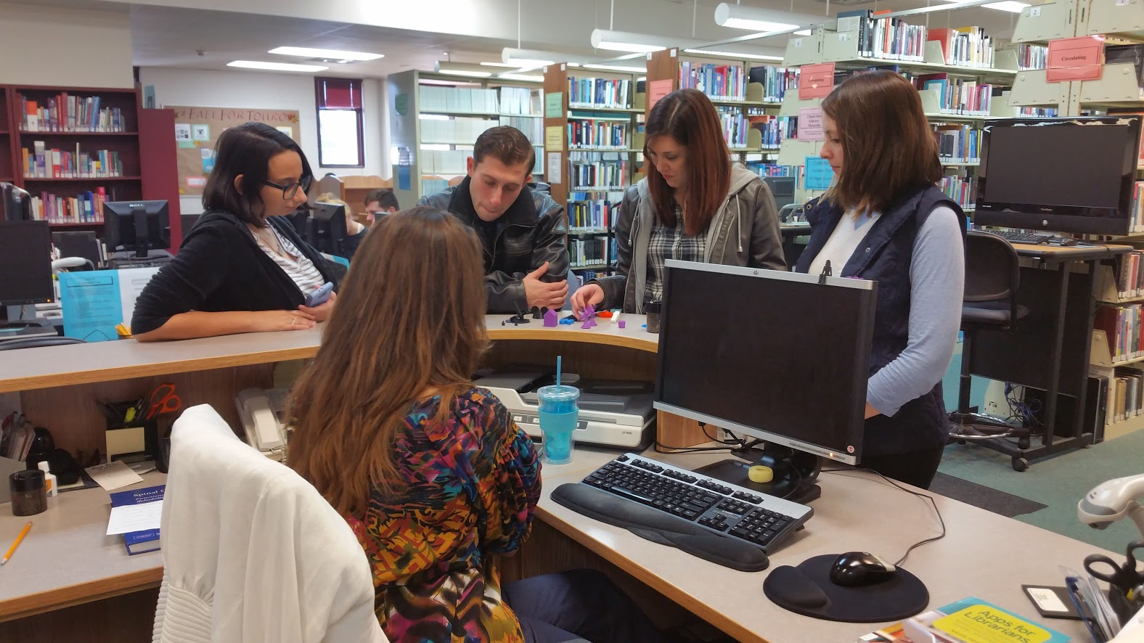
Benefits & Successes:
Library
Increased traffic into the library
Greater student and library staff interaction
Increased library visibility
Notes:
Joan The 3D program gave us the opportunity to have a relationship with the students while we worked together along the steps of their projects.
The 3D printer being based in the library caused traffic to come see us and spend time with us.
The noise also attracted attention having students ask questions and in turn caused us increased visibility.

Slide 25
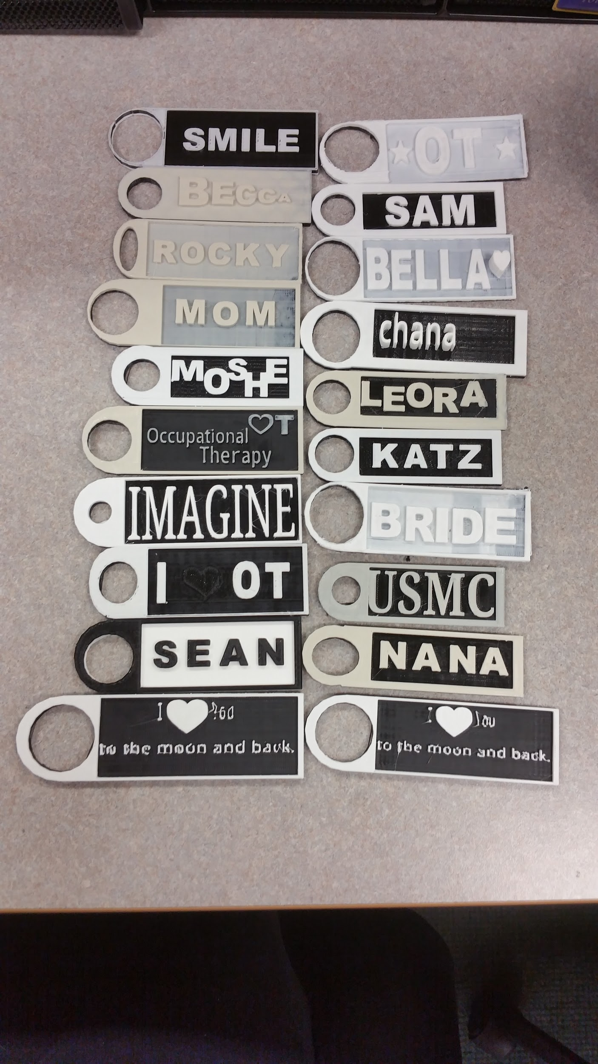



Benefits & Successes:
Students
Students gained new skills and hands-on experience before they graduate
3D printing promotes student innovation and creative thinking
Students have the ability to help real patients from their clinical rotations
Notes:
Joan: We exposed the students to something new and they tapped
Student gained new knowledge of a growing service they were unfamiliar with prior to this project. Since the projects inception, they have: experimented with 3d file design, been featured in several articles in print and online, presented at local school career days, etc.
Students are required to get creative in order to create usable assistive devices
Some students have given their projects to real patients from their clinical rotations that aid in every day activities that are typically extremely difficult or frustrating for them

Slide 26

Benefits & Successes: Smiles
Notes:
The students gain a sense of accomplishment by creating something they had no idea “how to” , surprised they could and then happy with the results.

Slide 27

Our 3D printed objects in the real world:
Notes:
Blanche
Katie

Slide 28
Barbara M. Jones, Director of ALA’s Office for Intellectual Freedom
“Librarians should not wait to begin a 3-D printing space for some ideal time in the future when all the problems will be solved. Start now, with your goal and some policies that will undoubtedly evolve. The rest will fall into place”
Notes:
Bulletin of the Association for Information Science and Technology Special Section: 3D Printing and Digital Fabrication Technologies in Libraries and Museums 2016

Slide 29





Thank you!
Katie Flood, Library Assistant, Touro College
ACRL New England for giving us the opportunity to present this program
Questions?
Notes:
Thanks to Katie!!!

