Slide 1


Sustainable Tourism Planning in Small Towns:
The Calgary Region Experience
Notes:
The purpose of this presentation is to provide a brief overview of the Calgary Regional Partnership work towards tourism development in the Region.
Our approach is based in a holistic view where tourism planning and development are considered as part of the sustainable development of the communities; sustainability requires taking into account the needs of local communities and travellers, as well as all the social, cultural, economic and environmental impacts and the complex relationships within the sector and with others.

Slide 2
Sustainable Approach in the Calgary Region
Notes:
The Calgary Metropolitan Plan is a 60 Year Sustainability Plan for the Calgary Region
This Plan was established in 2012 as the blueprint for accommodating growth over the next 60 years (from 1.4 Million to over 3.0 Million people by 2076)
The municipal members of the CRP have committed to the CMP by aligning their local plans.
http://www.calgaryregion.ca/cmp/

Slide 3
Sustainable Approach in the Calgary Region
Calgary Regional Partnership (CRP) & Calgary Metropolitan Plan (CMP)
Principles
  Protecting the natural environment and watershed
  Fostering the region’s economic vitality
  Accommodating growth in more compact settlement patters
  Integrating efficient regional infrastructure systems
  Supported through a regional governance
Notes:
The plan has five guiding principles that were developed with extensive public engagement.
These are based on the sustainable development principles and provide guidance for the partnership in its work.

Slide 4
Sustainable Tourism in the Calgary Region
Visitor
SUSTAINABLE
TOURISM
Environment
Society and Culture
Economy
Industry
Community
Notes:
CRP supports tourism initiatives in the region through a sustainable tourism approach
Quick overview: sustainable development seeks economic growth, raising the quality of life and social well being of the local communities without depleting neither the natural renewable resource base nor the cultural and social background, so that the following generations will have similar development opportunities. It is important to emphasize that the different aspects of sustainability should not compete; they should be equally important.
Despite being often deemed a “non extractive” industry (i.e. an industry that does not rely on the extraction of raw materials from the earth), tourism is still resource dependent. It relies on natural surroundings, communities and the steady supply of products to create experiences for visitors. In this context, the planning of sustainable tourism is based on a long term vision that considers the rights and aspirations of the future generations, promotes balance between the ethic, social and cultural values, recognizes the individual rights of indigenous people, rural and urban communities; it is responsible for managing the natural resources and preserving the biological diversity, it is economically efficient and viable in the long term and it is socially conscious and equitable in the distribution of the dividends generated by the activity.

Slide 5
CRP’s Tourism Project - Overview
 | 1 | 2 | 3
REGION-WIDE SCALE | PLANNING FOR A SUSTAINABLE FUTURE (GOA, CMP, MDPs) | PLANNING FOR SUSTAINABLE TOURISM | IMPLEMENTING THROUGH / WITH THE TOURISM INDUSTRY
MUNICIPAL SCALE
TOURISM BASED FACILITIES, BUSINESSES and ORGANIZATIONS
Marketing
& Delivery
Product Development
Notes:
In accordance to the sustainable tourism approach CRP has worked in collaboration with different partners and stakeholders working for a sustainable future in the Calgary region, not restricted to the tourism industry.
Our goal is to connect the municipalities, its business and organizations with local, regional, provincial and even national partners, programs and campaigns.
Some of the partners we have worked with are the Destination Marketing Organizations, Sub regional tourism groups, the Government of Alberta and Travel Alberta, Bow Valley College, Community Futures; in addition, we have participated in forums and events with the Canadian Tourism Commission to share some insights and updated info to our municipalities.
CRP also collaborates with other Regional Economic Development Alliances.
As the Provincially designated Regional Economic Development Alliance (REDA) for the Calgary Region, CRP is responsible for three core goals:
Building capacity for community and regional economic development success
Business investment, retention, expansion and attraction
Cultivating and fostering collaborative partnerships which support the strategic growth and economic sustainability of regions, communities and businesses

Slide 6












Emerging Sustainable Tourism Scales and Elements
Assist local municipalities
Understanding the
Tourism Landscape
Develop regional strategy,
assets & product development
Support broader marketing campaigns
Notes:
It is our goal to promote collaboration in all areas. When analyzing the tourism landscape in the Calgary Region, CRP has taken into account
The ongoing Municipal efforts; the existing Agencies and stakeholders; the multiple Funding sources present; the available Metrics & Statistics; the different Strategies and Programs, and the Gaps, Issues & Opportunities
In its strategy, CRP seeks to Assist local municipalities by
Securing tourism funding; providing information, expertise, data; supporting community & business engagement; facilitating regional cooperation; supporting their brand recognition – “we’re here!!”; supporting development of tourism assets; supporting marketing efforts and connecting them with regional initiatives (e.g. http://www.calgaryregionfocus.com/guide-to-calgary-region-day-trips/)
In the Development of the regional strategy, assets & product development CRP also works in areas like:
Regional Transit service to towns and the protection of natural areas and environmental assets. It also enables sharing potable water with everyone; provides a forum for dialogue and action; supports labour force attraction and arrange tourism training; supports the implementation of the Provincial Tourism Framework
And finally we also look to connect the municipalities with broader marketing campaigns in order to speak the same language and send a unique message.

Slide 7
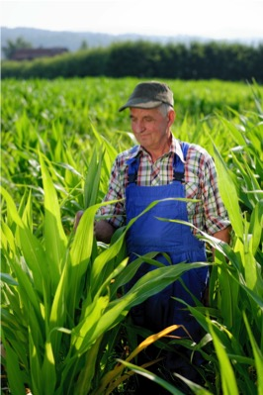


Sustainable Tourism Principles
South Australian Tourism Commission, 2003 (an example)
Being different
Achieving authenticity
Reflecting community values
Understanding and targeting the market
Enhancing the experience
Adding value
Respecting natural and cultural values
Notes:
These principles help communities understand the meaning of sustainable tourism and to better focus their initiatives and projects.

Slide 8


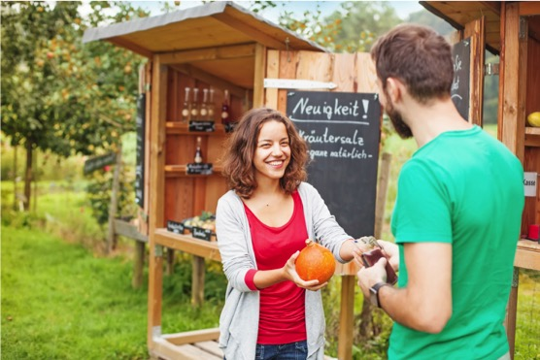
Sustainable Tourism Principles (cont.)
South Australian Tourism Commission, 2003 (an example)
Achieving conservation outcomes
Having good “content” (telling the story)
Achieving excellence and innovation design
Providing mutual benefits to visitors and hosts
Building local capacity
Notes:
Different organizations have developed several distinct lists of sustainable tourism principles taking into account the different areas in the sustainable development of the industry. We chose the current list because the principles listed here are very comprehensive ,“down to earth” and practical.
I would add one more principle: “educating the traveller”. Because we all are travellers, even in our own regions, cities and towns.

Slide 9

Data Collection in the Calgary Region
Summer 2015 – Pilot Project
Black Diamond, Chestermere, Cochrane, Irricana, Nanton and Strathmore
Notes:
One of the specific projects we developed in the region was the “data collection pilot project in the summer of 2015”. 6 municipalities participated in this pilot with the financial support and advice from the Tourism Research and Evaluation Department in the Alberta Culture and Tourism Ministry.
The purpose of this project was to collect information through a visitors survey in order to create a profile of visitors to small towns in the Calgary Region (e.g. how long they stay, what they do, how much they spend, etc.) to support tourism development in the municipalities and the region as a whole.

Slide 10

Data Collection in the Calgary Region
Summer 2015 – Pilot Project
Black Diamond, Chestermere, Cochrane, Irricana, Nanton and Strathmore
The Project
Final Report presented to Alberta Culture and Tourism – Feb 26, 2016 (report available on PDF)
Interest in similar projects from other regions
Lessons learned about the project: survey tool, info collected, project management
Notes:
Other regional organizations have approached us because they want to execute similar projects and they are interested not just in the results (data) but the learning from the process.
Besides the actual data, the report presents the successes, the challenges encountered and the strategies applied to overcome these challenges.
Some of these challenges were:
Overlapping dates for main events scheduled in the municipalities
Repeat events had repeat visitors (didn’t want to complete surveys again)
Bad weather
Use of iPads (outdoors)
Training process & hiring students (casual position)
Tool: Use of tables for some of the questions
These challenges also showed us some problems in the planning of the events and in the tourism management in these towns.
We also present suggestions about: the survey tool, the training process, the surveying itself, the best incentive to visitors, etc.
For full report please contact: Bibiana.cala@stmglobalconsulting.com
Bobmiller@calgaryregion.ca

Slide 11







Data Collection in the Calgary Region
Summer 2015 – Pilot Project
Benefits
Visitor Info . Strategy - Alberta Culture and Tourism
Hands on experience for students
Partnerships and community engagement
Regional Database
Visitor behaviour trends
Visitor awareness
Notes:
Project Highlights:
Successful development of partnerships and community engagement
First regional data collection project in the Calgary Region & first regional database for visitor information.
Supporting the Province in the visitor information strategy currently being developed by Alberta Culture and Tourism.
Visitor awareness about new tourism attractions
Visitor behaviour trends (locally & regionally):
Most visited local attractions
Outdoors: Many of the towns noted outdoor activities (e.g. splash parks/trails/beach) as one of the main local attractions that they visited
Shopping: In towns with a larger number of retail options, visitors listed shopping activities as one of their main local attraction (e.g. Nanton: Antiquing/Candy store; Black Diamond: Restaurants/galleries)
Campgrounds: This falls in line with where visitors were staying overnight (if applicable)
History/Culture: Visitors listed Museums/Historic locations/Rodeo etc. as local attractions that they had visited
Things visitors like the most
People; Outdoors(places, events and activities); Restaurants and Shopping
Hands on experience for students.

Slide 12
Data Collection in the Calgary Region
Summer 2015 – Pilot Project
Results
Meetings with local community & partners
“Our Best Costumer” (EQ: Cultural Explorer & Authentic Experiencer)
Info about trends and required improvements
Local partners used info for grant applications and improvements
  Catalyst for a discussion on local opportunities for tourism development & suggestions for future projects
Notes:
The conversation around the survey results acted as a catalyst for a discussion on tourism in the communities and it was a great opportunity for people to get together, share ideas and identify gaps in the Towns’ offerings.
The results helped us identifying the Calgary Region “Best Costumer” based on the Explorer Quotient™ Methodology (EQ)
(http://en.destinationcanada.com/resources-industry/explorer-quotient)
“EQ is a market segmentation tool developed by Environics Research Group, one of Canada's leading marketing and social research firms; they worked with the Canadian Tourism Commission (CTC) to develop the Explorer Quotient™ (EQ). This innovative market segmentation tool comes from the science of psychographics which look deeper at people's personal beliefs, social values and view of the world.
EQ Profiles: EQ breaks each geographic market down into different psychographic groups, called Explorer Types. Each type is identified by particular characteristics stemming from social and travel values, travel motivations and behaviours. The CTC selected Canada’s best Explorer Type prospects based on their affinity for the Canada. Keep Exploring brand, as well as love of travel, potential for being high-yield customers and propensity for word-of-mouth advocacy. This resulted in the selection of target types in each of the CTC’s primary geographic markets.
Suggestions for future projects arose from the discussion about trends and required improvements: Additional study on gaps in tourism offerings; Additional research about what Calgarians want to find in the small towns; It’s important to gather this info on a consistent basis to find out trends (e.g. every 2 years); More standardization based on info needs (why we need this info and for what); More specific info about why visitors come to specific towns/ attractions (What attracts them? What is unique in each Town?); Participants in the different towns are looking forward to seeing how the next steps roll out (new data collection project in 2017? additional communities?)

Slide 13
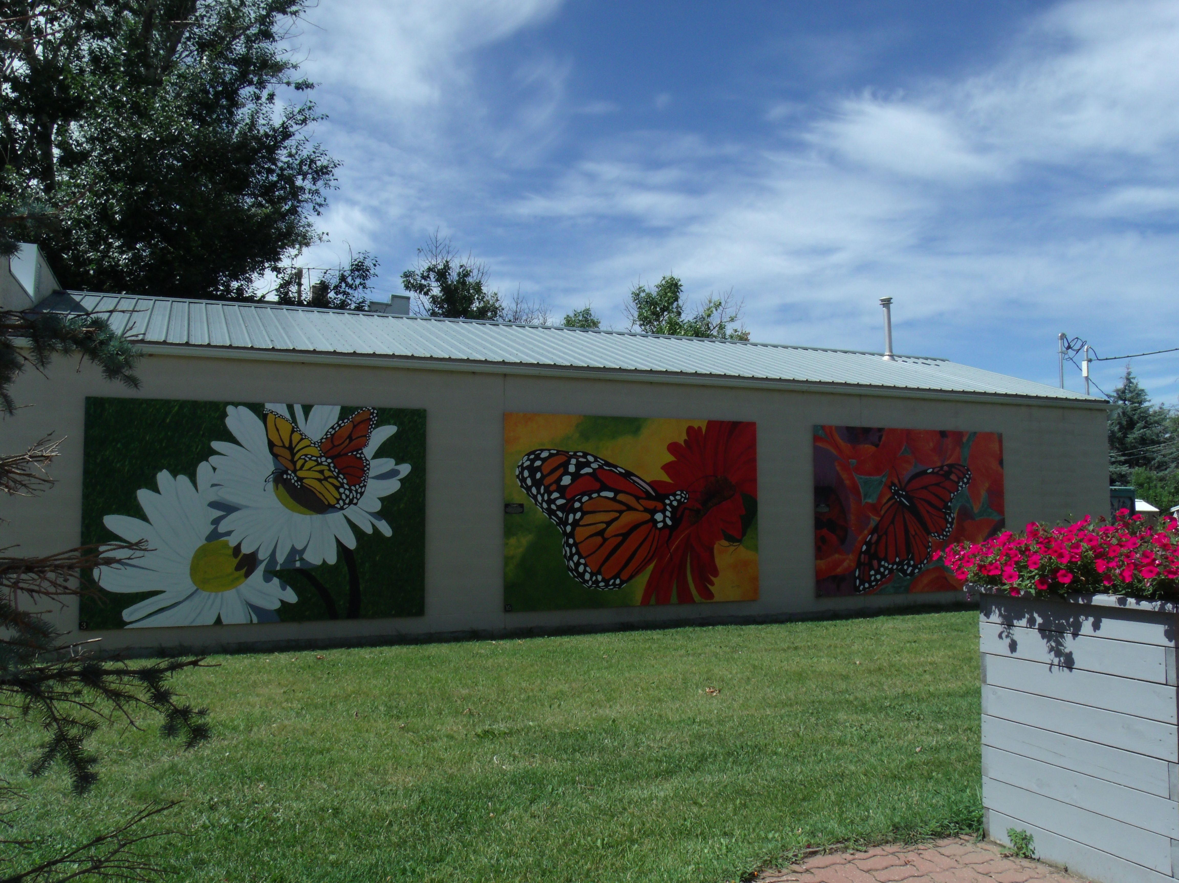
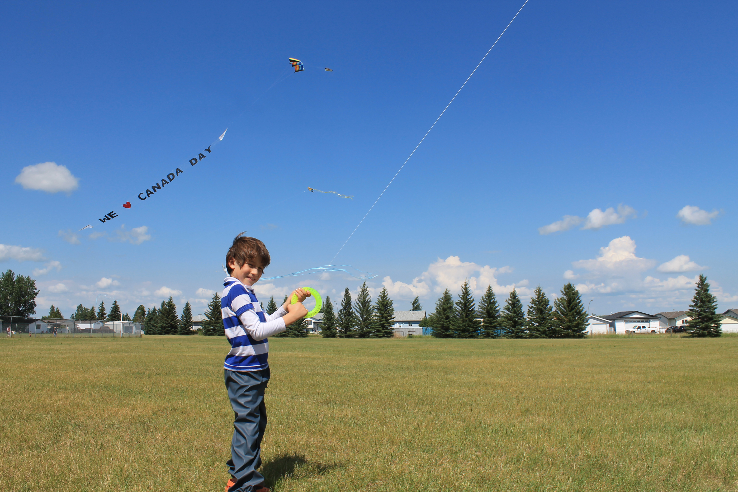
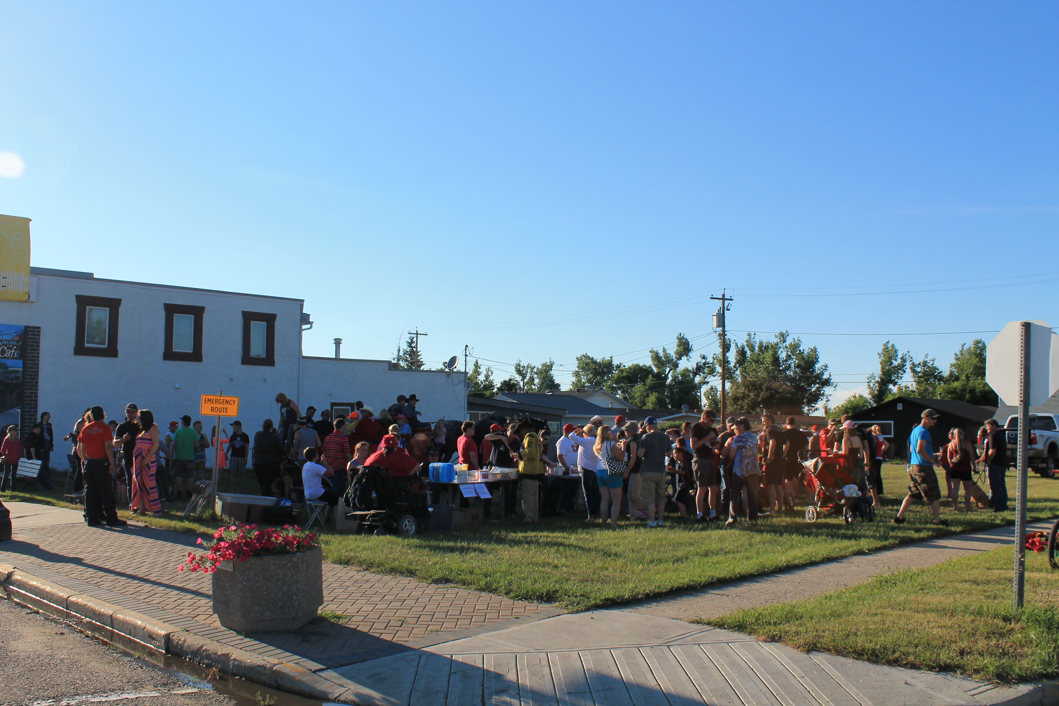
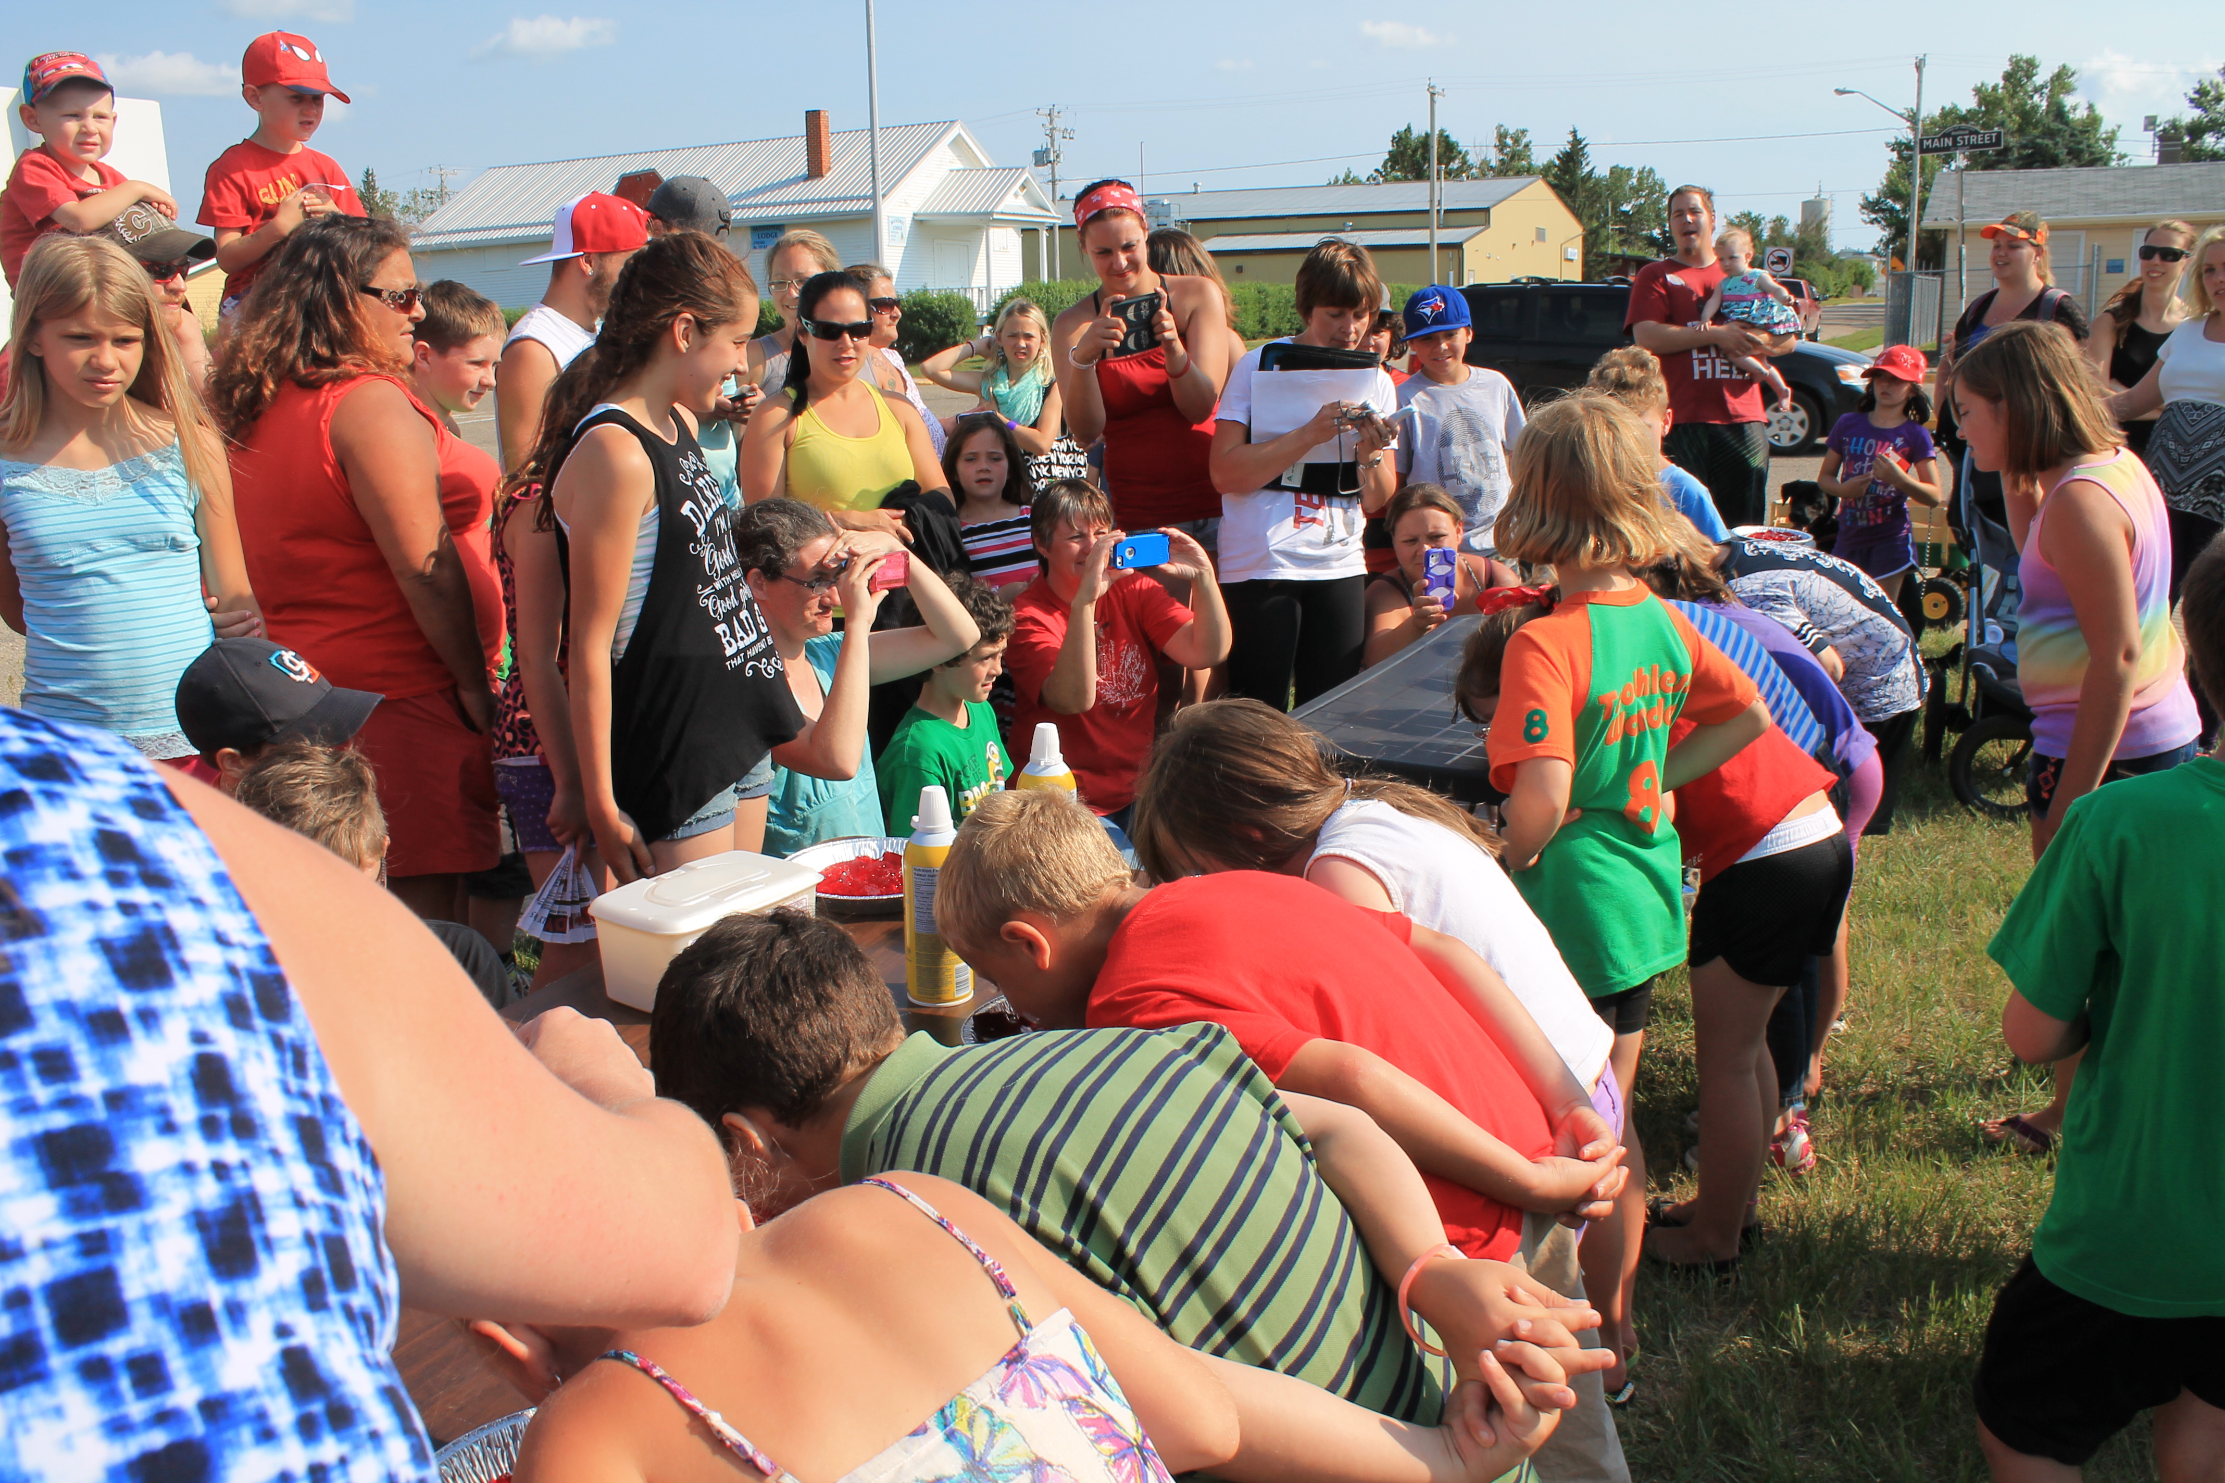
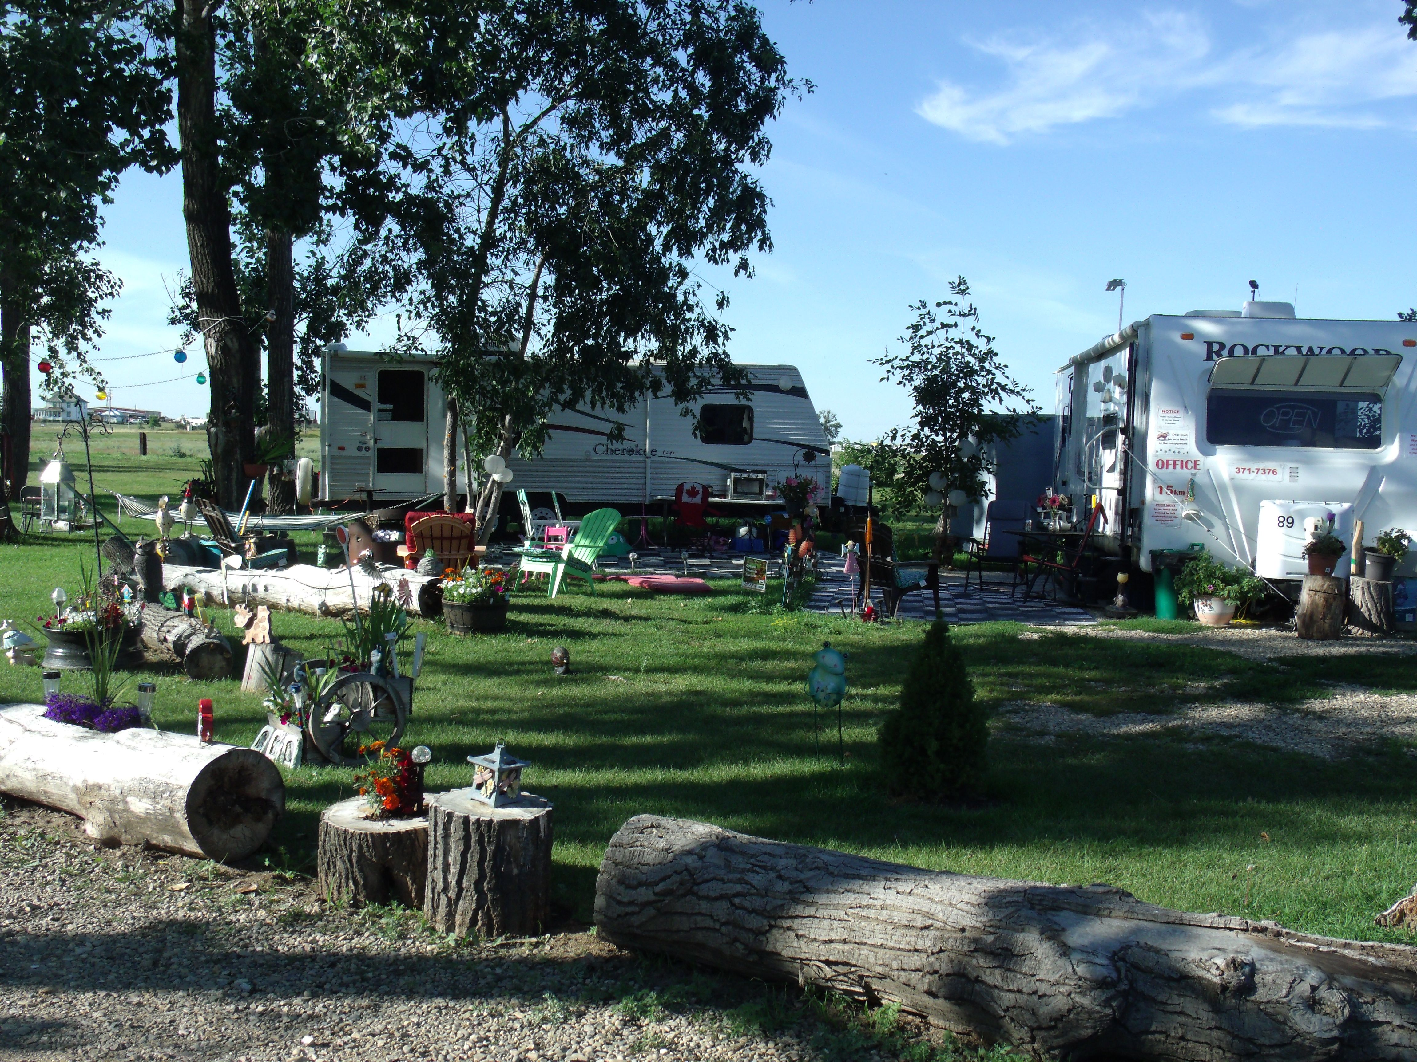
Tourism Assessment & Action Plan Project
Irricana, AB May 2015 – Sept 2016
Irricana Tourism Assessment Team & New EDTC
Notes:
Another tourism project developed by CRP:
The purpose of the “Tourism Asset Assessment and Action Plan Project”, in Irricana, AB., has been to provide a community-based assessment process of local tourism assets to support the development of a tourism strategy and action plan for the town. Tourism is recognized as one element of a broader economic development approach for the town. The proposed process was designed to integrate the perspectives of local residents and businesses, together with the expert advice and support of resource persons and organizations active in the regional tourism industry. The process has been used to assess the town’s current potential for tourism, to develop an understanding of the costs, benefits and implications (social, economic and environmental) of a stronger tourism focus for the town, and to develop and begin implementation of a strategy and Action Plan to serve as the basis for future initiatives. This assessment process provides a method to assess the viability of tourism in a specific destination to design a comprehensive strategy for tourism development.

Slide 14
Tourism Assessment Process
Develop Economic and Visitors Profiles
Identification of Potential Key Products & Initiatives
Identify High Potential Visitors
Project Scoping
Conduct Resident Attitude Survey
Establish
Tourism
Assessment
Team Mandate:
Sponsoring
Group (Town’s
Representatives)
Organize Leadership Team
(Tourism Assessment Team)
Visioning and Goal Setting
Estimate Impact Analysis
Actions for Implementation
Evaluation and Reporting (Summer 2015 & Summer 2016)
Identify Partners
Management & Development Assessment
Search for Funding Sources: Implementation actions
Attractions and Facilities Inventory & Community Asset Mapping Process
Communications and Marketing Plan
Notes:
The graphic above shows the original phases of the plan. As best practice, the plan needs to be revised to account for the communities' needs and priorities.
Although the plan hasn’t been strictly followed, its importance lies on providing a pathway to support the activities and initiatives along the way.

Slide 15

Tourism Assessment and Action Plan Project
Irricana, AB
Volunteers
Travel Alberta
Irricana Council
Representative
Canadian Badlands Tourism
“Tourism Assessment and
Action Plan Project
Irricana, AB”
Community Futures Wild Rose
Bow Valley College
Alberta Culture and Tourism
Tourism Calgary
Notes:
Collaborative approach:
Tourism Assessment Team (TAT): community volunteers and Council representative
Work with partners: the partners provided feedback about the process and specific tools for the actions being developed (Alberta Culture and Tourism, Travel Alberta, Canadian Badlands Tourism, Community Futures Wild Rose, Tourism Calgary, Bow Valley College)
While working in this project, we received an Invitation to collaborate with Canadian Badlands Tourism in the creation of a municipal tourism development tool (“The Tourism Pathway”). The Town is now working on the transition between their original plan and the implementation of this new tool.

Slide 16

Tourism Assessment and Action Plan Project
Irricana, AB
Actions Completed
Background info gathering
Meetings with community groups
Workshops and training
Visitor and Resident Surveys
Facilities and Assets Inventory
Assets Mapping Process
Destination Type Identification
Develop Plans
  Spring 2016: Strategic Plan
  Summer 2016: New Economic Development and Tourism Committee (EDTC)
  Fall 2016: 3-5 Years Irricana Action Plan
Notes:
“Between May 2015 and April 2016, the TAT was engaged in a tourism assessment process designed to integrate the perspectives of local residents and businesses with the expert advice and support of resource individuals and organizations active in the regional and provincial tourism industry. Intended to assess the Town’s potential for tourism and its associated benefits, the assessment process included a variety of activities, including but not limited to community meetings, awareness campaigns, workshops, both resident and visitor surveys, as well as the creation of an attractions and facilities inventory list and the beginnings of a community asset map. Most notably, the Team participated in a workshop with Travel Alberta to identify high potential visitors – Irricana’s “best customer.” The TAT also created a compendium of tourism-related tools and resources at the regional, provincial and national levels to help inform the Team’s strategic planning moving forward.
Based on the collective results of the tourism assessment process, the TAT developed an action plan for 2016 outlining broad goals and specific actions in five key areas: Events and activities, Facilities, Strategic Partnerships, Community Engagement and Marketing. The first phase of implementation begins in the summer of 2016.
Building on lessons learned, current action planning and the results of the tourism assessment process, the Town of Irricana and the Calgary Regional Partnership have agreed to move forward with the design of a 3-5 year Action Plan for sustainable tourism development in Irricana (2017-2021). Broadly speaking, the Action Plan will focus on three main areas of activity. First is the review of large and/or ongoing tourism projects identified by the TAT that are the most desirable and attainable for Irricana, the outcome being a prioritized list of potential mid- and long-term projects. Once high-priority candidate projects are determined, a process of project scoping will take place, allowing assessment of suitability to Irricana based on size, costs, manpower, logistics and future operating requirements. Finally, project funding and strategic partnership opportunities will be explored and identified for Council”.
(Irricana Tourism Asset Assessment & Strategy. Phase I Report to Council. Irricana, Alberta. April 18th, 2016)

Slide 17

Tourism Assessment and Action Plan Project
Irricana, AB
Key Learnings
Sustainable tourism strategy for Irricana (be authentic)
Telling our story
Implement through strong partnerships
Vision for Tourism Development in Irricana (TAT)
“Increase tourism that celebrates who we are and enhances our town through community engagement, increased economic opportunities and promotion”.
Notes:
Key Messages (learnings from the process)
Sustainable tourism strategy for Irricana: build on and celebrate who we are and what we have – be authentic
Telling our story: share the town’s stories (stories from its people); share more, through multiple channels
Implement through strong partnerships: where the town can establish and strengthen relationships that enhance sustainable tourism activities and pursue new tourism opportunities in creative and collaborative way.
The Calgary Regional Partnership and its Calgary Metropolitan Plan are strongly committed to strengthening local economies in regional municipalities. Thanks to the work of the Tourism Assessment Team along with the CRP facilitator and members of the “Resource Group,” the Town of Irricana is well positioned to execute tangible actions in support of a sustainable tourism plan that will have ongoing economic and social benefits to the community. We are one step closer to achieving our Vision, to “increase tourism that celebrates who we are and enhances our Town through community engagement, increased economic opportunities and promotion.”
(The notes on the process in Irricana were extracted from the “Irricana Tourism Assess Assessment and Strategy. Phase I. Report to Council. Irricana, Alberta. April 18th, 2016)

Slide 18
Sustainable Tourism Evaluation Matrix
Tool designed to formulate or evaluate a tourism project in a rural location
Evaluation Criteria | Sustainability Dimensions
 | Economical | Environmental | Social | Cultural | Political & Institutional
Demand for the products and services
Level of competitiveness compare with other products/attractions/experiences
Replicability
Efficiency in the use of resources
Equitable participation and self-management (by local communities)
Conservation of resources and public good
Technical-scientific sustainability
Relevance
Notes:
The Sustainable Tourism Evaluation Matrix is a tool designed to formulate or evaluate a tourism project in a rural location, based on the sustainability principles. This matrix cross references the sustainability dimensions (economical, environmental, social, cultural and political-institutional) against the projects’ evaluation criteria, which were designed based on the sustainable tourism principles and project management elements.
This tool is currently under review (new update summer 2017)
(Cala, Bibiana. Evaluación de Proyectos de Desarrollo Turístico Rural Desde la Perspectiva del Turismo Sostenible. (Rural Tourism Development Projects Evaluation from the Perspective of Sustainable Tourism) Germany: Editorial Académica Española, 2011)

Slide 19
Evaluation Criteria | Sustainability Dimensions
 | Economical | Environmental | Social | Cultural | Politico-Institutional
Demand for the products and services | Consider the factors that affect the flow of tourists; for example: Proximity and ease of transport to demand centers Quality of products and services offered Tourism seasonality management… Broad market trends and the need to understand specific segments Marketing “content” Access and security | Capitalize on the region's more attractive natural features and uncommon ecosystems in a sustainable way and promote them with visitors and local residents. | Generate associative processes (local and regional) that standardize the supply and channel the demand in an equitable way. Where appropriate, the project must promote “access for all”, including persons with disabilities and others who have specific access requirements. | Leverage the local and regional historical and cultural features to create unique experiences and products. | Sign in to /aligned with promotional campaigns and marketing initiatives at the municipal, regional, provincial and national level.
Technical-scientific sustainability | The project must have a solid and consistent conceptual background that justifies each of the activities and techniques proposed (minimize negative impacts and maximize positive ones). The project must take into account the risks and opportunities associated with the climate change adaptation.
Relevance | Relevance is understood as the degree of compliance with the originally set goals – whether or not they are working as envisioned and contributing to address the problems in an optimal and sustainable manner. The project promotes education and awareness for sustainable development – for all stakeholders.

Slide 20
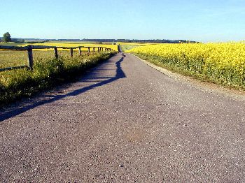
THANK YOU

Slide 21

BIBIANA CALA M.S.
STM GLOBAL CONSULTING
WWW.STMGLOBALCONSULTING.COM
Bibiana.Cala@stmglobalconsulting.com
403-966-1549

