Slide 1


ACRL/NEC & NELIG Joint Annual (Virtual) Conference
Connection, Disconnection, Reconnection:
How Are We Building Community Now?
June 1-3, 2022
Link to a complete list of sponsors:
https://whova.com/portal/webapp/aneac_202206/Sponsors
https://acrlnec.org/annual-conference/

Slide 2
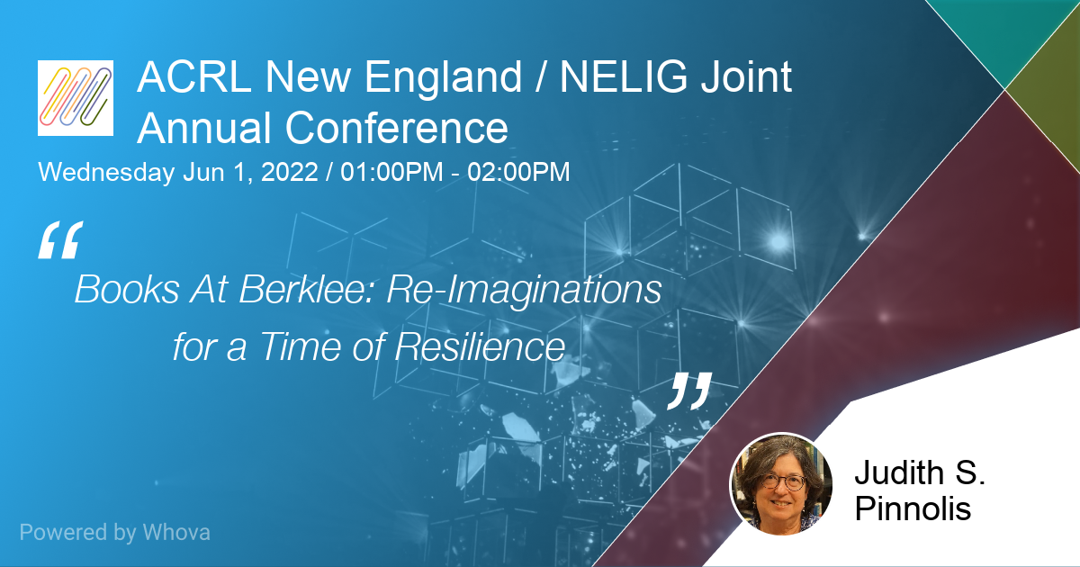

Slide 3
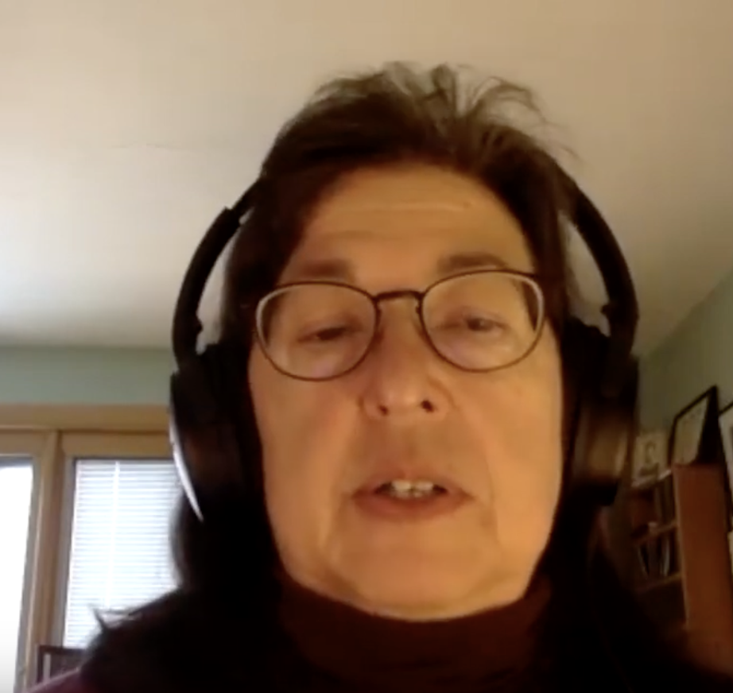
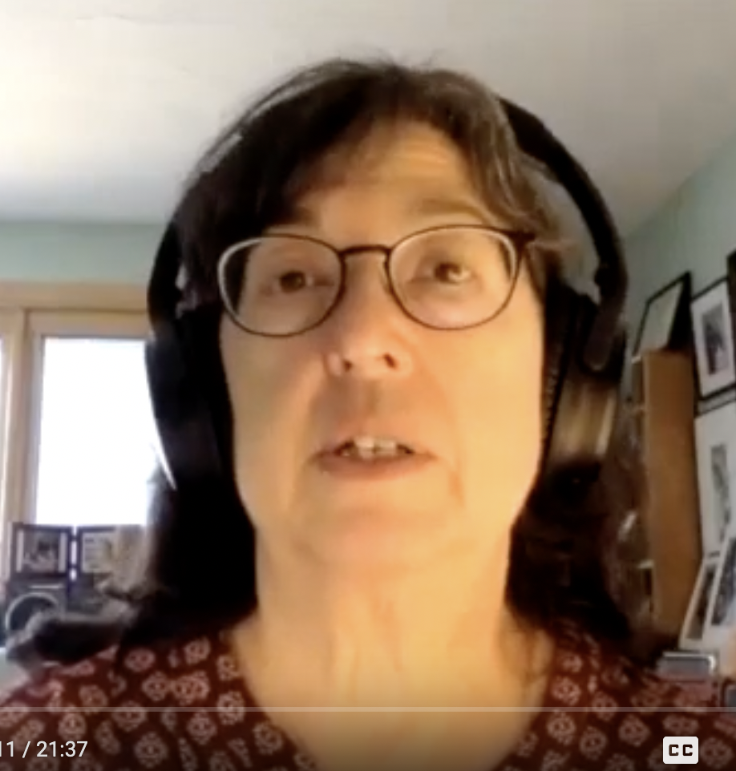
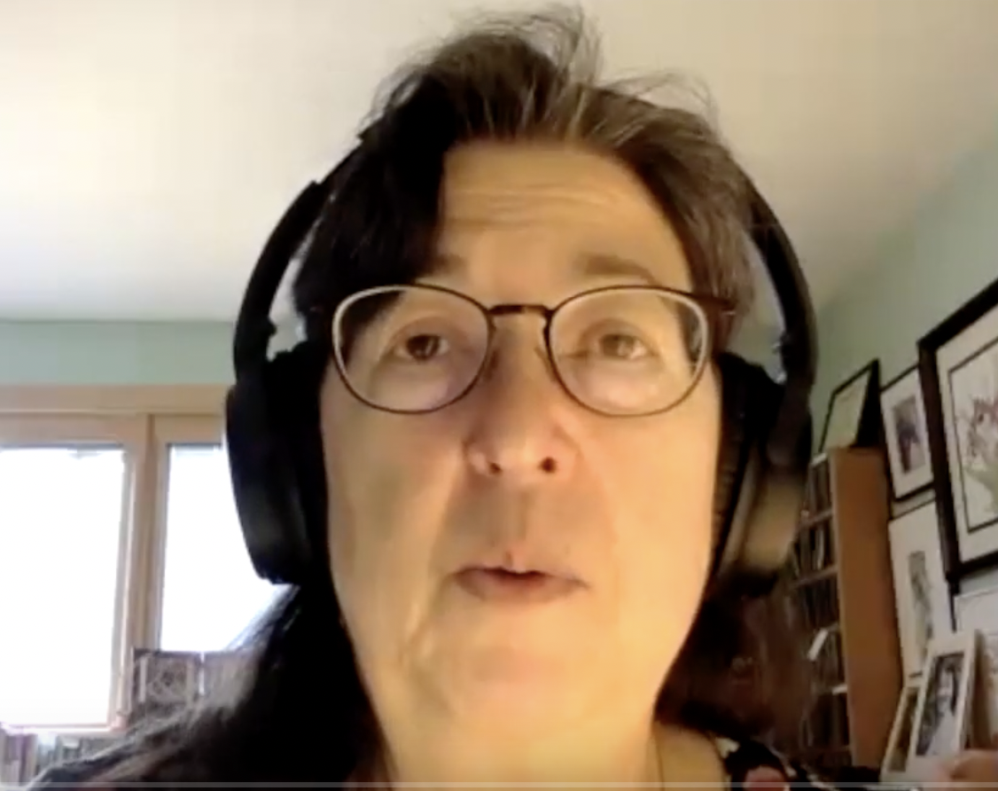
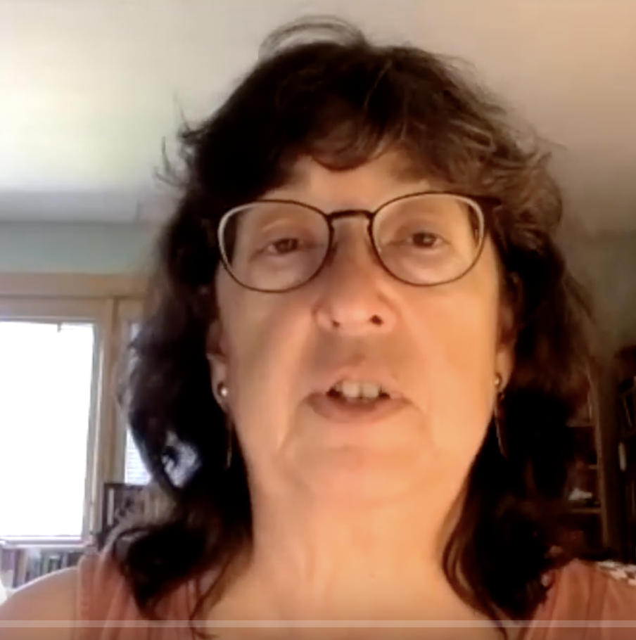
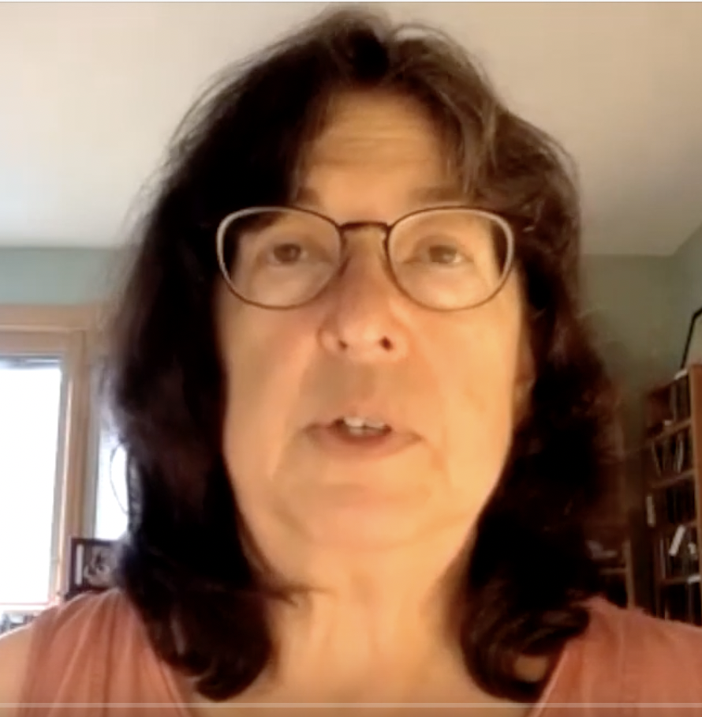
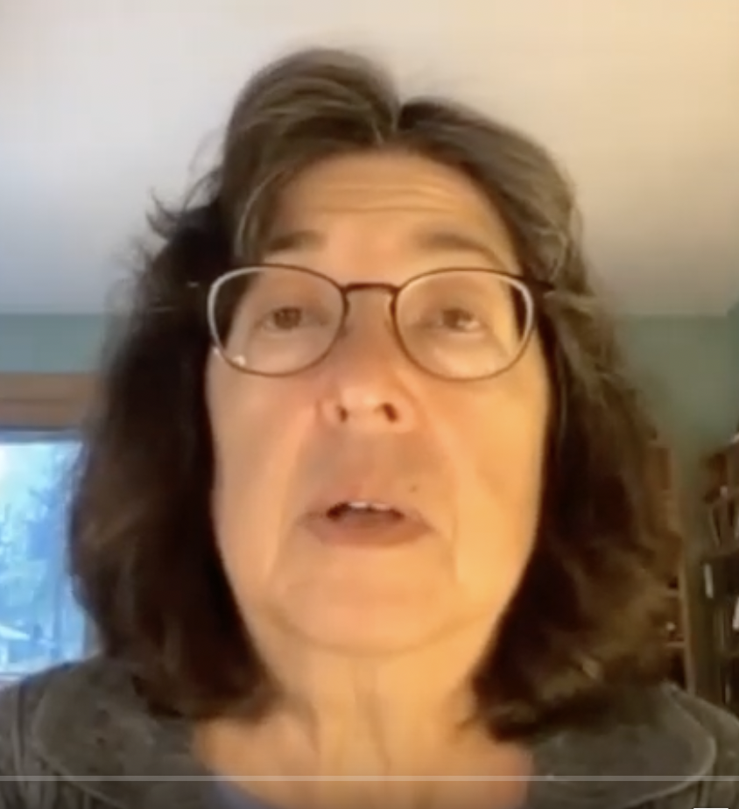
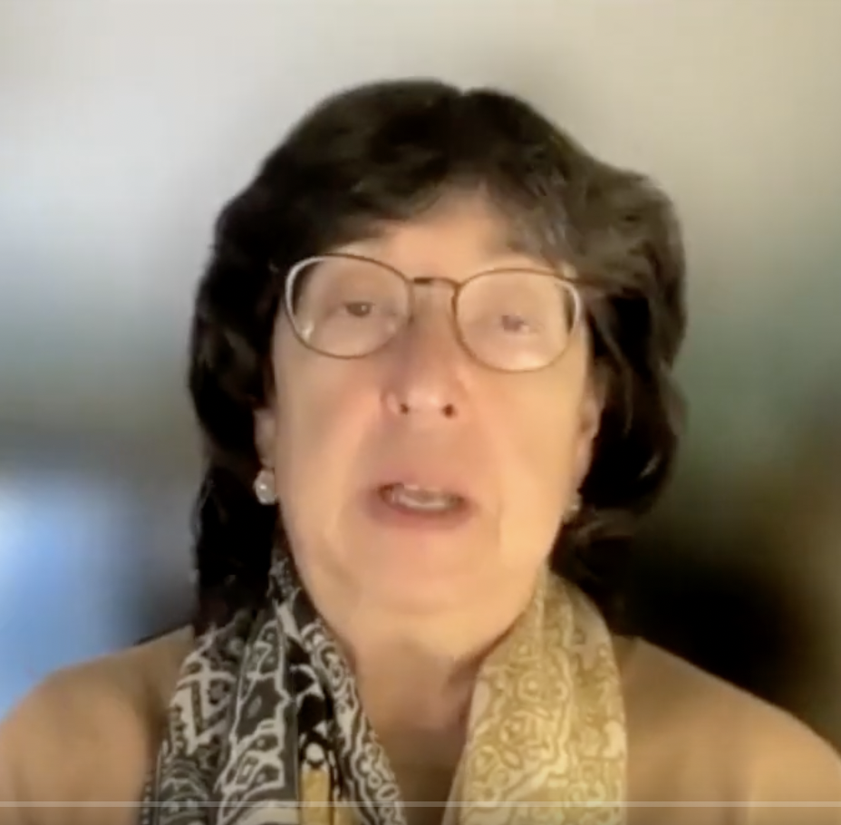
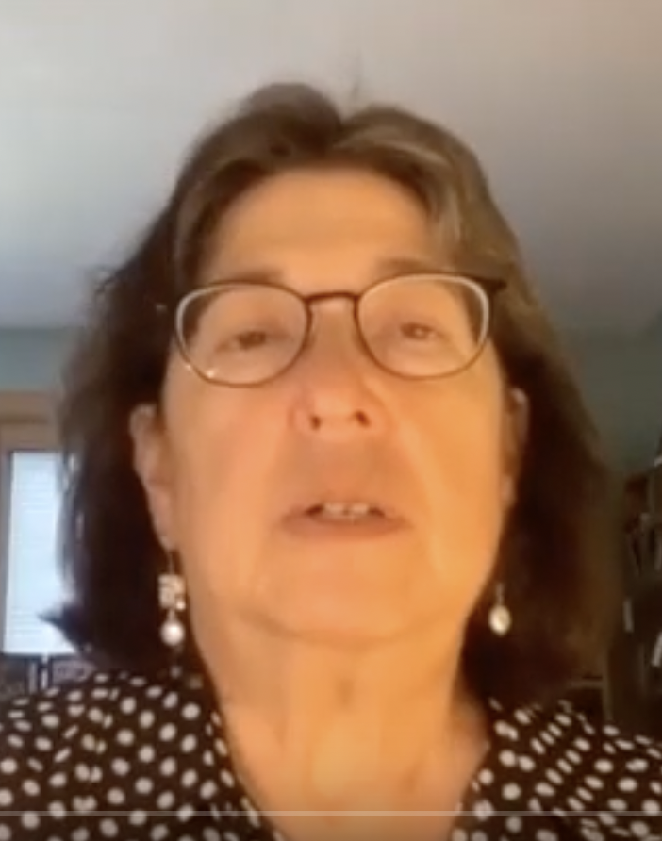
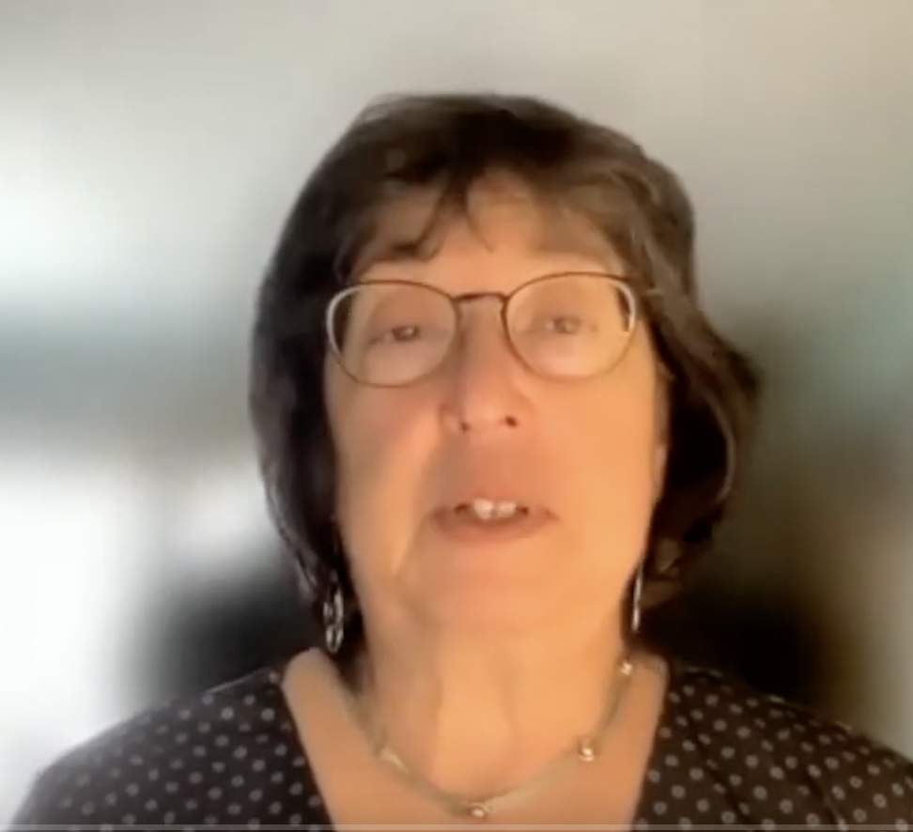
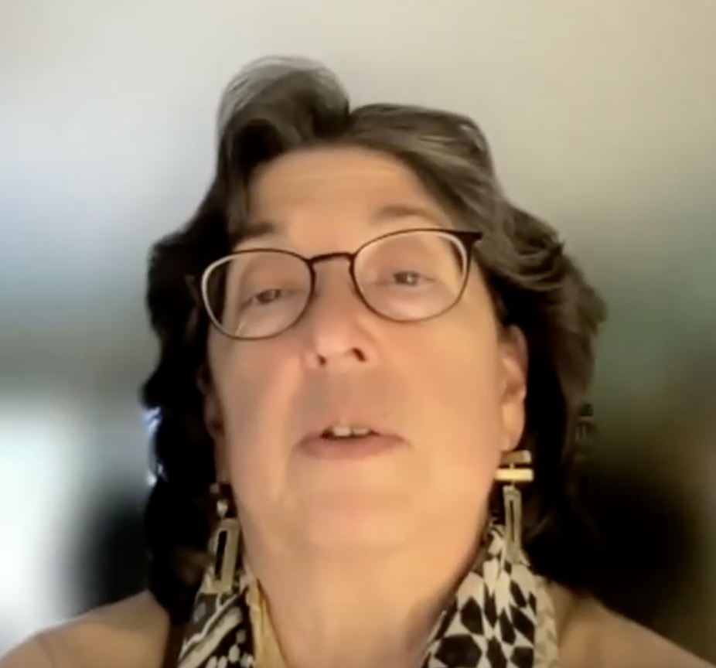
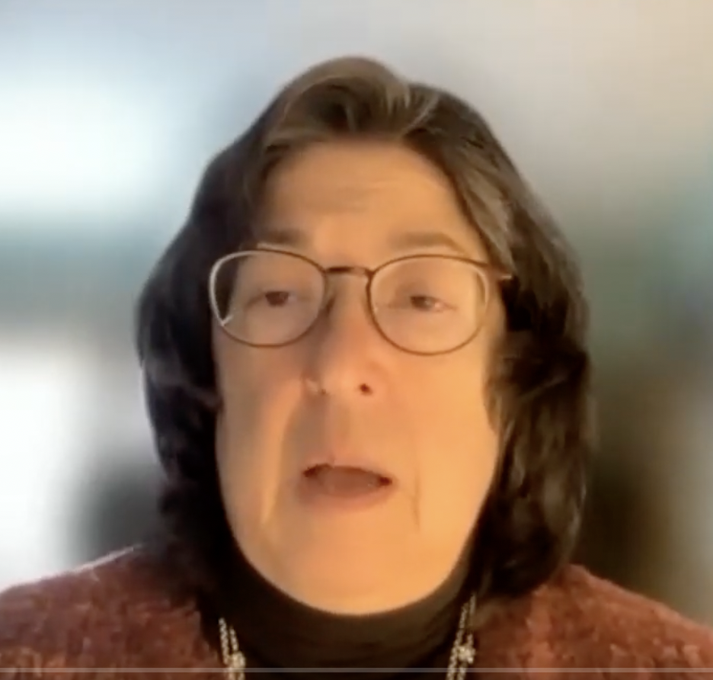
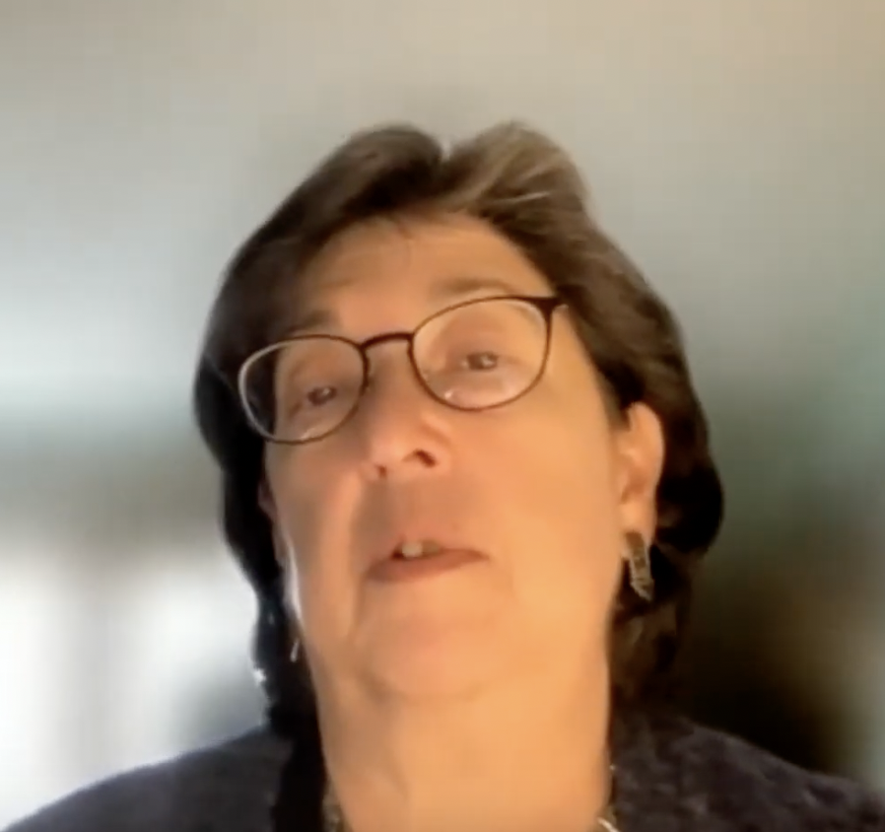
Post Vax --Back to More Normal Activities…
You Know it’s a Pandemic Project… When…Your Isolation Haircut gets long, longer, …longer…

Slide 4
How this got started
Collaborations with DEI
Expansion to faculty promoting library resources
Expansion to platform for faculty new publications
Added polish

Slide 5
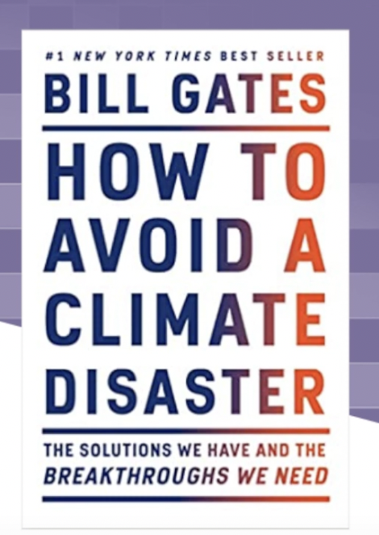

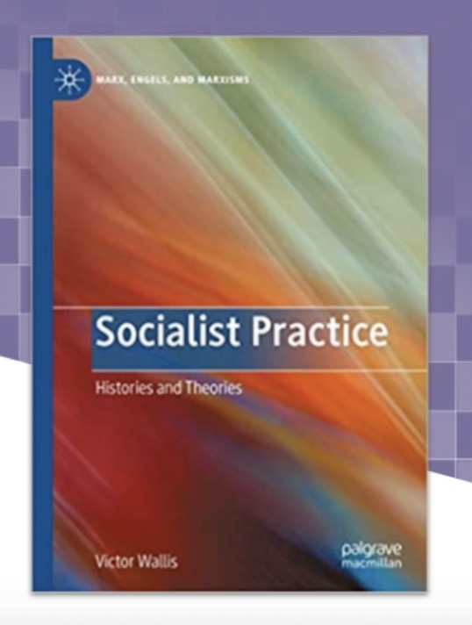

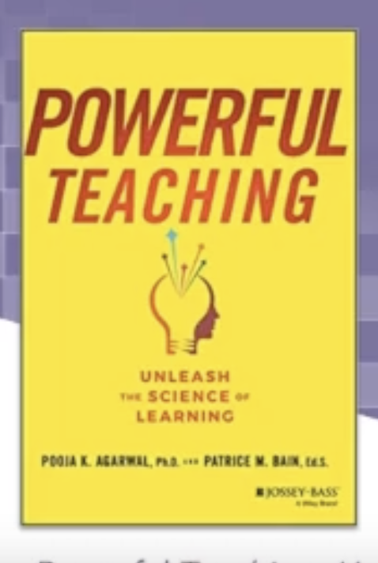

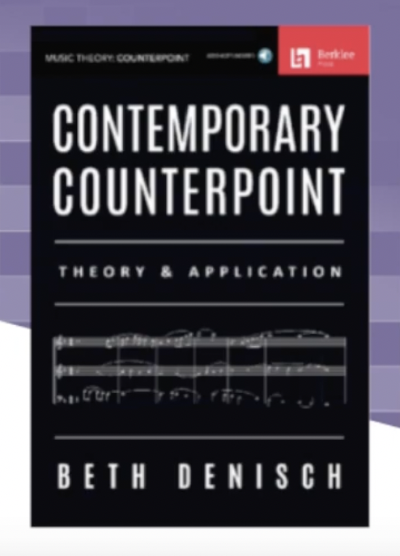




The Books at “Books @Berklee”

Slide 6


Library Resources Also Discussed

Slide 7
Purpose of Program
  To create community and connection during COVID
  Keep students and faculty engaged
  Keep up morale
  Support collections with marketing

Slide 8
What’s Involved?
My time
  Research faculty output– who has published?
  Choose title. –Sometimes in conjunction with faculty.
  Read the book!
  Get brief biography introduction to the interviewee -faculty member
  Develop questions. (May require research on issues discussed in book for context.)
  Develop and Send in “starter questions” and develop potential follow-up questions.
  Reminders about time and links
  Be flexible on scheduling– may have to reschedule several times
1 staff person– for editing video
NOTES:
We commissioned intro music/theme music for series– student composer
In-person recordings require space, reservations, more calendar coordination so more lead time, lighting, 2 videographers, more complex editing. Zoom is easier.

Slide 9
Techniques for Book Interviews
Know the purpose of your interview
Are you primarily about marketing the item to other library readers?
Are you primarily about getting the word out about the faculty member?
What are your goals in doing book interviews.
Know how book interviews differ from book reviews
Balancing entertainment as well as educational outlook
How serious should you be?
How do you make the interviewee feel comfortable?

Slide 10
Choosing works:
Based on a faculty’s recently published book
Resources or databases faculty want to talk about,
Book faculty feel is pertinent to some event (such as Earth Day),
or just a favorite book they want to share
Book discussed by other offices on campus, such as Diversity and Equity , Faculty Development…

Slide 11
Starter Questions:
Writing starter questions helps because…
Gets the discussion going “starter questions”
Gives a heads up to faculty about my reaction to the book
Gives me an outline as basis for discussion during the recording
Points out certain aspect we want to make sure are included
Makes faculty feel more comfortable. Is reassuring.
Selecting questions –based on content AND local interests

Slide 12
Online Interview techniques may apply
Prepare Yourself.
Be Punctual
Test Your Technology
Check Your Environment
Choose Your Background.
Speak Slowly and Clearly.
Listen Carefully
Dress for Success
Look at the Camera

Slide 13
Measure outcomes:
? How to measure?
Open to Unique Design in Every School
Overall number of videos? Is it Who is participating
Can it be expanded?
Can it be sustained?
Does it really NEED to continue?

Slide 14
Approaching faculty
Develop First Contact Plan
  Email or phone call or zoom discussion (since there were no “hallway moments” during COVID)
  Mention their book and why it might be of interest to the series
  Ask to speak to them about the idea first, and feel out their interest and time schedule
  Learn something about the faculty member and the book before meeting with them.

Slide 15
How to read the book for questions:
Take notes.
(With ebooks, --note the pages of good quotes).
Formulate questions while reading, based on the following criteria:
  What is the basic topic and theme of the book?
  Why might this book merit attention (in our case, the attention of music students)… why is it relevant to them?
  What special interesting factoid, data, or story jumps out when reading the book?
  What will help my audience understand or become intrigued by one of the most important topics?

Slide 16
More….Developing Questions
  Relevance to today: How can I use the understanding I gain from this book to my own life? Does the author have any advice about this?
  Do the homework
  What kinds of open-ended questions will get the author to talk more? or less?
  How can I control the direction of the interview? How do I gently steer the speaker in a direction that will have a story arc?
  What to do about political matters? Do I want the author to go there?

Slide 17
MISCELLANEOUS TIPS & HACKS
Start with a general question, such as,
“What prompted you to write this book?”
End with a general question such as,
“Is there anything else you’d like our viewers to know?”
Have one specific question that will elicit details from the speaker
Have a question that applies the topic to “everyday life, or current news, or concerns”, if possible!
Consider why anyone would want to spend their time with this book!! What are they likely to get out of it?
Ask a question that will lead the author to talk about the essential core issue.

Slide 18
Thank You!
Contact me for more information:
  jpinnolis@Berklee.edu
  To view ”Books@Berklee” videos, go to Berklee Library’s YouTube Channel:
  https://www.youtube.com/channel/UCnSmxig0gaRbr0bpLyG2kPQ

