Slide 1

No Zombies Here!
Kristi Castleberry​
Assistant Professor​ of English, NVU-Lyndon
An Inquiry-Based Learning Approach to an Embedded Librarian Project
Sam Boss
Assistant Professor
Director, NVU Libraries

Slide 2
Learning Objectives
apply framework concepts in a collaborative environment
nurture students’ critical approaches to new information
foster a sense of passion and encourage persistence by tying information literacy skills to issues of importance to the student

Slide 3
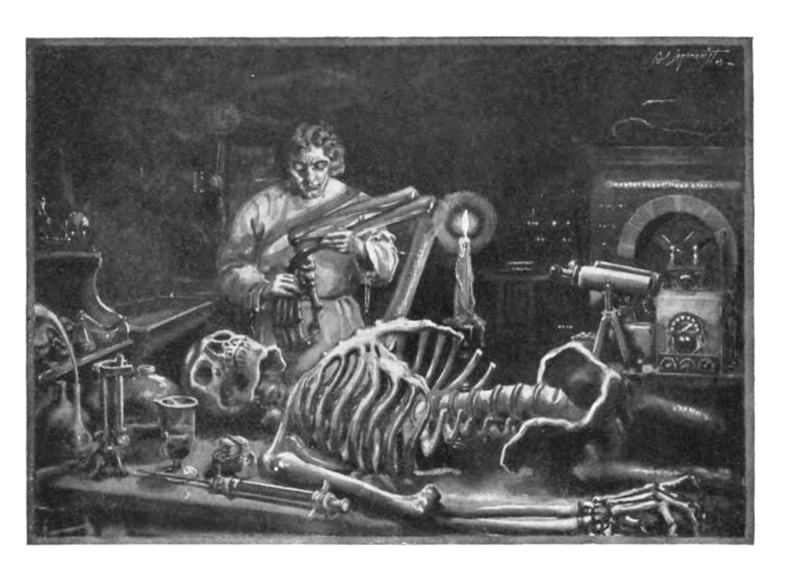

Slide 4
INT-2040
Basics & Evolution
  INT-2040 is an interdisciplinary class on critical thinking, reading, and writing
  Capstone of general education
  No set info lit component, so I’ve tried a range:
    First semester I included none
    Second I included one library workshop
    Then I upped it to two
    Then I began working with Sam in 2017 to add an embedded librarian element and we’ve enhanced the level of integration
Sophomore Critical Thinking Seminar

Slide 5
INT-2040
A home for information literacy & inquiry based learning
Critical thinking seminar
  Research & discussion opportunities
  Revisit foundational workshop(s) content
2 years of evolution
  Structure & content
    Less talk – more activity
    Frames integrated (or not)
  7 "library days" to a seamlessly integrated series of workshops.
IBL is an "education strategy that encourages asking questions and seeking the answers as a way to enhance student knowledge."
Ungvarsky, J. (2019). Inquiry-based learning. Salem Press Encyclopedia.

Slide 6
Weeks 1 & 2
Scholarship as Conversation
Introduction to the scholarly conversation
  Becoming members of a community
  Knowledge practices & dispositions
  Debate preparation workshop
Evolution
  Eliminated 1st visit (lecture-based)
  Moved activity 1 – before debate
  Student-driven topic selection
Debate Preparation
  Review of foundational resources (ENG-1081)
Cites the contributing work of others in their own information production (KP);
Critically evaluates contributions made by others in participatory information environments (KP);
Recognize they are often entering into an ongoing scholarly conversation and not a finished conversation (D)

Slide 7
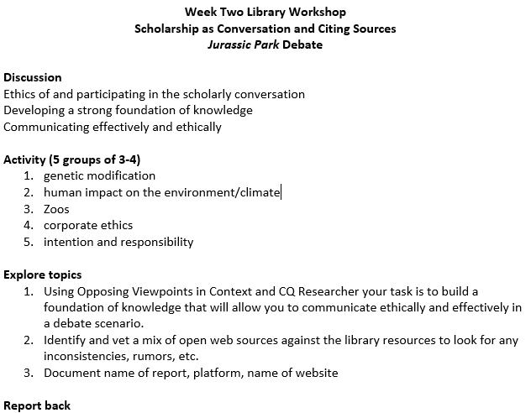
Weeks 1 & 2
Scholarship as Conversation
1. Revisit Library Workshop 1
2. Evaluate open web & proprietary foundational sources
3. Document sources

Slide 8
Reflection
Since moving the activity, have you noticed a difference in debate?
What can we do in the future? Can we tie it closer to the debate?
The Faculty Perspective

Slide 9
Week 9
Research as Inquiry & Searching as Strategic Exploration
Return to the Foundational Workshops
  Knowledge practices & dispositions
  ENG-1081/2 skills
Evolution
  Initially was a "topic building" workshop
  "Topic building" shifted to weeks 10 & 11
  Focus moved to search strategies & critical evaluation of an information source
Workshop/Activity
  "Revised" article / book worksheet
  What do we want to students to identify and why?
Uses various research methods, based on need, circumstance and type of inquiry (KP);
Uses differing search strategies and understands first attempts do not always produce desired results (KP & D);
Seeks multiple perspectives and values persistence (D)

Slide 10
Reflection
How has our collaboration on this activity made it more student-centered?
The Faculty Perspective

Slide 11
Week 10
Research as Inquiry & Information Creation as a Process
Students get into groups based on broad topics
Around 40 minutes for groups to work on narrowing topics
Groups experience how research and topic formation inform one another
By the end, the goal is for each group to have a defined research topic
At least 5 minutes per group to report back
Determine an appropriate scope of investigation (KP);
Use various research methods, based on need, circumstance, ad type of inquiry (KP);
Value intellectual curiosity in developing questions and learning new investigative methods (D)

Slide 12
Week 11
Authority is Constructed and Contextual
Get back into groups from the previous week
Groups work for about 25 minutes to look more closely at one library source and one open web source and examine the credibility of these sources
The goal is to have a defined research question
About 45 minutes (or 10 per group) to report back
Use research tools and indicators of authority to determine the credibility of sources (KP);
Recognize that authoritative content may be packaged formally or informally and may include sources of all media types (KP);
Develop and maintain an open mind when encountering varied and sometimes conflicting perspectives (D)

Slide 13
Week 11
Authority is Constructed and Contextual
For each source:
  Who is the author?
  What organization or institution are they affiliated with?
  What else have they published?
  What’s something interesting you found on their social media?
  Would you consider this person an expert in their field? Why?
  How/Why do you think this source would be useful for this topic?
  Anything else you noticed or discussed?
For a journal article:
  Who is the publisher?
  Is it peer-reviewed?
  Who’s the audience?
For a website:
  Who is the audience?
  What is the purpose of the site?
  Who’s behind it?
  Does it seem credible? Why?
Use research tools and indicators of authority to determine the credibility of sources (KP);
Recognize that authoritative content may be packaged formally or informally and may include sources of all media types (KP);
Develop and maintain an open mind when encountering varied and sometimes conflicting perspectives (D)

Slide 14
Reflection
We’ve developed this into a two-part activity over time. With your background in library instruction, what do you think the value of this extended workshop is?
The Librarian's Perspective

Slide 15
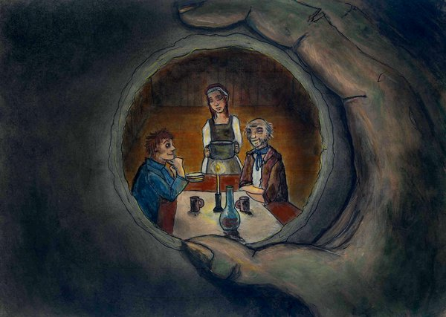
Week 13 and Beyond
Week 13 includes a guided research workshop in which students can research individually with us there to help
Students work on developing topics and writing drafts of their research proposals before our guided research
Although this is a standard activity that both of us have done in other classes, it becomes more in this class because students can build on the skills they have been developing all semester

Slide 16

Any questions?
We’d be glad to hear from you to continue the discussion, answer questions, and share materials!
You can reach us at:
samuel.boss@northernvermont.edu
kristi.castleberry@northernvermont.edu

