Slide 1

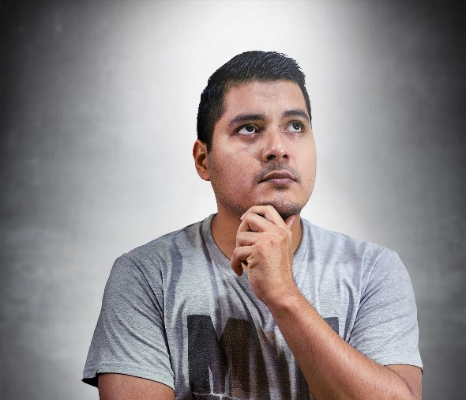


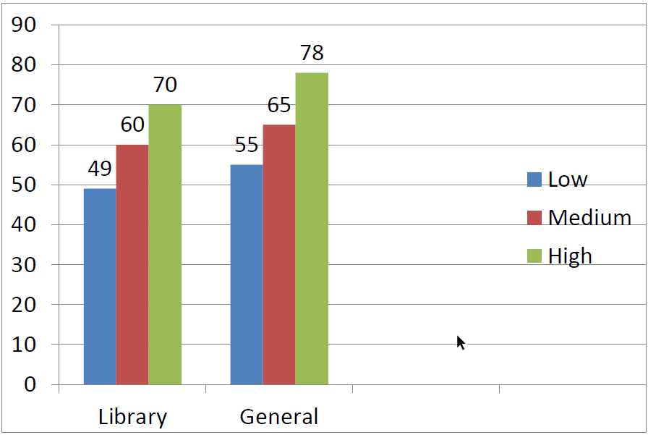
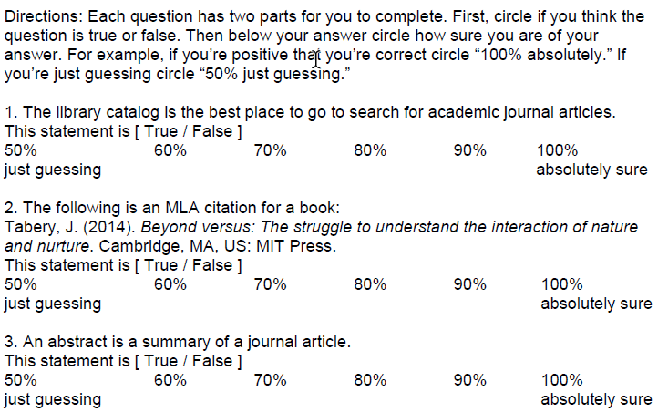
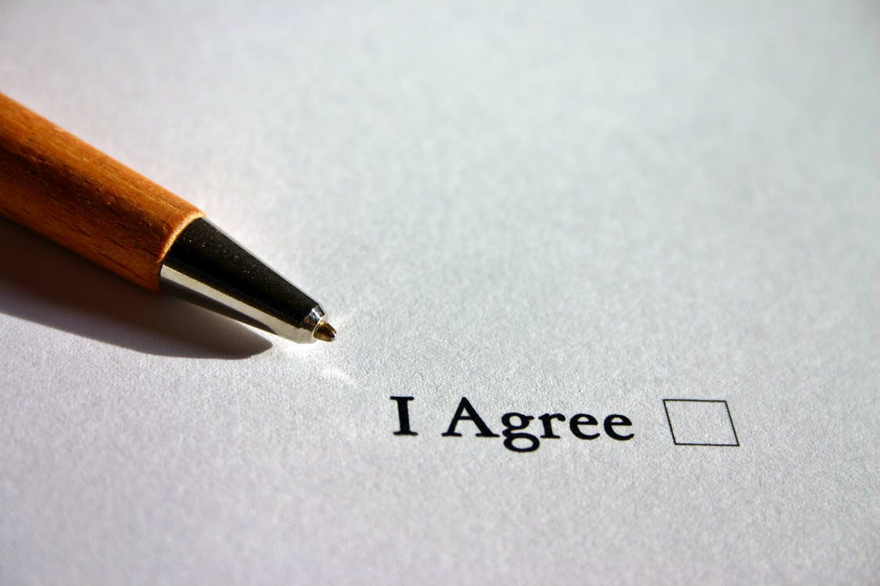

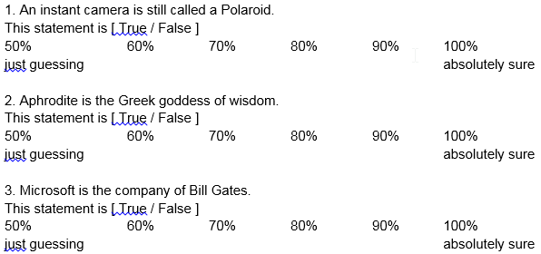
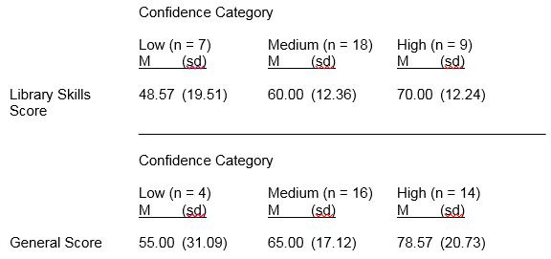
“The Library Catalog is Definitely the Best Place to Find Articles!”
Overconfidence Among Undergraduate Library Users
￼
Katelyn Angell, MLIS, MA
Long Island University, Brooklyn Campus
ABSTRACT
TITLE:
“The Library Catalog is Definitely the Best Place to Find Articles!” Overconfidence Among Undergraduate Library Users
BACKGROUND:
Beginning in the 1980s, researchers in a wide array of academic disciplines surveyed undergraduate students to learn if they were overconfident with regard to their knowledge of disciplinary subject matter. The majority of researchers have found that students tend to overestimate their abilities within a certain body of knowledge. Up until recently, most of these projects were conducted in the fields of education, psychology, and economics. In the past few years, several academic librarians have applied these methodologies to their undergraduate patrons, curious as to whether this population demonstrates similar overconfidence in their grasp of academic research.
OBJECTIVE AND METHODS:
The present study surveyed 34 undergraduates enrolled in psychology classes at a large urban university in the United States to determine if these students were overconfident about their knowledge in key library research areas. These questions included citing and referencing, identifying components of scholarly and popular sources, and developing and applying searches in electronic resources. A general knowledge survey was created for comparison purposes.
RESULTS AND DISCUSSION:
Statistical analysis showed that students displayed marked overconfidence on both tools, signifying a need for increased library and metacognitive skill instruction. These results were in line with the findings of similar studies conducted by researchers in disciplines such as psychology and economics.
METHODS
Participants
  34 undergraduates enrolled in undergraduate psychology classes
  Mean age: 25 years
  15 visited the library at least once for information literacy instruction
Measures
  Library Knowledge Confidence Scale
    10 true/false questions about library research skills
    Confidence level rating scale for each question
  General Knowledge Confidence Scale
    10 general trivia true/false questions
    Confidence level rating scale for each question
RESULTS
Each participant was categorized as low, medium, or high confidence to determine differences between incorrect answers and confidence levels for both library and general scales
Low scores on library knowledge scale (M=60)
  Translates into a “D” on standard grading scale
High confidence levels on library knowledge scale (M=2.35)
Low scores on general knowledge scale (M=69)
  Translates into a “D” on standard grading scale
High confidence levels on general knowledge scale (M=2.37)
Moderate positive relationship between scores on two tests (r=.36, p<.05)
  Performance on two tests was similar
DISCUSSION AND CONCLUSIONS
Conclusions
Alternative hypothesis was confirmed
  Students demonstrated overconfidence with regard to both library and general skills tests
    Results in line with psychology and educational literature
    Tendency to overinflate one’s knowledge can be extrapolated to additional topical areas
  Corroborated a similar study of undergraduate library patrons by Gross and Latham (2012)
    Students with lowest test scores most likely to show overconfidence
Limits
  Lack of diversity among gender and class year
    31 women and 3 men
  Small sample size
Strategies for decreasing overconfidence and improving research skills
Partner with teaching faculty to develop reflective and interactive courses featuring an embedded librarian (Polkinghorne & Wilton, 2010)
Teach students to carefully evaluate each answer on a test
  Reflect on their reasons for deciding that an answer is correct, first writing their rationale and then discussing their selection
  Teach metacognitive critical thinking skills with an emphasis on improving self-monitoring abilities (Molteni & Chan, 2015)
Investigate self-assessment of skills in outside disciplines, such as “human information behavior, the development of user interfaces, and evaluation of information systems and services” (Gross & Latham, 2012, p. 582)
Figure 1. Mean number of incorrect responses presented by confidence category
Sample questions from Library Knowledge Confidence Scale
Table 1. Means and standard deviations for the Library Knowledge and General Knowledge Scales and confidence levels
 | Scale Mean | Scale Standard Deviation | Confidence Mean | Confidence Standard Deviation
Library Skills | 60.9 | 15.47 | 2.35 | 0.35
General Knowledge | 69.41 | 20.74 | 2.37 | 0.47
WORKS CITED
Angell, K., & Kose, G. (2015). “The library catalog is definitely the best place to find articles!” Overconfidence among undergraduate library users. Partnership: The Canadian Journal of Library and Information Practice and Research, 10(2), 1-18.
Bruine de Bruin, W., Parker, A.M., & Fischhoff, B. (2007). Individual differences in adult decision-making competence. Journal of Personality and Social Psychology, 92(5), 938-956.
Gross, M., & Latham, D. (2012). What’s skill got to do with it?: Information literacy skills and self-views of ability among first-year college students. JASIST, 63(3), 574-583.
Molteni, V.E., & Chan, E.K. (2015). Student confidence/overconfidence in the research process. The Journal of Academic Librarianship, 41(1), 2-8.
Polkinghorne, S., & Wilton, S. (2010). Research is a verb: Exploring a new information literacy-embedded undergraduate research methods course. The Canadian Journal of Information and Library Science, 34(4), 457-473.
Table 2. Means and standard deviations for the number of incorrect answers on the Library and General Scales presented by confidence category (two one-way between-group ANOVAs)
Sample questions from General Knowledge Confidence Scale
Study Hypotheses
Null hypothesis: There will not be a significant relationship between test scores and confidence level on either instrument
Alternate hypothesis: The highest levels of confidence will be found in participants with the most incorrect answers
For additional information please contact:
Katelyn Angell
Assistant Professor/First Year Success Librarian
Long Island University, Brooklyn Campus
Katelyn.Angell@liu.edu

