Slide 1
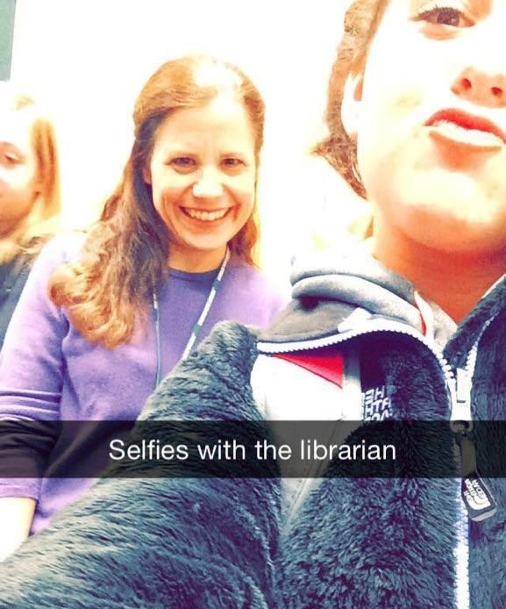

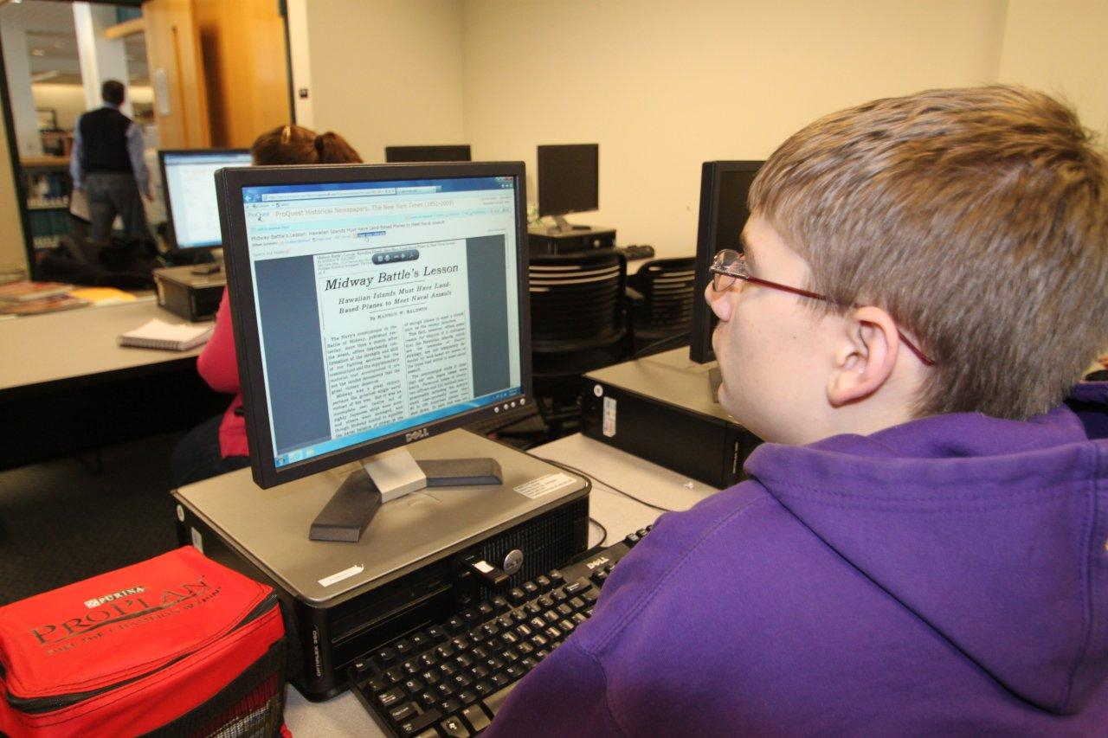
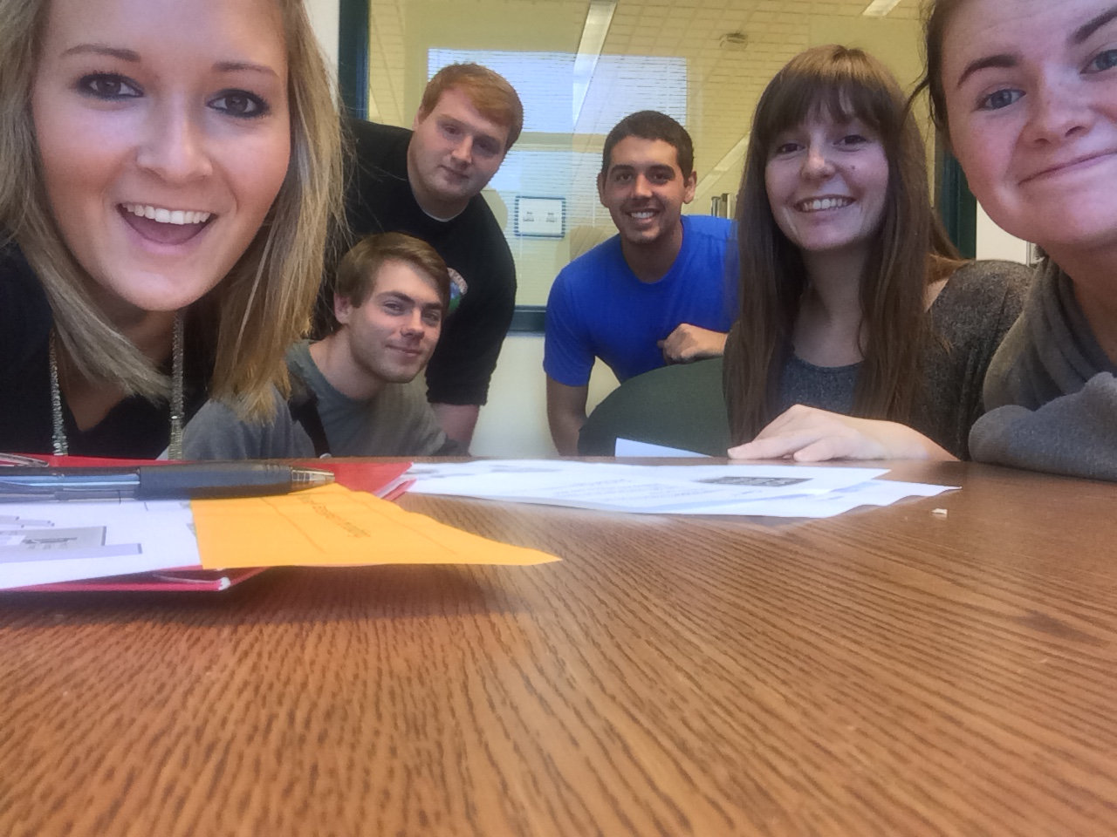
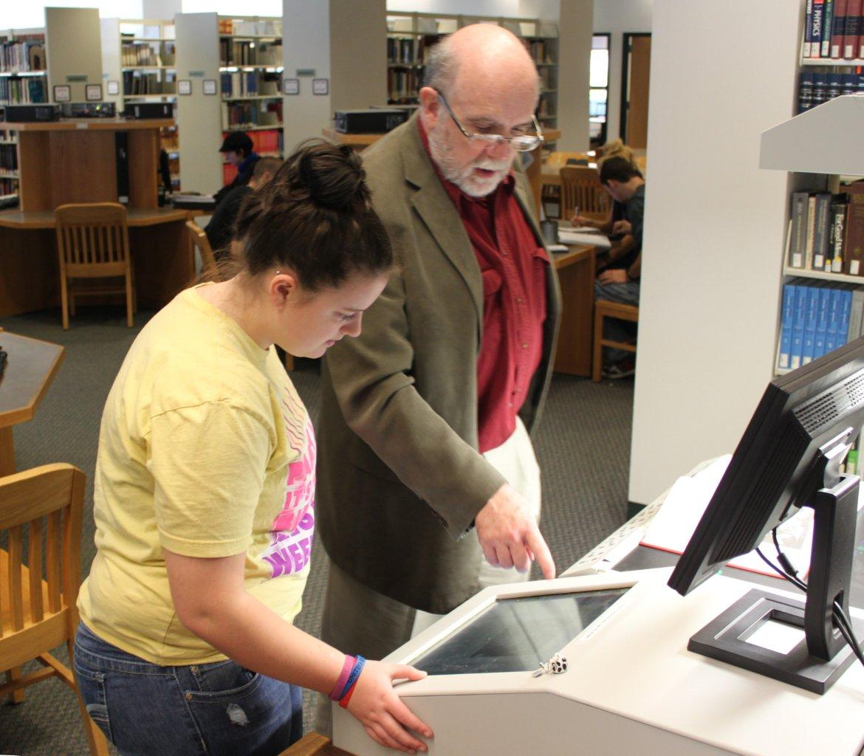
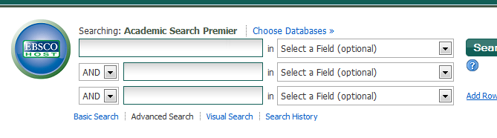
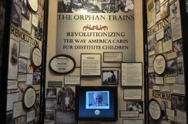
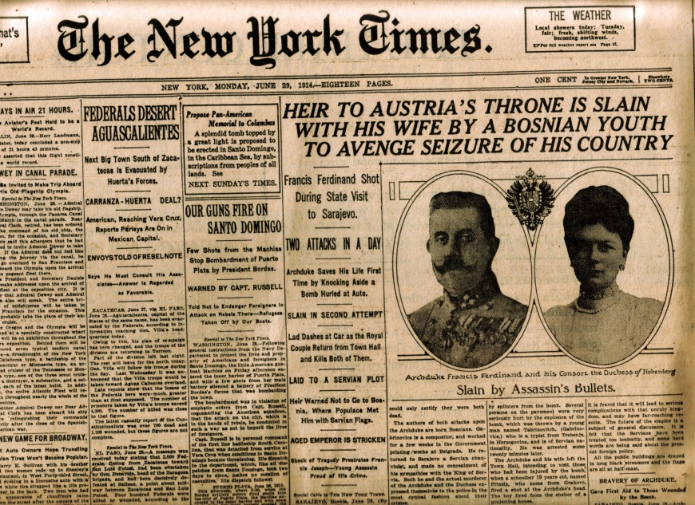
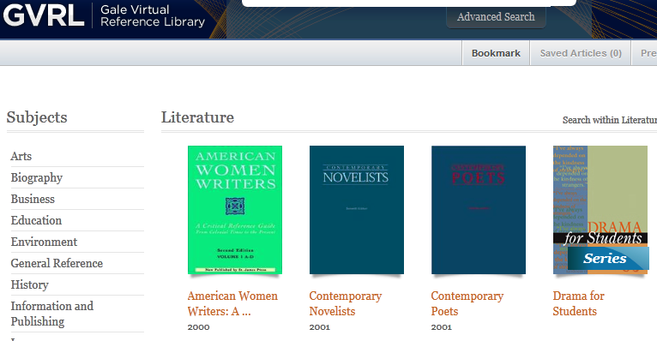
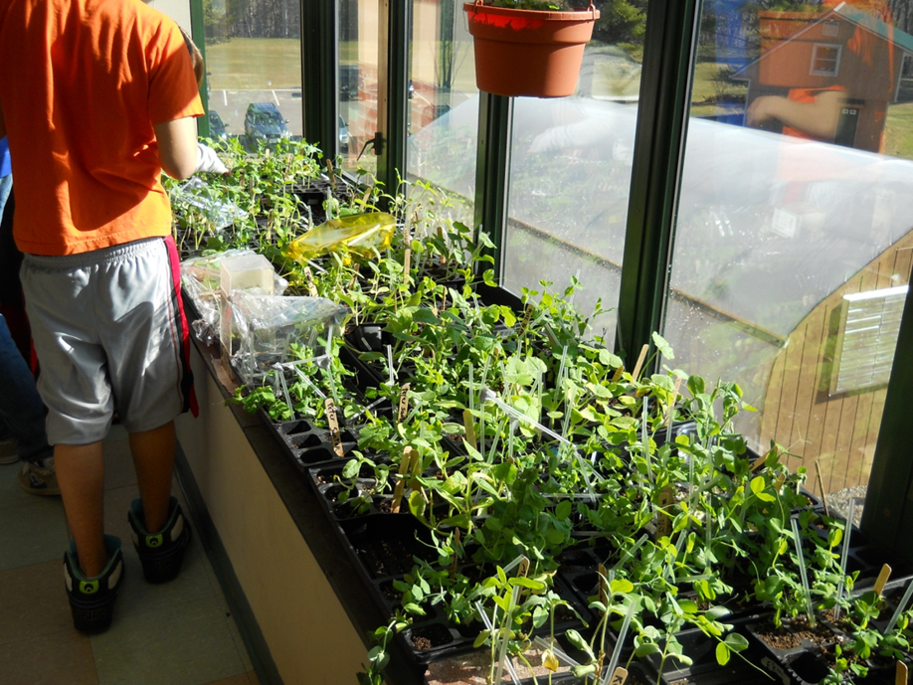
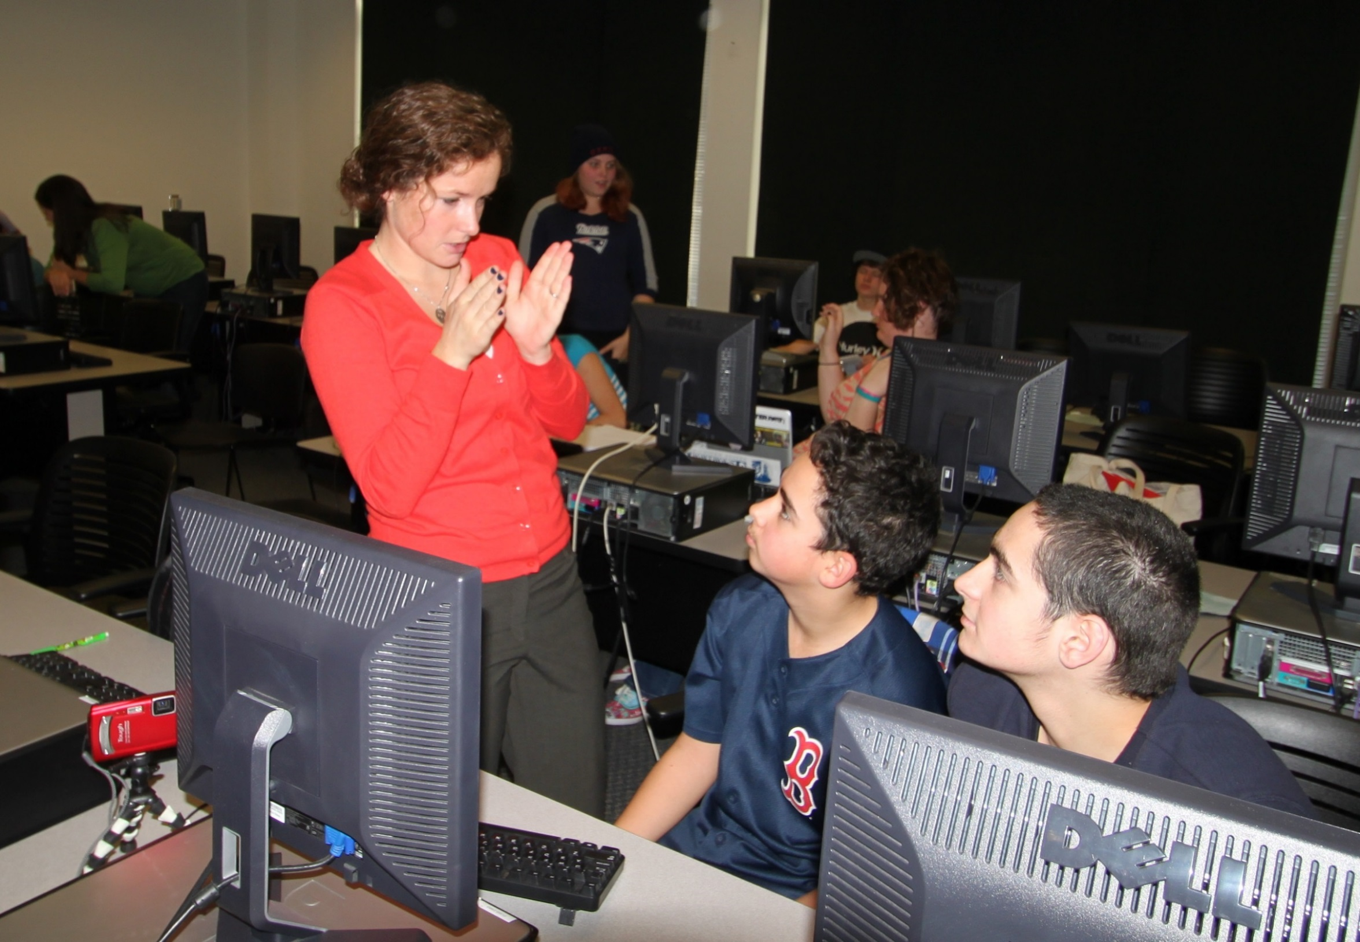
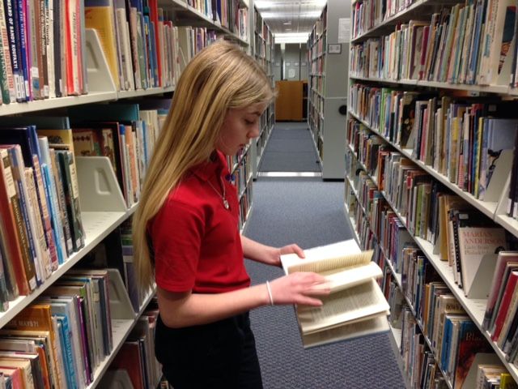
The New Frontier for Academic Library Outreach: Middle School Research Visits
Anne Jung-Mathews, Plymouth State University, NH
Why K-16 Matters
The Research Day
Sample Research Projects
National
History
Day
The Blueprint for Collaboration established between the ACRL and AASL in 2001 noted that information standards should seamlessly continue across all educational levels and that model collaborations should be developed and showcased.
Show basic resources not available in the school library and explore new tools.
Produce a happier, healthier plant.
“An understanding of the overall research process is difficult for students to understand unless they have been guided through it, given constructive feedback on their efforts, and provided the opportunity for reflection.” (Zoellner & Potter, 2010)
School visits provide service learning opportunities for your own students (Klopfler, Olwell & Hudock, 2004) and are an effective enrollment management tool.
Give students plenty of time to explore the library and university campus. Eat lunch at the dining hall and build in break times!

