Slide 1

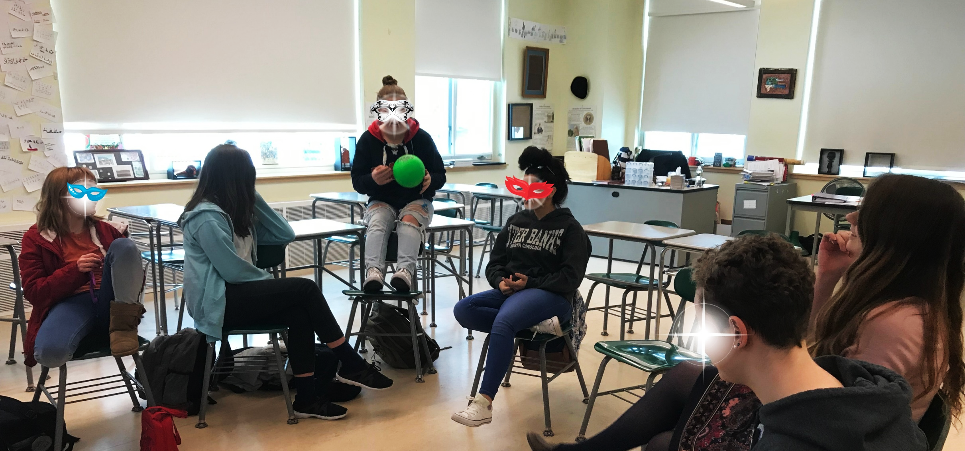

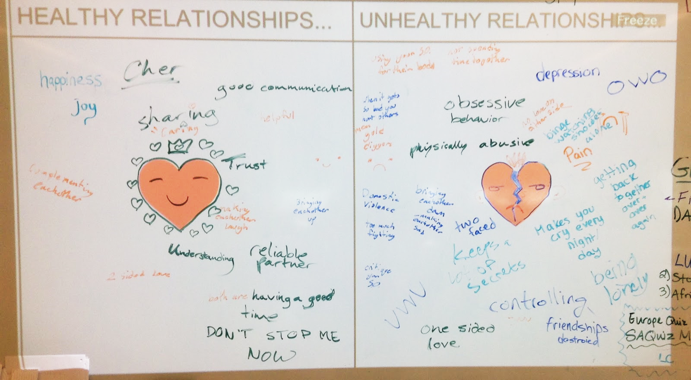


Abstract
The Importance of Social and Emotional Learning (SEL)
Female students ages 13-15 at a rural Massachusetts high school meet after school to explore and discuss real-world challenges faced by women and girls, reflect upon their own experiences, set goals, and develop leadership skills through the lens of the 7-Step Project-Based Learning Model.
Built upon the frameworks of both Social and Emotional Learning as well as Costa and Kallick’s Habits of Mind, this authentic, student-driven group is grounded by the following essential questions:
How do you navigate the world as a young woman? What kind of person do you want to become? What kind of community and world do you want to help create?
This experiential method of education seeks to promote learning through deliberate discussion, reflection, and action, which aligns with the purpose of Community Service Learning, in which students ”achieve real objectives for the community and deeper understanding and skills for themselves.”
“Inspiring girls to be strong, smart and bold relies heavily on girls having caring and supportive mentoring relationships, positive peer interactions, and an affirming environment where they can learn and pursue self-discovery.” – Girls Inc.
According to a study by the Collaborative for Academic, Social, and Emotional Learning (CASEL), students at schools that implement SEL programs show improvements in mental health, social skills, and academic achievement. They develop and sustain positive social behaviors, acquire skills likes empathy and teamwork, and experience fewer conduct problems, less emotional distress, and lower instances of drug use.
“Sister Squad” provides young women with the opportunity to experience social and emotional learning and personal growth in a safe, supportive, non-judgmental, and student-centered environment.
Resources
What Do We Do?
I wanted to create a space where 8th grade girls could:
Discuss their personal successes and struggles and support each other in times of need
Better prepare themselves for the academic and social challenges of high school and the world beyond
Develop social and emotional leadership skills that they can transfer into their social circles, sports teams, clubs, etc.
Become (more) empowered and confident in their sense of self
Developing these skills will help these young women navigate high school, college, the workplace, their social groups, and their family lives.
Each week, we meet in my classroom to explore a different topic from the list that we created. Most sessions begin with an unstructured brainstorm that functions both as a formative assessment and a warm-up activity (see image below). I prepare discussion questions or other supplemental materials such as videos or activities, and the student-led exploration of the topic continues organically.
Janet S. Eyler and Dwight E. Giles, Jr.: Service Learning or Community Engagement
https://cft.vanderbilt.edu/guides-sub-pages/teaching-through-community-engagement/
Arthur L. Costa and Bena Kallick: Habits of Mind
http://www.ascd.org/publications/books/108008/chapters/Describing-the-Habits-of-Mind.aspx
The Ophelia Project: Relational Aggression
https://www.opheliaproject.org/GirlsRA/GirlsMS.pdf
CASEL: SEL Impact
https://casel.org/impact/
Who Are the Students?
Our after-school group, affectionately known as “Sister Squad”, began when I approached female students in my 8th grade social studies classes who exhibited a variety of the habits of mind described by Costa and Kallick (1996) such as “creating, imagining, innovating” or “listening with understanding and empathy” and showed leadership skills or potential either in or out of the academic classroom environment.
I proposed the idea of an after-school group for girls and at our first meeting, the students led a discussion in which we brainstormed a list of topics that they were interested in exploring such as social media, gender inequality, female friendships, romantic relationships, self-esteem, as well as problems in the school and greater community for which we were interested finding solutions.
The original group of girls has since recruited more friends to join in. We meet on Mondays after school for about 45-60 minutes.
Anna Hartmann
Bridges to the Future

