Slide 1



So, What is GIS Anyway?
Forrest J. Bowlick, University of Massachusetts – Amherst

Slide 2
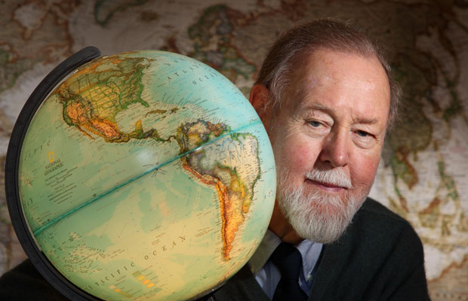
The Term GIS
The term Geographic Information System (a.k.a. GIS) appears to have been coined by Roger Tomlinson for the Canadian Department Forestry and Rural Development in the early 1960’s.
The Canada Geographic Information System (CGIS), created in 1966, was the world’s first true GIS.
Roger Tomlinson
Data for Decision
https://www.youtube.com/watch?v=3VLGvWEuZxI
Image source http://jegans.files.wordpress.com/2010/09/rogertomlinson.jpg

Slide 3
While We Watch
Think about how GIS is presented in this short clip.
Go to: tx.ag/GIS2 and answer questions
Make sure to input student ID # for participation credit.

Slide 4
Some GIS Definitions
A container of maps in digital form;
A computerized tool for solving geographic problems;
A spatial decision support system;
A mechanized inventory of geographically distributed features and facilities;
A tool for revealing what is otherwise invisible in geographic information;
A tool for performing operations on geographic data that are too tedious or expensive or inaccurate if performed by hand
Taken from Longley et al. 2005. Geographic Information Systems and Science 2nd

Slide 5
The Province of GIS
Geographical Information Systems or GIS have been a technical revolution within geography (and sister disciplines), but what exactly is a GIS?
GIS is more than a software package.
GIS is built upon geography, cartography, database theory, statistics, etc…to help organize and analyze SPATIAL data.

Slide 6
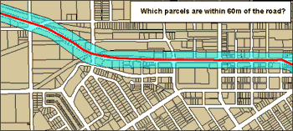
We can use GIS to answer a host of questions...

Slide 7
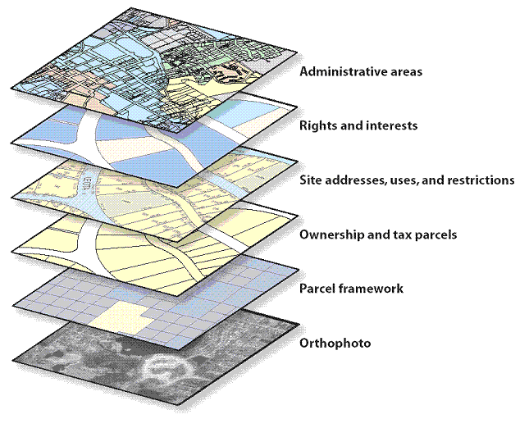
GIS is a way to organize different data elements or ‘themes’
Source: http://webhelp.esri.com/arcgisserver/9.3/java/geodatabases/data_themes_as_layers.gif

Slide 8
SPATIAL, SPATIAL, SPATIAL!
It is the notion of SPATIAL data that makes GIS unique.
At a minimum, a GIS must then be composed of at least three things
1) A Database containing attribute information
2) Spatial or Map Information
3) A way to link (1) and (2)

Slide 9
What is GIS?
That very much depends on who you ask…
GIS is a Tool Box
GIS is an Information System
GIS is an Approach to Science
(adapted from) Keith Clarke’s Getting Started with Geographic Information Systems

Slide 10
The Functional Aspects of GIS
A GIS can do the following things with spatial information:
Capture
Archive
Retrieve
Project
Analyze
Display

Slide 11
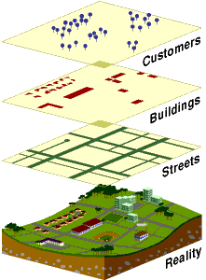
GIS is an ‘abstraction’ of Reality

Slide 12
ArcMap Demo

Slide 13
Key GIS Use Tips
Always read, understand and follow the directions that come with your tools.
Someone has had your problem before…and probably posted about it on the internet.

Slide 14
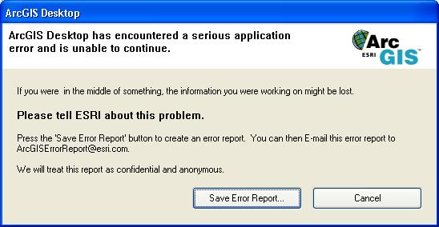
Read the Manuals
Help is always your best friend.
It is very much in your best interest to become skillful in searching.
If I or your TA can find an answer to your question with our first Google Search…don’t you think we wonder if you really searched before asking us?
arcgis error 00732
http://gis.stackexchange.com/questions/79718/arcpy-error-000732-when-applysymbologyfromlayer
http://help.arcgis.com/EN/arcgisdesktop/10.0/help/00vp/00vp00000017000732.htm

Slide 15

Backup!
Backup Often, think about how much time you want to lose…
Backup your data with multiple means of access
Never have your only copy on a Thumb Drive
If there are files you don’t want people to see then don’t put them on your thumb drive
Source: http://mjbwebstorage.blob.core.windows.net/markjbrownmedia/2015/04/BackupsAreForWimps.jpg

Slide 16
To Summarize…
GIS represents a lot of different ideas and conceptions.
How you interact with the GIS will change over time.
Keep in mind that what you think GIS is might not be what someone else does…

