Slide 1




Afghanistan University Support and Workforce Development Program

Slide 2

Thanks to All for Your Support
The Higher Education Project (HEP) has been a great success - thanks in part to the strong support of all the offices on campus.
Together we learned how to manage being the prime contractor on a large and complex international project.

Slide 3
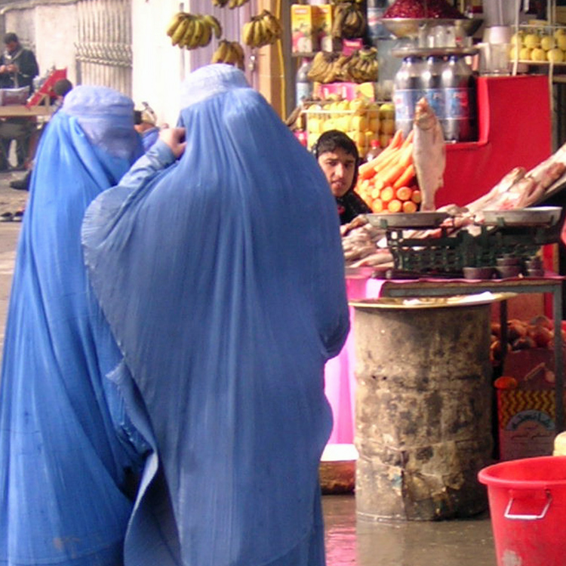
UMass Campus Team
David R. Evans
Joe Berger
Barbara Gravin Wilbur
Hunter Gray
Hassan Aslami
Regina Gillis
Rohina Amiri
Mujtaba Hedayet

Slide 4

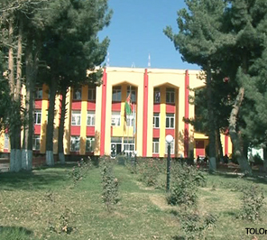
UMass & Afghanistan Higher education
HEP 1 - UMass as sub to AED (2006 – 2011)
HEP 2 - UMass as prime (2011- 2014)
AUSWDP – UMass as sub to FHI360 (2014-2019)

Slide 5
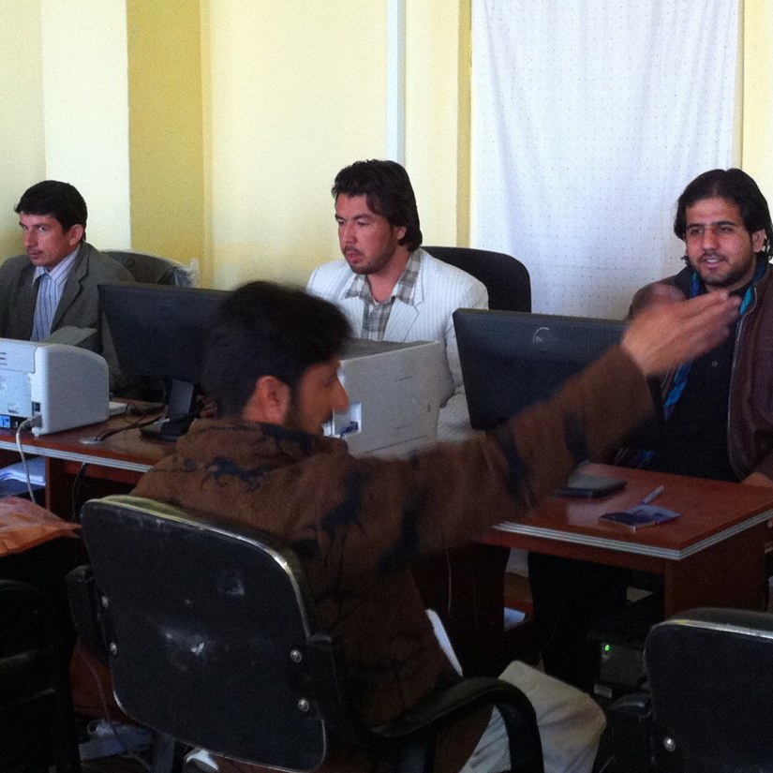
Accomplishments of HEP
Five classes have graduated from the M. Ed. Program – 110 students, half of them women.
The first class from the new MPPA will graduate in March 2014. The second class is being admitted now.
A new Associate Degree in IT is admitting its first class in March 2014
Substantial capacity development has occurred in the MoHE

Slide 6
Transition Timeline
Jan
March
April
Feb
HEP 2
AUSWDP
UMass Pre-Authorization

Slide 7
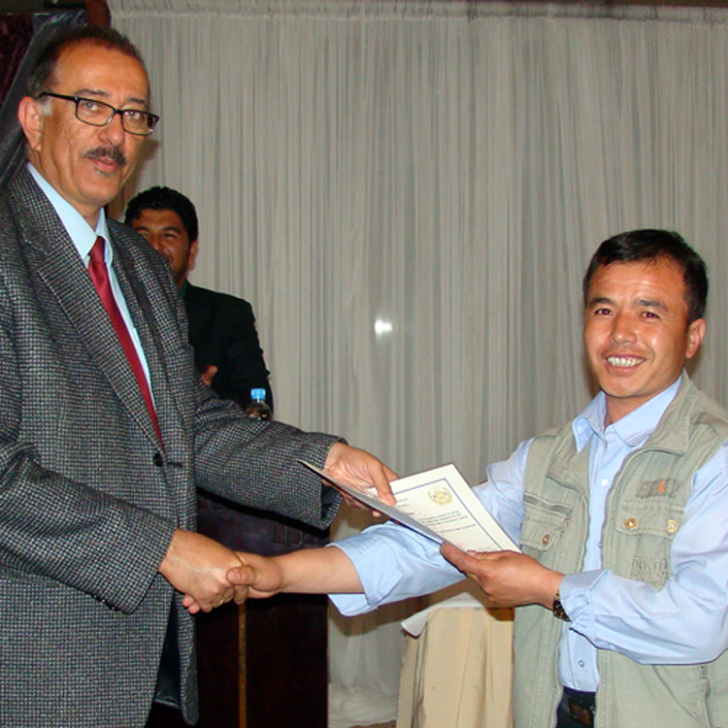
Close out of Hep 2 – February 2014
Tasks during close out
Disposition of Property – transferred to AUSWDP
Complete Final Project Report
Transfer Financial/Human Resource Documents to UMass
Close out all financial transactions

Slide 8
Transition - January & February
Tasks during transition
House & Office shared by staff of two projects while FHI360 decides on facilities
Most HEP personnel finish January 31
Some key personnel continue into February either on HEP or split between projects. (Finance, HR, IT)
All Afghan staff given two-month (Feb-Mar) fixed contracts financed through UMass/AUSWDP account

Slide 9
Authorization from FHI360
UMass will pay field costs for FHI until they have an account and financial system in place
Authorization valid January 1 through April 30, 2014
Allows UMass to pre-establish an account prior to finalizing sub-contract
Limit of $1.12 million
UMass pay leases and service contracts through March
Some key personnel continue into February either on HEP or split between projects. (Finance, HR, IT)
All Afghan staff given two month (Feb-Mar) fixed contracts financed through UMass/AUSWDP account

Slide 10
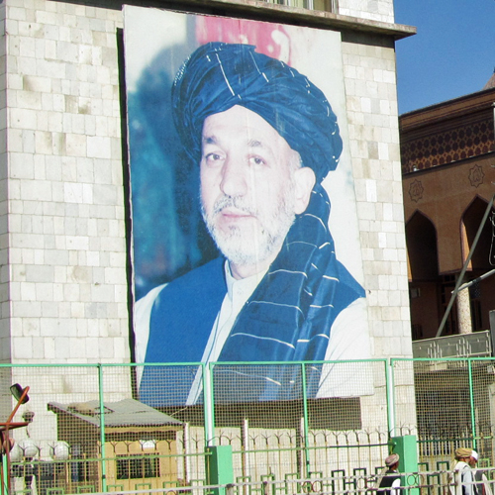
AUSWDP Consortium
FHI360 – Prime Contractor
UMass Amherst – CIE
Purdue University
Altai Consulting
Afghan Holding Group

Slide 11

Family Health Initiative 360
FHI 360 works side by side with ministries, communities, schools, teachers and families to create education systems that respond to the complex, dynamic and diverse needs of the people they serve. Our programs emphasize the use of data for decision-making, foster student-centered learning and promote education in fragile and post-conflict areas. We are a leader in designing international exchanges that promote leadership, professional development and global collaboration.

Slide 12

Project Overview
Purpose
  Increase the skills and employability of professionally qualified Afghan men and women in the private and public sectors
  Component 1: Strengthening MoHE
  Component 2: Working with 10 Universities

Slide 13
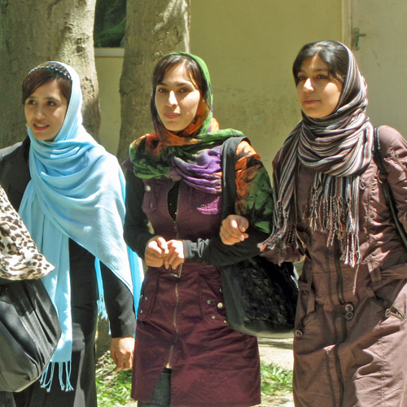
Component 1: Strengthen Ministry of Higher Education’s Systems and Management Capacity
Strengthen MoHE’s management systems for implementing and monitoring university quality assurance and accreditation standards
Develop policy and procedural capacity to support public university autonomy
Improve management of the MoHE’s human, financial and other resources

Slide 14
Component 2: Strengthen university management, academic programs, and links to employers
Strengthen university Quality Assurance and management systems
Strengthen existing curricula and develop new programs for
market-oriented skills
Develop and pilot Associate Degree programs
Establish career and partnership centers
Establish university partnerships between select Afghan universities and US/international universities and the private sector

Slide 15
Challenges for UMass
Learning to be a sub-contractor with FHI360
Working with incremental obligations
Creating a sub-contract with Community Colleges in International Development (CCID)
Identifying 3 US Community Colleges to partner with Afghan Universities using sub-contracts

Slide 16
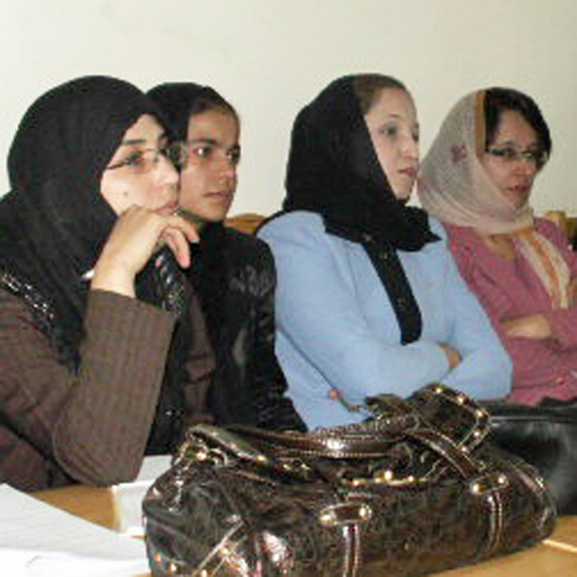
Changes from HEP 2
In this contract UMass will generally not be responsible for
Relations & Reporting to USAID
Procurement in Afghanistan
House & Office, services, transport
Security
Local travel

Slide 17
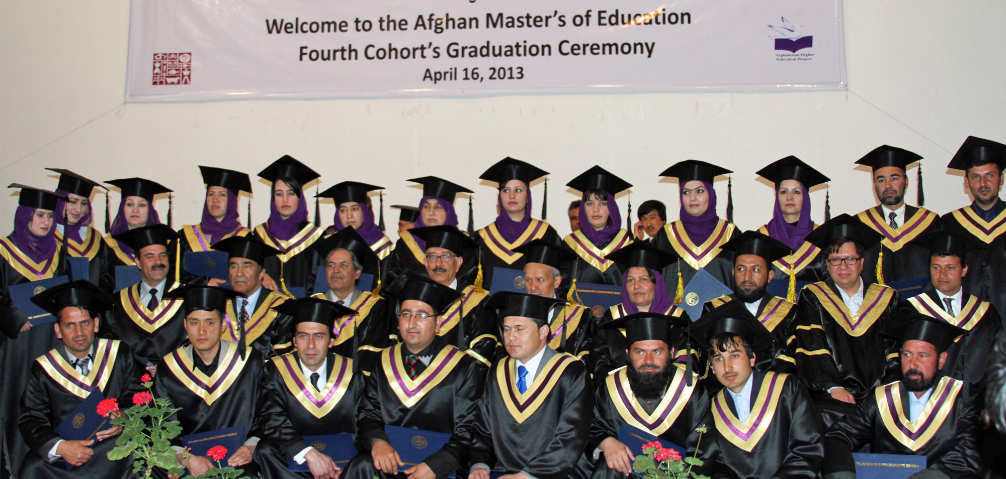
The future of Afghanistan

