Slide 1
Data Integration
DRMS
May 15, 2018
Kathleen Berry
DRMS Unit Coordinator

Slide 2
Multiple data sources=Duplication!
Duplication of effort every step of the way: set up, maintenance, removal
Duplicate records means cluttered and confusing search results
De-duplicate records in search results of our primary interface, Discovery Search
  duplicate records confuse users
  push other relevant content down

Slide 3
What is Data Integration?
Reduce duplication of staff effort/records across our Library systems
Approved by SMG and put into practice in DRMS October 2016
Provide the best quality search and retrieval experience in our primary Interface Discovery Search (EDS).

Slide 4
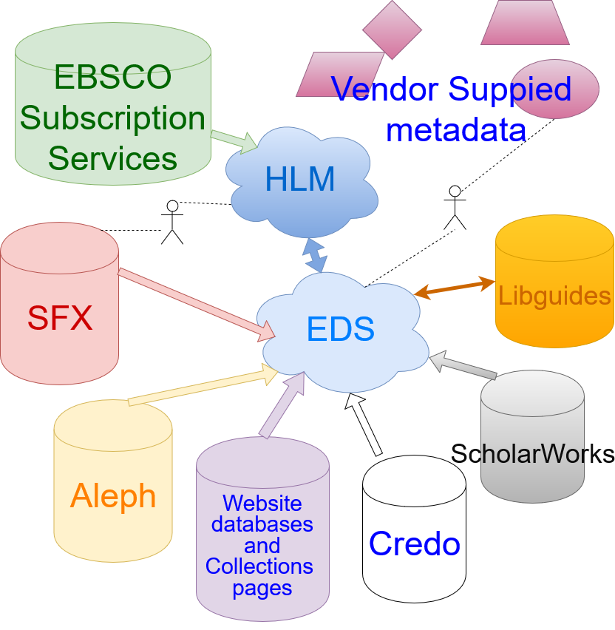
Notes:
harvesting your MARCXML records metadata via OAI-PMH (Open Archives Initiative Protocol for Metadata Harvesting) to create and maintain your custom catalog database. Using OAI-PMH for automated harvesting bypasses the more commonly used process of exporting a file from your ILS and sending it to us via FTP on a regular basis.

Slide 5
Data Integration Process:
Research!
What is the resource type?
Does the vendor supplied metadata in EDS accurately represent what we purchased/subscribed to?
Does the resource have MARC records available?
Talk it out!
Team creates strategy for maintenance
Act!
We activate or load and when necessary reevaluate and change strategy.

Slide 6
Benefits of Vendor metadata in EDS
Ebsco does the work for us!
  metadata is maintained between ebsco and vendors
Ebsco automatically loads/sets up access for ebooks we purchase from them.
Ebsco manages content purchased via them in HLM (Holding and Link Management)
Notes:
We save ourselves the effort of updating/overlaying and deleting/adding records to Aleph and then de-duping in EDS.

Slide 7
How often does Aleph data refresh in EDS?
Twice a week!
File of updated/deletes/new records sent to Ebsco.
Ebsco catalog team compares to last load and then processes.
8% difference? Double check the load!

Slide 8
Thank you!
Questions?

Slide 9
Discovery Search solves problems of novice users
Competing priorities
Research anxiety
Poor navigation aids/skills
Notes:
While more advanced users (think graduate students or faculty) often have several go-to resources that are part of their research process, novice users are dealing with several kinds of obstacles during the research process that a single search box helps solve for them:
Competing priorities. These include other academic priorities, like other deadlines or exams, as well as non-academic priorities like jobs, caring for family or experiencing the social side of college. These competing priorities mean users are looking for ways to make the research process more efficient, and a single place to search fits the bill.
Research anxiety. For novice users, there is often a strong sense that library resources are for people who know how to do research, and they don’t identify themselves that way. The more complicated the interaction, the more the interaction reinforces this belief and the more likely users are to abandon the library completely for something that feels more familiar and comfortable.
Poor navigation aids. Now, I’m not saying this is the case at UMass, but library websites often reflect more about the library’s administration than they do their users’ needs. This means that finding the several places they’re supposed to search for an assignment can feel like a huge burden. There are several factors that may be at work here:
List of databases is buried/hard to find
Databases are named/described in ways that don’t make clear what’s available in them
Users may have received some library training, but not enough to feel confident using the databases this way

Slide 10
Material types and sources for EDS
Ebook/ebook collections =Aleph or EDS vendor data
Ejournal/ Ejournal package/Article database=Discovery Search (EDS) and SFX
Audio/video /visual collections=Aleph or EDS vendor data
Archival materials= Aleph records to represent collection
Thesis and dissertations= Scholarworks or Aleph
Physical materials stored in the library= Aleph

Slide 11
Aleph Clean Up Project

Slide 12
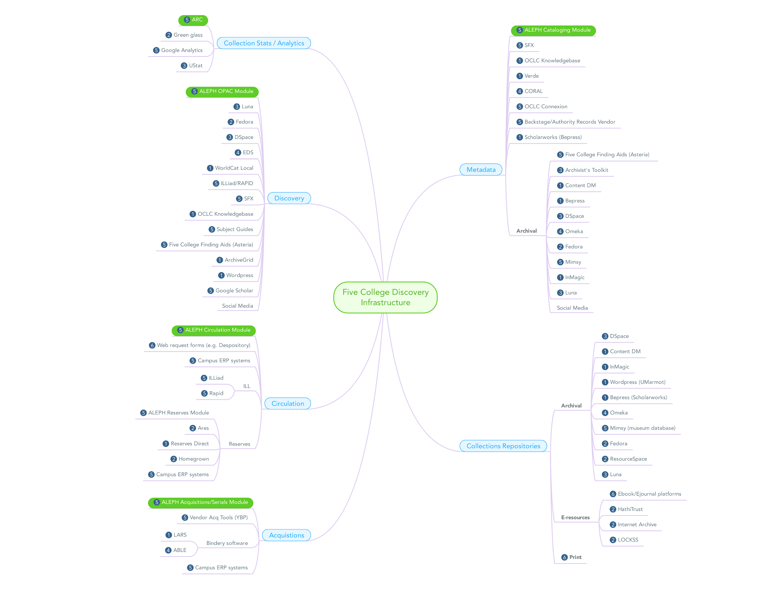

Slide 13
Types of linking
Aleph Records
Smart Linking
Custom Links
Smart Linking Plus

Slide 14

Aleph
A crafted file of Aleph Records is sent to Ebsco every couple days
Displays only when 856$z =
  link to free resource
  “begins with UMass or Five College”
  View collection description

Slide 15


Smart linking
Smart Linking provides a user the Ebsco copy of the PDF full text/html full text
  Note: The CITATION of an article could be provided by a non-Ebsco vendor, but the FT copy is from Ebsco.
  Difference between Smart Linking and Persistent Links
    Smart links have session information, Persistent links do not.
  If Ebsco does not have a PDF, a custom link is presented to the article/resource

Slide 16
Custom Links
When ebsco cannot find a PDF of an article in their servers, they send the researcher out to the database that provided the citation information of the article/resource.
custom linking best practices

Slide 17



So many different types of Customlinks!

Slide 18

Smart Linking Plus
"linked Full text"- is linked FT to our Ebsco journal subscriptions.

Slide 19
How do we prioritize linking?
  Our ranking system matches/works like our SFX ranking system.
  Each search result citation is run down the list to find the FIRST AVAILABLE resource with Full text
    When EBSCO does not have the PDF/html (aka Smart Linking) it scans the connected DBs to provide the custom link to the full text i.e.-
    instead of

Slide 20
How do we prioritize linking?
  The list of databases who give EBSCO citation/PDFs to support the smart linking is currently on libwire
  Home » Divisions & Departments » Information Resources Management » 2017July25 Discovery Search Data partners

Slide 21
Open URLs
What are they?
A standardized way to pass information about a particular item or resource.
How do libraries use them?
Pass citation information from an A&I source to a library service that provides the desired access (which is usually set to full text).

Slide 22
example
http://sfx1.exlibris-usa.com/demo?
sid=ebsco:medline&
aulast=Moll&
auinit=JR&
date=2000-11-03&
stitle=J%20Biol%20Chem&
volume=275&
issue=44&
spage=34826

Slide 23
SFX OpenURL generator
This tool is used to troubleshoot broken links in SFX
  Also helpful to learn how these URLS are using information!
Gale’s inbound OpenURL generator is also used for troubleshooting by some.

Slide 24
OpenURL information:
Worldcat OpenURL Resource
The OpenURL and OpenURL Framework: Demystifying Link Resolution
Wikipedia! The article is actually great

