Slide 1

Community Over Commercialization
World Librarians Club: A Panel
Tuesday, October 24, 2023
W.E.B. Du Bois Center
Mia Klotz, Hari Krishnan, Samantha O’Connor, Sravya Tanikella, Charles Schweik, and Theresa Dooley
University of Massachusetts Amherst University Libraries

Slide 2


Our Agenda
Introductions (Who are we?)
Background (Our Origin Story)
Why Librarians?
Technical Workflow
The Search Process
Questions

Slide 3
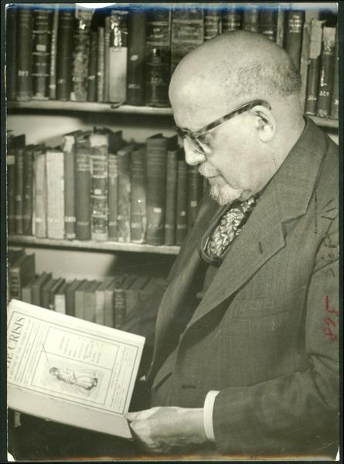
“The name Du Bois means hatred of racism and colonialism, of repression and bigotry, and devotion to science, brotherhood, popular and national equality, and socialism.”
Herbert Aptheker, 1968
W. E. B. Du Bois in his office, ca. 1948. W. E. B. Du Bois Papers (MS 312). Special Collections and University Archives, University of Massachusetts Amherst Libraries

Slide 4
Introductions
Who Are We?
Did you know?
We are a Registered Student Organization, and all students can join! You can find our page in Campus Pulse.

Slide 5
Background
Our Origin Story
Did you know?
This has been a collaboration with the UMass Libraries since day one.

Slide 6



Slide 7
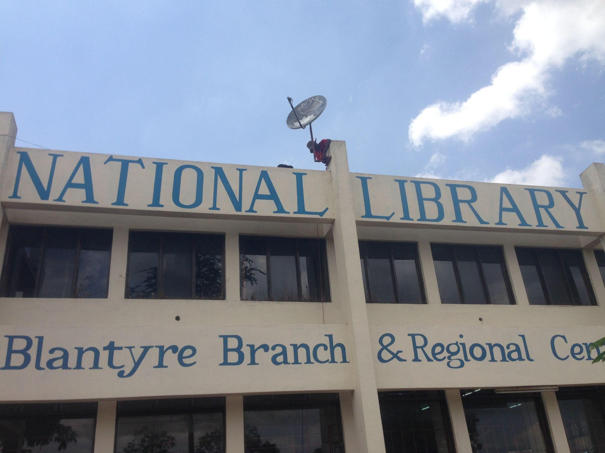
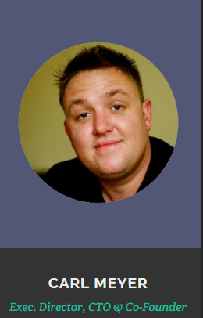
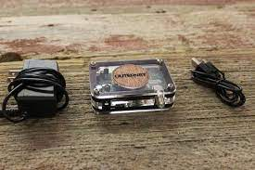
Outernet

Slide 8
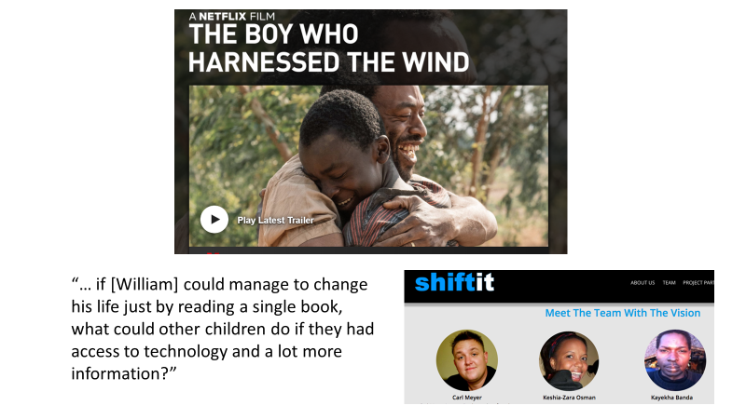

Slide 9

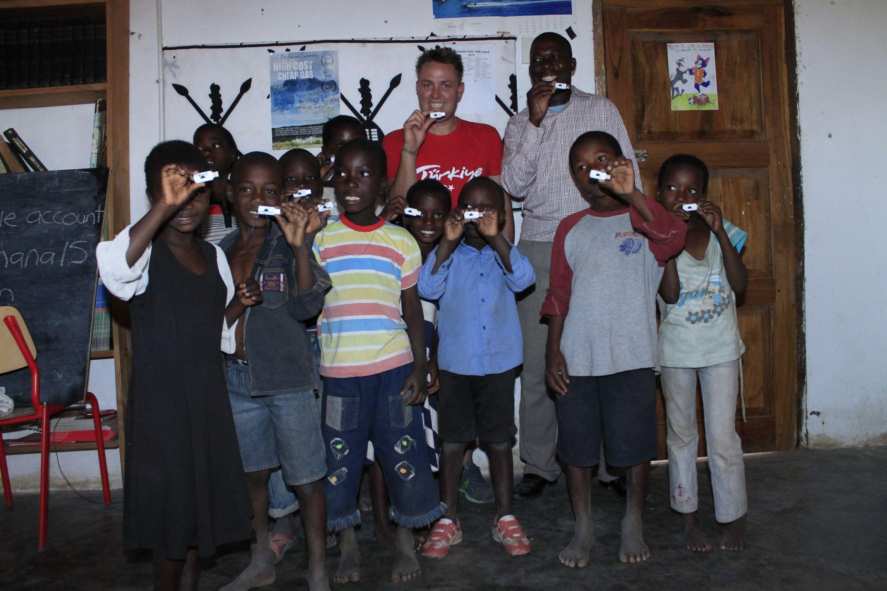
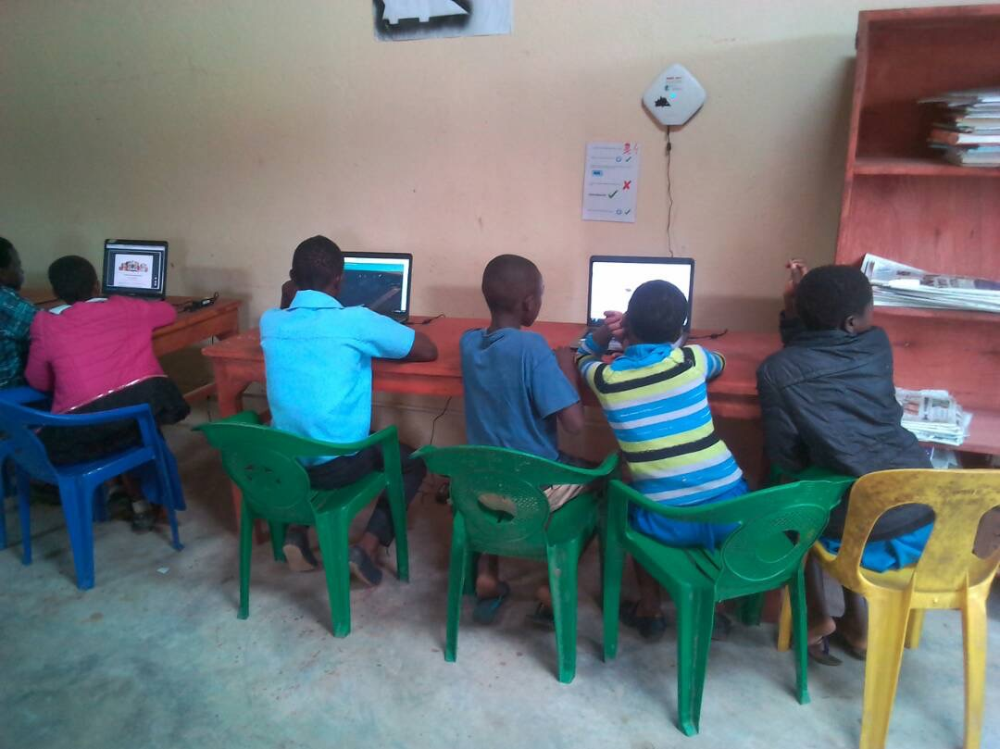

Slide 10
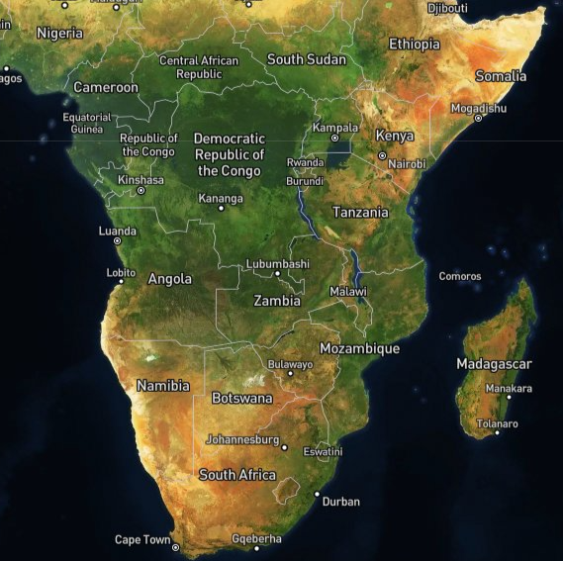
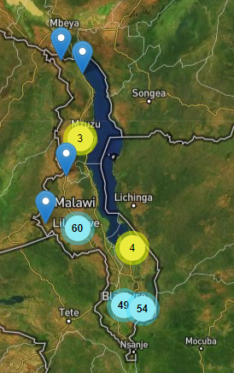
Pre-pandemic – we had about 25 schools and libraries operational.

Slide 11
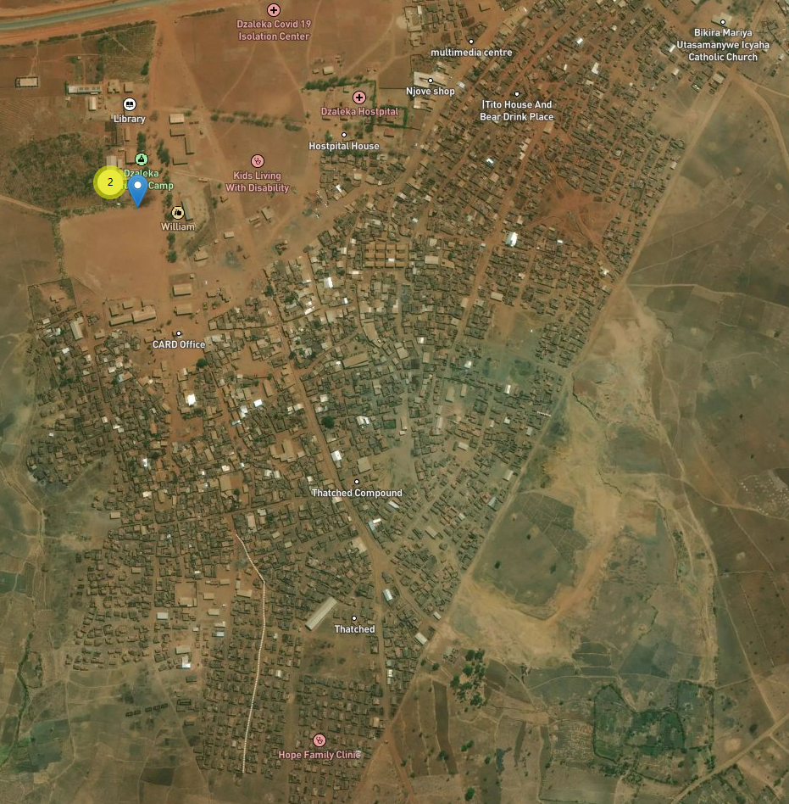
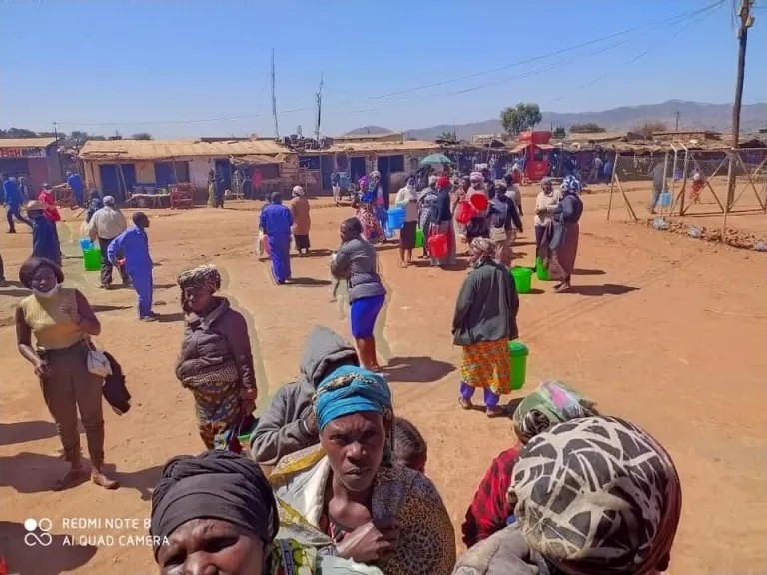
Our latest! June 2025
Dzaleka Refugee Camp, Malawi

Slide 12
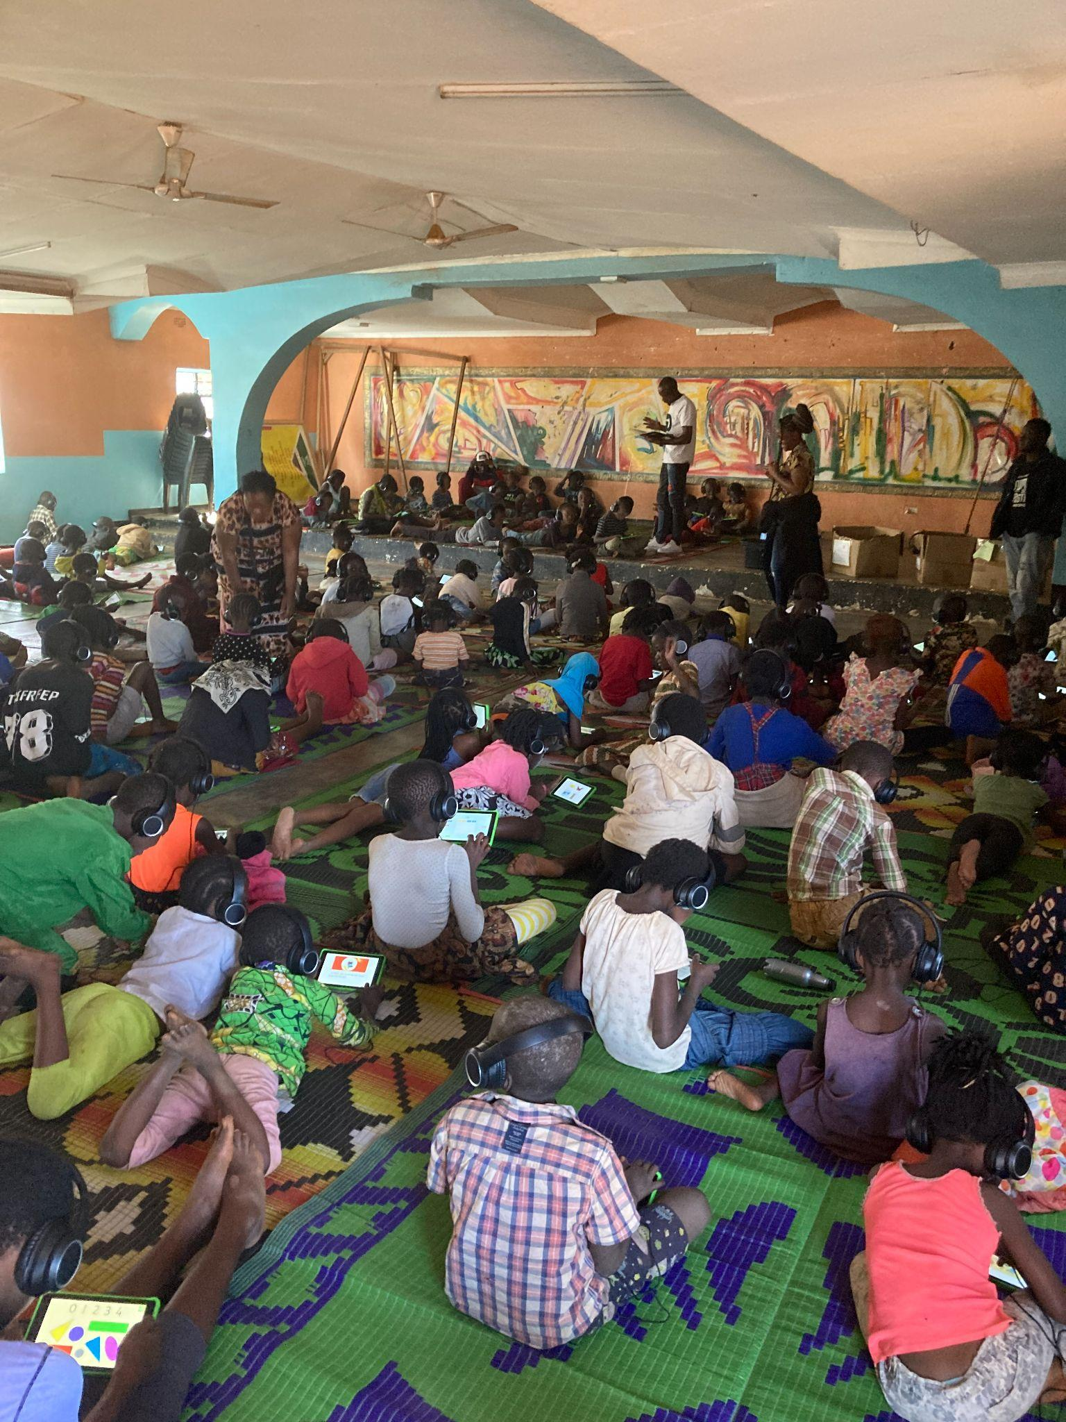


Slide 13
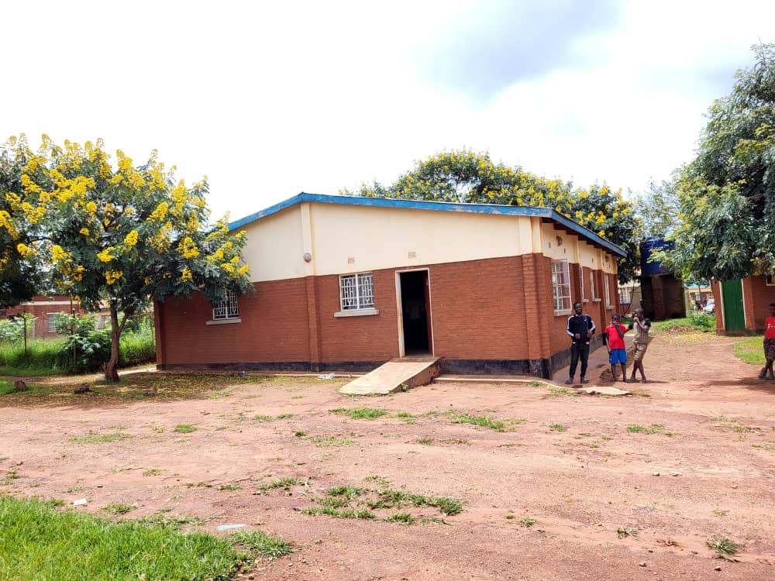
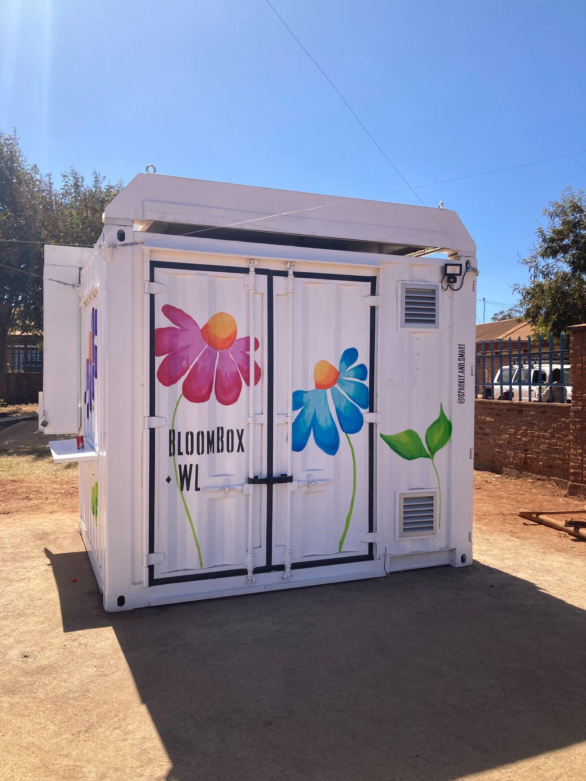
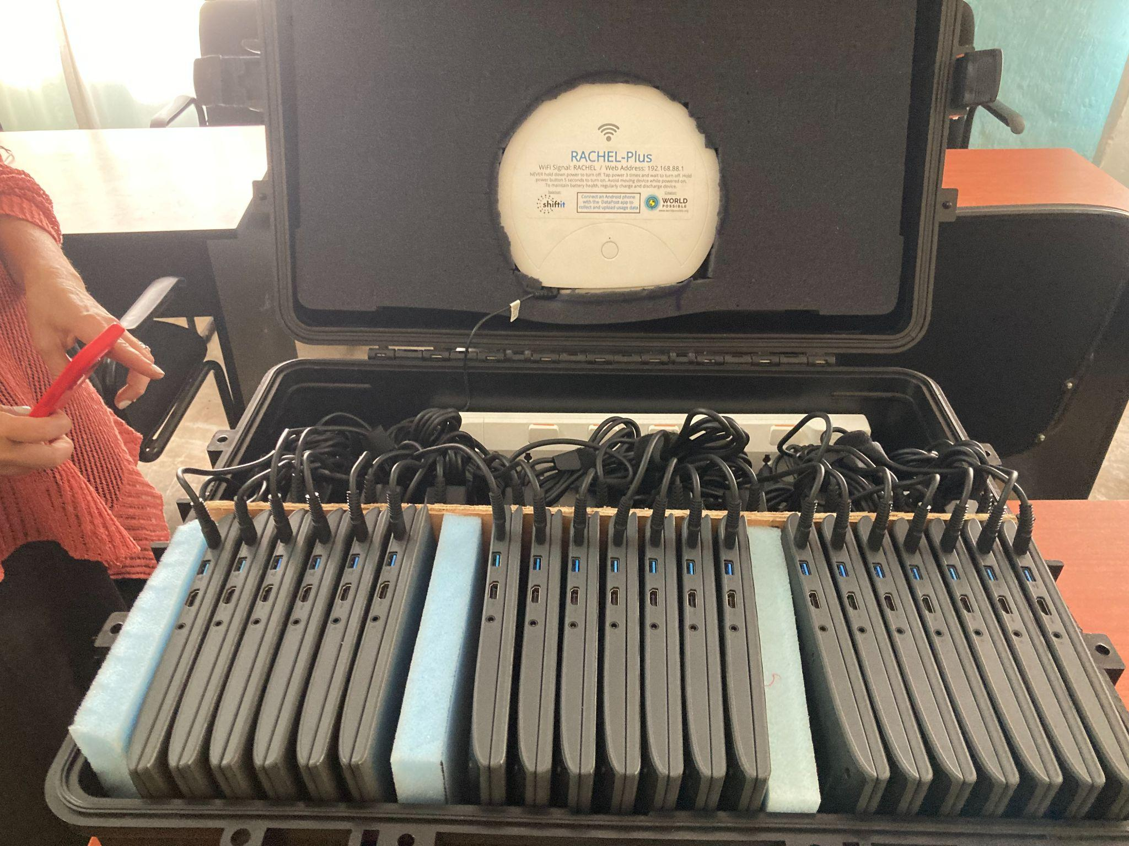

Slide 14
Why Librarians?
  Organizing and preserving information
  Reference Interviews
  Understanding our users - getting to know our communities
  Open resources
Did you know?
Not only are OER’s free to retain, they’re free to reuse, revise, remix, and redistribute.

Slide 15
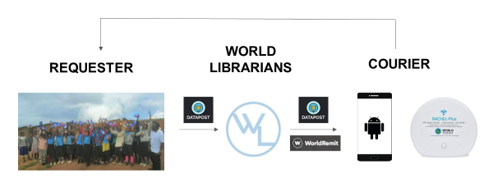
The technology that makes it possible
RACHEL
DATAPOST
Keepod
World Remit

Slide 16
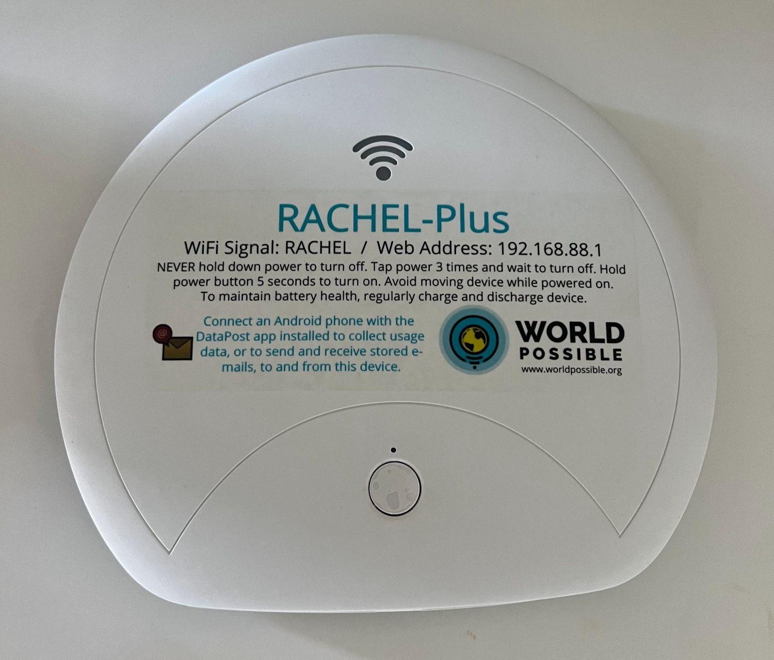

www.rachel.worldpossible.org

Slide 17
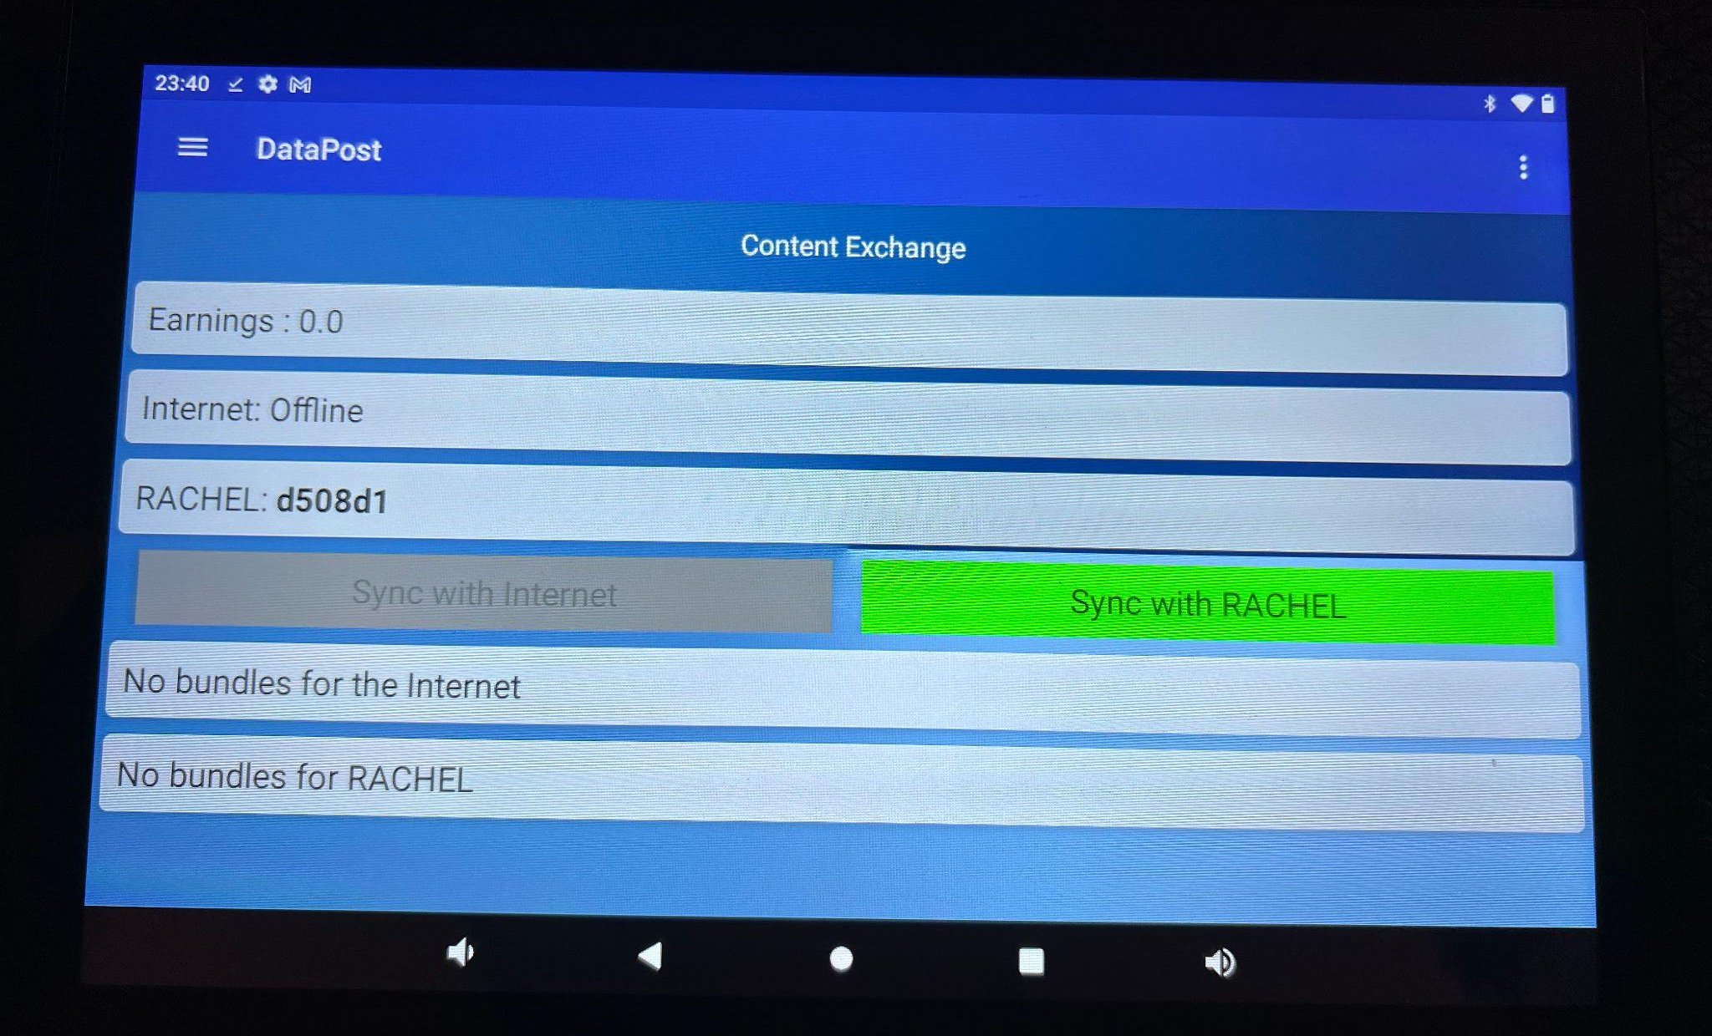

Notes:
DataPost is a quick and easy way to get information to and from your RACHEL device without needing to put RACHEL on the internet. Anyone travelling to your RACHEL device with an Android Phone can serve as a digital mail courier, bringing new emails to RACHEL and picking up outgoing e-mails from the device.

Slide 18
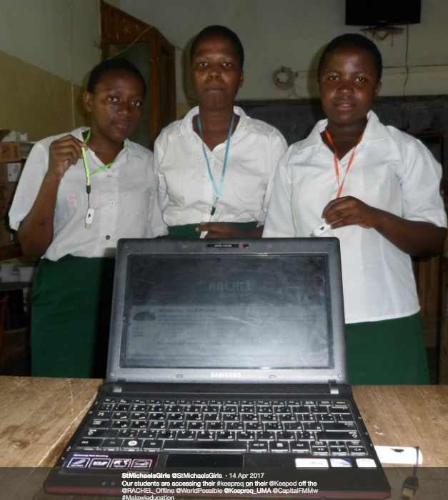
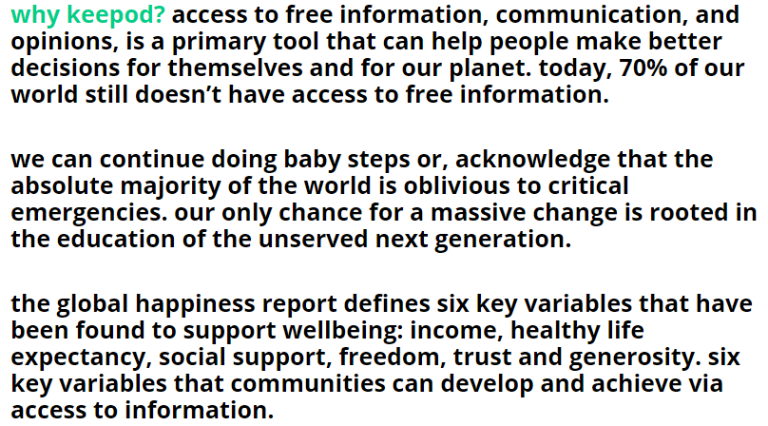
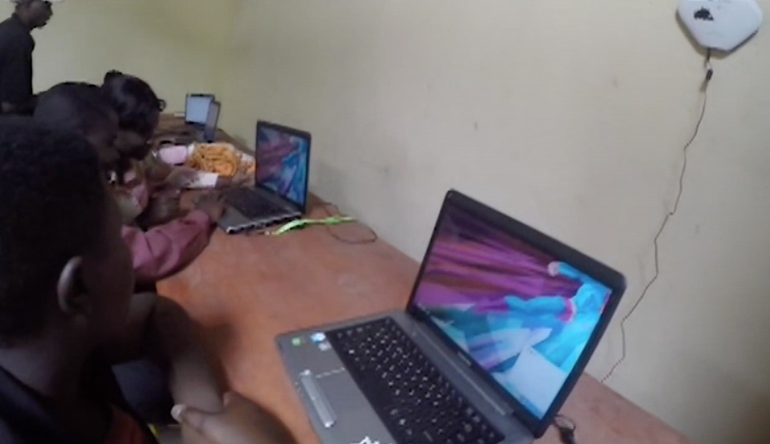
"The $7 PC!"

Slide 19
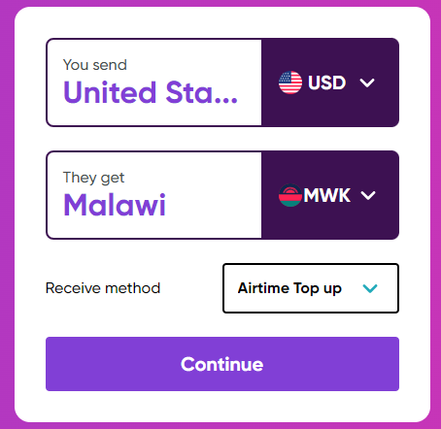


Slide 20
Search Process
How do we find OER?
Did you know?
XXX

Slide 21
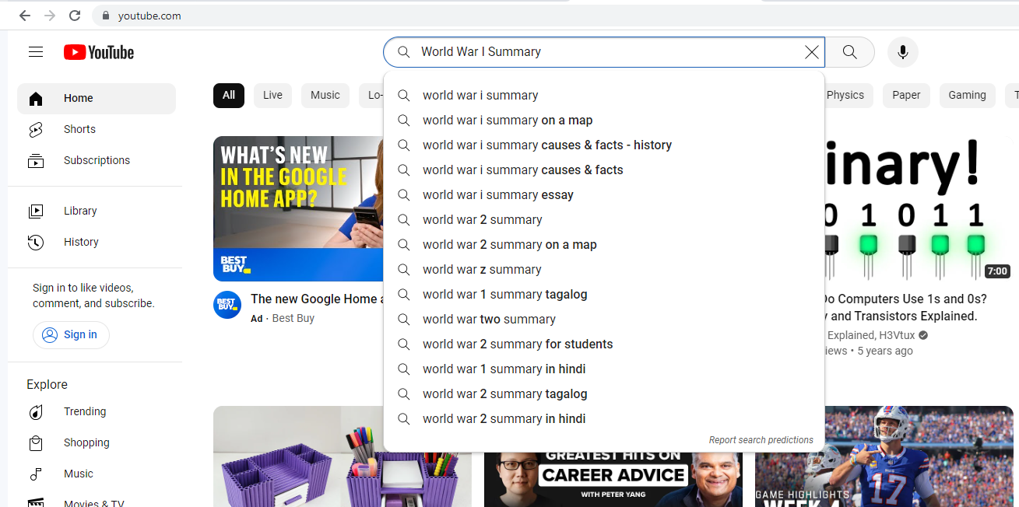
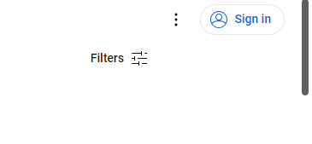
How to Search Using Youtube

Slide 22
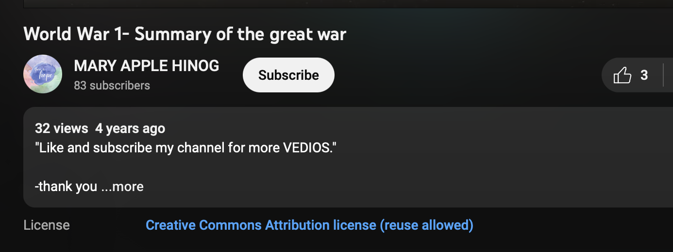
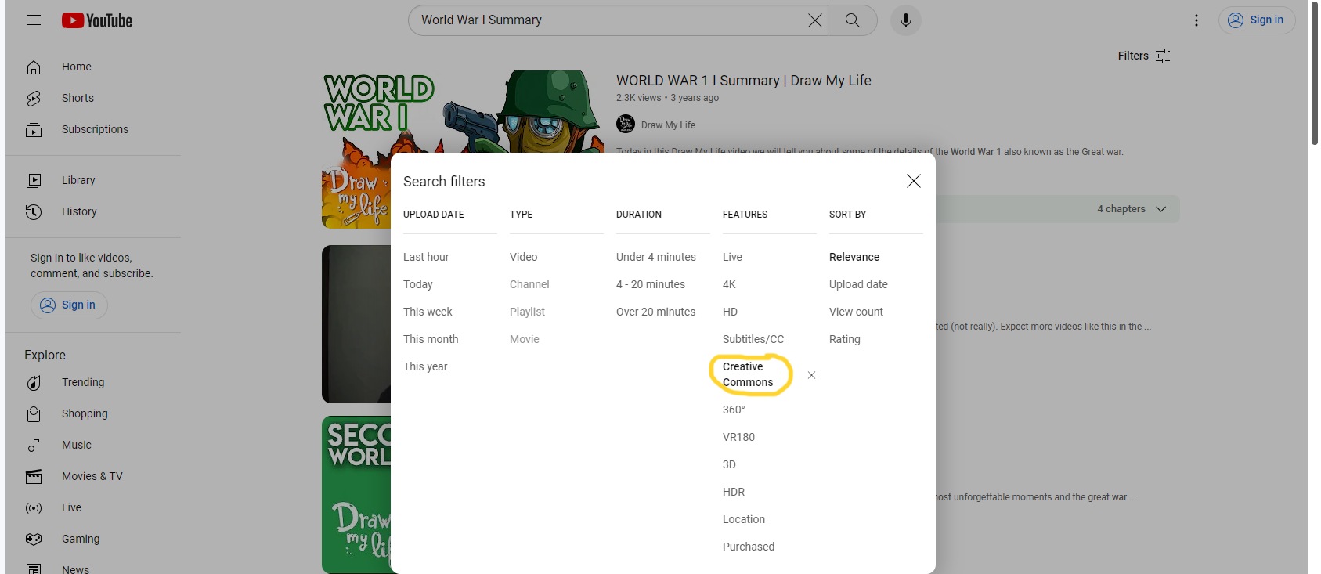
How to Search Using Youtube
Select the “Creative Commons” filter

Slide 23
Resources to find OER
CreativeCommons.org
a. Allows choice of which web page to explore with creative commons. Useful to search only the creative commons sides of Google and Youtube specifically.
Mason OER Metafinder (MOM)
a. Older age range of open source downloadable textbooks, different repositories, full lesson plans, syllabi, test banks, etc.
OER Commons
Openly Available Sources Integrated Search (OASIS)
Pressbooks Directory

Slide 24
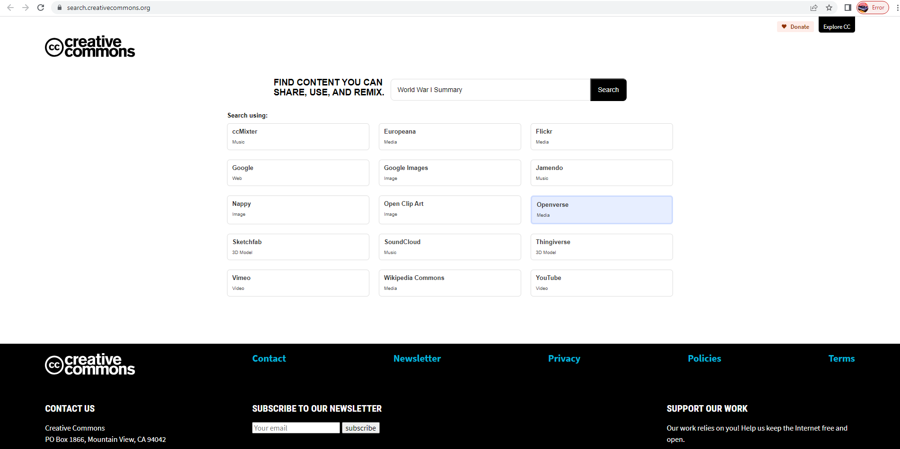
Searching Using the Provided Links

Slide 25
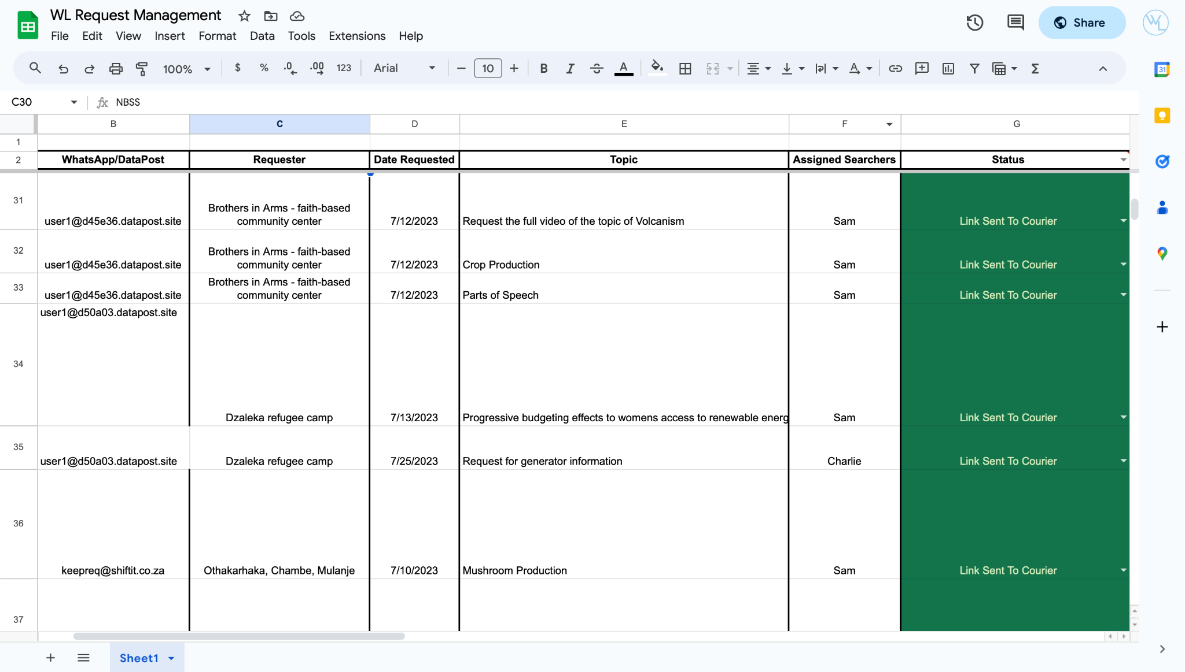
World Librarians Request Management Spreadsheet

Slide 26
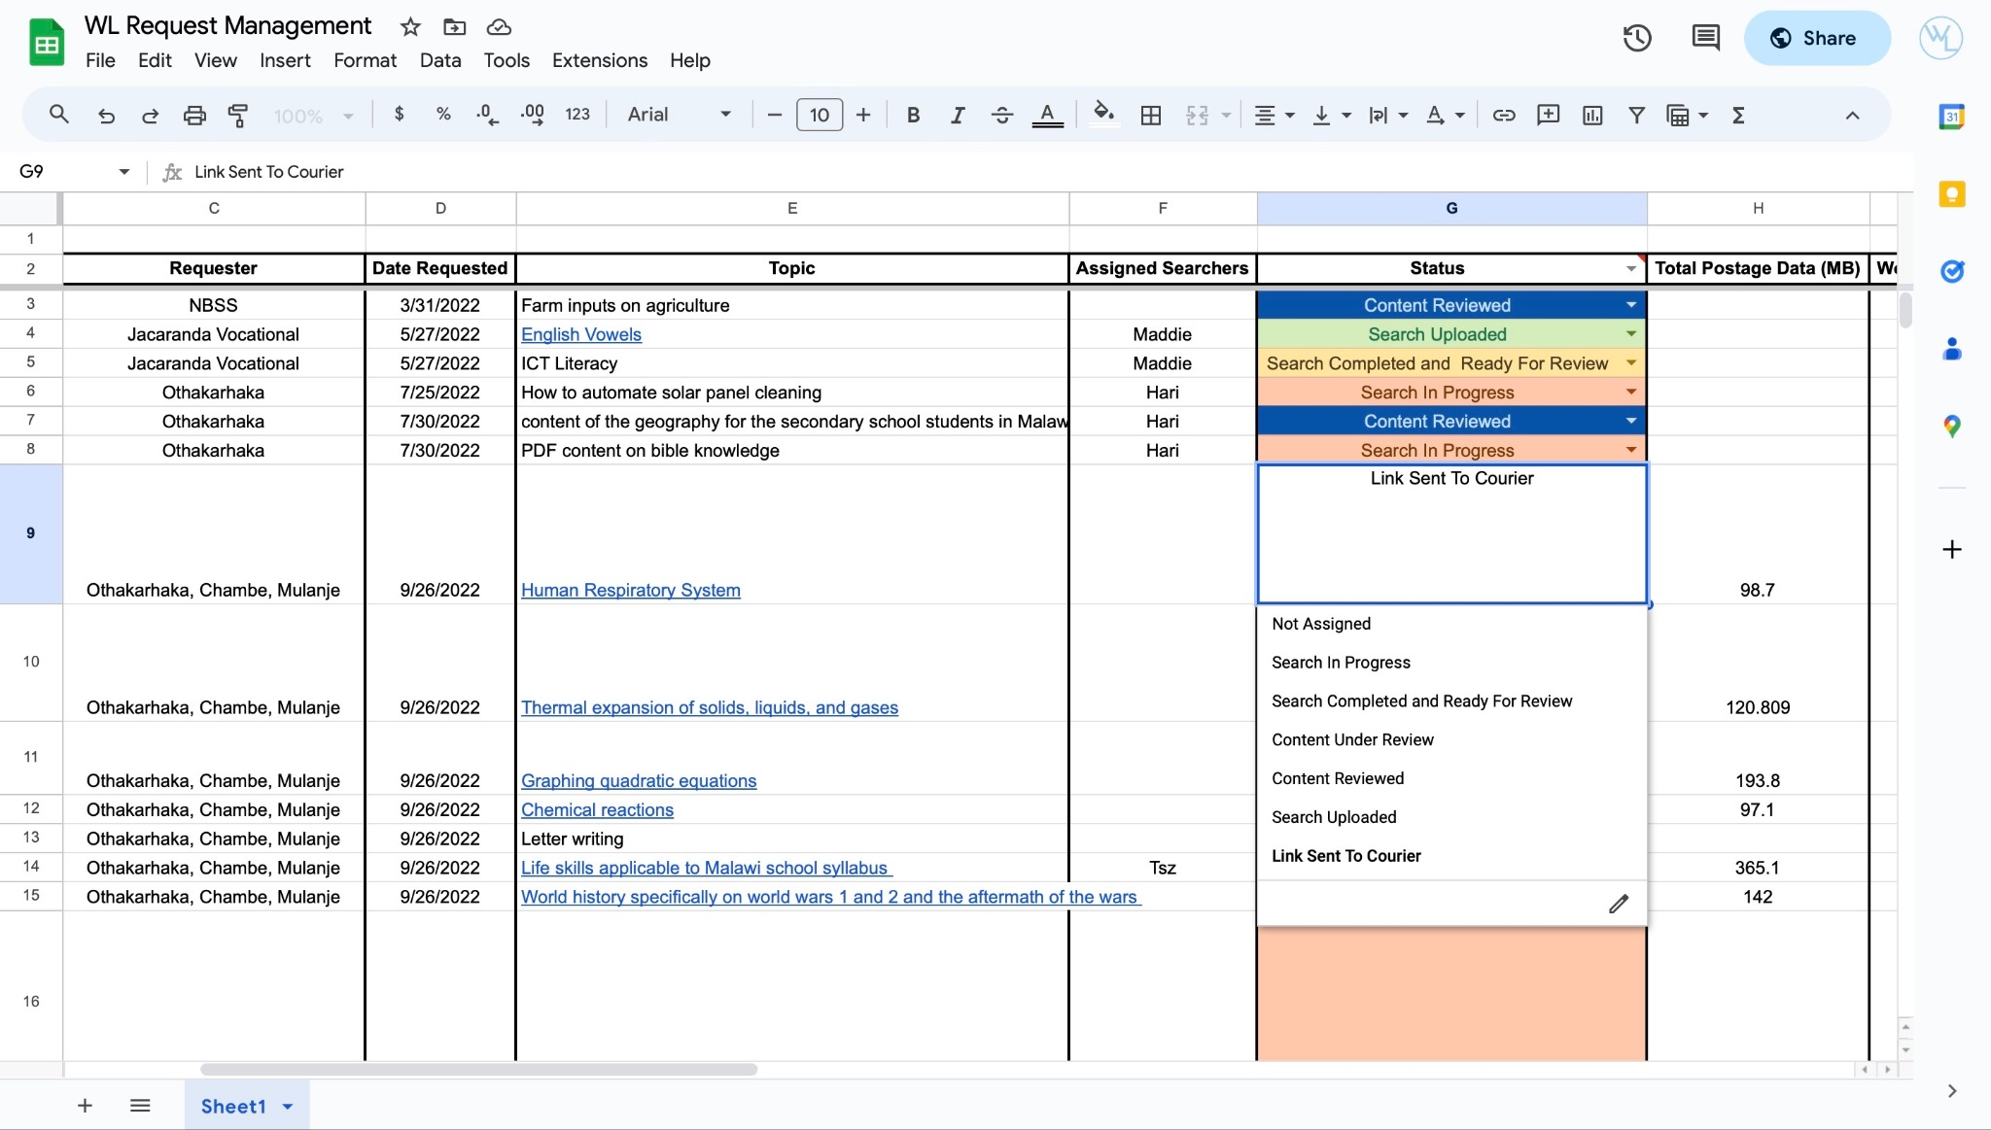
Status of Search Requests

Slide 27
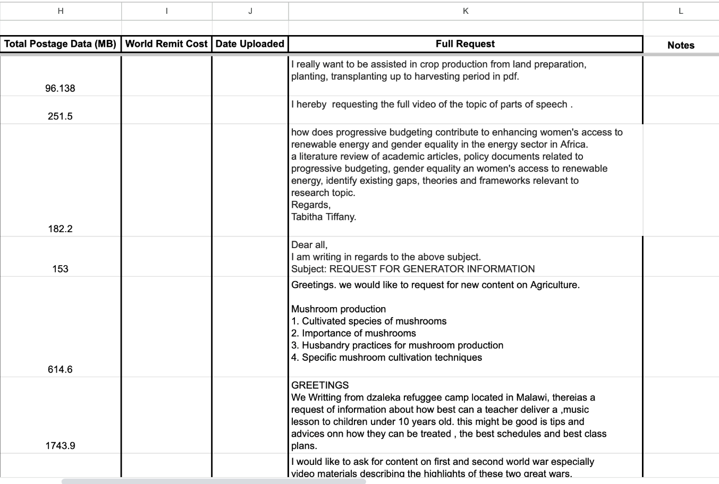
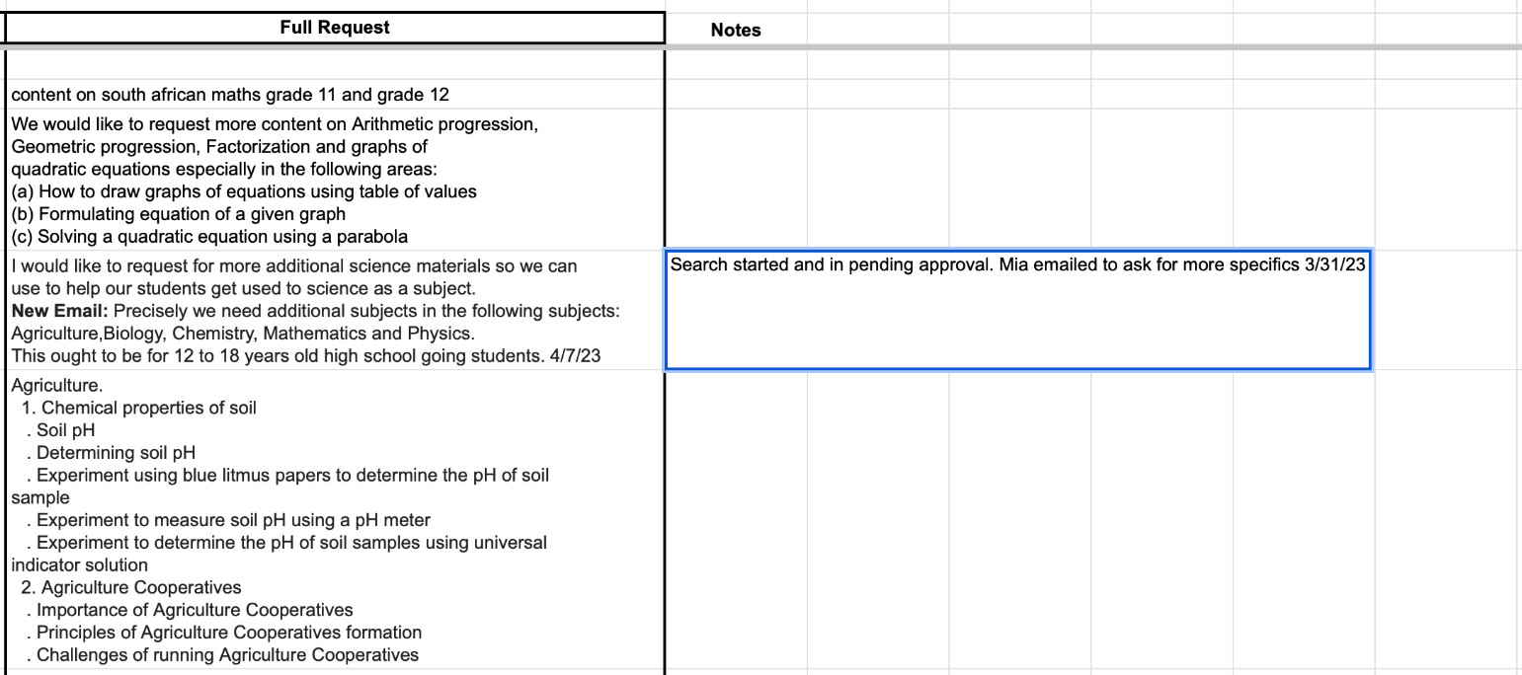
Full Request and Notes

Slide 28
What does “Community Over Commercialization” mean to you?

Slide 29
How would you describe the impact World Librarians has had on you?

Slide 30
One of the important elements of this club is our task in tackling colonialism by providing information requested BY our partners - has that affected how you approach evaluating sources? Has it affected your own education and research?

Slide 31
Has your understanding of libraries been impacted at all through your involvement in World Librarians?

Slide 32
What are the biggest challenges you’re facing with World Librarians?

Slide 33
What opportunities do you see World Librarians pursuing in the future?

Slide 34
Do you have more questions?
uma.worldlibrarians@gmail.com

Slide 35
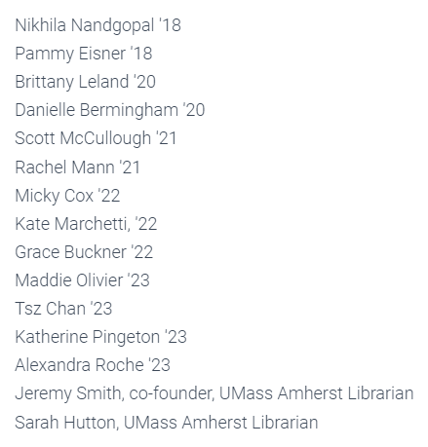
A shout-out to past World Librarians
UMass Team Members!
… and thank you to the
UMass Libraries and Scholarly Communication office for the ongoing encouragement and support!

Slide 36
Get Involved!
Students can join through Campus Pulse
Learn more and donate at worldlibrarians.org

