Slide 1
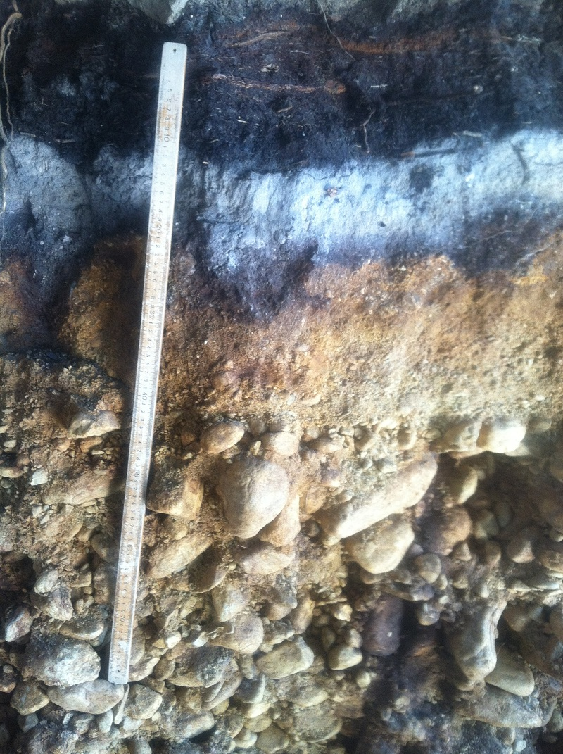
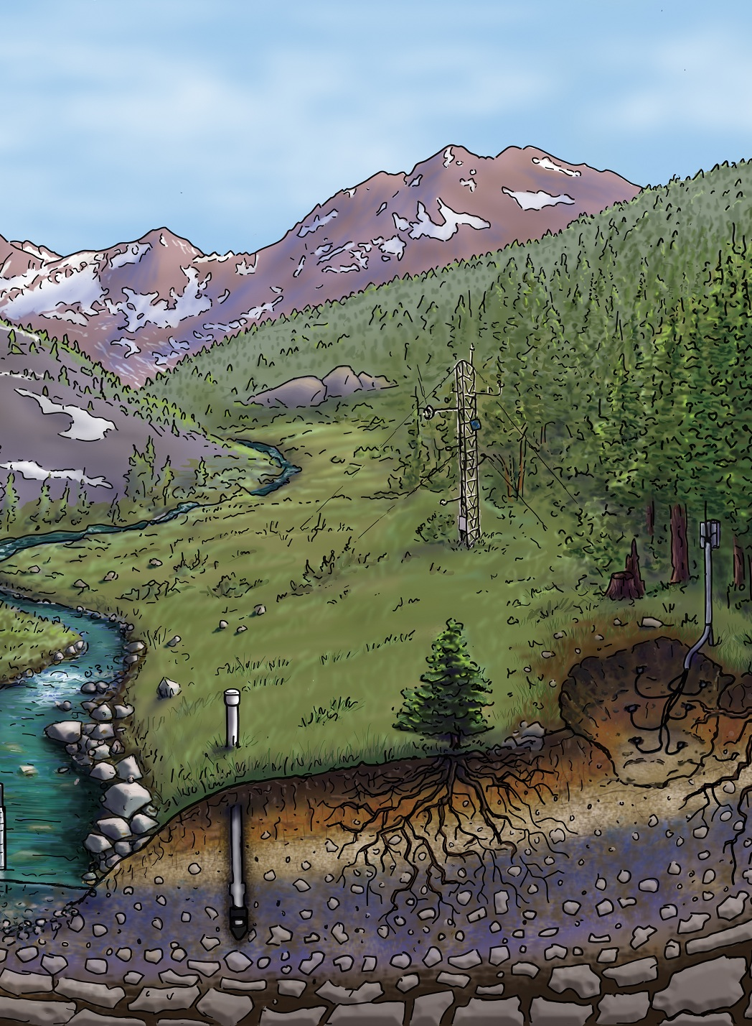

Dr. Justin B. Richardson
Dept of Geosciences
University of Massachusetts Amherst

Slide 2


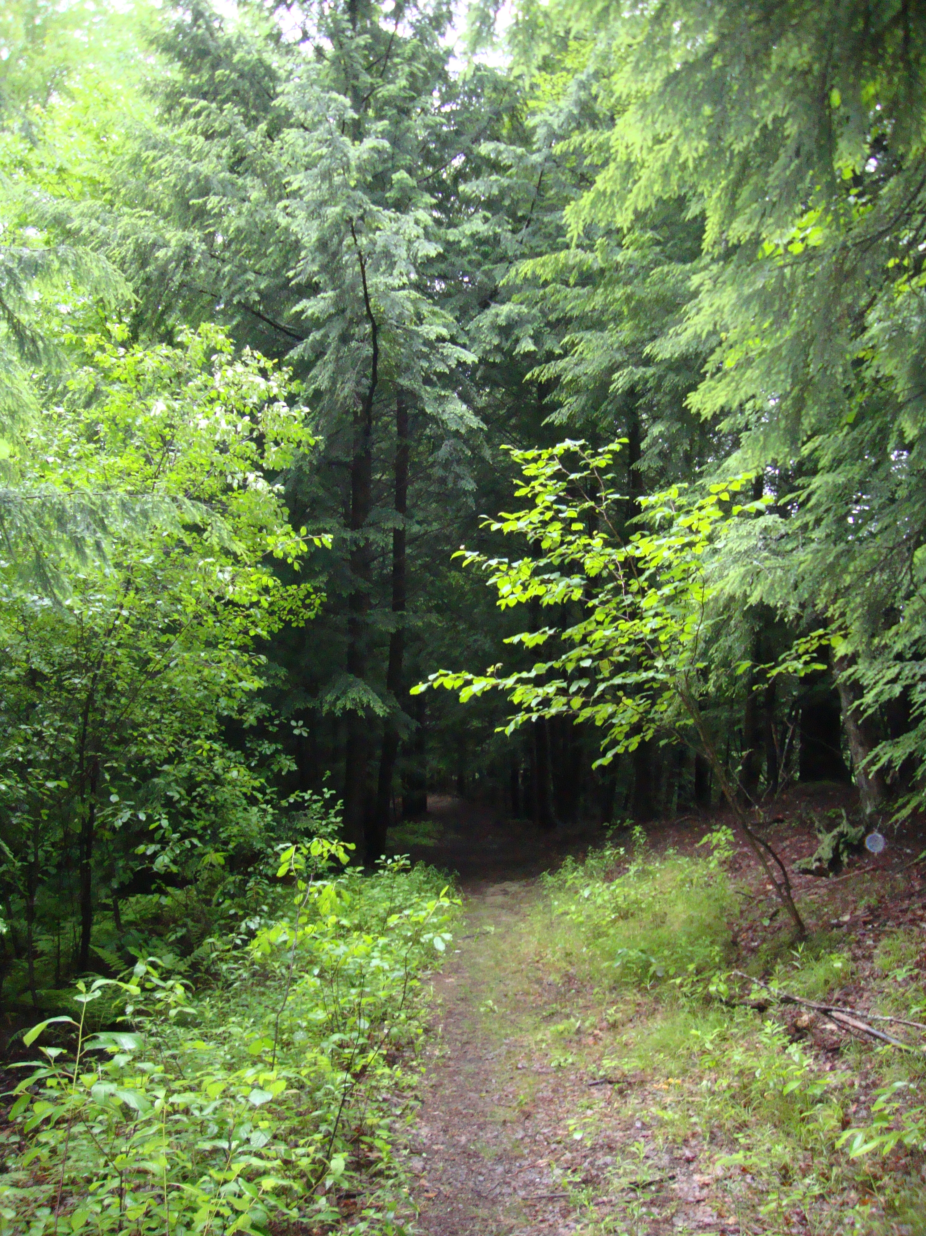
What is Biogeochemistry?
Atmosphere
Lithosphere
Problems I tackle:
Toxicity from metals in plants and animals.
Nutrient sourcing and uptake by plants.
Forest soil mitigation of water and atmospheric pollutants.
Feedback between climate change and forest soils.
Climate Change
Hydrosphere
Biogeochemistry
Biosphere

Slide 3
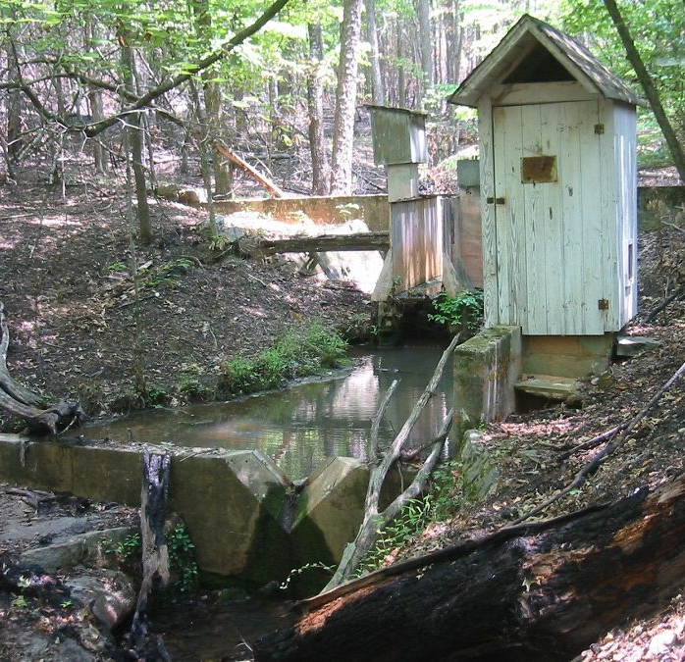
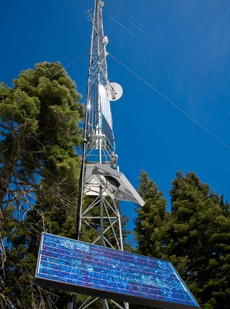
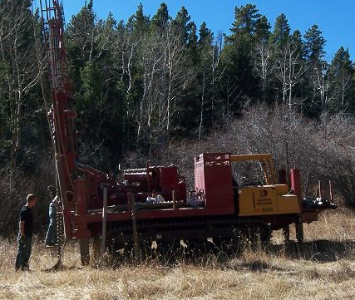
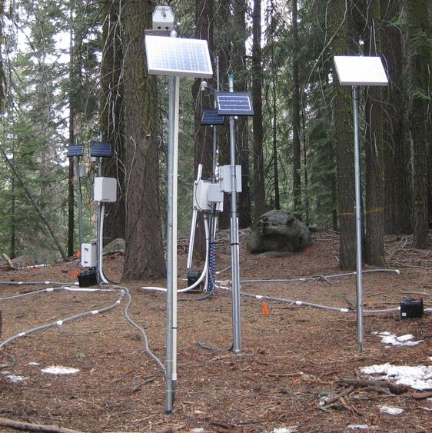
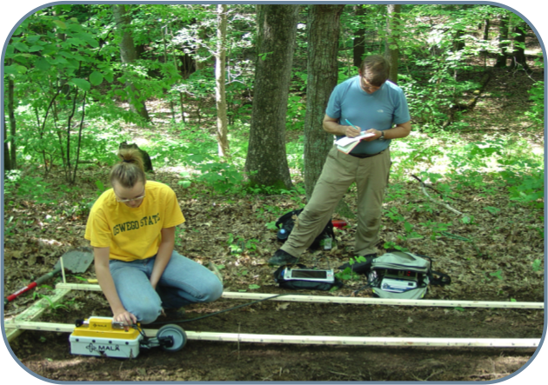
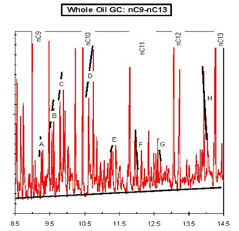
Access to data powers Biogeochemistry
Hydrological data
Atmospheric data
Soil-Bedrock cores
Vegetation data
Geophysical data
Geochemical data

Slide 5

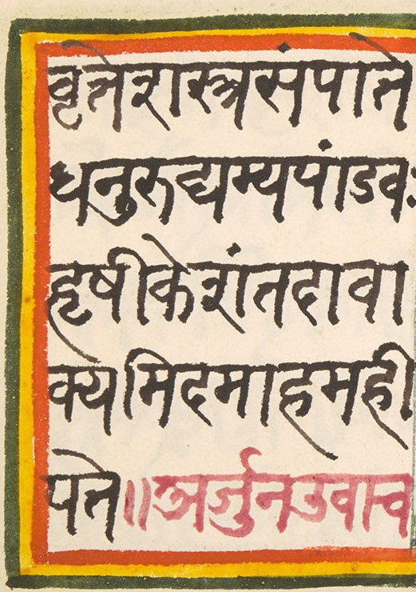

Key problems stop Biogeochemical data from being open and accessible
Problem 1: Selfish big data generators
  Data sharing may not directly benefit the generators.
Problem 2: Data lost in translation
  Data are similar but not comparable or usable.
Problem 3: Pay to play
  Journals or repositories charge for access or storage

Slide 6

Problem 1 - Selfish big data generators
Biogeochemical data is expensive to generate due to labor costs, specialized equipment, remote locations.
Making data open allows others to use the data and generate publications, potentially allowing future projects to be ‘scooped’ or they may not cite their work.
Open data can allow for authors from developing nations to leverage the insights and publish on new questions.
Solution 1: Recognize data sets are intellectual contributions.
Solution 2: President Biden administration “data from federally funded research belong to the American public.”

Slide 7
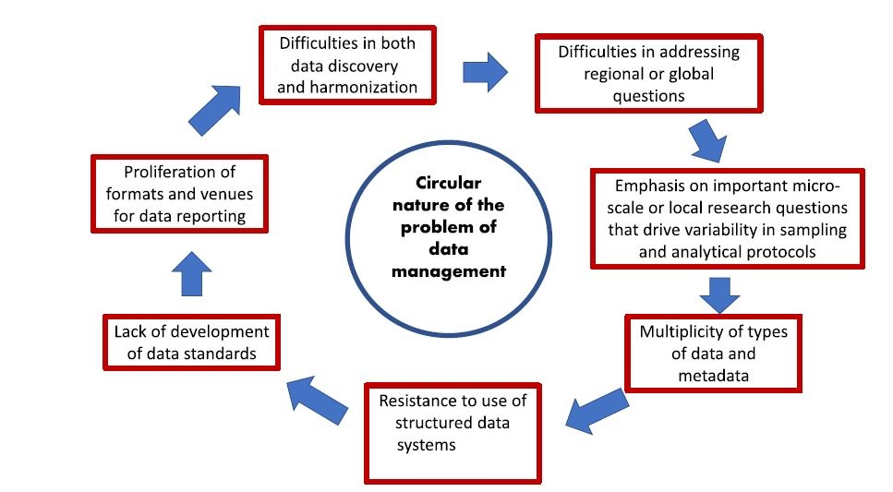

Problem 2 –Lost in translation
Solution:
Develop standard methods and protocols for metadata

Slide 8


Problem 3 – Pay to play
Many repositories for biogeochemical data or publications charge money due to server space or curation.
Data repositories allows others to find, understand, and use data to answer new questions.
Solution 1: Since curation costs money, researchers are beginning to use standardized curation of their own metadata so deposited data can be used.
Solution 2: Biogeochemists have data on >55 different repositories but are moving towards a few central library systems that are free and supported not by publishing data.

Slide 9
In conclusion
Biogeochemists generate and need many big data sets, which are expensive to create but essential for capturing the effects of climate change.
Incentives are starting to promote open data sharing.
Standardizing protocols is big for translating data across areas.
Through changing management, biogeochemists can make their data findable, understandable, and usable.

