Slide 1
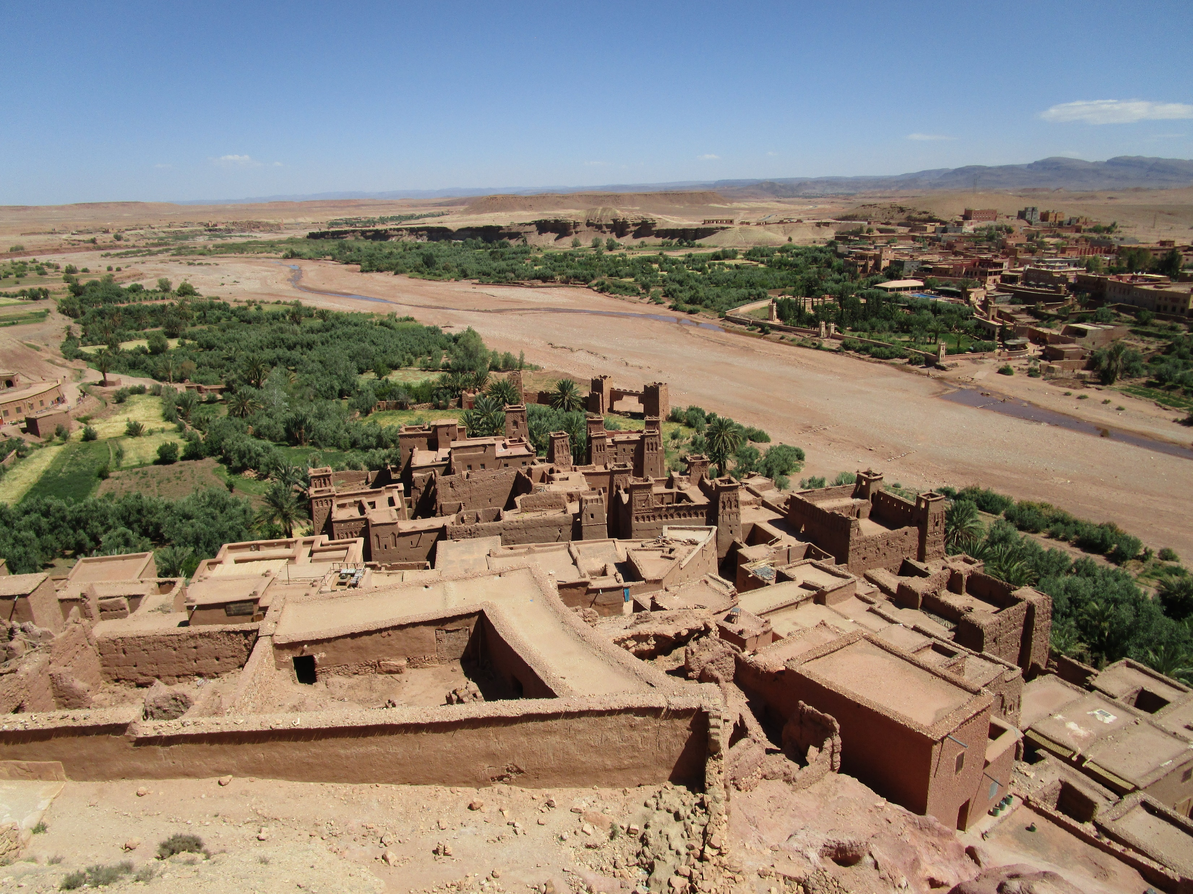
RURAL HERITAGE- LANDSCAPES AND BEYOND
PATRIMOINE RURAL - PAYSAGES ET AU-DELÀ
Beyond the 'war on nature' and the 'attacks on culture': the CultureNature Journey through Rural Landscapes
Ms Kristal Buckley AO,
Adj. Professor Dr Susan McIntyre-Tamwoy
Ms Haifaa Abedalhaleem
ICOMOS Advisory Committee Scientific Symposium
Symposium scientifique du Conseil consultatif de l’ICOMOS
17 October 2019 at Marrakesh, Morocco
17 octobre 2019 à Marrakech, Maroc

Slide 2
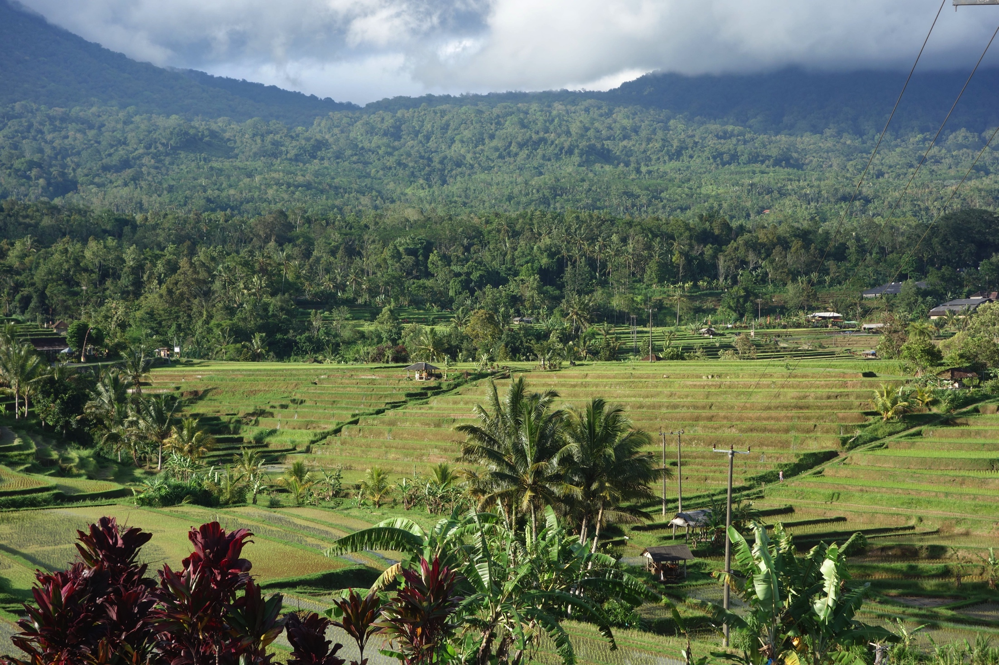
The Cultural Landscape of Bali Province – Subaks as an expression of the philosophy of Tri Hita Karana

Slide 3
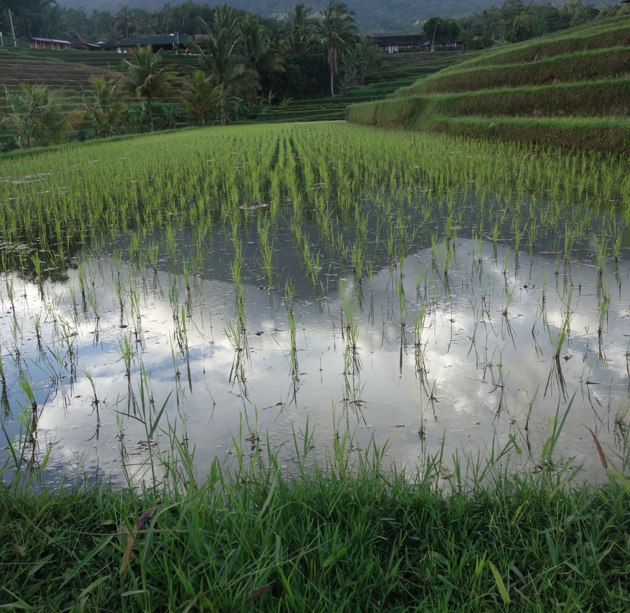

Slide 4
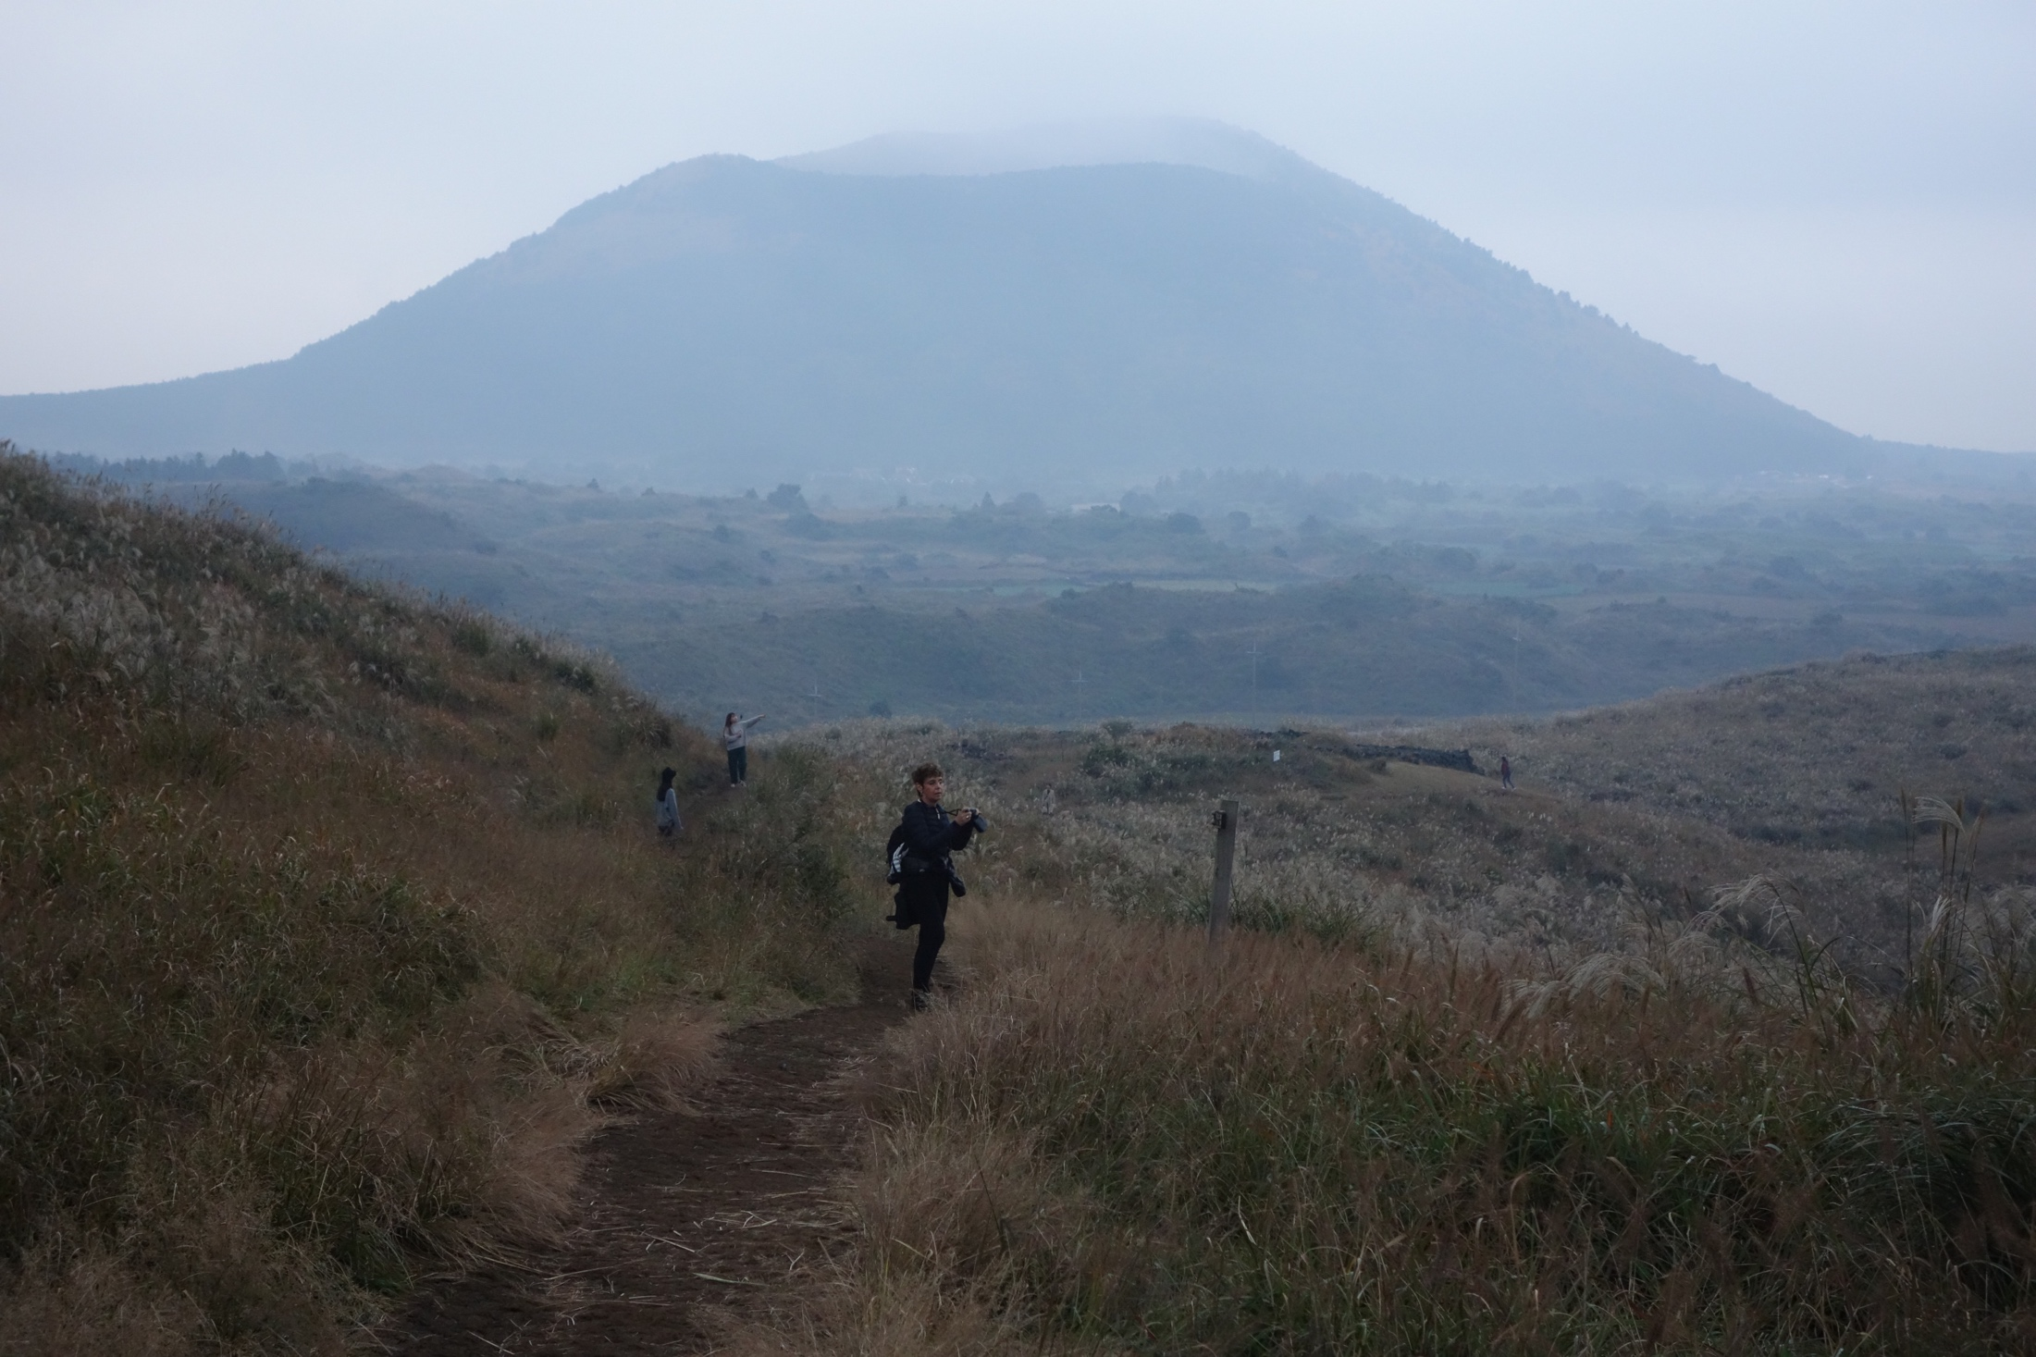
Jeju Island, Republic of Korea

Slide 5
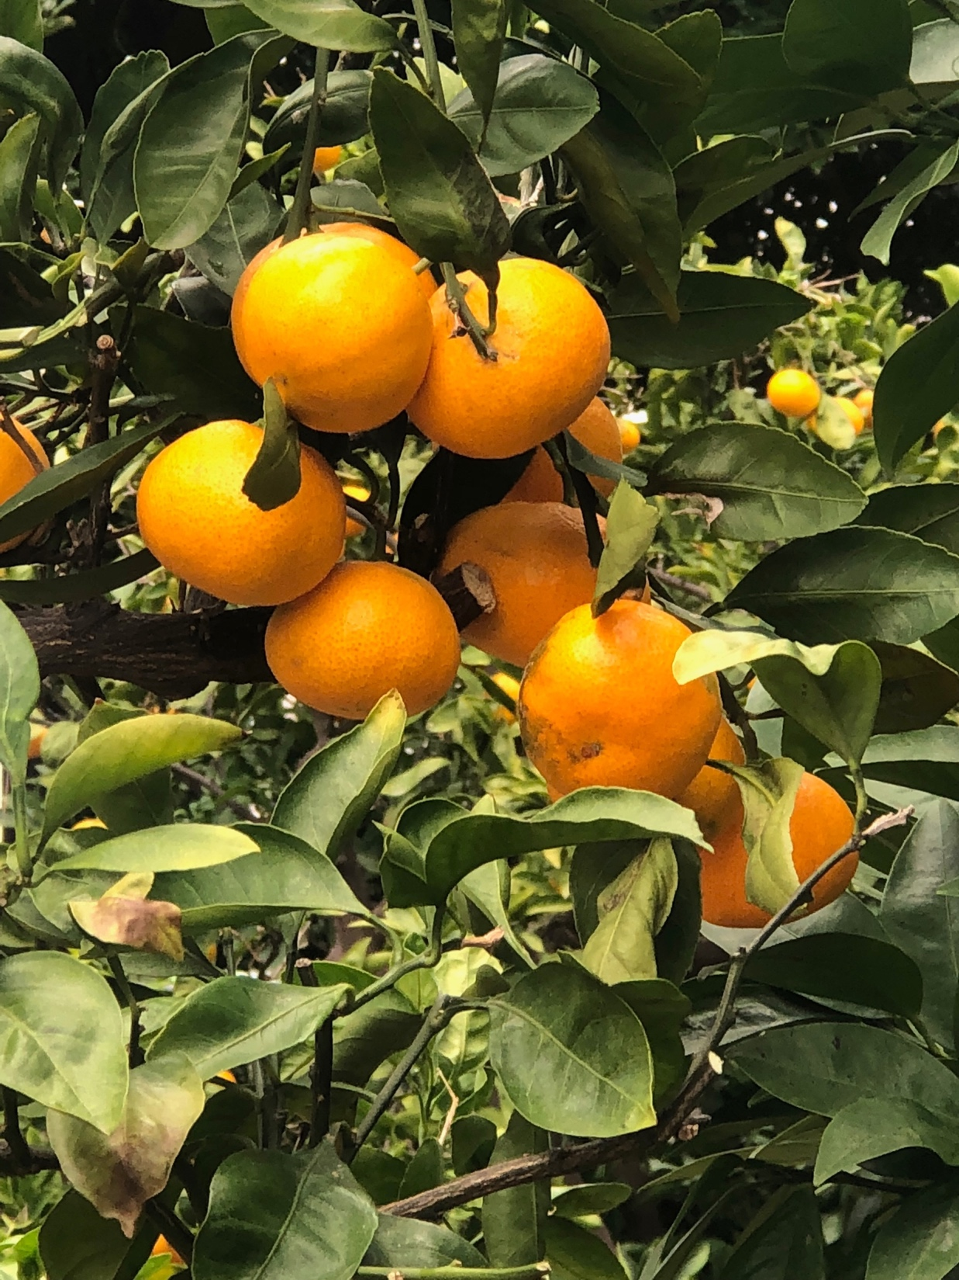
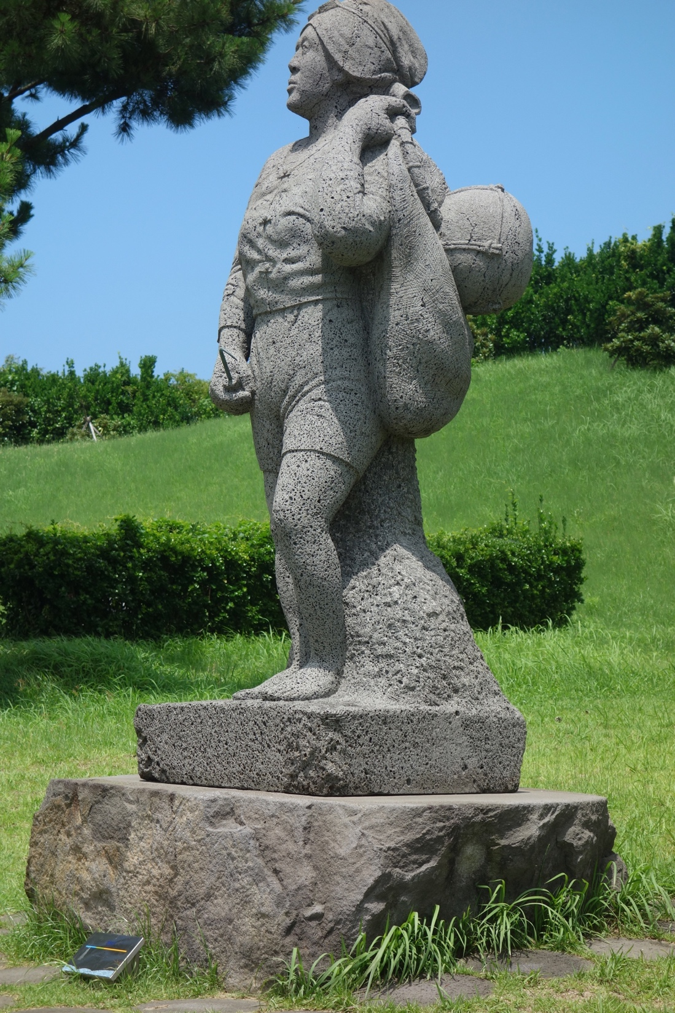

Slide 6
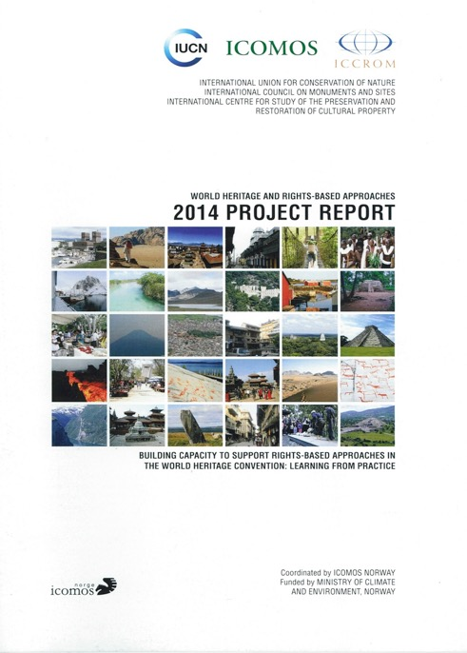
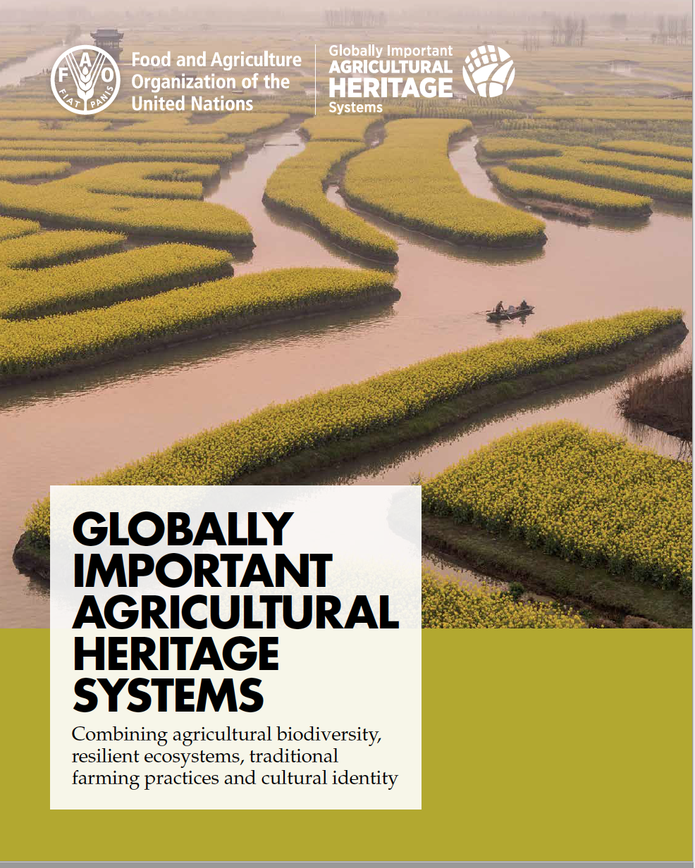

Slide 7
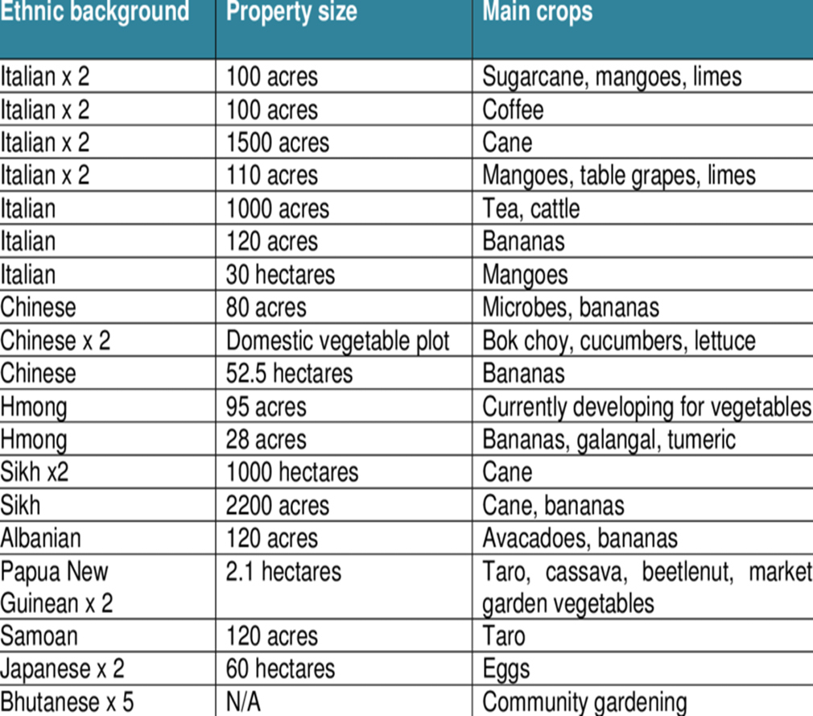
Case Study: Culturally Diverse Farming Communities in Far North Queensland, Australia
Rural Heritage- Landscapes and Beyond 17-Oct-2019 Patrimoine Rural - Paysages et Au-Delà Buckley, McIntyre-Tamwoy, Abedalhaleem

Slide 8
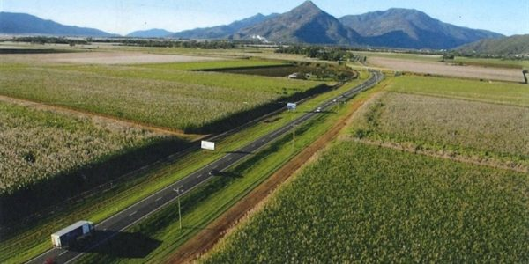
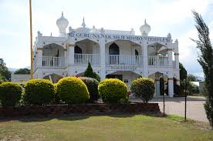
Rural Heritage- Landscapes and Beyond 17-Oct-2019 Patrimoine Rural - Paysages et Au-Delà Buckley, McIntyre-Tamwoy, Abedalhaleem

Slide 9
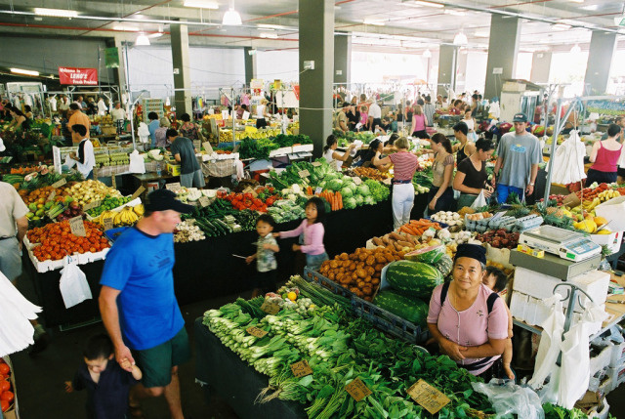
Rural Heritage- Landscapes and Beyond 17-Oct-2019 Patrimoine Rural - Paysages et Au-Delà Buckley, McIntyre-Tamwoy, Abedalhaleem

Slide 10
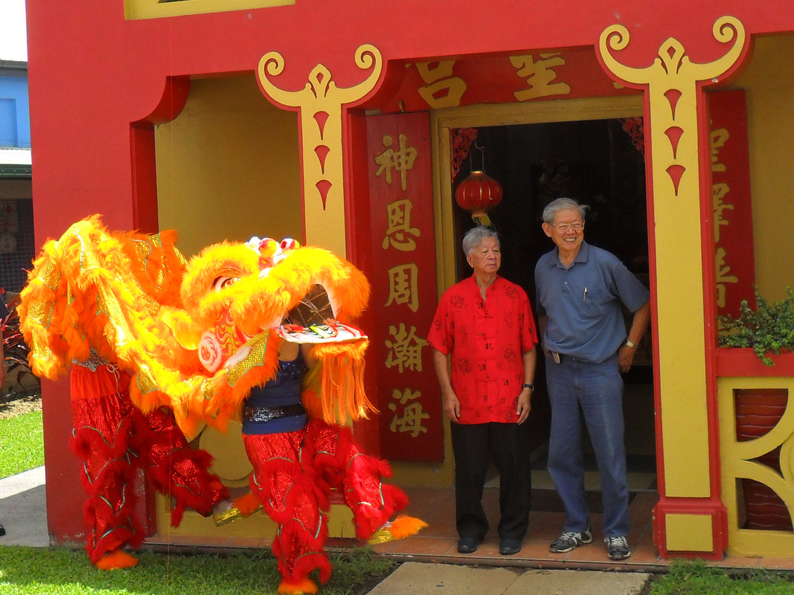
Rural Heritage- Landscapes and Beyond 17-Oct-2019 Patrimoine Rural - Paysages et Au-Delà Buckley, McIntyre-Tamwoy, Abedalhaleem

Slide 11
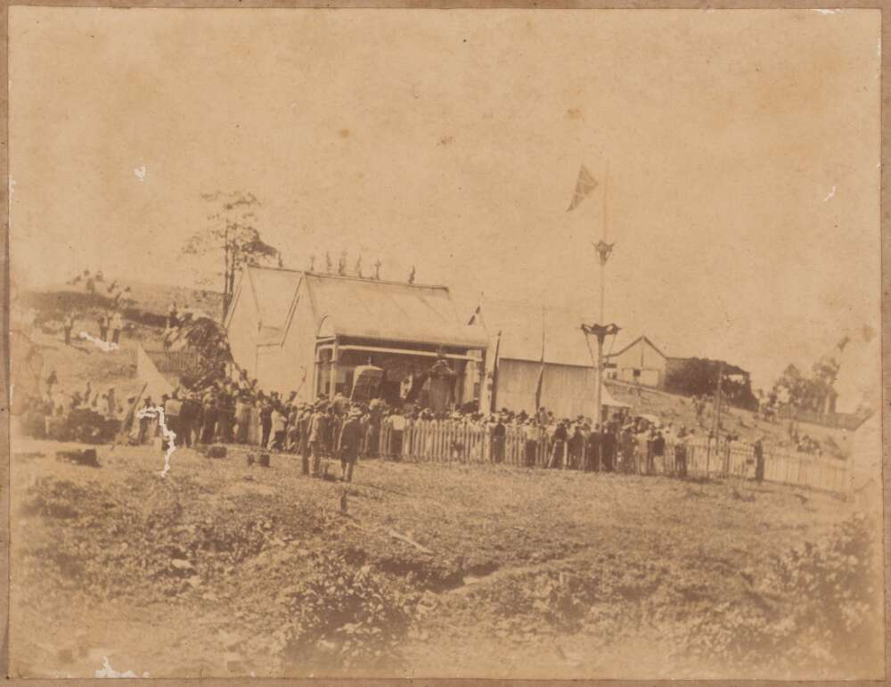
Rural Heritage- Landscapes and Beyond 17-Oct-2019 Patrimoine Rural - Paysages et Au-Delà Buckley, McIntyre-Tamwoy, Abedalhaleem

Slide 12
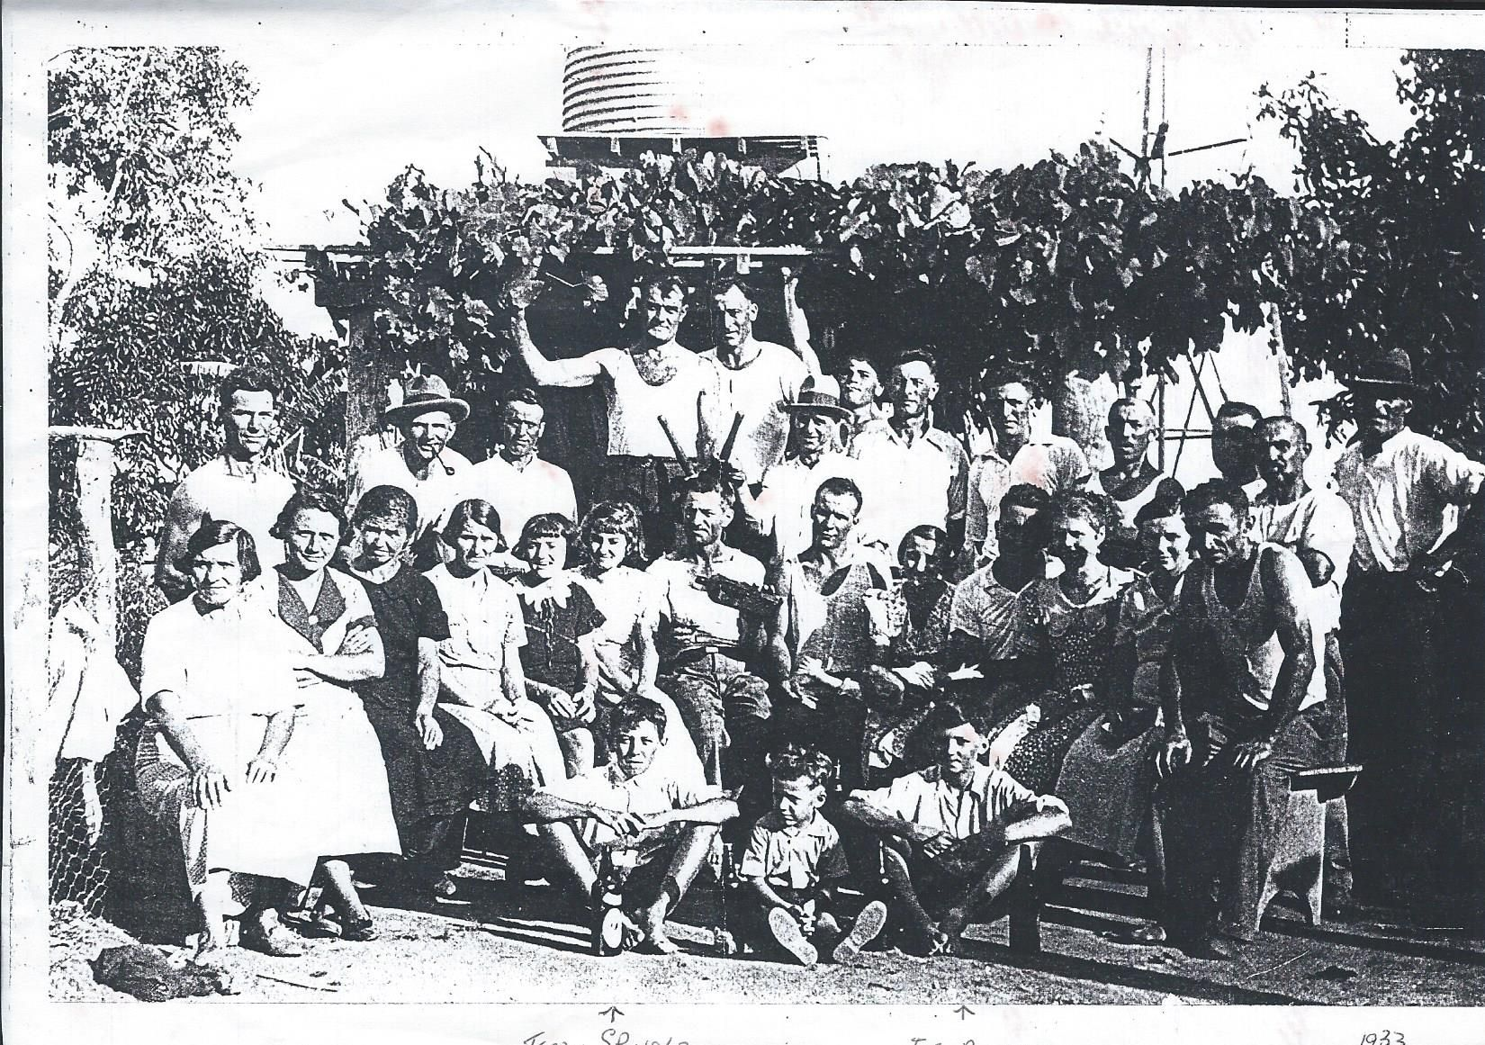
Use Calibri Light 32 Pt for Headings English/French
Utilisez Calibri Light 32 Pt pour les titres anglais / français
Add image 220 dpi - Ajouter une image 220 dpi
Text in Black or White Calibri 18 to 24 Point English/French
Texte en noir ou blanc Calibri 18 à 24 points anglais / français
No more than 5 lines-50 words - Pas plus de 5 lignes-50 mots
Rural Heritage- Landscapes and Beyond 17-Oct-2019 Patrimoine Rural - Paysages et Au-Delà Buckley, McIntyre-Tamwoy, Abedalhaleem
Notes:
Italian migrants in the 1920s/30s who pioneered cane farming in Home Hill, north Queensland, Australia

Slide 13
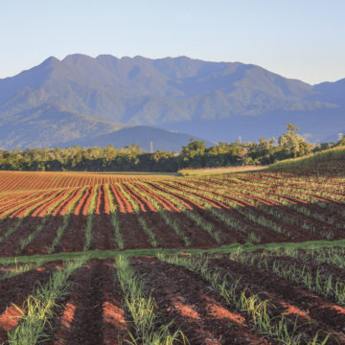
Rural Heritage- Landscapes and Beyond 17-Oct-2019 Patrimoine Rural - Paysages et Au-Delà Buckley, McIntyre-Tamwoy, Abedalhaleem

Slide 14
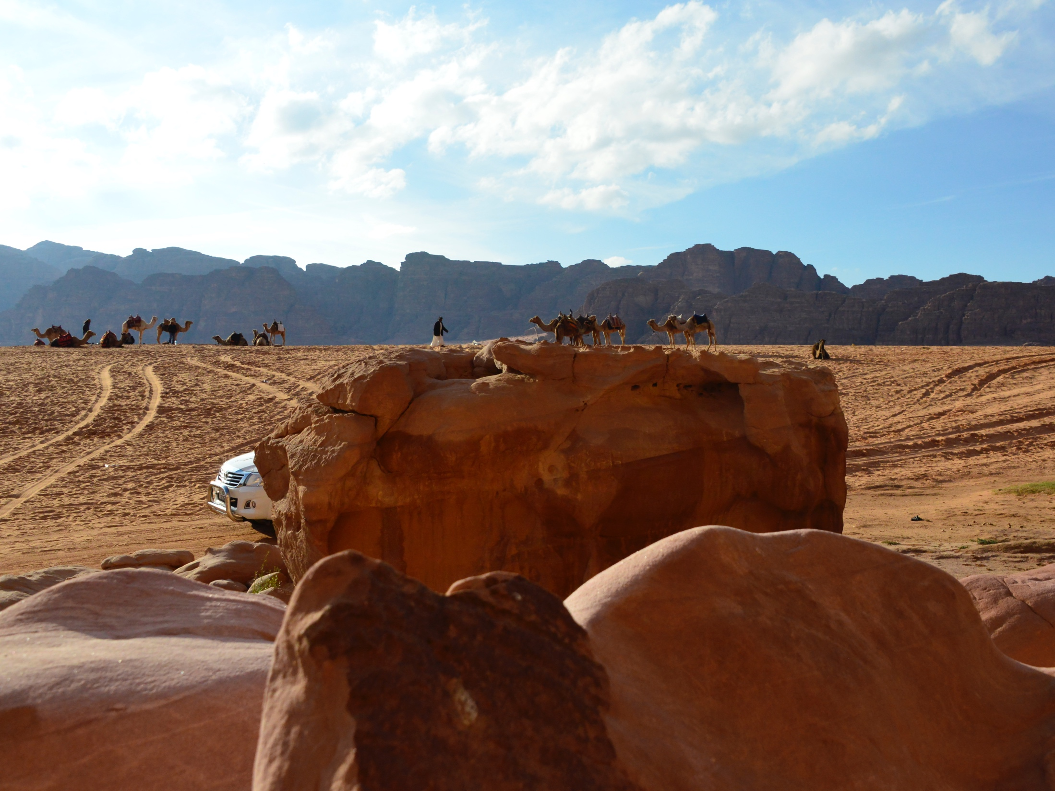
The impacts of wars and civil conflicts on the Arab region
Haifaa Abedalhaleem

Slide 15
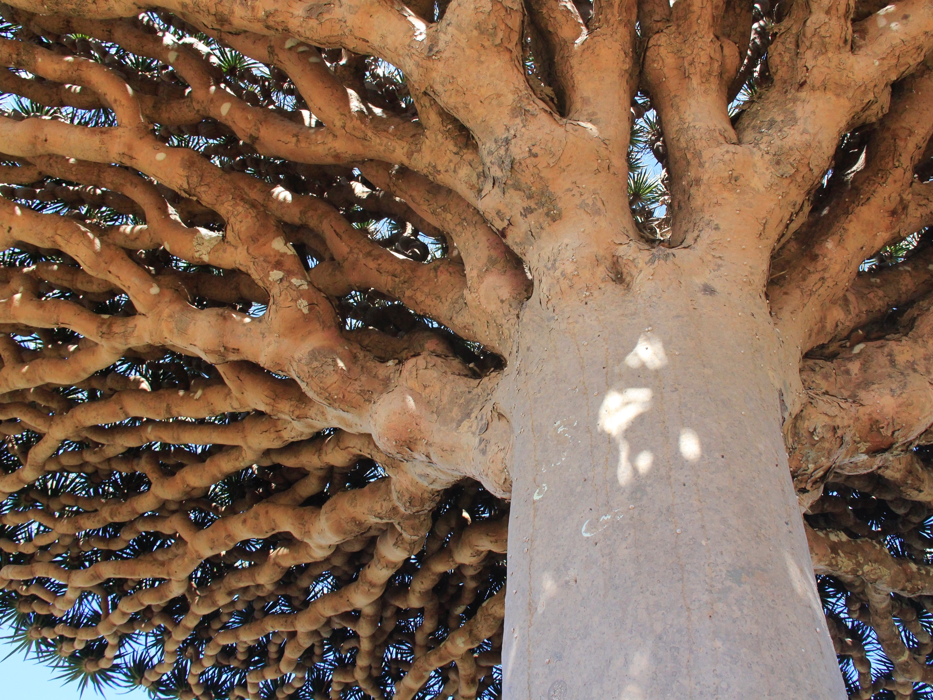
Socotra Archipelago

Slide 16
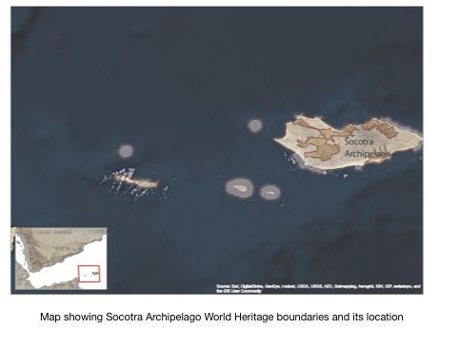
Socotra Archipelago
The Islands are Isolated
80,000 inhabitants and increasing
People depends on natural resources for living
Yemen suffers from political instability.
Attracts big investments with no real impact on-ground positive impact on their living
International Conservation projects since early 90’s but no evidence of long-term impacts.

Slide 17
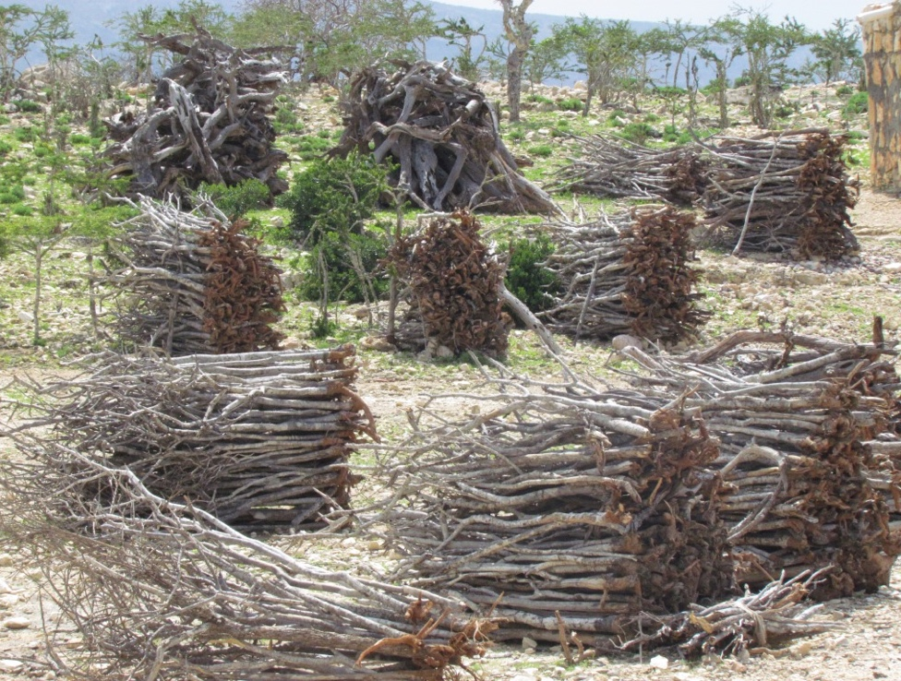

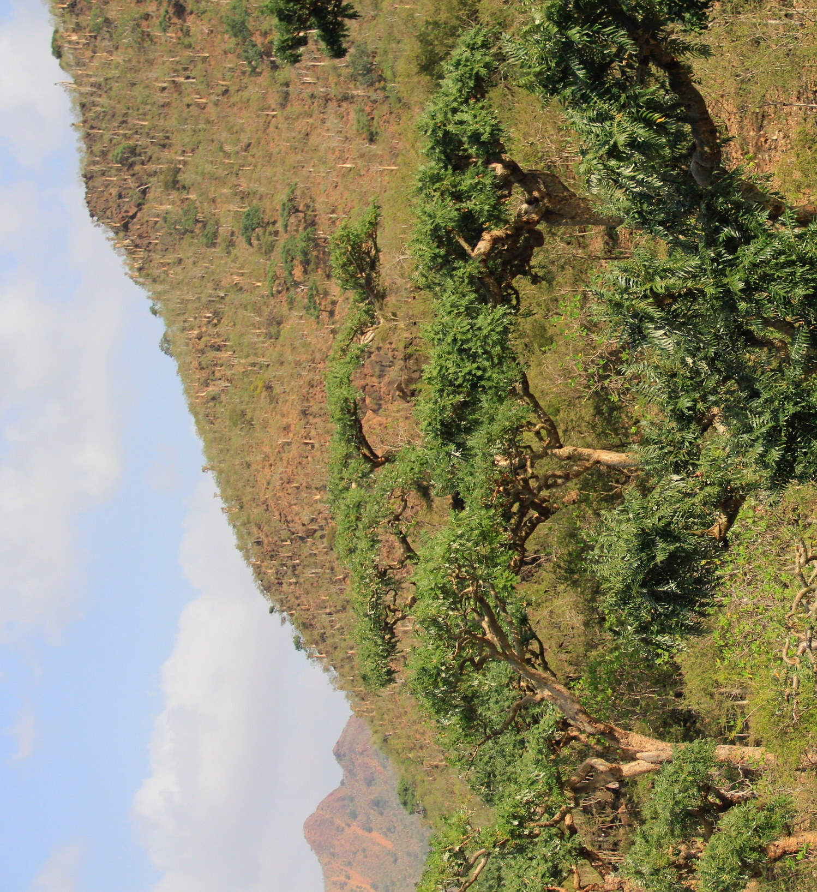
Political instability increases the level of isolation of Socotra Archipelago, this affects access to the fuel resources.
Notes:
```

Slide 18
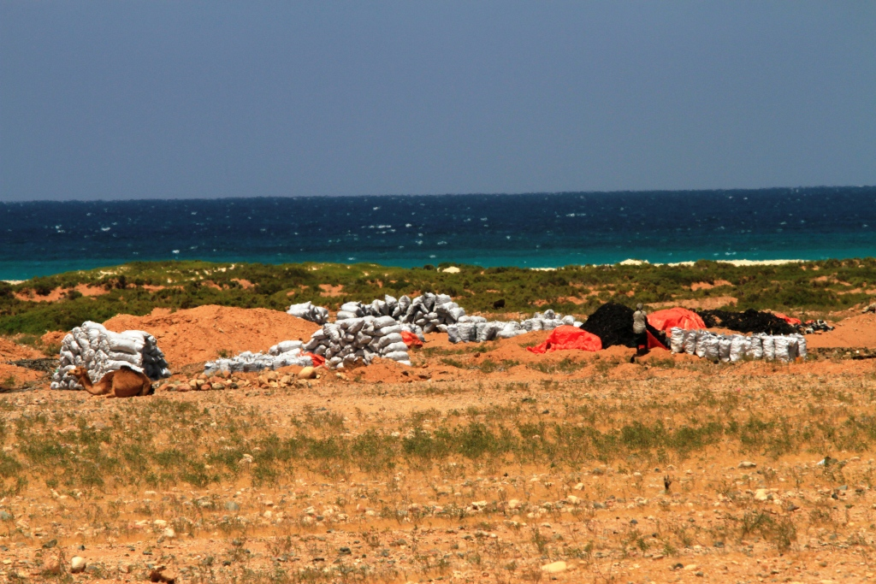
Rural Heritage- Landscapes and Beyond 17-Oct-2019 Patrimoine Rural - Paysages et Au-Delà Authors Family Name-Nom de famille des auteurs

Slide 19
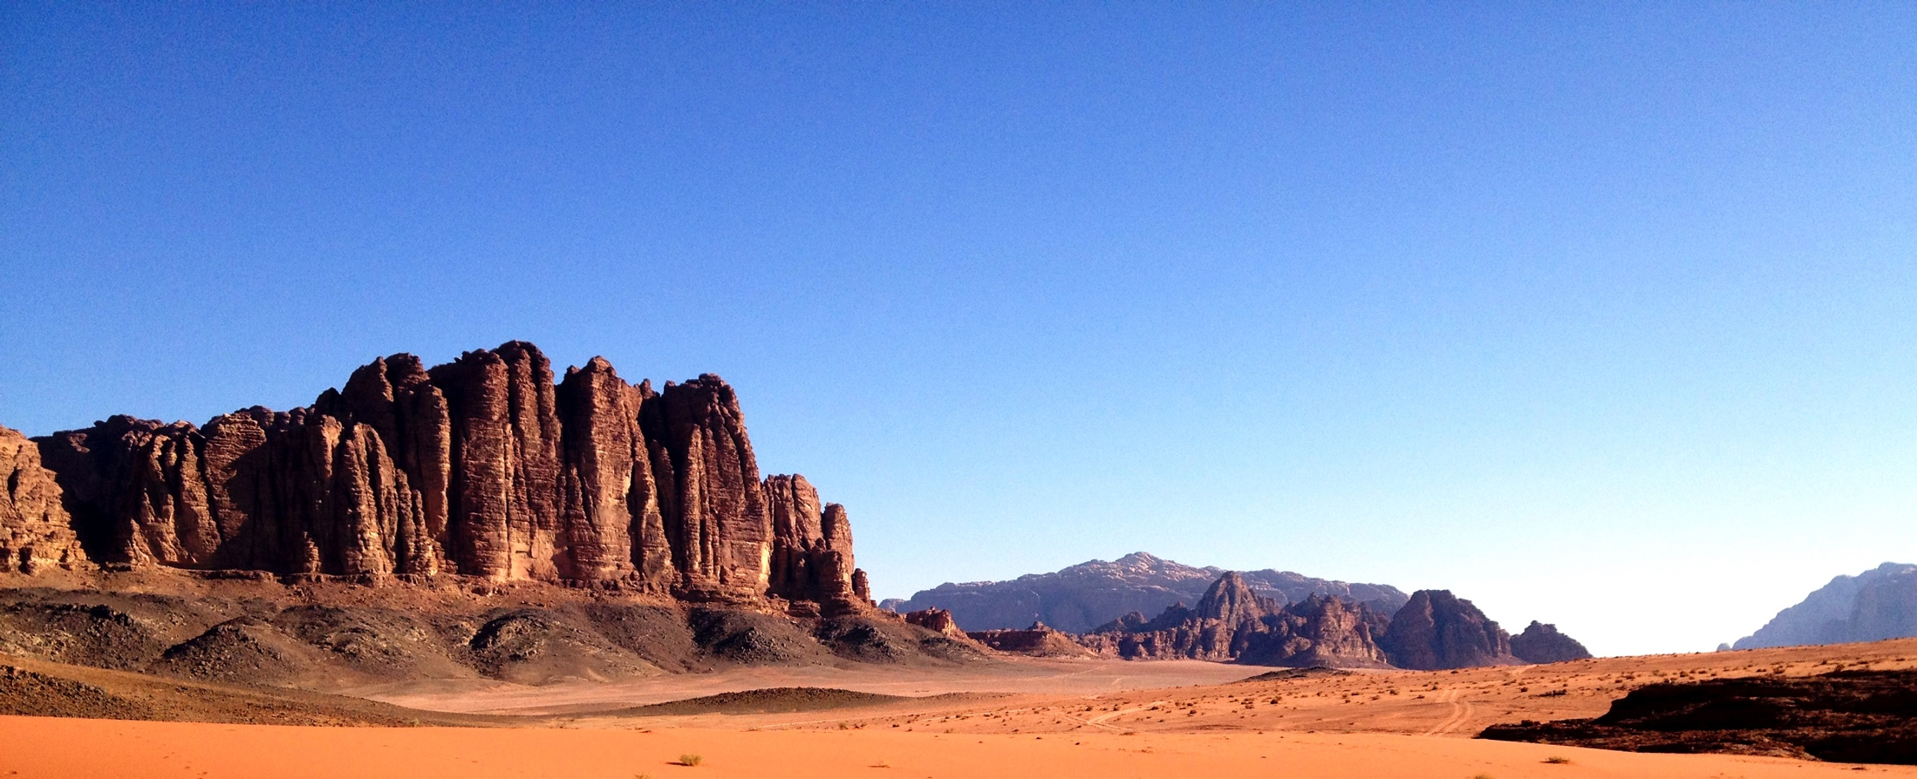
Wadi Rum Protected Area
The site inscribed in 2011 under criterion (vii) for its outstanding beauty, and spectacular desert landscape

Slide 20
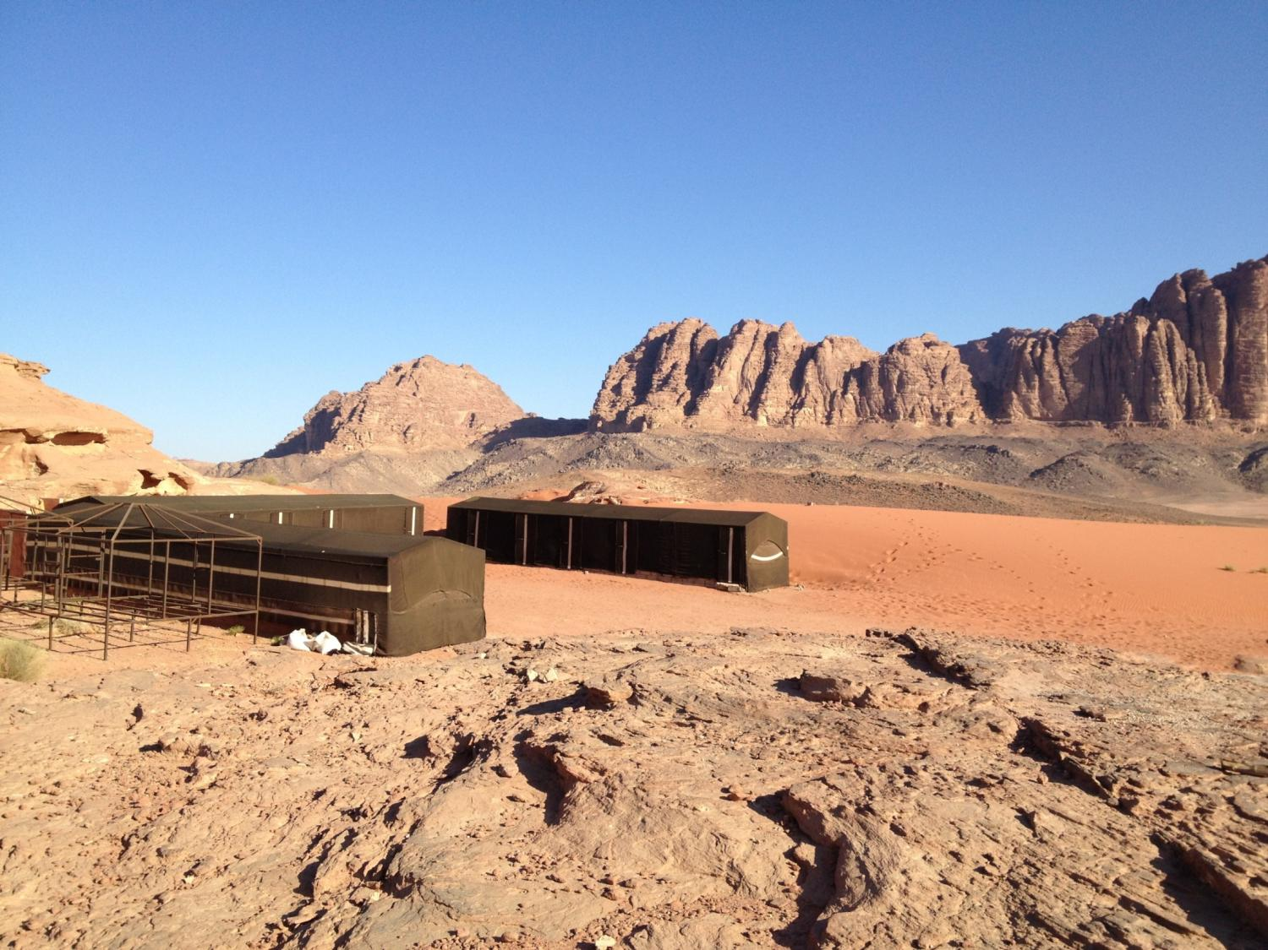

Slide 21
