Slide 1
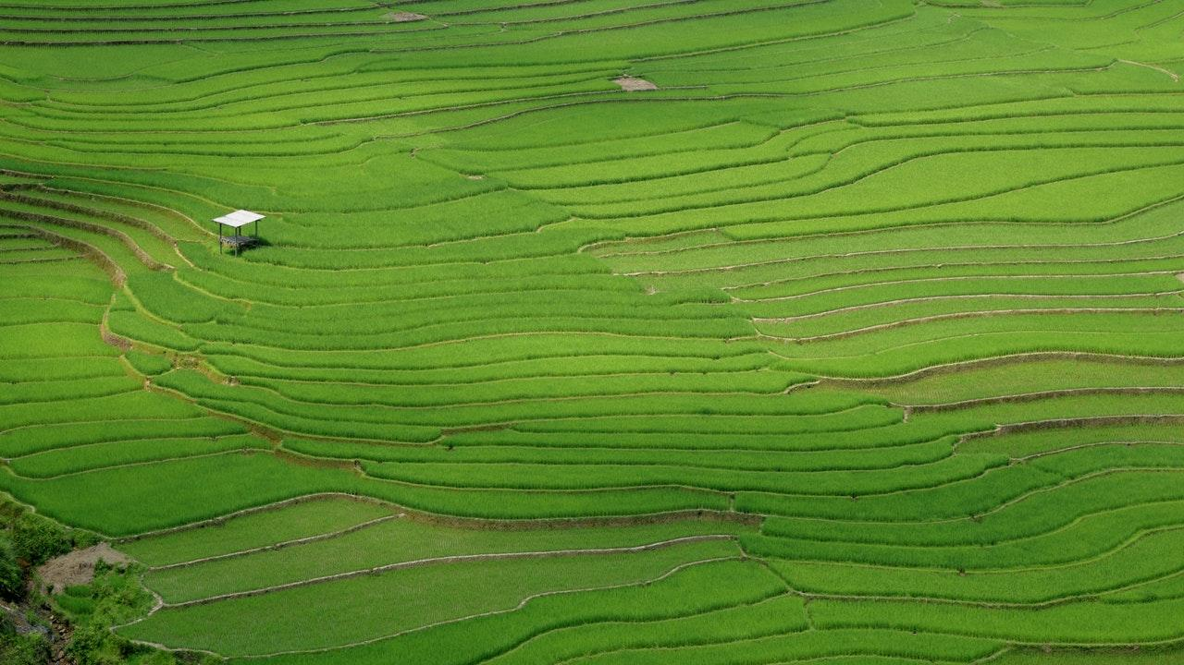
How not to grow an ORCID program
Rebecca Reznik-Zellen and Lisa Palmer
ACRL New England Chapter Annual Conference
Friday, May 4, 2018 | Plymouth, MA

Slide 2

About ORCID
Persistent digital identifier for researchers
“Distinguish yourself and get credit for your work”
Integrated into key research workflows
Open, non-profit membership organization

Slide 3

Our situation at UMMS
Providing ORCID services and outreach
Implementing Altmetric Explorer for Institutions
Offered membership opportunity through NERL consortium

Slide 4

Our vision
Facilitate
Facilitate the creation of a new ORCID or connect to an existing ORCID without imposing a requirement or burden on faculty
Connect
Link to University’s credentials so some validated information can be pre-populated
Push
Push institutional data to ORCID profiles, e.g., employment and publications from faculty profiles system
https://members.orcid.org/api/workflow/RIM-systems

Slide 5
Our challenges
Complexity
ORCID integration options and technical implementation were more complex than we anticipated.
Priorities
We were competing for IT staff time with the Altmetrics project, their other priorities, and their development cycle.
Time
Membership renewal came up before we had made much progress.

Slide 6

Lessons Learned

Slide 7
Lay the foundation
Understand what you want to accomplish
Recognize your limitations
Identify where and with whom you need to collaborate

Slide 8
Allow time for the process
Check your assumptions
Distinguish between others’ interest and their commitment
Acknowledge the pace and politics of your institution

Slide 9
Communicate
Create shared value of/
vision for the project
Understand and respect collaborators’ constraints and workflows
Express your constraints and workflows

Slide 10
Keep in mind
The need for ORCID is not uniform.
The value of ORCID is invisible.
ORCID is non-trivial to implement.
Seamless integration is critical to success.

Slide 11
Thanks!
ANY QUESTIONS?
You can find us at
@rebeccarz | rreznikz@library.umass.edu https://orcid.org/0000-0001-9321-8284
@lapalmer14 | lisa.palmer@umassmed.edu https://orcid.org/0000-0002-4116-1279

Slide 12

Credits
Special thanks to all the people who made and released these awesome resources for free:
Presentation template by SlidesCarnival
Photographs by Unsplash

