Slide 1

Arduino microcontrollers in the classroom: teaching how to phrase effective science questions and how to answer them with original data
Science & Engineering Saturday Seminar
Tony Dinsmore, UMass Physics,
January 25, 2020
Discussion stems from a UMass course, Physics 192M, taught in spring 2018-2020.
All course materials are available; please email dinsmore@physics.umass.edu

Slide 2
Why design a new course?
Our Physics BS program provides a powerful skillset in problem solving, analytical thinking, model building, quantitative analysis. (Also, writing, presenting, some computational skills.)
What’s missing?
We would like students to graduate with…
a major independent accomplishment
    (achieved without the direction of an instructor in a pre-set, weekly progression.*
making an original object or conceptual model without an explicit, step-by-step recipe.*
confidence to address new challenges using their analytical skillset.*
practice conceiving and executing their own experiment, calculation, or project,
  where they figure out what to learn, and then learn it.
*even if they don’t work with a faculty-led research group.
Would similar goals apply to K-12 education?
Can we do this in a classroom setting? We’re trying a 1-credit course for UMass freshmen. Optional.
Provide these experiences in the context of science and exploring the unknown.
  Defining effective science questions is foundational in science research.
Successful parts (if any) to be incorporated into lab-course curriculum.
Long run: incorporate makerspaces into the curriculum to provide 4-year support.

Slide 3
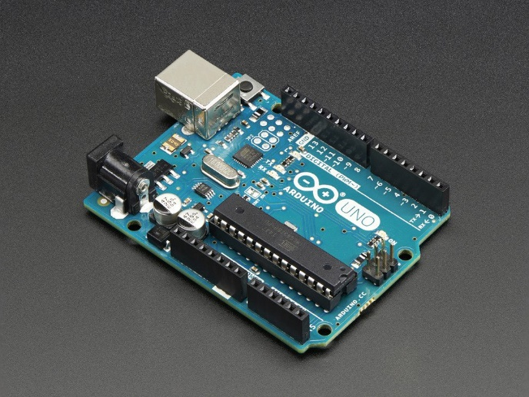
Physics192M: Introduction to measurement using the Arduino
By the end of the course, students will have defined their own question, set up a device to collect data, and answered the question. The course also provides a first experience (for many) in creating a logical sequence of steps to carry out a task, in preparation for programming. No prior experience with computing or hardware is needed.
Key skills to be developed:
(i) Defining a curiosity-driven question in a constructive way.
(ii) Designing, making, and trouble-shooting an apparatus to measure a physical quantity.
(iii) Facility with the hardware-software interface.
(iv) Confidence in completing a technical task independently.
Comments for potential instructors:
1 credit. One 2-h meeting plus 1-2 h homework/week.
Pre-req: Intro-level mechanics; that’s it.
1 faculty instructor + 1 TA for up to 20 students.
No textbook but each student should plan $20 for parts.
  Be ready to quietly help students with $$.
  This year, we bought 40 Arduinos and loaned them.
Don’t be anxious about getting stumped on technical Qs.
www.adafruit.com

Slide 4
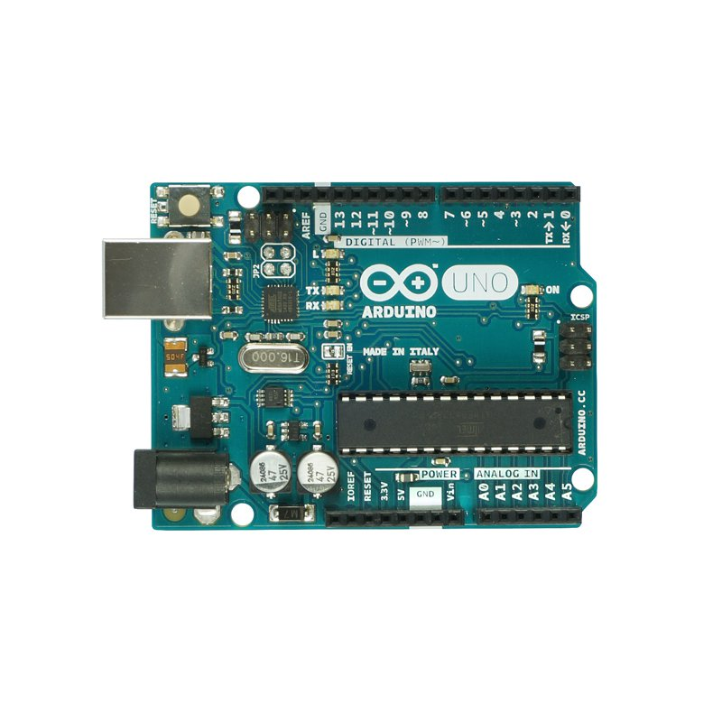
The pins of an Arduino (or Elegoo) Uno
The Elegoo Uno R3 is about $10-$15.
The Arduino Uno R3 is $22.
It’s quite powerful.
One limitation: it’s slow (~1kHz)

Slide 5
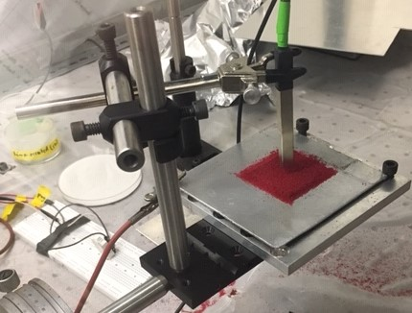
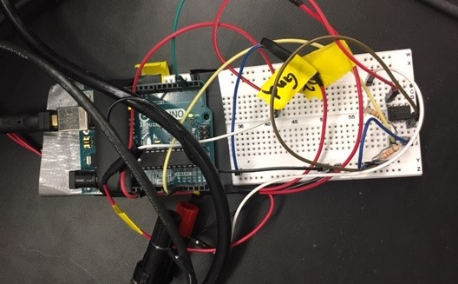
serious tool
The Arduino is a fun toy
Surface voltage of charged sand
Surface voltage probe
Humidity
(Adafruit, $5)
Mark Lewis, BS 2017
Dry, charged sand
Lower humidity
Acquisition
Almost everyone has a powerful computer laptop.
We don’t need LabVIEW or special cards ($1k) for serious data acquisition & control.
Courses using Arduinos for measurement rather than control (e.g., robotics) are not common.

Slide 6


Some inspiring, useful devices
www.adafruit.com
RGB Color Sensor, $7.95
Motion sensor, $9.95
Ultrasonic distance sensor, $3.95, $6.95
Flex sensor, $7.95
Vibration sensors, $0.95+
Hall Effect sensor (magnetic field), $2.00
Microphone with amplifier, (MAX4466 or MAX9814), $6.95-$7.95
Fluid-immersible temperature sensor, $9.95
Soil moisture sensor, $7.95
Temperature and humidity, $3.95, $9.95
Door closing sensor, $3.95
Touch sensor, $5.95
Rubber cord stretch sensor, $9.95
Pressure sensor, $14.95
Luminosity sensor, $5.95
IR thermal camera ($39.95+)
Remote temperature sensors (IR), various
www.arduino.cc
Smart-phone interface/bluetooth
Relays (Arduino can control a 115V line)
Megapixel cameras
WiFi
GPS
Motor controllers (stepper, servo)
RFIDs
Solar panels
LED displays
Touch screens

Slide 7
Proposed schedule for today:
  Example questions/projects from my class.
  Divide into groups of ~4 for small-group discussion:
            “What makes an “effective science question?”
          Report back, discuss among the whole group
  Get to know the Arduino
          Essential components & steps
          Set up to measure temperature or light intensity
    – 20-minute break –
            Set up to measure light intensity or temperature
    Divide into groups according to interest or teaching level:
            “How can we teach these skills in a classroom?”
          (Which skills? What projects? What aspects to emphasize?)
          Report back, discuss among the whole group
  Summary of what Tony does in his course.
  Converge on some lesson plans?
30 min
60 min
40 min
40 min
10 min
30 min
(Several details added near the end – where to get help, saving/exporting data, some details on Tony’s class, etc)

Slide 8
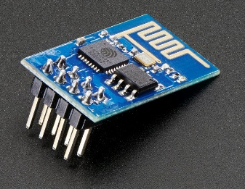
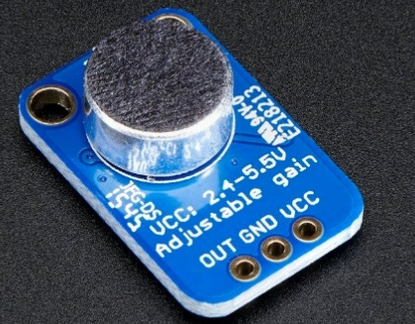
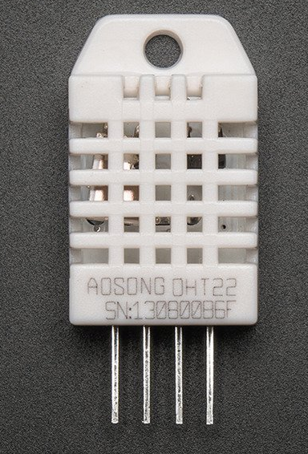
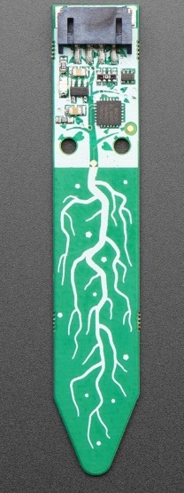
  Example questions from Phys192M
How does GPS location on campus affect the connection strength of the eduroam wireless network?
How does ambient noise change based on what part of campus you are in?
How loud does my ukulele have to be in order to hear it my suitemates’ room?
How does the volume of my room when my neighbors aren't home compare to the volume of my room when my neighbors are making noise?
As I take a shower, how do temperature and humidity of the bathroom correlate as function of time?
How does the weather affect the amount of people that are signed into my residential hall?
How long does it take for my plants to dry out to the point where they need another watering? [Several plant-related!]
What is the acceleration rate and top speed of my RC car?
How much movement do I make in my sleep compared to when laying perfectly still in bed?
What is my average maximum exhalation time for blowing a note into my flute, and does this
vary with pitch?
How does the air quality of my room [CO₂, VOCs] change over the course of the day?
How long does my dog sleep on my bed while I am away?

Slide 9
Posing an effective science question
Feb 24 | April 17
How does temperature affect the amount of people who enter and exit residential buildings? | How does the weather affect the amount of people that are signed into my residential hall?
How loud are my neighbors at night? | How does the volume of my room when my neighbors aren't home compare to the volume of my room when my neighbors are making noise?
Is there a point in the day when the room is empty? | For how long is my room empty of people?
How does the sound level in my room vary throughout the day? | When is the best time in my room to study?
How can I make an RC car move with a battery, electric motor, a remote, and an additional arduino as the motor controller? | what is the acceleration rate and top speed of my RC car?
Questions about the habits of individual people other than the experimenter are not allowed.
Notes:
We revisit our science questions about 3-4x during the semester.

Slide 10
What makes an “effective science question?”
8 + 20 min
(We can certainly take more time if desired.)
  Divide into groups of ~4.
    for 8 minutes, discuss “what makes an “effective science question?”
      (How do you know? What’s not an effective question?)
      Choose a note-taker.
  Report back to the group as a whole
  Whole-group discussion
What we discussed:
Can be replicated by a peer
Measureable, testable, data output, not yes/no
Different from a demonstration
Open-ended
Will involve or support background technical knowledge
Legal, affordable, safe, and fitting within time constraints
Relevant to students, provocative
Leads to more Qs, not chasing rainbows
Supports experiments with good controls
Doesn’t need a clear hypothesis,
  or could disprove the hypothesis
(my favorite)

Slide 11
What makes an “effective science question?”
According to Tony, an effective science question…
is specific enough to allow measurement of defined quantities.
can be answered quantitatively.
  does not have a yes/no answer.
  could have more than one possible answer, including the unexpected.
  can be answered with a plot, ideally one with a well-defined independent parameter.
does not have to have broad interest.
does not have to be “fundamental” or otherwise sciency.
has an answer that will be interesting or informative, e.g., for situations other than the specified one. (Sometimes interesting questions can’t yield interesting/informative answers; these are not effective.)

Slide 12
Proposed schedule for today:
  Example questions/projects from my class.
  Divide into groups of ~4 for small-group discussion:
            “What makes an “effective science question?”
          Report back, discuss among the whole group
  Get to know the Arduino
          Essential components & steps
          Set up to measure temperature or light intensity
    – 20-minute break –
            Set up to measure light intensity or temperature
    Divide into groups according to interest or teaching level:
            “How can we teach these skills in a classroom?”
          (Which skills? What projects? What aspects to emphasize?)
          Report back, discuss among the whole group
  Summary of what Tony does in his course.
  Converge on some lesson plans?
30 min
60 min
40 min
40 min
10 min
30 min

Slide 13
The pins of an Arduino (or Elegoo) Uno
You might have the “Mega,” which is a bit different.
You might have one made by “Elegoo”

Slide 14
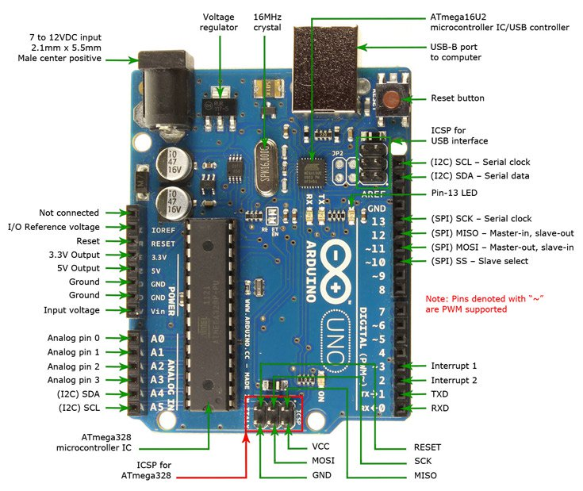
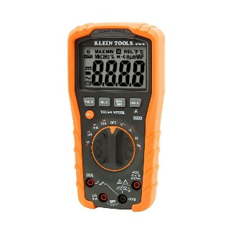
The pins of an Arduino (or Elegoo) Uno
Fortunately, devices that you buy have instructions available so you don’t have to know details. But an overview is helpful:
Plug for AC adapter
The USB cables are of type AB.
The microcontroller has a memory. You can upload a program (“sketch”) from your laptop, then disconnect the laptop. The Arduino will function by itself as long as it has power.
Press this reset button to force your sketch to start again from the top.
These 3 LEDs tell you things:
“RX” is lit when Arduino receives data. ”TX”is lit when it transmits data. “L” is controlled by pin 13. “On” (near bottom) means that the Arduino has power.
I/O = “in/out”
This side of the board has the digital in/out (I/O) pins. As inputs, they read 0 if input<2.5V and 1 if input >2.5V.
As outputs, they are either 0 or 5V.
Some pins are marked ~, which means PWM (pulse-wave modulation). These pins output rapid pulses of 0 or 5V such that the time-averaged V can range from 0-5V. Good for LED control.
Most of these pins also have other specialized functions.
3.3V and 5V pins out a constant voltage. Can be used to power devices. Also useful as reference voltages for testing.
Measure voltage relative to ground (GND). Range = 0-5V, converted to 10-bit value (0-1023). They have other specialized functions too.

Slide 15
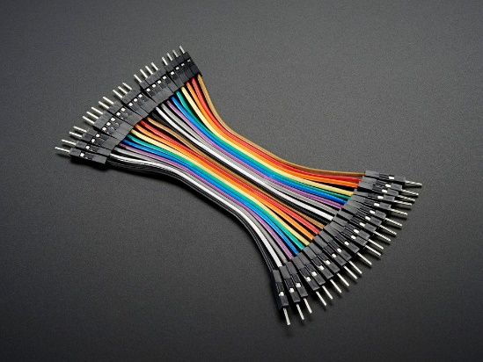
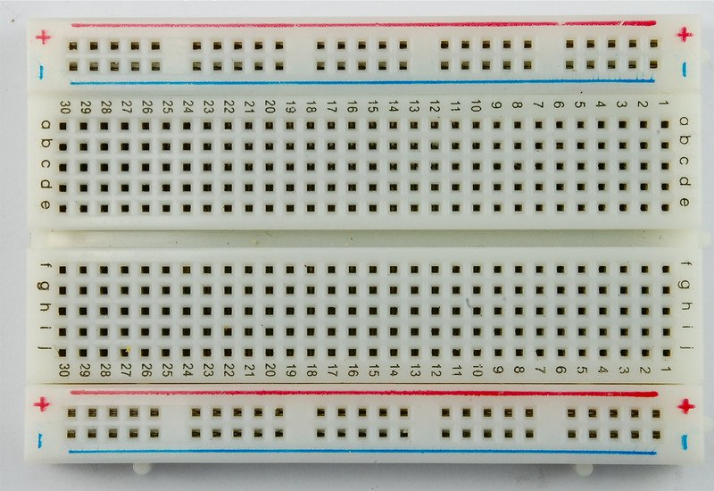

Breadboard, wires, etc. can be useful
Jumper wires (get male/male) plug into breadboards. $2 for 20.
Breadboards are for making circuits without soldering. ($5)
Pins are connected along columns near the center and along rows at the edges, as shown.
Integrated circuit (IC) chips should be mounted on the groove at the center
Multimeters are available for $20 and up. If you get one, be sure it can measure voltage, current, and resistance.

Slide 16
First goal: use pin “A0” to measure a voltage, relative to ground.
(This
We’ll measure ΔV.
We’ll use the pre-installed program called “AnalogReadSerial.” (Details on next slides)
(We used AnalogReadSerial, but I think that it’s easier to start with ReadAnalogVoltage. The reason is that the latter does a little calculation to make the reported value into a real voltage. AnalogReadSerial gives an integer value on a linear scale from 0→ 1023.)

Slide 17
You are welcome to use a UMass laptop
Also free to borrow an Arduino, detectors, resistors, wires, breadboards, etc.
If you have your own laptop and want to install the Arduino software, go to:
https://www.arduino.cc/en/main/software (or Google “Arduino IDE”)
The “web editor” works but is not ideal for repeated use.
Download and install Arduino 1.8.10. (Windows, Mac or Linux)
Don’t use the “Windows App” link for a laptop or desktop.

Slide 18
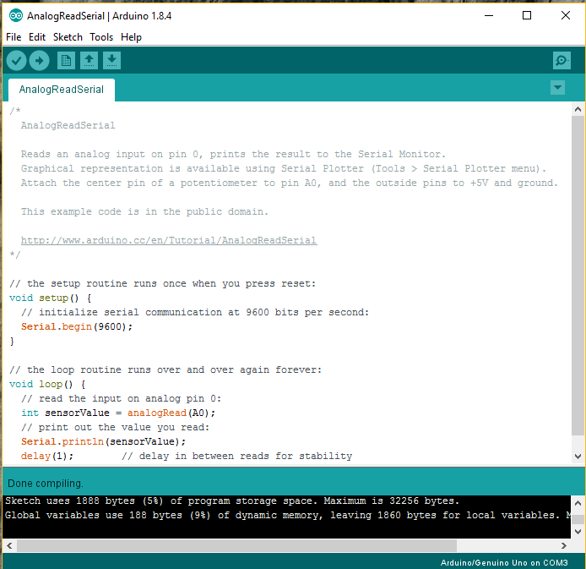
The Arduino IDE
The IDE converts your commands into machine code- it’s an interface. The language is like C++, but if you’ve never programmed you can get started fairly quickly by copying example code. There is a vast array of helpful resources online.
(or ReadAnalogVoltage; see slide 16)
Let’s get started: Run “Arduino.exe.” Menu: file…Examples…01.Basics…AnalogReadSerial. It should look like this (see at right):
Click on the arrow to compile your code and upload it to the Arduino. If it fails:
Click on the check button next to it. If you have a syntax error, you’ll see orange text at the bottom of the screen.
If it compiles OK, you might have a “USB port” error. The most common errors are fixed by Menu: Tools…Board, or Tools…Port. You may have to do this many times.
This message is good news: the code was compiled and uploaded.

Slide 19
Click here to open a window that shows the data coming from the “Serial.println” command.
You can add comments (notes to yourself) between “/*” and “*/” . Or, on any line after “//”. Do yourself a favor and write many detailed comments!
“void setup() {…}” runs just once and has commands to get your board set up. Your device instructions tell you what to write here.
“Void” means a function that does not return a value. “void() setup” has some initialization steps.
Void loop() defines a function that just runs and runs and runs… The function does things (lights flash…beep…write data….etc) but no data is passed to the main program (hence “void”).

Slide 20
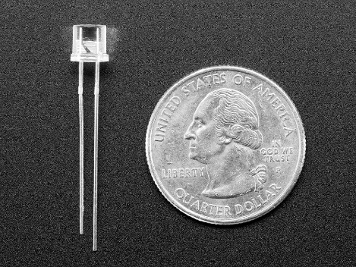
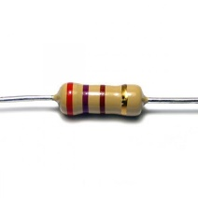
Try one of these:
(I recommend this one first if you’re new to this)
Light intensity, phototransistor #2831, $0.95 from Adafruit
Temperature, TMP36 sensor; $1.50 from Adafruit
to A0
to 3.3 V or 5V pin
to GND
Writing
side
up
pin A0
+5
R approx. 10 kΩ

Slide 21
Measuring temperature
Temperature, TMP36 sensor; $1.50 from Adafruit
to A0
The code:
Start with “AnalogReadSerial.”
1) Find this line:
int sensorValue = analogRead(A0);
2) Below it, add these lines:
// Convert the analog reading to voltage:
float voltage = sensorValue * (5.0 / 1023.0);
// convert to T using mfr’s formula:
float tempValueC = (1000.*voltage - 500.)/10.;
float tempValueF = (9./5.)*tempValueC + 32.;
3) Replace the existing “Serial.Print” line with this:
Serial.println(tempValueF);
4) Replace “delay(1);” with “delay(500);”
5) Compile, fix mistakes, repeat. Upload.
6) Open serial monitor
to 3.3 V or 5V pin
to GND
Converts “sensorValue” to a calibrated voltage
Writing
side
up
Hold the device with flat/printed side toward you. If the device gets very hot, it’s in backward.
Breadboards are for making circuits w/o soldering. Pins are connected along columns near the center and along rows at the edges, as shown in red.

Slide 22
Exporting data for analysis
How fast does the T sensor respond? If you heat up your temperature sensor with your fingers and let it go, what is the function that describes the cooling-down process? Is it the same as the warming-up process?
Here is the simplest way to export data to answer a question like this: Open up the IDE serial window. When you are ready to start collecting data, press the “Clear output” button on the serial monitor window. Turn off autoscroll. When you’ve collected enough data, select all (crtl-a) and copy and paste into a spreadsheet such as Excel. Then you can manipulate the data, plot it, etc.
For two-column data (such as temperature and time), you can print the data in each row with commas (see next slide). For Excel: copy/paste the data into a .txt file, and then import it with Excel. Try this with test data first; you might have to change the format to make it work. For Google sheets: copy/paste directly into a single column of a GoogleSheets spreadsheet, look for the little clipboard icon, and select “Split text to columns.”
Here’s how you could print data with each row having multiple data points separated by commas:
Serial.print(variableA);
Serial.print(",");
Serial.println(variableB);
Serial.print (without the ln) prints and remains on the same line.
Serial.println prints, and then makes a new line.
Try it. There’s also an example on next slide.

Slide 23
Adding time (not discussed during the workshop but some of you asked about it)
/*Modified by Tony Dinsmore, Jan. 2020, starting from ReadAnalogVoltage.
Lines were added to report the time as well as voltage in format appropriate for comma-delimited
data file. You can copy the serial window results and paste them into a Wordpad file and
save as "text.dat" and then import that file into Excel as 2 columns of data.
If you press the reset button on the board, you will see the program and the time start again.
*/
/*
ReadAnalogVoltage
Reads an analog input on pin 0, converts it to voltage, and prints the result to the Serial Monitor.
Graphical representation is available using Serial Plotter (Tools > Serial Plotter menu).
Attach the center pin of a potentiometer to pin A0, and the outside pins to +5V and ground.
This example code is in the public domain.
http://www.arduino.cc/en/Tutorial/ReadAnalogVoltage
*/
//First, define some variables. (This could also be done in loop())
unsigned long t; // Need this for time. Unsigned long can hold a large value, which is
//necessary because our program might run for a large # of milliseonds!
double ts; //We will use this for the time in seconds. Double precision is used so that the
// number of seconds can be large.
// The setup routine runs once after uploading the program or after pressing the reset button:
void setup() {
// initialize serial communication at 9600 bits per second:
Serial.begin(9600);
Serial.println("Time (seconds), Voltage (V)");
}
// The loop routine runs over and over again forever:
void loop() {
// First, read the input on analog pin 0:
int sensorValue = analogRead(A0);
// Note the time, measured from when the Arduino started running this program:
t = millis(); //The variable t was defined in setup()
// Convert the analog reading (which goes from 0 - 1023) to a voltage (0 - 5V):
float voltage = sensorValue * (5.0 / 1023.0);
//Next, convert the time to seconds. The variable ts was defined in setup().
ts=t/1000.;
// print out the values of time , voltage:
Serial.print(ts); // removed "ln" from the print command to present line break
Serial.print(" , ");
Serial.println(voltage);
delay(1000);
}
To collect measurements of two or more parameters, it’s easiest to print them in a comma-delimited format using the Arduino. Then you can export to Excel or Google sheets, etc. The following program will do this. From your IDE: file…New.. And them remove everything in the window, and then copy/paste the text below into it.

Slide 24
breaktime

Slide 25
Proposed schedule for today:
  Example questions/projects from my class.
  Divide into groups of ~4 for small-group discussion:
            “What makes an “effective science question?”
          Report back, discuss among the whole group
  Get to know the Arduino
          Essential components & steps
          Set up to measure temperature or light intensity
    – 20-minute break –
            Set up to measure light intensity or temperature
    Divide into groups according to interest or teaching level:
            “How can we teach these skills in a classroom?”
          (Which skills? What projects? What aspects to emphasize?)
          Report back, discuss among the whole group
  Summary of what Tony does in his course.
  Converge on some lesson plans?
30 min
60 min
40 min
40 min
10 min
30 min

Slide 26
Measuring light intensity and responding to it:
Start with “AnalogReadSerial.”
1) Find this line:
int sensorValue = analogRead(A0);
2) Below it, add these lines:
// Convert the analog reading to voltage:
float voltage = sensorValue * (5.0 / 1023.0);
3) Replace the existing “Serial.Print” line with this:
Serial.println(voltage);
if (voltage < 0.9){
Serial.println(“light low – turning on LED");
analogWrite(10, 140);
}
else{
analogWrite(10, 0);
}
4) Compile, fix mistakes, repeat. Upload.
5) Open serial monitor
Light intensity, phototransistor #2831, $0.95 from Adafruit
pin A0
+5
This line turns on an LED:
Connect an LED with long pin at #10 and short pin at GND.
(It’s better practice to insert a resistor between the LED and GND because sometimes LEDs will burn out if you don’t, but many LEDs will be fine.)
R approx. 10 kΩ

Slide 27
Proposed schedule for today:
  Example questions/projects from my class.
  Divide into groups of ~4 for small-group discussion:
            “What makes an “effective science question?”
          Report back, discuss among the whole group
  Get to know the Arduino
          Essential components & steps
          Set up to measure temperature or light intensity
    – 20-minute break –
            Set up to measure light intensity or temperature
    Divide into groups according to interest or teaching level:
            “How can we teach these skills in a classroom?”
          (Which skills? What projects? What aspects to emphasize?)
          Report back, discuss among the whole group
  Summary of what Tony does in his course.
  Converge on some lesson plans?
30 min
60 min
40 min
40 min
10 min
30 min

Slide 28
How can we teach these skills in a classroom?
15 + 25 min
(We can certainly take more time if desired.)
  What groups shall we form? (By grade level? By type of science? By…?)
  Divide into groups
            For 3 minutes, discuss “How can we teach these skills in a classroom?”
            (Which skills? What projects? What aspects to emphasize?)
          Choose a note-taker.
  Report back to the group as a whole.

Slide 29
How can we teach these skills in a classroom?
Tony’s week-by-week schedule, 2019
W01: Get started with the Arduino. Measure voltage, measure temperature.
W02: Go further with temperature. “What happens to the temperature in my room when I am asleep?”
Sketching imaginary data. (symbols; never curves); arithmetic in the code; “millis()”, exporting data to spreadsheets for plotting. HW: measure and plot T(t) and discuss.
W03: Measuring light intensity with the phototransistor. Coding logic-based decisions. Control LEDs. Voltage, current, and Ohm’s Law. HW: set up the device, plot the data.
W04: Loops. Mean, standard deviation, standard error of the mean. HW: write a code to do this.
W05: Start working on final project. More loops; libraries. HW: write two questions, list necessary devices.
W06: Coding tips and pitfalls: matching data types, arrays, “=“ as assignment operator, functions, memory capacity of the Arduino. HW: choose one question and refine it; sketch imaginary data; refine design.
W07: More on coding tips & memory. HW: refine the question and parts list.
W08: Correlations in data. HW: show preliminary data and write down two conclusions from it. If data not available, sketch imaginary data and discuss.
W09: Schematic diagrams and wiring diagrams. HW assignment: make one of each.
W10: “What makes a science question effective?” HW10: refine question, continue working on project. List 1-2 technical hurdles remaining.
W11: In class: work on project. Review hurdles with instructor. Leave early to collect data if approved.
W12: “ “ “
W13: In-class presentation
Finally, a written document.

Slide 30
Things done well & not so well in P192M
Things done well, mostly after learning from first time teaching:
Students like designing their own project.
Students like learning skills they think will be useful outside the class.
The tone in class is constructive and stimulating. Students help one another.
In class, when instructors review work that students posted for assignment, it is always constructive.
Timing has improved:
  We get started with data acquisition and plotting fast.
  A staged sequence of mini-projects (temp, light…could use one more?)
  A staged sequence of specific coding skills across a few weeks. ← response to student comments
Handouts with distilled programming tips are useful. There’s too much info online, not all of it relevant.
Schematic and wiring diagrams are a good and surprisingly challenging exercise. Could be done earlier.
2-hour in-class period much better than 1.25-hour, which is far too short! ← response to student comments
As many as 20 students in a section is OK with a good teaching assistant; 7 is a bit small.
The course “allowed [a student] to go above and beyond what I was capable of doing, and FAIL. Failing and switching the basis of my project without an extreme impact to my grade was beyond valuable to me. “

Slide 31
Schematic diagram
Wiring diagram
Computer
Arduino Uno
Phototransistor
(Adafruit #2831)
Voltage detector
USB to computer
+5 V
Power
Anolog in
Resistor, 10 kΩ
5V
GND
A0
Light sensor
10 kΩ
What are the main parts and their function? (Not technical specs or names.)
How does the information or current flow?
Don’t forget the computer.
What wire goes where?
What are the names and (maybe) technical specs?
It might be harder to see how the information or current flows.

Slide 32
Things to be improved
For this semester:
Compel students to write things down on paper – daily sketches, diagrams, record of things done…
Adopt a more focused approach to designing a good question. Do this later in the semester, after students have prelim data.
Don’t let students squeak by with little work in the beginning; it affects their final project.
Give more explicit feedback on HWs. This varied. Sometimes we gave extensive feedback in class, sometimes not. (If this were a 2-credit class, I’d have them revise assignments)
Upgrades to the handouts always need to be made as I learn things (usually from the students).
Seating locations: Pairing students at workbenches is good; too spread across the class is not.

Slide 33
Where to get help
Organized, structured help or tutorials:
There are many books about Arduinos but I don’t know any one well enough to specifically recommend it.
Arduino website: a tour through built-in examples: https://www.arduino.cc/en/Tutorial/BuiltInExamples
(When you go to file…Examples… you find many built-in programs. These are very good for getting to know
the capabilities.
Arduino website: Education resources, https://www.arduino.cc/education
Ad-hoc, on-the-fly help:
A list of functions (computer commands): https://www.arduino.cc/reference/en/#functions . This page lists many useful things, and each is a link.
Searching for commands or functions: same URL as above, using the search function at the top of the page. For example, if you type “time,” it will bring you to “millis()”
Google. Type the name of your sensor. If that gives too many options, try adding “Arduino” to your search terms.
Adafruit: For example, search for “sensors” and take a look.

Slide 34
Requirements and grading
• Attendance at the scheduled class time is strictly required. For each missed class, the final grade will be reduced by a full grade point (i.e., by 5 points) unless there is a medical reason (with note) or pre-arranged excuse.
• Homeworks are worth 30% of your grade in total.
• Projects. The final project will be worth 40% of the grade. There are two mini-projects during the semester, worth a total of 20%.
• Participation in class is worth 10%. Participation includes being ready to start work promptly at the start of class, being active in class, and contributing in a positive way to the class environment.
• Grades will be based on your efforts and progress made from where you started.
B → student has done all of the required elements and demonstrates a satisfactory understanding. The assignments were intelligible to non-expert peers.
Higher grade → high level of creativity and/or critical thinking.
Lower grade → if parts of the experiment or questions are done incorrectly, or if the report is poorly organized or otherwise hard to understand.
D or F is given if the student misunderstood the major goal of the lab (which I hope will not happen).

Slide 35
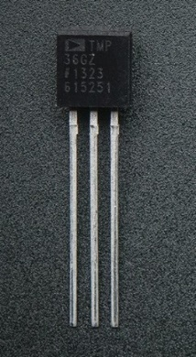
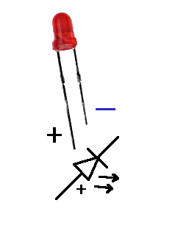
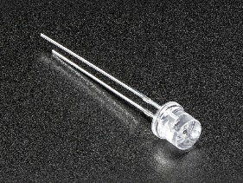
Three example devices
Temperature sensor: TMP36. https://www.adafruit.com/product/165
It’s not the most precise temp. sensor but is simple to use and inexpensive ($1.50)
Placing it with the flat, labeled side facing (up as shown):
Pin 1 (left): Voltage input for power. This is called V_{CC} and should be 2.7-5.5 VDC
Pin 2: to analog input, such as pin A0. You’ll need to tell your IDE sketch (programs) which Arduino pin you use.
Pin 3 (right): GND
Note: if it gets hot, you’ve wired it backward. Watch out – you can destroy it.
LED. https://learn.adafruit.com/all-about-leds . Monochromatic LEDS have 2 pins.
Long pin: High-V side. (anode)
Short pin: low-V side. (cathode) Could be ground, but not necessarily.
Note: If ΔV is too high, the device will be damaged. Max ΔV can be as low as 2.5 or can be above 3.2 V. If it’s set up backward, it does not do anything.
Photosensor (phototransistor). https://www.adafruit.com/product/2831. ($0.95)
Long pin: High-V side.
Short pin: low-V side, then to resistor to ground.

Slide 36
Log-scale plot, showing exponential relaxation of T back to room temperature.
T(t) - 80 °F
T(0) - 80 °F
time (s)

Slide 37
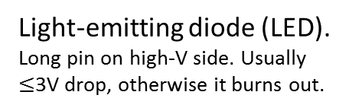
Some common components & symbols
Voltage supply, DC (VDC).
(For a chip, the high-V side for power is often called V_{CC} or V_{DD})
+
-
What is the Arduino doing here?
pin A₀
+5
Resistor.
Ohm’s law: I = ΔV/R
R approx. 10 kΩ
Ground. (V=0, “GND”)
Integrated circuit (IC) chip. Each pin is has a role. Dot shows which pin is #1.
1
6
V_{DD}⁺
GND
2
5
3
4
Answer: Measuring the photocurrent, which is related to detected light intensity. Pin A0 reads an “analog” voltage and converts it to a 10-bit value (0-1023): it’s an “analog to digital converter.” Keep in mind that it measures voltage difference relative to ground, so that it’s actually measuring the voltage drop across the resistor. By Ohm’s law, this tells us the current flowing (called “photocurrent”): I=V/R.
Voltmeter.
Measures ΔV, not V.
V
Light-emitting diode (LED). Long pin on high-V side. Usually $≤$3V drop, otherwise it burns out.
(low V)
Tip for drawing and interpreting circuit diagrams: assume no current flows through a voltmeter (e.g., the wire to A0, above). Also, no current flows through the ground connection ( ); it only holds V=0 at that point. Assume that all points connected by a wire have the same V.
Phototransistor. Long pin on high-V side. Minimal current flows in dark; current is proportional to light intensity.
(low V)

