Slide 1


SuperHero
Robotics
UMass STEM-Ed Saturday Seminar
Prof. Frank Sup
Mechanical & Industrial Engineering
Prof. Brian Umberger
Kinesiology
Students: Nick Sawyer, Shannon Fan, Andrew Sciotti, Youssef Jaber, Mark Price, Vinh Nguyen, Ericber Francisco, Julio Aparicio

Slide 2
Today’s Agenda
8:30 – Coffee
9:00 – Exoskeletons & Mechatronics
10:00 – Human Anatomy & Biomechanics
10:50 – Break
11:00 – Building the ExBow
12:00 – Arduino Setup and Basic Startup Tutorial
12:30 – Flexing with the ExBow

Slide 3
Learning Objectives
Understand what is an exoskeleton and how do they work
Understand how humans move and how we can use robots to assist our movements
How to build and control a basic elbow exoskeleton

Slide 4
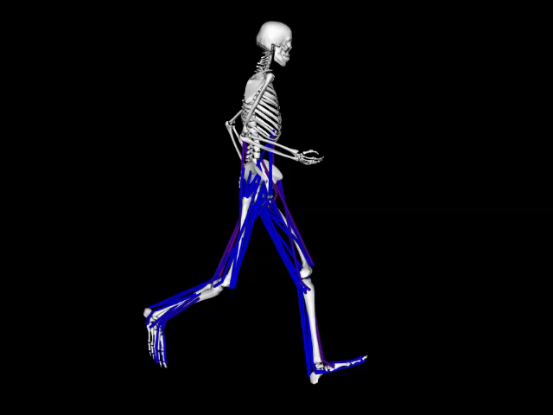
Integrating anatomy & biomechanics to understand human movement

Slide 5
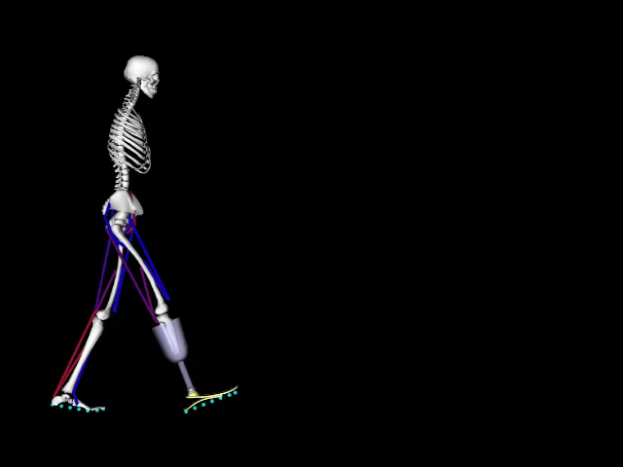
Integrating anatomy & biomechanics to understand human movement

Slide 6
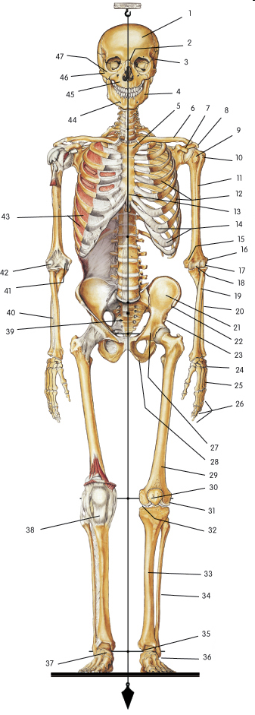
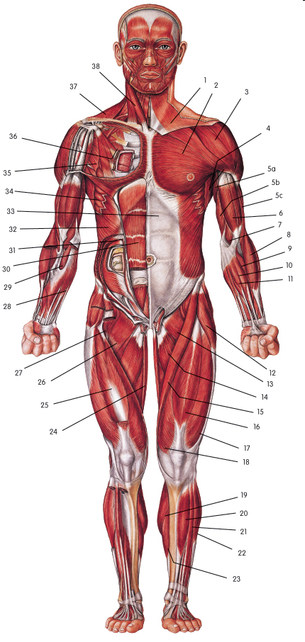
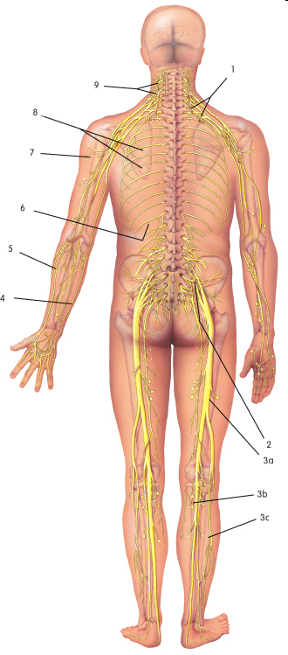
Human Organ Systems
Three organ systems are especially important for movement:
Skeletal
Muscular
Nervous
© Sparkcharts
© Sparkcharts
© Sparkcharts

Slide 7
Skeletal System
Skeleton
consists of 206 bones
divided into two components
  axial skeleton (central)
  appendicular skeleton (peripheral)
© Sparkcharts

Slide 8
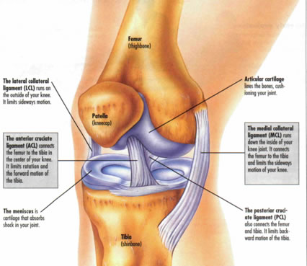
Joints
Joint: the articulation between two or more bones
Typically classified by the motions they permit
Most relevant example:
diarthrodial: freely moveable joints that permit motion about one, two or three axes

Slide 9
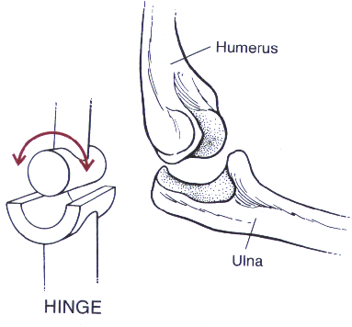
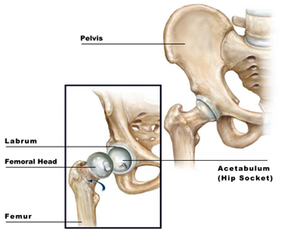
Types of Joints
Two examples:
Hinge joint (uni-axial)
Reciprocal convex and concave cylindrical surfaces
Ball-and-socket (tri-axial)
Reciprocal concave and convex spherical surfaces

Slide 10
Muscular System
Muscular System
  Three types of muscle tissue:
    Cardiac muscle
    Smooth muscle
    Skeletal muscle
  Consists of muscles attached to bones by tendons
  Provides for maintenance of posture
  Represent the motors that power movement of the body
© Sparkcharts

Slide 11
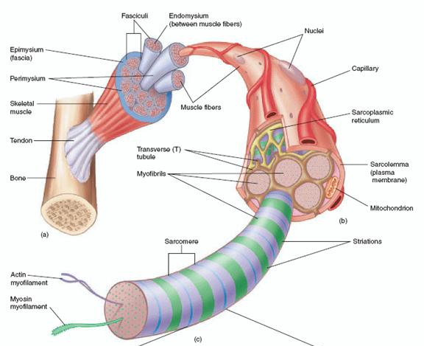
Muscular System
Muscle Structure
Organization
  whole muscle
  fascicle
  fiber
  myofibril
  myofilament
Connective Tissue
  epimysium
  perimysium
  endomysium

Slide 12
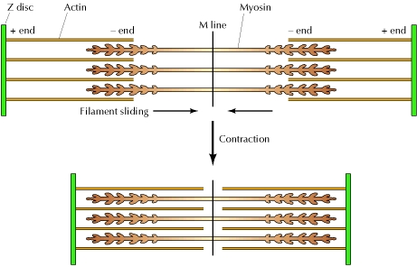
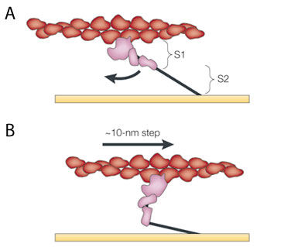
Muscular System
Sliding Filament Theory
Muscle length change results from the sliding of the thin (actin) and thick (myosin) myofilaments in the sarcomere
Cross Bridge Theory
Muscle force production results from the myosin heads binding to sites on actin and rotating
Requires presence of Ca⁺⁺; powered by ATP splitting

Slide 13
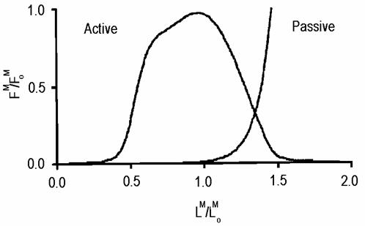
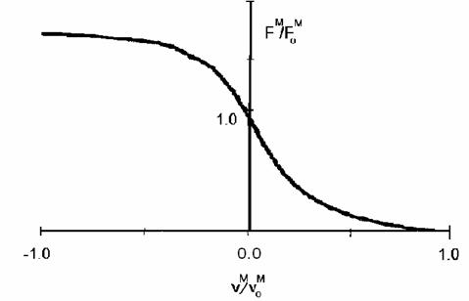
Muscular System
Muscle is a highly nonlinear actuator
Force-Length Relation
muscle force depends on length
  active and passive contributions
Force-Velocity Relation
muscle force depends on velocity
  force drops with increased shortening velocity
  force rises with increased lengthening velocity

Slide 14
Nervous System
Nervous System
  Brain, spinal cord, and nerves
  Receives sensory information about the body and environment
  Provides motor commands to the muscles
  Plays the primary role in learning and controlling movements
© Sparkcharts

Slide 15
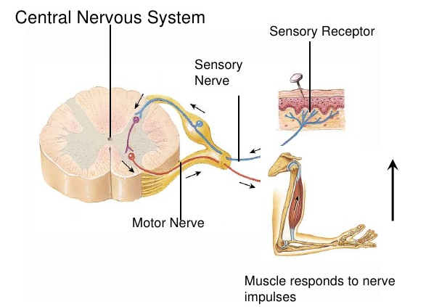
Neuromuscular Control
Reflex control: fast, simple, reactive, but non-adaptive

Slide 16
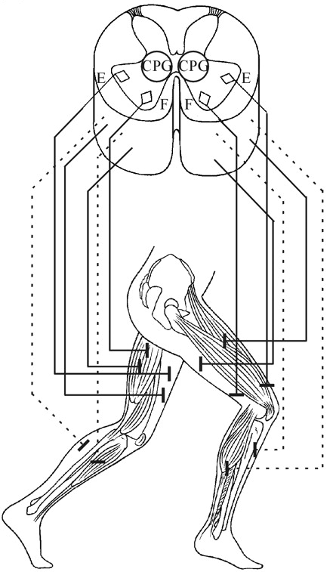
Neuromuscular Control
Pattern generation:
More sophisticated and robust than reflexes
Requires little cortical input
Still has limited adaptability
Pattern generator for locomotion

Slide 17
Neuromuscular Control
Voluntary control:
Most complex and most flexible
Involves cortical centers
Highly adaptable
Employs feedback and feedforward mechanisms

Slide 18
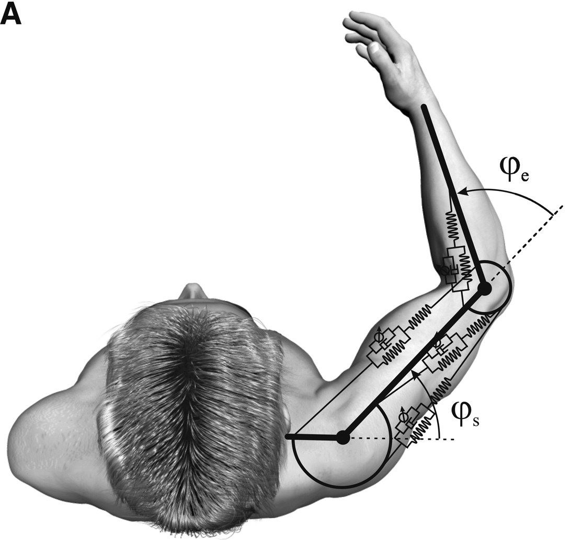
Musculoskeletal Transformations
Linear ⇒ Rotational ⇒ Linear
Linear: muscle actuation
Rotational: joint motion
Linear (sometime curvilinear): motion of segment endpoint (e.g. hand or foot) or the whole body
Kistemaker et al. (2010)

Slide 19
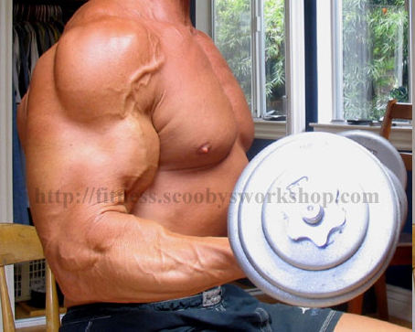
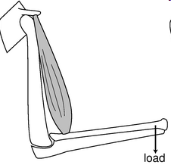
Muscle-Joint Function
Muscles generate forces that give rise to torques at the joints
These torques cause joint rotation and endpoint translation
muscle
muscle
load

Slide 20
Muscle-Joint Function
Example: static analysis
ΣT = 0 ⇒ T_{muscle} - T_{load} = 0
so, T_{muscle} = T_{load}
and, (F d)_{muscle} = (F d)_{load}
Note that d_{load} is >> than d_{muscle}, so F_{muscle} must be >> than F_{load}!
muscle
F_{muscle}
d_{muscle}
F_{load}
d_{load}

Slide 21
Studying Human Movement
Two main approaches:
Experimental
  Motion capture
  Force/pressure measurement
  Electromyography
Modeling & Simulation
  Musculoskeletal modeling
  Dynamic simulation
  Optimal control

Slide 22
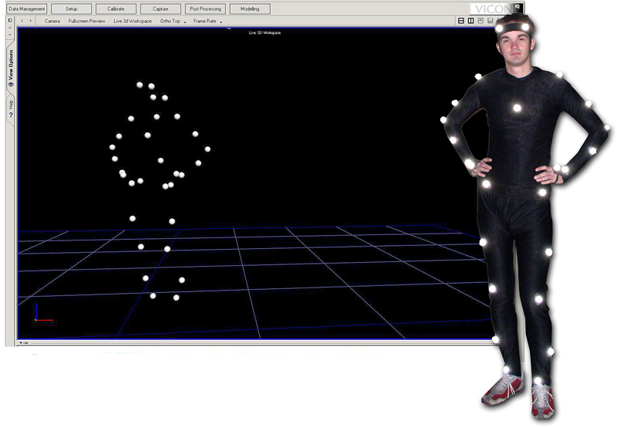
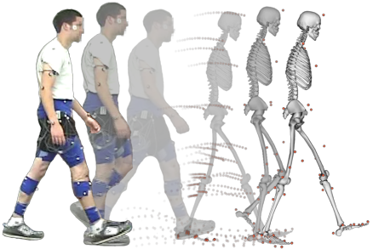
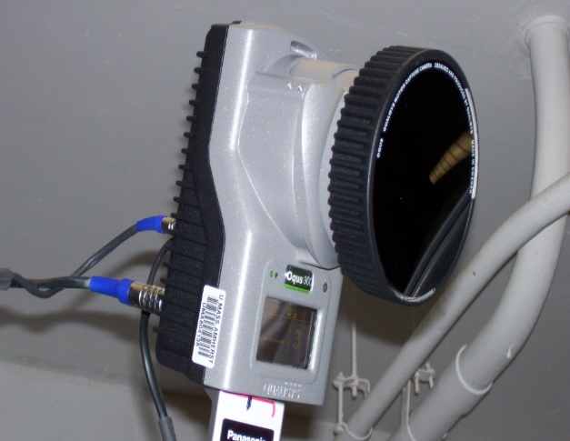
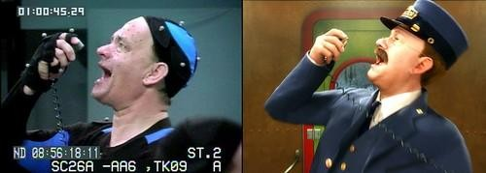
Motion Capture

Slide 23
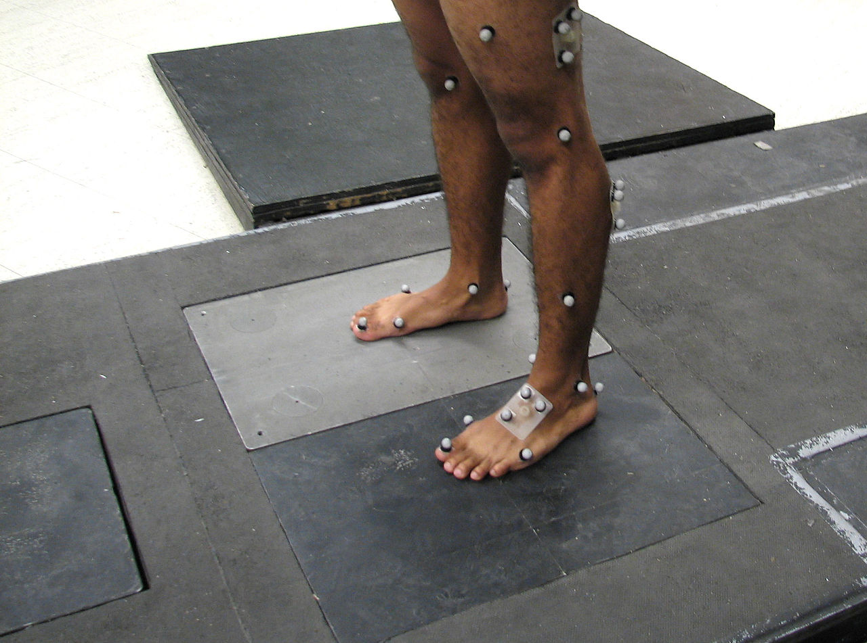
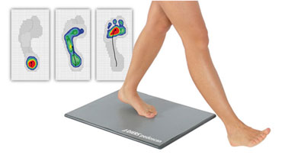
Force/Pressure Measurement

Slide 24
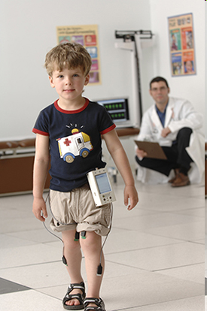
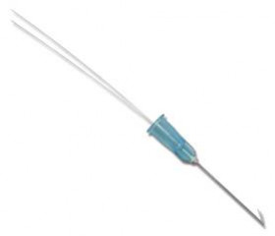
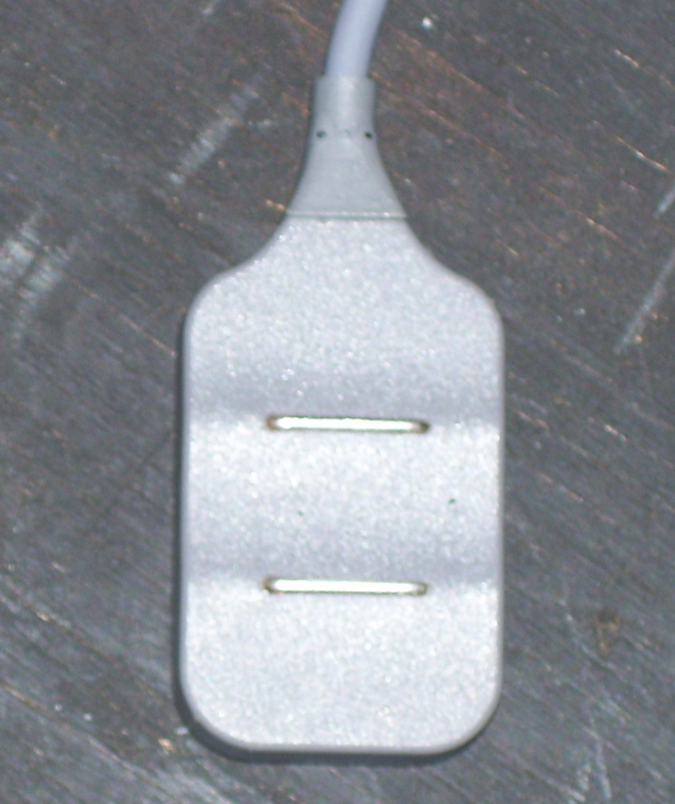
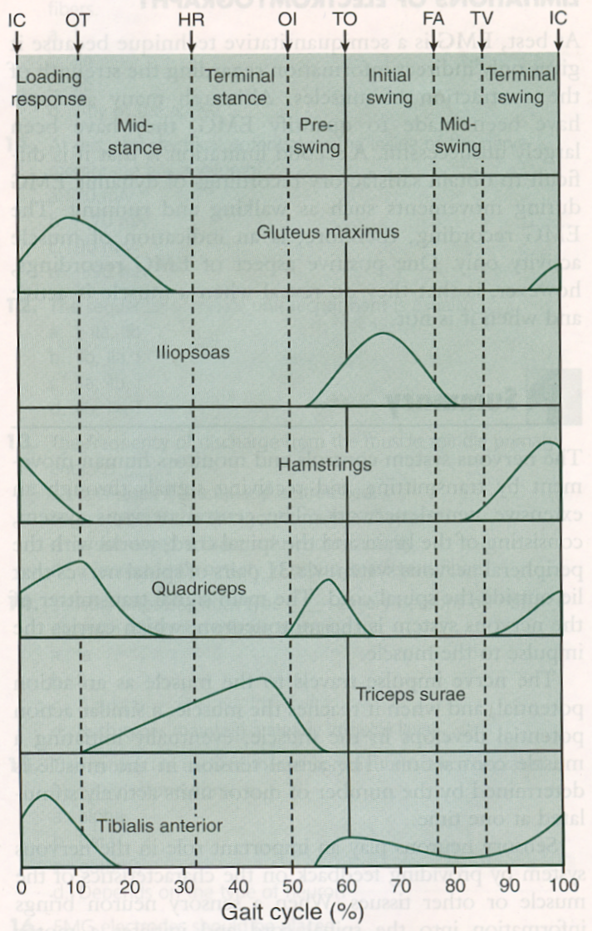
Electromyography
EMG electrodes

Slide 25
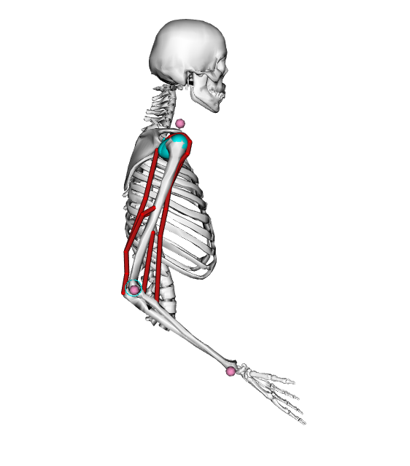
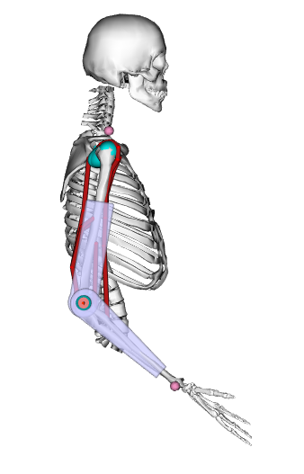
Modeling, Simulation & Control
Example: aid in the design of assistive devices
Muscles
Exoskeleton
Body
segments
DC motor
Vinh Nguyen

Slide 26
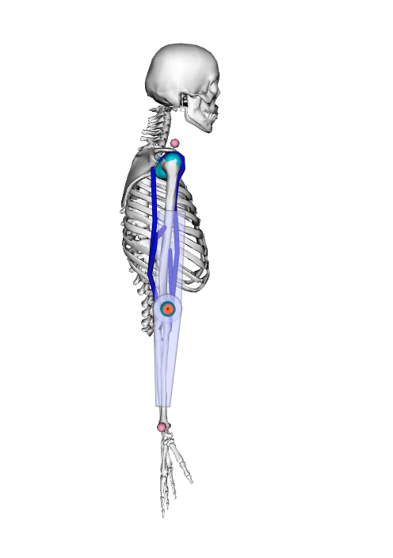
Modeling, Simulation & Control
Vinh Nguyen

Slide 27
Questions?

