Slide 1
Design of an Educational Robotic Exoskeleton
Shanon Fan, Youssef Jaber, Nick Sawyer, Andrew Sciotti, Frank Sup
Notes:
Previous College Experience
Major, Class
What I would like to do
Makerspace

Slide 2
Goals for the ExBow
Make a low cost robotic exoskeleton
Safe to use
  Low torque
  Avoid pinching points
  Easy to stop
Easy to use and replicate
Uses parts and tools that are relatively easy to acquire
Motion is caused by some sort of sensor
Accessible as an educational tool

Slide 3
Educational Values
Physics
  Torque
  Gear Ratios
Electronics
  Coding with the Arduino
  How circuits work and how to use a breadboard
Engineering Design
  What are different ways that this could have been designed?

Slide 4
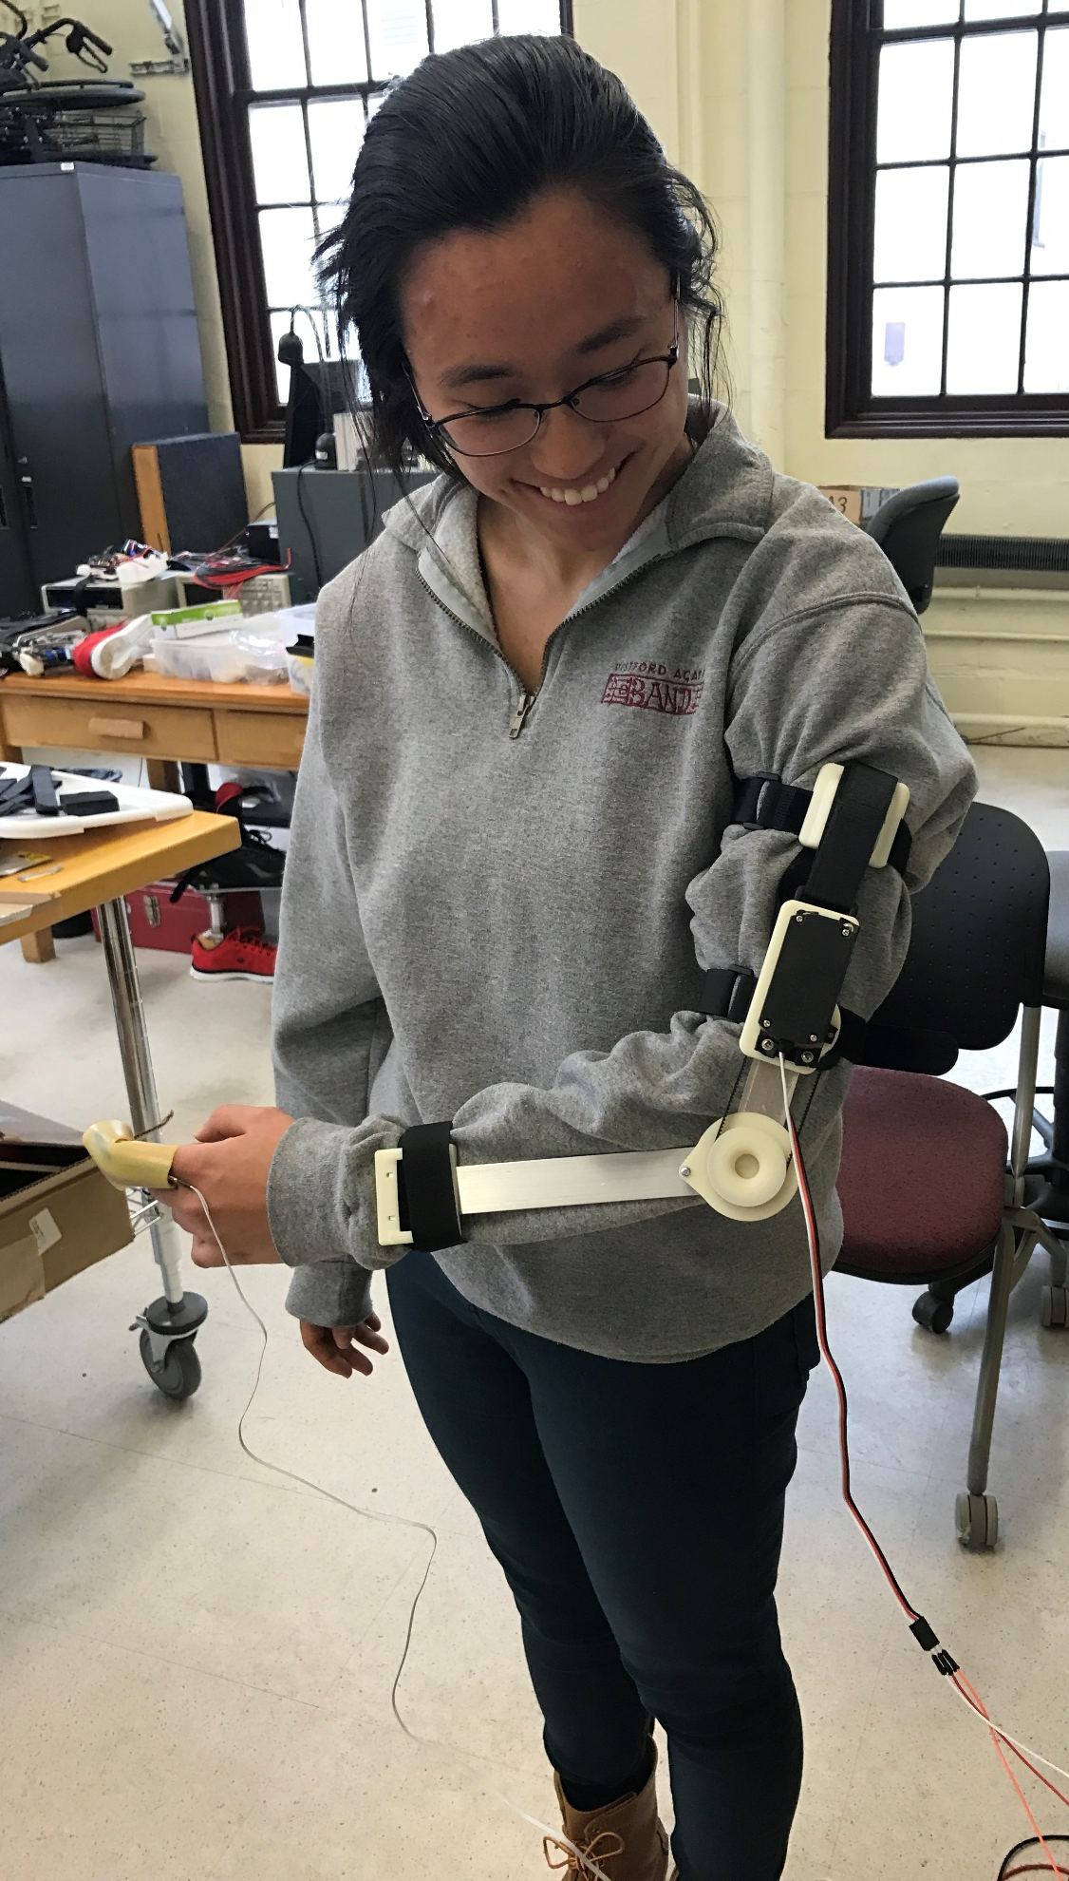
Functioning ExBow
Notes:
Let’s start off with a very exciting video of
While she bends her finger, the motor will turn her arm

Slide 5
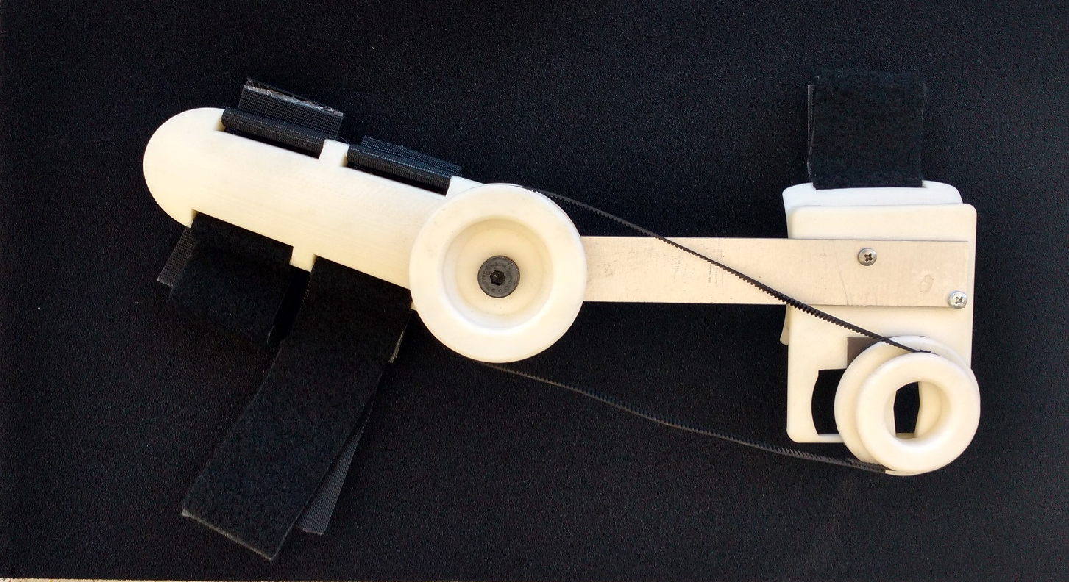
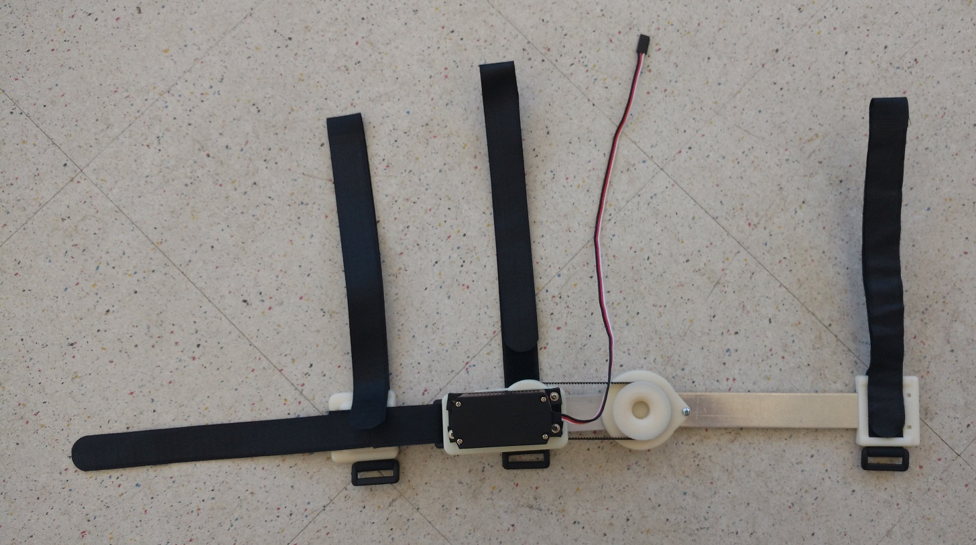
Original
Design
New
Design

Slide 6
Improvements
Reduce cost
Reduce the amount of printed plastic
Make it easier to put on
Faster and easier assembly
Be able to change gear ratio quickly and easily
Be able to adjust the belt tension
Continuous loop belt
Make a better joint
Notes:
3D Printed Parts can be costly, especially if you do it through a separate service, rather than on your own printer.
The original Velcro on the arm was extremely strong, making it next to impossible to put on alone.
The original design had a belt that was glued together and because there was nothing to adjust the tension, the belt was screwed onto the gears

Slide 7
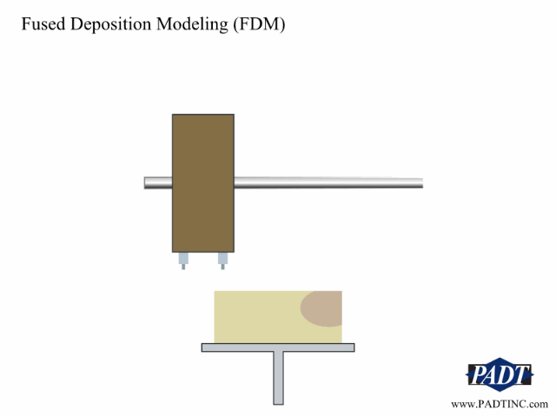
3D Printing Basics
http://www.padtinc.com/blog/additive-mfg/rapid-prototyping-technology-animations
Found at P-D-A-T
Notes:
Fused deposition modeling is the process of melting a strand of plastic and laying it down.
Imagine that you are icing a cake with a round pipette. You’d start with the outside wall and then fill the inside and then build up on top of that layer starting with the outer wall again.
This image is from an article written by Eric Miller.
P-D-A-T, according to http://www.padtinc.com/ is “PADT is the Southwest's leading provider of
Numerical Simulation, Product Development, and 3D Printing products and services.”

Slide 8
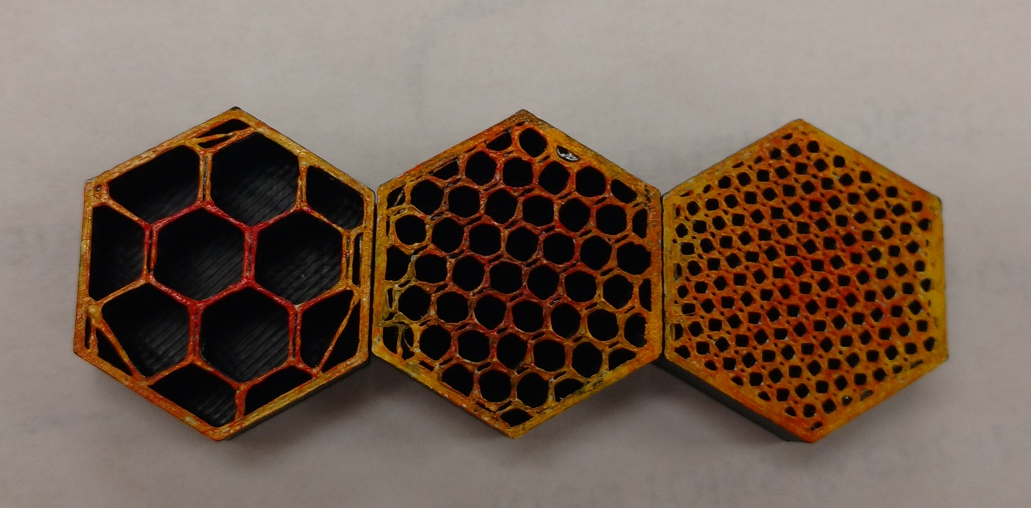
Makerbot Replicator 2x (has dual extruders)
Makerbot software allows you to adjust the density, or infill of the parts that you are printing. As such you are able to adjust the strength of your 3D Prints to a certain extent.
10%
25%
50%
Notes:
The higher the density of your part, the more strength it will have and the higher the cost will be.
You can also adjust the layer height, which will change the print time drastically, while not changing the overall weight of your print.
The following pictures used Makerbot software to estimate a print time and a weight of the material.

Slide 9
Original Design 20% Solid
180.49 grams
16 hr. 17 min.
Notes:
Each of the original parts is relatively large and therefore fairly costly. This is printed without supports.

Slide 10
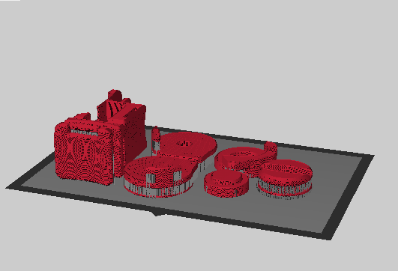
New Design 50% Solid
153.57 grams ABS
9.08 grams Support
21 hr. 21 min.
Notes:
Including the support material at a higher strength, it still requires less printed material.
At 20% infill:
-117.47 grams ABS
-8.83 grams Support
-8hr 59min
The time is higher because it has a very low layer height, at .10mm. More ridges, but the ridges will be smaller.

Slide 11
What’s in each kit:
7-3D Printed Parts
2-Aluminum Bars
1-Bolt
Extra Wood Screws**
  (To be used on gear only)
1-Timing Belt
4-Velcro Straps
1-USB Flash Drive
1-Bend Sensor Assembly
1-Battery Pack
1-Wire Extension**
1-Servo Motor Kit
6-AA Batteries
1- Medium Breadboard
1-Nano-Arduino
Small lengths of wire**
Misc. Electronic Components**
1-Mini-B USB Cable

Slide 12
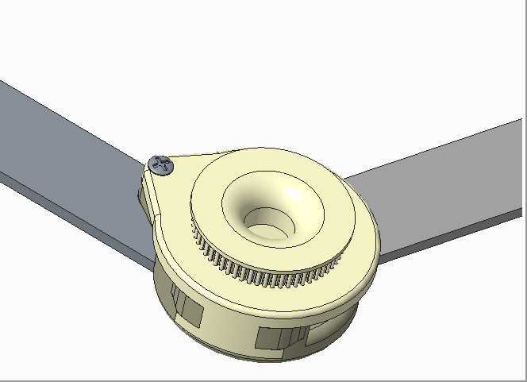
The Elbow- Sandwich Joint
Notes:
120 Degrees of rotation
Only 1 screw

Slide 13
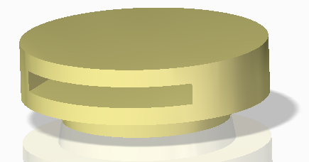
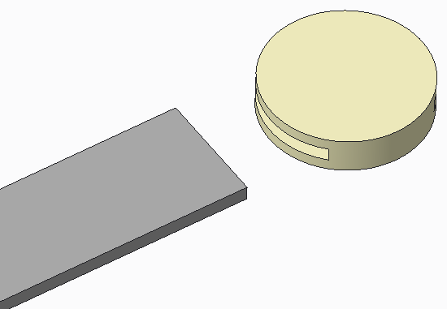
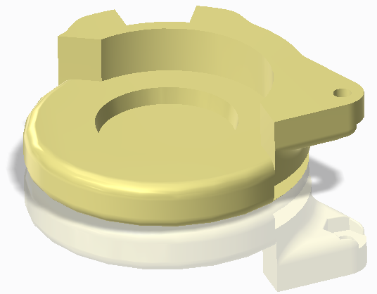
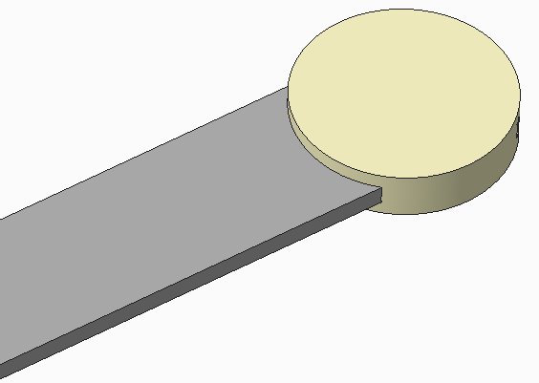
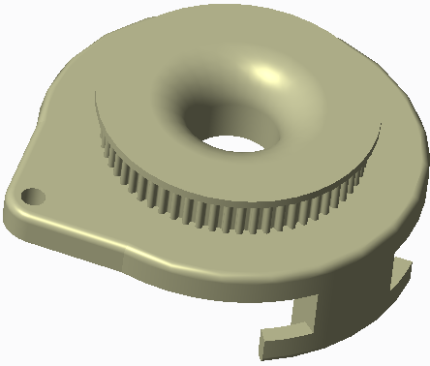
A
A
1
B
A
C
Step: 1
Notes:
Each kit should have the following:
Wafer- Nub on the bottom is a truncated cone with a 10 degree angle. Holes in the back to allow for glue and/or air to escape when putting in the aluminum bar. They are located there to reduce the chances of additional friction
Print Orientation!!!
Wafer pocket- negative of the truncated cone also has 10 degree angle. Holes in bottom allow for gasses to escape.
Take notice of the nut, hole and the divot in the side.
Mention Print Orientation!!!!

Slide 14
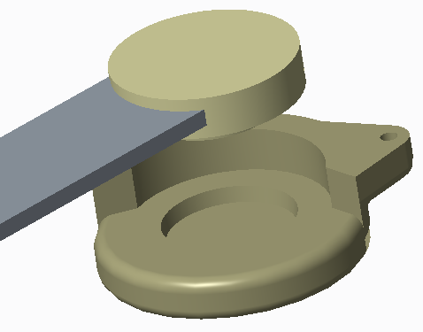
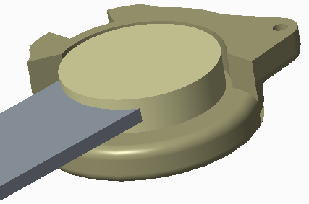
A
A
B
B
A
C
Step: 2
B
Notes:
Each kit should have the following:
Wafer- Nub on the bottom is a truncated cone with a 10 degree angle. Holes in the back to allow for glue and/or air to escape when putting in the aluminum bar. They are located there to reduce the chances of additional friction
Print Orientation!!!
Wafer pocket- negative of the truncated cone also has 10 degree angle. Holes in bottom allow for gasses to escape.
Take notice of the nut, hole and the divot in the side.
Mention Print Orientation!!!!

Slide 15
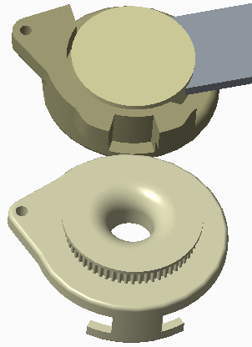
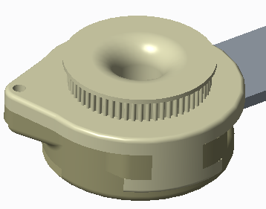
B
A
A
B
C
C
C
Step: 3
B
Notes:
Each kit should have the following:
Wafer- Nub on the bottom is a truncated cone with a 10 degree angle. Holes in the back to allow for glue and/or air to escape when putting in the aluminum bar. They are located there to reduce the chances of additional friction
Print Orientation!!!
Wafer pocket- negative of the truncated cone also has 10 degree angle. Holes in bottom allow for gasses to escape.
Take notice of the nut, hole and the divot in the side.
Mention Print Orientation!!!!

Slide 16
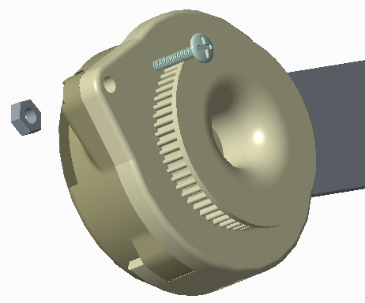
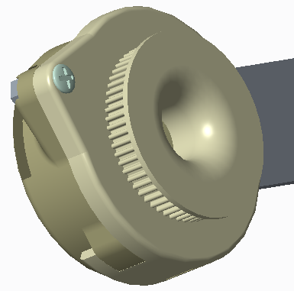
A
B
C
Step: 4
Notes:
Each kit should have the following:
Wafer- Nub on the bottom is a truncated cone with a 10 degree angle. Holes in the back to allow for glue and/or air to escape when putting in the aluminum bar. They are located there to reduce the chances of additional friction
Print Orientation!!!
Wafer pocket- negative of the truncated cone also has 10 degree angle. Holes in bottom allow for gasses to escape.
Take notice of the nut, hole and the divot in the side.
Mention Print Orientation!!!!

Slide 17
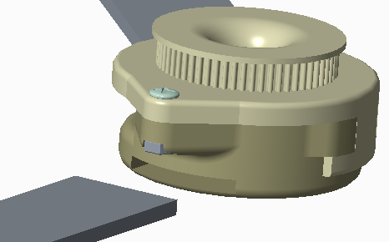
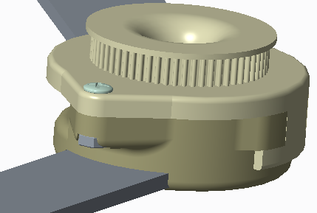
A
2
B
C
Step: 5
Notes:
Each kit should have the following:
Wafer- Nub on the bottom is a truncated cone with a 10 degree angle. Holes in the back to allow for glue and/or air to escape when putting in the aluminum bar. They are located there to reduce the chances of additional friction
Print Orientation!!!
Wafer pocket- negative of the truncated cone also has 10 degree angle. Holes in bottom allow for gasses to escape.
Take notice of the nut, hole and the divot in the side.
Mention Print Orientation!!!!

Slide 18
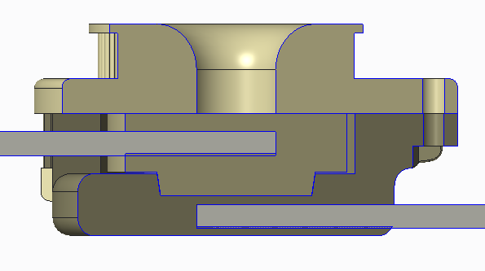
Squeezing Force

Slide 19
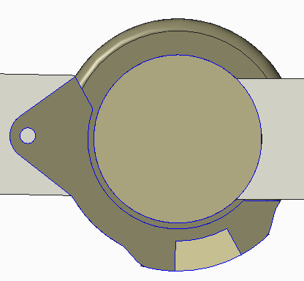
Rotational Force Balance
Notes:
The T-Shaped key on part C will push against part B

Slide 21
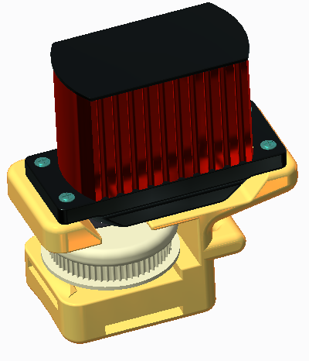
The Motor Mount
Notes:
120 Degrees of rotation

Slide 22
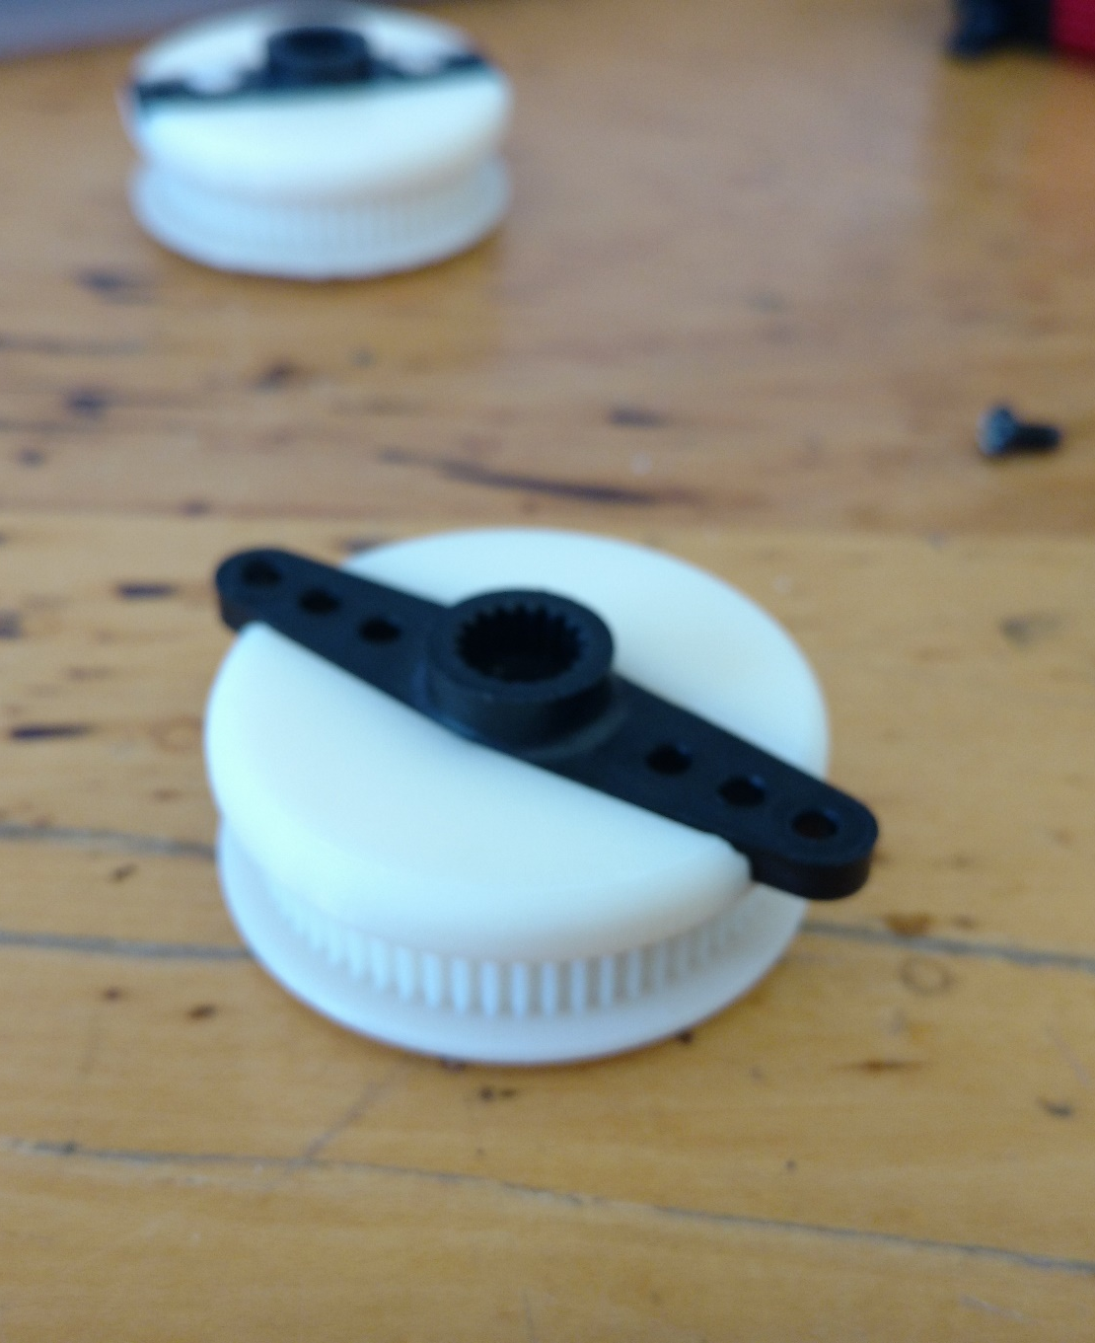
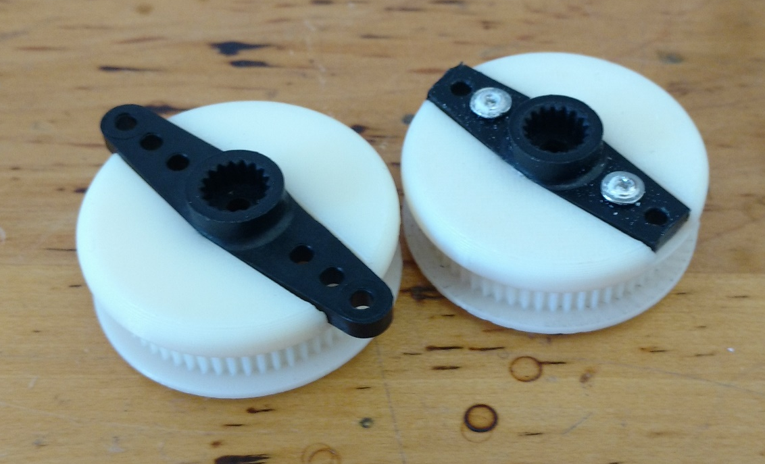
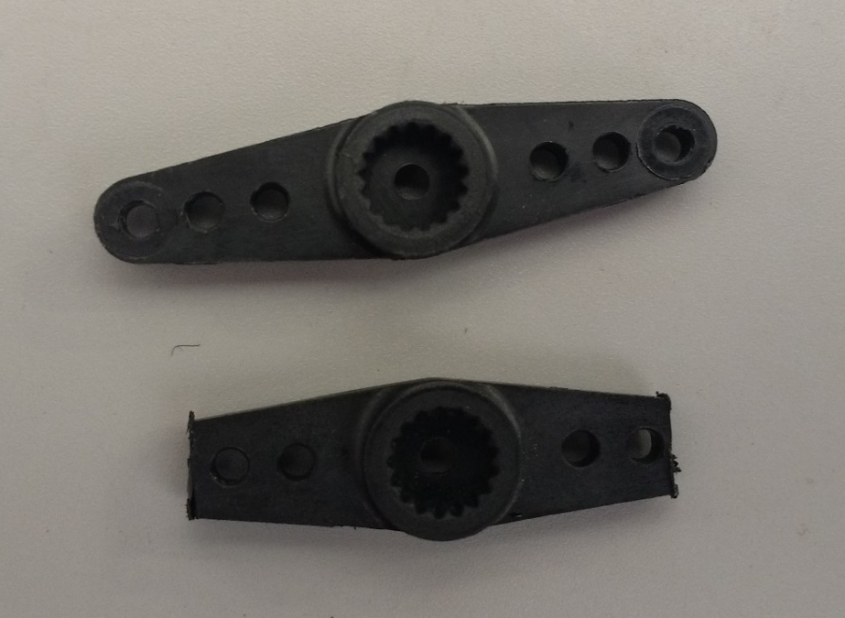
T-Bar

Slide 23
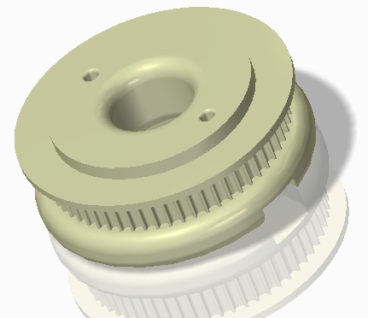
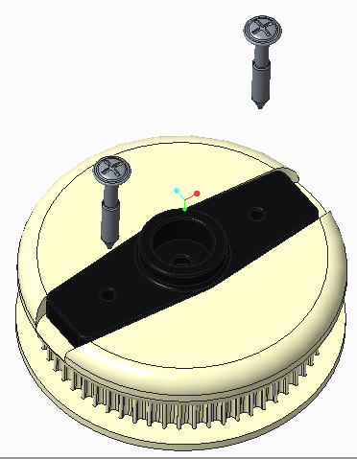
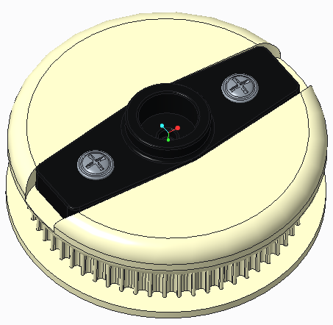
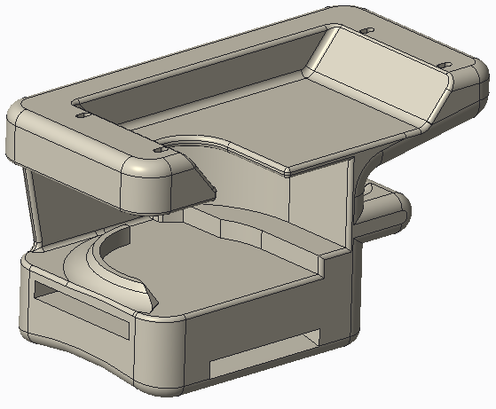
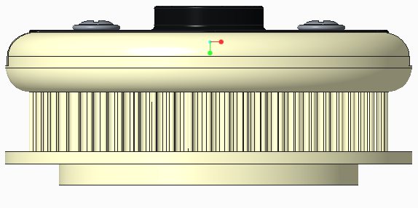
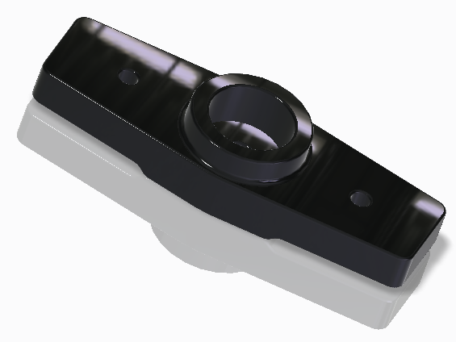
Part D and T-Bar
D
E
T-Bar
Step: 6
Notes:
Put in the wood screws included in the Adafruit bag

Slide 24
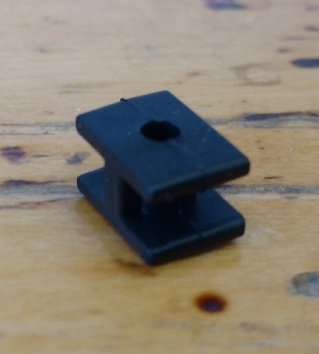
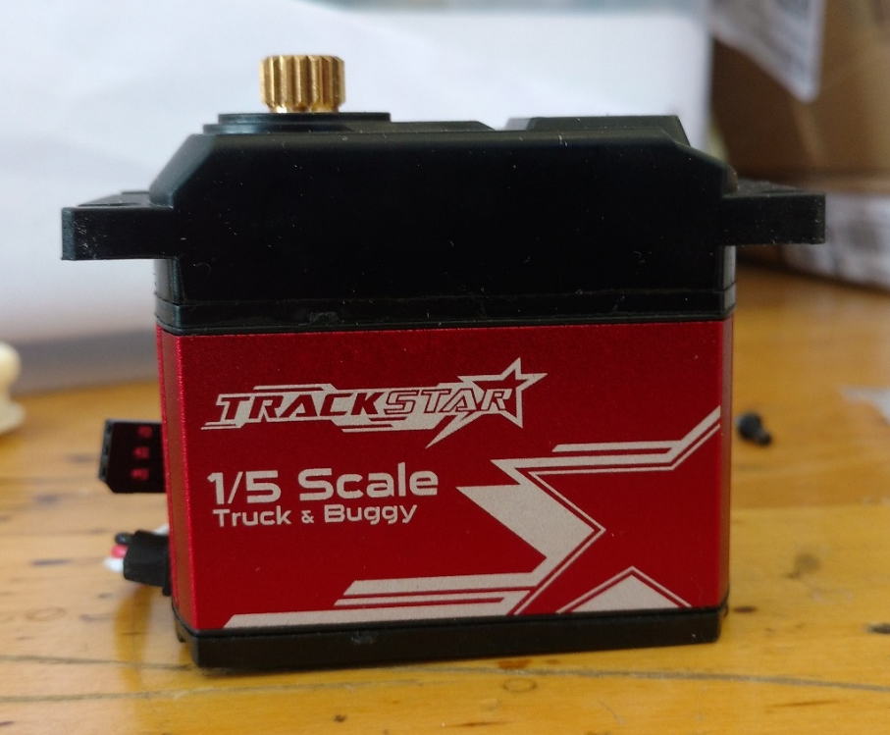
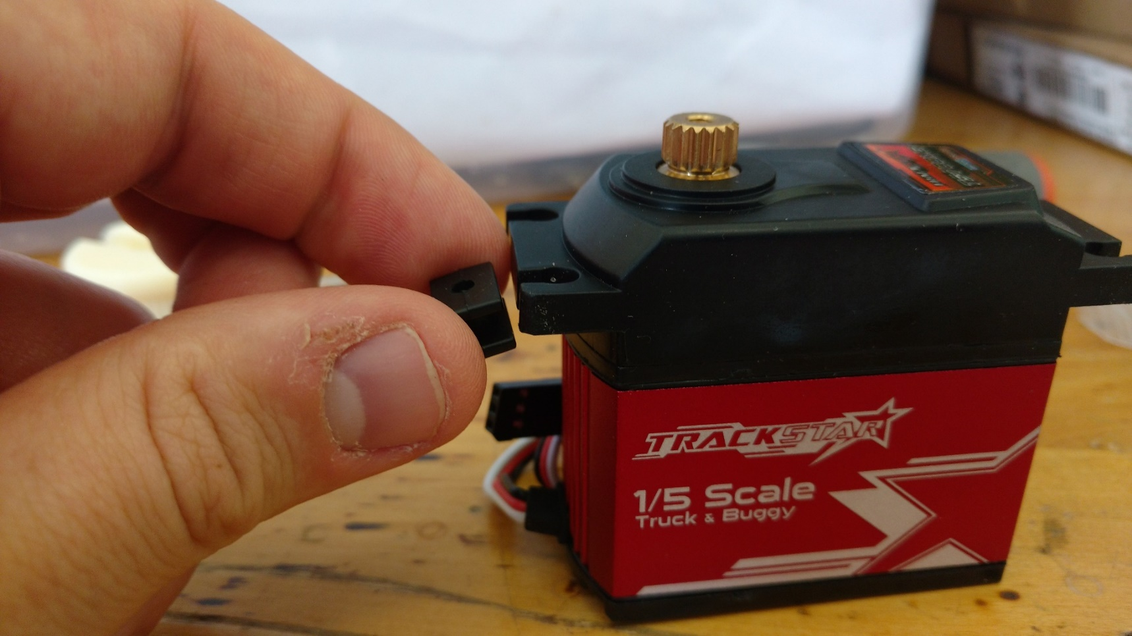
Putting on the shock absorbers
4x

Slide 25
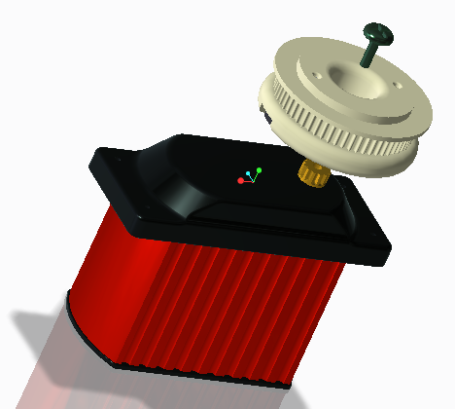
Part D and motor
D
E
T-Bar
Step: 7

Slide 26
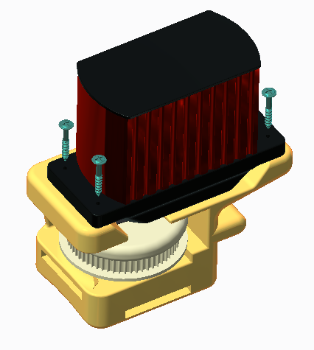
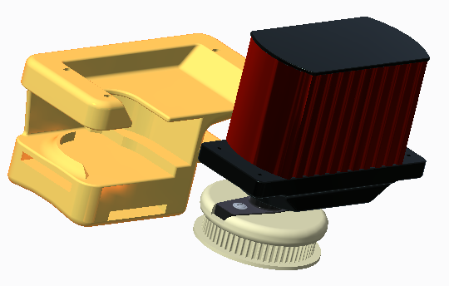
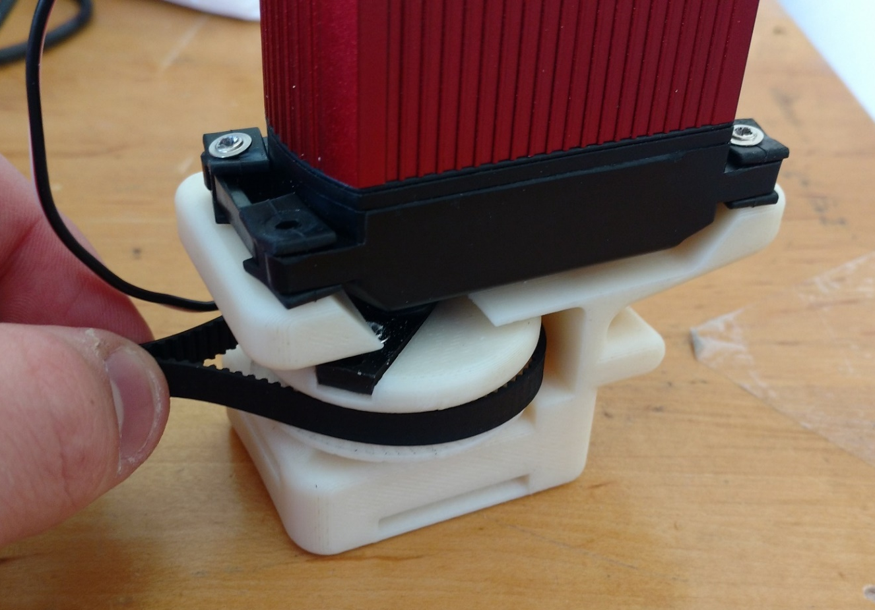
Slide motor into the mount
D
E
E
T-Bar
Step: 8
Notes:
Make sure to put the belt around the gear before sliding the motor into the motor mount.

Slide 27
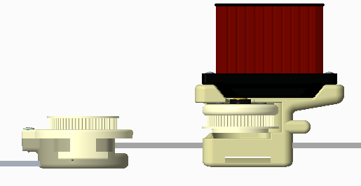
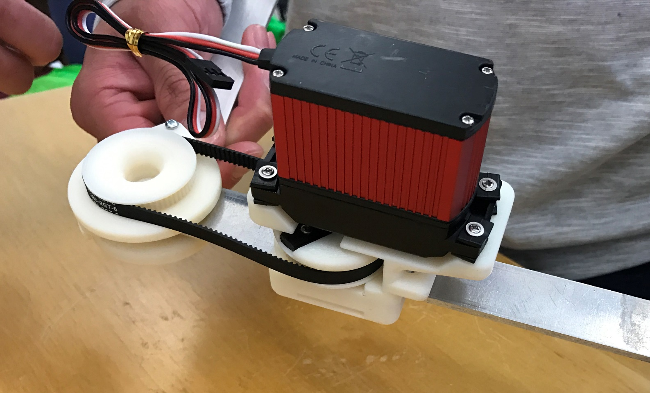
Slide mount onto the aluminum bar
Step: 9
Notes:
Make sure to put the belt around the gear before sliding the motor into the motor mount.

Slide 28
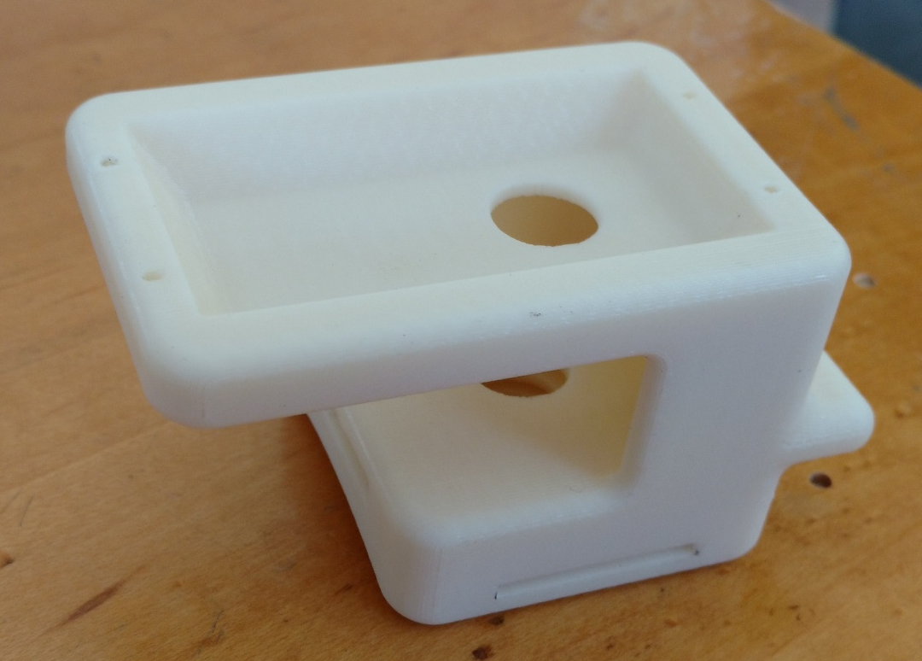
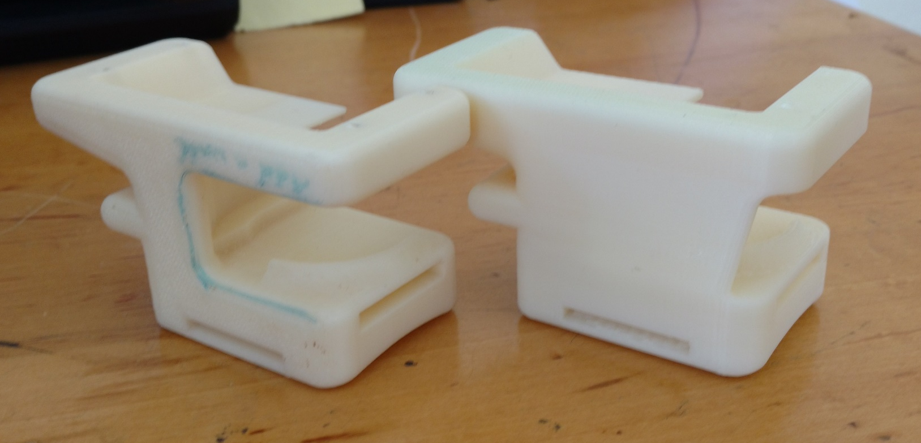
Different iterations of the Motor Mount
i
ii
iii
Notes:
Modified from the original design to have both a tensioning strap in the back and puts the motor above the arm instead of next to the arm. The servo is mounted first and the gear is mounted onto the bottom and screwed through the hole in the bottom. A large problem is that the aluminum bar cannot be in the motor mount before the gear is attached.
Centers the motor over the support, and allows for the servo to be mounted from the side and adds a lip so that the

Slide 29
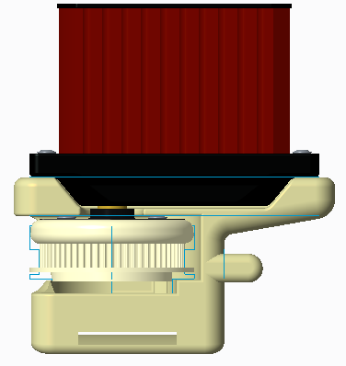
Motor Mount Tension

Slide 30
Forces on the gear
Motor
Belt
Lip

Slide 31
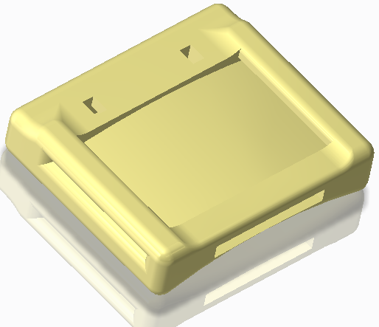
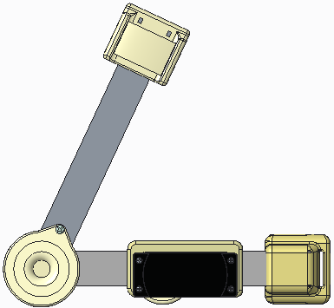
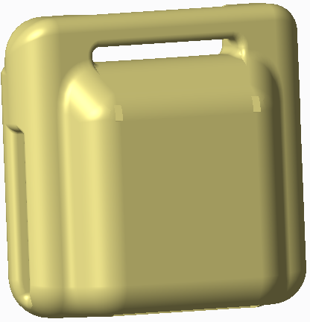
Adding the Rest…
F
F
G
2
Step: 10
1
G
Notes:
120 Degrees of rotation

Slide 32
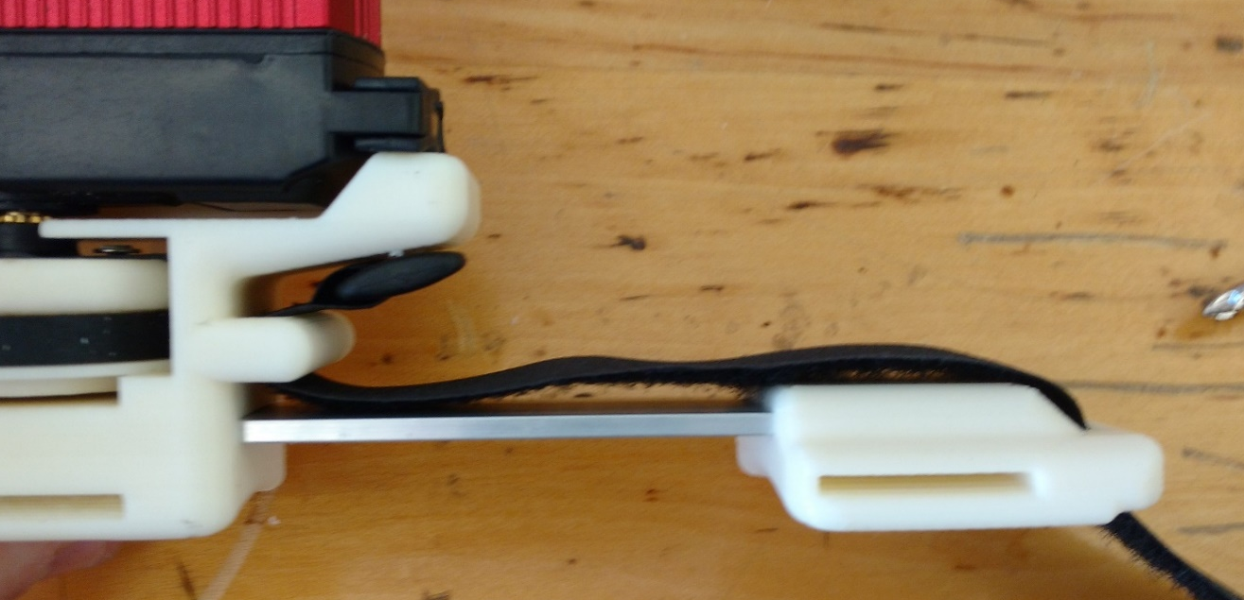
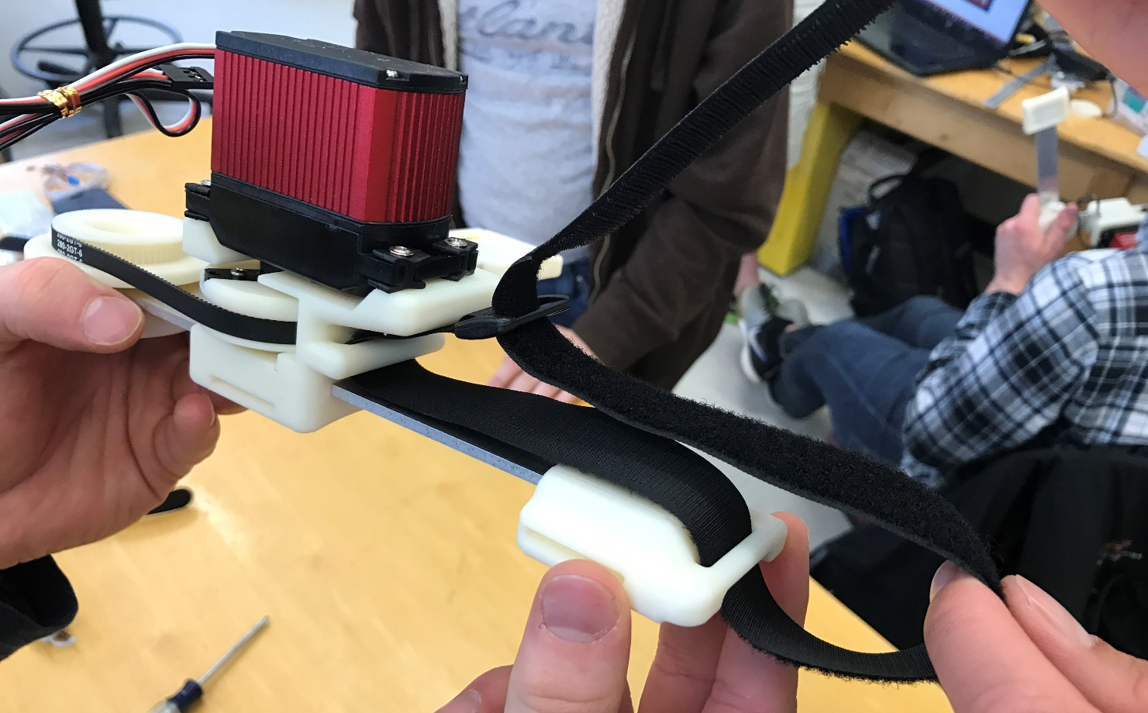
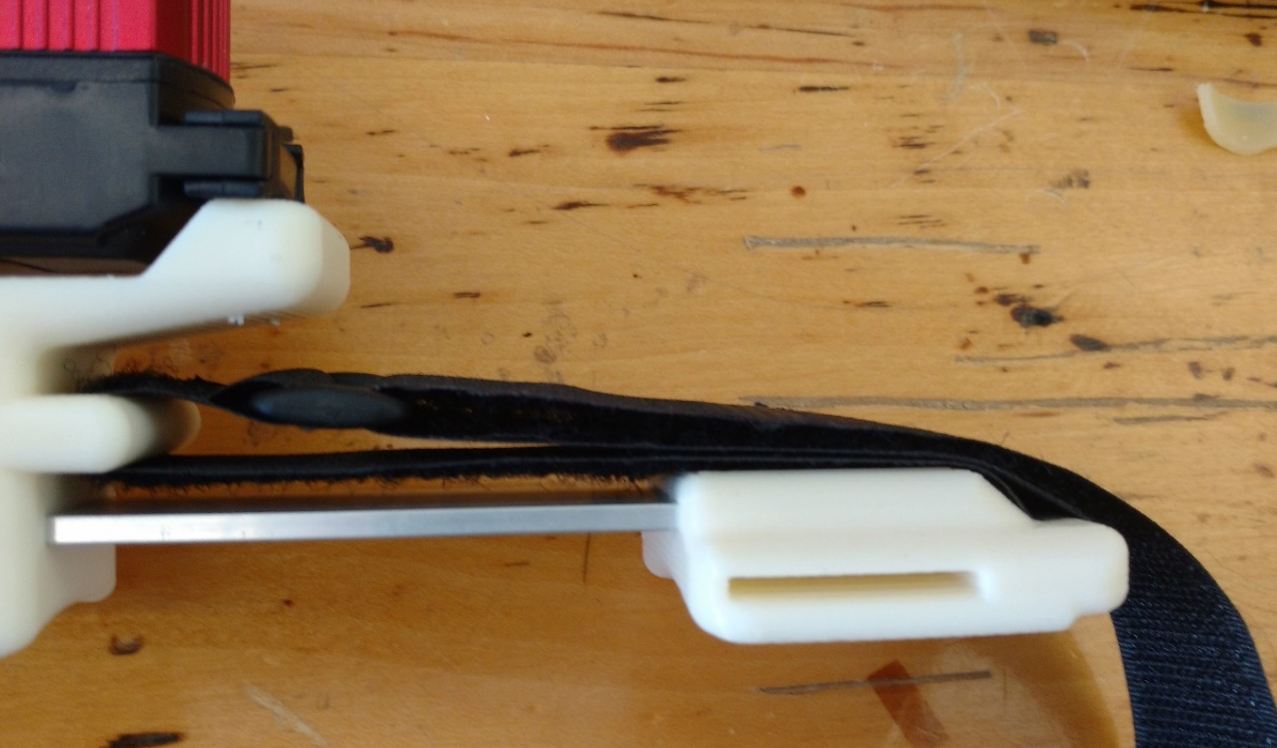
Step: 11
Notes:
The addition of this Velcro strap allows use to adjust the tension of the belt connecting the two gears. The greater the tension, the less likely we are to have any slippage.
Use the Velcro with a line down the middle of it to attach the two.

Slide 33



Step: 12 - Complete

