Slide 1
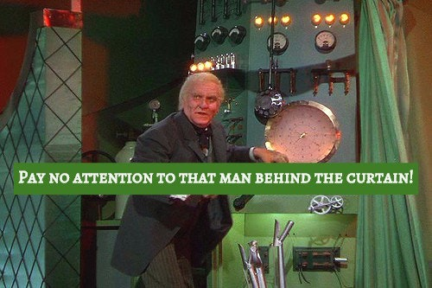
Mary Ann Stoddart
Aleph Systems Coordinator AKA the Wizard behind the curtain
WOMAN
Kathleen Berry
DRMS Unit Coordinator
Notes:
How long as MAS worked here? Does she mind if you mention that?
ILS Coordinator critical to the success of a library. This role is a full time job!

Slide 2

Image credit: http://www.littlehouseartstudio.com/blog/ Without A Net concert fundraiser—Saturday, August 4, at Bull Mansion, Worcester. Proceeds to benefit the UMass Memorial Cancer Center of Excellence.
Notes:
First things that MAS said to me when teaching me about Aleph.
HAVE TO know what you are doing, HAVE to double check everything before implementation.
Basically- you need to bring your A game to work everyday, and she does!

Slide 3
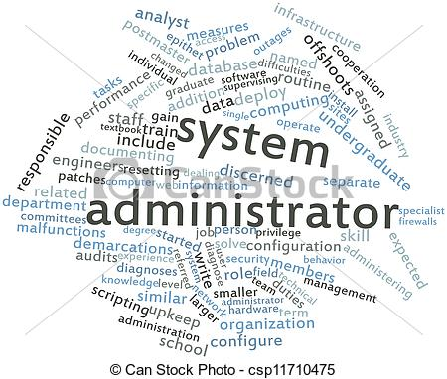
Notes:
Library business as usual=successful ILS administration
Balancing routine system maintenance with project work
Technical and Soft (aka people) skills
Highlight terms of importance

Slide 4

Notes:
manipulate and import bibliographic record files into the library resource management system, automating when possible;
extract and manipulate data files to support the data needs of the Library as a whole;
develop macros and templates that provide efficiencies in work processes; create and maintain programs and scripts to enhance operations.
Yankee Book Loads- even though the process is automatic it still needs vigilant observation- YBP still periodically sends files to the wrong place, or in the wrong order, it causes a cascade of bad records that load into Aleph that is time consuming to clean up.

Slide 5
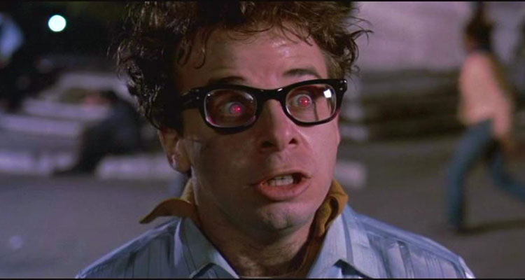
Gatekeeper/ Keymaster
I am the Keymaster!
Notes:
Delicately constructs accounts to empower a user while also ensuring they will not get themselves in trouble
Give everyone as much freedom as they can handle, when they are ready for it.

Slide 6
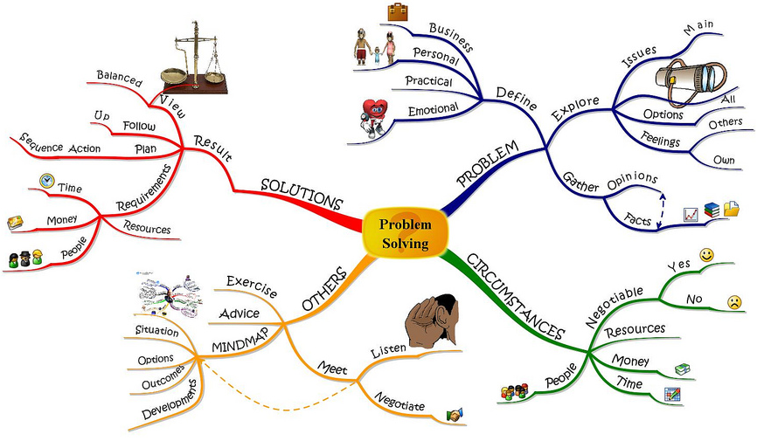
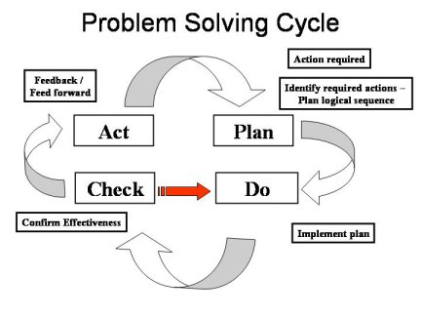
Notes:
If your project has something to do with materials or patrons chances are you need to reference MAS to assist with planning and implementation!
She clearly articulates the constraints, outlines steps for possible procedures, or highlights opportunities of a given project relating to Aleph data.
Learn from our past! MAS is a wealth if institutional knowledge. She can give insight on the context and circumstances of the past that inform today's situation.
Point out all the areas where we are involved in the problem solving map.
Example projects
Linking project-
Tested different methods in order to craft options for how to finish the linking project
ILL and Commcat : Subject – Eliminating Recalls from UM items checked out to ILL/Comcat libraries.
SELweeding projects
Patron barcodes with the 1 in the 10th digit
Matching amazon titles by ISBN to our holdings in Aleph for Reserves
New community Borrower patron status was created… this involved the patron status, loan rules, billing tables and notice job run changes for circulation

Slide 7
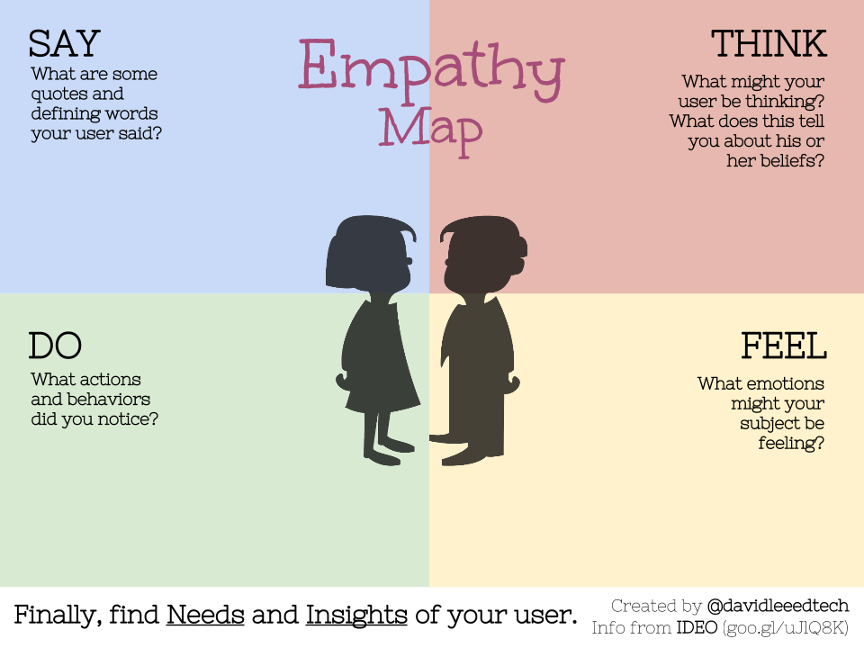
Notes:
Mentioned soft skills earlier. I think this is a critical aspect of a system coordinator.
Listens to your needs, asks questions to clarify, in order to provide the best solution possible.
Is humble and will ask for help on the occasions it is necessary. Closely collaborates with Rick and Steve, as well as with others in the FC!

Slide 8

http://keithrosen.com/2015/05/peer-to-peer-coaching-your-new-secret-weapon/
Notes:
train library staff
One on one or Group trainings- MAS is here to help you gain skills you need to be more empowered and confident in your job.
Every month MAS sits with at 2-4 of your colleagues to show them now to do something new each month.

Slide 9

https://adoptionstar.com/wp-content/uploads/8778091.gif
Notes:
AAG (Aleph Advisory Group) - Collaborate with peers at other 5 Colleges
Other groups?
Staff Council Chair
She recounted to me a conversation she had had with the old library Director Jay. He confided that he didn’t understand/appreciate the detailed, technical work she did until he got to know her via staff council. Her participation in a library wide committee brought our perspectives to the table and helped other departments understand what exactly we do behind the IRM curtain.

Slide 10
Thank you Mary Ann for all the amazing work you do to support the mission of the library!

