Slide 1

This work is licensed under a Creative Commons Attribution 4.0 International License.
Sustaining Accessible OER at Scale

Slide 2
Who we are
Jeremy Anderson
Deputy Chief of Academic & Administrative Technology
jeanderson@baypath.edu
Erica Pelletier
Junior Course Builder
elpelletier@baypath.edu
Notes:
Tell the three year story
Year 1: We started building adaptive OER courses - started with 6 or 7
Year 2: How we ramped up - 55 adaptive OER courses, another 35 or so traditional OER courses
Year 3: How we’re doing sustainable things - printing, content management, and for today: accessibility
The nice thing, though, is what the findings are widely applicable

Slide 3
Our scale
31% 484k
$
Course catalog OER/ no-cost
Student savings AY19
Notes:
When I talk about scale, I want to give you a sense
Of 290 courses, a shade over 90 are OER or no-cost

Slide 4
What we’re going to do
Best practices in digital accessibility for OER
Methods to sustain digital accessibility of OER at scale

Slide 5
Best practices
Notes:
Best practices
Externally validated frameworks
Vendor partnership

Slide 6
Frameworks
Universal Design for Learning (UDL)
Web Content Accessibility Guidelines (WCAG) 2.x
(also Quality Matters)
Notes:
Universal Design for Learning provides us with general principles that we apply during course and content design
Web Content Accessibility Guidelines provide specific steps for fulfilling UDL principles

Slide 7
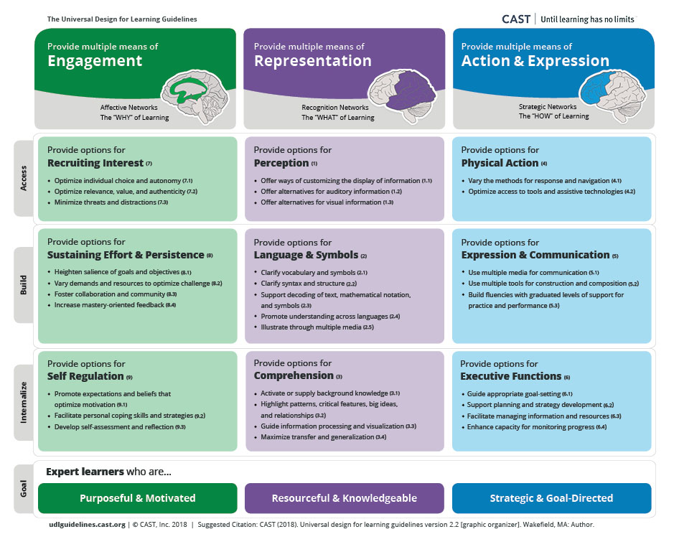
UDL
Alternative representations
Customizable display
Variable navigation
Clear language
Notes:
UDL Guidelines graphic organizer
The UDL Guidelines are set up in columns (principles, left to right: engagement, representation, action & expression) and rows (top to bottom: access, build, internalize) with the goal of UDL (expert learners). Principle: Provide multiple means of engagement. Illustration of a brain with the center of the brain highlighted to show the affective networks: the “WHY” of learning. Guideline: Provide options for recruiting interest. Checkpoints: Optimize individual choice and autonomy, Optimize relevance, value, and authenticity, Minimize threats and distractions. Guideline: Provide options for sustaining effort and persistence. Checkpoints: Heighten salience of goals and objectives, Vary demands and resources to optimize challenge, Foster collaboration and community, Increase mastery-oriented feedback. Guideline: Provide options for self regulation. Checkpoints: Promote expectations and beliefs that optimize motivation, Facilitate personal coping skills and strategies, Develop self-assessment and reflection. Principle: Provide multiple means of representation. Illustration of a brain with the back of the brain highlighted to show the recognition networks: the “WHAT” of learning. Guideline: Provide options for perception. Checkpoints: Offer ways of customizing the display of information, Offer alternatives for auditory information, Offer alternatives for visual information. Guideline: Provide options for language and symbols. Checkpoints: Clarify vocabulary and symbols, Clarify syntax and structure, Support decoding of text, mathematical notation, and symbols, Promote understanding across languages, Illustrate through multiple media. Guideline: Provide options for comprehension. Checkpoints: Activate or supply background knowledge, Highlight patterns, critical features, big ideas, and relationships, Guide information processing and visualization, Maximize transfer and generalization. Principle: Provide multiple means of action & expression. Illustration of a brain with the front of the brain highlighted to show the strategic networks: the "HOW" of learning. Guideline: Provide options for physical action. Checkpoints: Vary the methods for response and navigation, Optimize access to tools and assistive technologies. Guideline: Provide options for expression and communication. Checkpoints: Use multiple media for communication, Use multiple tools for construction and composition, Build fluencies with graduated levels of support for practice and performance. Guideline: Provide options for executive functions. Checkpoints: Guide appropriate goal-setting, Support planning and strategy development, Facilitate managing information and resources, Enhance capacity for monitoring progress. The "access" row of the UDL Guidelines includes: Provide options for recruiting interest (engagement), Provide options for perception (representation), and Provide options for physical action (action & expression). The “build” row of the UDL Guidelines includes: Provide options for sustaining effort and persistence (engagement), Provide options for language and symbols (representation), and Provide options for expression and communication (action & expression). The “internalize” row of the UDL Guidelines includes: Provide options for self regulation (engagement), Provide options for comprehension (representation), and Provide options for executive functions (action & expression). The goal of UDL is expert learners who are: purposeful and motivated, resourceful and knowledgeable, and strategic and goal-directed.

Slide 8
UDL - What
Alternative representations
...
WCAG - How
1.1.1 Image descriptions
1.2.2 Video captions
1.2.3 Audio description
1.4.4 Resize text
...
Notes:
Example of alignment of framework and guidelines

Slide 9

Partners committed to accessibility
Accessibility statement
Accessibility roadmap
VPAT
Notes:
Describe Pressbooks as solutions
Linked out to PB’s accessibility measures
Branching more into authoring side, too
Steel Wagstaff - steel@pressbooks.com

Slide 10
Practices to sustain

Slide 11
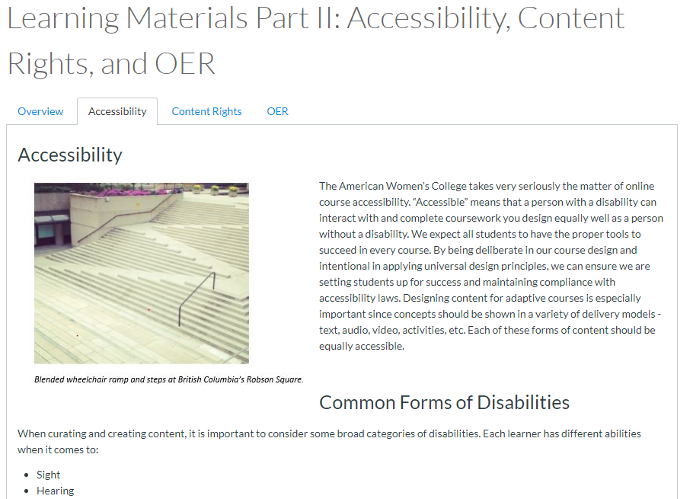
Training - subject matter experts
Read / watch content
Knowledge check
Apply to work sample
Notes:
SMEs are our frontline academics. We also lunch and learn with program directors and lead faculty.
Provide general guidelines in onboarding training
Quiz asks SMEs to identify and react to different accessibility concerns
Must complete a work sample - one of our templates - and receive feedback from facilitator on accessibility, copyright, format
Introductory text on TAWC’s accessibility philosophy captured on the slide as an image:
Acceessibility
The American Women’s College takes very seriously the matter of online course accessibility. “Accessible” means that a person with a disability can interact with and complete coursework you design equally well as a person without a disability. We expect all students to have the proper tools to succeed in every course. By being deliberate in our course design and intentional in applying universal design principles, we can ensure we are setting students up for success and maintaining compliance with accessibility laws. Designing content for adaptive courses is especially important since concepts should be shown in a variety of delivery models - text, audio, video, activities, etc. Each of these forms of content should be equally accessible.
Common Forms of Disability
When curating and creating content, it is important to consider some broad categories of disabilities. Each learner has different abilities when it comes to:
Sight
Hearing
Touch and motion
Symbolic processing (reading)
Cognitive/Neurological (i.e. Dyslexia, ADHD, etc)
As such, all content should be accessible to learners who use technologies such as screen readers (text-to-audio, i.e.), captions (audio-to-text, i.e.), and keyboards for navigation.

Slide 12
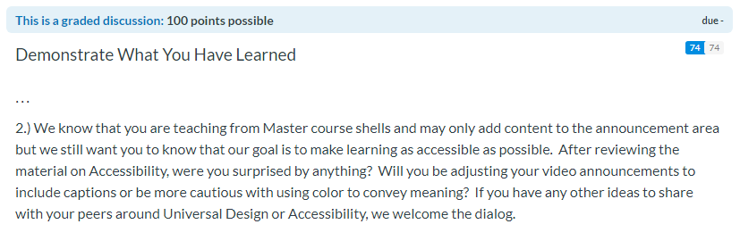
Training - instructors
Read / watch content, then discuss & share ideas
Notes:
This is one piece of a module in our TAWC micro mastery series, a training aimed at existing faculty members
The course covers many skills that we ask our instructors to engage, in a much more in-depth than our onboarding.
Discussion board prompt captured on the slide as an image:
We know that you are teaching from Master course shells and may only add content to the announcement area but we still want you to know that our goal is to make learning as accessible as possible. After reviewing the material on Accessibility, were you surprised by anything? Will you be adjusting your video announcements to include captions or be more cautious with using color to convey meaning? If you have any other ideas to share with your peers around Universal Design or Accessibility, we welcome the dialog.

Slide 13
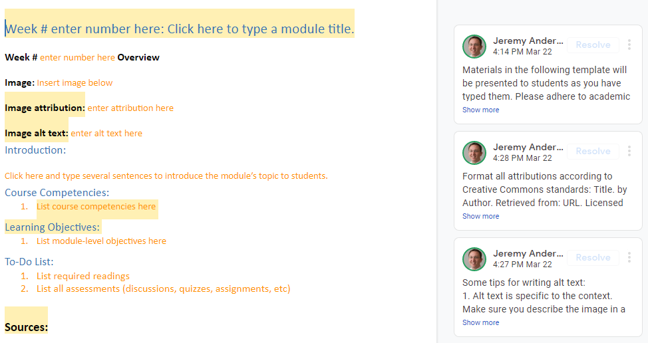
Job aid
Notes:
Image on slide is of a sample job aid. Important features include:
Document structure
Header levels already applied
Ordered and unordered lists already applied
Alternative representations
Require image alt text
Caption request form available (though ID team tends to audit on own)
Navigation
Consistent design across modules
Headers have descriptive language
Comment feature in GDocs to provide additional guidance to SMEs

Slide 14
Quality assurance
UDL & QM pre-review
Job aid review
Product review
UDL & QM post-review
ID
ID
SME
ID
Notes:
Adapted CAST rubric for pre- and post-assessments

Slide 15
Thank you!

Slide 16
Contact us
elpelletier@baypath.edu
jeanderson@baypath.edu

Slide 17
Materials
UDL guidelines from CAST
Web Content Accessibility Guidelines (WCAG) 2.1
Adapted CAST rubric for pre- and post-assessments
Job aid for module design with guiding comments

