Slide 1
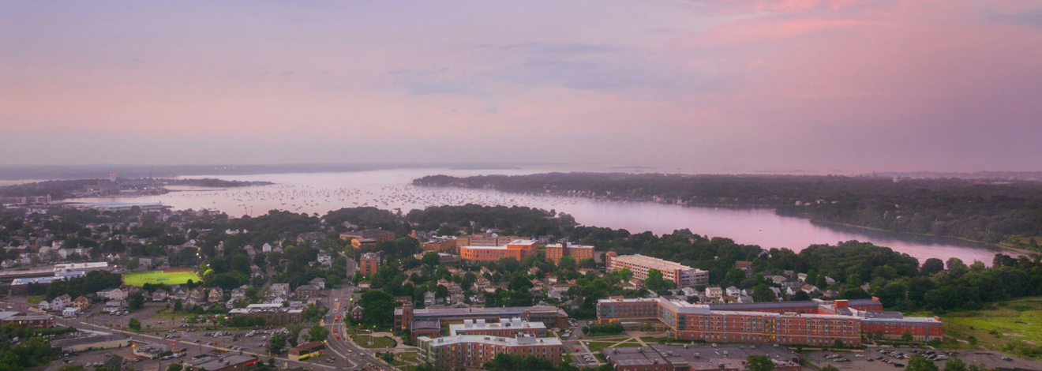
OER FROM THE GROUND UP:
Building a Faculty Development-based OER Initiative
Elizabeth McKeigue, Gail Rankin, and Roopika Risam
Salem State University
Northeast Regional OER Summit
UMass Amherst
May 22, 2019
Attribution-Non-Commercial-ShareAlike 4.0 International (CC BY-NC-SA 4.0)

Slide 2
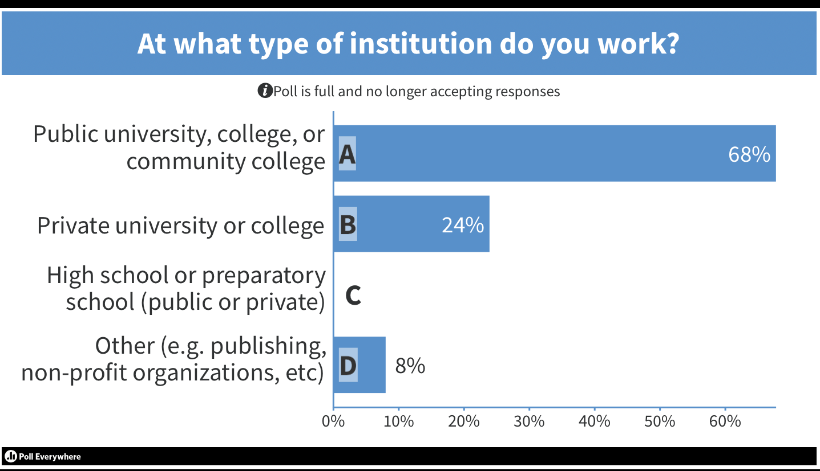

Slide 3
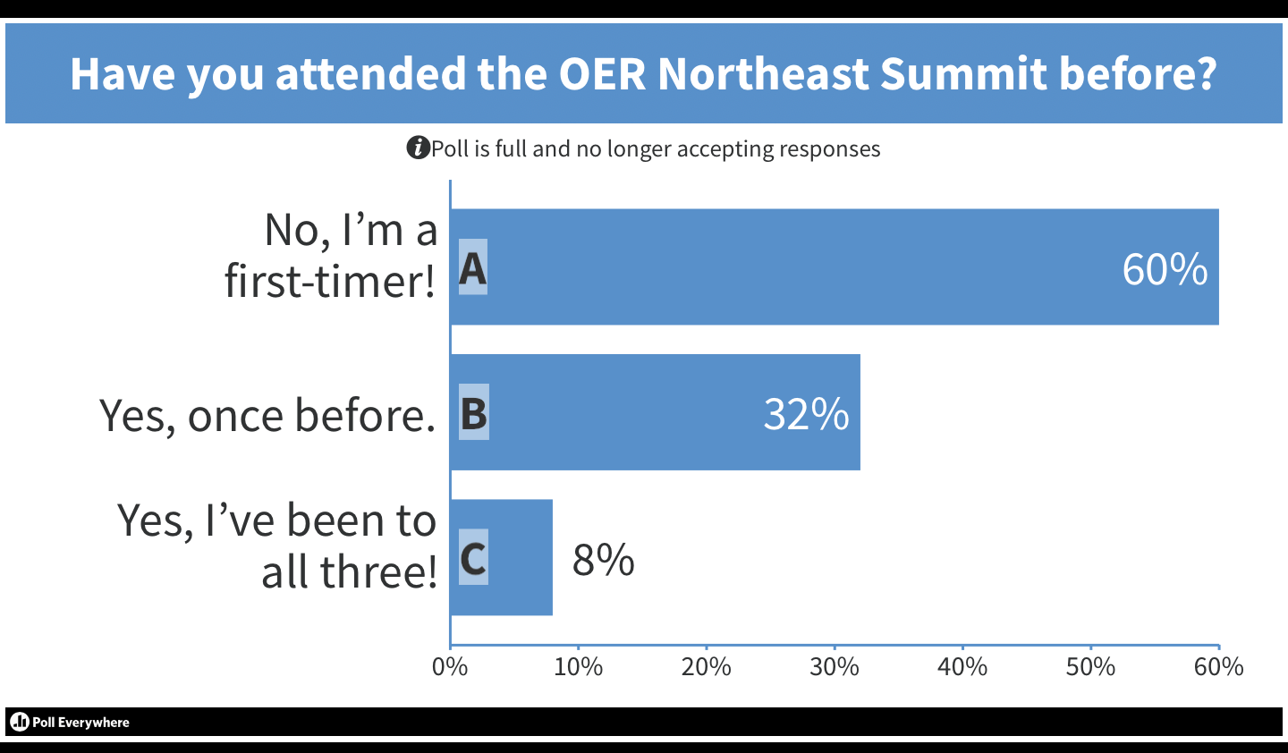

Slide 4


ONE YEAR AGO…
May 31, 2018
  No programmatic OER initiative
  Some OER support, but ad-hoc and decentralized
  No dedicated funding
NOW
May 22, 2019
  $100K grant
  50+ faculty engaged in OER work
  On track for $500,000 in savings for students by AY 2020

Slide 5
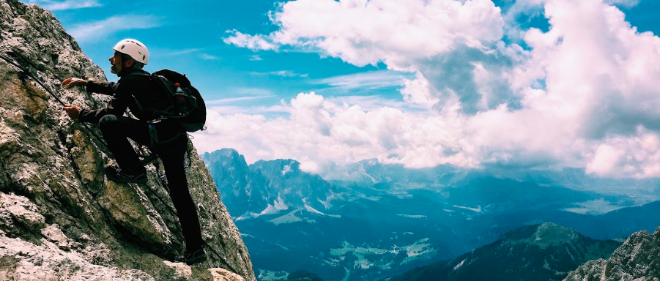
Objectives for this Session
Discover strategies for starting an OER initiative
Identify best practices for engaging faculty with OER adoption
Develop methods for demonstrating & communicating value

Slide 6
Strategies for getting started

Slide 7
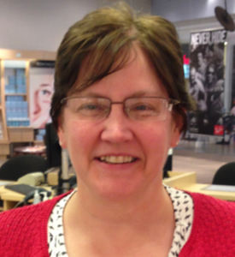
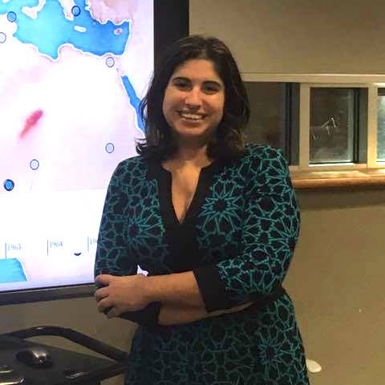
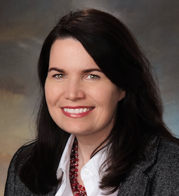

Build A Team
Required:
Passionate about the topic
Good communicator
No fear of time commitment
Preferred:
Cross-unit representation
Faculty status
Access to money
Access to & influence with senior leadership
Faculty
Library
Academic Tech & IT

Slide 8
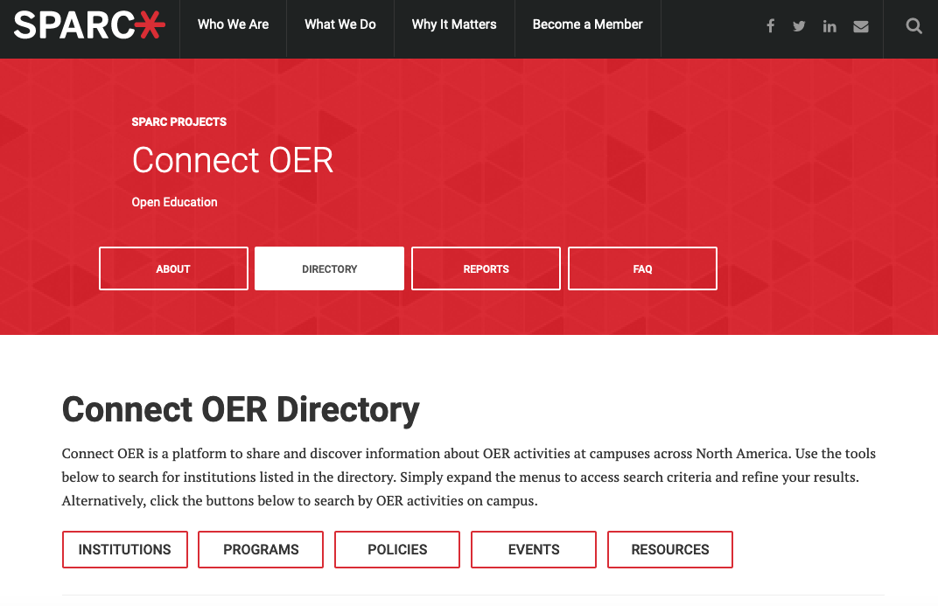
Do Your Research

Slide 9
Envision Scalable Goals
Mission: Implement a campus-wide, programmatic, and varied approach to faculty professional development.
Goals:
  Raise awareness of how to discover quality open educational resources and lower-cost materials.
  Facilitate expansion of adoption of OER and affordable texts by faculty, where appropriate for discipline.
  Incentivize innovative creation and publication by our faculty of open educational resources.
  Appeal to a variety of learning styles.

Slide 10
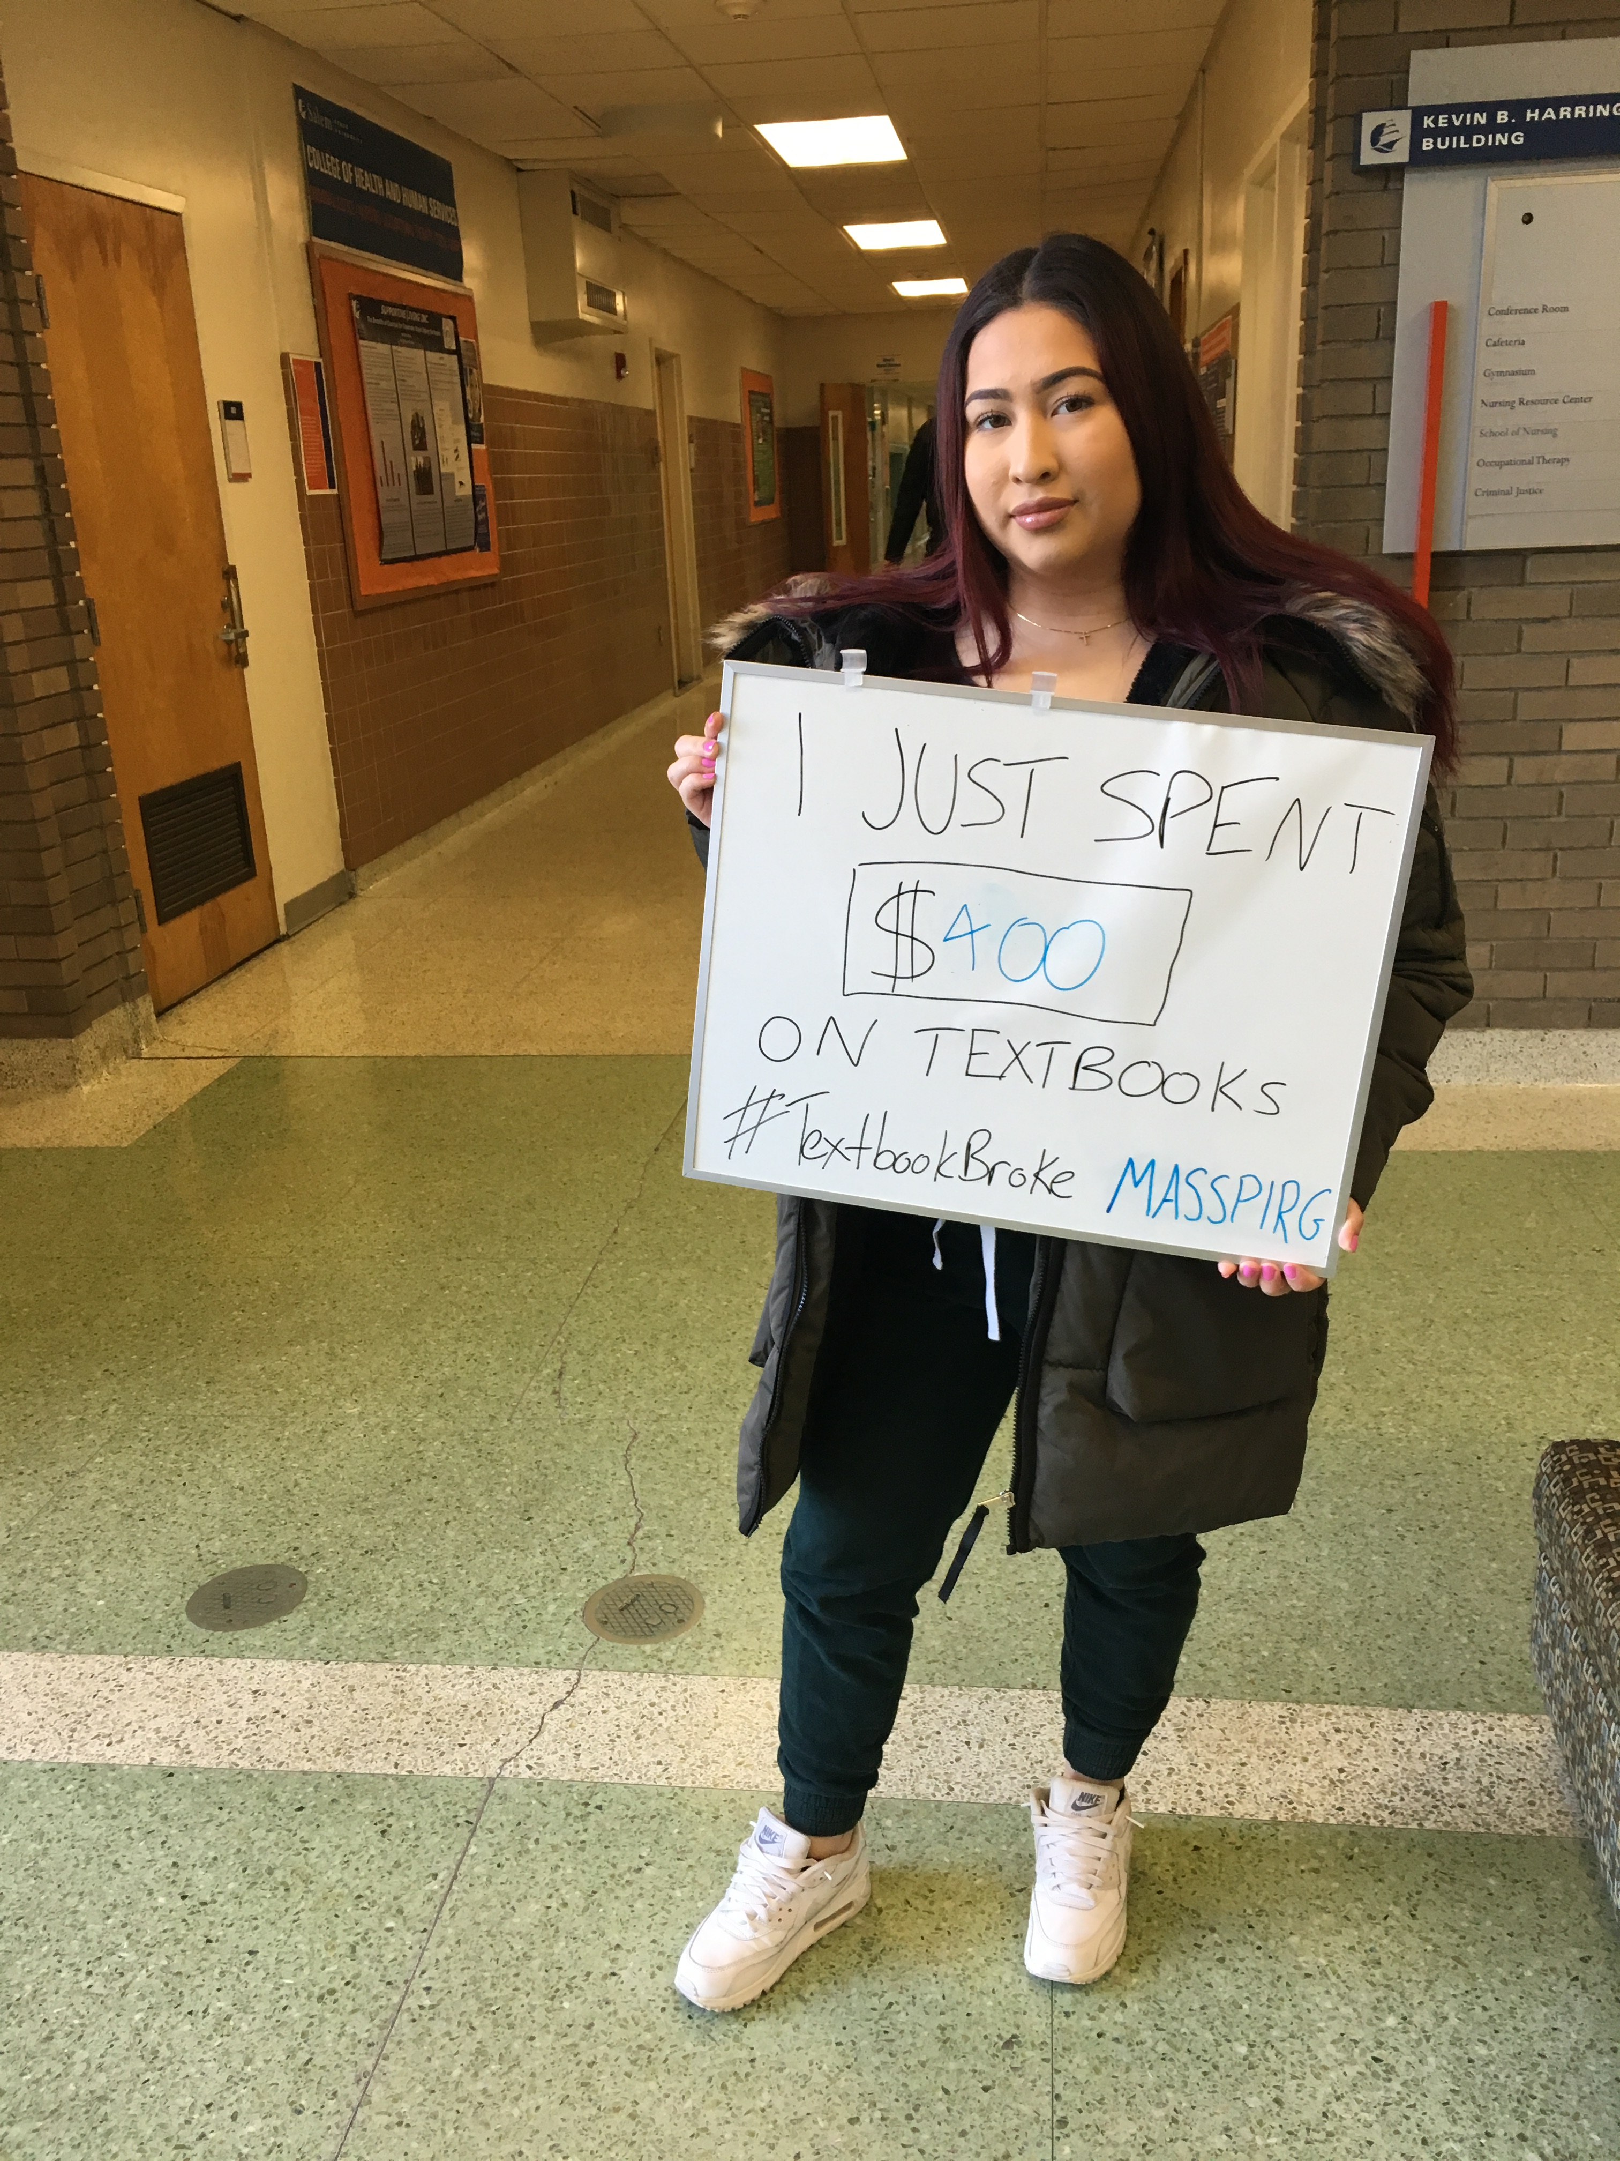
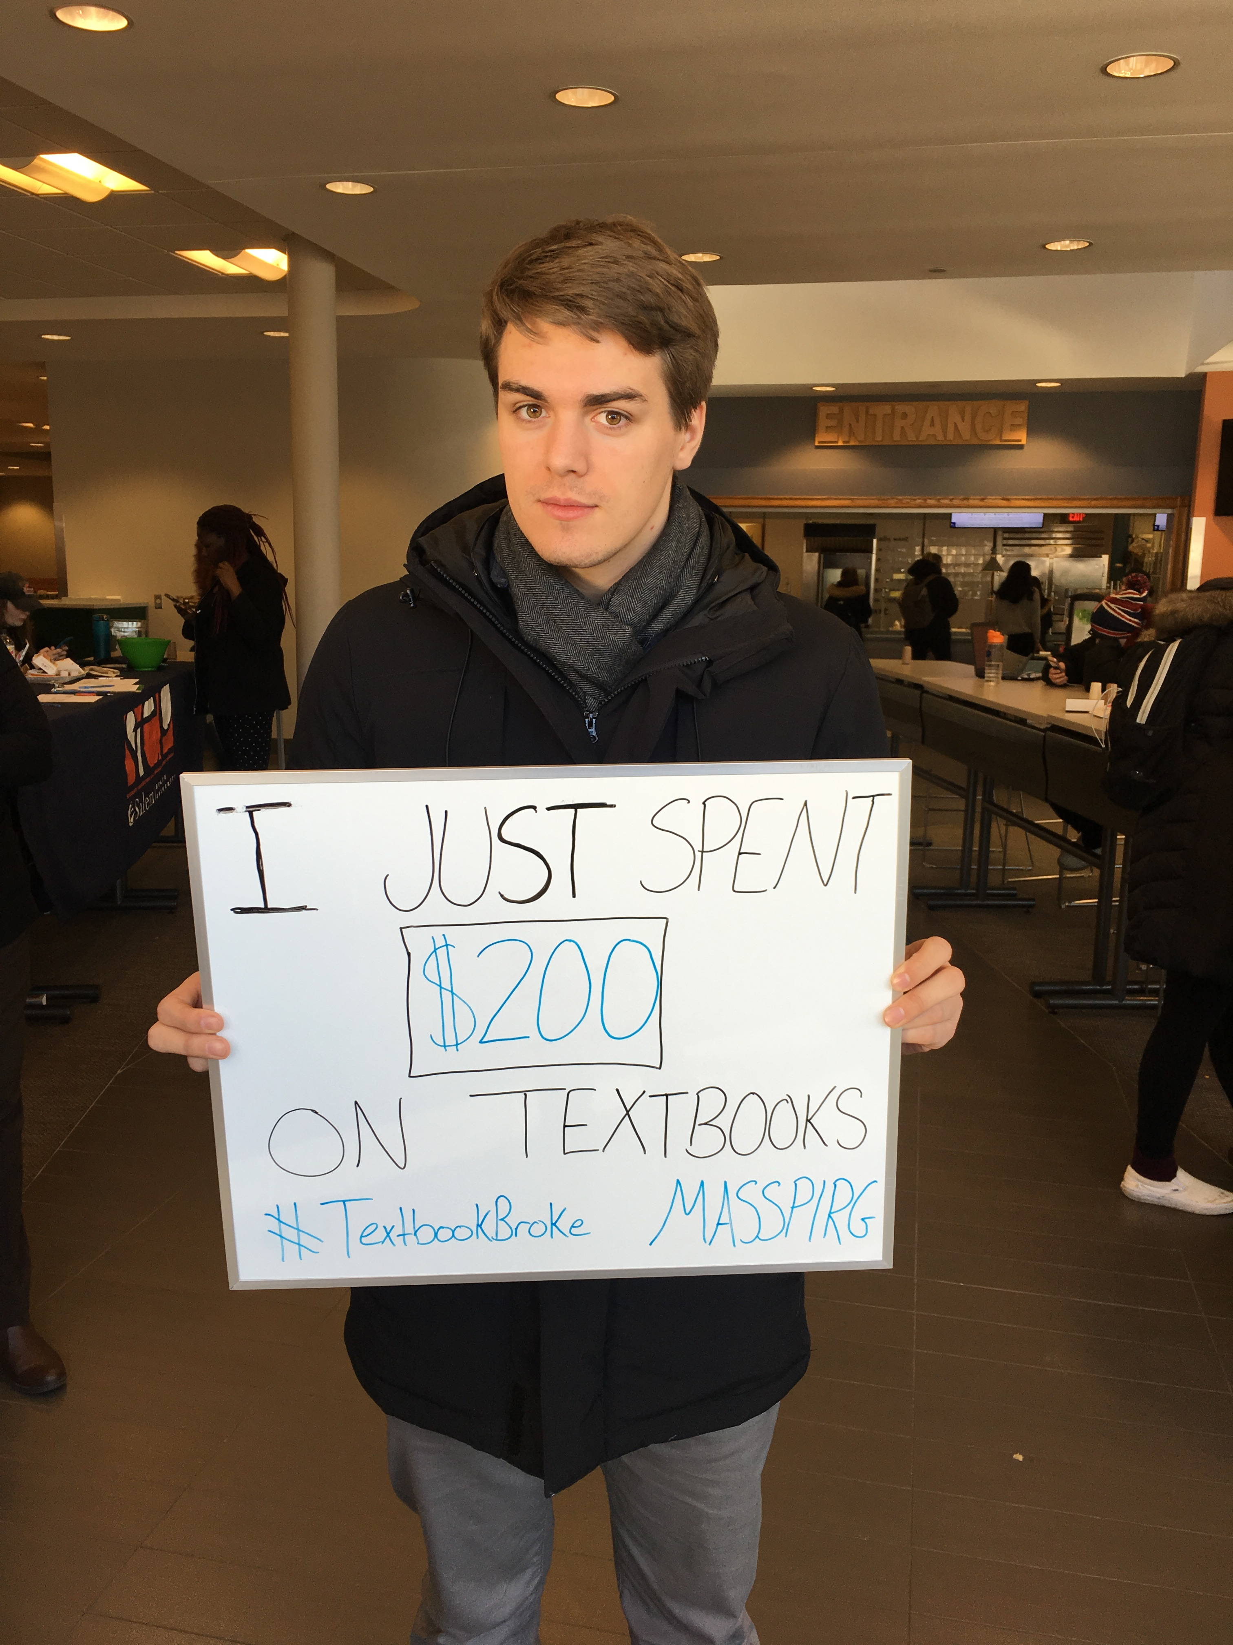
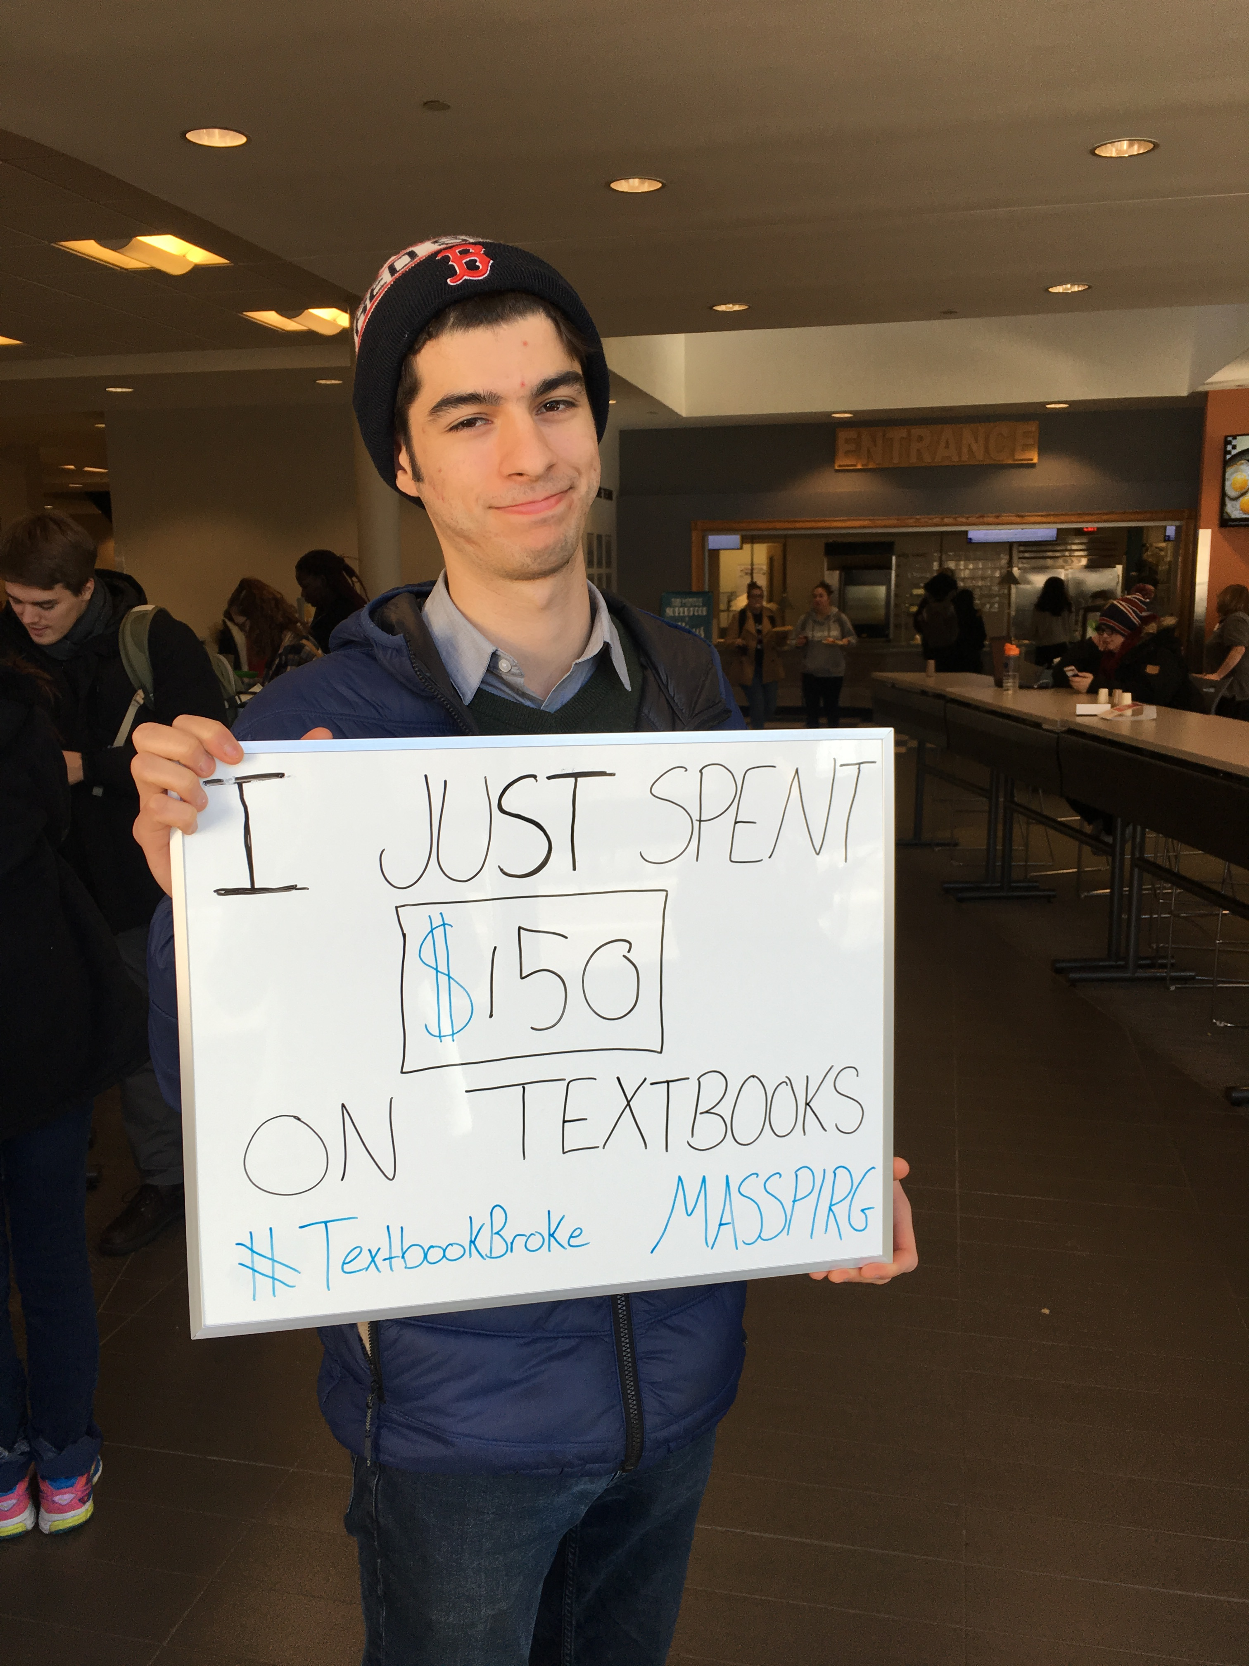
Brand it and Sell it a.k.a. “Make it a Thing”
Names matter: Viking OER & Textbook Affordability Initiative
Present at major campus meetings and ask to get on agendas
Photo Credit: Samantha Giffen from MASSPIRG

Slide 11

Seek Funding Sources
Big money = Grants!
Reallocate existing internal funding
Create the *ideal* project budget, then cut from there
MA DHE Performance Incentive Fund (PIF) Grant made this work possible in such a short timeframe

Slide 12
Some Best Practices for Faculty Engagement

Slide 13

Viking OER & Textbook Affordability Initiative
1. Raising Awareness
  Events, workshops, campus task force, & surveys
2. Faculty Learning Communities
  Faculty-led working groups meeting regularly over course of a semester
3. Innovation Mini-Grants
  Independent work
4. Summer Institute
  Intensive 3-day immersive group learning

Slide 14
Raising Awareness
$ = low cost/labor only
$$ = funding needed
$$$ = lots of funding needed
Partnered with students & MASSPIRG to create and administer student survey (n = 595) $
Working with the bookstore $
Administered a faculty survey $
Open Education Week Events $
Formed the OER & Textbook Affordability Task Force $$
Reimbursing travel for faculty to attend Mass Open Ed workshops $$
Hired a 25 hr/wk, benefitted OER coordinator $$$

Slide 15
Faculty Learning Communities $$$
FLC for OER in Counseling Professions
  1 coordinator (Education) and 6 members = 7
  Courses impacted: Grad level Psychology, Education, Social Work
FLC for OER in Theatre & Speech Communication
  1 coordinator (Theatre) and 6 members = 7
  Courses impacted: All courses that fulfill Oral Communication Gen Ed
FLC for OER in World History
  1 coordinator (History) and 3 members = 4
  Courses impacted: All courses that fulfill World History Gen Ed

Slide 16
Innovation Mini-Grants $$$
15 adoption grants ($1,000 each) and 5 creation grants ($3,000 each)
Call for applicants: via deans, dept chairs, academic affairs newsletter
22 applicants total
Some applicants for creation became adoption: 2 creation grants ($3,000 each) and 18 adoption ($1,000 each)
Faculty receive one-on-one consults and support from librarians and instructional technologists

Slide 17
Summer Institute $$$
3-day intensive workshop for OER adoption
10 faculty participants = $1,000 each
Facilitators include librarians, teaching & learning staff, academic technology staff, as well as invited outside speakers
Includes time for faculty to work on their own course in a supported environment with experts in the room

Slide 18
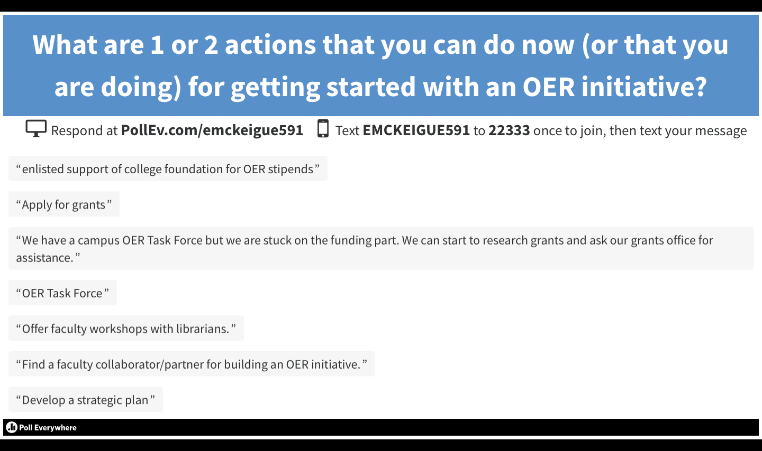

Slide 19
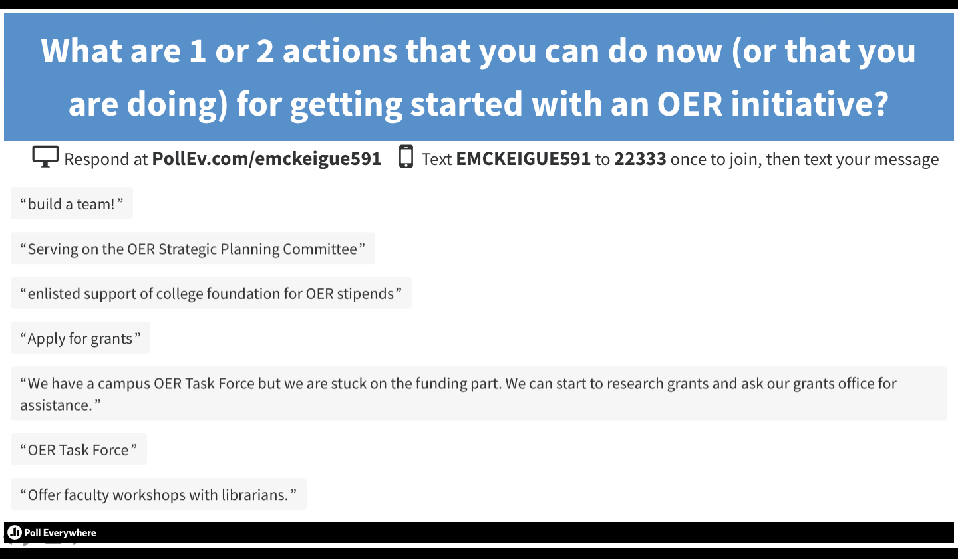

Slide 20
Thank you!
Questions?
Please see our website at
libguides.salemstate.edu/oer
and feel free to contact any of us!

