Slide 1
Encouraging Experimentation and Creativity through Professional Development:
Turning our Failures into Best Practices
Amanda Piekart, Bonnie Lafazan and Jessica Kiebler
Berkeley college

Slide 2
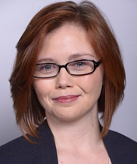
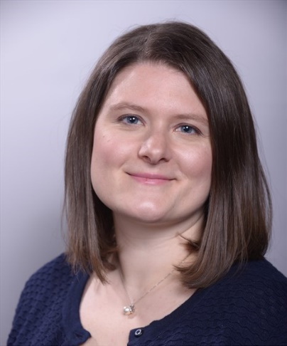
Amanda is the Director of Research & Instructional Services for all Berkeley College Libraries.
Amanda Piekart
Bonnie is the Library Director at the Berkeley College Woodbridge, New Jersey Campus.
Bonnie Lafazan
Jessica is the Library Director at the Berkeley College White Plains Campus in Westchester County New York.
Jessica Kiebler

Slide 3

Freedom and empowerment

Slide 4
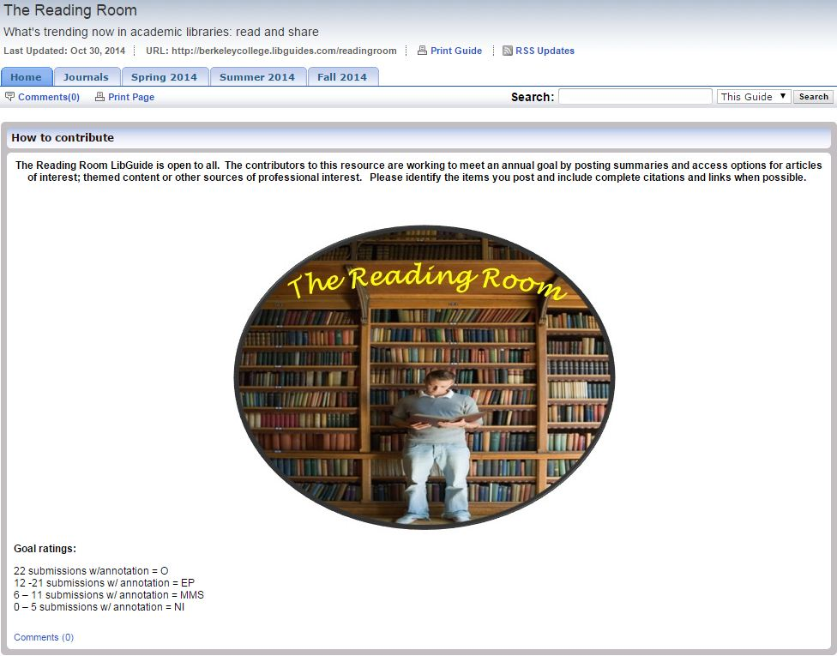

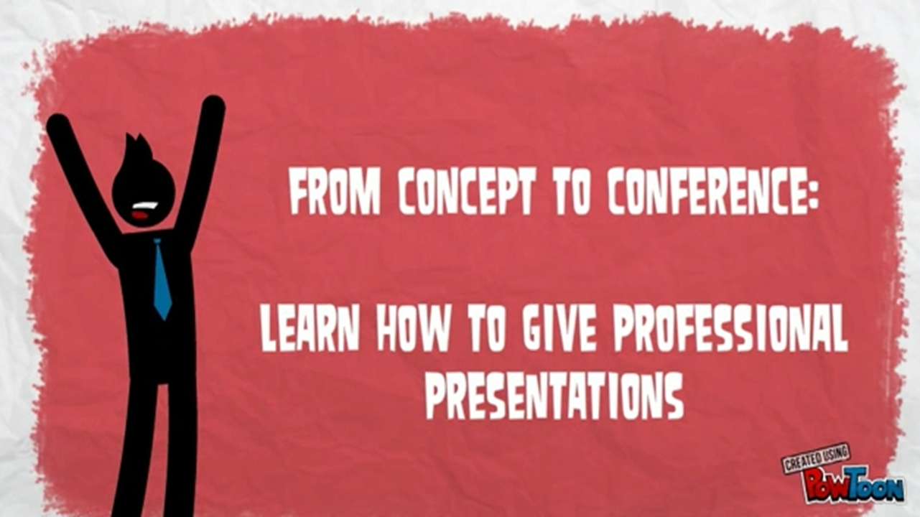
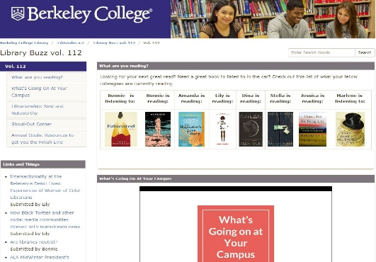

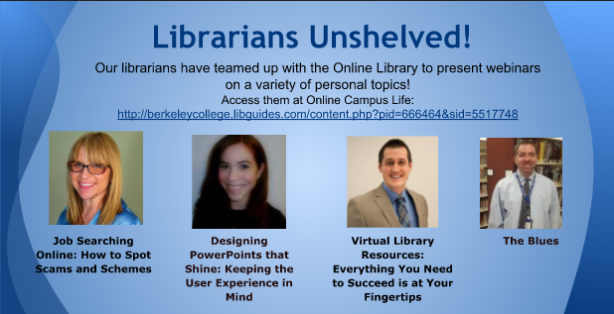



Workshop on Professional Development
Independent Reading
Teaching Circle
Newsletter
Asynchronous
Topical Workshops
PD via Social Media
Week long
Peer Feedback

Slide 5
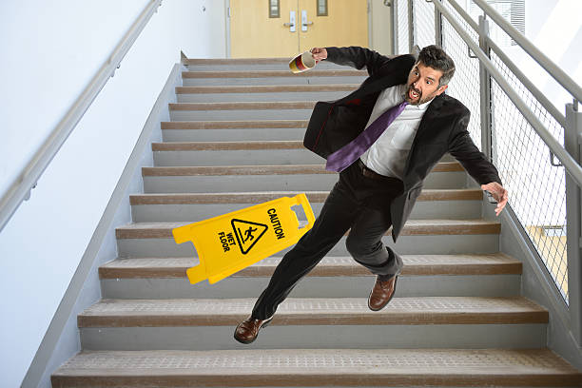

Slide 6
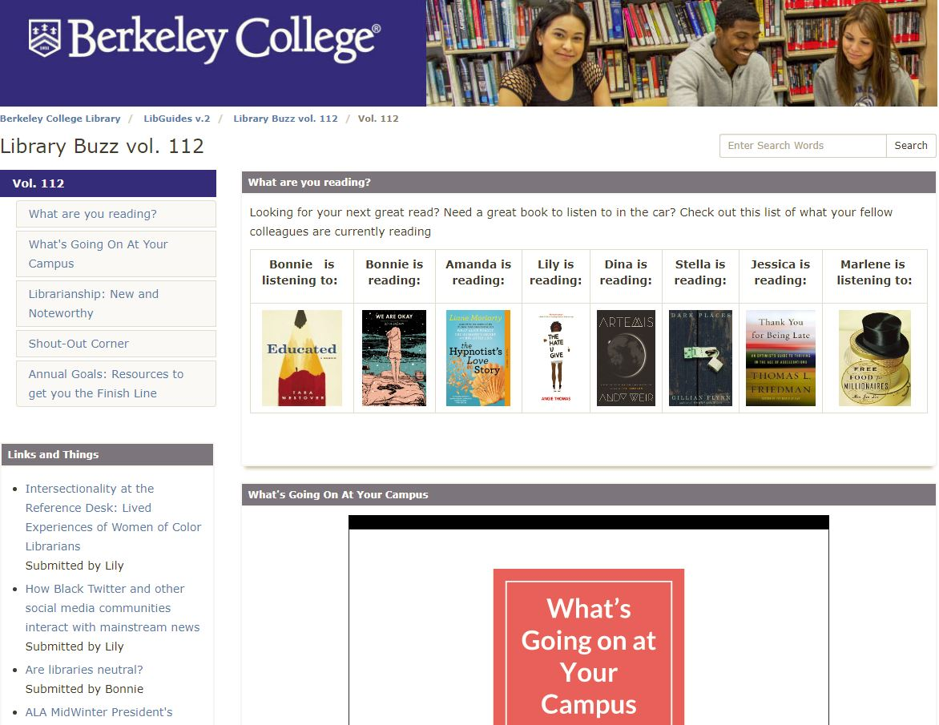

Overcoming Lack of Participation

Slide 7
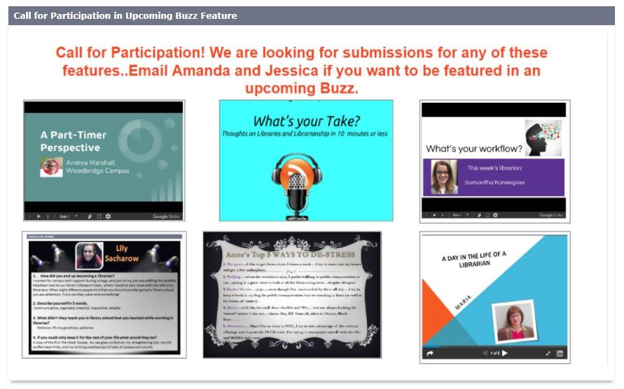

Slide 8
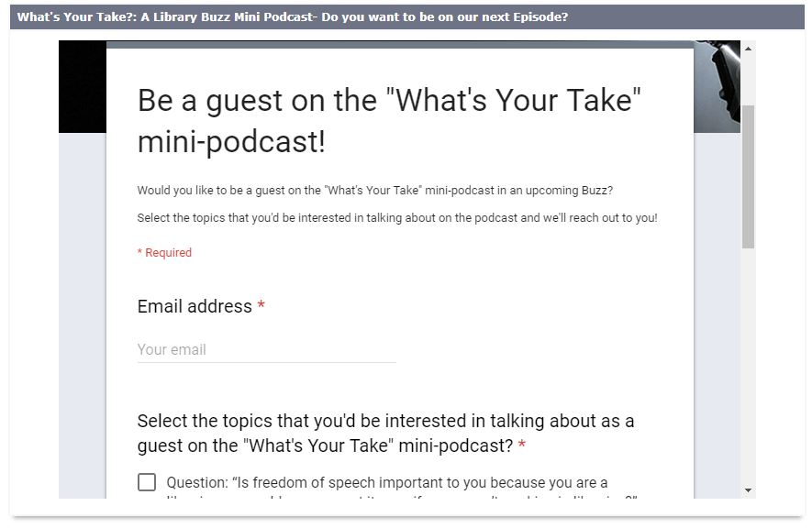

Instant Participation

Slide 9
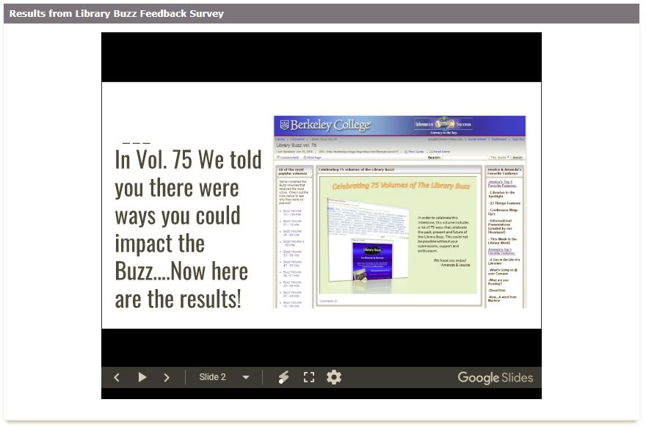
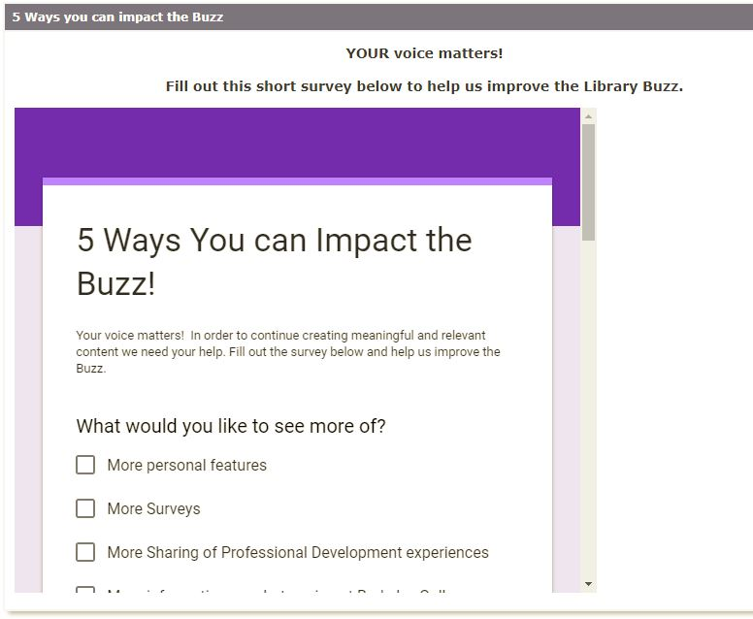


Slide 10
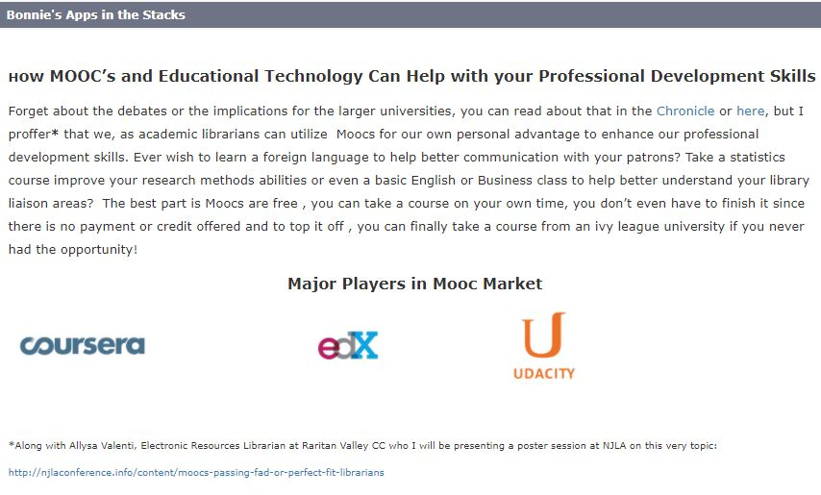
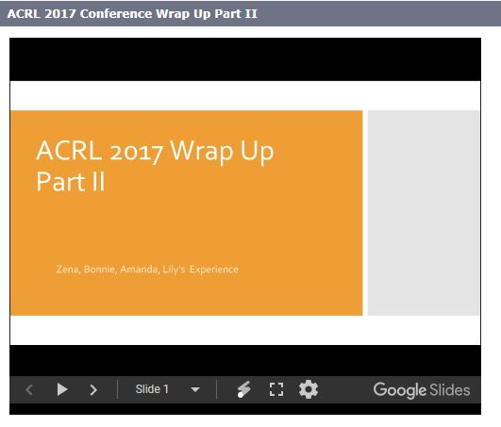
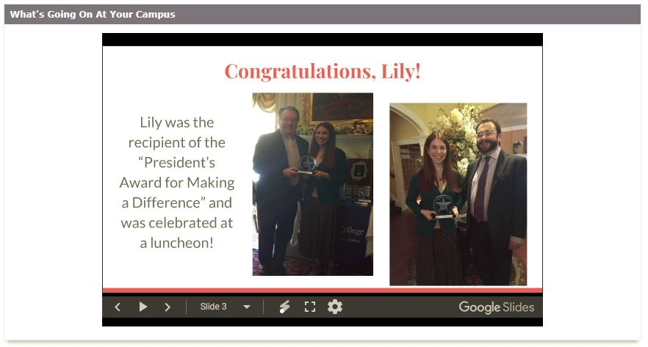
Variety of Opportunities & Options

Slide 11
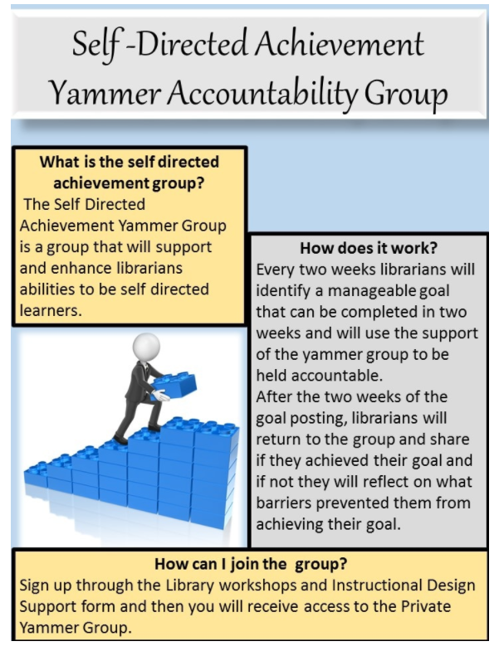
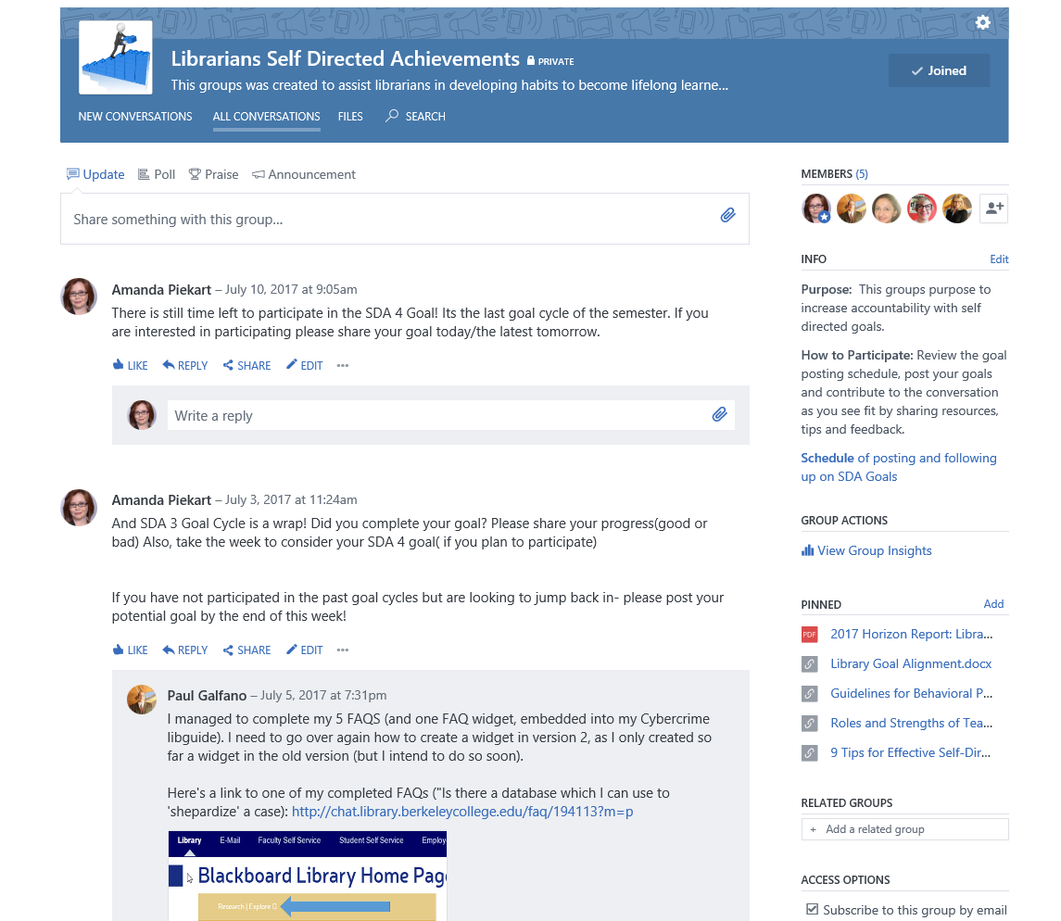
Make Participation Intuitive

Slide 12
Share best practices to increase confidence

Slide 13
Confusion from complex processes

Slide 14
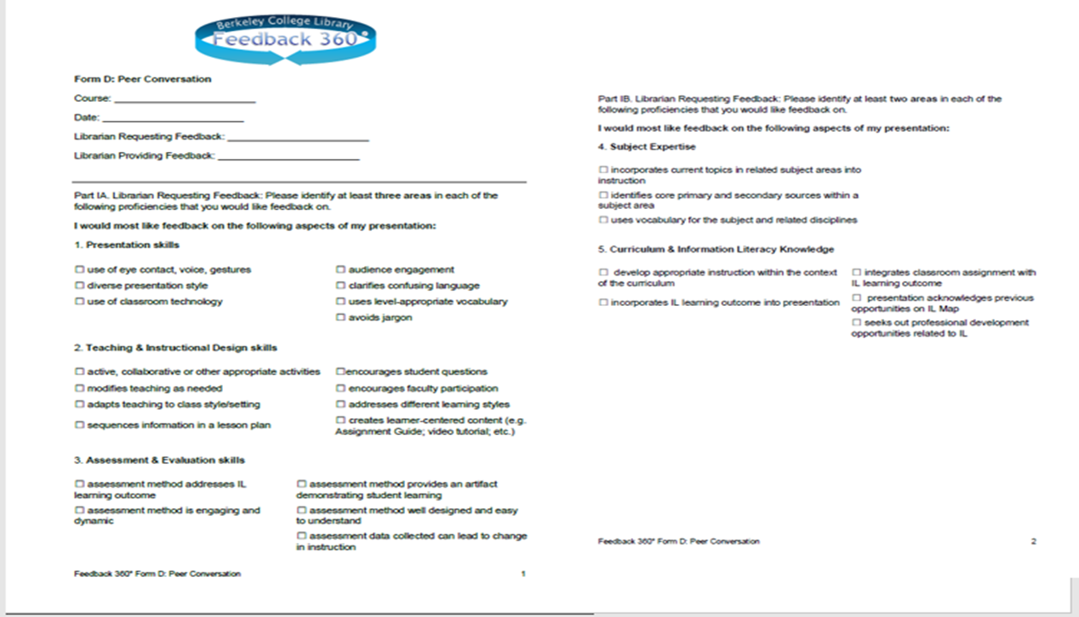
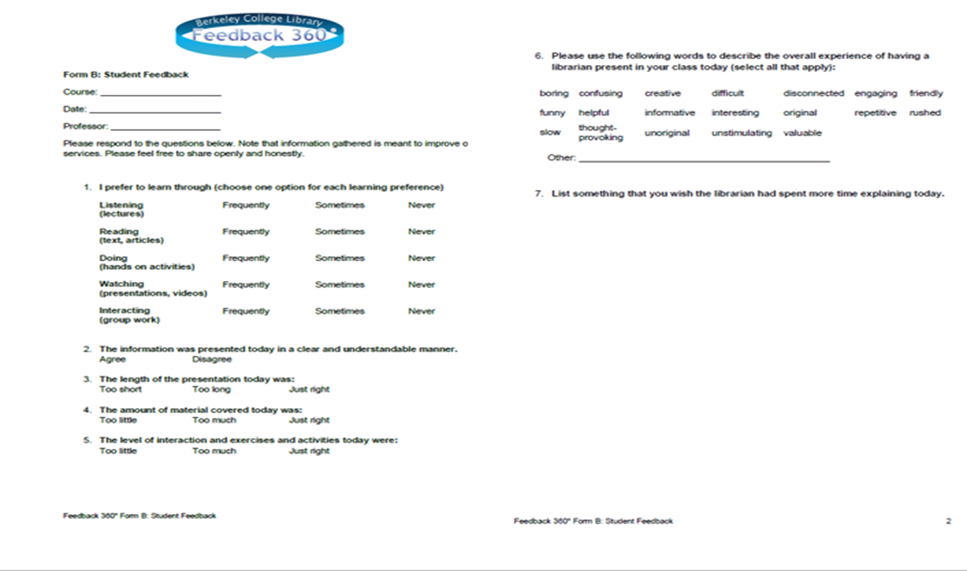
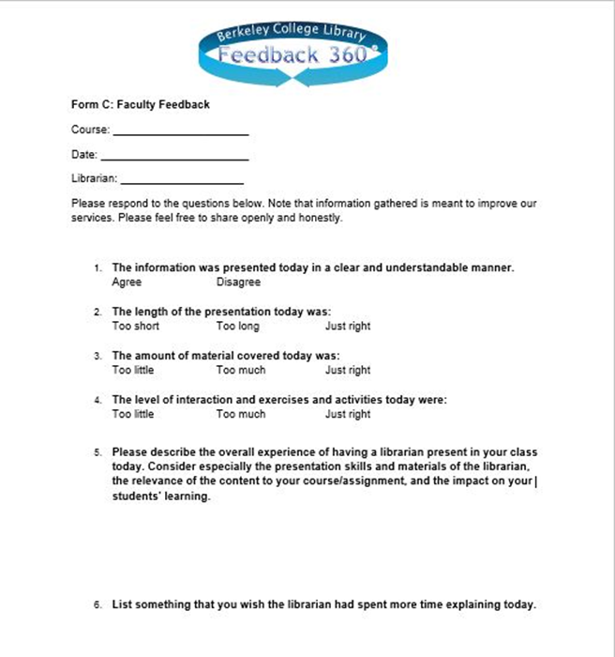
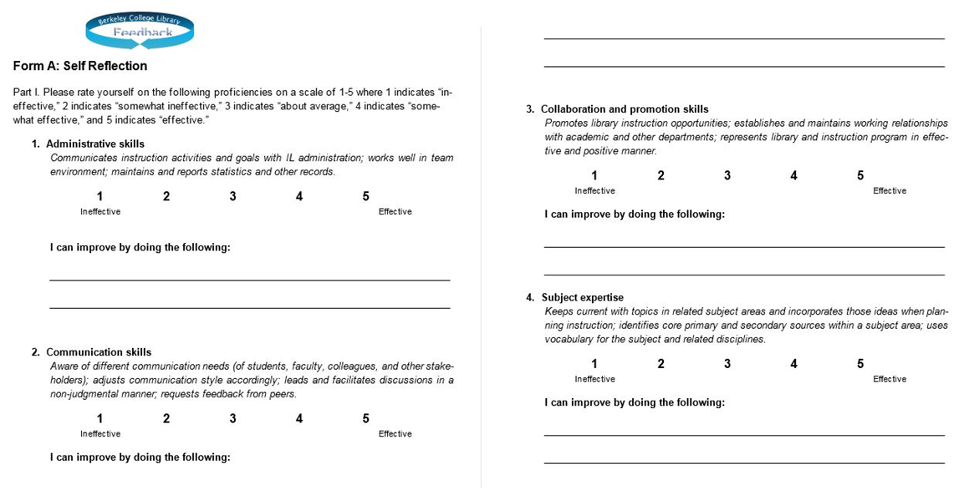

Slide 15
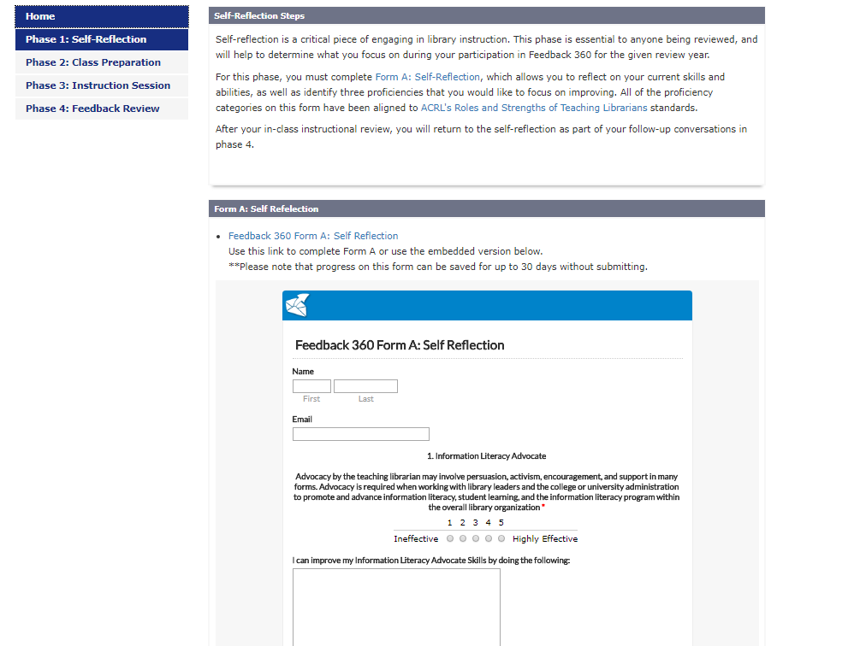
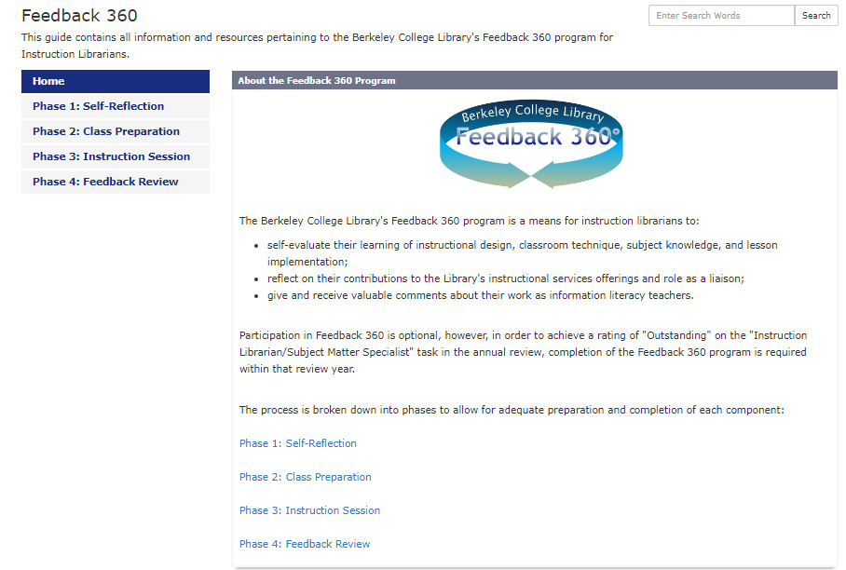
Feedback 360 Reboot

Slide 16
Overlooked event logistics
Week-long in Service Event

Slide 17
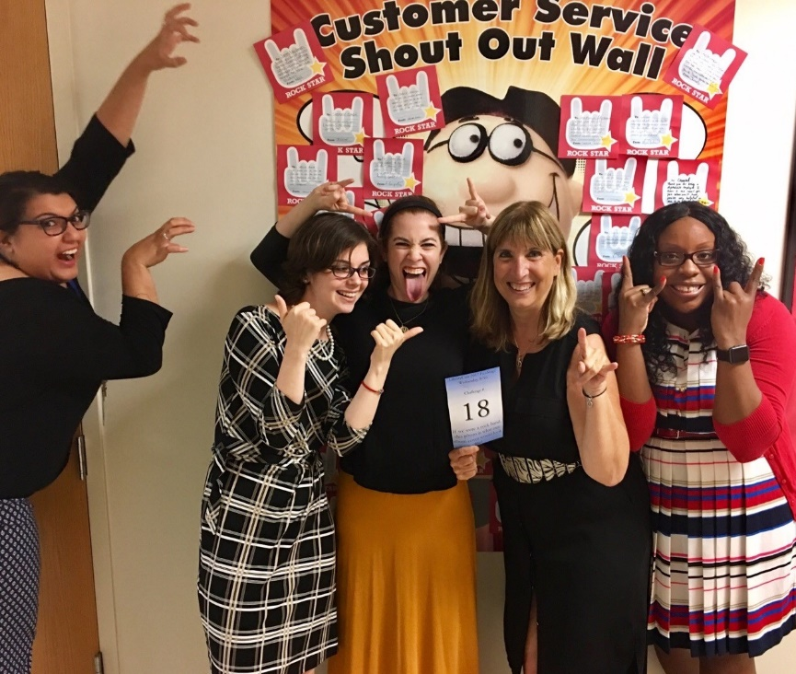
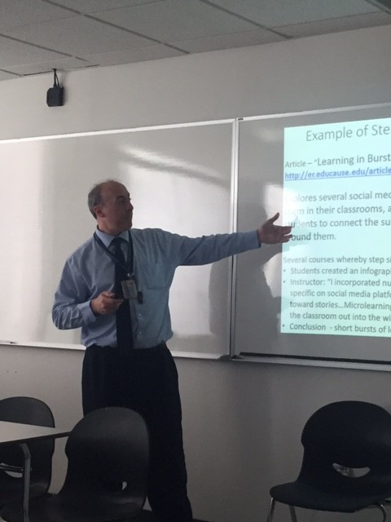
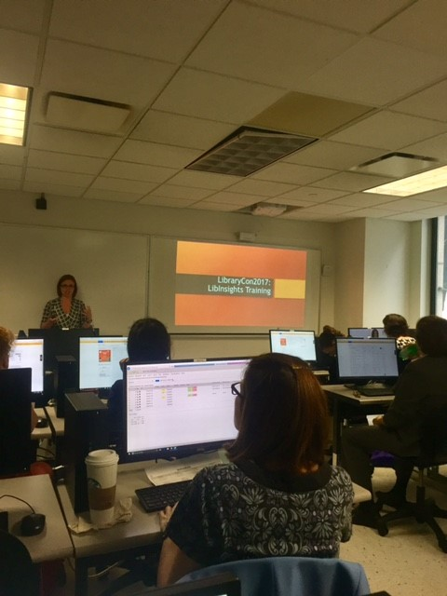
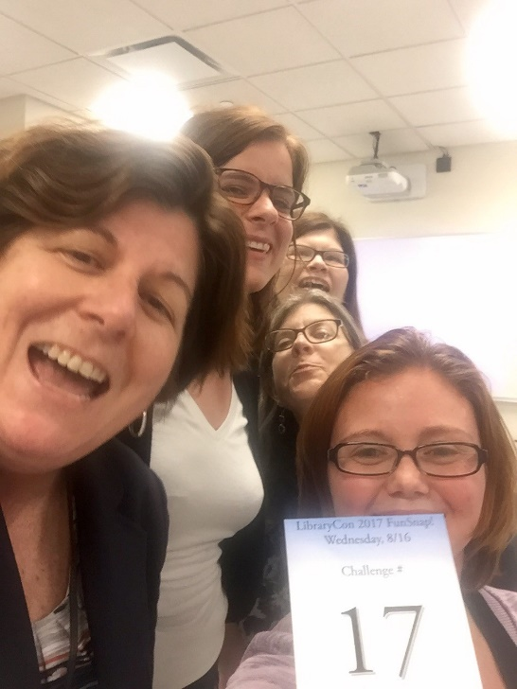

Slide 18
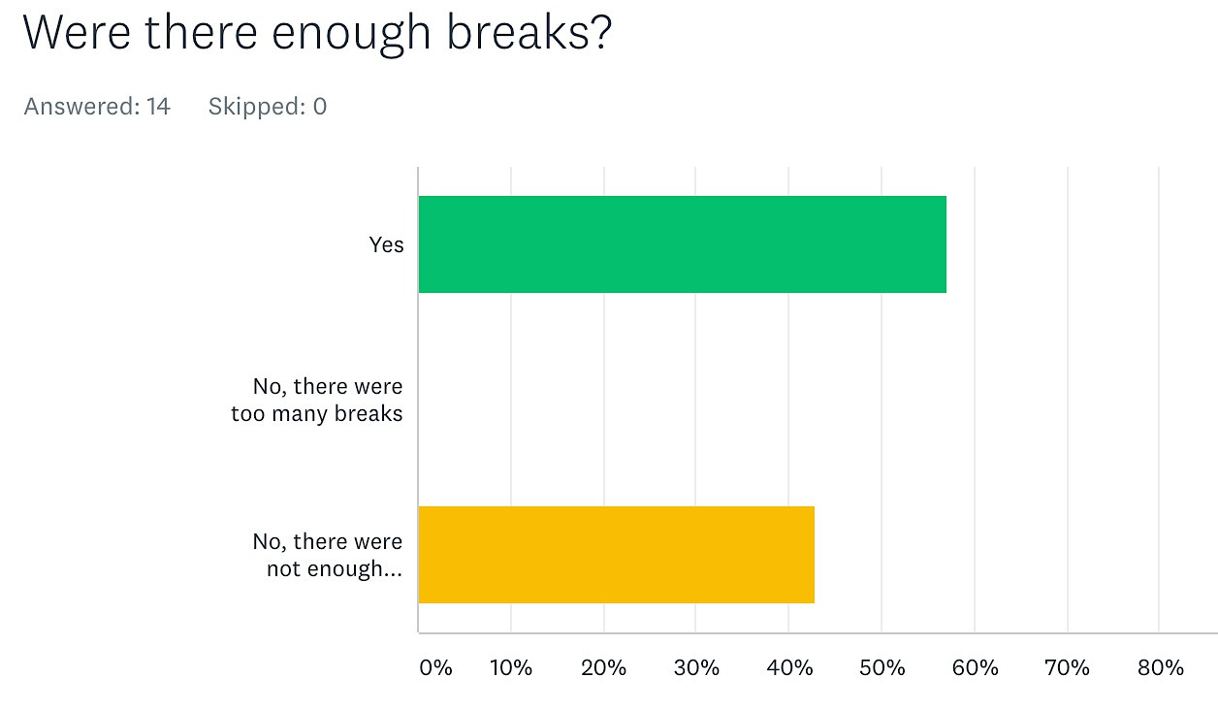
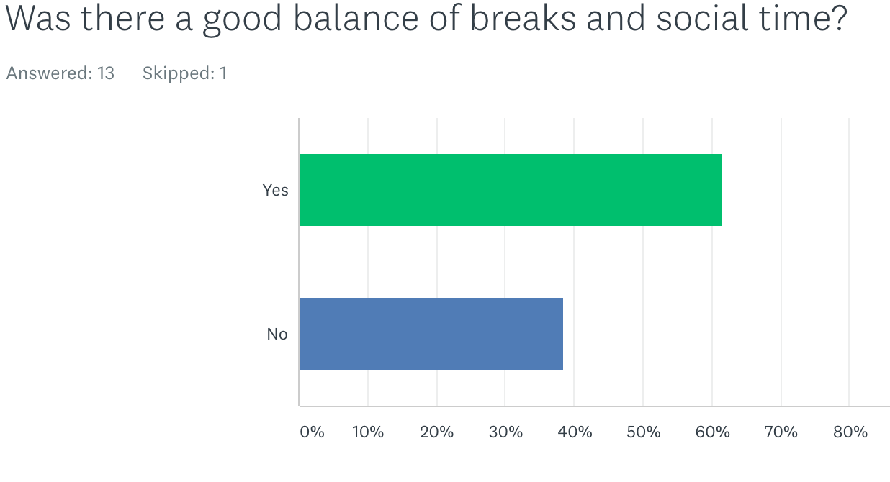
Not enough breaks !
Not enough balance of breaks and social time!

Slide 20
Buy in

Slide 21
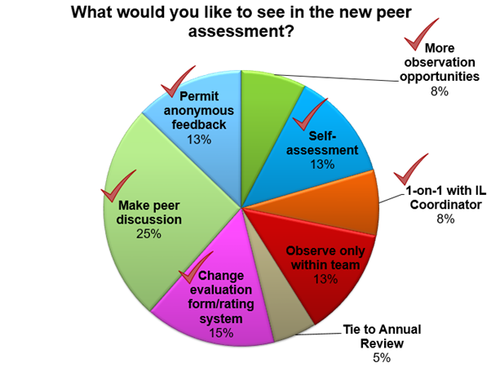
Peer Observation
Feedback 360

Slide 22

In-service Library Conference
MORE FEEDBACK !

Slide 23



Wrap up of Missteps
Overcoming Lack of Participation
Confusion over complex processes
Overlooking Logistics
Buy-in

Slide 24

Best Practices
Provide opportunities for participation that are voluntary

Slide 25

Best Practices
Include a wide range of opportunities – a range from smaller stakes to higher stakes that encourage people to use the best of their creativity and skillsets
Teaching Circle

Slide 26
Best Practices
Design methods of feedback that encourage participation such as e-forms

Slide 27
Best Practices
Don’t just ask for feedback – Put it into practice and follow up!

Slide 28
Best Practices
Offer a wide range of opportunities and formats that allow people to contribute in their own ways.
In-person workshop
Online, one-shot or longer term

Slide 29
Best Practices
Creating an culture of robust professional growth.

Slide 30

Reflection + Refining
=
Professional Development Success!

