Slide 1
From Self-Guided to Staff-Led: Cross-Training Initiatives in the ISA
Presented by Jess LaJoie

Slide 2
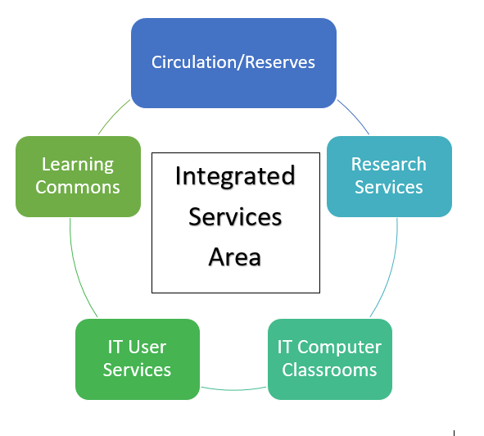
Self-Guided Training Initiative
Summer & Fall 2018
Created in response to the impending merger of Circulation/Reserves, Learning Commons, Research Services, IT Computer Classrooms, IT User Services into the Integrated Services Area
  Designed Moodle course “UMASS Libraries ISA Training” as primary training resource for Tier One skills
    Documentation and training materials from all of the comprising groups of the ISA
  Shadowing Exercises
  Assessment Quizzes
  In Person Assessment

Slide 3
Inconsistent Results
Challenging amount of training materials
Materials difficult to interpret without context
Quizzes difficult to pass
ISA build not conducive to application
No incentive for students and staff
Shadowing sessions had varying results
Technical difficulties with Moodle

Slide 4
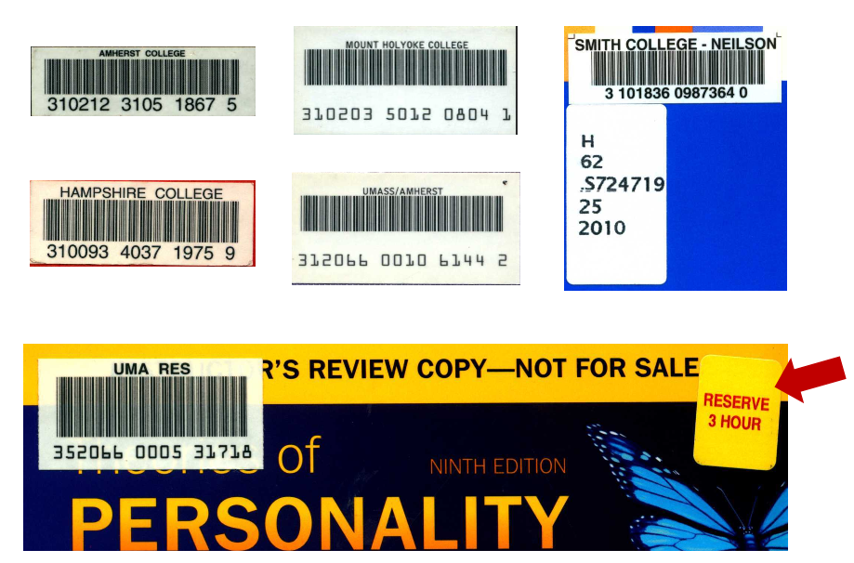
A New Strategy
December 2018
Staff-led, small group training sessions with personalized approach
  Physical application with context
  Q&A
  Activities
  Handouts
  Walkthrough of the workspace
Trial sessions in January with LC supervisors

Slide 5
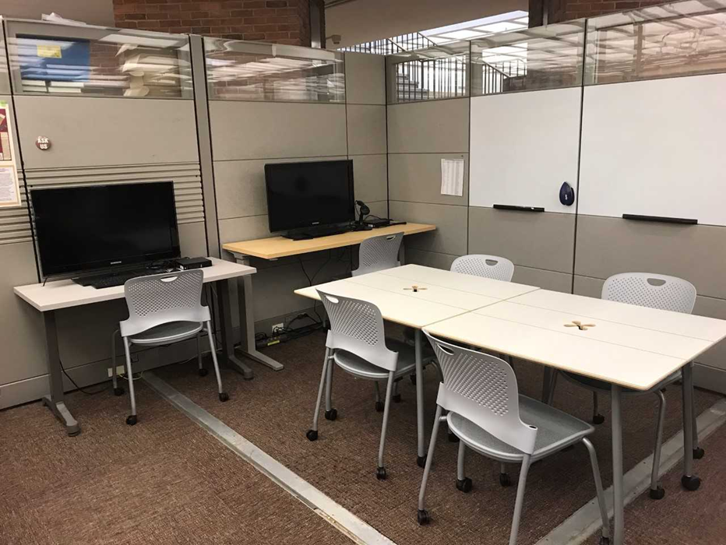
Staff-led Training Initiative
Spring 2019
Tier 1 Circulation & Reserves Skills
  Reading call numbers
  Aleph Procedures
    5 College Items
    ILLS
    COMCAT
  Circulating laptops and other multi-media equipment
  Fines/Appeals
  “Do not renew” list

Slide 6
Overall Findings
Cross-training became more consistent
  LC and RS students completing circulation tier 1 skills
Camaraderie between students and staff improved
  United front
  Asking for help & referrals
Staff-led training being applied to other ISA cross-training endeavors
  Learning Commons F.A.Q. and walkthrough
  Research Services

