Slide 1

Platform and Pedagogy for OER
Northeast OER Summit
May 26, 2022
Doug Casey and Kevin Corcoran

Slide 2

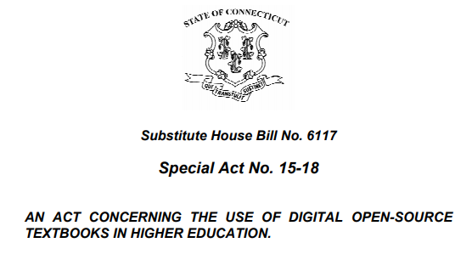
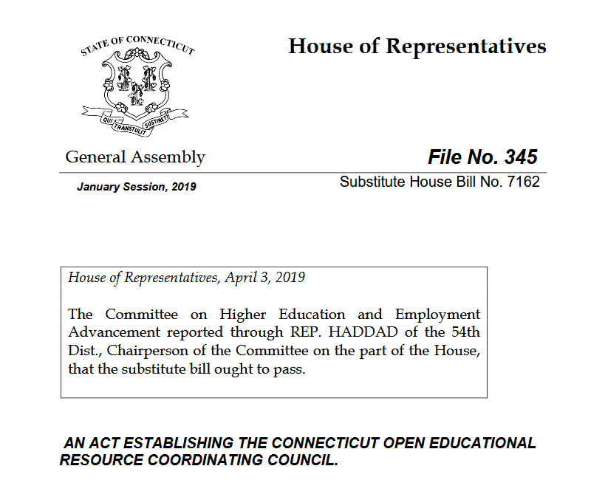
Connecticut Higher Ed Efforts
Special Act 15-18 (Signed into law July 2, 2015)
Established an OER Task Force
  Study the Use of OER
  Build Awareness of OER
  Report Back to Legislation of Findings
Open Textbook Pilots for UCONN & CSCU
Public Act 19-117 Section 147 (Signed into law July 1, 2019)
Established the CT OER Coordinating Council
  Build Awareness & Promote Best Practices
  Identify Opportunities for OER adoption
  Establish/Administer a Competitive
  Grant Program
  Report Back to Legislation of Findings

Slide 3


Connecticut K-12 Efforts
#GoOpen - 2017
US Department of Ed's Office of Educational Technology launched #GoOpen
  District & State Pledge
  Aligned with national Ed Tech plan
Connecticut K-20+ commitment sponsored by CT Commission for Educational Technology
GoOpenCT – 2019
K-20+ survey & awareness campaign
  Aligned with state's Ed Tech plan
  Identify Opportunities for OER collaboration
  Establish Infrastructure supports
Sponsored by CT Commission for Educational Technology

Slide 4
Connecticut OER Coordinating Council
2020 OER Grant Program
  2,000+ students saved over $265,000
2021 OER Grant Program
  1,800+ students saved over $227,000 in Fall 2021 alone
Over 1st 2 Years
  3,800 students saved $492,000 across 165 course sections
GoOpen CT Repository
  All adopted & created materials stored
Statewide Higher Ed Survey
  Institutions reported nearly 24,000 students saved over $2.7 million in 2020-2021 AY
CT OER Coordinating Council

Slide 5
Open Education Resources - Defined
“A teaching, learning, or research resource that is offered freely to users in at least one form and that either resides in the public domain or has been released under an open copyright license that allows for its free use, reuse, modification, and sharing with attribution.”
Affordable College Textbook Act (H.R.2107) introduced during the 116th Congress (2019-2020)
Examples
full courses
course materials
modules
textbooks
streaming videos
tests
software
and any other tools, materials, or techniques used to support access to knowledge.”

Slide 6
Open Pedagogy Defined
Open Pedagogy and Open Education Practices (OEP)
Focuses on learners as creators/co-contributors to public knowledge (not just consumers)
Leverages open licensing for development and publication

Slide 7
Faculty Benefits
Access | Customization | Collaboration
Supplement or replace current curriculum Address student access and readiness (Day 1) Just-in-time materials Appropriate copyright | Build your own resources from existing OER Add localization / contextualization Academic freedom –unbundle from publisher | Peer Review Collaborative approaches to teaching / learning License your own OER so others can use it

Slide 8
Learner Benefits
Access | Context | Collaboration
Day 1 Access Cost Avoidance – Financial Barrier Removal Multiple Formats | Localization Representation | Creator Co-Contributor Public Good Assignments
Notes:
Emphasizing relevancy, but also the ability to contribute

Slide 9
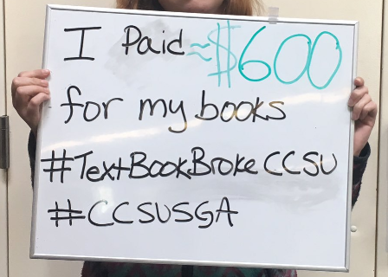
Framing Access
  “Students cannot keep up with rising tuition, minimum wage and the cost of 10 textbooks (they’ll likely use once) while trying to work and maintain a healthy GPA.”
  - Connecticut Student Participating in 2020 CT OER Grant Program
#TextbookBroke CCSU

Slide 10
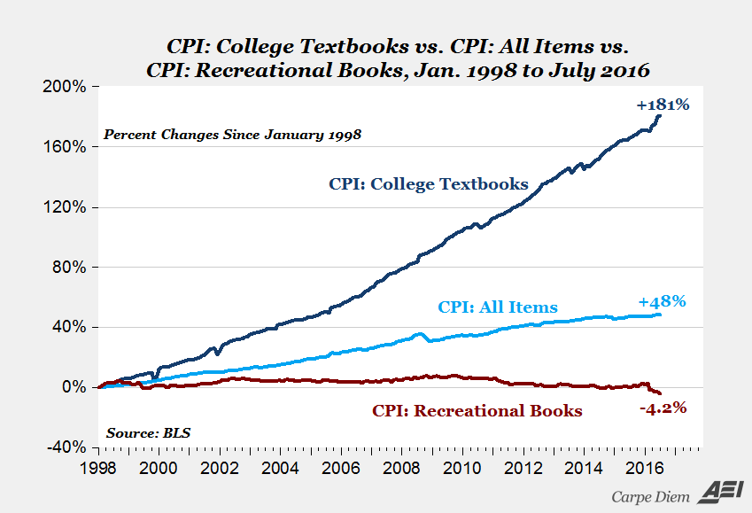
Textbook Pricing & CT Student Spending
CT FTE | SPARC Average Cost | Projected Textbook Costs (Full Load – Full Year)
150,000 | $110/course | $165,000,000/year
According to the Connecticut Office of Higher Education’s (OHE) Enrollment and Full-Time Equivalency data, over 150,000 FTEs were enrolled in Connecticut institutions in 2018.

Slide 11
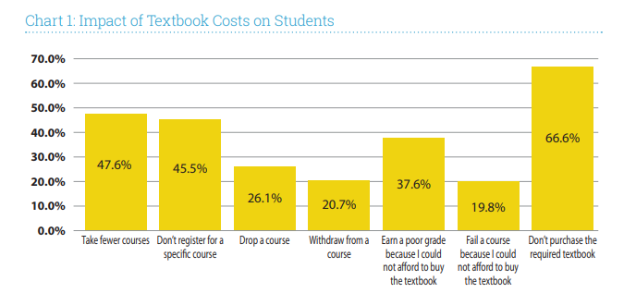
Academic Impact of Textbook Cost
Florida Virtual Campus. (2016). 2016 Florida Student Textbook & Course Materials Survey. Tallahassee, FL.

Slide 12



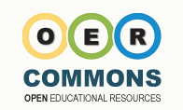


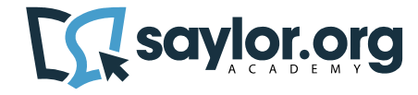

OER as a Solution
OER is free to access digitally and offline (and low cost for print)
OER has supplemental materials
OER has homework platforms
OER is peer reviewed

Slide 13
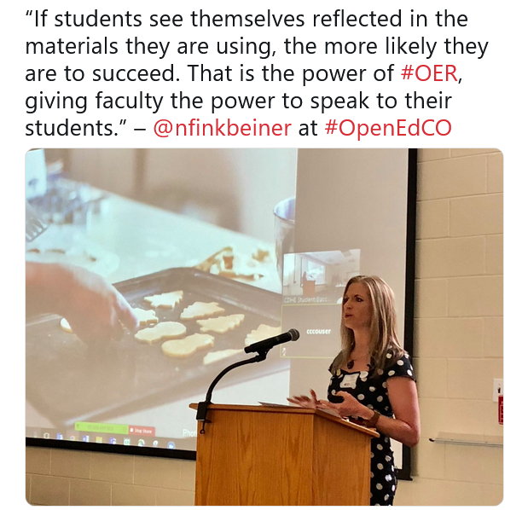
Framing Representation
“If students see themselves reflected in the materials they are using, the more likely they are to succeed. That is the power of OER – giving faculty the power to speak to their students.”
Nicole Finkbeiner, OpenStax, May 2019
Notes:
The power of adapting and revising OER beyond adoption.
What if our students had a more active role?

Slide 14
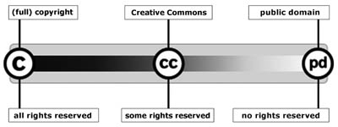
Copyright Licensing
http://www.aliprandi.org/cc-user-guide/html/index.html#chapter1_par1

Slide 15
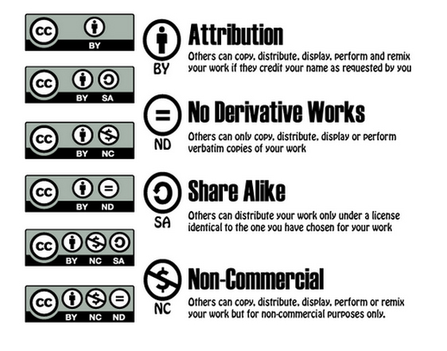
Creative Commons Licensing
By Giffin Francoeur - https://www.emaze.com/@AIZOWOCR/Creative-Commons!
15
Notes:
“Some rights reserved” - retain copyright while allowing others to copy, distribute, and make some uses of their work — at least non-commercially

Slide 16
5 Rs of OER Permissions
Retain
Make and own copies
Reuse
Use in a wide range of ways
Revise
Adapt, modify, and improve
Combine two or more
Share with others
Remix
Redistribute
See www.opencontent.org for full definition.
Notes:
Key permissions when curating and creating OER

Slide 17
OER as Representative
OER allows revision of content
Can make content more accessible
Can make content multimodal
Can make content more contextualized
OER allows for remixing of different content items
Can mix two or more OER items to create a new resource
OER allows for collaboration & ability to allow multiple perspectives
Can have local or global partners
Can have student partners

Slide 18
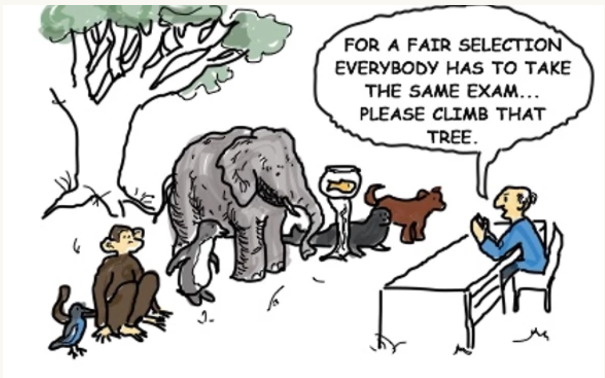
Framing Opportunity
Notes:
Einstein

Slide 19
Framing Open Pedagogy
“Disposable Assignments”
“These are assignments that students complain about doing and faculty complain about grading. They’re assignments that add no value to the world – after a student spends three hours creating it, a teacher spends 30 minutes grading it, and then the student throws it away. Not only do these assignments add no value to the world, they actually suck value out of the world. Talk about an incredible waste of time and brain power (an a potentially huge source of cognitive surplus)!”
David Wiley, “What is Open Pedagogy?” (2013)
‘[Open pedagogy helps students to] see content as something they can curate and create, and to help them see themselves as contributing members to the public marketplace of ideas.
Essentially, this is a move from thinking about OER as open textbooks and thinking about them as opening textbooks.”
DeRosa, R and Robison S, “From OER to Open Pedagogy: Harnessing the Power of Open” (2017)
Notes:
Many of us have a folder of works we created as grads and undergrads sitting in a folder somewhere. I certainly do.

Slide 20
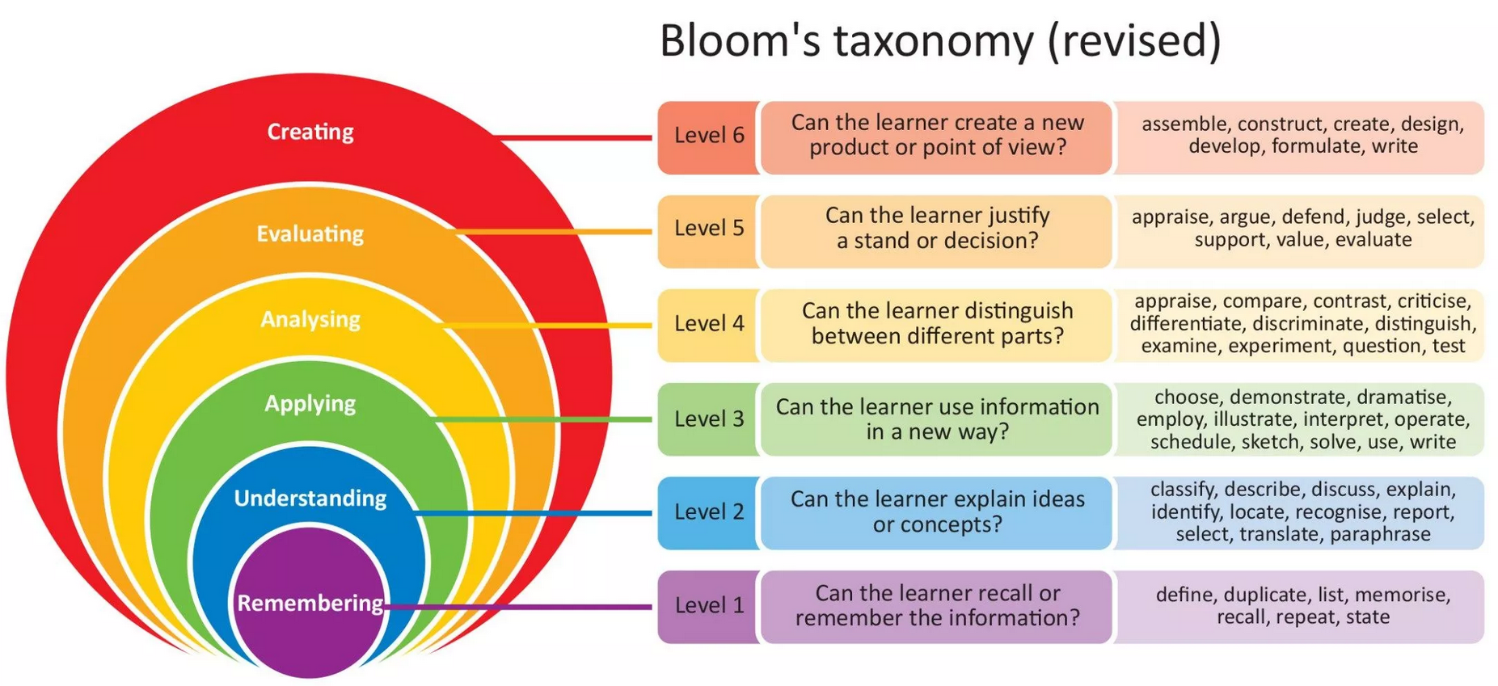
Bloom’s Taxonomy
https://www.niallmcnulty.com/2019/12/introduction-to-blooms-taxonomy/
Notes:
Higher order thinking – demonstrating mastery in a new form

Slide 21
Why Use Go Open CT?
Co-Creation and Sharing of Educational Materials Across Institutions
Common Alignments Across Districts
  Standards
  Grades
  Subjects
  Quality
Efficiencies
Sustainability

Slide 22
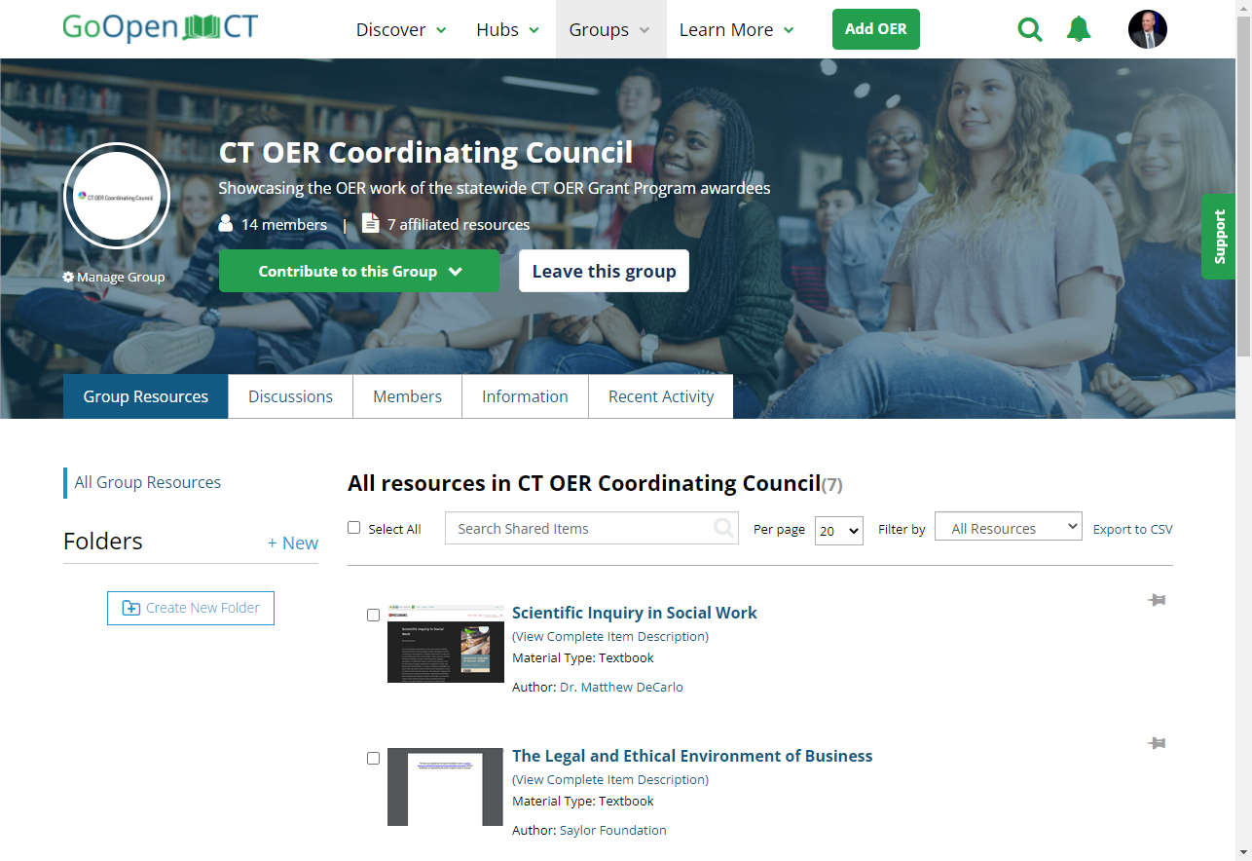
Opportunities
Groups
Course Creation
Curation of Resources
Roll Up to State Level
District or School
Internal or Broad Sharing
YOU Decide

Slide 23
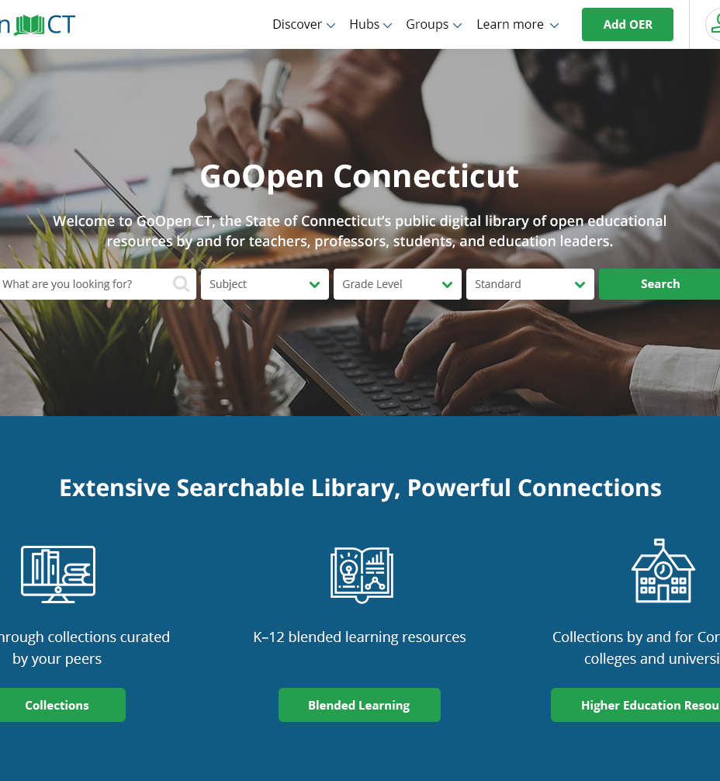
Key Features
Discovery: Find and use
Curation: Organize and share
Evaluation: Align and review
Author: Create and remix
Notes:
Nearly 7,000 learning materials from more than 30 content collections

Slide 24

Contact
Doug.Casey@ct.gov
(860) 622-2224
@CTEdTech
@DougCasey
@GoOpenCT
www.CT.gov/EdTech
kcorcoran@commnet.edu
(860) 723-0159
@kevincorcoran
www.ctoer.org

