Slide 1
Thermally/Chemically Activated Self-Assembling 3-D containers Using 2-D Patterns
https://www.youtube.com/watch?v=RekqLDjv80o

Slide 2
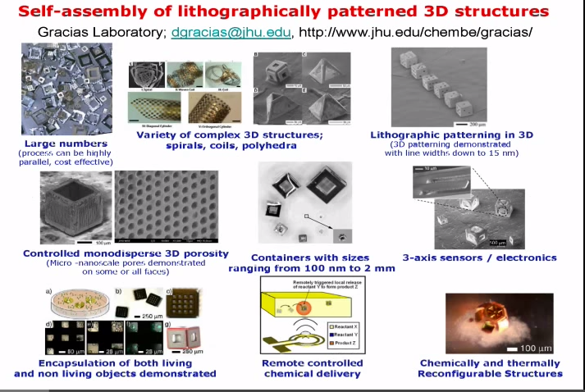

Slide 3
Nanotechnology Application
Chemistry
Polyhedral Micro containers
-- Chemical encapsulation
-- Spatially controlled chemical
reactions
-- Remotely guided chemical release
-- Controlled drug delivery or on-site
chemical reactions
Biomedical
-- microgrippers-- biopsies

Slide 4
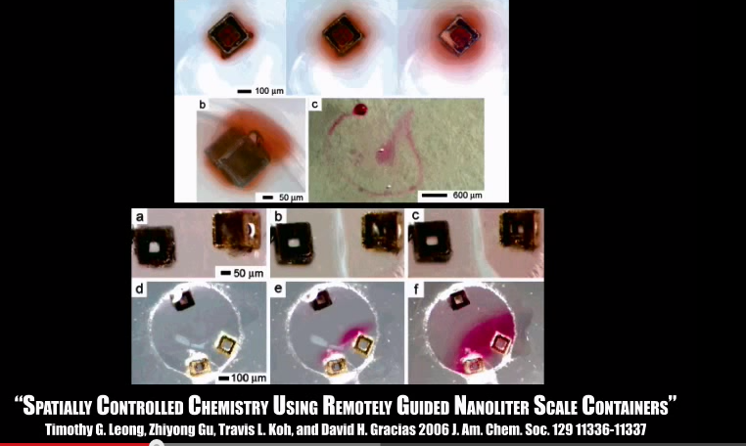

Slide 5
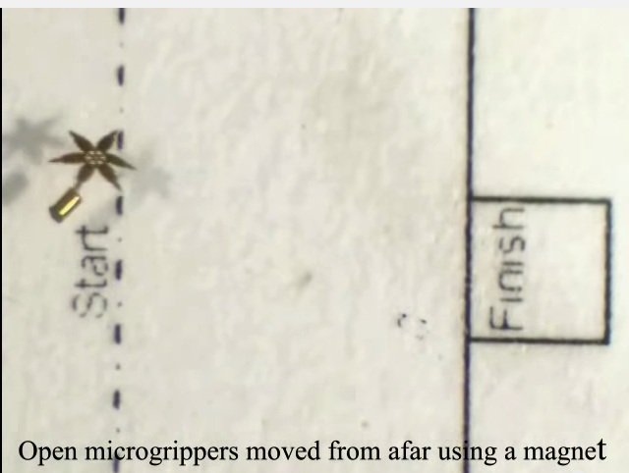

Slide 6
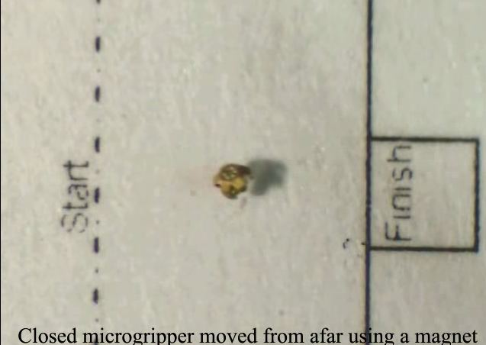

Slide 7
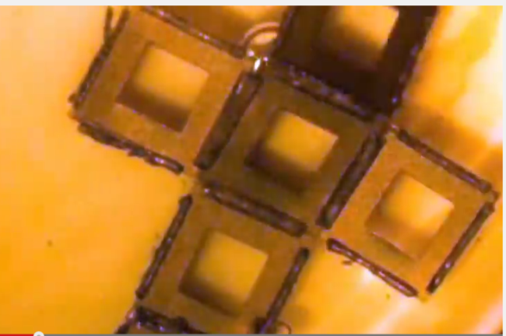
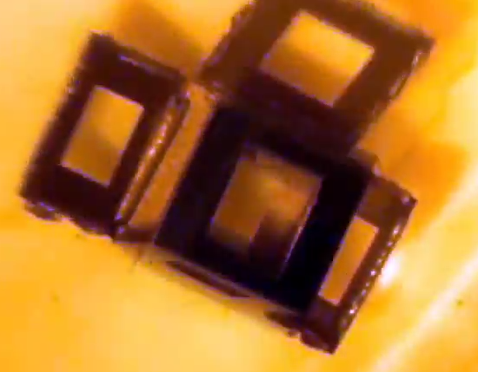
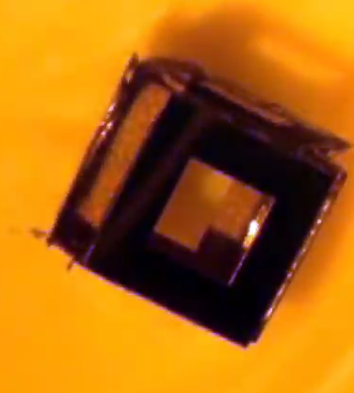
Hands-On Activity: Creating a 3-D self-assembling container from a 2-D net

Slide 8
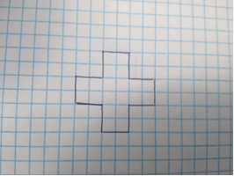
Draw a net on graph paper for a cube whose faces measure 1.5 cm x 1.5 cm

Slide 9
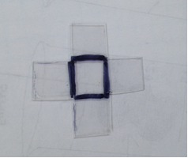
* Cut the net out of shrink film plastic.
* Draw black lines on the edges that will be the folding edges.

Slide 10
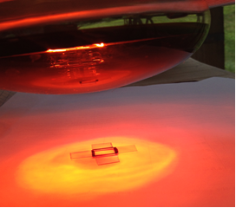
Put the net on a piece of white paper and expose to an infrared heat source.

Slide 11
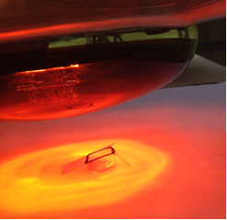
Differential Heating Creates Conditions for Self-Assembly

Slide 12
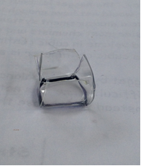
Finished cube– created by a middle-schooler

