Slide 1
Avoiding the Ivory Tower of Babel:
Library Instruction for ESL Students
Patrick Quinn, Library Coordinator
Marci Cohen, Assistant Head
Music Library, Boston University Libraries
May 28, 2021

Slide 2
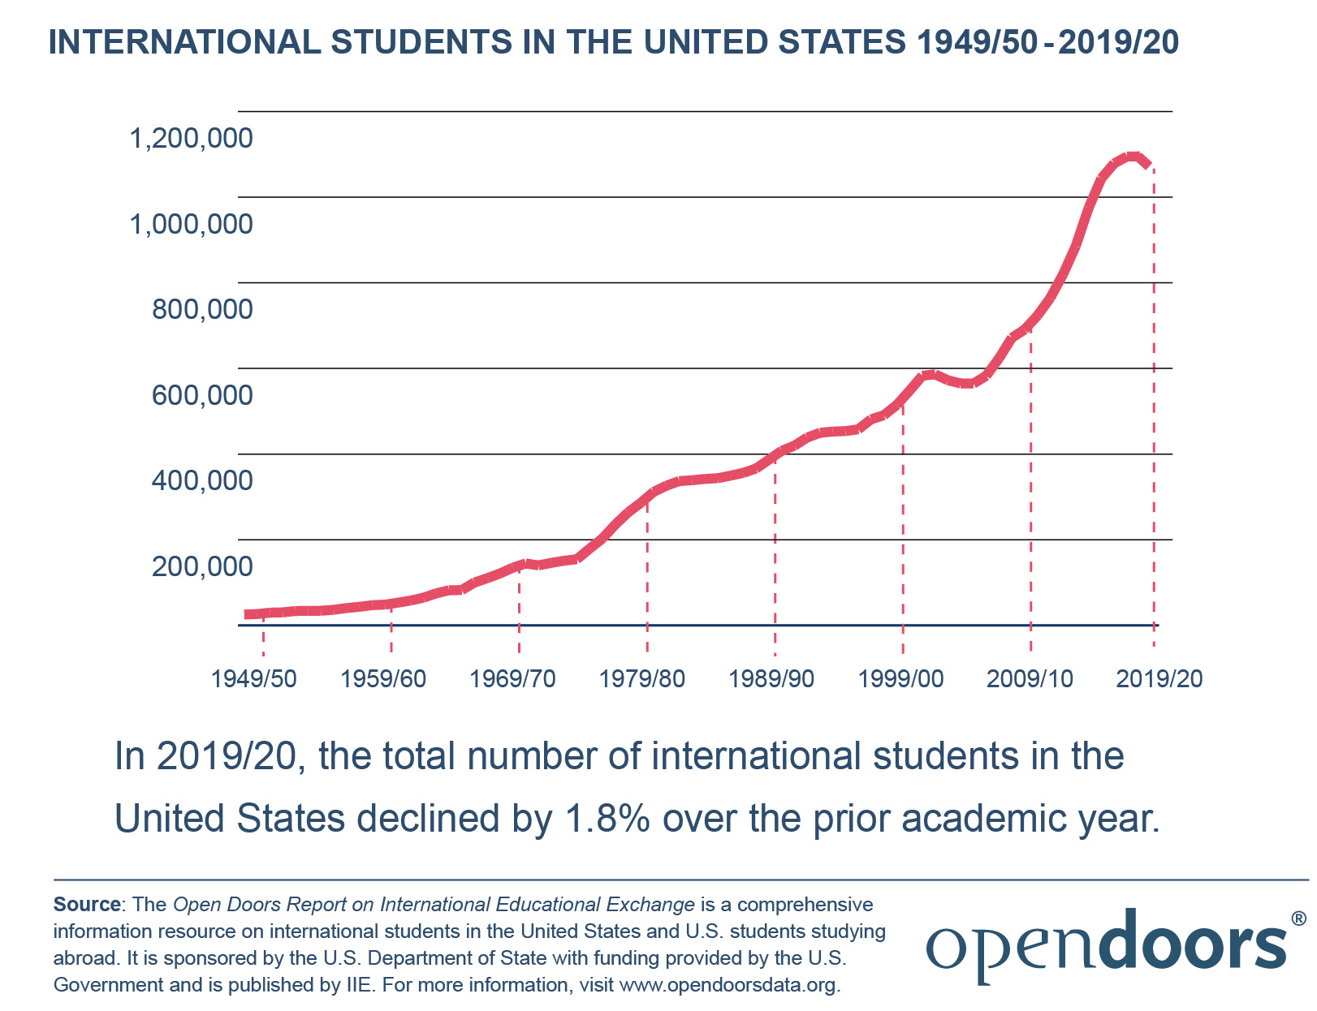

Slide 3
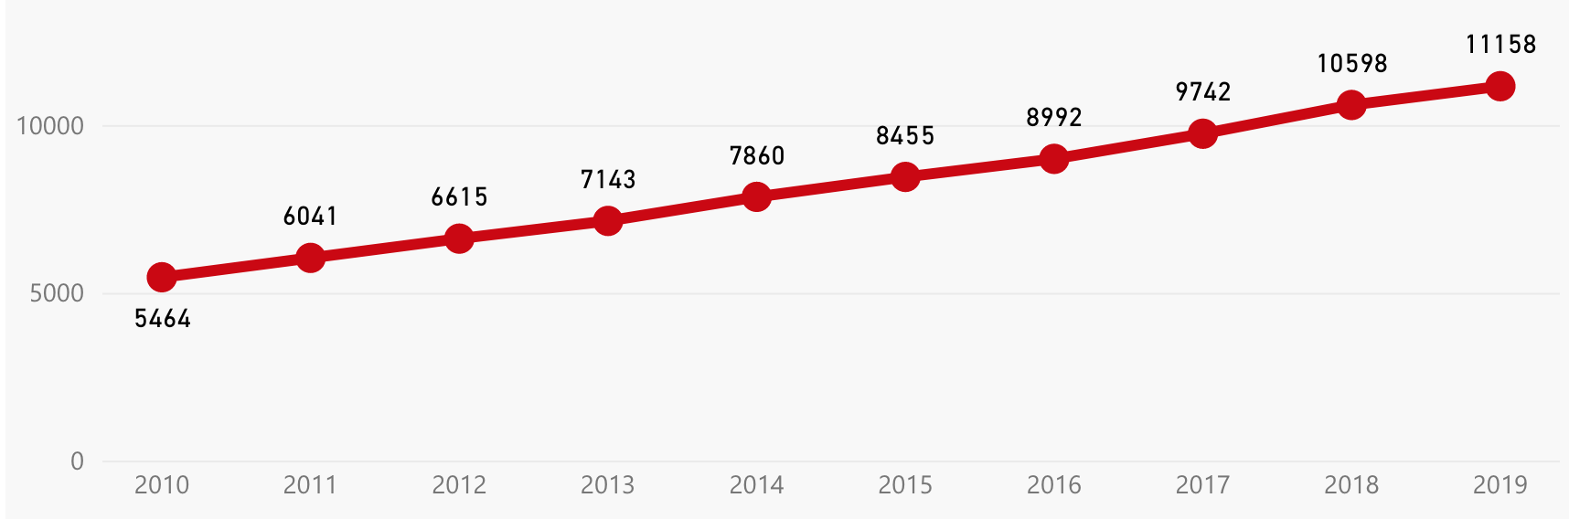
International Students at Boston University

Slide 4
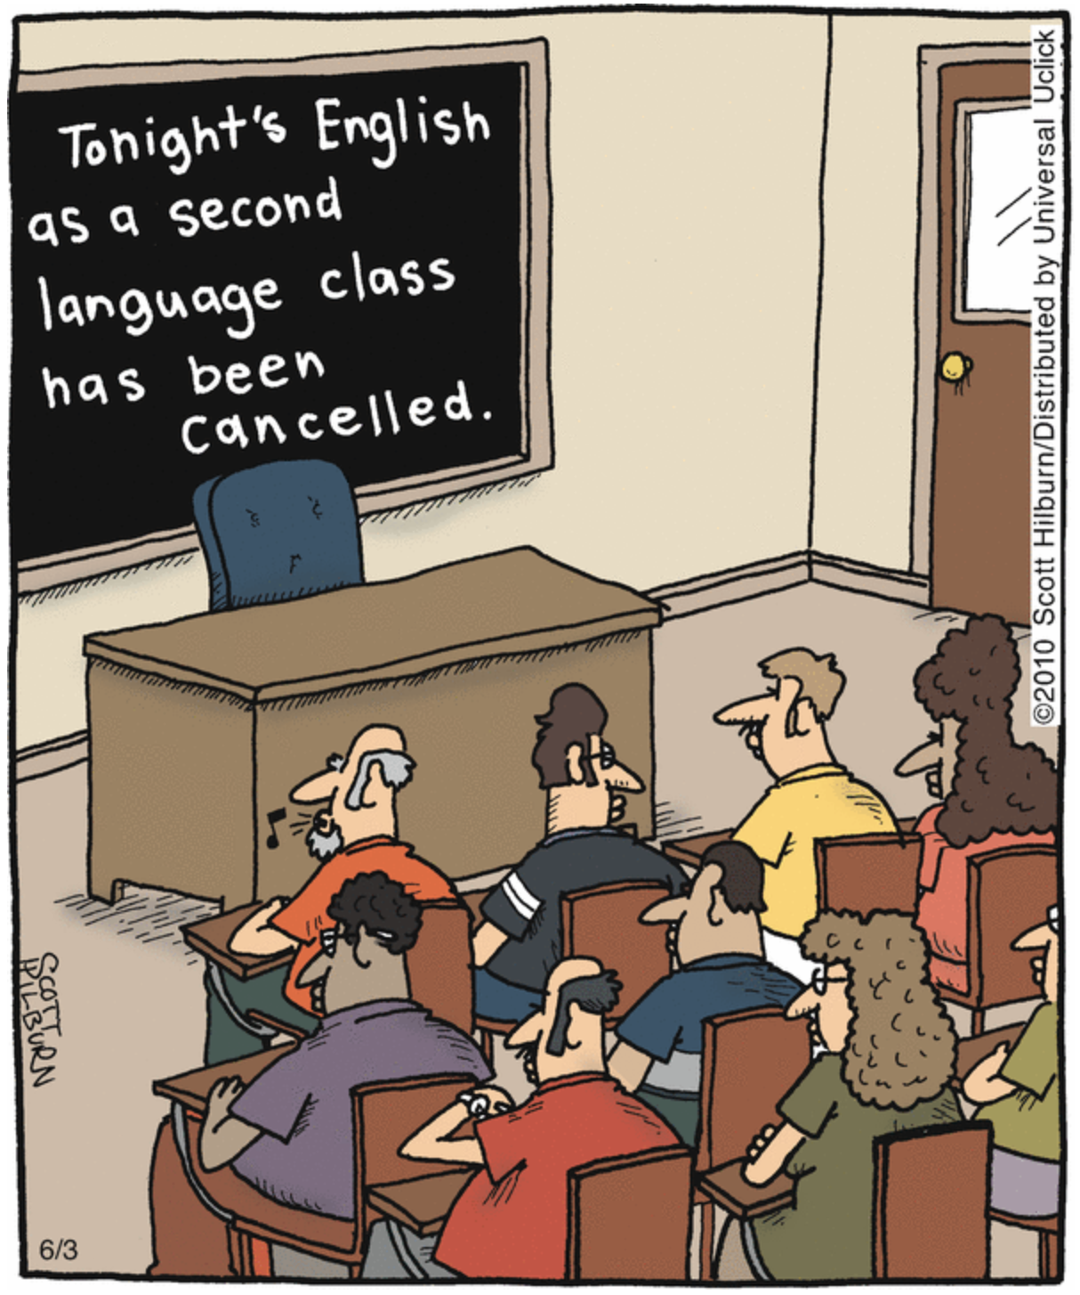

Slide 5
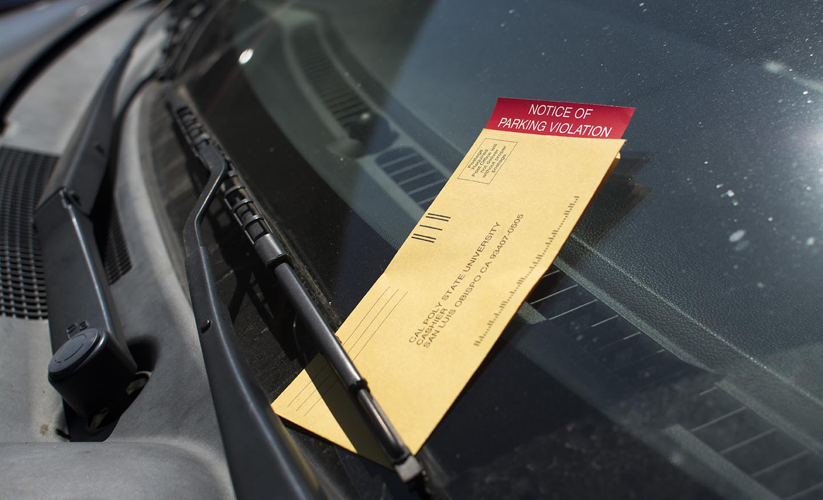
Citation

Slide 6
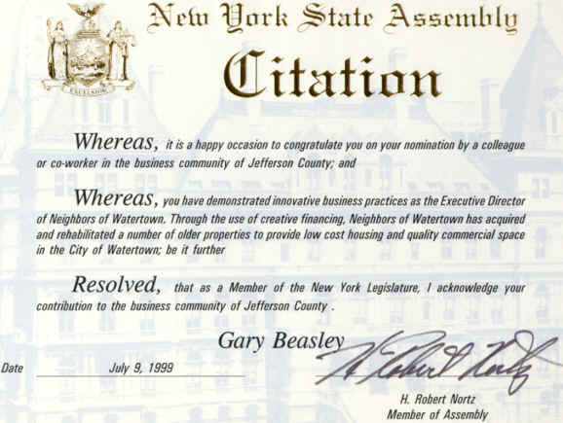
Citation

Slide 7

Citation

Slide 8

Abstract

Slide 9
Article
a an the

Slide 10
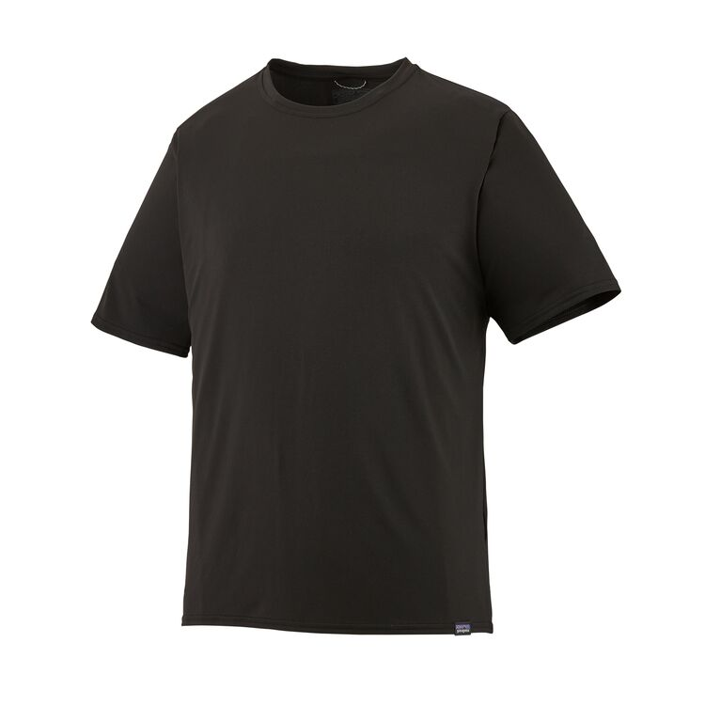
Article

Slide 11
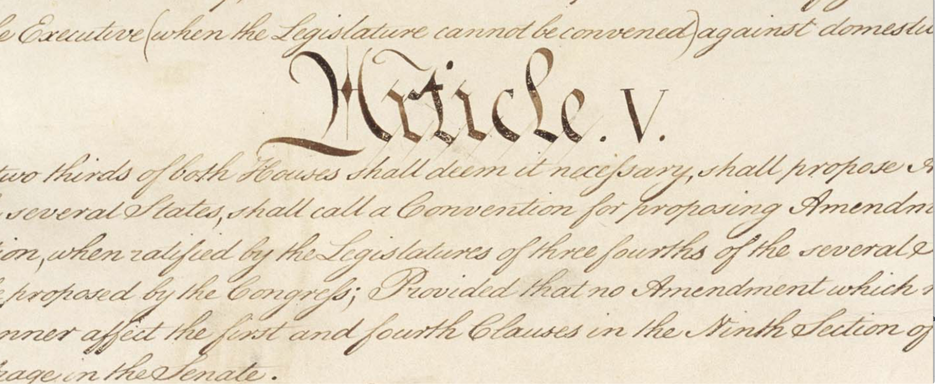
Article

Slide 12
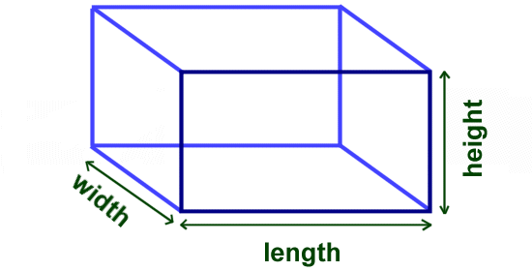
Volume

Slide 13


Volume

Slide 14
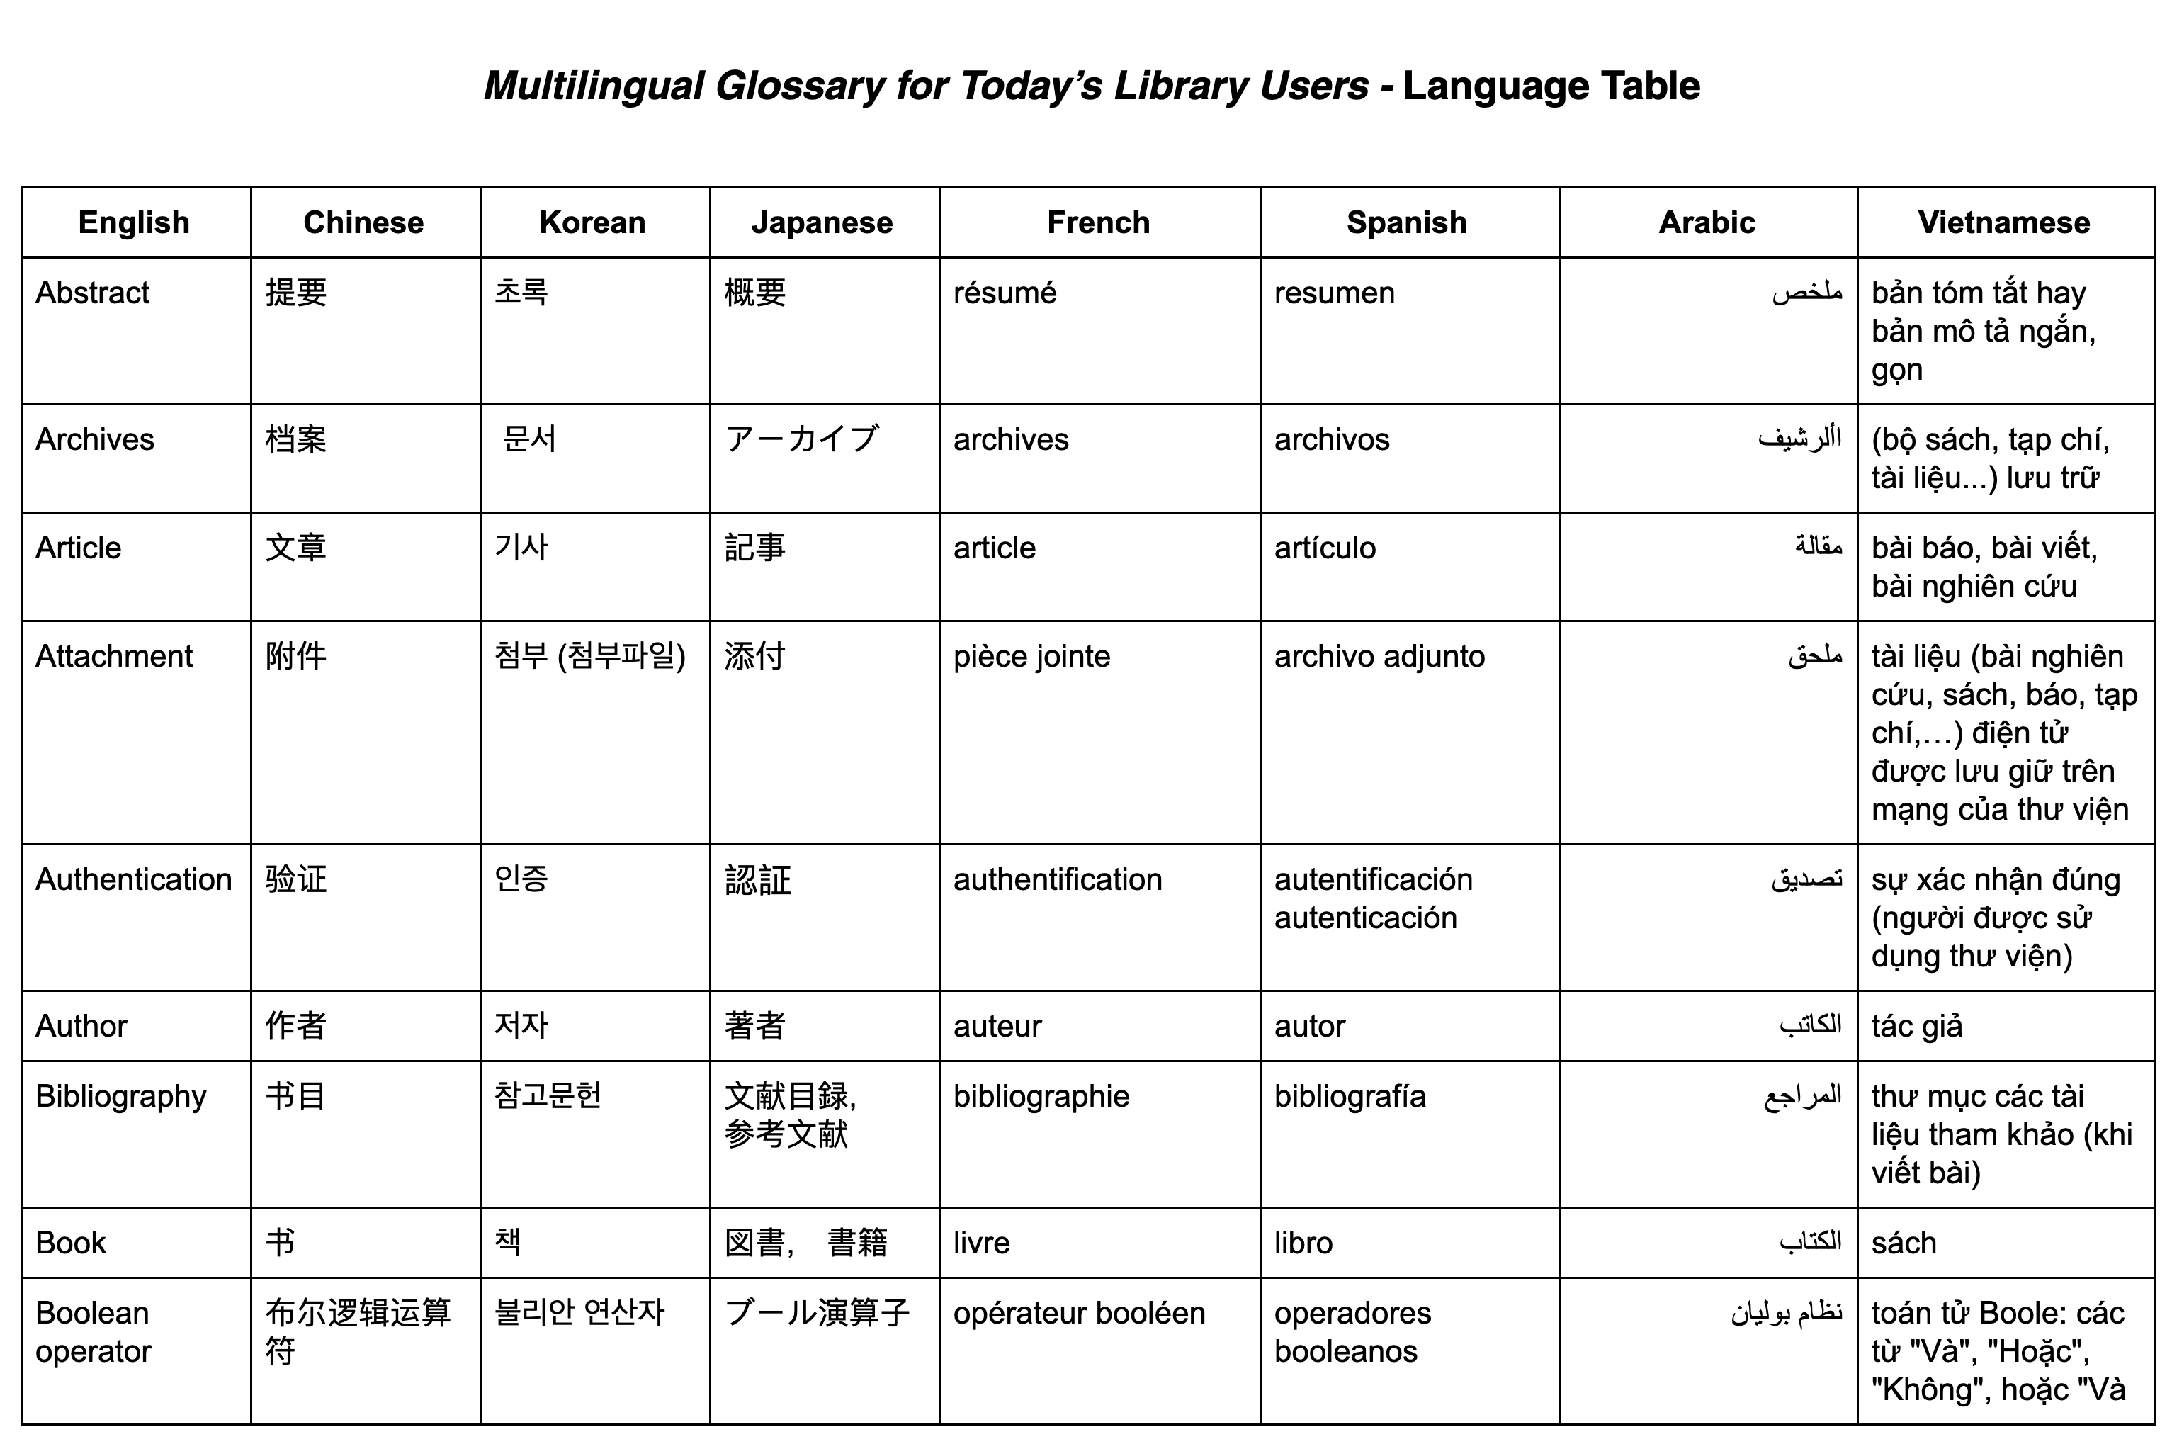

Slide 15
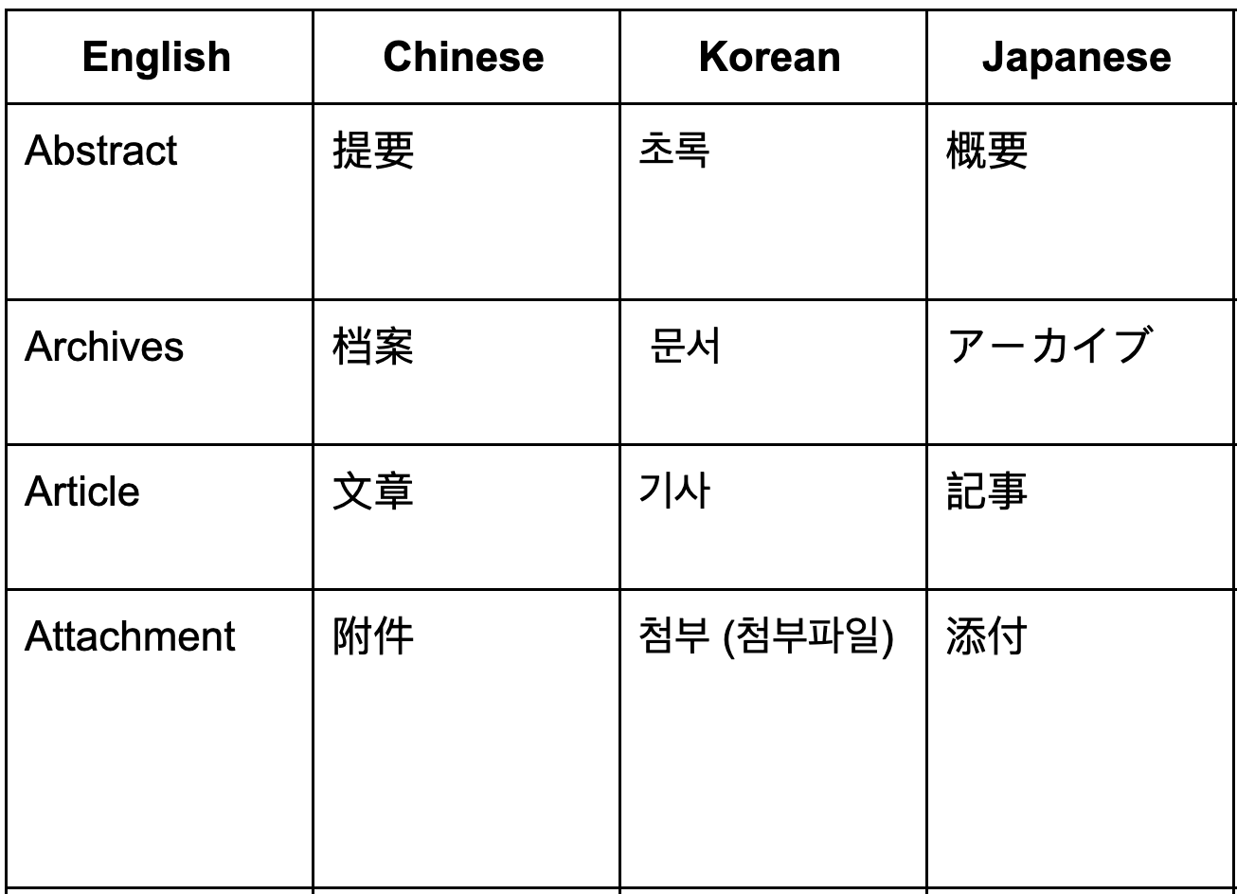

Slide 16
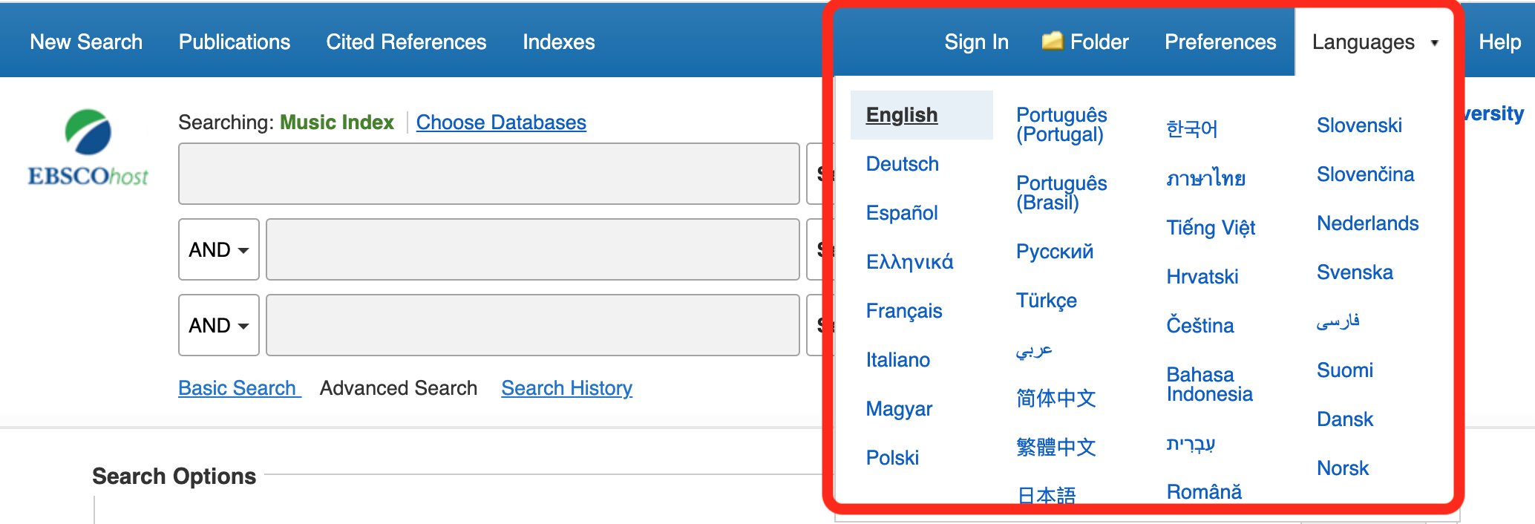

Slide 17
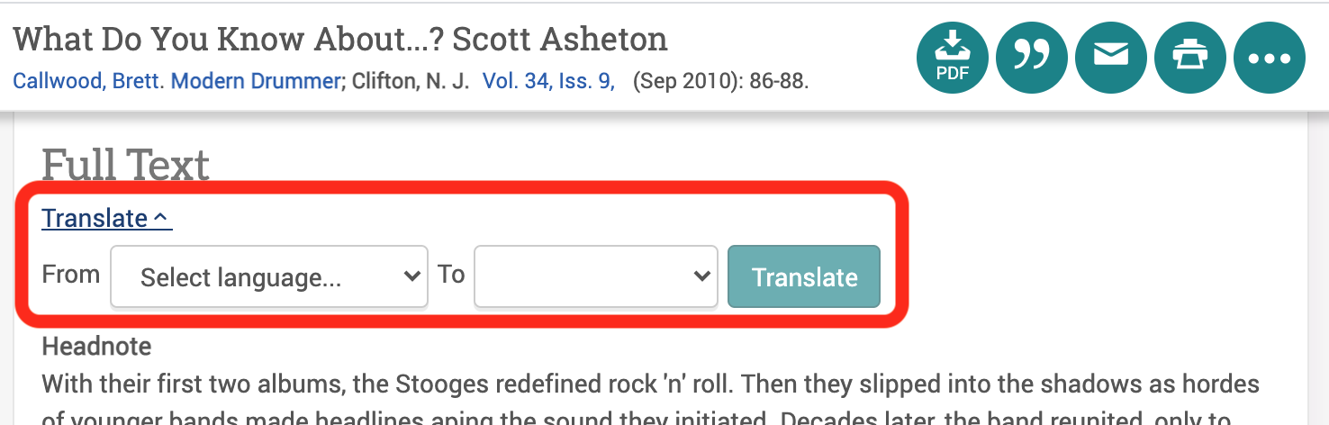

Slide 18
Minute Paper Assessment
The most useful thing I learned in the session...
I still have questions about … (email optional for follow-up)

Slide 19
Patrick Quinn pquinn6@bu.edu
Marci Cohen mcohen2@bu.edu

