Slide 1
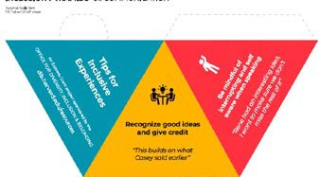
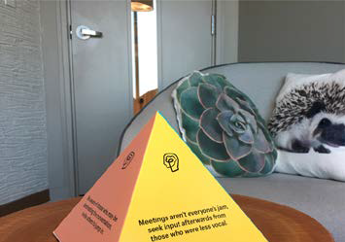
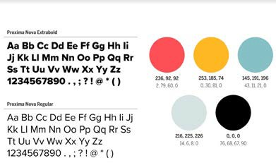
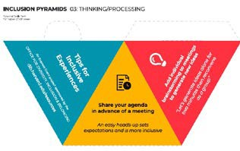
Fostering Inslusive Meetings with Inclusion Pyramids Jess Rios & Allison Herrera
Introduction & Grant Proposal
Values & Design
Wrap Up
In 2019 our university sent out a call for grant pro- posals that address issues around diversity, inclusion, and belonging. We wanted to address non-inclusive meeting practices and behaviors.
With lots of research, discussion, and feedback from the community we had 4 subject areas and values for supporting inclusive meetings.
As our project continued, COVID-19 was changing the environment of the world and the workplace. We were able to share templates for the pyramids digitally, so even if we couldn’t place them in shared spaces as work, we could still share online for those interested.
Communication
Recognize good ideas and give credit
Be mindful of interrupting and self aware when speaking
We received a grant for inclusions pyramids based on an idea from Shopify’s UX Lead. These pyramids are active reminders that encourage inclusive behaviors during meetings.
Accessibility
Using a microphone includes people with hearing impairments Support accessibilty accomodations
Thinking & Processing
Share your slides and agenda beforehand
Add individiual brarinstorming to meetings to generate new ideas
Gender Neutral Language
“They” is a neutral word that can be used instead of “he/her”
There are many ways to address a group! Hi all, hi everyone, hello folks, hello team, Y’all, friends, people
Shopify’s pyramid
We received the grant! (Along with our colleague, Enrique Diaz)

