Slide 1
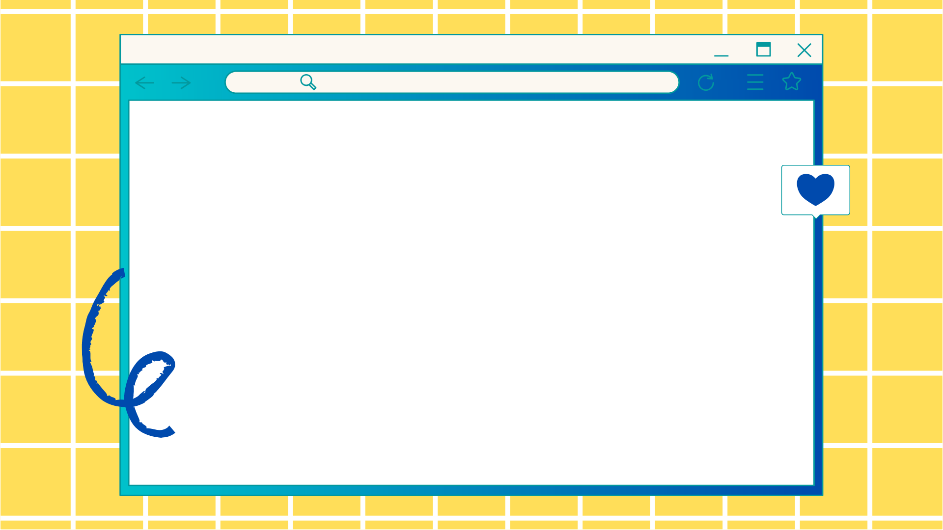
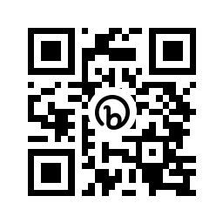
Remote Onboarding:
Growing and Maintaining Community
ACRL/NEC & NELIG Joint Conference
June 3, 2022
Accessible Documents & Toolbox →
Notes:
Lauren speaks
And Christine does Poll

Slide 2

Presenters:
Lauren Movlai (she/her)
Reference & Instruction Librarian
UMass Boston since April 2020
lauren.movlai@umb.edu
Christine Elliott (she/they)
Reference & Instruction Librarian
UMass Boston since May 2021
christine.elliott@umb.edu
Notes:
Lauren introduces self
Christine introduces self

Slide 3

Agenda
3. Establishing Community
1. Background
2. Our Experiences
4.
Successes & Challenges
5.
Recommendations
& Toolbox
6.
Q&A
Discussion
Notes:
Christine

Slide 4

Background
Why did we want to present on this topic?
Share personal experiences relating to transitioning to a new professional job during COVID -19 disruptions
Provide a space for other professionals to share
their experiences
Highlight practices institutions can apply to help
new hires establish a sense of belonging
Notes:
Christine

Slide 5

Lauren’s Experiences
Began job search end of 2019 from Houghton, MI
Interviewed in-person late February 2020
Many other jobs I had applied for, the hiring was frozen or canceled part-way through the process
I was offered the job 2 days after UMass Boston made the switch to being fully remote (mid March 2020)
I began work April 2020 from Houghton MI, and moved to the Boston area in August 2020, had my first day in person end of August 2021
Notes:
Lauren

Slide 6
Christine’s Experiences
Began job searching in 2020 from Huntingdon, PA
First-time job searching and interviewing fully-remote
  No on-campus visits
  No idea what campus looked like
  No idea what Boston was like
Hired in April and started remotely May 2021
Began in-person work August 2021
Notes:
Christine

Slide 7
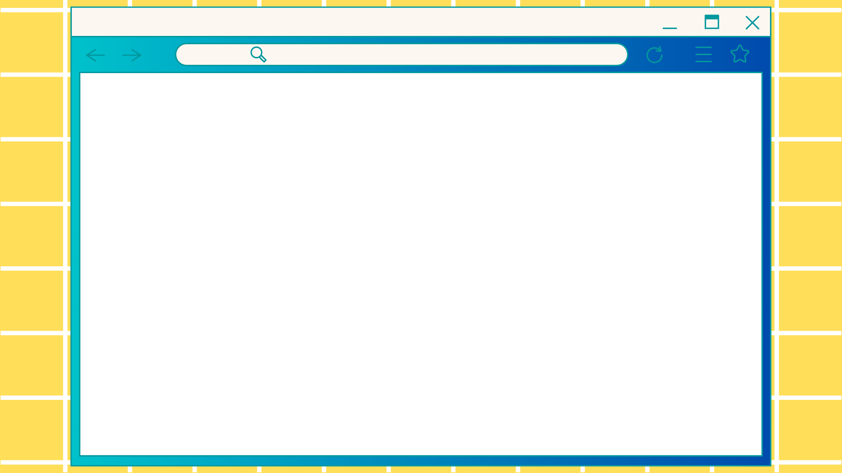
Establishing Community - Hiring
Technology & Methods
Interview
Zoom used for remote interviews
Consistent emails from search committee head and administrative assistant
Hiring Process
Support through the library’s business office (email)
Fully remote contact with university human resources
  Flexibility with submitting proof of citizenship and employment documentation
Notes:
Christine

Slide 8
Establishing Community - Onboarding
Technology & Methods
Onboarding Remotely
Zoom, Microsoft Teams, Email
  Immediately connected to broader library community
  Shared conversations regarding Boston and UMass
  Connected with Faculty/Staff Union
Remote library-wide meeting to connect with colleagues synchronously
Onboarding In-Person
Department met on campus before Fall semester start to tour campus and gather important items (keys, ID cards)
  Lunch together!
In-Person library-wide meeting prior to semester starting
Notes:
Lauren

Slide 9

Successes
Reference, Outreach, & Instruction
Consistent check-in’s (daily and weekly)
Documentation shared immediately in
Google Drive and Microsoft OneDrive
UMass Boston (institution)
Flexible processes through HR
Union members were welcoming
Daily updates on COVID and remote expectations/ changes
Notes:
Lauren

Slide 10
Successes (cont.)
Healey Library
Connected with other library departments
and individuals ASAP
Teams Messaging & Emails
  Welcome messages
  Fav. Boston locations and food
  Recommended neighborhoods
Weekly all-staff meetings with 10 minute
checkin’s and community building
opportunities
Funding for remote access to large-scale conferences like ALA
Notes:
Christine

Slide 11

Inconsistent communication
  Less frequent touch-points for checking-in with individuals and teams (shifting from remote to in-person)
Information sharing not consistent
  Inconsistent documentation
Assumed knowledge of library expectations/workflows when shift to in-person began for fully-remote hires
  How to connect to WIFI on Campus, setting up on-campus work area
  Pre-COVID workflows
Challenges
Maybe you’ll recognize some of these challenges based on your own experiences?
Notes:
Christine

Slide 12
Intentional connection building efforts disbanded when work shifted back to in-person modalities
  Assumptions that being in-person would be enough to maintain community
  Intentional connection building/belonging work is required REGARDLESS of modalities
Social anxiety
  How to communicate with people again!
  Having two onboarding events can be very overwhelming and exhausting for remote hires
  Navigating/maintaining connections made virtually as people meet face-to-face
Challenges (Cont.)
Maybe you’ll recognize some of these challenges based on your own experiences?
Notes:
Lauren

Slide 13
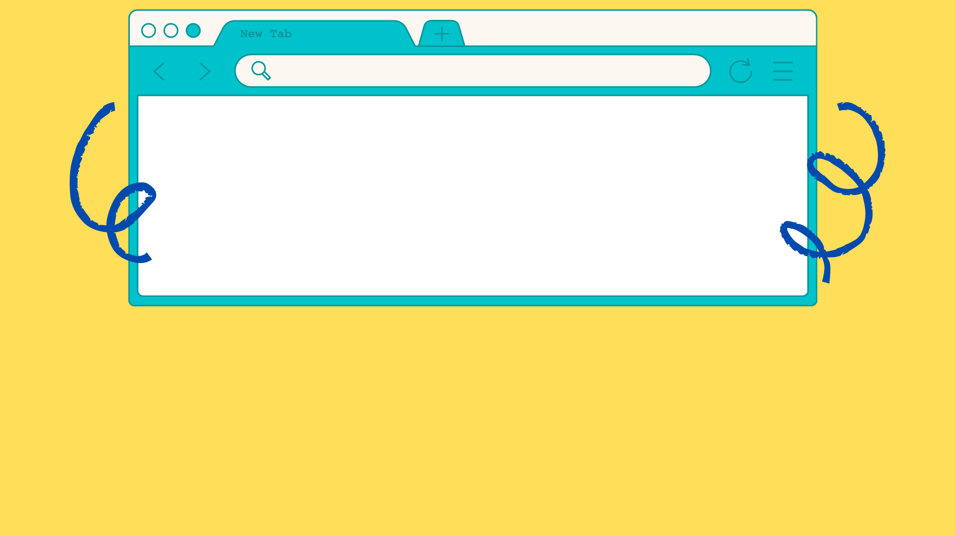
Recommendations
Establishing and Maintaining Community (regardless of remote/in-person onboarding)
Remain curious and aware of staff expectations and needs during modality shifts (this applies beyond remote/hybrid/in-person work)
  Exercise flexibility
Fight assumptions
  A year of remote work does not mean that staff know about pre-COVID or pre-remote workflows
Notes:
Lauren

Slide 14
Recommendations (cont.)
Establishing and Maintaining Community (regardless of remote/in-person onboarding)
Establish consistent and frequent information sharing practices
  Communication and documentation formats
Establish connections outside of department/library to foster community
Notes:
Christine

Slide 15
Toolbox & Accessible Documents
Helpful Resources for You!
https://bit.ly/3L6rgrb
Presentation access
Helpful Literature
Survey/Assessment Ideas
Technology Recommendations
Notes:
Christine (introduces) & Lauren

Slide 16
Thank you!
Q&A and Open Discussion
Share a positive/ challenging experience you had if you were hired during the pandemic.
As part of the hiring process, what was a particular goal you had to ensure that new hires felt included in your community?
During the hiring or onboarding process, what is one action you or your library performed to establish connection and a sense of belonging?
How was a sense of belonging established while working remotely at your workplace?
What were the biggest challenges/changes when switching between modalities at your workplace?
Slides and free images were obtained from www.canva.com | Slide Template: Pale Yellow Pink Digitalism Simple Presentation
Notes:
Christine create Slido or something

