Slide 1
What if you build it and they don’t come?
Lindley homol
l.homol@northeastern.edu

Slide 2
By the end of this session you will…
Gain ideas about how to promote and brand tutorials so they see increased usage
1
Learn how to decide the best content to cover in tutorials
2
Consider alternate methods of instruction to reach online/distance students
3
Notes:
And the third is that you’ll also consider alternate methods of instruction to reach online or distance students.

Slide 3
Summer 2016
Met with doctoral students and faculty
Instructional videos requested
Fall 2016
Created a series of short video tutorials for Education
Promoted collection to doctoral faculty
Spring 2017
Research and Instruction department geared up to create interdisciplinary research tutorials
Low usage of Education tutorials
Summer 2017
R&I created video tutorials
Fall 2017
Initial set of interdisciplinary tutorials shared with faculty and students

Slide 4
The Education Tutorials
What everyone wanted but (almost) no one used

Slide 5
Background
Liaison librarian to Education department at Northeastern
Graduate programs online and at regional campuses in Seattle and Charlotte

Slide 6
Designing and Developing The tutorials
Topics came from student suggestions at residency and frequently asked questions
Created 12 short screencast videos using PowerPoint slides and Kaltura CaptureSpace Lite
Topics included:
  Using Boolean operators
  Phrase searching
  Keyword vs. Subject searching
  Finding full-text articles
  Finding dissertations

Slide 7
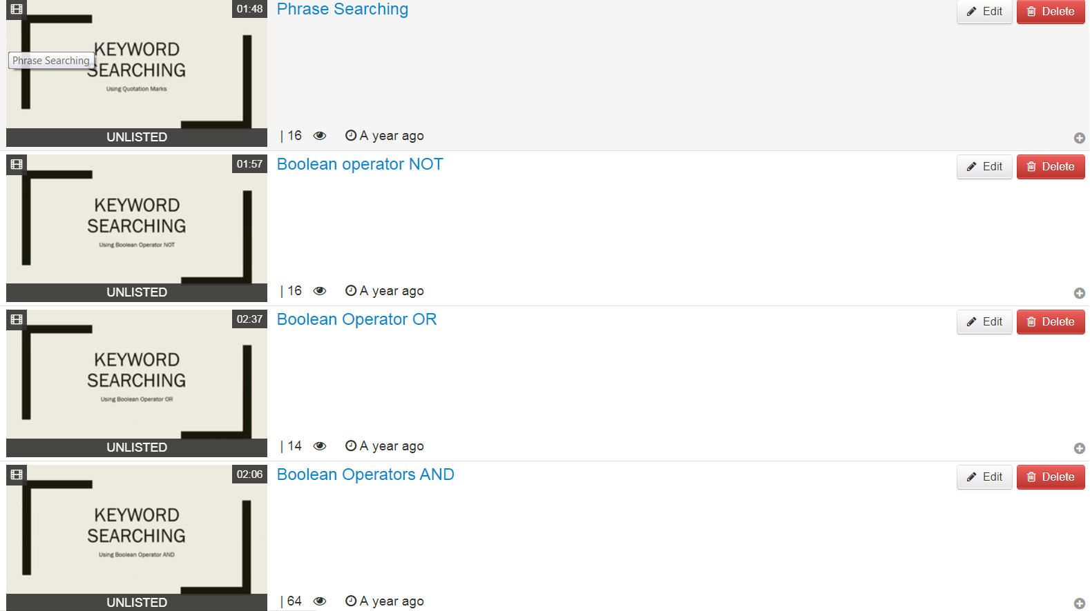

Slide 8
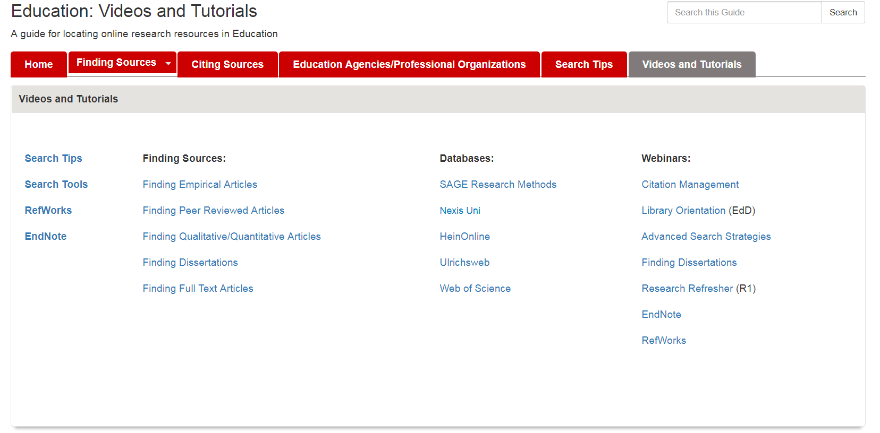
Posting the Tutorials

Slide 9
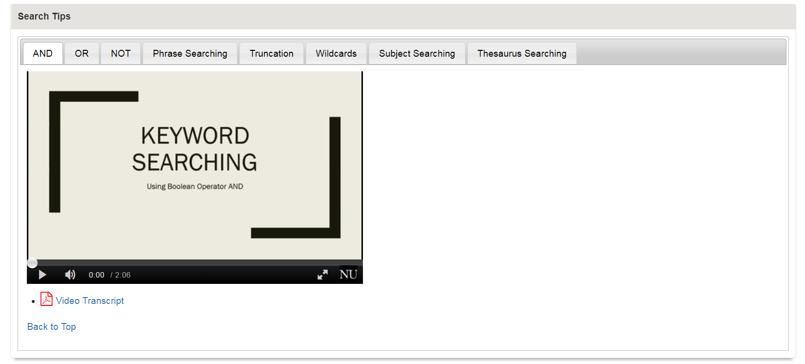
Posting the Tutorials

Slide 10
Promoting the tutorials
Emailed faculty for four doctoral foundation courses when tutorials were complete
Offered links/embed codes for individual video tutorials

Slide 11
Tutorial usage by topic

Slide 12
Tutorial usage by Quarter

Slide 13
So what went wrong?

Slide 14
Location, Location, Location

Slide 15
Location, location, location

Slide 16
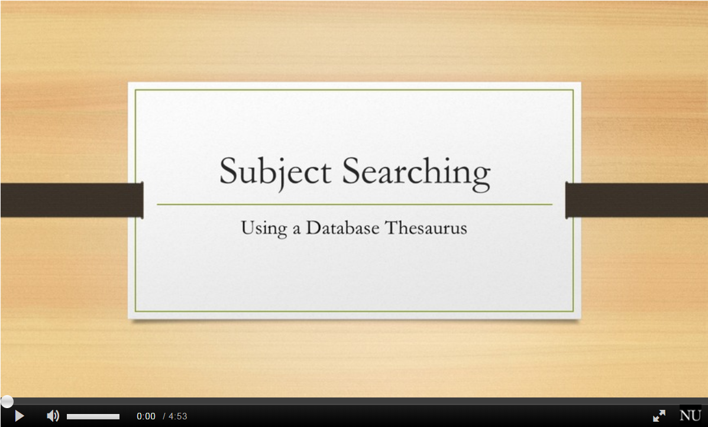
Video titles
Titles conveyed concept covered, not what the video would help the student do
Students don’t know what they don’t know—make the titles recognizable for their mental models

Slide 17
The Interdisciplinary research tutorials
Failing forward

Slide 18
Designing and developing the tutorials
Initial list of topics identified from reference desk statistics
R&I librarians voted for the most crucial topics from this list to decide on the first tutorials to develop
Created 6 short screencasts, 6 slide-based presentations, and 4 handouts
Topics included:
  Building a search (generating keywords/search terms)
  Search strategies (Boolean operators, truncation, etc.)
  Finding peer reviewed sources
  Is this article scholarly?
  Choosing a topic/building a research question

Slide 19

Designing and developing the tutorials
Communications department developed a branded template for slide and screencast tutorials
Screencasts were recorded in Camtasia, captioned, and then uploaded to Kaltura mediaspace

Slide 20
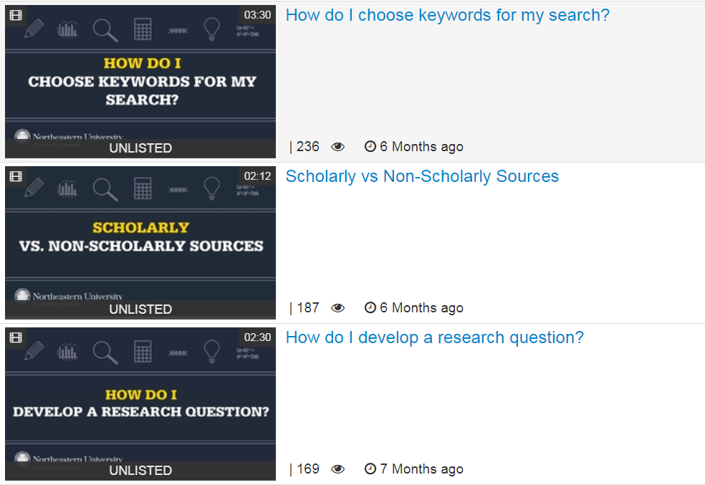

Slide 21
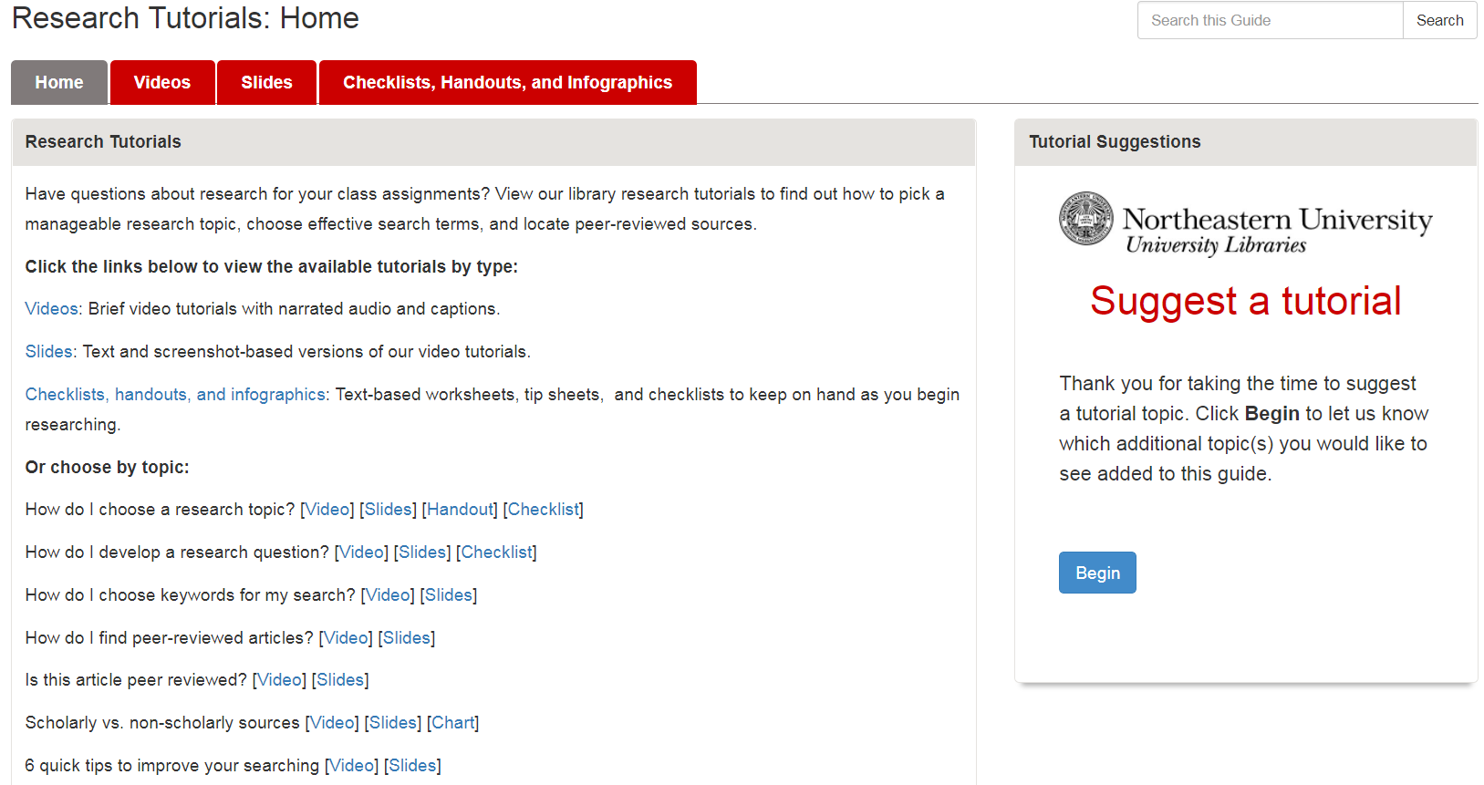
Posting the Tutorials

Slide 22
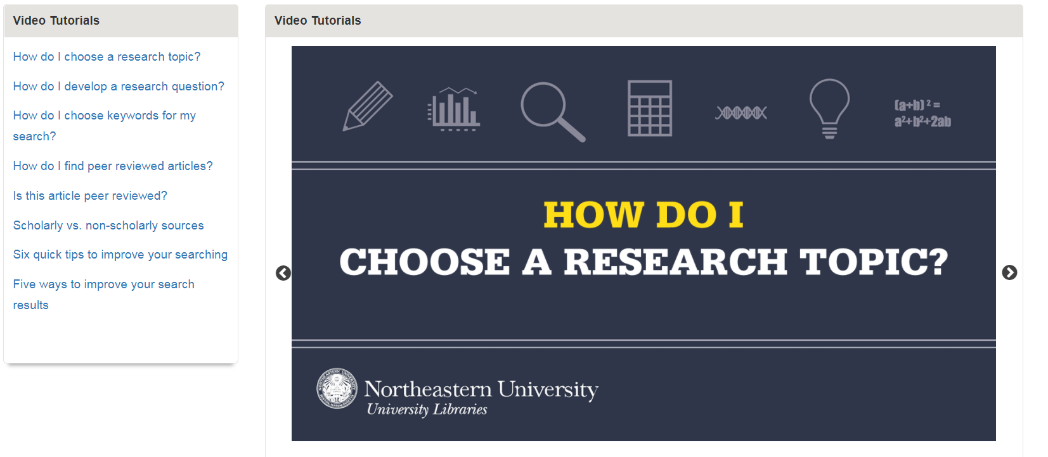
Posting the Tutorials

Slide 23
Promoting the tutorials
Liaisons shared with their departments
Research Tutorials guide shared before, during, or after instruction sessions
Tutorials shared in library blog post (Fall), all-faculty email (Spring)
FAQ entries added for tutorial topics with links to the videos

Slide 24
Tutorial usage by topic

Slide 25
Tutorial Views by semester

Slide 26
Tutorial downloads from DRS
DRS Views | 316
DRS Downloads | 189
DRS Streams | 23

Slide 27
What made the difference?

Slide 28

Tutorial naming conventions
Librarian’s mental model
Answers “what’s in it for me?”

Slide 29
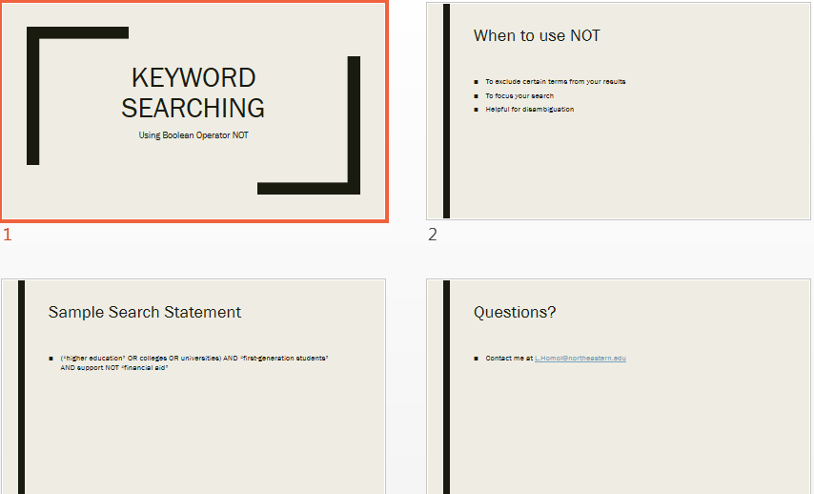
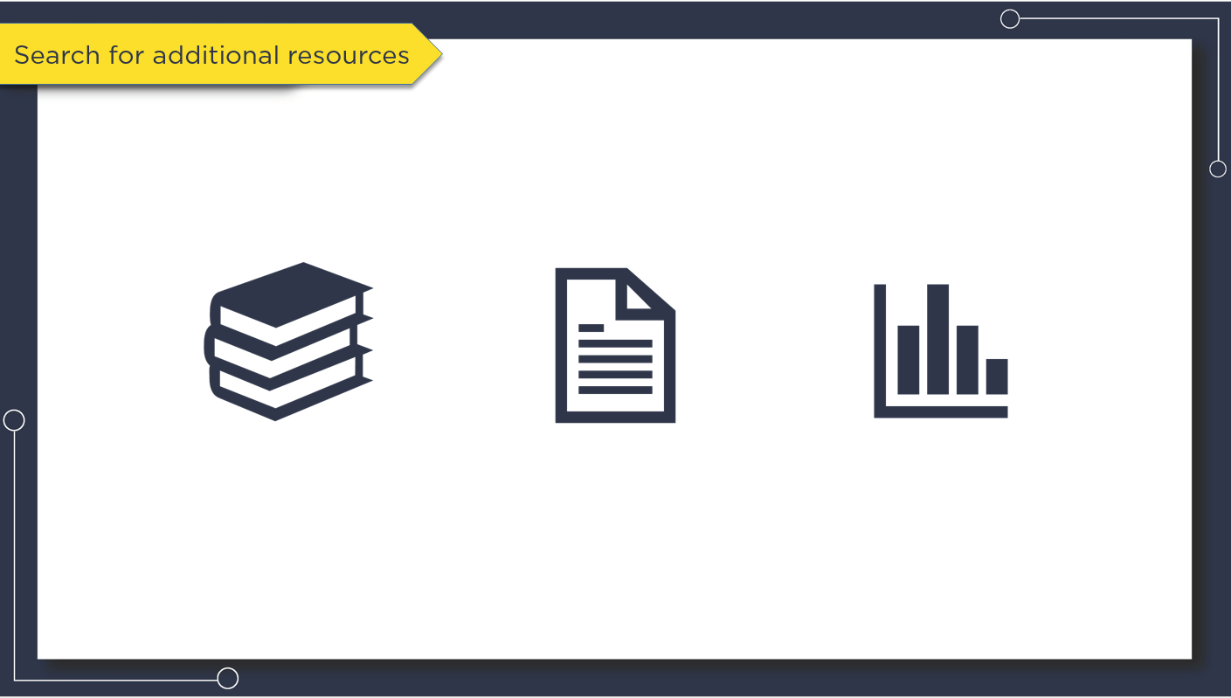
Tutorial design
Text heavy slides
Dynamic, graphics-focused slides

Slide 30
LibGuide Organization
Tabbed boxes made some tutorials invisible
Clearer wayfinding through direct links

Slide 31
Tutorial access
Only included on libguide
Posted multiple places to promote discovery
Research Tutorials LibGuide
DRS—allowed download for embedding directly in LMS
Library FAQ

Slide 32
Tutorial promotion
promoted to faculty
Promoted to faculty and students
Emailed faculty when tutorials were ready
Emailed faculty about tutorials
Promoted tutorials in instruction sessions
Promoted tutorials on library website and newsletter

Slide 33
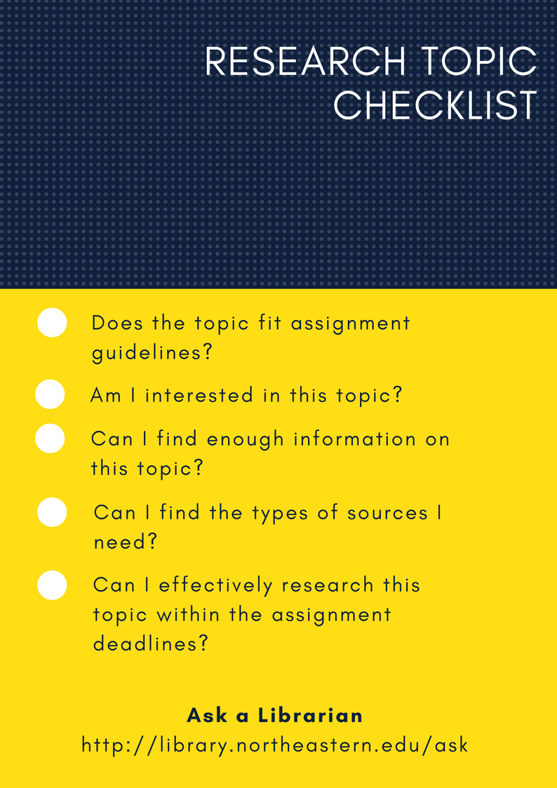
format options
Only video tutorials
Videos, slides, or handouts

Slide 34
All hands on deck
Solo librarian approach
Collaborative effort
Designed and developed by a single librarian
Designed and developed by a team, with several sets of eyes providing input and edits to content and scripting language

Slide 35

Improving the Education videos
Make titles more user-friendly
“Full Text” Video Usage increase

Slide 36
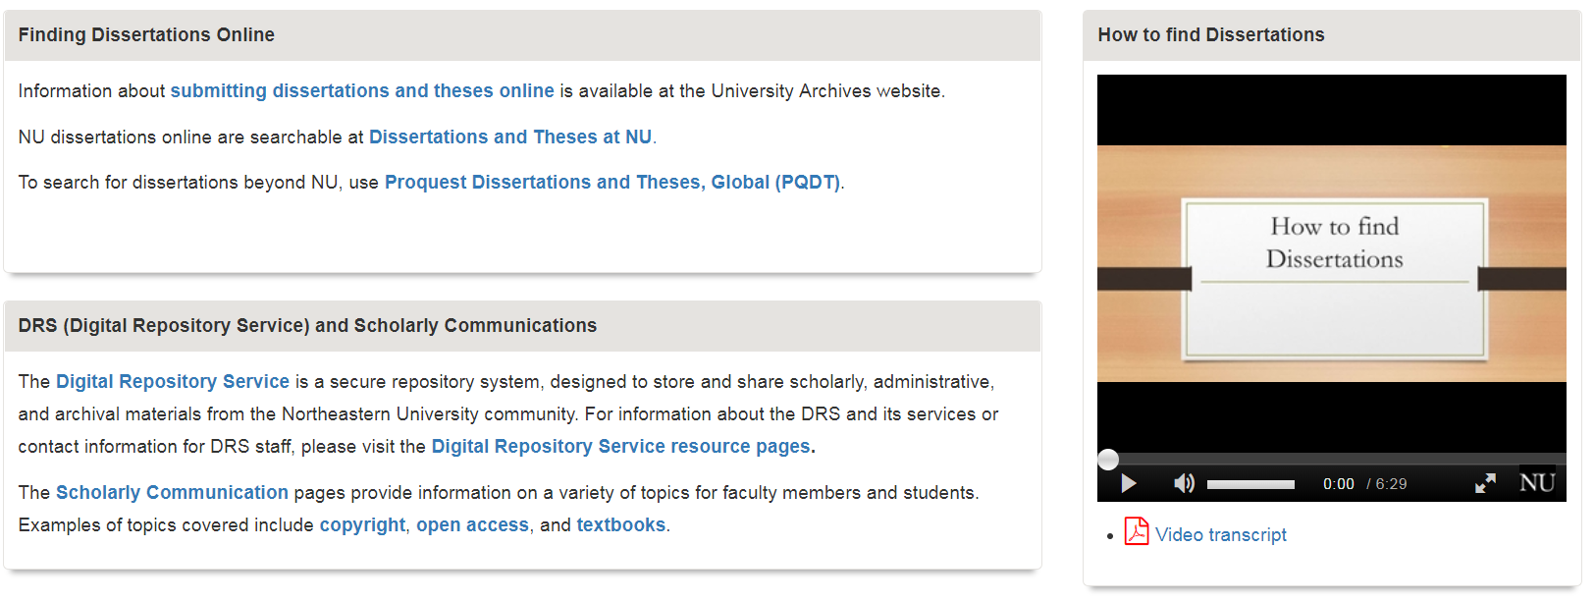
improving the education videos
Place tutorials at point of need in guide
“Dissertations” video Usage increase

Slide 37
A silver lining
getting creative with library instruction

Slide 38
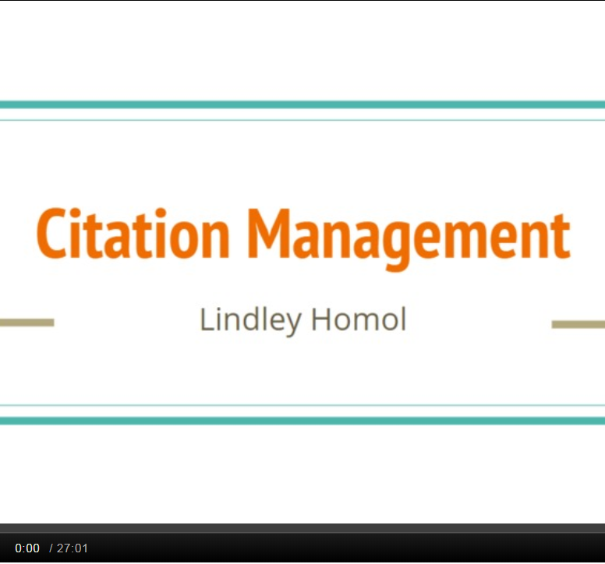
The Education videos weren’t working
So I suggested library webinars, scaffolded to specific courses and course assignments

Slide 39
Education webinars
Scaffolded to Intro to Doctoral Studies course assignments
Answered and gave context to repeat questions
Offered live meeting option for interested students
Webinar recorded for asynchronous viewing

Slide 40
Webinar engagement

Slide 41
Webinar engagement

Slide 42
Why did the webinars succeed?

Slide 43
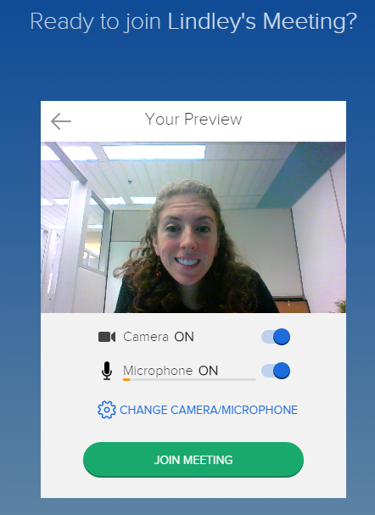
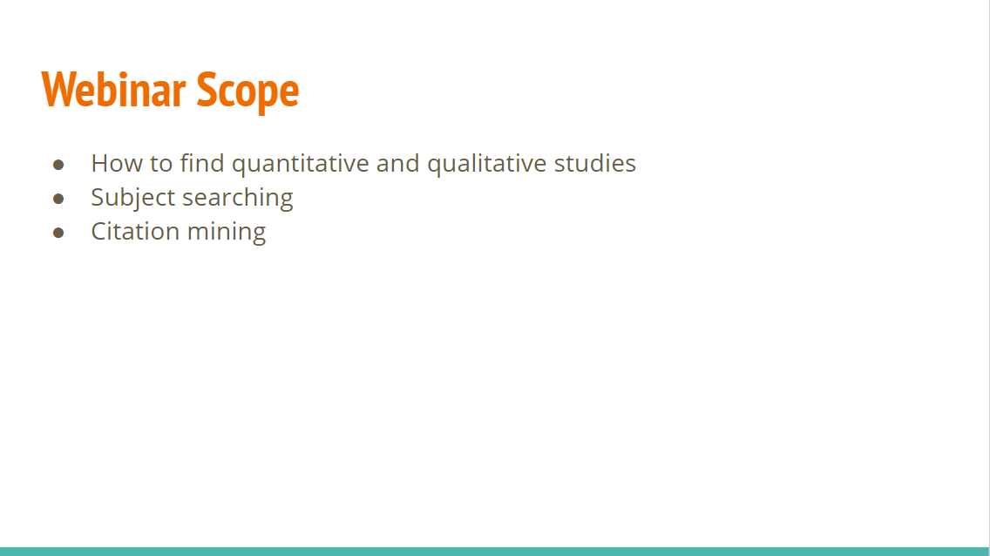
Scaffolding & Personalization
Targeted specific assignments and questions
Created a sense of community

Slide 44
Promotion
Entire doctoral program received an email blast about the first round of webinars
Schedules and links to live sessions and recordings included in classrooms

Slide 45
Questions?
l.Homol@northeastern.edu

