Slide 1
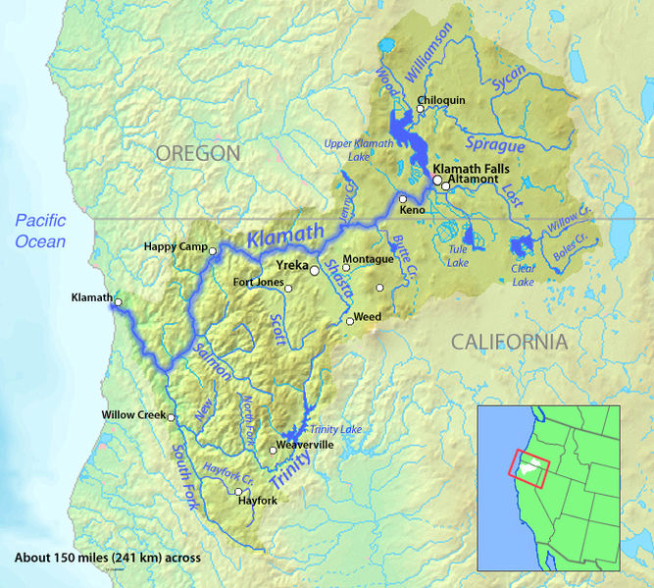

Slide 2
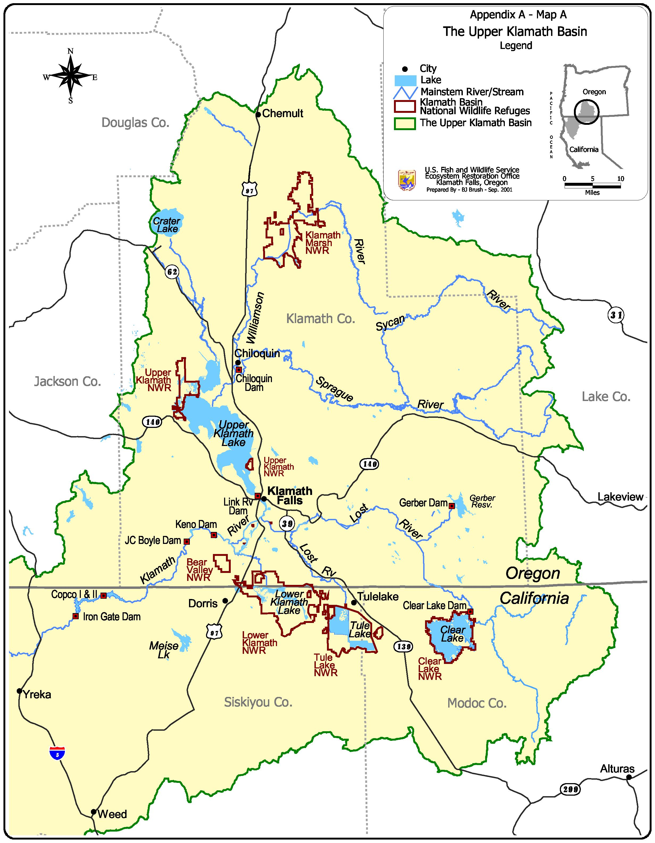
Notes:
Population K Falls about 21,000, about 50,,, for entire region: More cattle than people outside the cite of KF

Slide 3
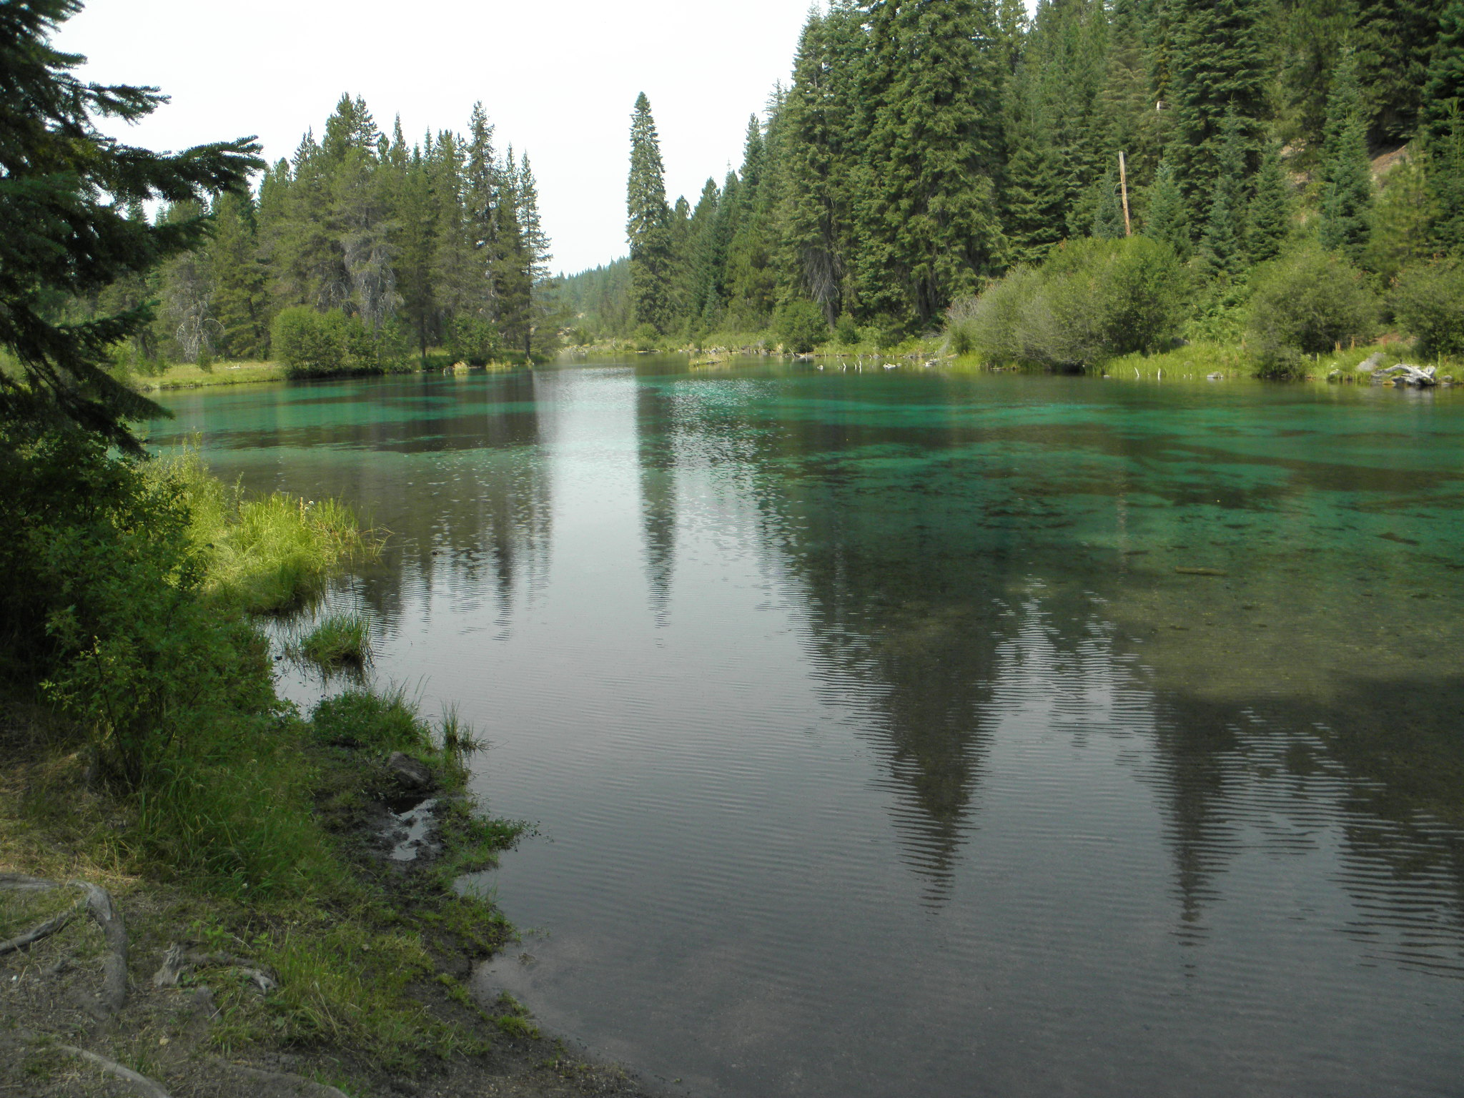

Slide 4
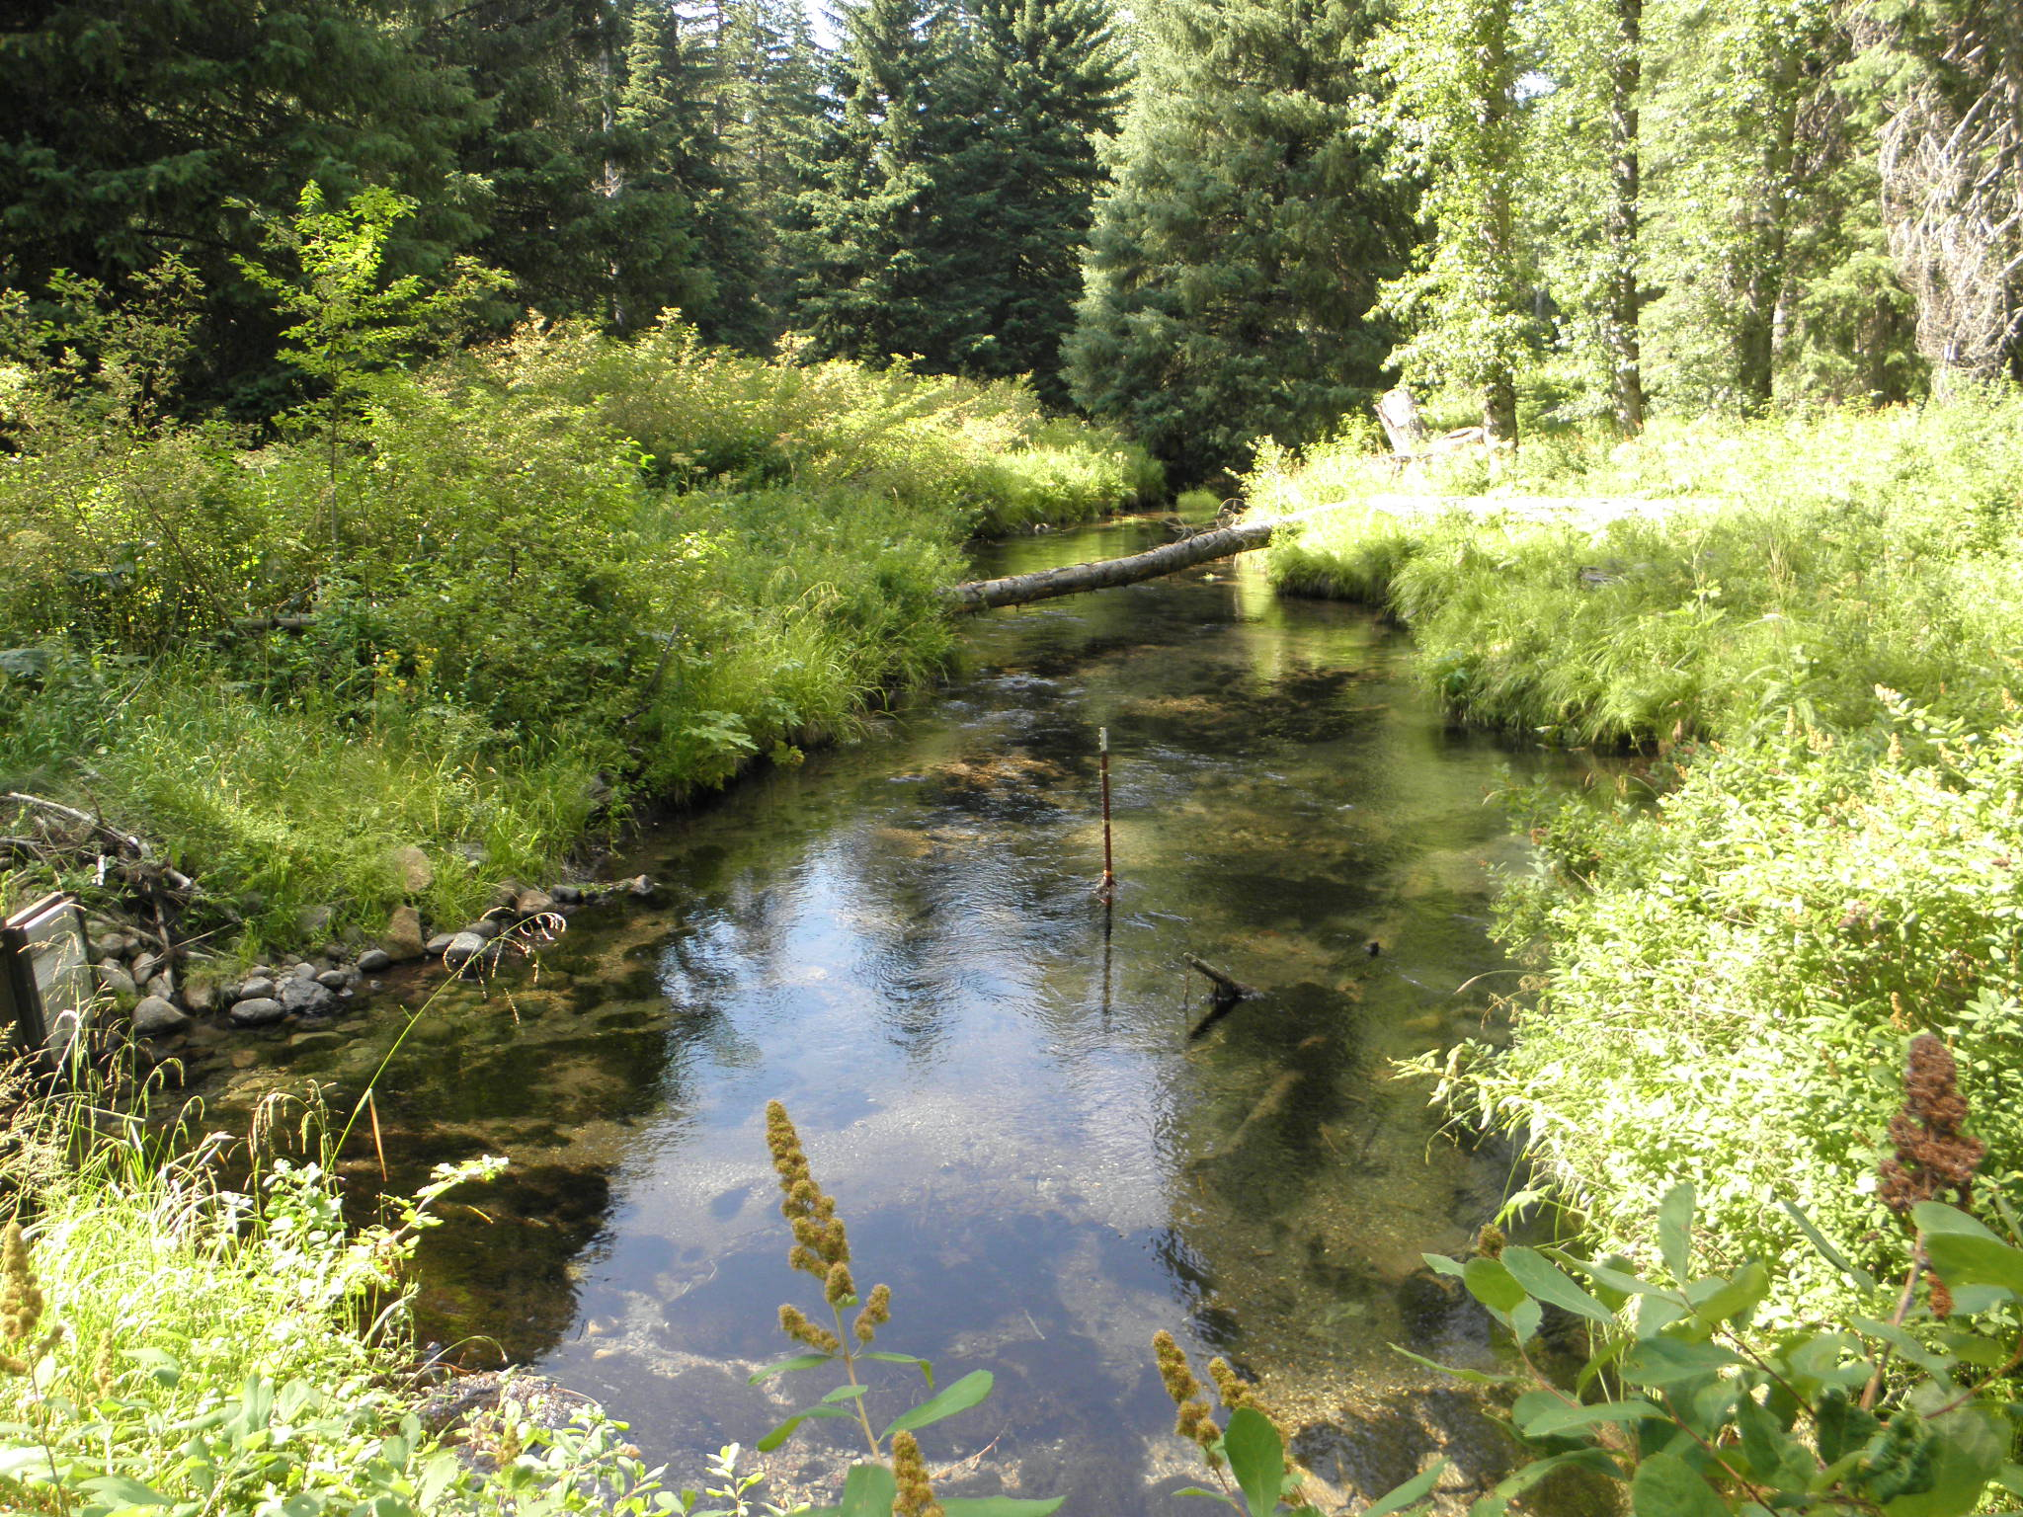

Slide 5
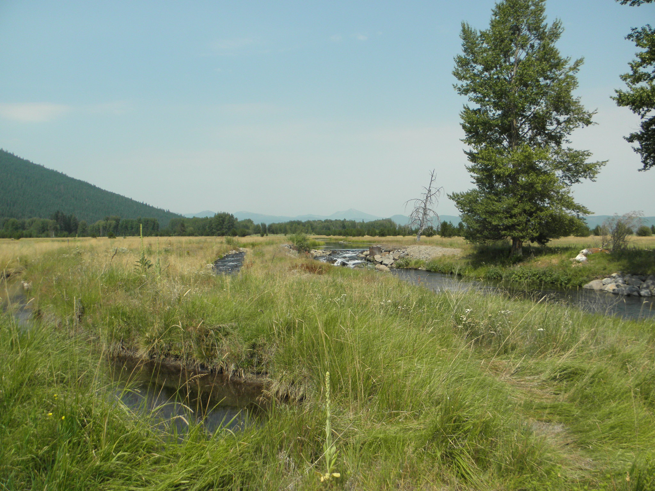

Slide 6
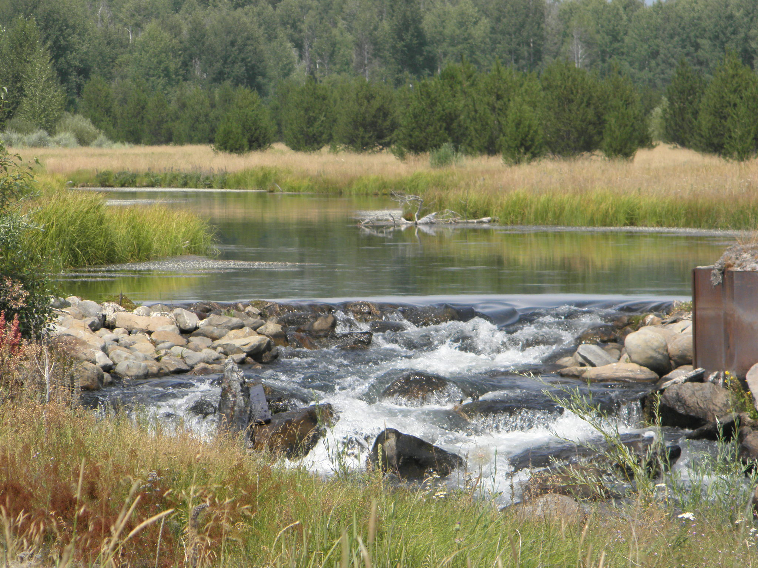

Slide 7
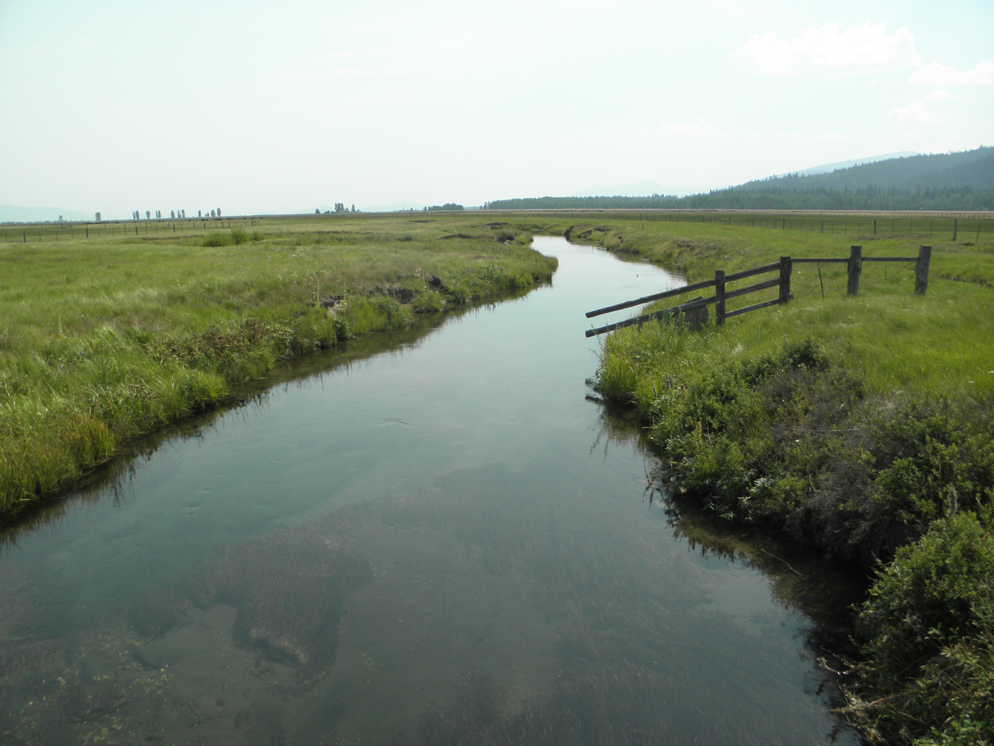

Slide 8
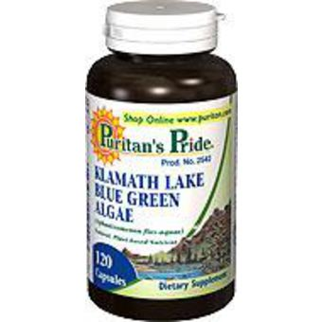

Slide 9
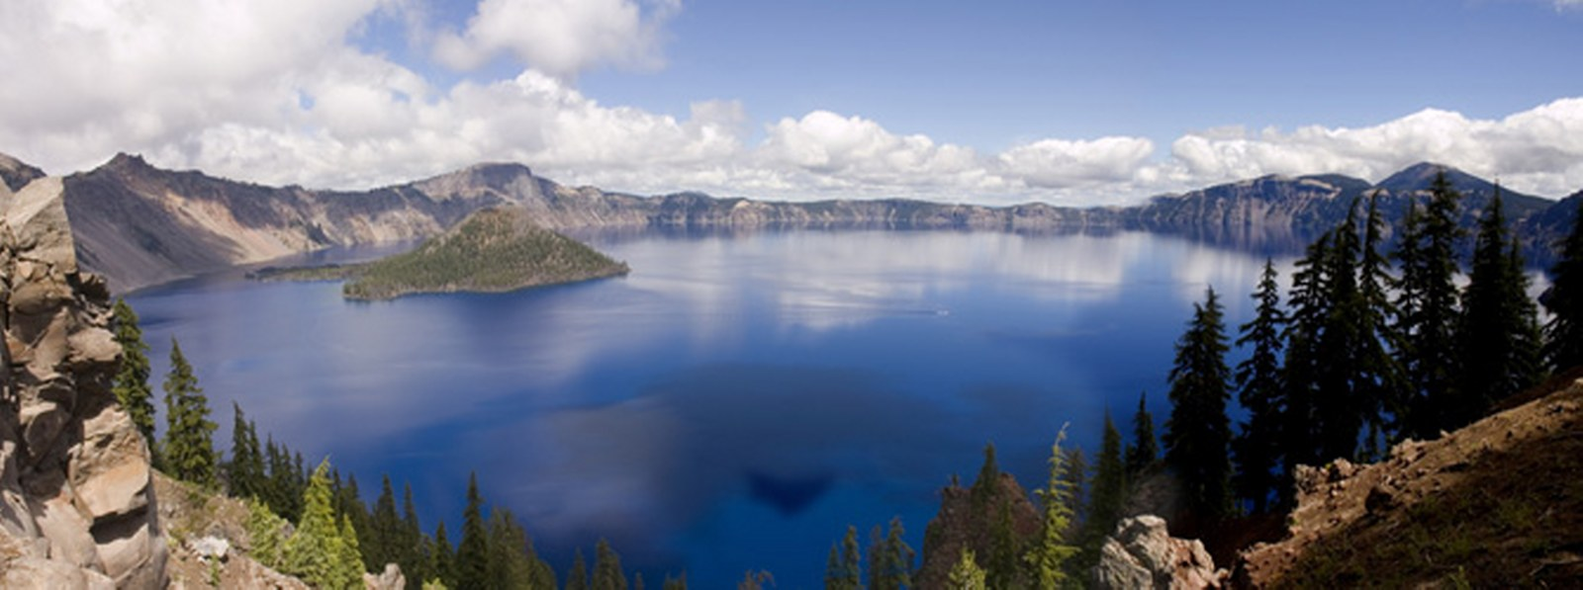
WILD-GROWN KLAMATH LAKE BLUE-GREEN ALGAE

Slide 10
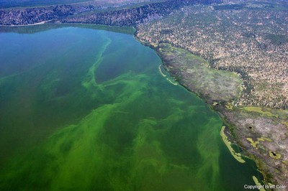

Slide 11
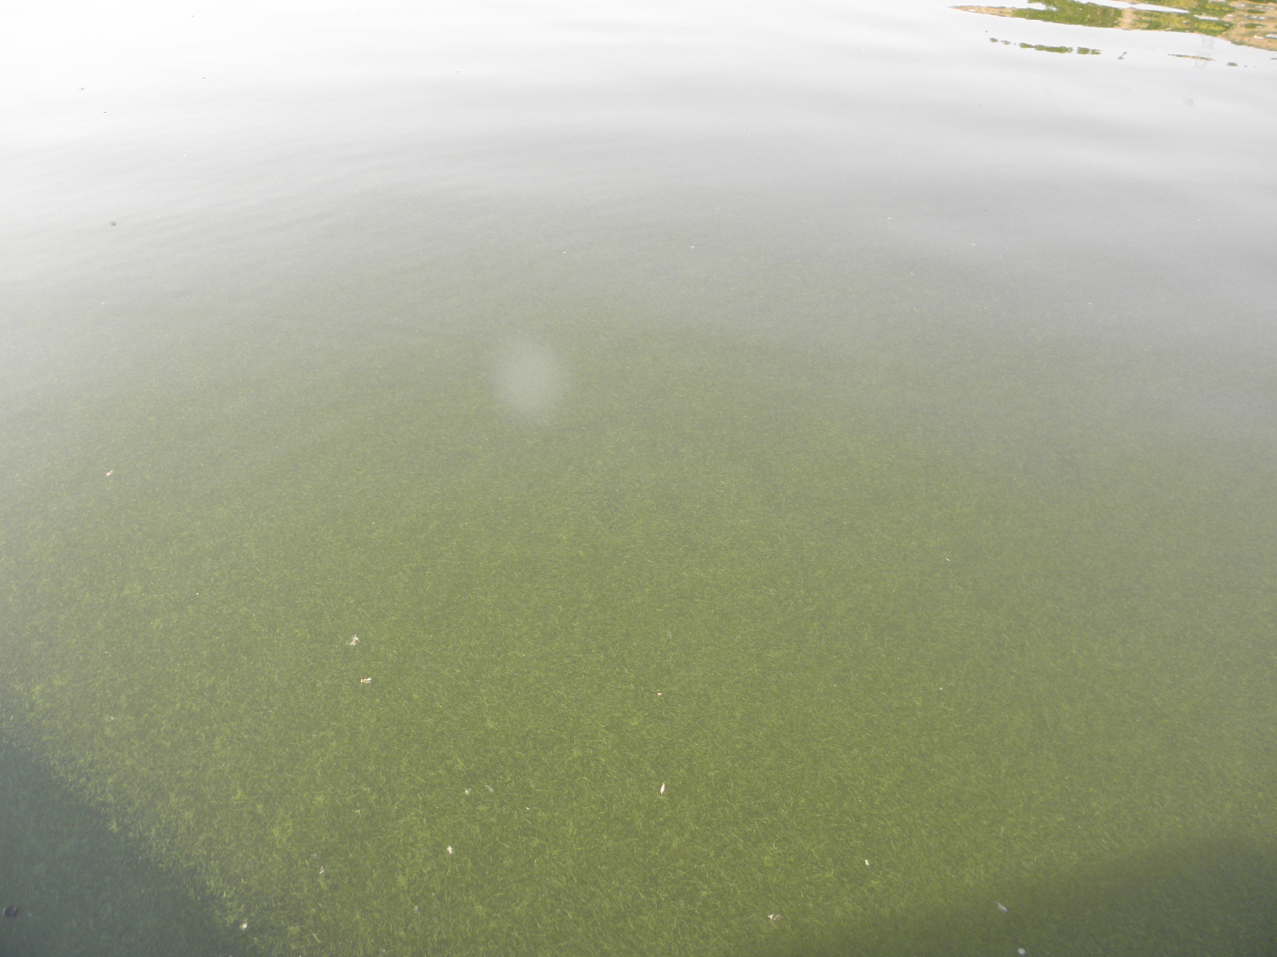

Slide 12
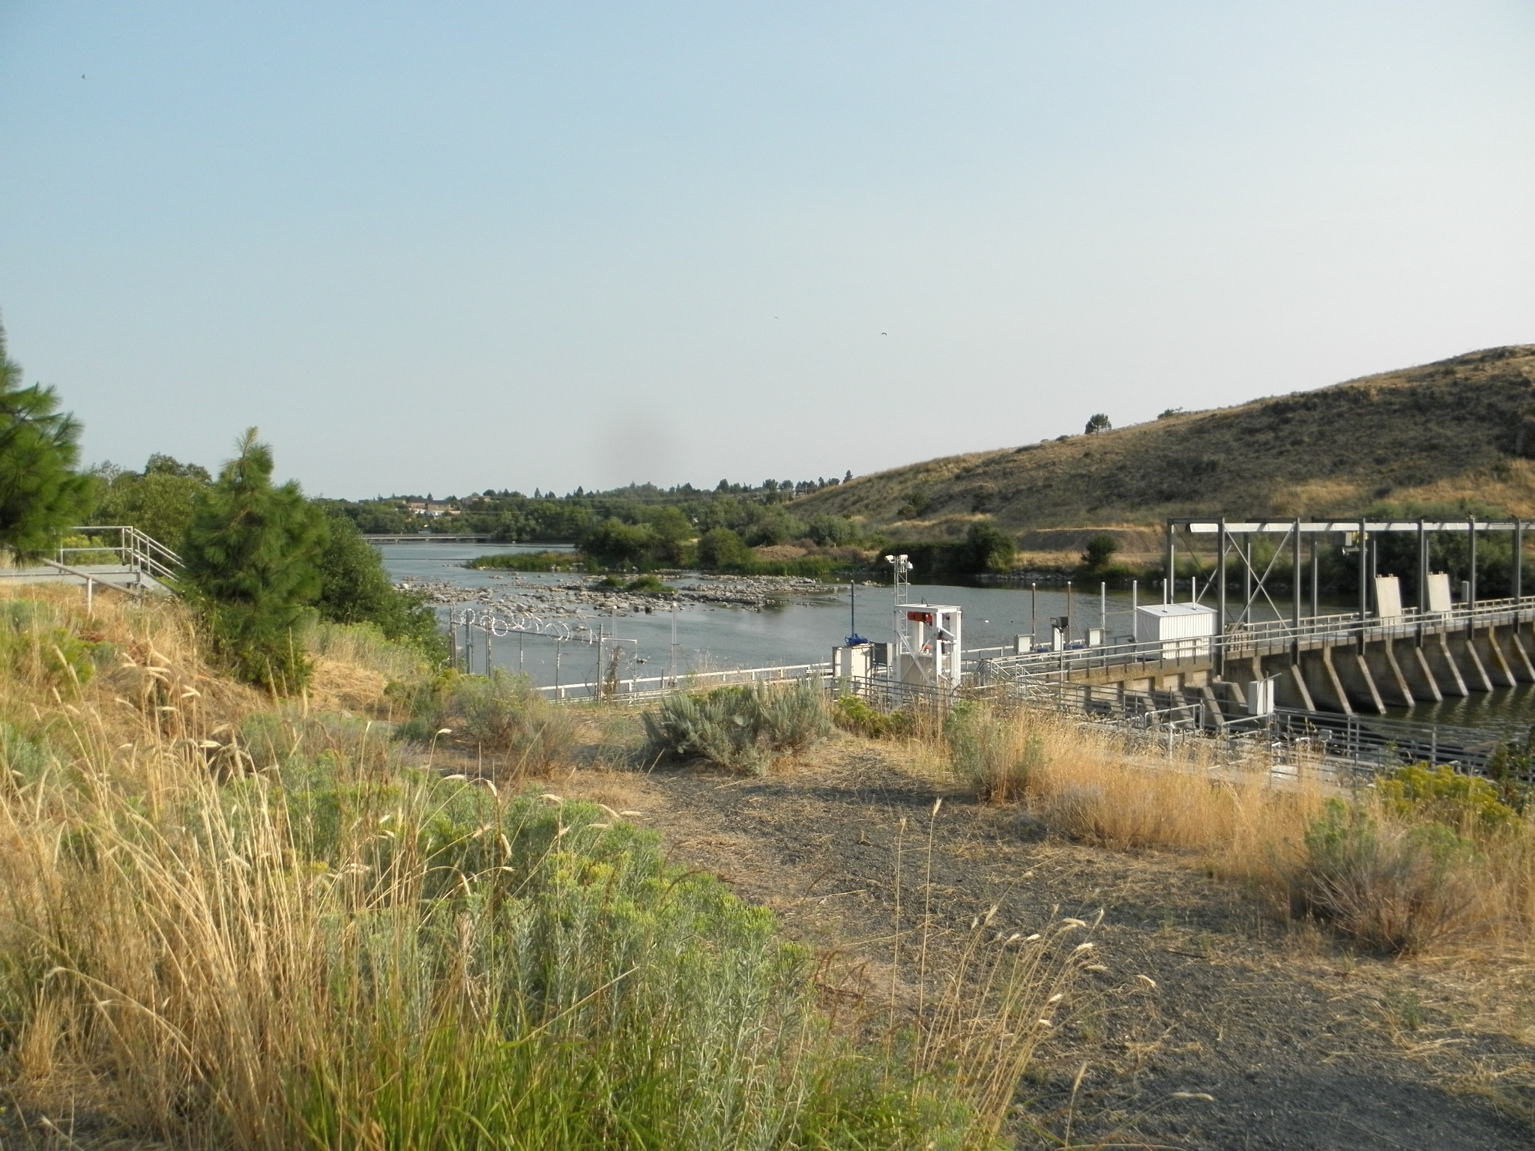

Slide 14
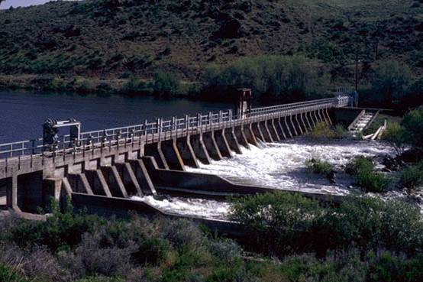

Slide 15
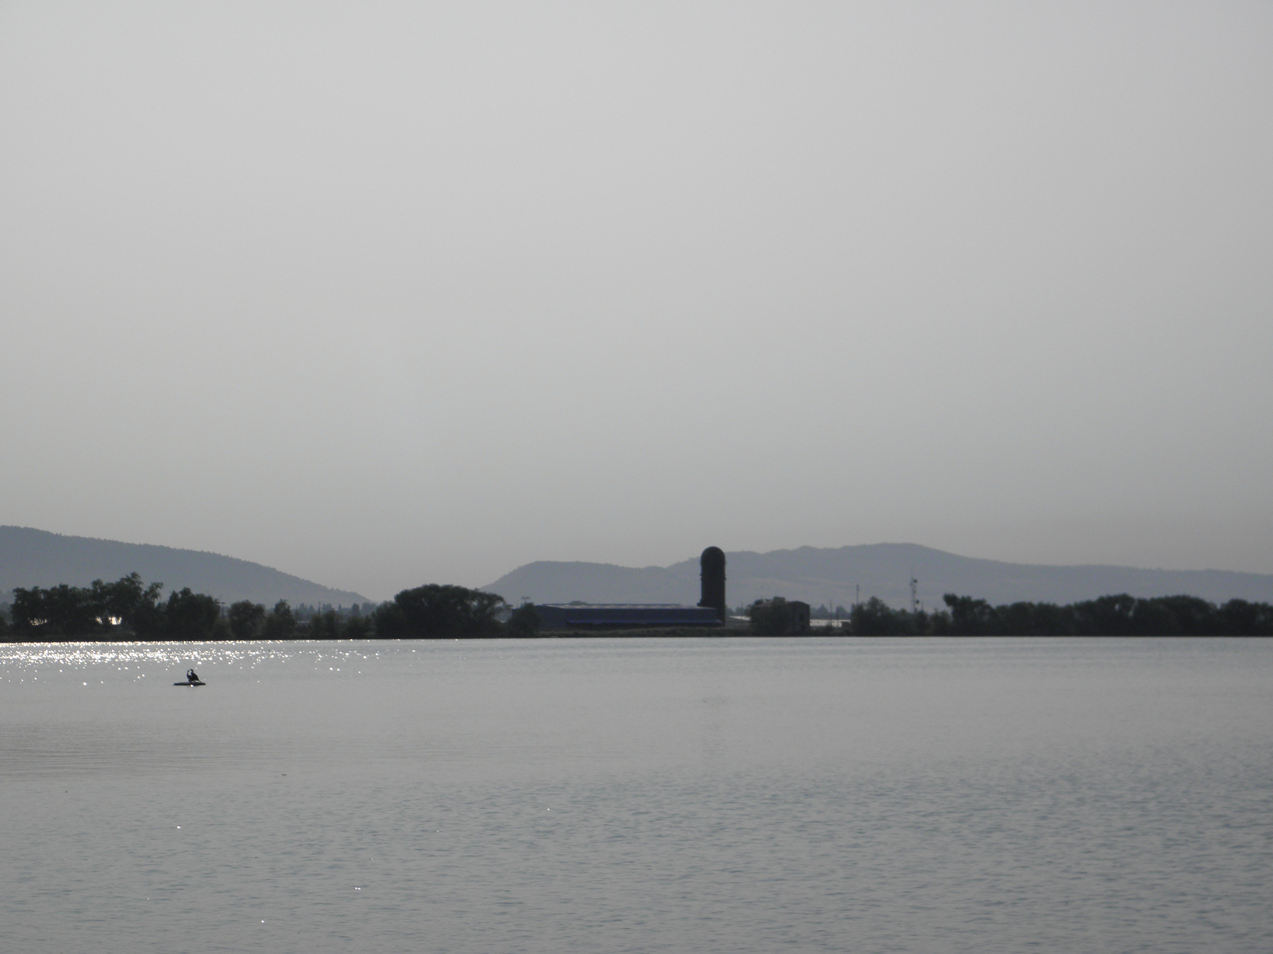

Slide 16
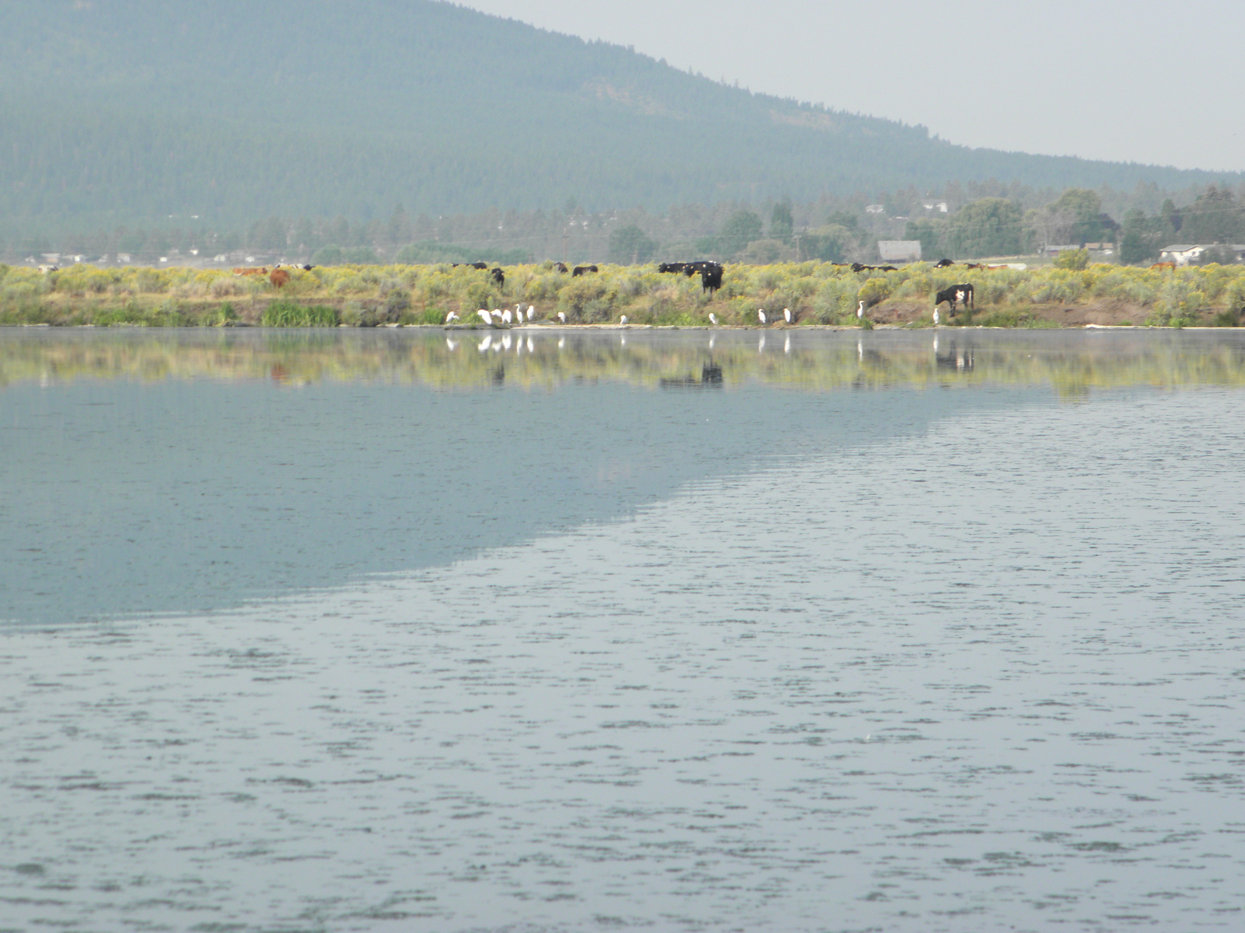

Slide 17
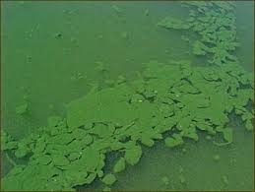

Slide 18
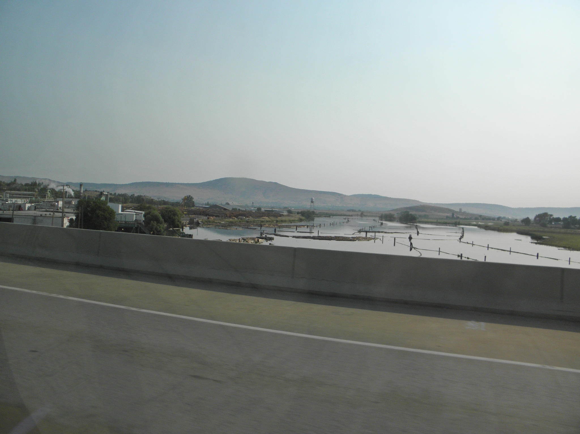

Slide 19
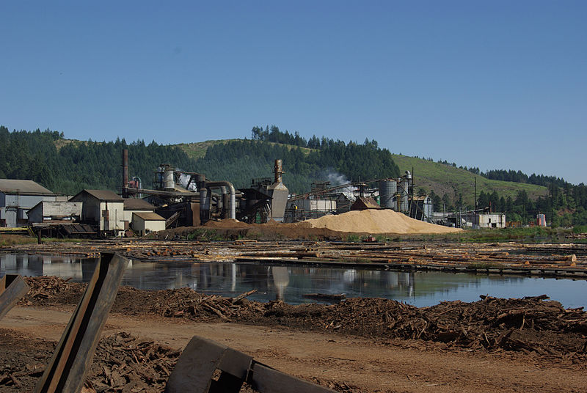

Slide 21
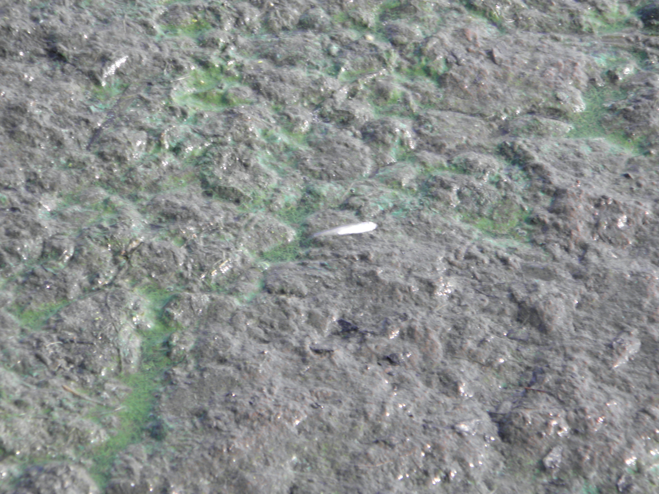

Slide 22
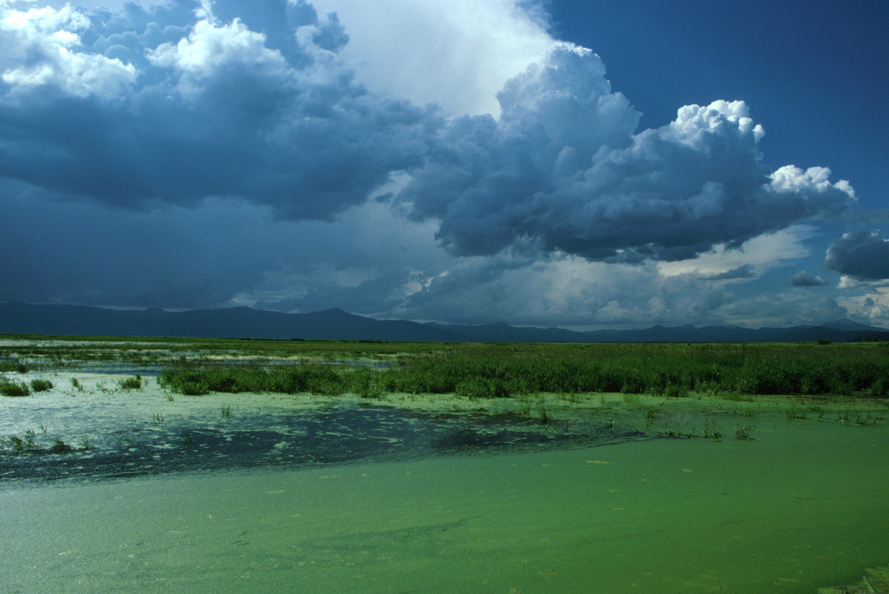

Slide 23
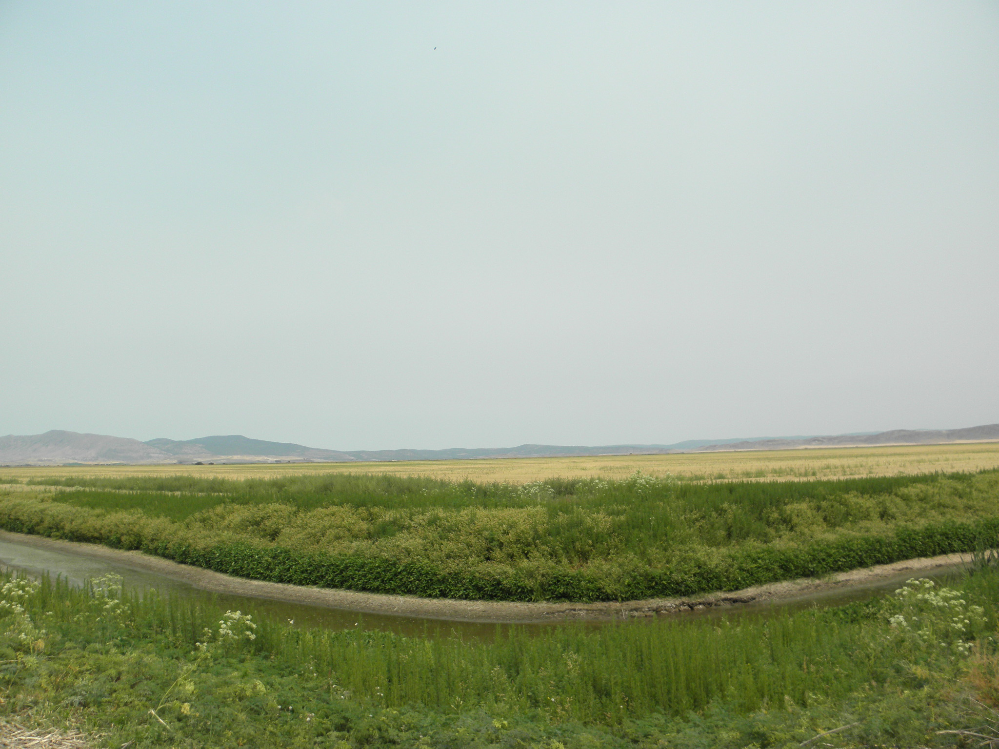

Slide 24
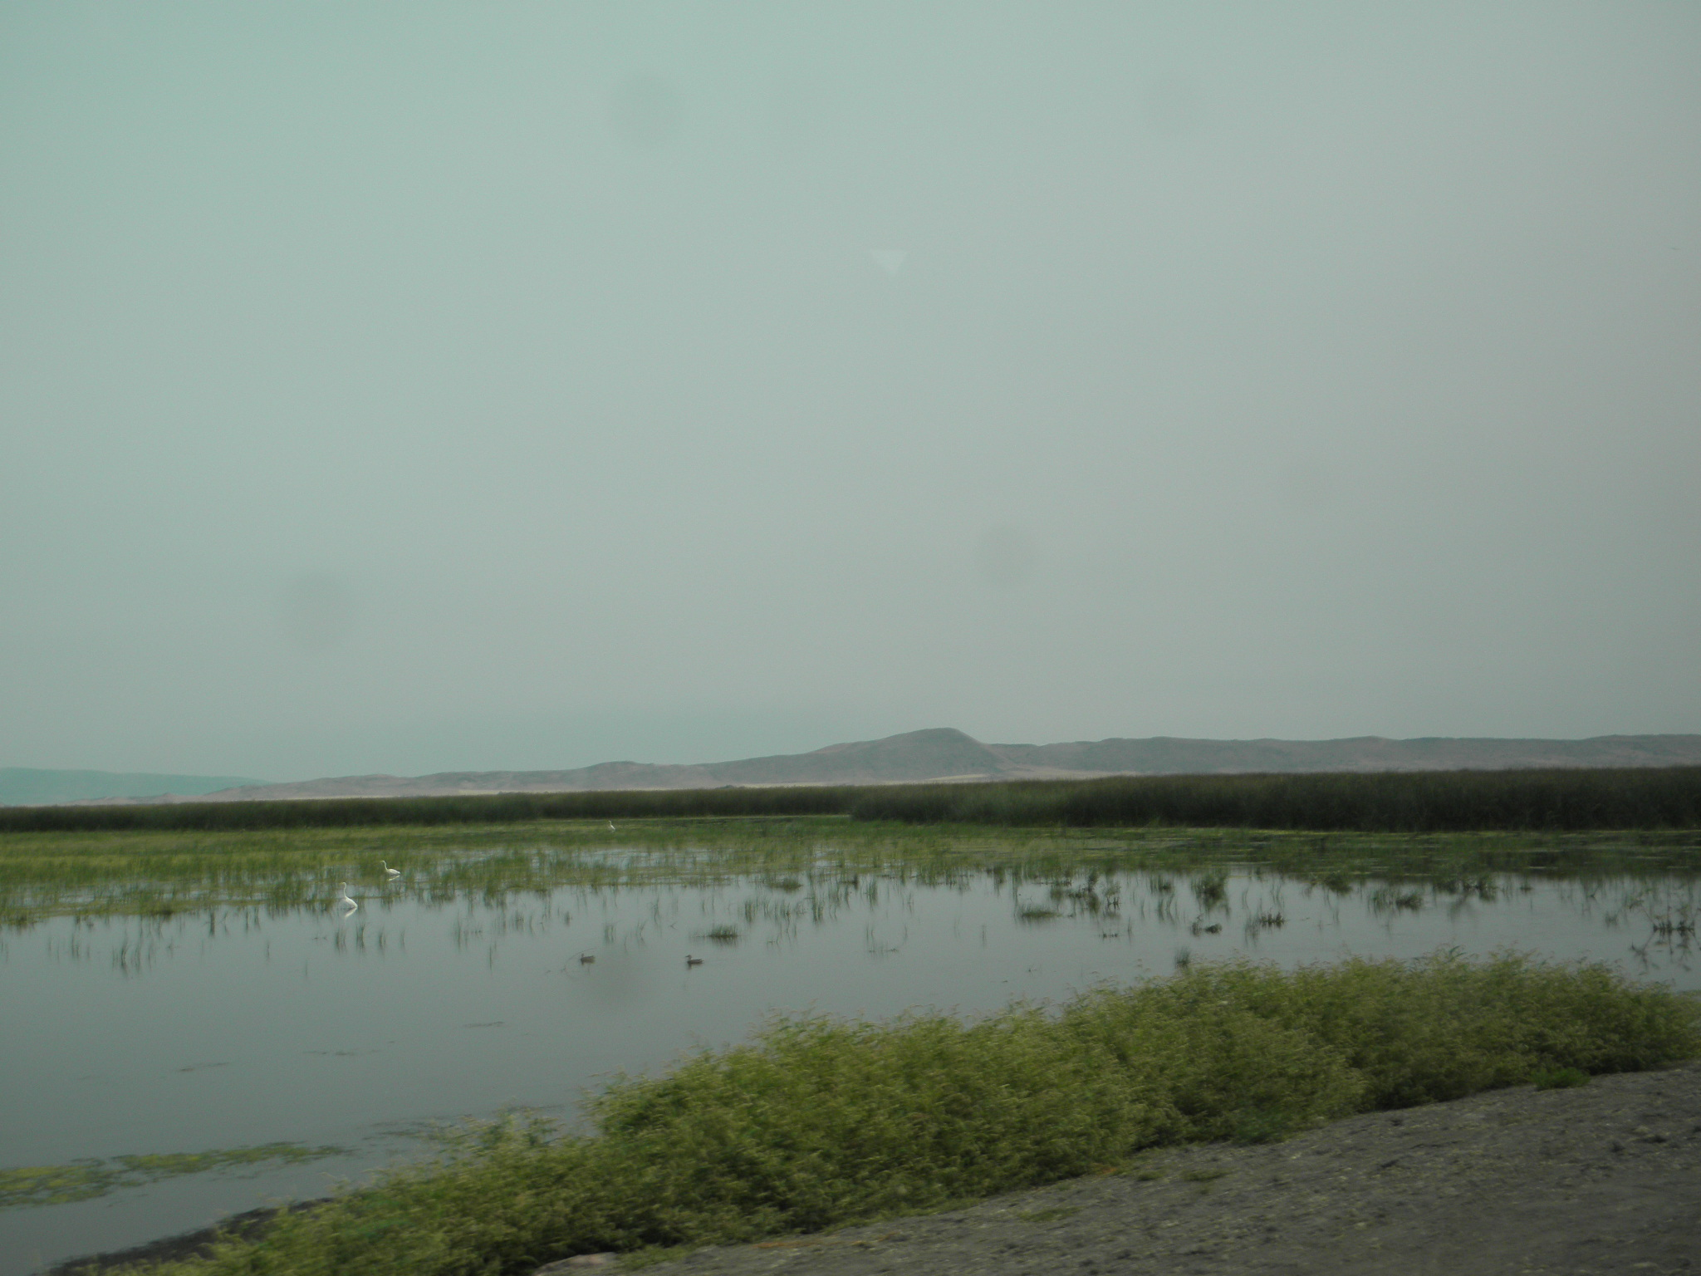

Slide 25
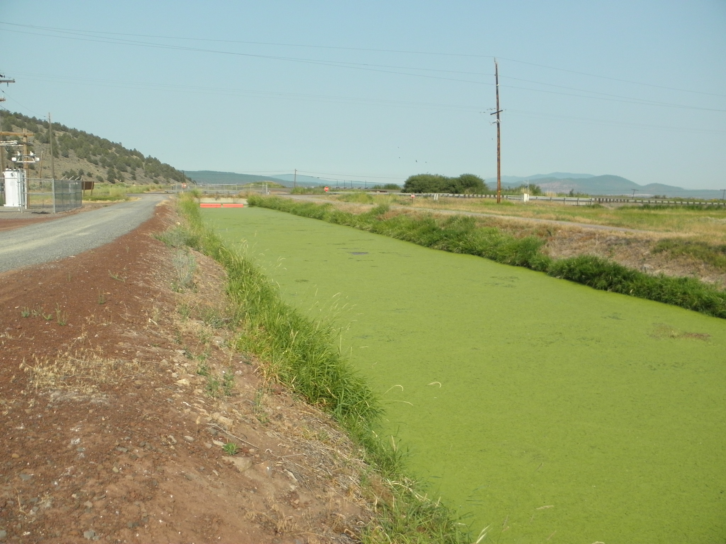

Slide 26
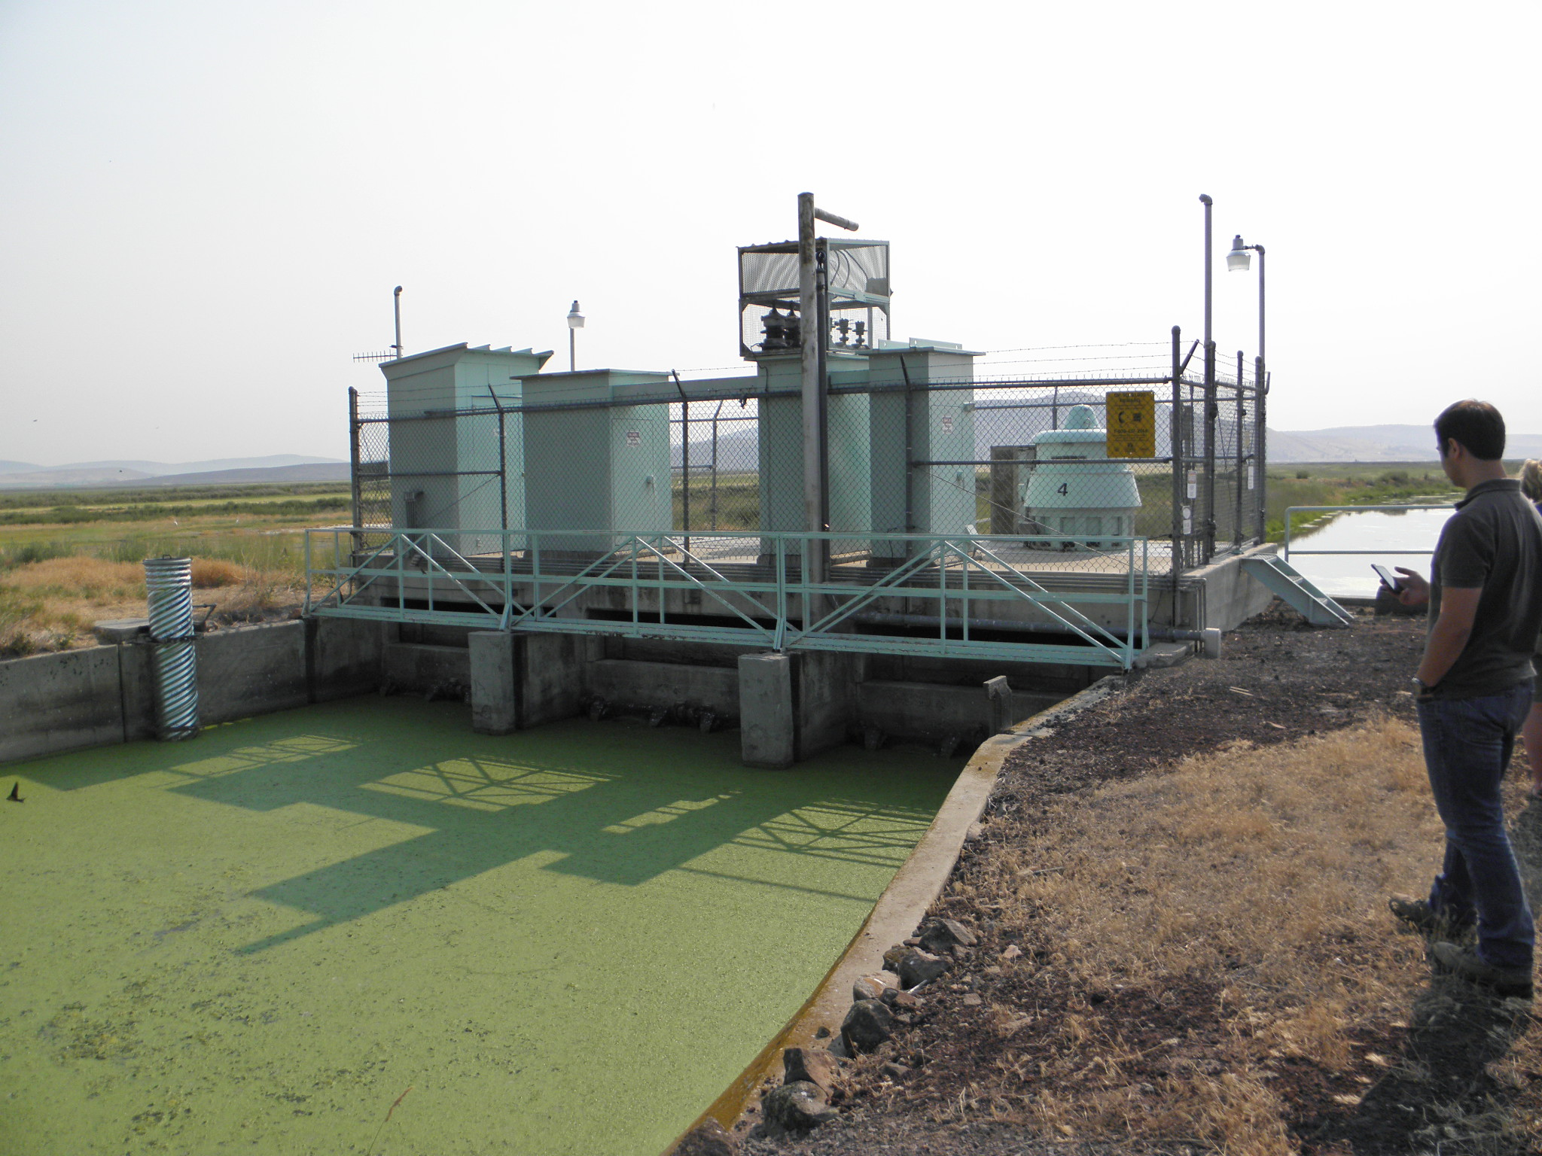

Slide 27
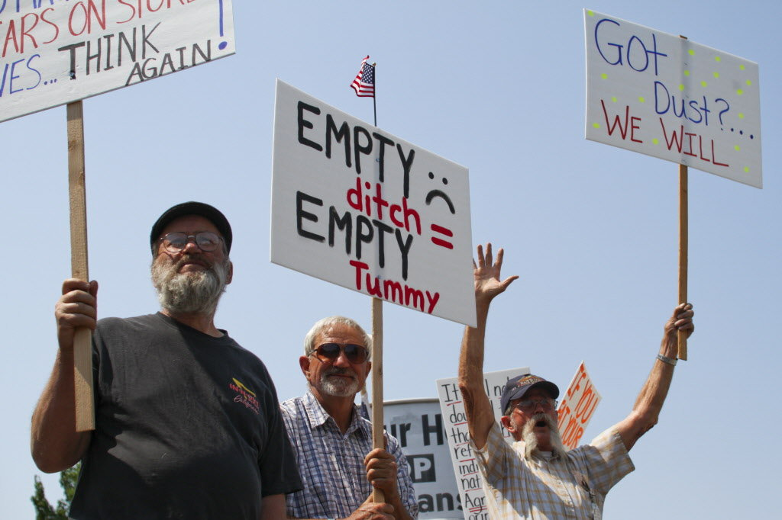

Slide 28
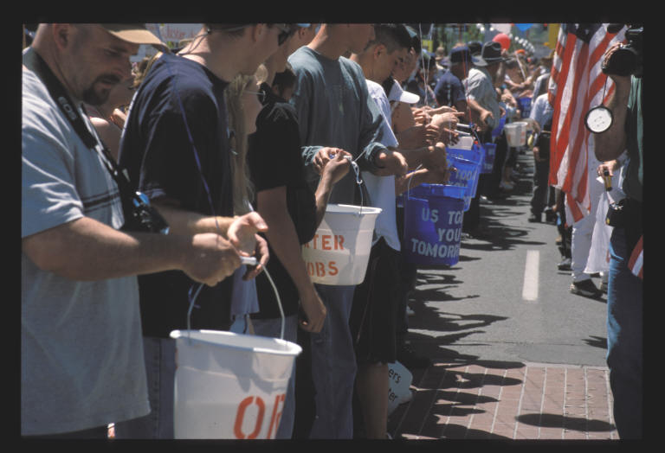

Slide 29
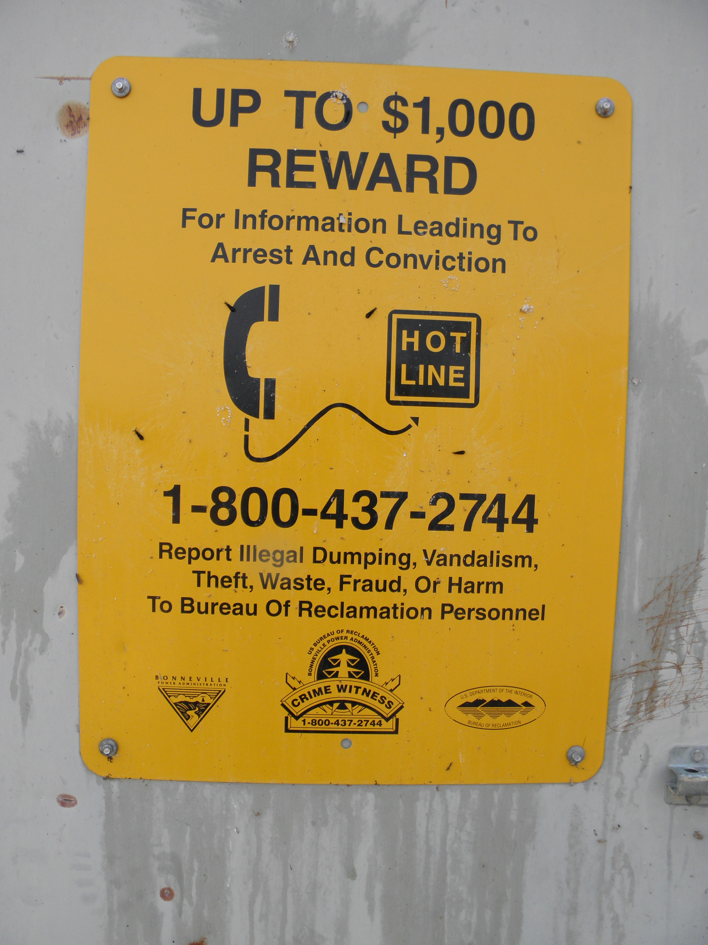

Slide 30
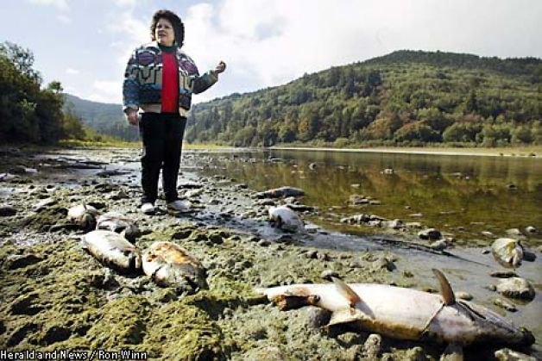

Slide 31
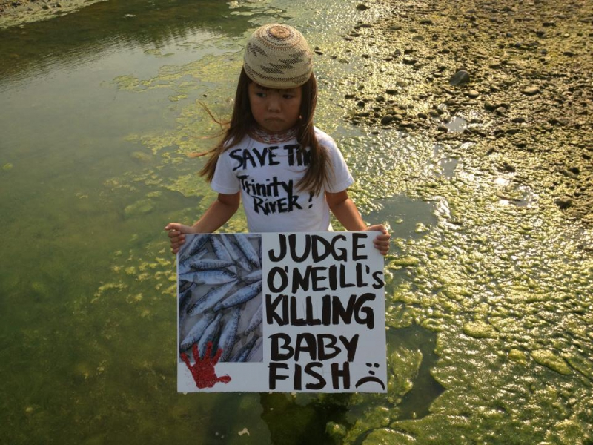

Slide 32
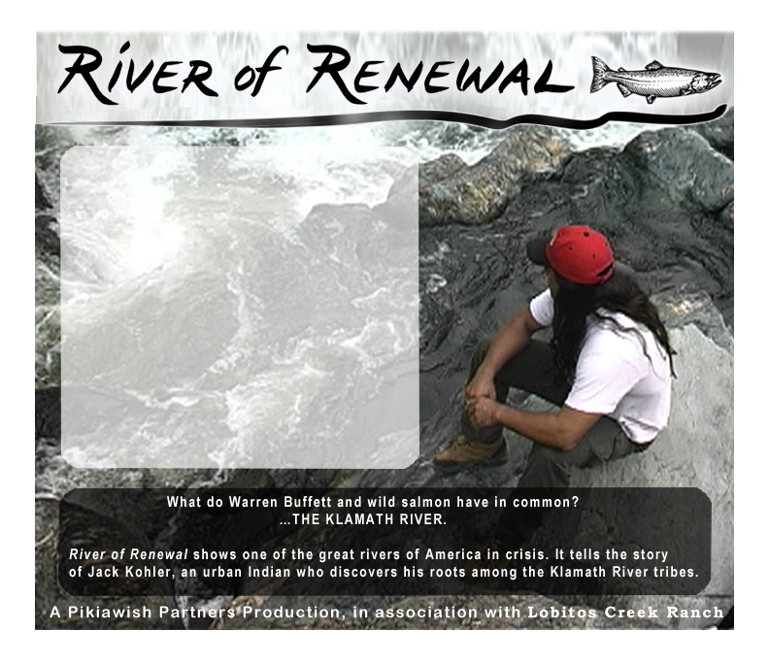

Slide 33
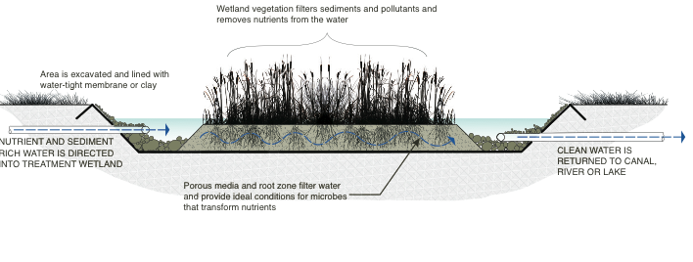

Slide 35
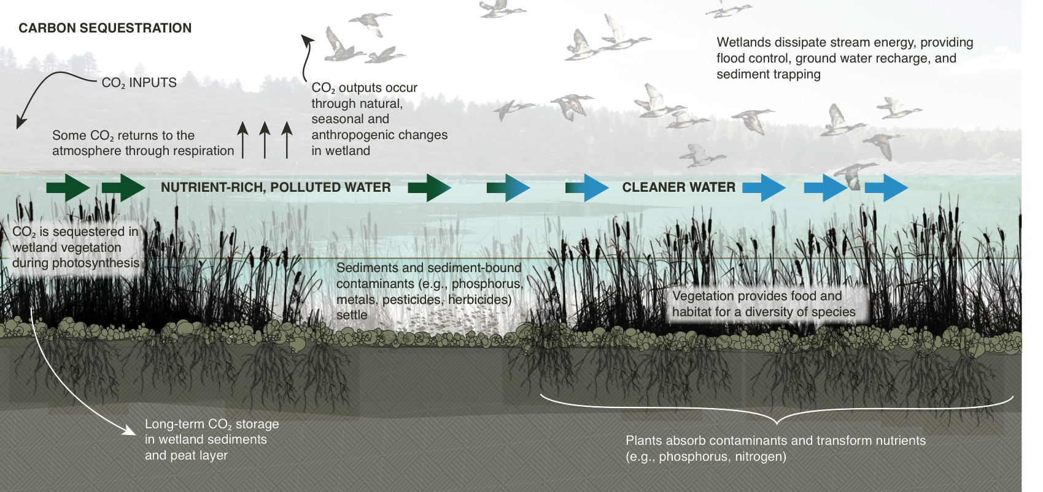

Slide 36
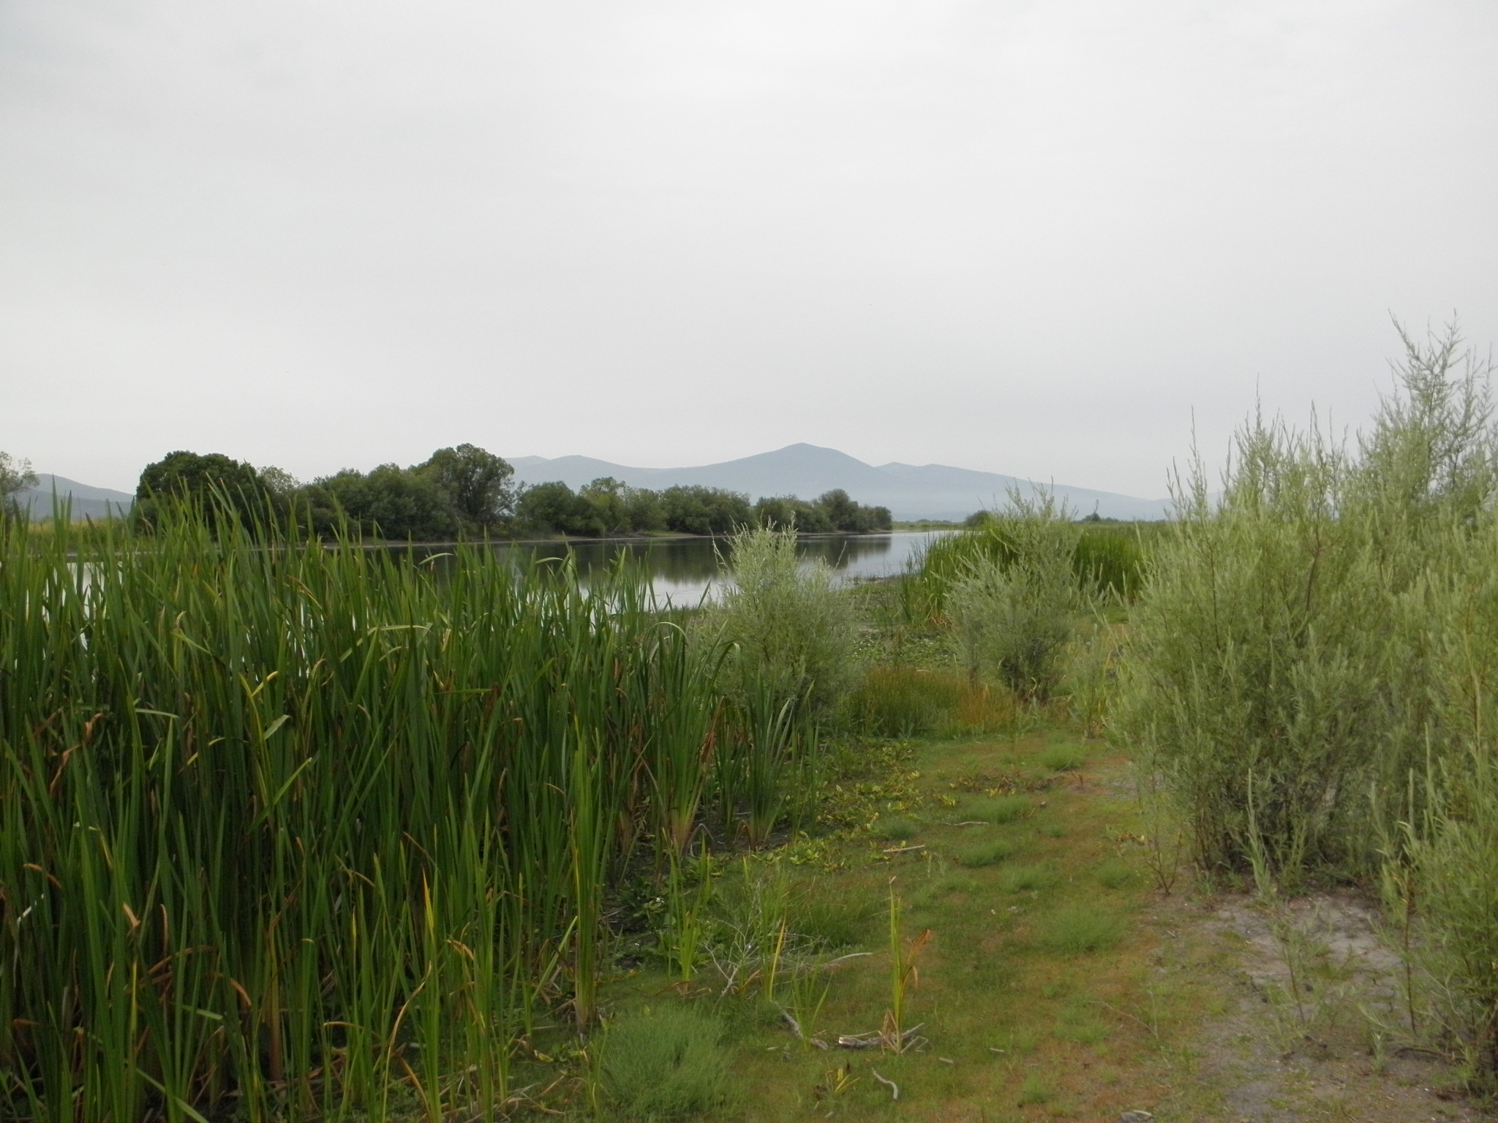

Slide 37
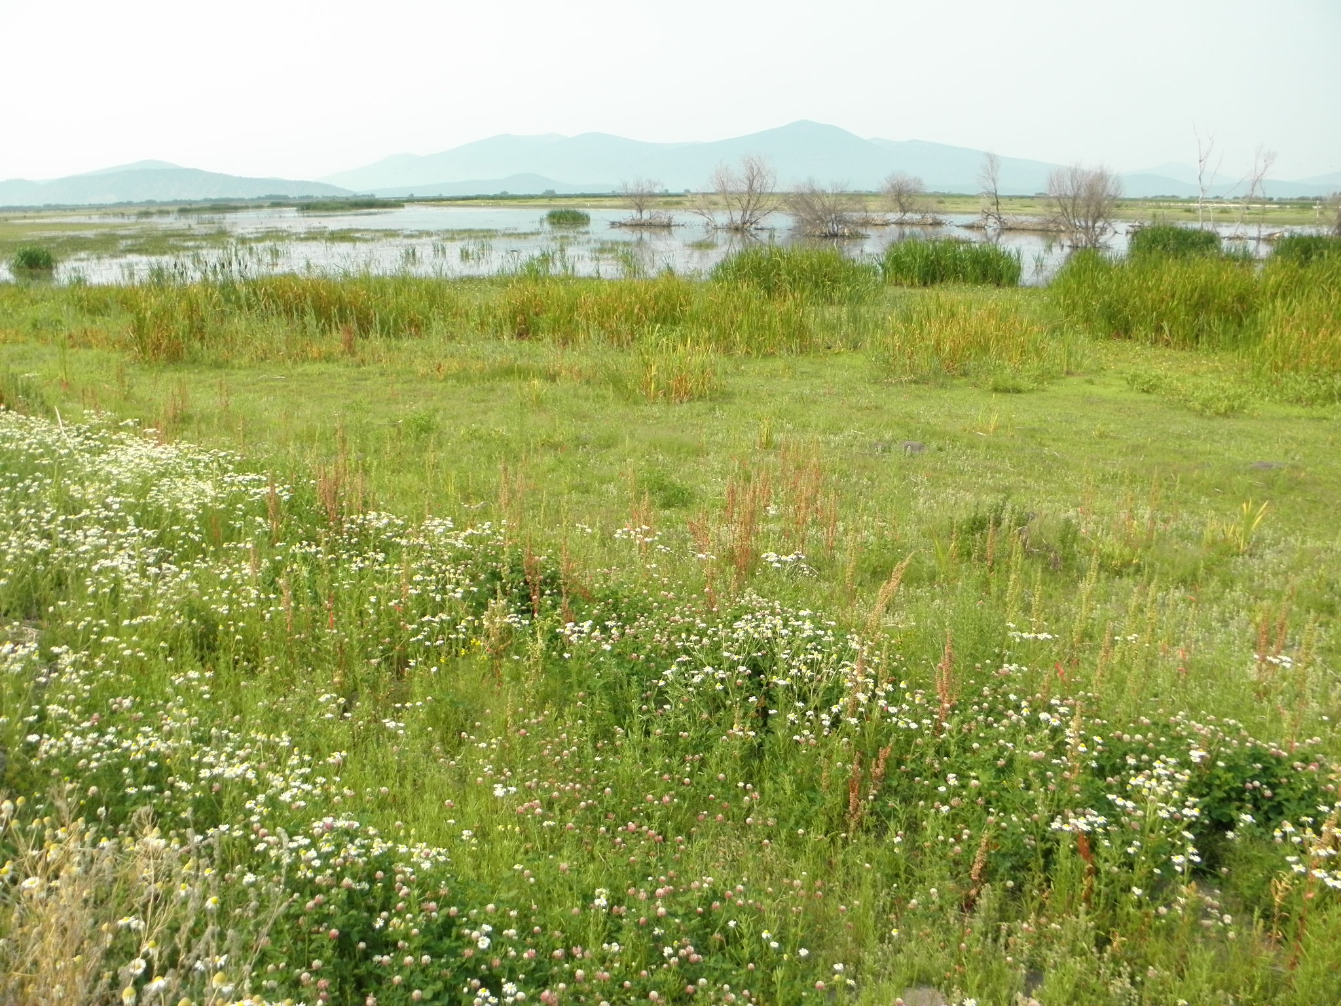

Slide 38
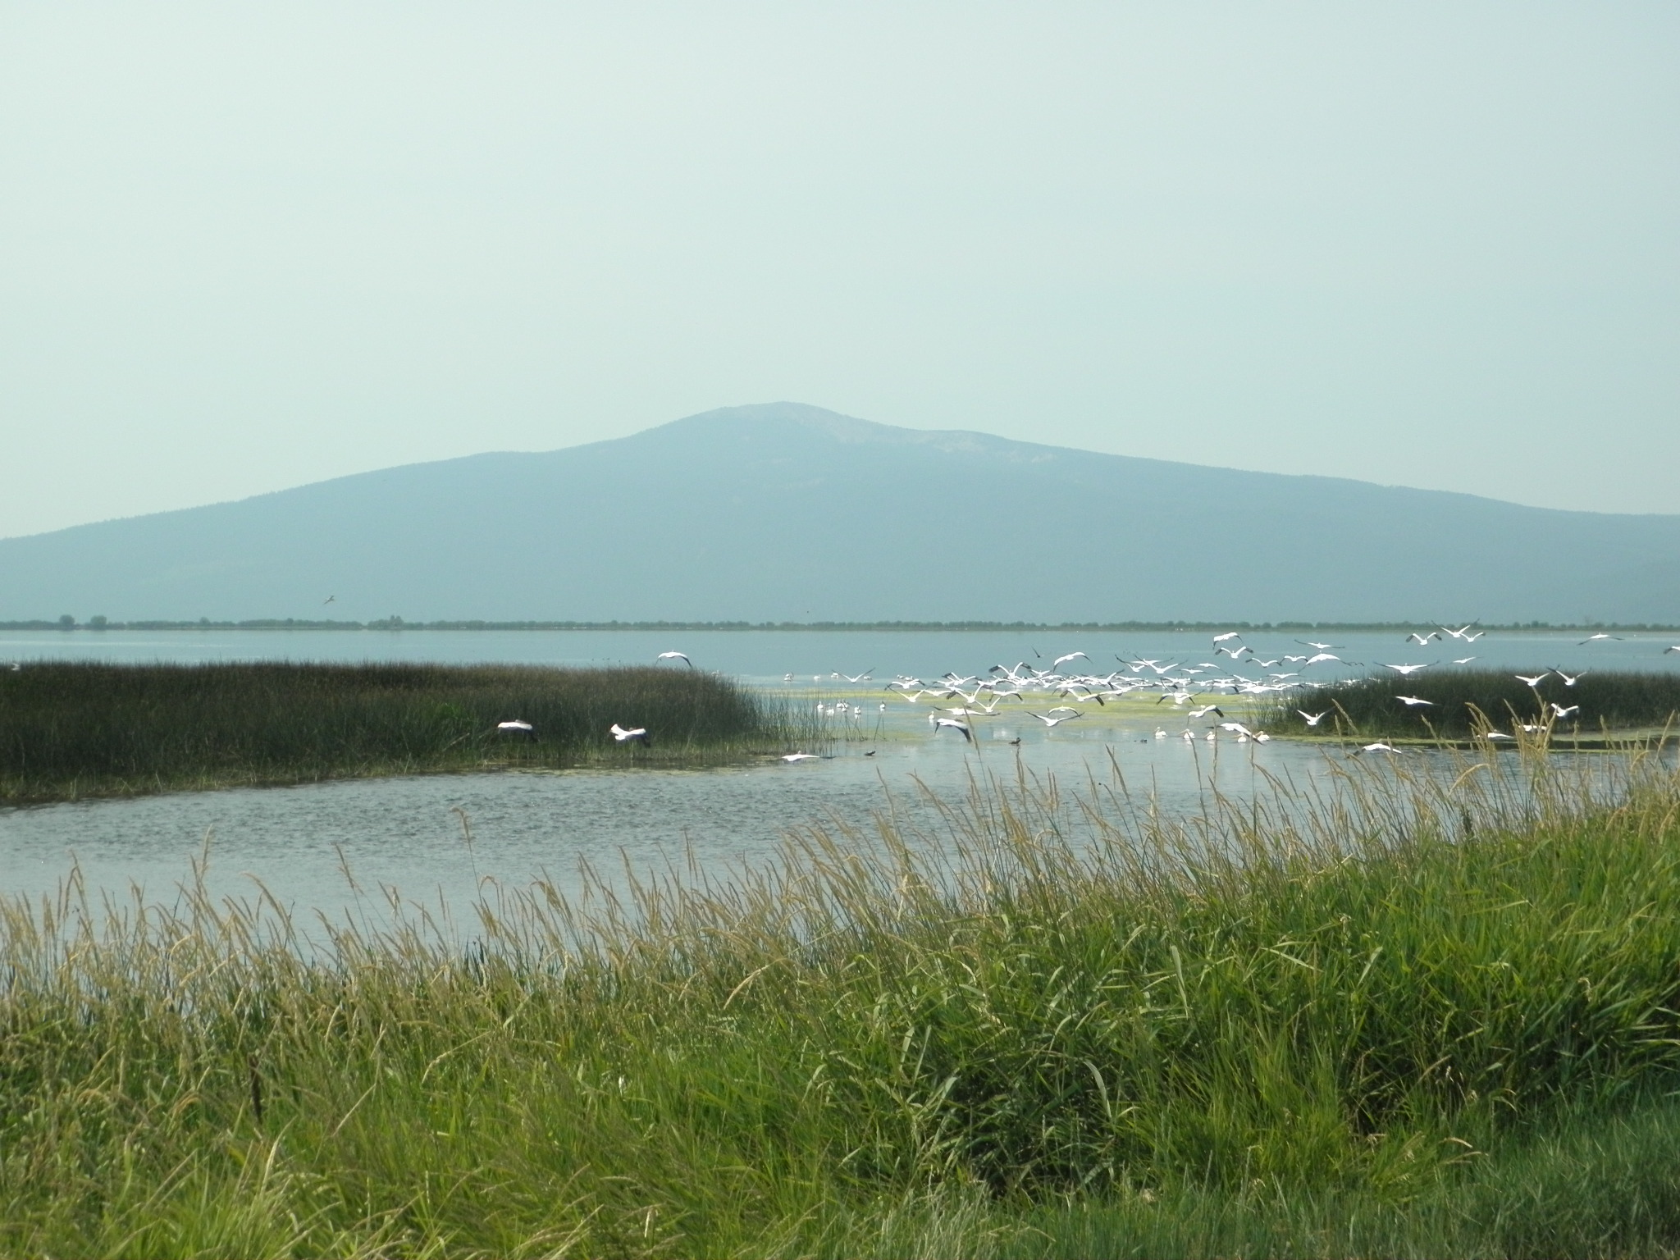

Slide 40
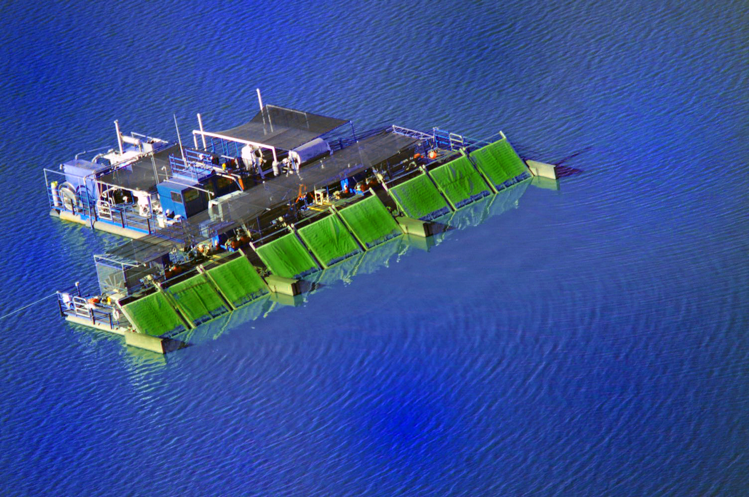

Slide 41
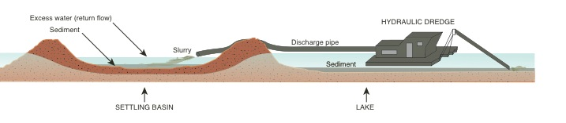

Slide 42
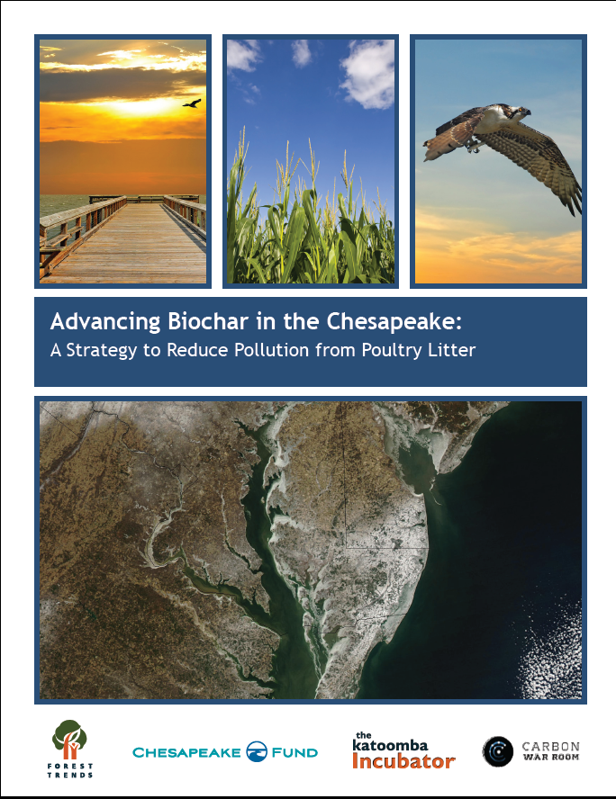
Current Resources

Slide 43
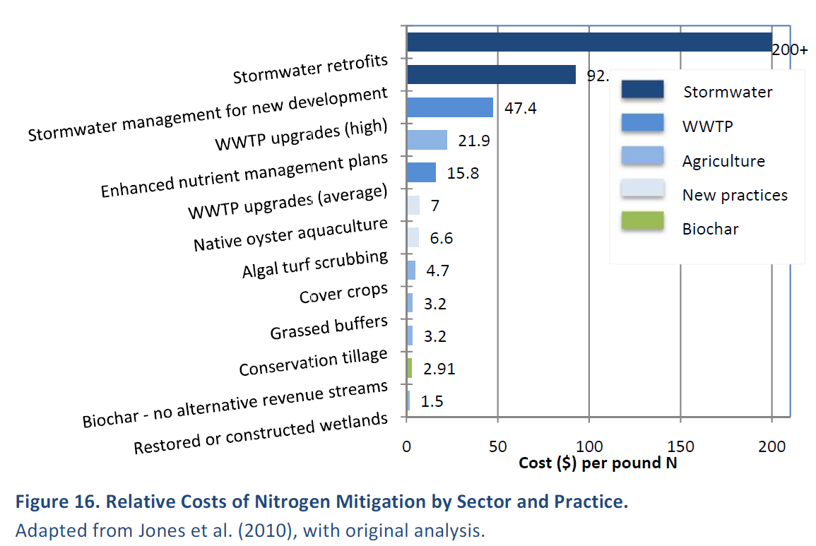
Relative Costs of Nitrogen Mitigation by Sector and Practice

Slide 44
"The United States Environmental Protection Agency (USEPA), Pacific Southwest Region is exploring the potential for biochar to improve surface and ground water quality. USEPA also promotes the effective reuse of waste materials and practices that help mitigate the impacts of climate change. Our review of the literature indicates biochar is especially well suited for nutrient removal from water, and in improving soil structure and fertility that could result in reduced sediment loading of surface waters. Research has also demonstrated biochar's carbon sequestration capacity and its cost effectiveness when a feedstock that is considered a waste product of an industrial process is available near biochar production facilities. As most biochar research has been conducted at the laboratory- or bench-scale, large-scale field applications of biochar practices and technologies are needed to demonstrate the ability of biochar to prevent nutrients and sediment from entering surface and/or ground water." Eric Byous Sustainable Infrastructure Office (WTR-4) USEPA, Region 9

Slide 45
