Slide 1
Interlibrary Loan & Document Delivery
C&D Showcase
15 May 2019

Slide 2
Meet the team
Rachel
Kate
Michael
Tea
Steve
John

Slide 3
Borrowing
for our patrons from other libraries
~17,000 Article requests/year
  95% success rate
~10,000 Loan requests/year
  77% success rate
Lending
from our collections to other libraries
~20,000 Article requests/year
  65% success rate
~15,000 Loan requests/year
  62% success rate
Document Delivery
for our patrons from our collections
~5,800 Article requests/year
  99% success rate
~45 Loan requests/year
  99% success rate

Slide 4
2018 Top 5 Borrowing Cancellation Reasons
1,011 | We requested this item through the Five College Catalog for you.
472 | Cancelled by Customer.
181 | We have exhausted all possible sources.
178 | This is a duplicate request.
159 | The full text of this item is available online.

Slide 5
New This Year
Improve Access and Discovery
Advance Staff Development
Implement Accessibility Standards
Streamlining
Student Employment Success
Support Affordability
Internal & External Partnerships

Slide 6
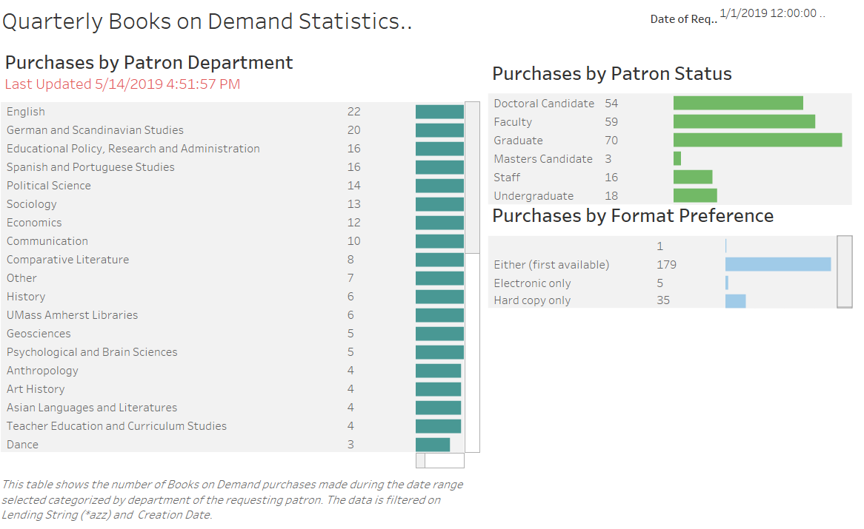
Streamlining
Internal & External Partnerships
Improve Access and Discovery
Books on Demand Statistics in Tableau

Slide 7
Return Shipping for Library Express Items
Since January 2019, Interlibrary Loan provides a paid return labels with books mailed to UMass Amherst distance patrons beyond the Pioneer Valley
Support Affordability
“Library Express is amazing. It has changed my scholarly life. I can't believe I didn't know about it for my first three years at UMass. The only suggestion I have is to advertise it more widely, so that faculty who are far from campus--like myself--can make use of it. And the shipping return label is just icing on the cake. Simply amazing.”
- Faculty member in Political Science
Improve Access and Discovery

Slide 8
16 Week Loans to RapidR Libraries
Increasing our loan time benefits both borrowing and lending libraries by:
Saving Interlibrary Loan staff time coordinating requests for renewals from other libraries, or processing requests for a new copy of the same material
Reducing shipping costs, as patrons will be more likely to use a single copy rather than requesting a second copy as their material comes due
Improving patron experience, as they do not need to spend time reaching out to the Interlibrary Loan department, worrying about due dates, or waiting for a new copy of the book they need
Streamlining
Improve Access and Discovery
Internal & External Partnerships

Slide 9
Evaluating OCR Options (Summer 2019)
Optical Character Recognition (OCR) is a bare baseline for accessibility
All scans we create have OCR...
...but we have no control over what we receive from other libraries!
This summer, we begin testing software options to solve this
Implement Accessibility Standards
Internal & External Partnerships
Streamlining

Slide 10
Future of Resource Sharing Management Systems

Slide 11



Atlas Systems (OCLC)
OCLC
Project Bedrock
RapidILL
IndexData
“Next Gen Resource Sharing”
ExLibris

Slide 12
ILLiad
9.1 - Scheduled for August 2019
Fully Accessible/Responsive Web Pages
Enhanced Rapid/RapidR Integration
Authentication Enhancements
Automatic User Creation
Improved addon support & automation
9.2 - Scheduled for May 2020
HTML Email
Native NCIP Support
Shipping Provider Integration
Renewals Process Enhancements
Smart Queues
New Print Templating System
(reports of ILLiad’s death were greatly exaggerated)

Slide 13
?
Questions?

