Slide 1


THE OPEN HUB
Six Years of a Collaborative OER Initiative
New England Faculty Development Consortium Fall Meeting
Nov 17, 2017
This work is licensed with a Creative Commons Attribution-NonCommercial 4.0 International license

Slide 2
What About You?

Slide 3
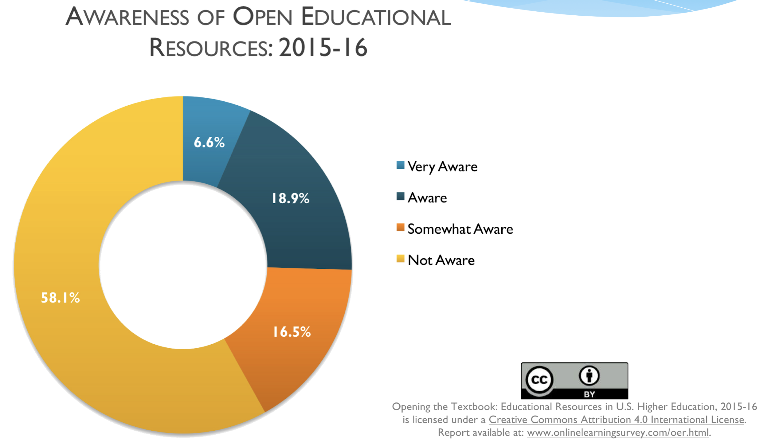
Faculty Awareness
Notes:
This Babson Survey Research group report shows how unaware faculty are of OER today. It’s getting better, but not by much.

Slide 4
Seeking Solutions
Notes:
•OEI started in 2011 with money supplied by the then provost and the library. To fund grants of between $1000 and $2500.
•Subsequent funds came from the Friends of the Library, and the Institute Teaching Excellence & Faculty Development office and the IT program.
•The grants have been offered in 8 grant cycles.

Slide 5


Slide 6
Open Education Initiative @UMass Amherst
The OEI is a faculty incentive program that encourages:
the creation of new teaching materials
the use of existing open information resources to support student learning
the use of library subscription materials
the development of open technologies

Slide 7
UMass Amherst Partnerships
Libraries
Teaching Excellence & Faculty Development
Instructional Innovation
Notes:
Libraries
•Workshops for OER, copyright, & Creative Commons licensing
•Liaison consultations to find resources and create new content
•Circulation & electronic reserves staff help to find subscription materials
Information Technology
•Classroom technologies & hosting
•Instructional technologies and experimentation. (e.g webpages, educational software, etc.)
Teaching Excellence & Faculty Development (Institute for Teaching & Faculty Development)
•Suggest OER when faculty want to increase interactive learning
•Support faculty creating new curriculum materials and scaffolding

Slide 8
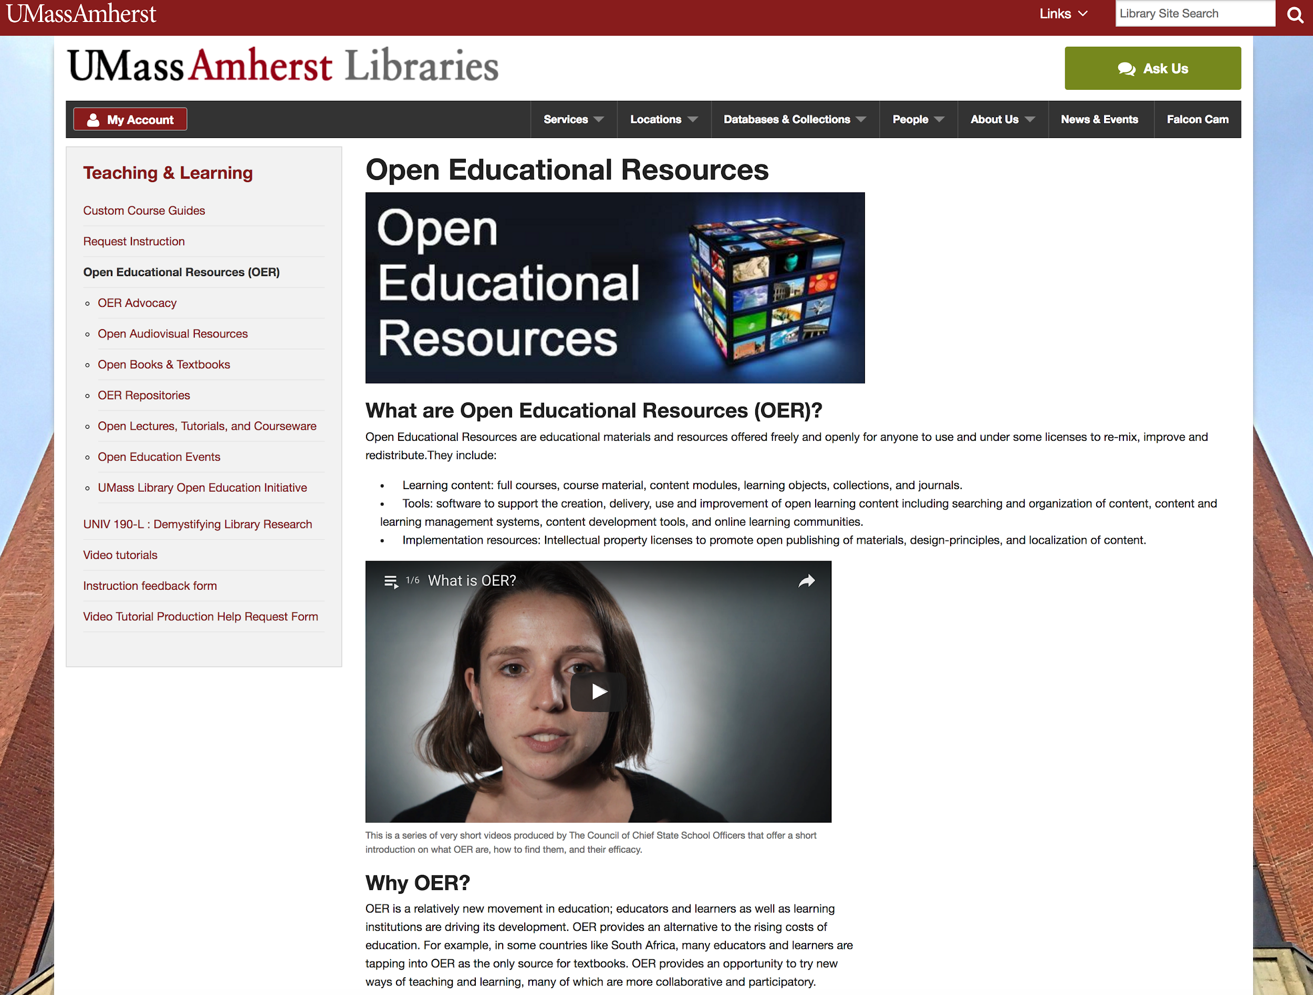
Library OER Website

Slide 9




Slide 10
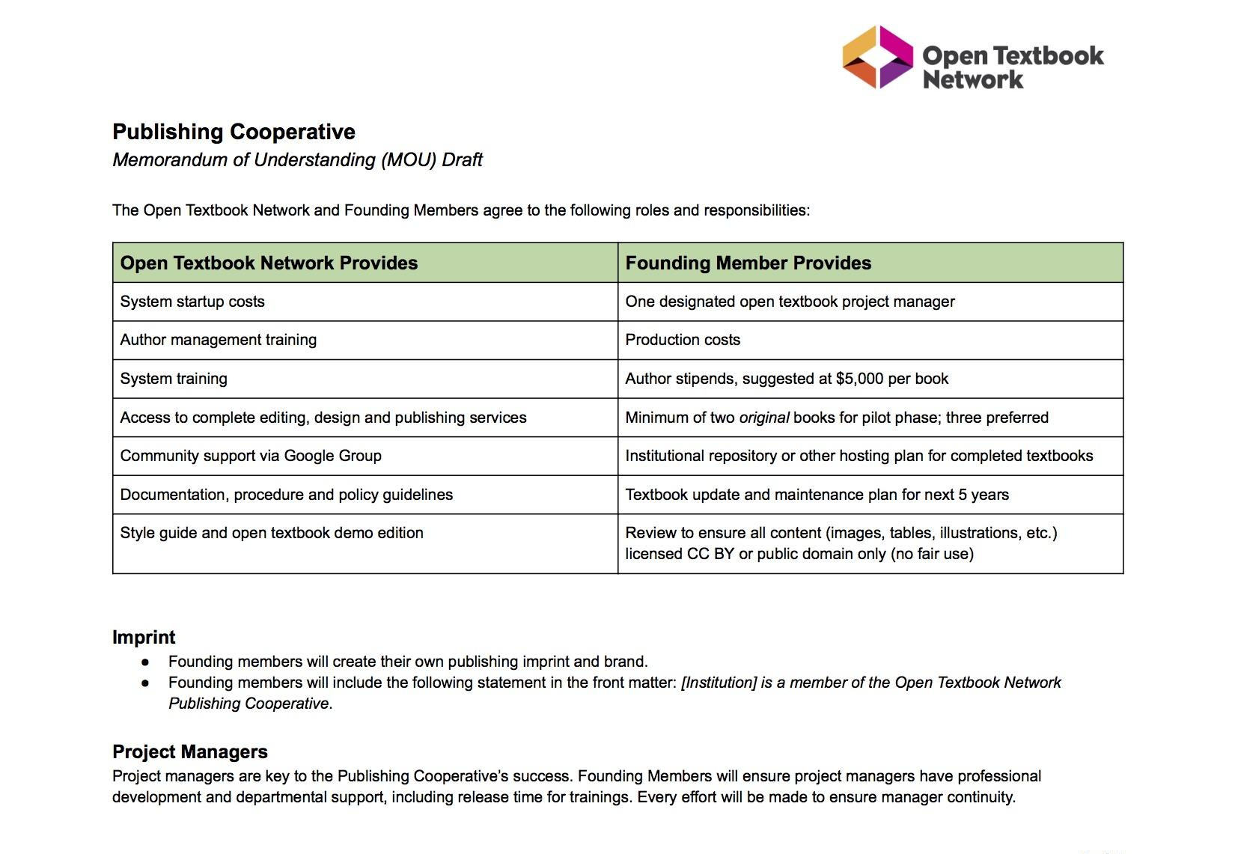
OTN Publishing Cooperative

Slide 11
Faculty Project Types
Adopt
Replace commercial textbook with open textbook
Adapt
Combine existing OER, library resources, and newly created material
Create
Create entirely new open course materials

Slide 12
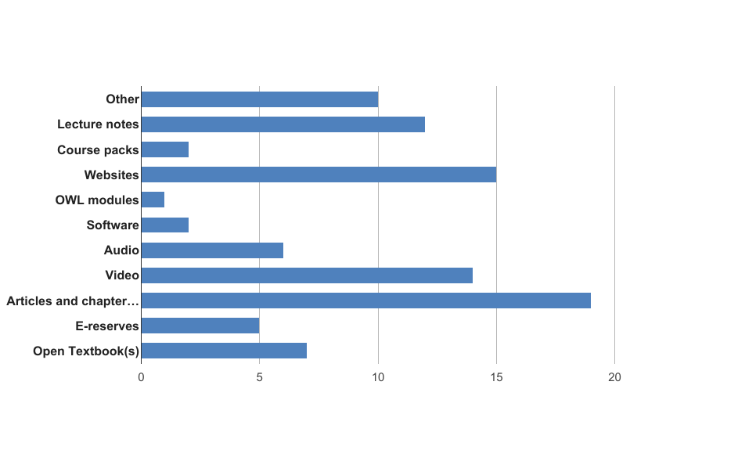
Material Types

Slide 13
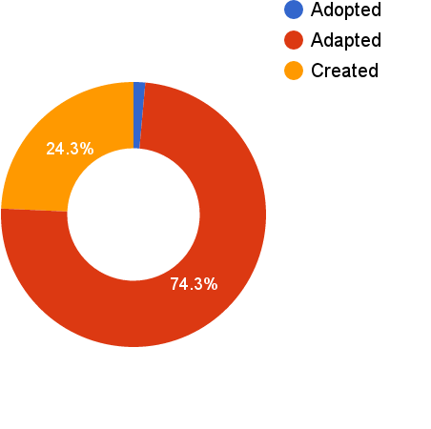
Faculty Project Types

Slide 14


Slide 15
OER Assessment

Slide 16
Results Since 2011
$1.6 million
student savings
$100,000
invested
10,000 students, 60+ faculty, & over 100 classes
impacted

Slide 17
Total Savings Over Time By College
College of Natural Sciences | 5,203 | $860,773
College of Social and Behavioral Sciences | 1,630 | $219,085
College of Humanities & Fine Arts | 699 | $96,709
College of Engineering | 818 | $169,091
College of Education | 727 | $85,098
College of Nursing | 146 | $17,785
Honors College | 187 | $7,835
Stockbridge School of Agriculture | 275 | $51,838
Isenberg School of Management | 612 | $57,085
School of Public Health and Health Sciences | 307 | $66,135
 | 10,793 | $1,631,433.25

Slide 18
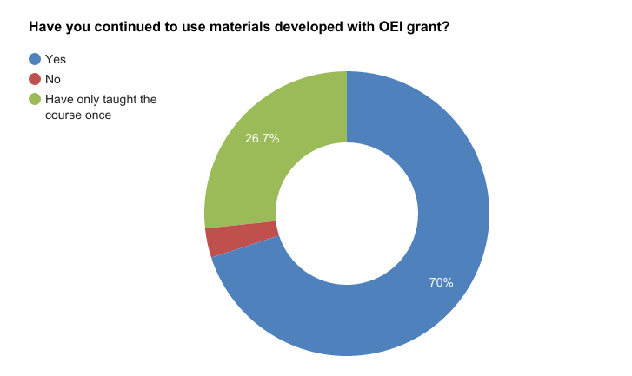

Slide 19
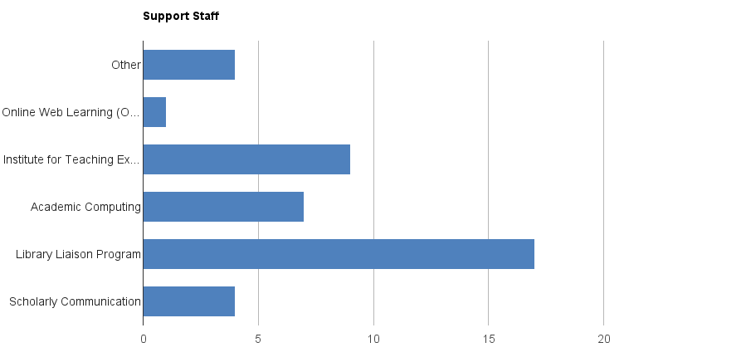

Slide 20
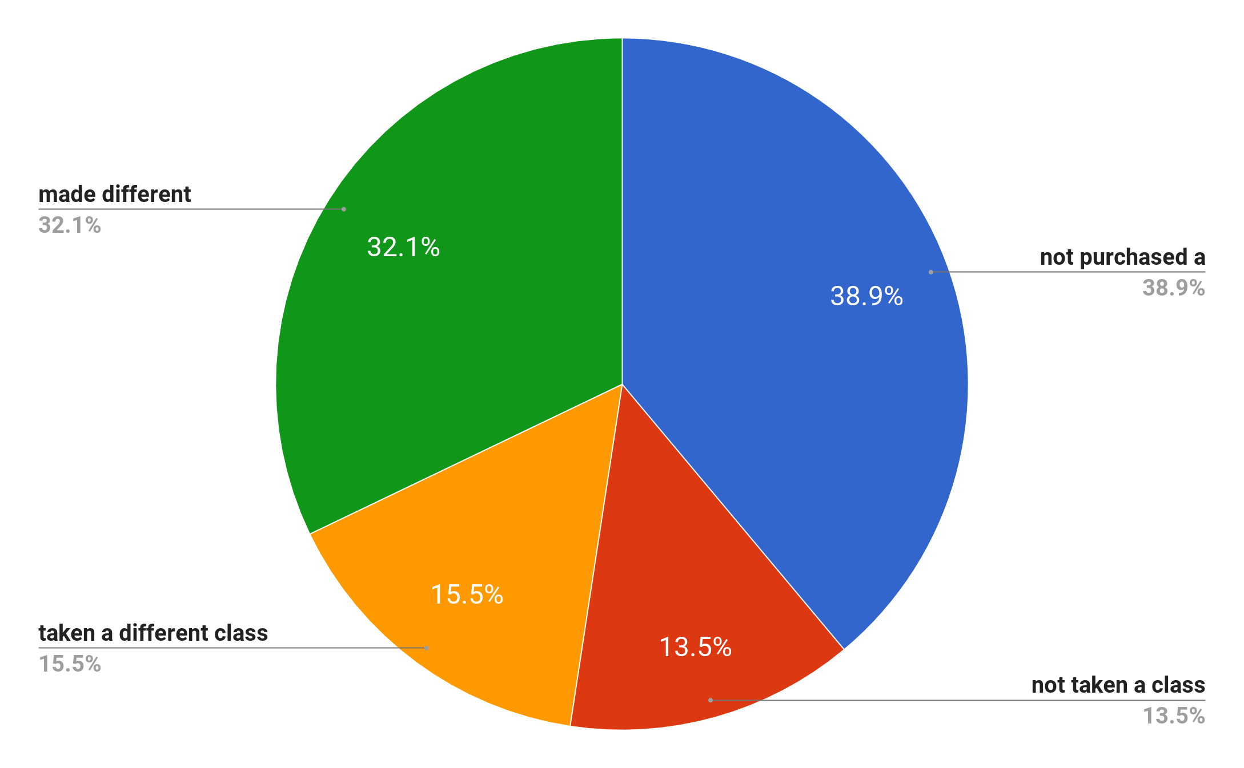
Student Feedback
2016 survey of 458 UMass Students
Notes:
This shows how textbook costs are affecting the academic decisions of our students. From a 2016 survey of 458 students in courses that took part in our program

Slide 21
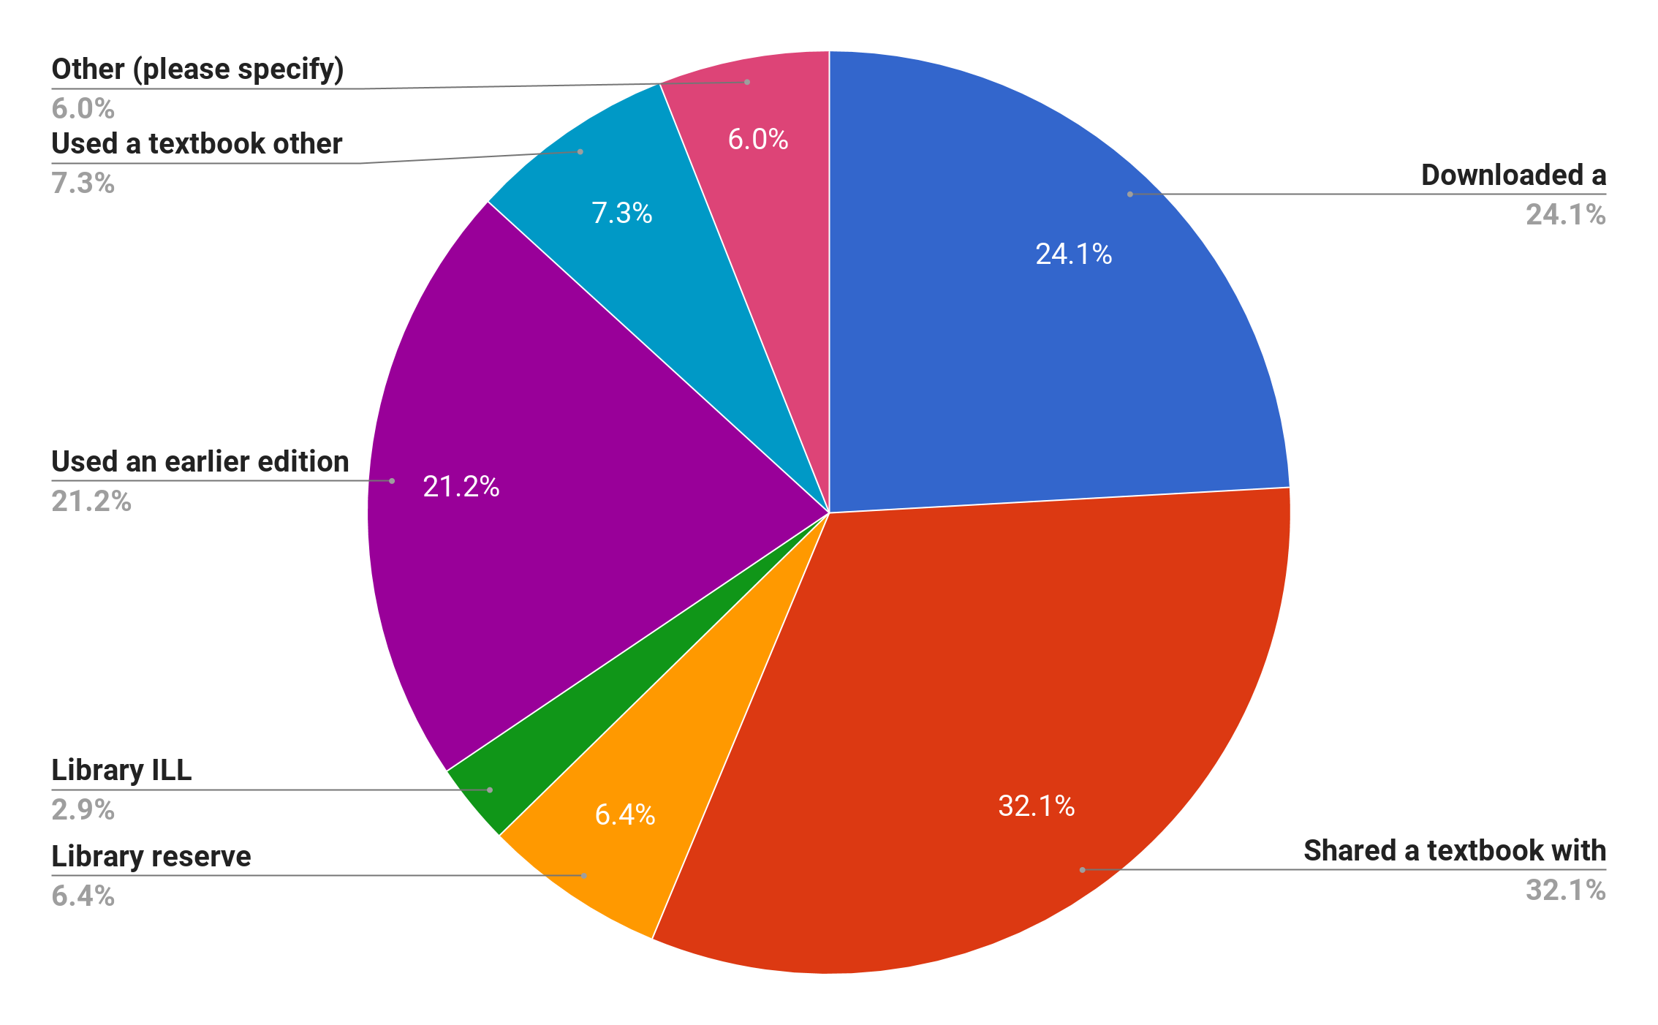
Student Feedback
2016 survey of 458 UMass Students
Notes:
This shows how textbook costs are driving students to seek alternatives to buying their own textbooks including a quarter of whom are illegally downloading textbooks.

Slide 22
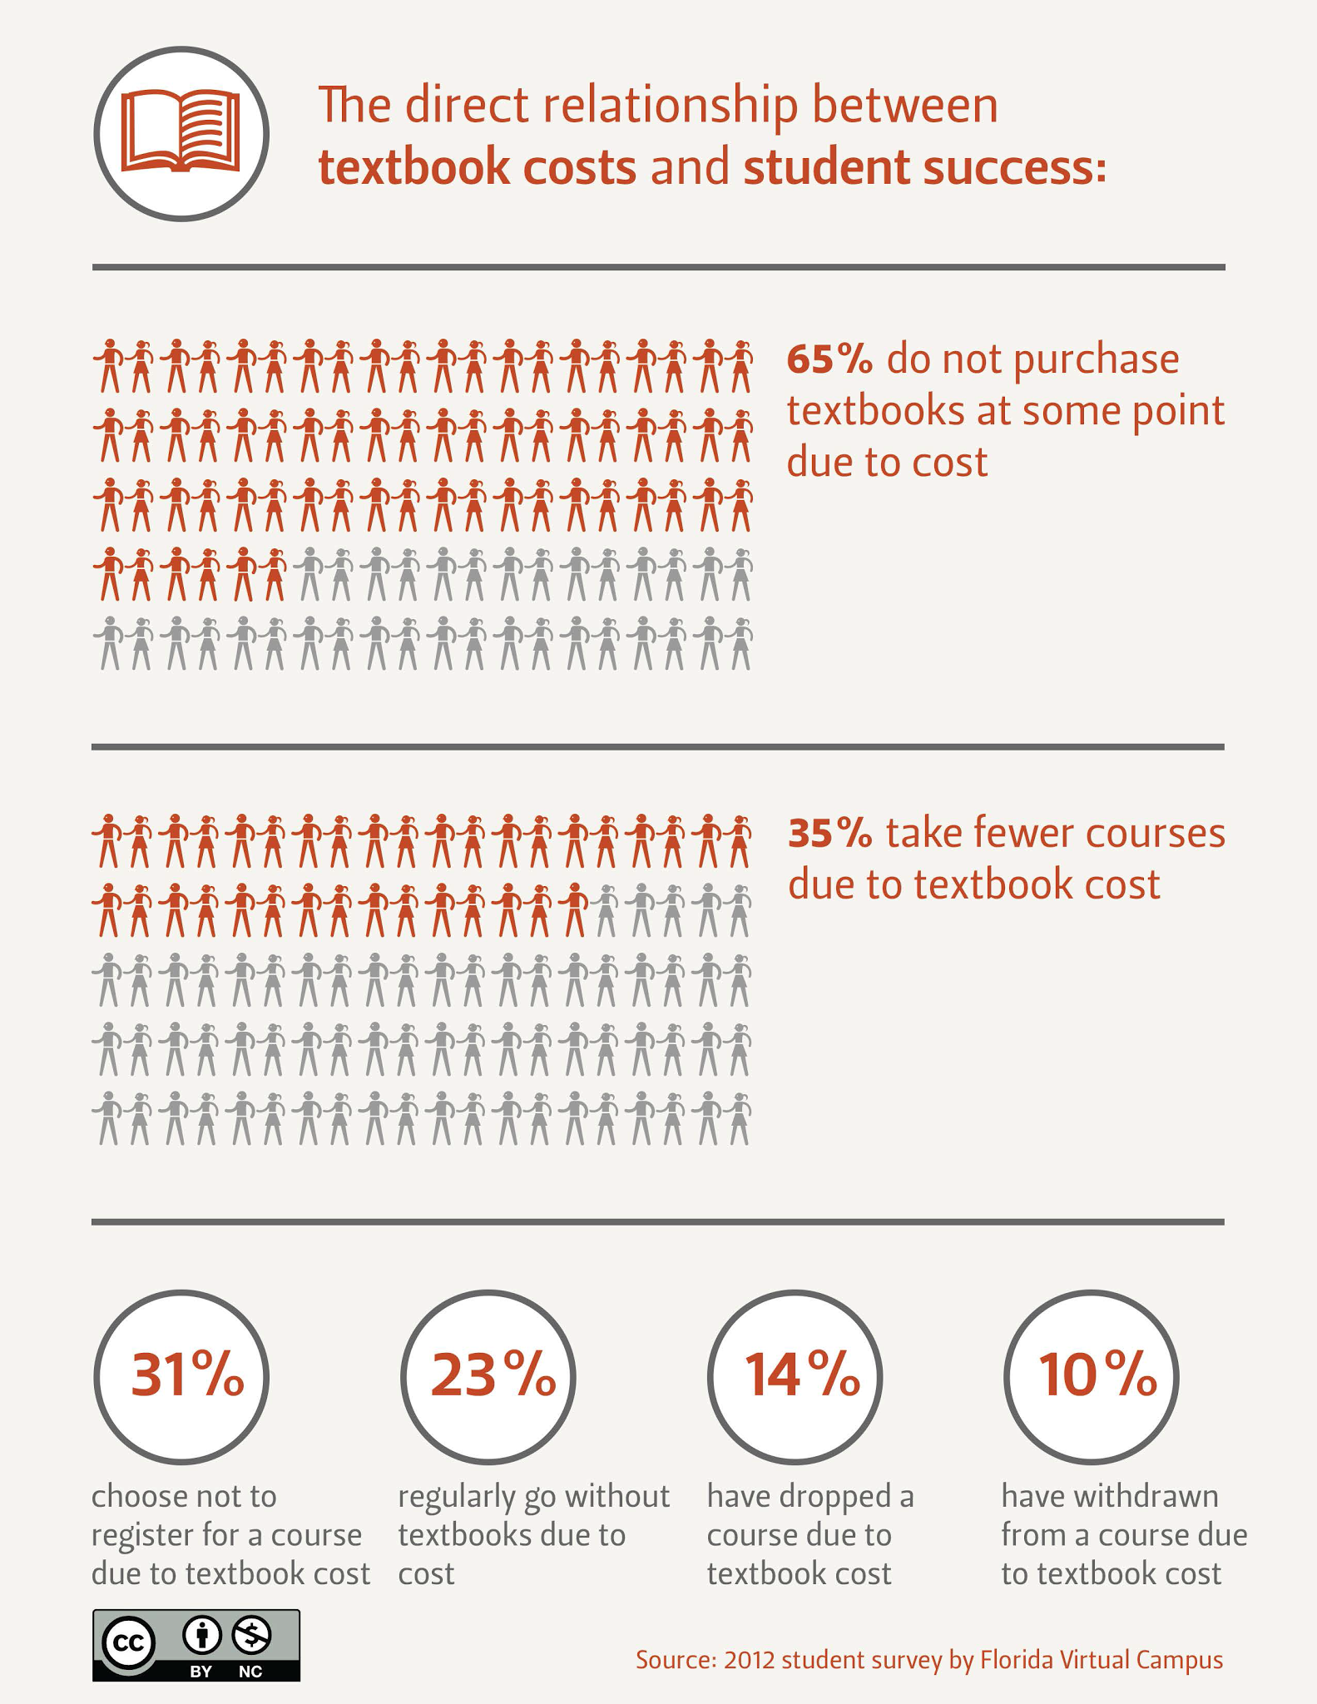
Notes:
This 2012 survey by the Florida Virtual Campus mirrors much of what we found in our survey.

Slide 23
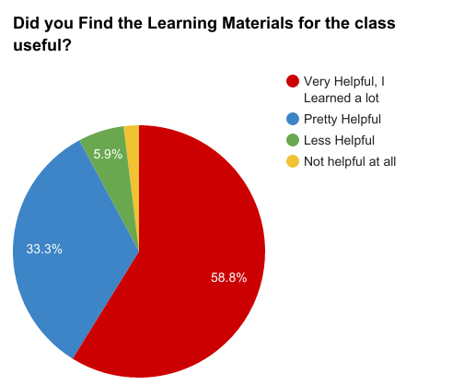
Results
2016 survey of 458 UMass Students

Slide 24
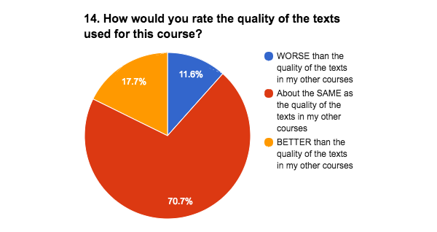
Student Feedback
2016 survey of 458 UMass Students

Slide 25
Thanks!
Questions?
Jeremy Smith
jlsmith@library.umass.edu

