Slide 1
Gift Economies
in the Gig Economy:
Imagining solidarity, cooperation, coalition, refuge, and regeneration
Matthew Cheney
Plymouth State University
Northeast OER Summit, 2019
macheney@plymouth.edu
Notes:
(The proposed subtitle of this presentation was “Avoiding Unintentional Fallacies”. The reason for the change should be clear by the end.)

Slide 2
this presentation is available at http://bit.ly/GiftGigOER
"Gift Economies in the Gig Economy"
by Matthew Cheney is licensed under CC BY-NC-SA 4.0

Slide 3
Preface: Note on method
This presentation is a sketch.
Every topic could be expanded to significantly greater depth.
Our time is short.
Some transitions will be skipped, connections elided, knowledge assumed.
With luck, your curiosity will be sparked.

Slide 4
To begin: A brief meditation
(inspired by Kate Bowles)

Slide 5
Take a moment and think about...

Slide 6
What did it cost you to be here?
How are you paying that cost?
Notes:
(Interpret “cost” in whatever way works for you.)

Slide 7
Who is working on your behalf while you are here?
Notes:
(Working at your job or working at your home or working in some other sphere that’s important to your existence)

Slide 8
Who is not here today who would benefit from the experience?
What obstacles do they face?

Slide 9

The Trial (dir. Orson Welles)
Notes:
One central theme for today’s session is this: There are always people working around us, working for us, working in place of us. It’s important to remember them. It’s important to build systems that do not render them invisible or contribute to their oppression. (And of course, we should acknowledge that the “us” and “them” here are porous, and also sometimes we are more “them” than “us”...)

Slide 10
To begin,
a tale of two
Twitter streams

Slide 11
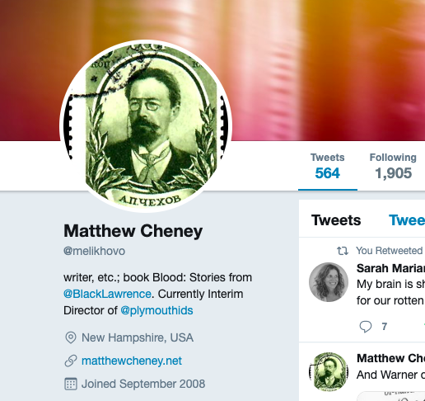
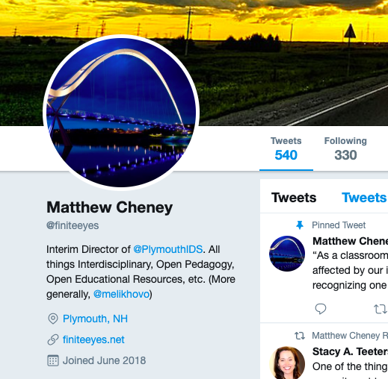
https://twitter.com/melikhovo
https://twitter.com/finiteeyes
Notes:
I have two professional identities: that of a creative writer of essays and short stories and that of an academic engaged with Open Pedagogy, Open Education, OER, and Interdisciplinary Studies. I keep these two identities separate via two separate Twitter accounts. As the accounts have matured, as I’ve followed more people and been followed by others, as I’ve participated in various conversations, I’ve been fascinated not so much by what overlaps between the two but by what diverges. Again and again, I have been struck by how the conversations on these two streams diverge — diverge not just in their topics, but also, and more importantly, in how they value what they value, even when they value the same things.

Slide 12
https://twitter.com/melikhovo
Notes:
Among the artists, writers, musicians, and filmmakers that I follow — some of whom are my close friends, some of whom are strangers — giving away what you create for free is generally thought to be foolish, and the difficulty of surviving as a creative person when it’s so easy for people not to pay you for your work is a topic of great concern.

Slide 14
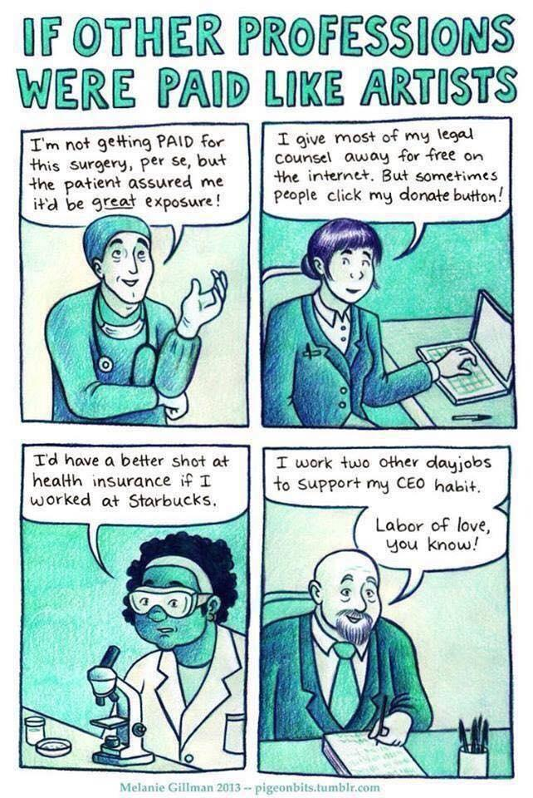
by Melanie Gillman
http://pigeonbits.tumblr.com/

Slide 15
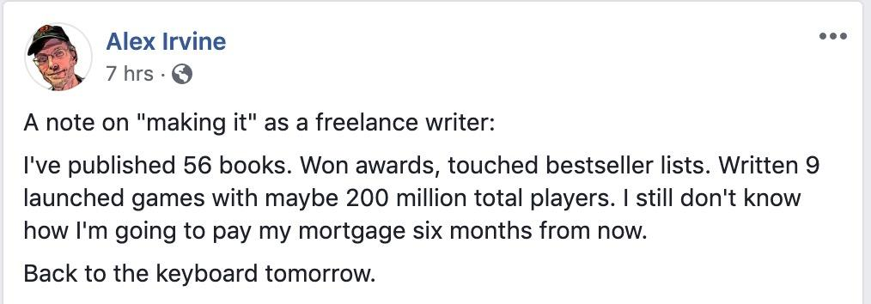

Slide 16
https://twitter.com/finiteeyes
Notes:
Meanwhile, on my other Twitter stream, giving away what you create is considered normal. After all, most of the people I follow here — some my close friends, many total strangers — are academics, and academics long ago accepted the idea that they should not be paid for what they create. Their discussions are all about how to get the work that they’ve done for no direct pay out there in the world and not locked away behind a paywall where somebody else collects money for it. (Here at an OER summit, I expect these are arguments you are familiar with.)
With these differences in mind, I give you right here in these two separate Twitter streams...

Slide 17
gig
gift
Notes:
The gig economy vs. the gift economy.
Let us pause for a moment of quick, and certainly inadequate, definitions. Perhaps the easiest way to keep the differences between gig and gift economies clear is to think of two well-known companies.

Slide 18
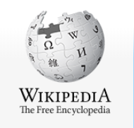

gig
gift
Notes:
Uber is at the center of the gig economy to such an extent that it’s been popular to talk about “the Uberization of X” or to call something “the Uber of Y”. And Wikipedia is a well-known community of volunteer laborers, a community with a sense of social mission that shares enough elements of the ideals of a gift economy for it to work as a metonym for it, at least for our purposes here today.

Slide 19

“With the quick growth of the internet in work placement in the late 1990s, first through Craigslist and today through Upwork … short-term work gained a new name: gig labor.”
Notes:
Quote from TEMP by Louis Hyman, Viking, 2018, p. 8

Slide 20
“After the Great Recession, Americans in need of work turned to the gig economy to get them through, and once again Silicon Valley had a boom. Firms that had formerly outsourced through temp agencies and consultancies could now do so with a website as the middleman.”
Notes:
Quote from TEMP by Louis Hyman, Viking, 2018, p. 9

Slide 21
“This gig economy may appear to be driven by new technology, or even just Uber, but behind it is a deep history of the making and unmaking of what most of us consider to be our dream— economic security—and that story is more about management ideas and business values than about any app.”
Notes:
Quote from TEMP by Louis Hyman, Viking, 2018, p. 9

Slide 22
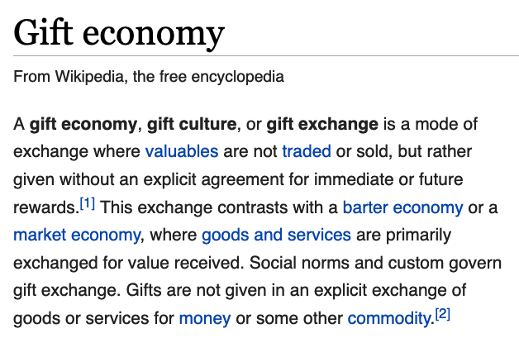
Notes:
And it seems only appropriate to get our definition of “gift economy” from Wikipedia, where the general description in the first paragraph states: “A gift economy, gift culture, or gift exchange is a mode of exchange where valuables are not traded or sold, but rather given without an explicit agreement for immediate or future rewards. This exchange contrasts with a barter economy or a market economy, where goods and services are primarily exchanged for value received. Social norms and custom govern gift exchange. Gifts are not given in an explicit exchange of goods or services for money or some other commodity.”

Slide 23


Slide 24
gig
gift
Notes:
Despite their different experiences and frustrations, I think my two Twitter streams actually demonstrate similar sorts of desires. Both streams are full of people who aspire to do work they find fulfilling and to be able to make a living.

Slide 25
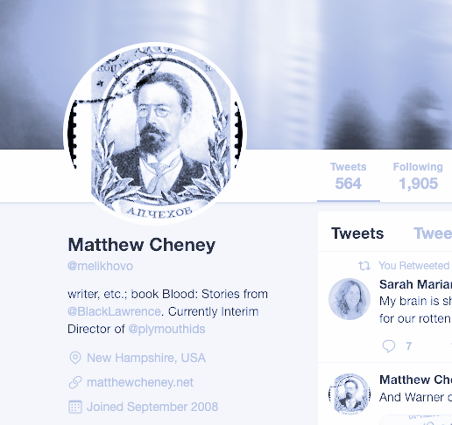
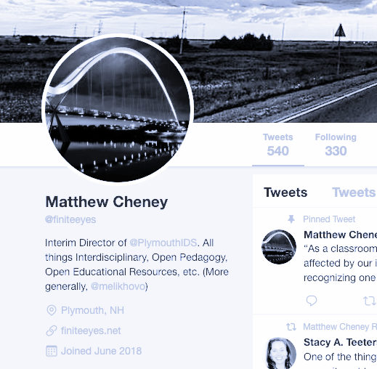
desire for
fulfilling work
and
to make a living
gig
gift
Notes:
And both are full of people really struggling, and often failing, to achieve those goals. Just because you want to create a gift economy doesn’t mean you’re not living in a gig economy. Which brings us to

Slide 26
the problem
Notes:
The problem that the general economy is closer to the gig economy than the gift economy.

Slide 27
general economy
is closer to the gig economy than the gift economy
Notes:
and we all live, whether we like it or not, in the general economy

Slide 28
so any gift economy is in danger of being deformed by the gig economy
Notes:
so any gift economy is in danger of being deformed by the gig economy

Slide 29


Notes:
For any of us who care about gift economies, this is a sad state of affairs.
Which brings us to...

Slide 30

Neoliberalism!
Notes:
Neoliberalism! A contested term, certainly, but one that we ought to be able to have a general sense of by now. Think of it as the financialization of everything. Neoliberalism is an ideology — and maybe even more than an ideology. Adam Kotsko has recently called it a political theology, and that makes some sense to me.

Slide 31

“Whereas classical liberalism insisted that capitalism had to be allowed free rein within its sphere, under neoliberalism capitalism no longer has a set sphere. We are always ‘on the clock,’ always accruing (or squandering) various forms of financial and social capital.”
Notes:
Kotsko, NEOLIBERALISM’S DEMONS, Stanford Univ. Press, 2018: “Whereas classical liberalism insisted that capitalism had to be allowed free rein within its sphere, under neoliberalism capitalism no longer has a set sphere. We are always ‘on the clock,’ always accruing (or squandering) various forms of financial and social capital.” (6)

Slide 32
“I consider neoliberal ideology a form of theology — it is a discourse that aims to reshape the world.”
Notes:
Kotsko, NEOLIBERALISM’S DEMONS, Stanford Univ. Press, 2018: “I consider neoliberal ideology a form of theology — it is a discourse that aims to reshape the world.” (7)

Slide 33
We know that a key feature of neoliberalism is its ability to commodify almost everything, including resistance.
Notes:
We know that a key feature of neoliberalism is its ability to commodify almost everything, including resistance.

Slide 34

This is what makes it so difficult to avoid exploitation when trying to creating a gift economy within a neoliberal world.
Notes:
This is what makes it so difficult to avoid exploitation when trying to creating a gift economy within a neoliberal world.

Slide 35

Notes:
We want to make the world more open and connected, right? This is a nice graphic that says just that. But you know where it comes from? Not a 2010 OER Summit. Rather, it comes from Mark Zuckerberg.

Slide 36

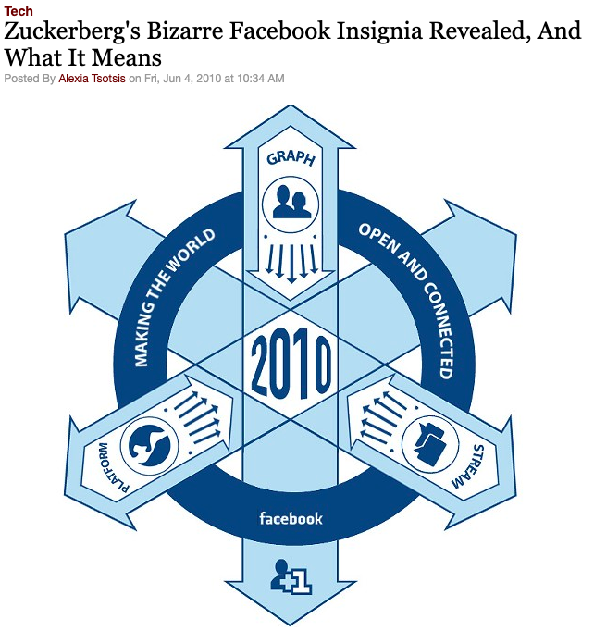
Notes:
The language of openness and connection is easily used to express the ideals of, for instance, Facebook.
Source: https://archives.sfweekly.com/thesnitch/2010/06/04/zuckerbergs-bizarre-facebook-insignia-revealed-and-what-it-means?showFullText=true

Slide 37

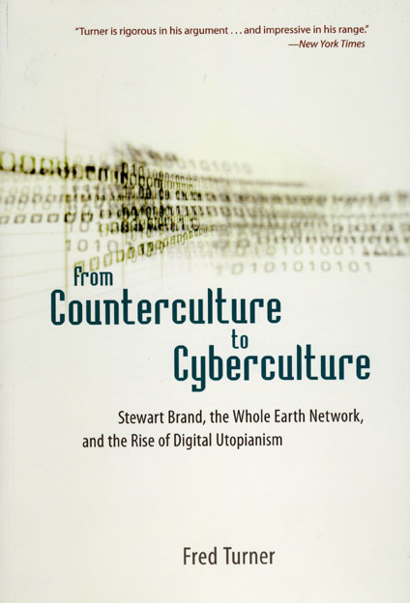
Notes:
Fred Turner, among others, has shown how the ideals of the ‘60s counterculture were easily adapted to the entrepreneurial ethos of Silicon Valley. Thomas Frank, decades ago, came up with a name for the process: commodified dissent.

Slide 38
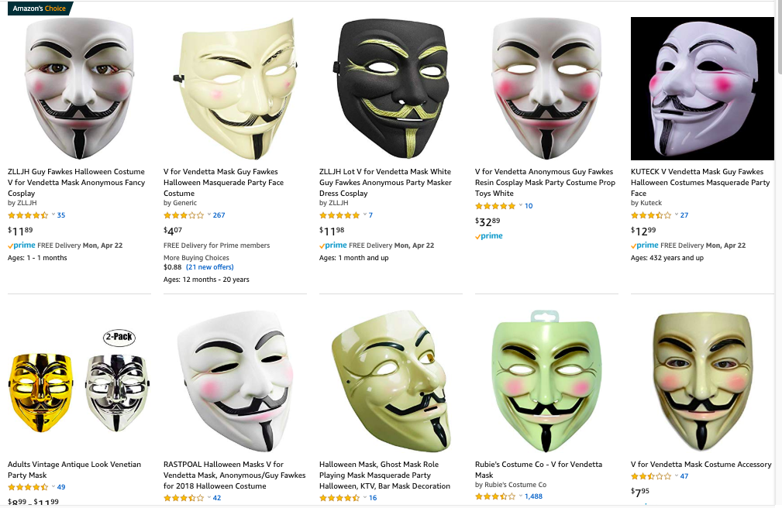
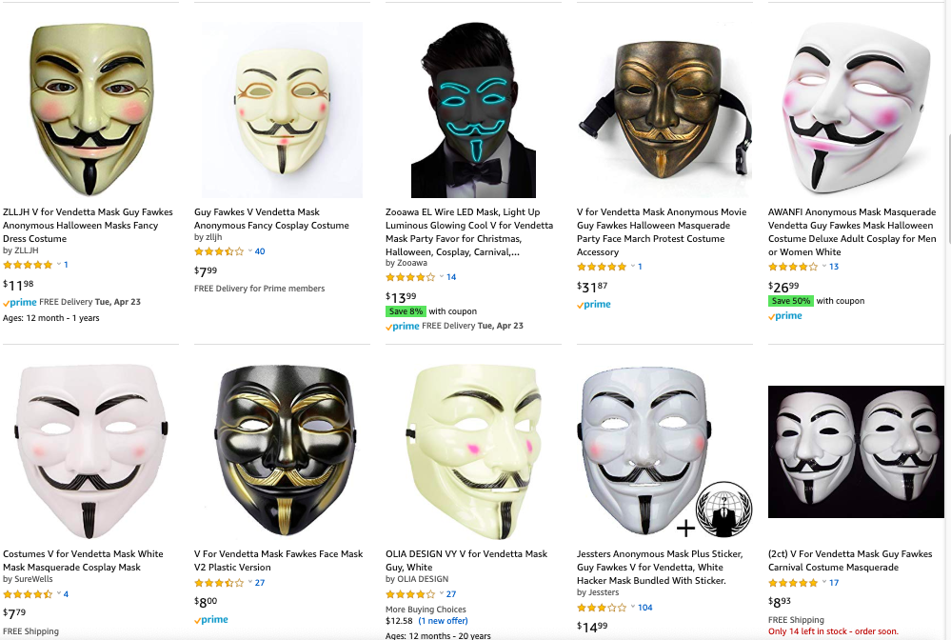
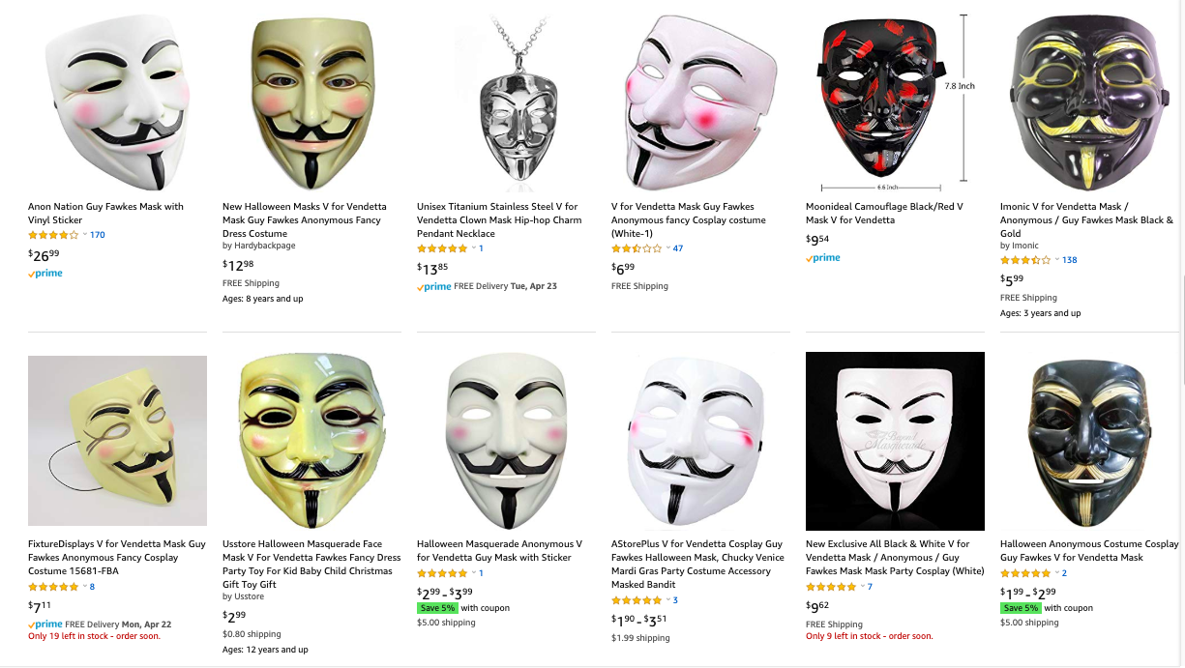
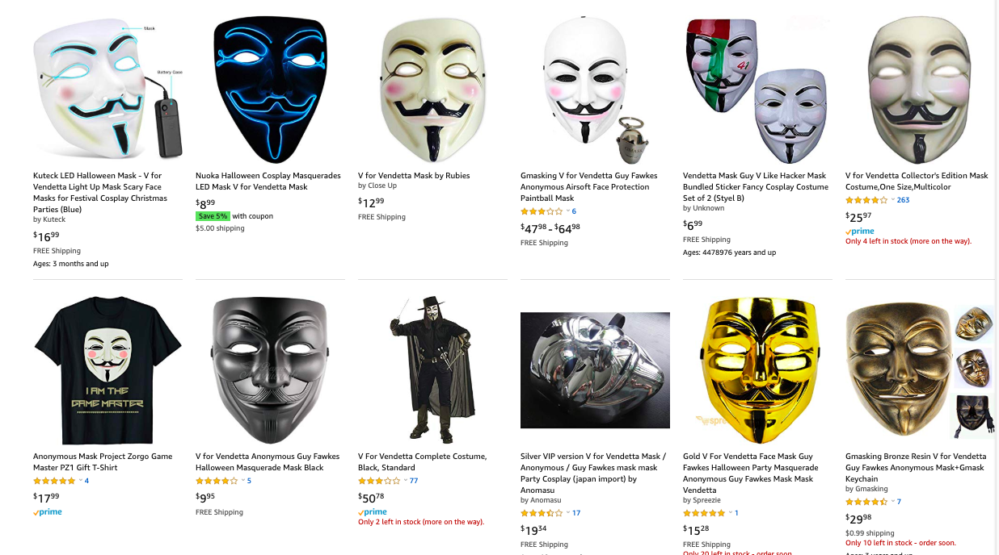
commodified dissent
Notes:
OER that is just a product or just a kind of resource is easy to commodify.
[cf. Thomas Frank, “The American Nonconformist in the Age of the Commercialization of Dissent” and Commodify Your Dissent.]

Slide 39
A resource is not a vision.
Without vision, and without the values that attach to and develop from a vision, dissent is a pose, not a program.
Notes:
A resource is not a vision.
Without vision, and without the values that attach to and develop from a vision, dissent is a pose, not a program.

Slide 40


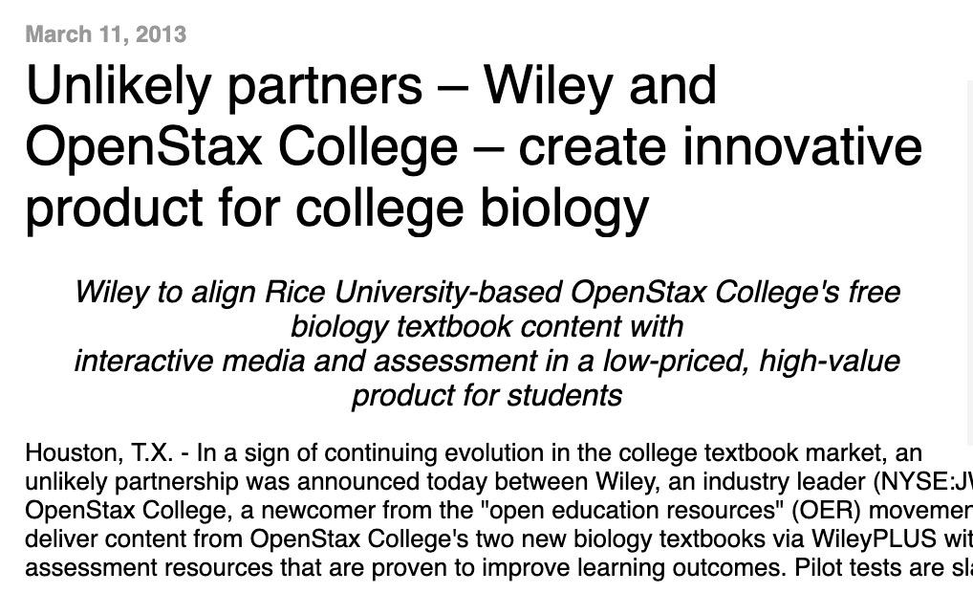
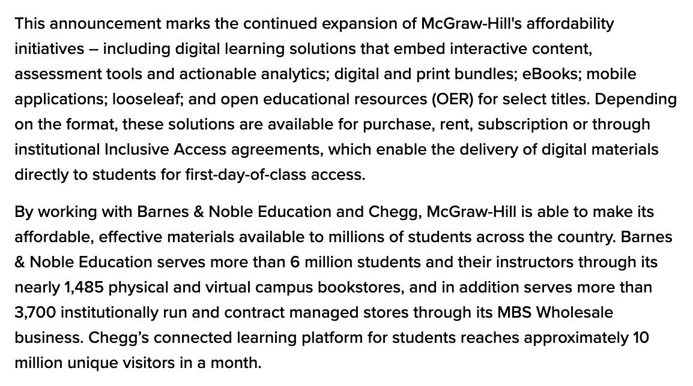
commodified dissent
Notes:
But even with a vision, even with clear values, we are vulnerable if we are not vigilant.

Slide 41

“Ideas do not circulate freely when they are treated as commodities.” —Lewis Hyde
Notes:
In his 1981 book The Gift, Lewis Hyde offers various examples of the ways that capitalism infiltrates, undermines, deforms, and destroys gift economies. Like an apple eaten from the inside by a worm, the outer husk of a gift economy may remain, but once you look deeper you discover nothing but emptiness and rot.

Slide 42

Harvard Square image by Chensiyuan, Wikimedia Commons
Notes:
Though it still has certain aspects of a Medieval guild — a kind of cooperative economy — academia exists within the general economy of our late capitalist, neoliberal, globalized, imperial world. And remember what we said about the general economy.

Slide 43
general economy
is closer to the gig economy than the gift economy
Notes:
Especially in these times of fierce neoliberalization, the university has many features that aren’t just closer to the gig economy but absolutely exemplary of it.

Slide 44
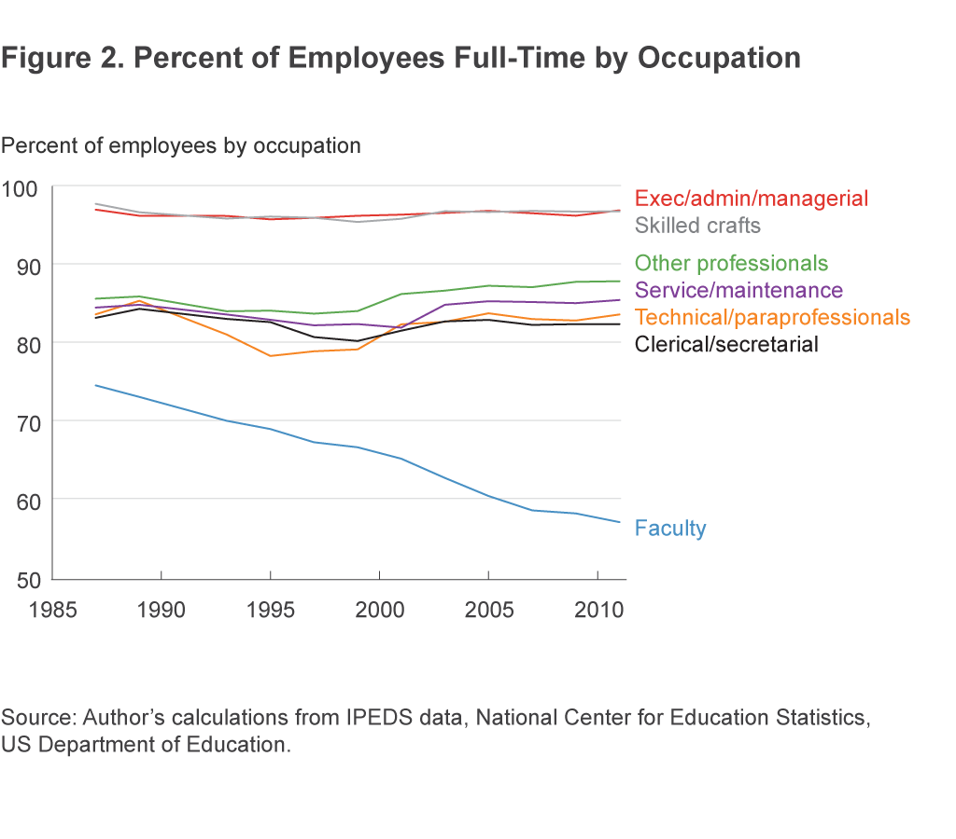
Peter L. Hinrichs
“Trends in Employment at US Colleges and Universities, 1987–2013”
Notes:
I don’t have time to go into all the horrors of adjunctification, casualization, the death of tenure, etc. We all know these stories. Most of us have lived these stories or are living them now. But because we are familiar with these stories, those of us who are not living them, or have escaped some of their worst features, may become complacent, may too easily forget that there are human costs to the structure of our work, may too easily forget that there are MULTIPLE news reports and essays titled “The Death of an Adjunct”.

Slide 45
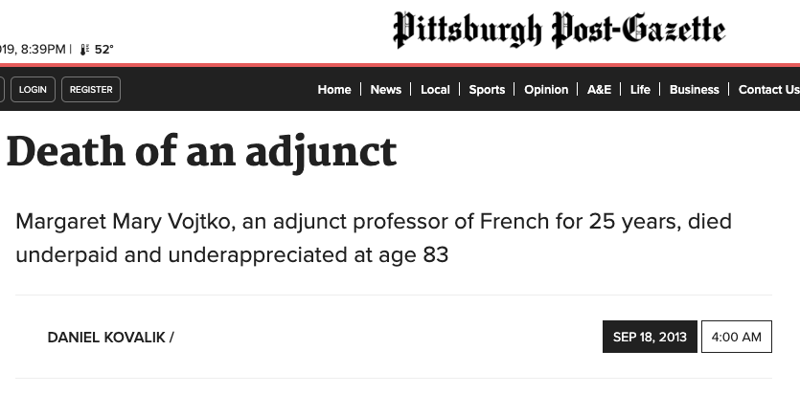
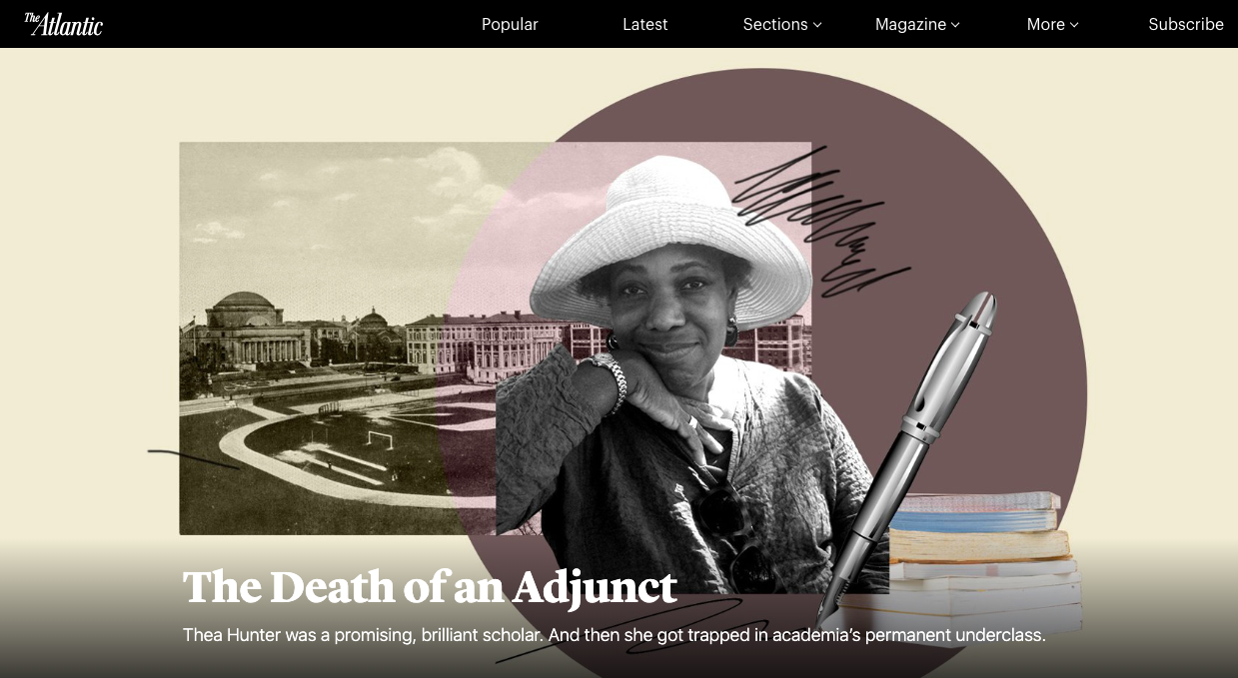
2013
2019
Notes:
These are our workplaces. These are the places where we are trying to build a gift economy. But whose labor creates the gifts? And who benefits from this economy? Here is where our work is most open to fallacious thinking, despite good intentions — here, where, if we are not always aware and careful and deliberate, our best intentions may be borne by the shoulders, backs, and legs, by the expertise and experience, by the emotions of vulnerable workers. We must be able to imagine how to work better. And we must acknowledge that in many institutions, the freedom to create OER is a great privilege.

Slide 46
OER tend to be created by people who aren’t marginalized and can afford some risk.
Notes:
Let’s acknowledge this: Creating OER is a risky proposition for many people in academia. OER doesn’t fit easily into the reputational economy of academia. At best, it may not help you much when it comes to promotion and/or tenure, at worst it may hurt you. If you are a contingent worker in a department that does not embrace OER, are you able to put yourself out there and risk being seen as unserious, unscholarly, lacking rigor — can you risk losing your income?

Slide 47
open
Notes:
I want to talk about open. And I want to talk about

Slide 48
values
Notes:
values. And I want to see if we can find ways to open our talk of values and

Slide 49
open
values
Notes:
to talk of open values.

Slide 50
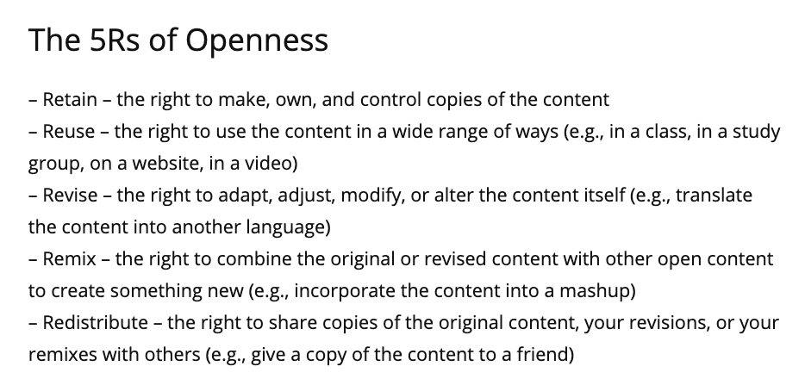
—David Wiley
Notes:
David Wiley’s 5Rs of Openness provide us with one set of values. They are useful as far as they go, but I personally find them … fine? I guess. A bit … uninspiring? As a creative writer, too, I find some ways people interpret them … off-putting — but I don’t have time here to go off on a rant about why I insist on the Noncommercial requirement on any CC licenses I use. We can save that rant for another time. But I do want to acknowledge something that I am far from the first to point out. We must stay aware of the ways that people have had their work stolen in the past.

Slide 51


Notes:
Asking people who are members of groups that have historically been oppressed, who have had their contributions stolen, attributed to someone else, who have been marginalized, ignored, laughed at, jailed, redlined, killed — asking such folks to give their work away can be a tough ask. Read Sarah Schulman’s Stagestruck, a pretty persuasive account of how straight white guy Jonathan Larson took so much of his blockbuster musical Rent from her lesbian novel People in Trouble.

Slide 52
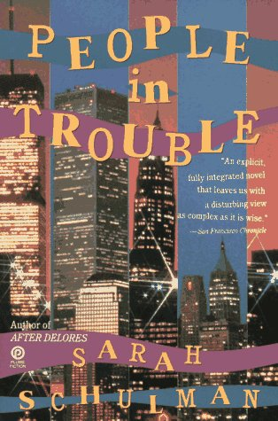
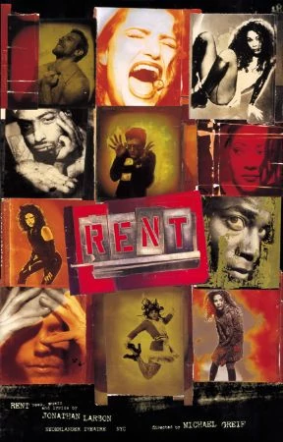

Notes:
Read that and tell me Sarah Schulman should’ve released her novel under an open license.

Slide 53
open?
values?
Notes:
We need to think about values.
And so, seeking to be positive, I want to propose some more general principles or keywords that I hope complement the 5Rs of Openness but also remind us of deeper core values.

Slide 54
solidarity
cooperation
coalition
refuge
regeneration
Notes:
Solidarity, cooperation, coalition, refuge, regeneration. Five more words to bring to the forefront of our vocabularies. Are these words guides or goals, realities or ideals, necessities or dreams? Well, it depends. It depends on what we’re talking about, what our experiences and desires are, what time of day it is. Personally, I am interested less in the words as separate concepts than the possibilities they evoke together. We can mix and match them in various ways, and the simple act of doing so opens new ways of thinking about how to avoid exploitation, how to escape, perhaps, some of the traps of neoliberalism, how to stay aware, vigilant, how to honor individual labor and intellect and creativity within a communal project. And thus, maybe, how to protect our gift economies within the general economy and all its gigginess. For instance,

Slide 55
solidarity
cooperation
coalition
A trio for participation
Notes:
If we think of the first three together as a trio for participation, we can ask ourselves what it means to show solidarity, what it means to cooperate, what it means to form a coalition, and, perhaps most importantly, what it means to consider all three as necessary to participating in a relationship that tries to avoid exploitation. These are separate concepts that overlap and together create a harmony.
We can also consider our remaining keywords together.

Slide 56
refuge
regeneration
Outcomes of care
Notes:
We might think of these two concepts, refuge and regeneration, as the outcomes of care. By caring for our work and caring for each other we allow refuge for those who need it and regeneration for what has been scoured, scarred, and strip-mined. “How do we manifest care in our work?” we might ask ourselves. Not just care for our work, but care within it, care as a value our work upholds and shares. (I’m building on some ideas from Kate Bowles here.) How might our work allow refuge, how might it regenerate what deserves to be regenerated, what has been lost or abused or so marginalized as to be nearly beyond perception? If such questions seem irrelevant to what we are doing here, irrelevant to our work, then I suggest that our conception of our work is too narrow for a world as destructive as our own, and that it is, instead, not the questions but rather our work that might be irrelevant.

Slide 57
solidarity
cooperation
coalition
refuge
regeneration
Notes:
We could mix the words in other ways, too — regeneration, for instance, might require coalitions, that is, groups of people cooperating despite differences of background, values, opinions. While cooperation is necessary for coalitions, coalitions are not necessarily necessary for cooperation. (We might think of coaltions as particularly difficult cooperations.) In any case, I think it is important not to think of these words separately, because it is too easy for them to become superficial, and words that become superficial too easily become alibis. But for now they will do, because my goal here is not to produce a timeless, universal, immutable rubric, but rather to suggest a few tools to reduce exploitation, pathways of thinking to increase the benefits of the gift economy while mitigating the oppressions and exploitations of the gig economy.

Slide 58

image via NASA
Notes:
Imagine

Slide 59

Notes:
solidarity

Slide 60

photo by Akhil Verma on Unsplash
Notes:
cooperation

Slide 61
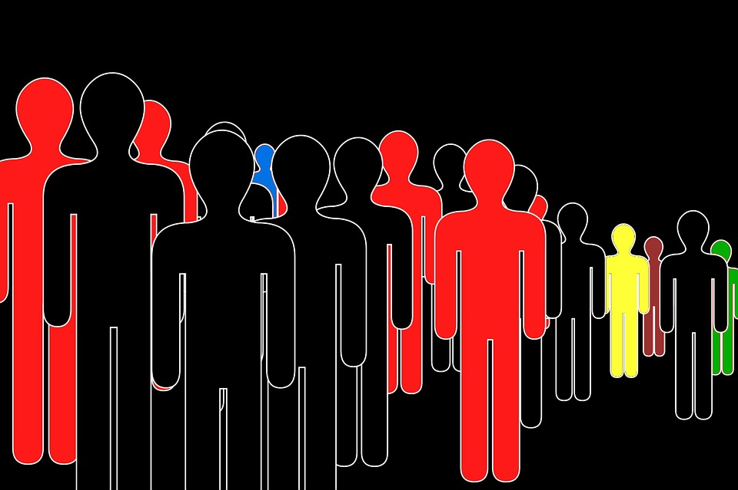
image by witt_digital, Pixabay
Notes:
coalition

Slide 62

Photo by Zoltan Tasi on Unsplash
Notes:
refuge

Slide 63
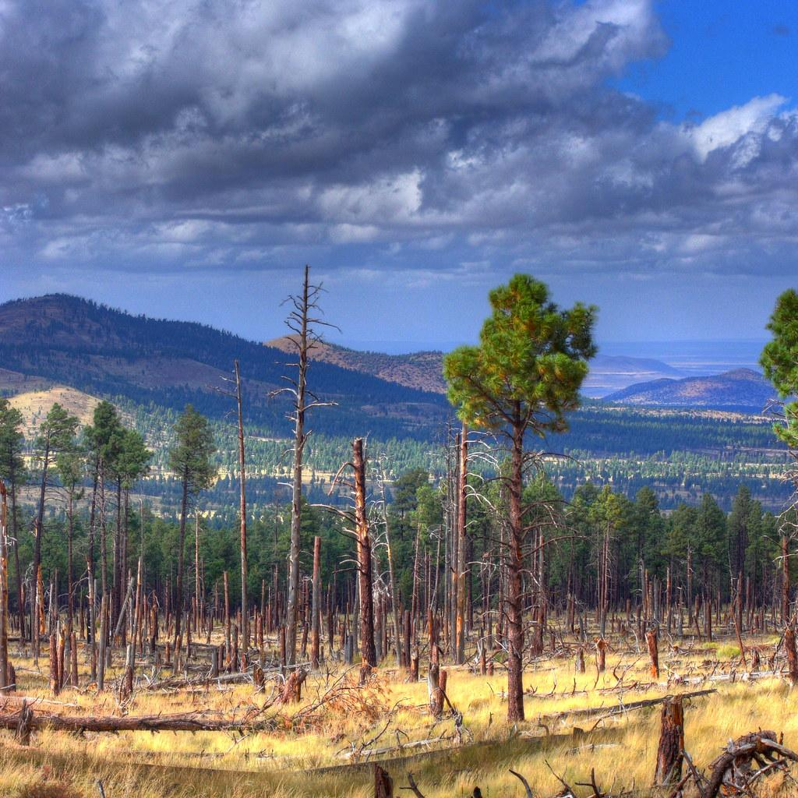
photo by Kevin Dooley, Flickr
Notes:
regeneration

Slide 64
open
Notes:
open

Slide 65
Appendix: Further Reading
A few items not mentioned in the presentation that may be of interest:
“Can We Decolonize OER/Open?” by Taskeen Adam, et al.
Playing to the Crowd: Musicians, Audiences, and the Intimate Work of Connection by Nancy K. Baym
The Adjunct Underclass by Herb Childress
The Reorder of Things: The University and Its Pedagogies of Minority Difference by Roderick A. Ferguson
“Is It Possible to Decolonize the Commons? An interview with Jane Anderson of Local Contexts” by Jennie Rose Halperin
Common As Air: Revolution, Art, and Ownership by Lewis Hyde
Gigged: The End of the Job and the Future of Work by Sarah Kessler
"Knowledge Unlatched, Failed Transparency, and the Commercialisation of Open Access Book Publishing” by Marcel Knöchelmann
“Changing our (Dis)Course: A Distinctive Social Justice Aligned Definition of Open Education” by Sarah R. Lamber
Resistance by Barry Lopez
“Coalition Politics” by Bernice Johnson Reagon
“Unite and Fight” by Kate Redburn
Everything for Everybody by Nathan Schneider
Wilding: Returning Nature to a Farm by Isabella Tree
“Inclusive Design: The Bell Curve, the Starburst and the Virtuous Tornado” by Jutta Treviranus

Slide 66
this presentation is available at http://bit.ly/GiftGigOER
"Gift Economies in the Gig Economy"
by Matthew Cheney is licensed under CC BY-NC-SA 4.0

