Slide 1
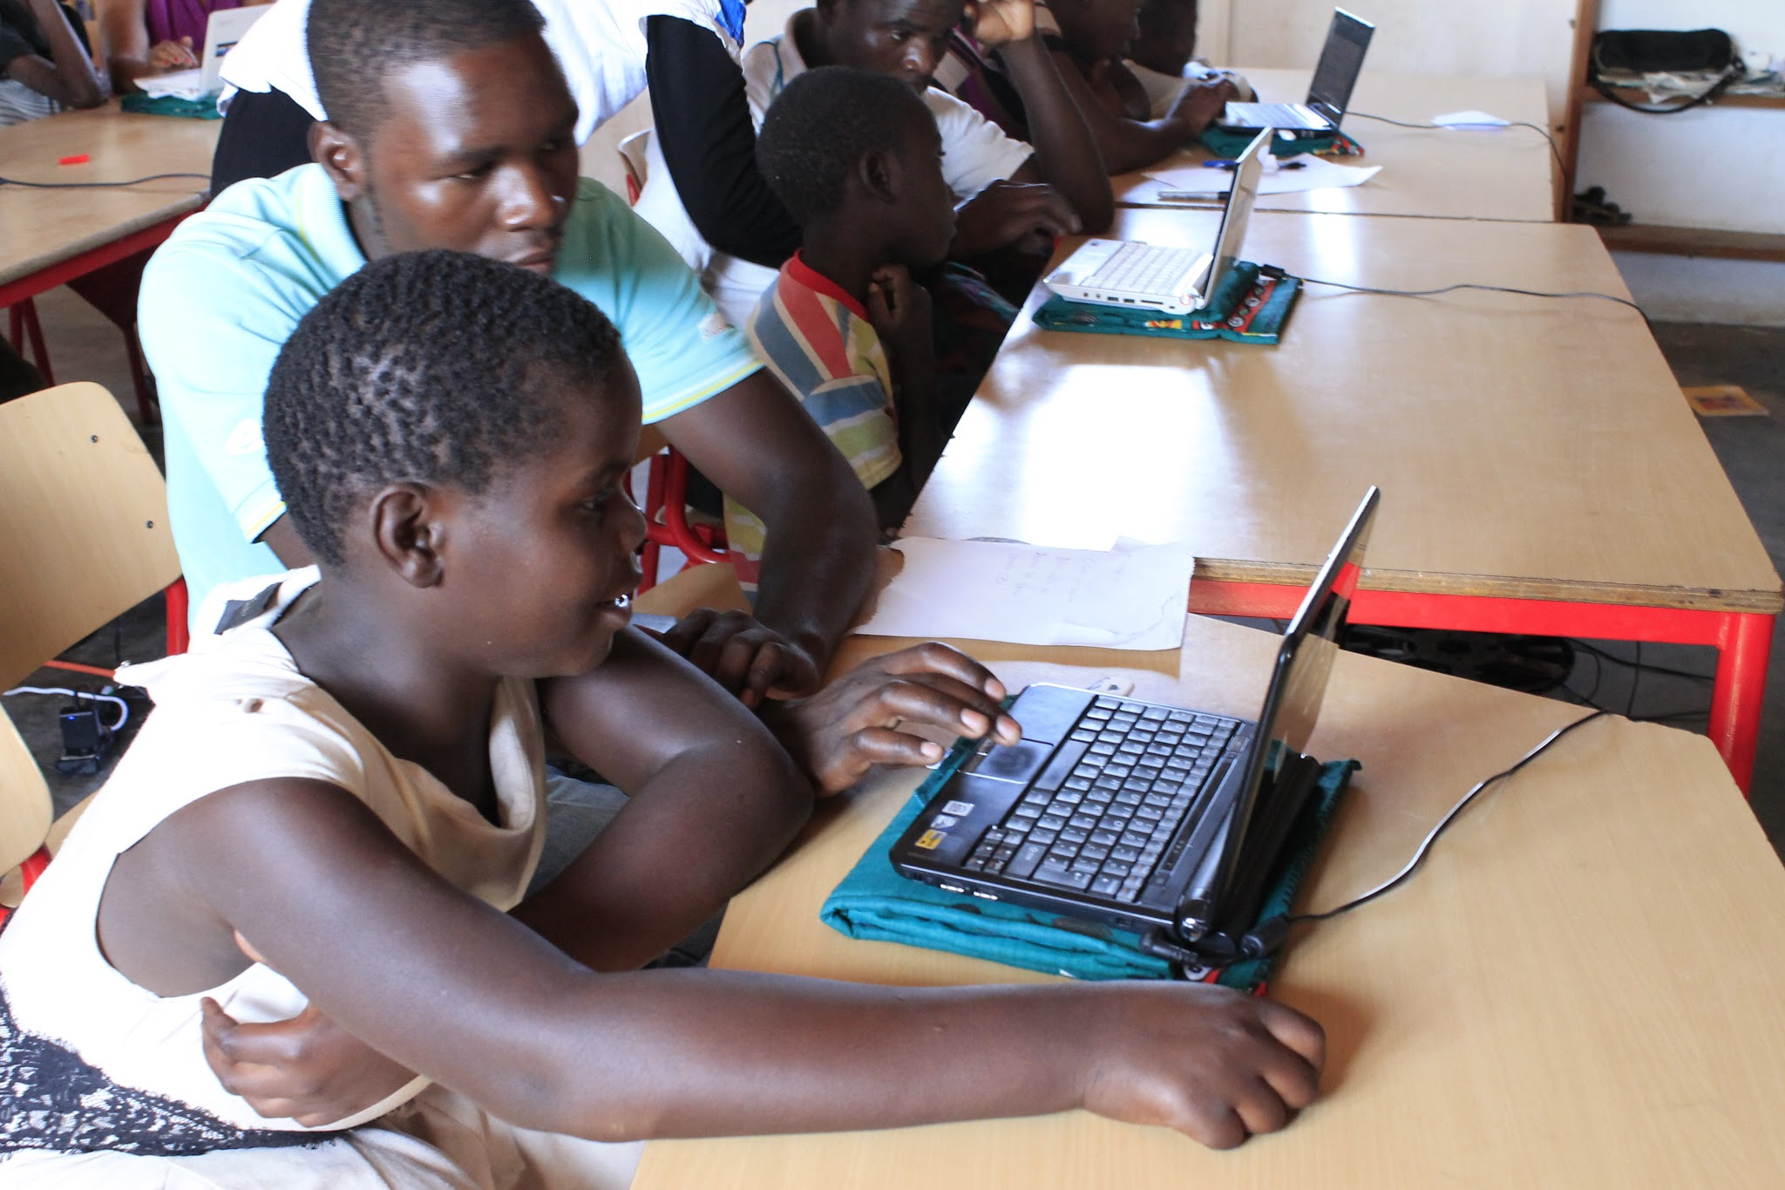

Closing the Digital Divide
Sharing OER with Libraries, Schools and Public
Health Facilities in Africa and the World
Jeremy Smith - UMass Amherst
Carl Meyer - Shift IT
Jeremy Schwartz - World Possible
Charlie Schweik - UMass Amhert
By Jeremy Smith, Charlie Schweik, Carl Meyer, Jeremy Schwartz
This work is licensed under the Creative Commons Attribution 4.0 International License.

Slide 2
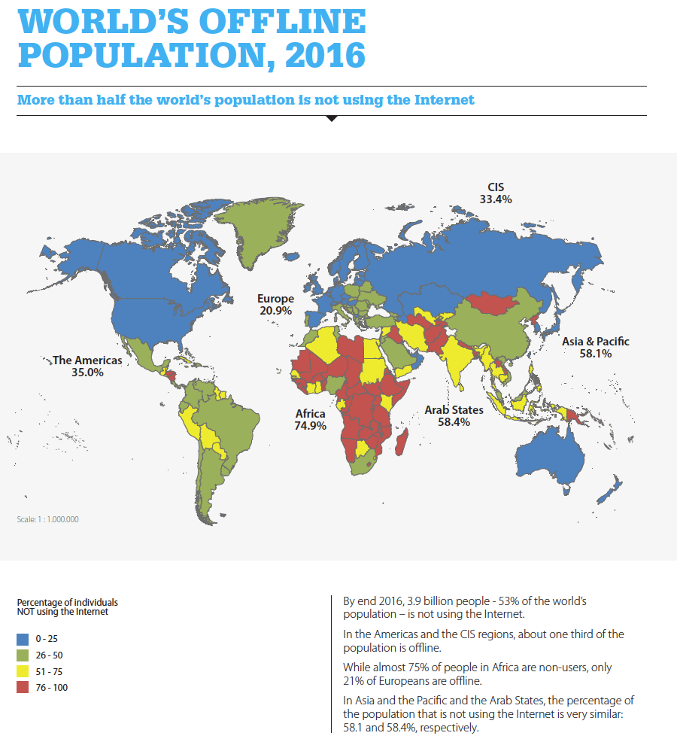
53% of the world’s population, lack
information capital
that could be key toward bettering their lives in the way
they themselves
think it should be improved
(Source: International Telecommunication Union [ITU], 2016b, p. 2)

Slide 3
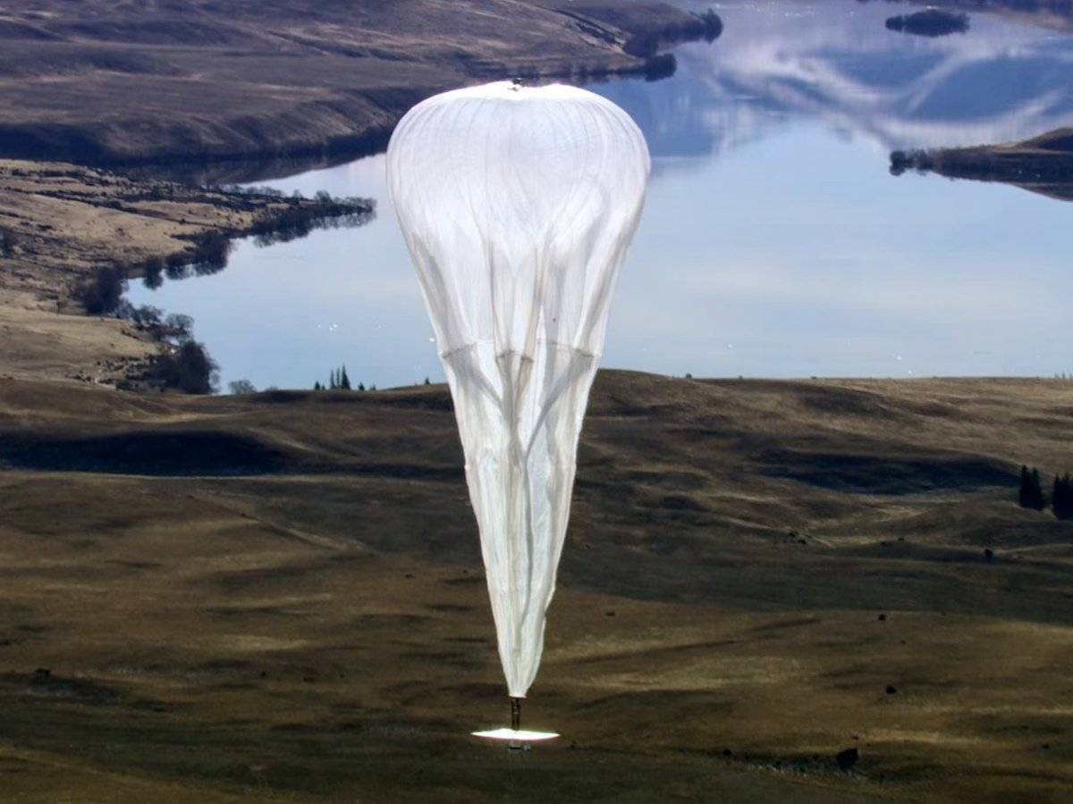
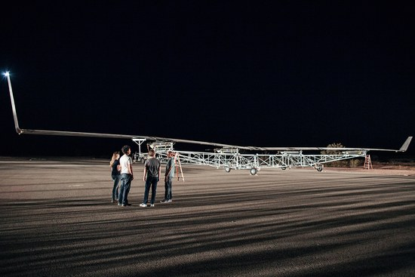
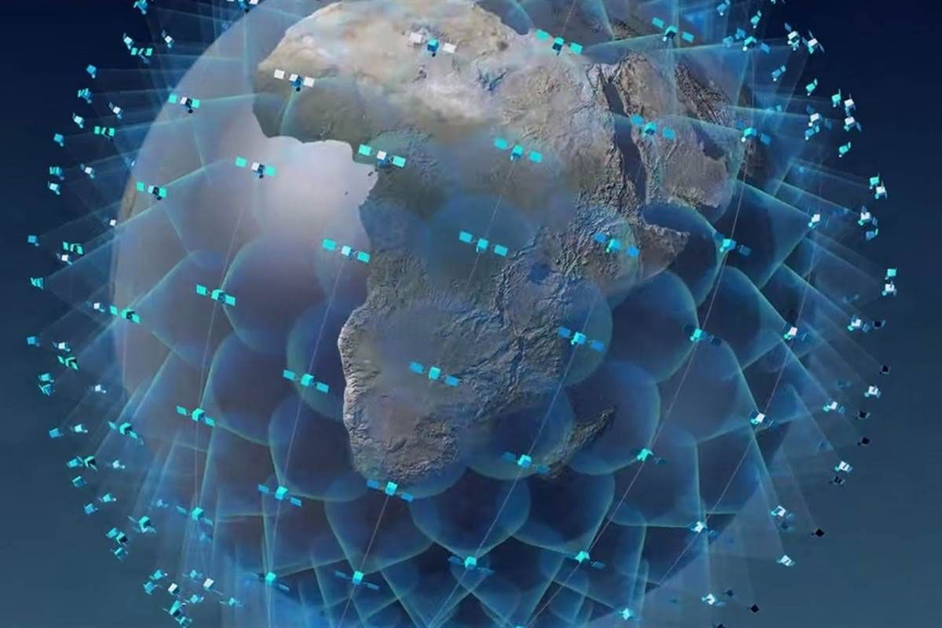
Efforts to close the digital divide
Google’s Project Loon
Facebook’s Aquila Drone
OneWeb’s Proposed
Satellite Constellation

Slide 4
An Alternative and Operational System
No cost to the ‘bit-less’
Provides the ‘bit-less’ information THEY want
Relies on “Open Access” and “Commons-based Peer Production”

Slide 5
Commons-based Peer Production
(Yochai Benkler, 2006)
An internet-based phenomenon, with three key characteristics
Identification of problems and their solutions are “decentralized”
Diverse motivations of participants
Governance is separated from property

Slide 6
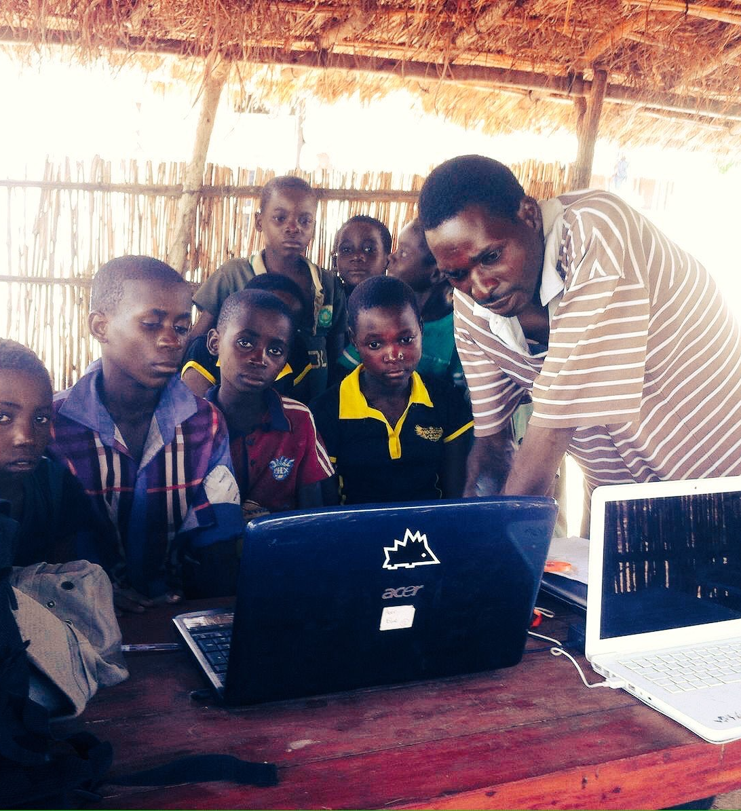
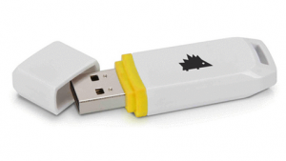
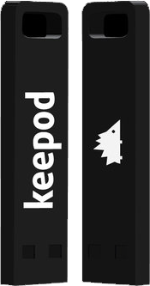
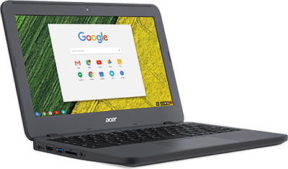
OER Technology Framework: $12 Keepod PC for Students
Keepod v1
Keepod vNext
Keepod USB PC
Boots to Chromium OS
Students use Keepods to access OER

Slide 7
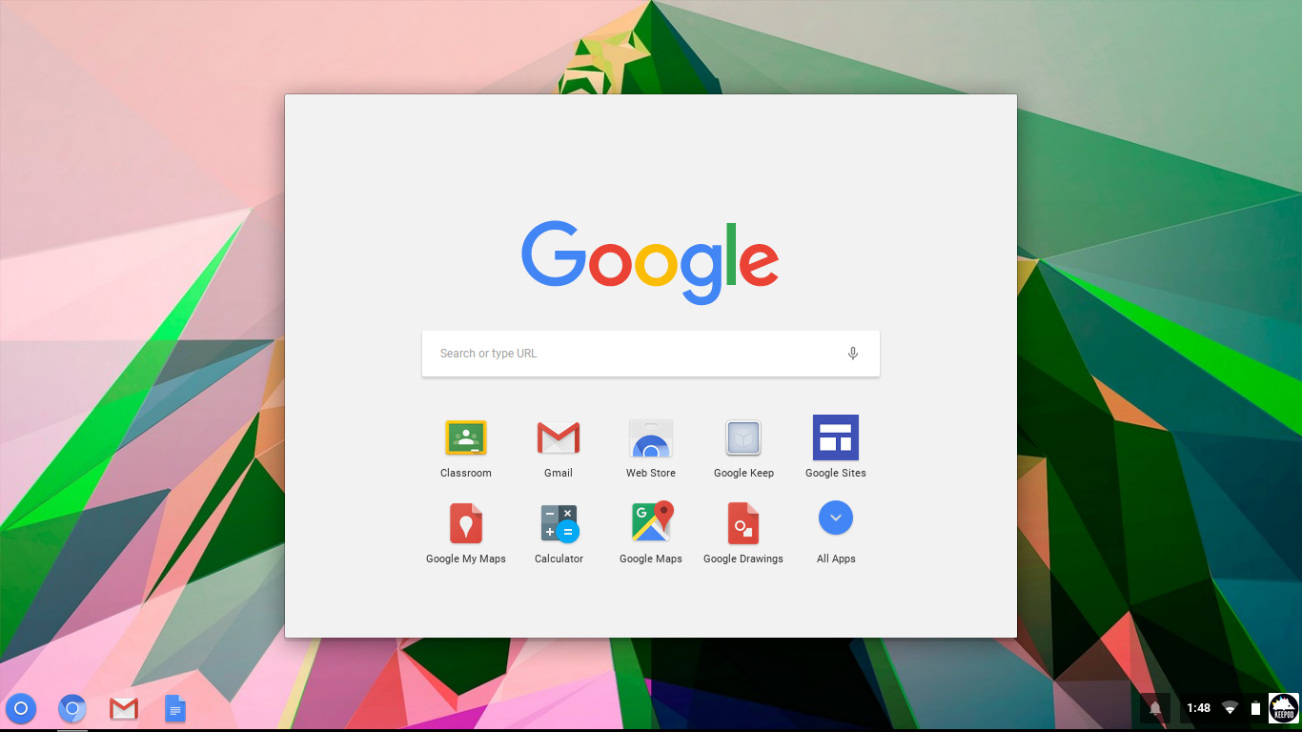
OER Partners: Google Apps for Education

Slide 8
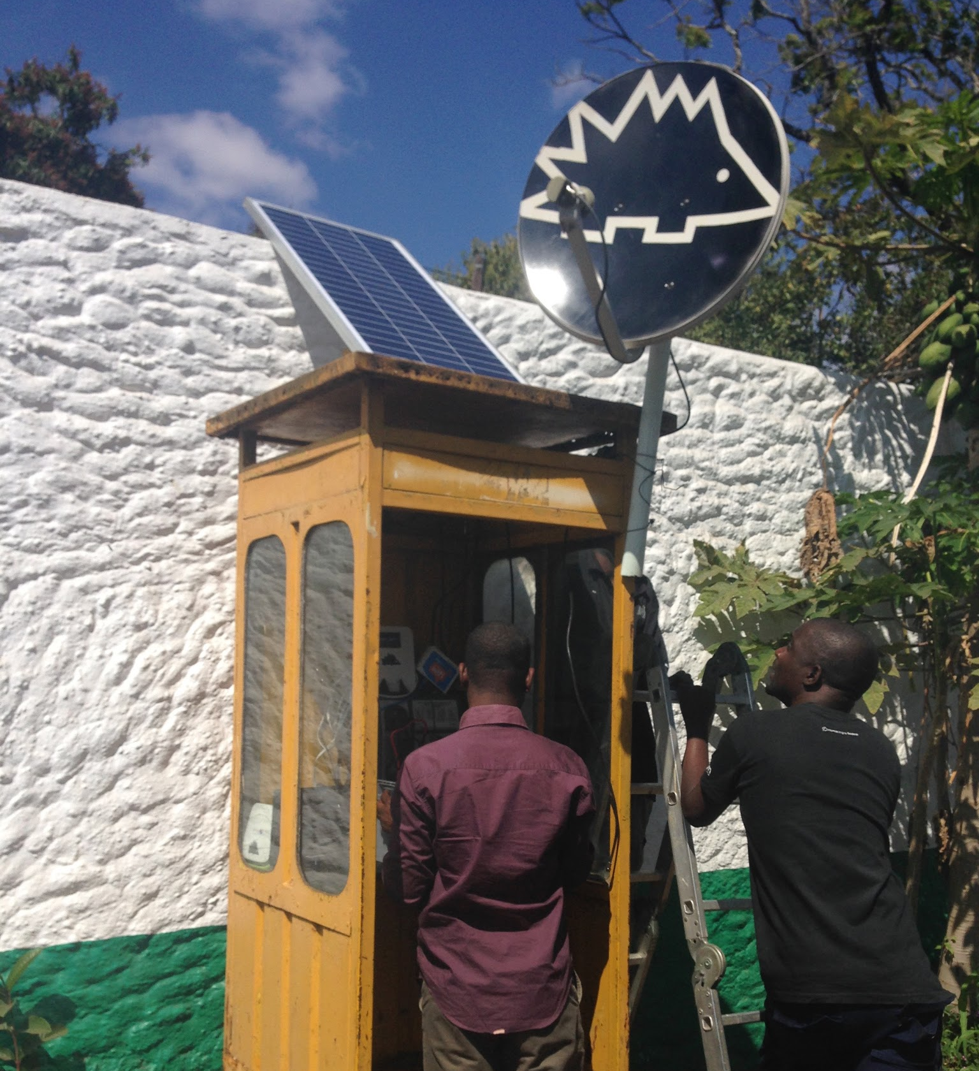
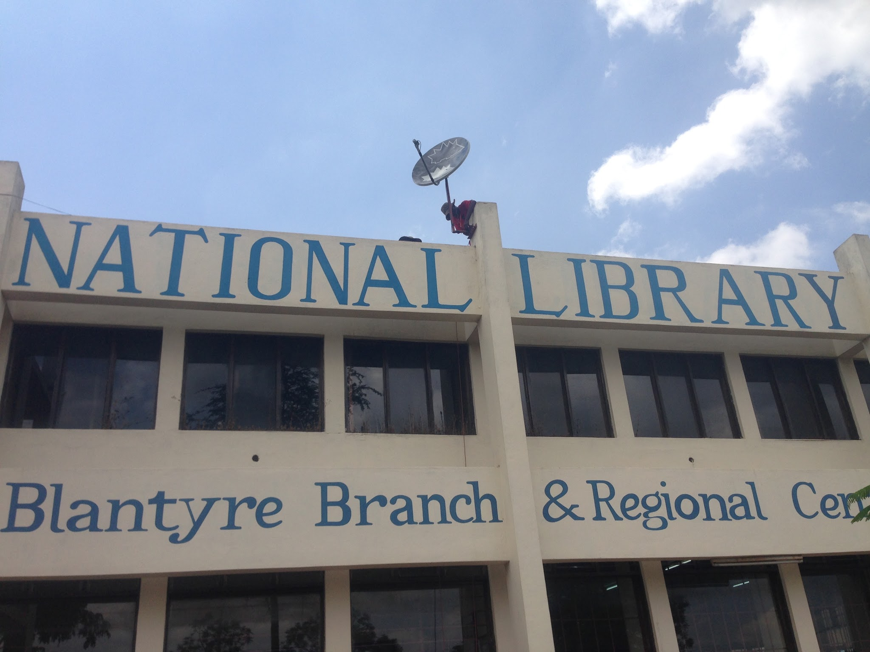
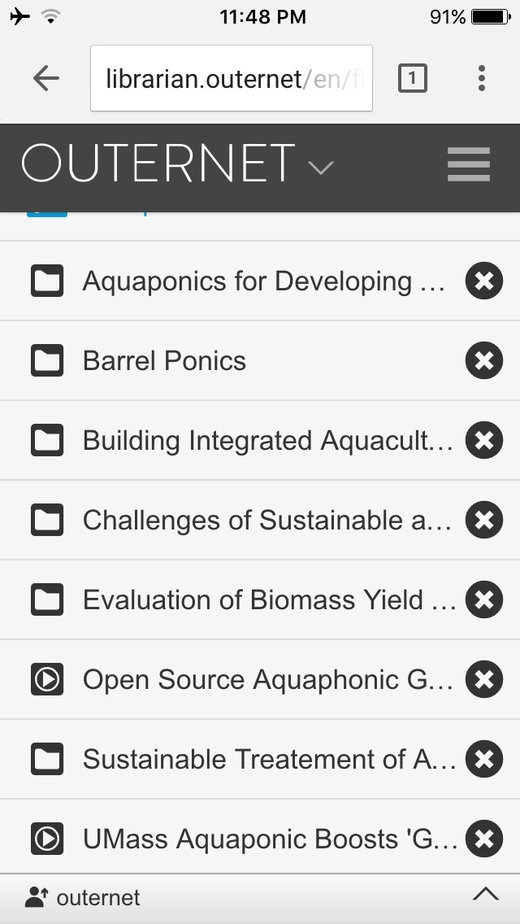
OER Technology Framework: v1…Outernet for OER Delivery
Outernet Mobile Hotspots
Outernet National Library
Outernet Content Browser

Slide 9
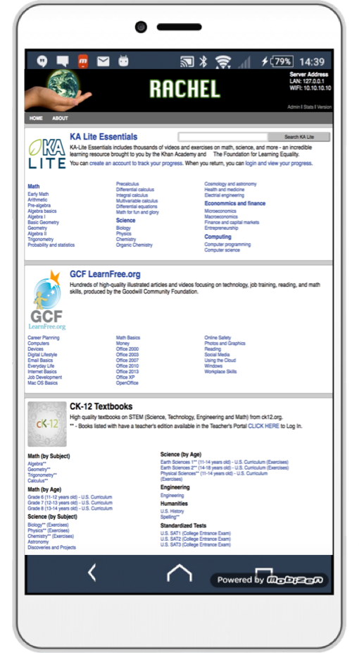
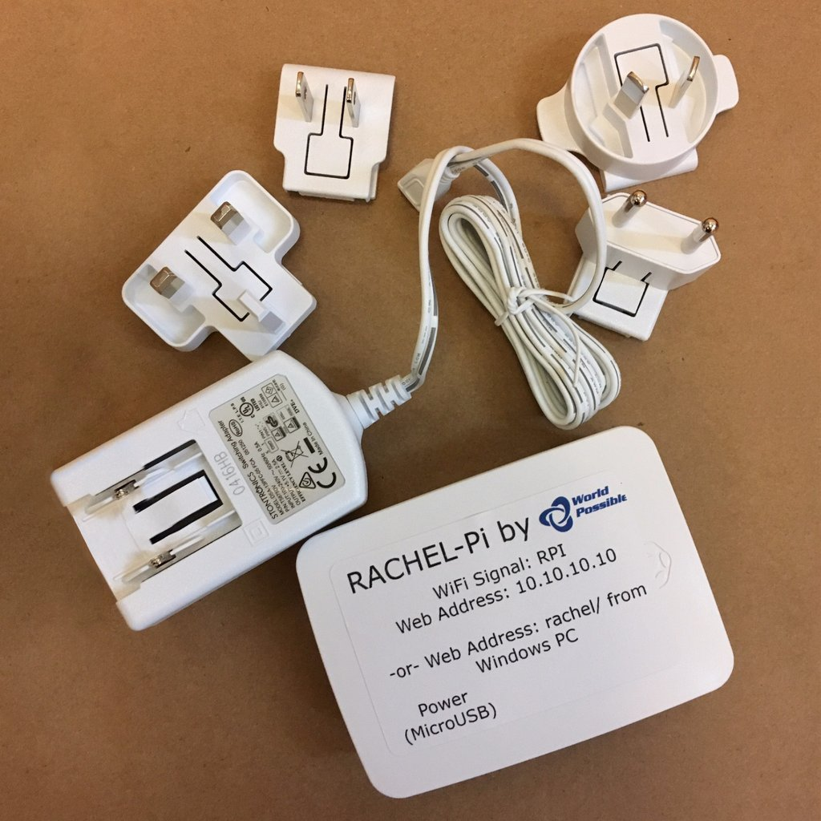
OER Technology Framework: v2…World Possible & Rachel Pi
Rachel Pi Server & Hotspot Device
Rachel Pi OER Content Packs

Slide 10
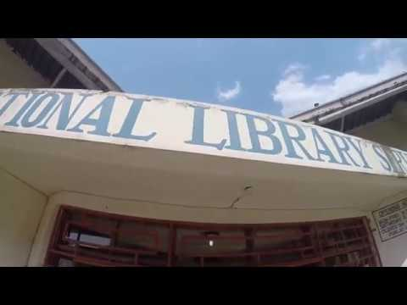
OpenEd 2017 Presentation by Carl Meyer

Slide 11
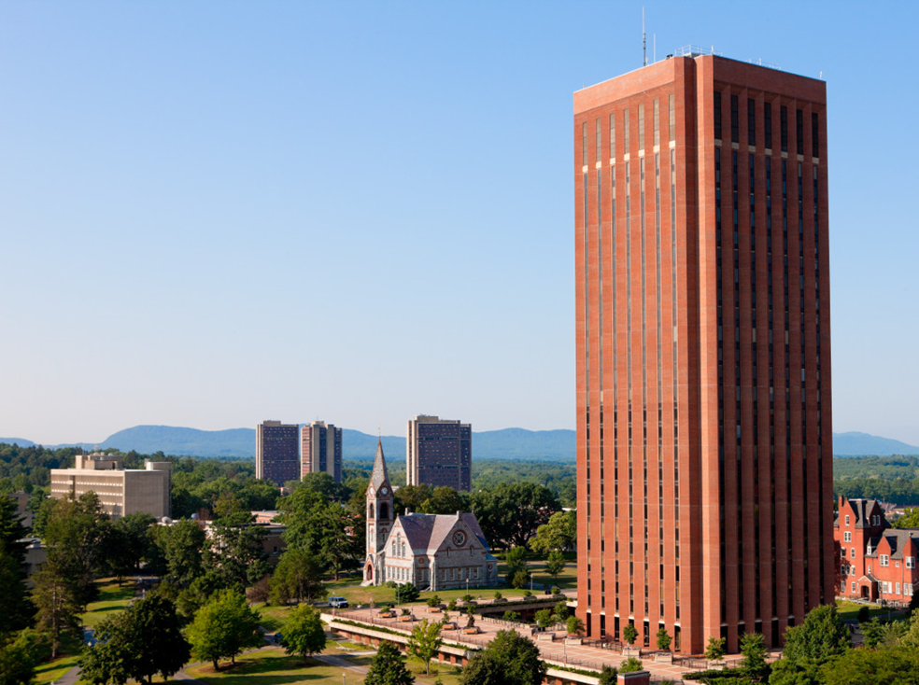
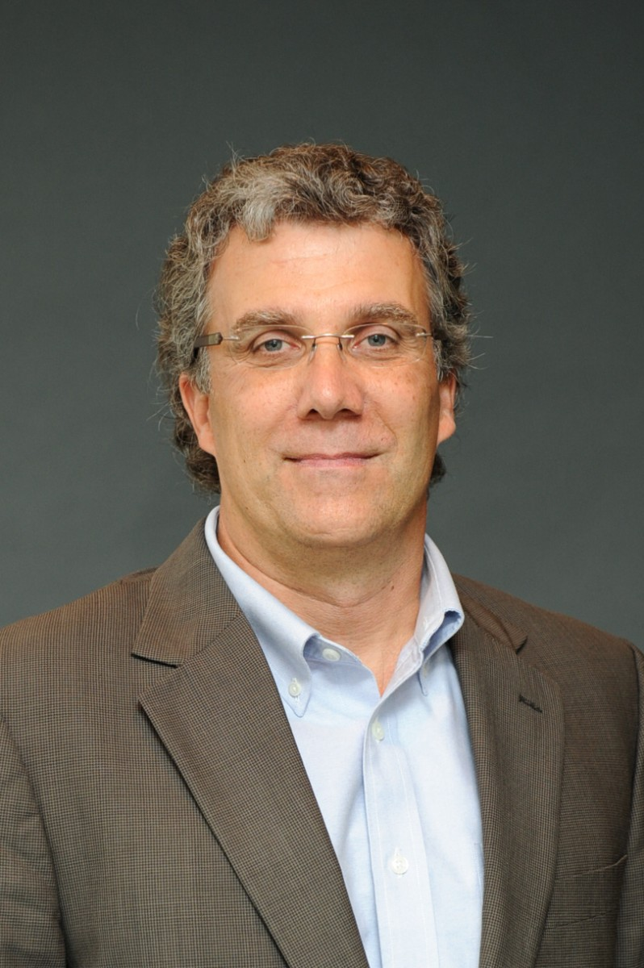
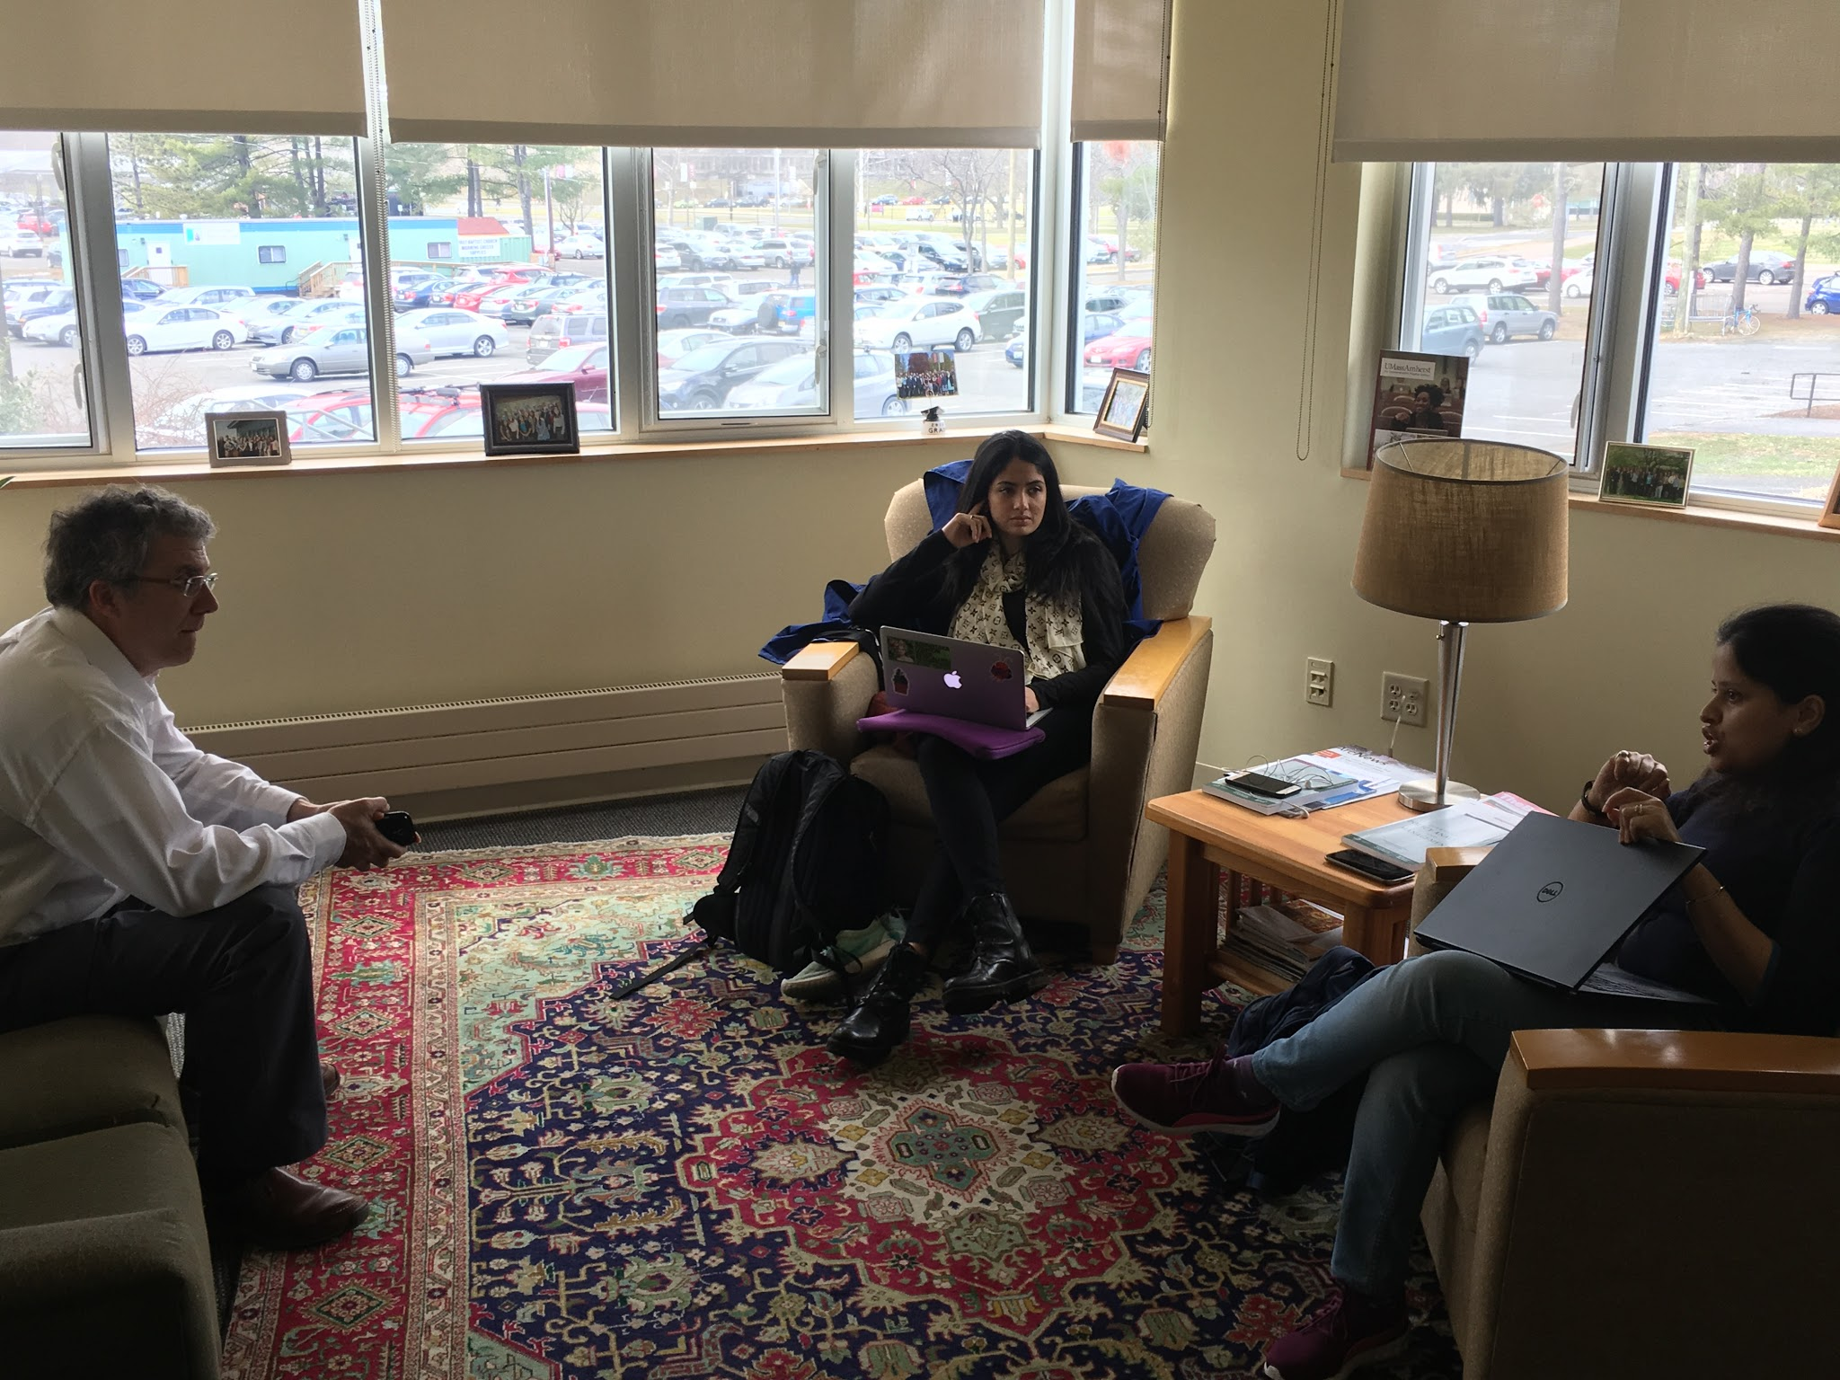
OER Partners: University of Massachusetts Amherst
UMass Amherst Library
Professor Charlie Schweik
School of Public Policy
Global Librarians Team

Slide 12

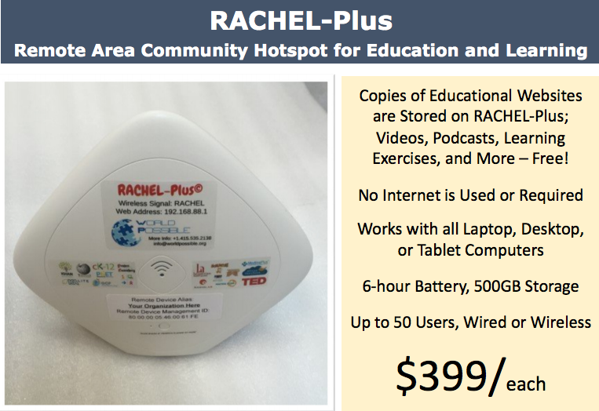
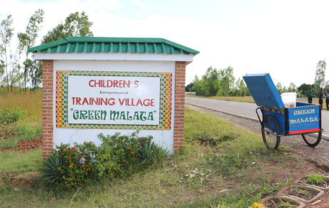
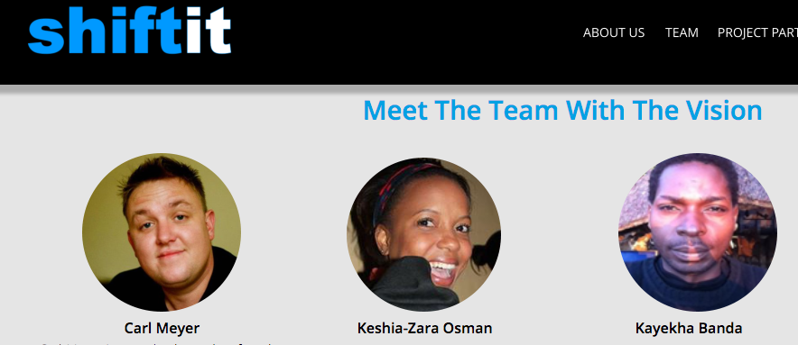

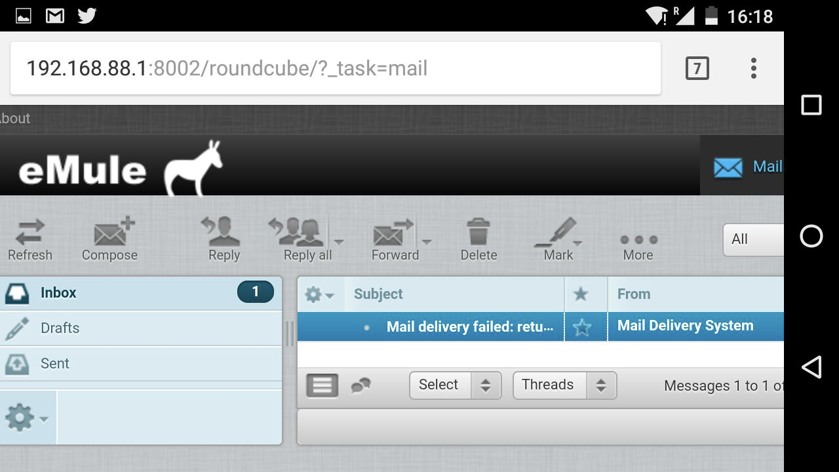


System Components
1. A “Requester” – with a Smartphone or Data Plan
2. World Possible’s “RACHEL Plus”
3. A Peer “Searcher”
4. An “intermediary” in-country Courier with Internet access
5. Communication/Storage systems
Twitter
Google Drive
Slack
eMule

Slide 13
Wi-Fi: RACHEL
Web Address: 192.168.88.1

Slide 14
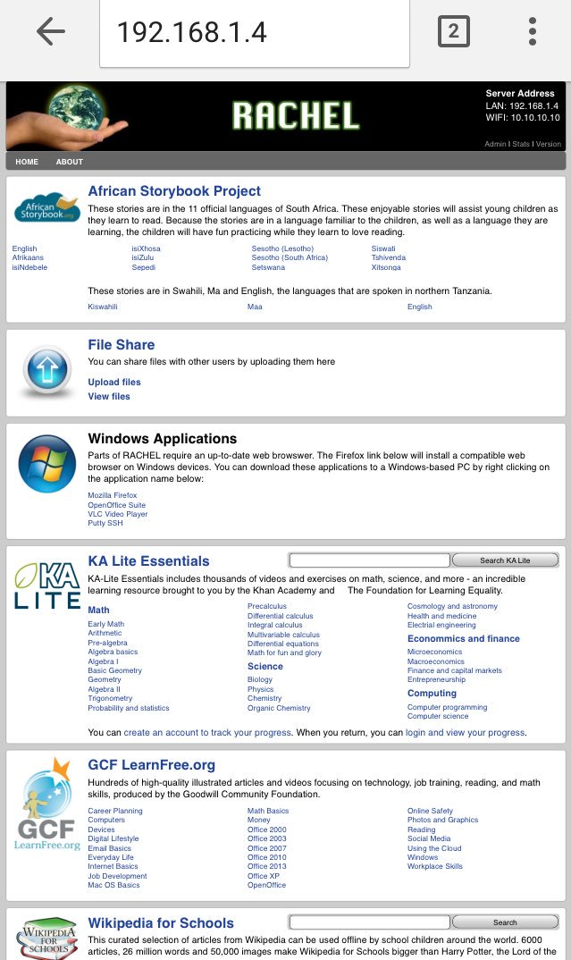
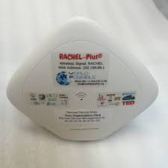

A key
component
for this project

Slide 15

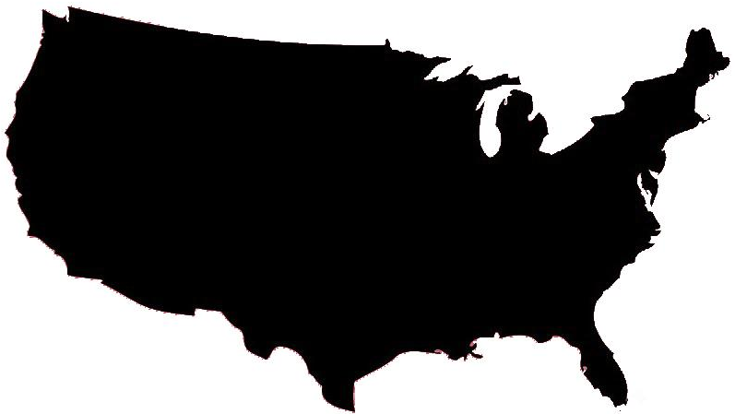
Step 1. Establish Requester – Searcher Peer relationship
Peer “Bit-less” Requester
Intermediary Courier
Peer Searcher

Slide 16
Step 2. Establish Requester – Searcher Communication
Peer “Bit-less” Requester
Teacher or librarian with a mobile data plan
Messaging
Peer Searcher

Slide 17
Step 3. Requester sends a content request
Peer “Bit-less” Requester
Teacher or librarian with a mobile data plan
Content Request
Peer Searcher

Slide 18
Step 4. Request Acknowledged
Peer “Bit-less” Requester
Teacher or librarian with a mobile data plan
Request Acknowledged
Peer Searcher

Slide 19
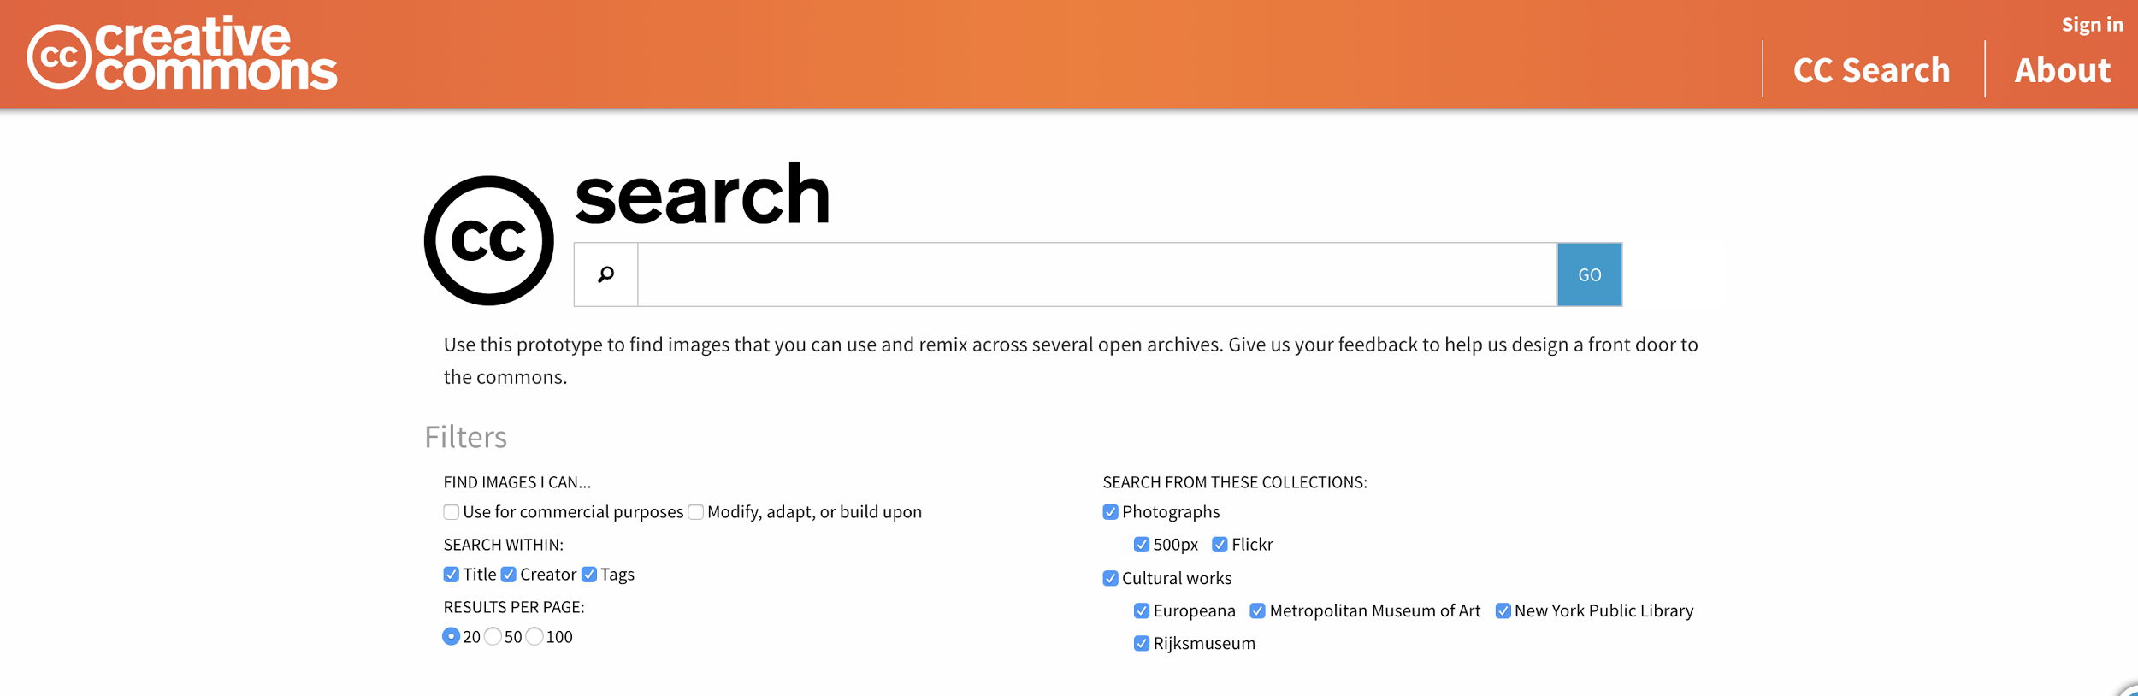
Step 5. Searcher looks for relevant Open Access digital content
PDF
Video
Audio
Peer Searcher

Slide 20
Step 6. Searcher shares found content with in-country Courier
Intermediary Courier
Google Drive
Peer Searcher
Peer “Bit-less” Requester
“Content found, on its way”

Slide 21
Step 7. Courier physically delivers content to requester; uploads to RACHEL Plus
Intermediary Courier
Peer “Bit-less” Requester

Slide 22
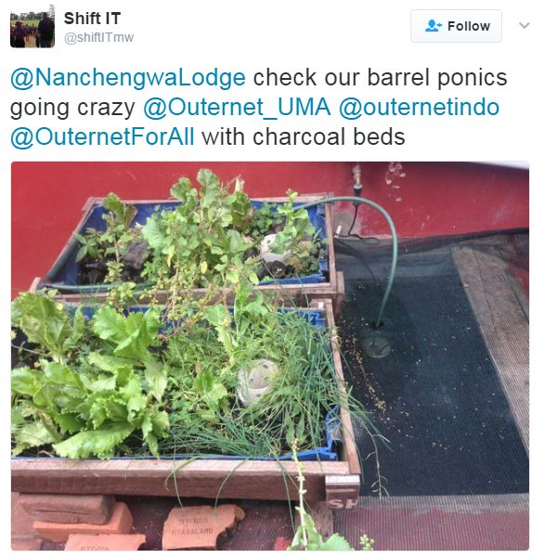
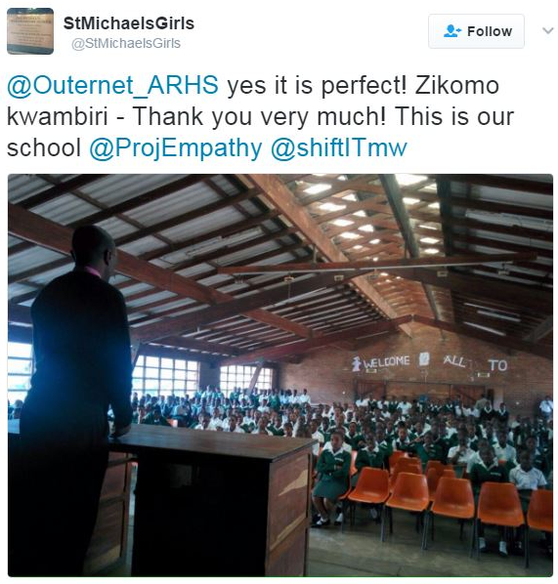
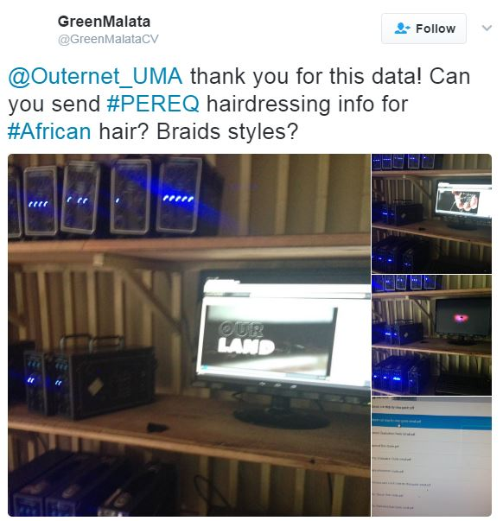
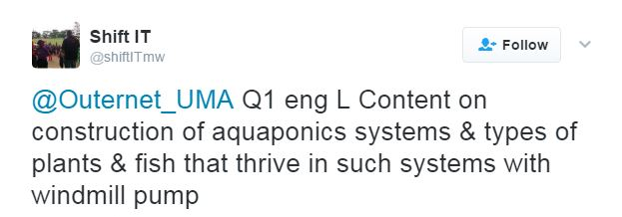
OER Workflow: Captured Feedback Improves the Process

Slide 23
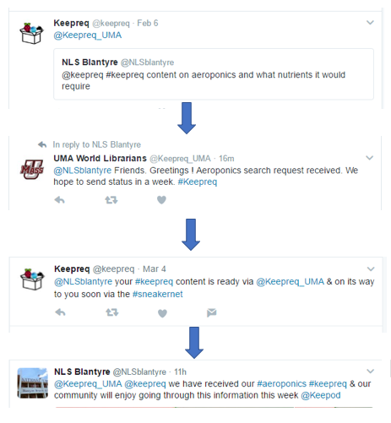
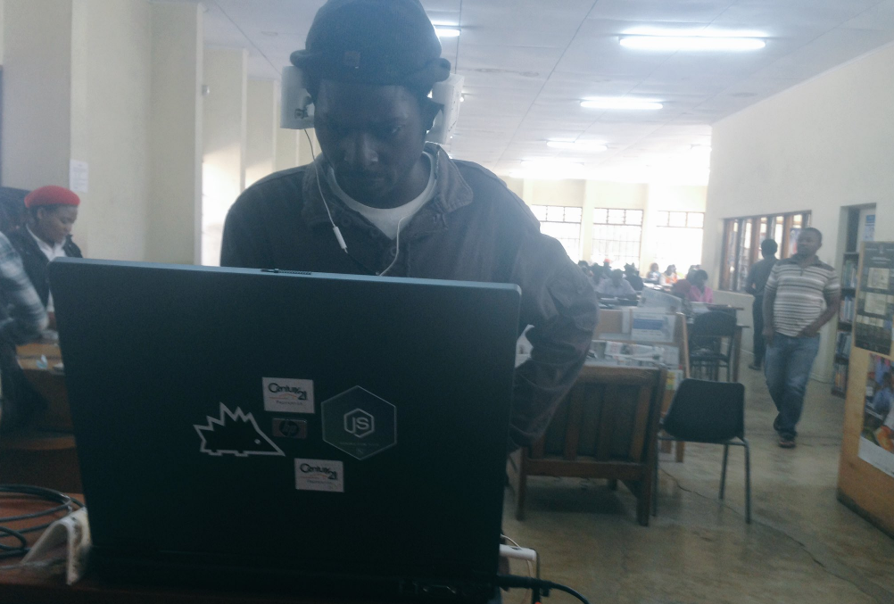
Twitter conversation example
National Library System
Blantyre Branch, Malawi

Slide 24
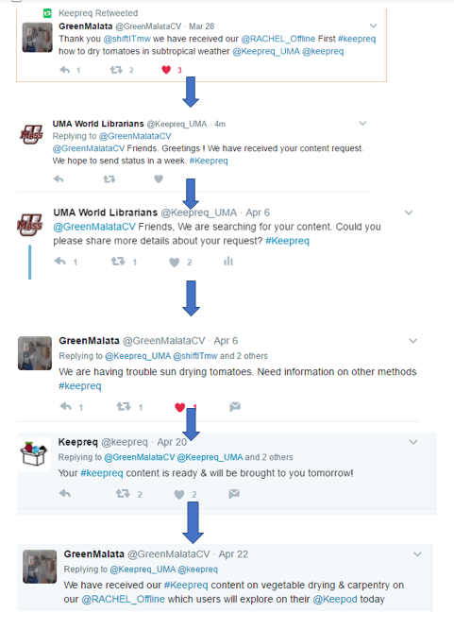
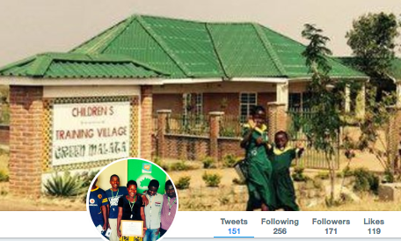
Twitter conversation example
Green Malata School, Malawi

Slide 25
Commons-based Peer Production
(Yochai Benkler, 2006)
Identification of problems and their solutions are “decentralized”
    Problem: Information need by requester
    Solution: Information found by searcher
Diverse motivations of participants
    Searcher motivations: “serious leisure”; Paid (e.g., research librarian); “to do good” (e.g., peer kids in searcher school)
Governance is separated from property
    World Possible’s RACHEL database IS a system where governance is not separated from property
    Request-search-upload IS decentralized, self governing peer to peer system

Slide 26
Conclusion
Multiple operational peer-to-peer instances in Malawi
Want to develop a system that can be replicated and scaled up
Want to expand the peer-to-peer network
By Jeremy Smith, Charlie Schweik, Carl Meyer, Jeremy Schwartz
This work is licensed under the Creative Commons Attribution 4.0 International License.

