Slide 1
Preparing for Migration
~Or~
No, we are not stuffing everything into a box
and moving

Slide 2
FOLIO Timeline
Full update at the FIve Colleges all staff!
Spring 2019
Reprioritization of go live requirements
January 2020
Start migration or another assessment of development
Fall 2019
Assess development in relation to our go live requirements
Summer or fall 2020
FOLIO as
‘System of Record’

Slide 3
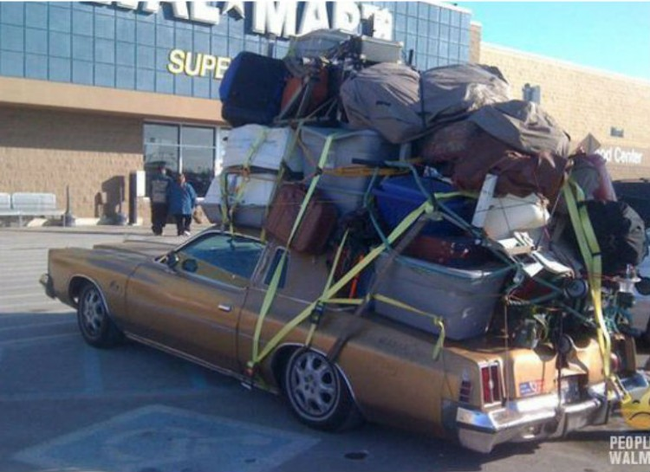

Slide 4
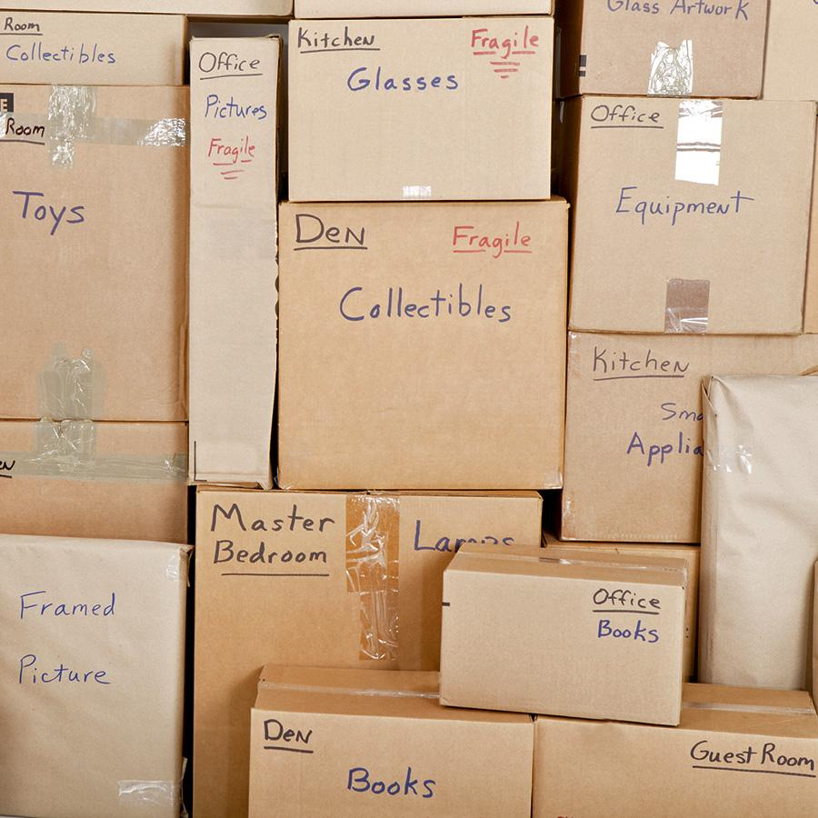

Slide 5
Five Colleges Shared Principles
Shared resource: The Five College libraries collections make up a single and shared library resource.
Best practices: In an agile manner, standardize, streamline and improve best practices.
Alignment: FOLIO is an opportunity to align multiple systems and create a more unified presentation of Five College library data; enabling more seamless access to collections.
https://docs.google.com/document/d/1ebJuwXSYTxG5GCWLOPnPFhS3V7spjvip3nSASusKZ_8/edit

Slide 6
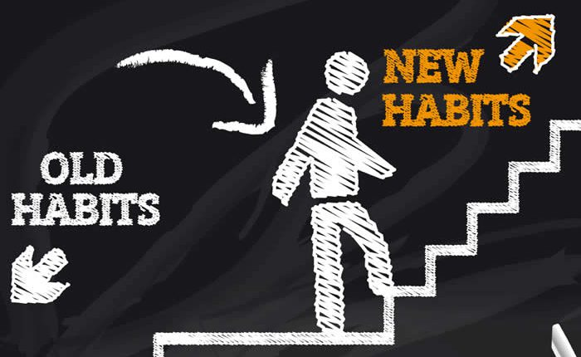
Five Colleges

Slide 7

Aleph Cleanup
Pan-consortial FOLIO project
Responsible shared data management

Slide 8
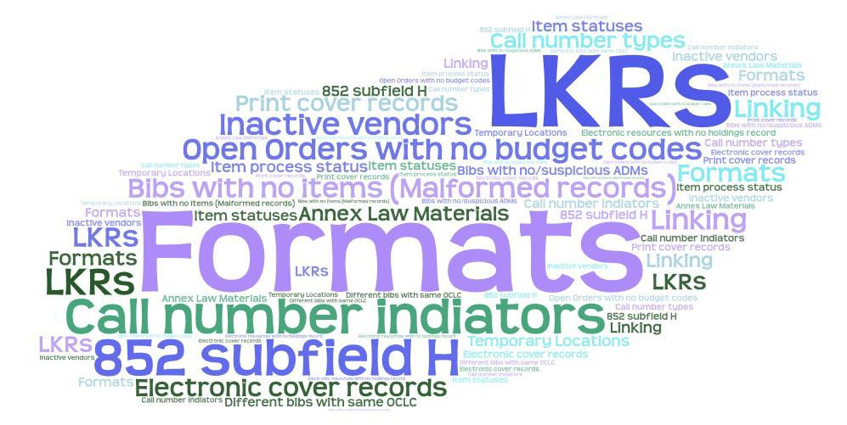

Slide 9
FC FOLIO Working Groups
Bib Merge
Users (to evolve into Circulation fall 2019)
Inventory
Electronic Resources Management
Acquisitions
More to come...

Slide 10
Shared Principle: Shared resources and Alignment
Bib Merge
Recommendation coming July 2019
Less deduplication
Consistency in description
Patron Types
Consistent, universal borrowing privileges
Unique patron groups still welcome (UMA summer programs)
Material Types
Consistency vital for shared Library System Platform

Slide 11
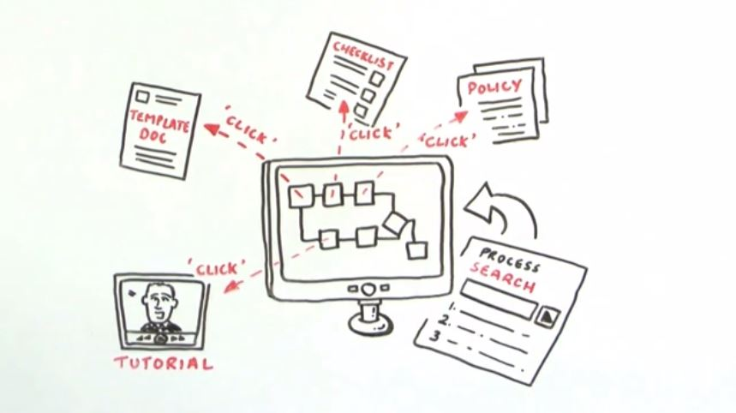
Shared Principle: Best Practices
Documentation review
Standardizing processes
Strategizing for migration
Place your screenshot here

Slide 12
Thanks!
Any questions?
You can find me:
UMA IRM and/or FC FOLIO SLACK
kgberry@umass.edu
Special thanks to all the people who made and released these awesome presentation templates for free at SlidesCarnival

Slide 13
Bib + Holding + Item
FOLIO
To successfully migrate our data from Aleph into FOLIO...
Aleph
Bib
Holding
Item

Slide 14
Aleph Cleanup Projects
Formats
Ilse and Laurence will evaluate and correct inconsistencies.
Call number type
Lucy and David to finish.
Inactive Vendors
Scott and Rebecca vetting vendor records not associated with orders.
852 cleanup
Rick and Kat crafting reports.
Orders with SV status and no budget codes
Scott is evaluating.
DRMS will be given a list to bulk close.
Malformed records
Acquisitions is analyzing records with interesting order statuses.
Rick is pulling v9 together for further distillation.

Slide 15
Five Colleges Shared Principles
Additional functionality: Once core functionality is established, improvements, and additional functionality can be explored and prioritized.
Communication: Commitment to transparent communication throughout all stages of the project.
Respect one another: When we debate and discuss differing opinions, we will always show respect to individuals. All of us will end up compromising on some aspects of the design or the project work. We recognize that this is hard work and time consuming. Many of us may be pushed outside of our comfort zone; however, we will remain respectful to one another.
https://docs.google.com/document/d/1ebJuwXSYTxG5GCWLOPnPFhS3V7spjvip3nSASusKZ_8/edit

Slide 16
SlidesCarnival icons are editable shapes.
This means that you can:
Resize them without losing quality.
Change fill color and opacity.
Isn’t that nice? :)
Examples:

Slide 17
Hello!
I am Jayden Smith
I am here because I love to give presentations.
You can find me at @username

Slide 18
Transition headline
Let’s start with the first set of slides

Slide 19
Quotations are commonly printed as a means of inspiration and to invoke philosophical thoughts from the reader.

Slide 20
This is a slide title
Here you have a list of items
And some text
But remember not to overload your slides with content
Your audience will listen to you or read the content, but won’t do both.

Slide 21
BIG CONCEPT
Bring the attention of your audience over a key concept using icons or illustrations

Slide 22
You can also split your content
White
Is the color of milk and fresh snow, the color produced by the combination of all the colors of the visible spectrum.
Black
Is the color of coal, ebony, and of outer space. It is the darkest color, the result of the absence of or complete absorption of light.

Slide 23
In two or three columns
Yellow
Is the color of gold, butter and ripe lemons. In the spectrum of visible light, yellow is found between green and orange.
Blue
Is the colour of the clear sky and the deep sea. It is located between violet and green on the optical spectrum.
Red
Is the color of blood, and because of this it has historically been associated with sacrifice, danger and courage.

Slide 24

A picture is worth a thousand words
A complex idea can be conveyed with just a single still image, namely making it possible to absorb large amounts of data quickly.

Slide 25
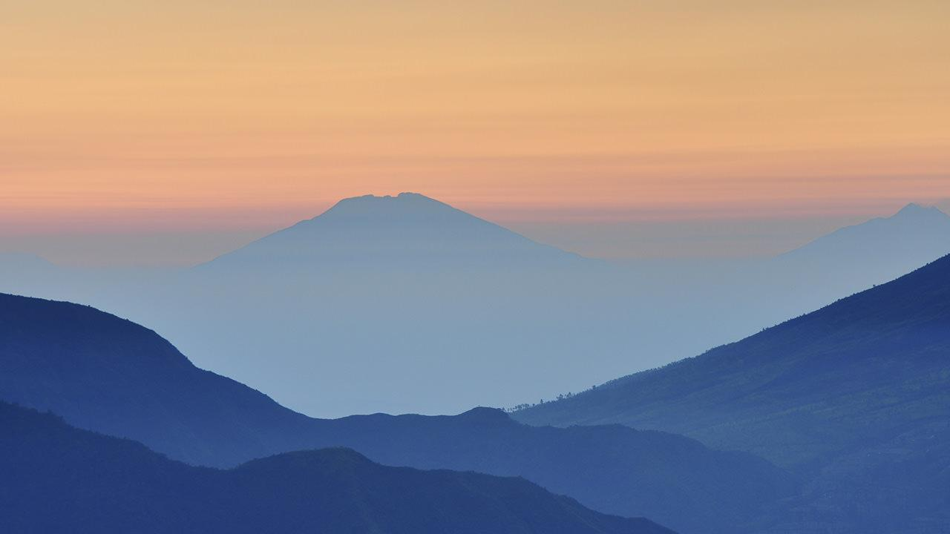
Want big impact? Use big image.

Slide 26
Use charts to explain your ideas
White
Gray
Black

Slide 27
And tables to compare data
 | A | B | C
Yellow | 10 | 20 | 7
Blue | 30 | 15 | 10
Orange | 5 | 24 | 16

Slide 28
Maps
our office

Slide 29
89,526,124
Whoa! That’s a big number, aren’t you proud?

Slide 30
89,526,124$
185,244 users
100%
That’s a lot of money
And a lot of users
Total success!

Slide 31
Our process is easy
first
second
last

Slide 32
Let’s review some concepts
Yellow
Is the color of gold, butter and ripe lemons. In the spectrum of visible light, yellow is found between green and orange.
Blue
Is the colour of the clear sky and the deep sea. It is located between violet and green on the optical spectrum.
Red
Is the color of blood, and because of this it has historically been associated with sacrifice, danger and courage.
Yellow
Is the color of gold, butter and ripe lemons. In the spectrum of visible light, yellow is found between green and orange.
Blue
Is the colour of the clear sky and the deep sea. It is located between violet and green on the optical spectrum.
Red
Is the color of blood, and because of this it has historically been associated with sacrifice, danger and courage.

Slide 33
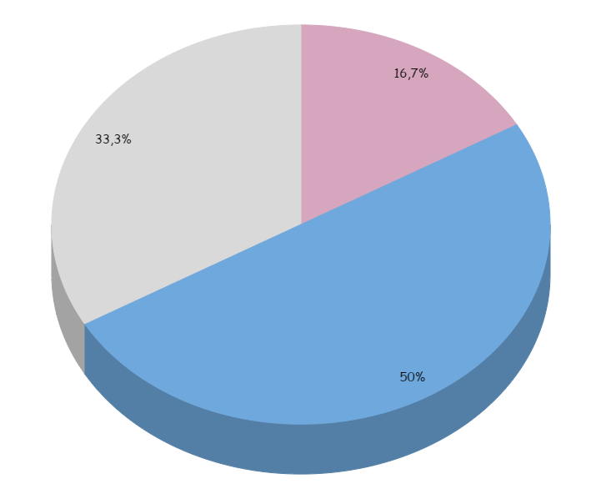
You can insert graphs from Google Sheets

Slide 34
Android project
Show and explain your web, app or software projects using these gadget templates.
Place your screenshot here

Slide 35
iPhone project
Show and explain your web, app or software projects using these gadget templates.
Place your screenshot here

Slide 36
Tablet project
Show and explain your web, app or software projects using these gadget templates.
Place your screenshot here

Slide 37
Desktop project
Show and explain your web, app or software projects using these gadget templates.
Place your screenshot here

Slide 38
Thanks!
Any questions?
You can find me at:
@username
user@mail.me

Slide 39
Credits
Special thanks to all the people who made and released these awesome resources for free:
Presentation template by SlidesCarnival
Photographs by Unsplash

Slide 40
Presentation design
This presentation uses the following typographies and colors:
Titles: Patrick Hand SC
Body copy: Sniglet
You can download the fonts on these pages:
https://www.fontsquirrel.com/fonts/sniglet
http://www.1001freefonts.com/patrick_hand_sc.font
You don’t need to keep this slide in your presentation. It’s only here to serve you as a design guide if you need to create new slides or download the fonts to edit the presentation in PowerPoint®

