Slide 1

Thank You
PLATINUM Sponsor

Slide 2

Thank You
GOLD Sponsor

Slide 3

Thank You
GOLD Sponsor

Slide 4

Thank You
GOLD Sponsor for Session 2C:
Growing Sustainable Communities

Slide 5

Thank You
GOLD Sponsor

Slide 6

Thank You
SILVER Sponsor

Slide 7

Thank You
Conference Supporter

Slide 8

Thank You
PLATINUM Sponsor

Slide 9


Thank You
Conference Supporters

Slide 10

Thank You
PLATINUM Sponsor

Slide 11


Thank You
Conference Supporters

Slide 12




Non-Profit Affiliates
www.amherstarea.com
www.aimnet.org
www.actionnewengland.org
www.cetonline.org
www.myonlinechamber.com

Slide 13





Non-Profit Affiliates
www.energyandsustainability.com
www.cooppower.coop
www.westernmassedc.com
www.greeneconomymedia.com

Slide 14






Non-Profit Affiliates
www.mattcenter.org
www.berkshirepioneerrcd.org/mfep
www.ag.umass.edu
www.massitsallhere.com
And the Northern Tier Energy Sector Partnership
www.fhreb.org
www.gcc.edu

Slide 15





Non-Profit Affiliates
massgreenstcc.com/
www.cleanenergycouncil.org
www.nebaworks.com
www.massecon.com
www.nesea.org

Slide 16






Non-Profit Affiliates
www.newiee.org
www.pvpc.org
www.rebhc.org
usgbcma.org
www.umass.edu/windenergy

Slide 17



Non-Profit Affiliates
www.wne.edu
www.sebane.org
www.umassalumni.com

Slide 18



Non-Profit Affiliates

Slide 19
CEC ‘10 Session Moderators…
Brian Beauregard, Holyoke Gas and Electric
Marybeth Campbell, Massachusetts Clean Energy Center
Vincent DeVito, Institute for Energy & Sustainability
Said Dini, Western New England University
Michael Ryan, President, ACTION, Association of Cleantech Incubators of New England
Jef Sharp, Panève, LLC
Mike Vedovelli, MA Office of Business Development

Slide 20
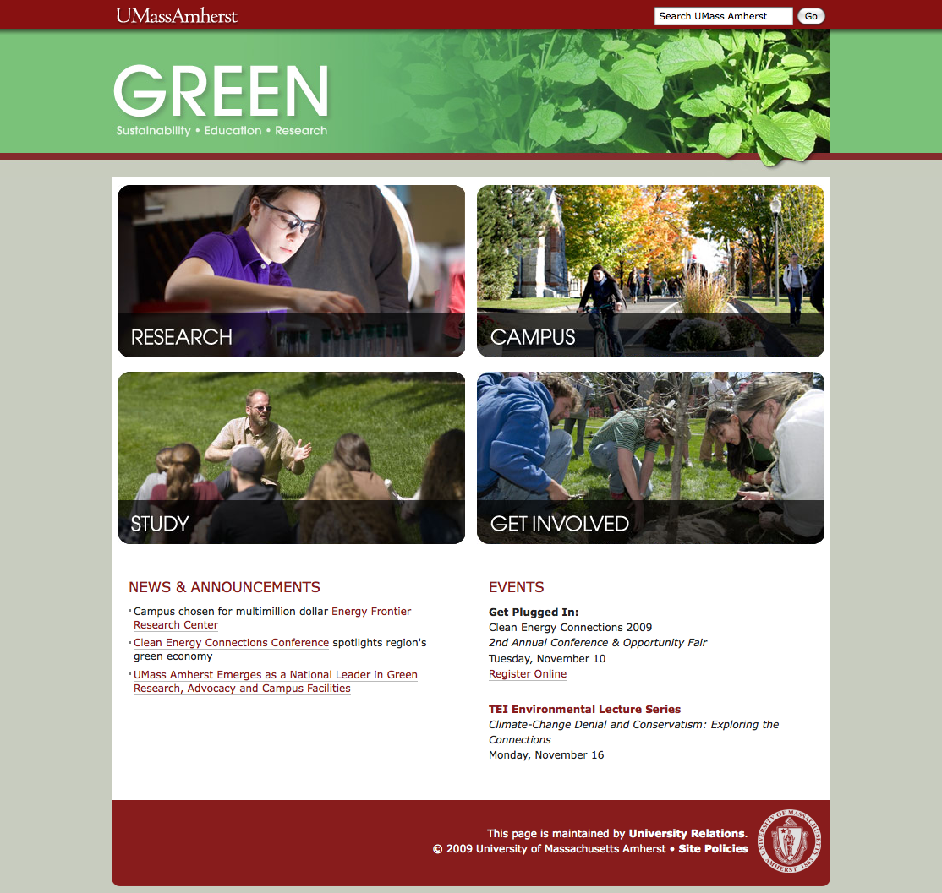
All things GREEN at UMass:
www.umass.edu/green

Slide 21
Strategy to Develop a Green Regional Economy
See Conference Notebook or visit
www.pvpc.org

