Slide 1
Peer Mentoring:
During Transitioning & Turbulent Times
by
Shin Freedman, MLS, MBA
Framingham State University
Presented at
ACRL New England Chapter Conference
May 2021
Shin Freedman sfreedman@Framingham.edu Twitter@ShinFreedman
ORCID http://orcid.org/0000-0003-0710-0146
ResearchGate http://www.researchgate.net/profile/shin_freedman/?ev=hdcxprf
Member of Google Scholars http://scholar.google.com/citations?user=WTFQGkMAAAAJ
Member of Framingham State University Digital Repository http://works.bepress.com/shin_freedman/

Slide 2
Presenter Biography
Head, Scholarly Resources & Collections at Framingham State University
Author of 3 books: Becoming a Library Leader, ACRL, 2020, Narrative Inquires from Fulbright Educators to China: Cross-Cultural Connections in Higher Education, Routledge, 2019, and A Doll for a Day: Growing Up in Post-war Korea, 2019
U.S. Fulbright Scholar to China (2016)
Frequent lecturer on the subject of professional identity of academic librarians; collegiality, civility, and collaboration in academia, & library leadership
Shin has conducted mentoring workshops at Dartmouth College Biomedical Conference (2009);University of Massachusetts, Amherst Campus (2011); SHC (2019 & 2020); Mass. Conference of Chief Librarians of Mass Public Higher Education Institutions (2021)
Currently serve as a mentor for the ALA/ACRL Spectrum Mentoring Committee

Slide 3
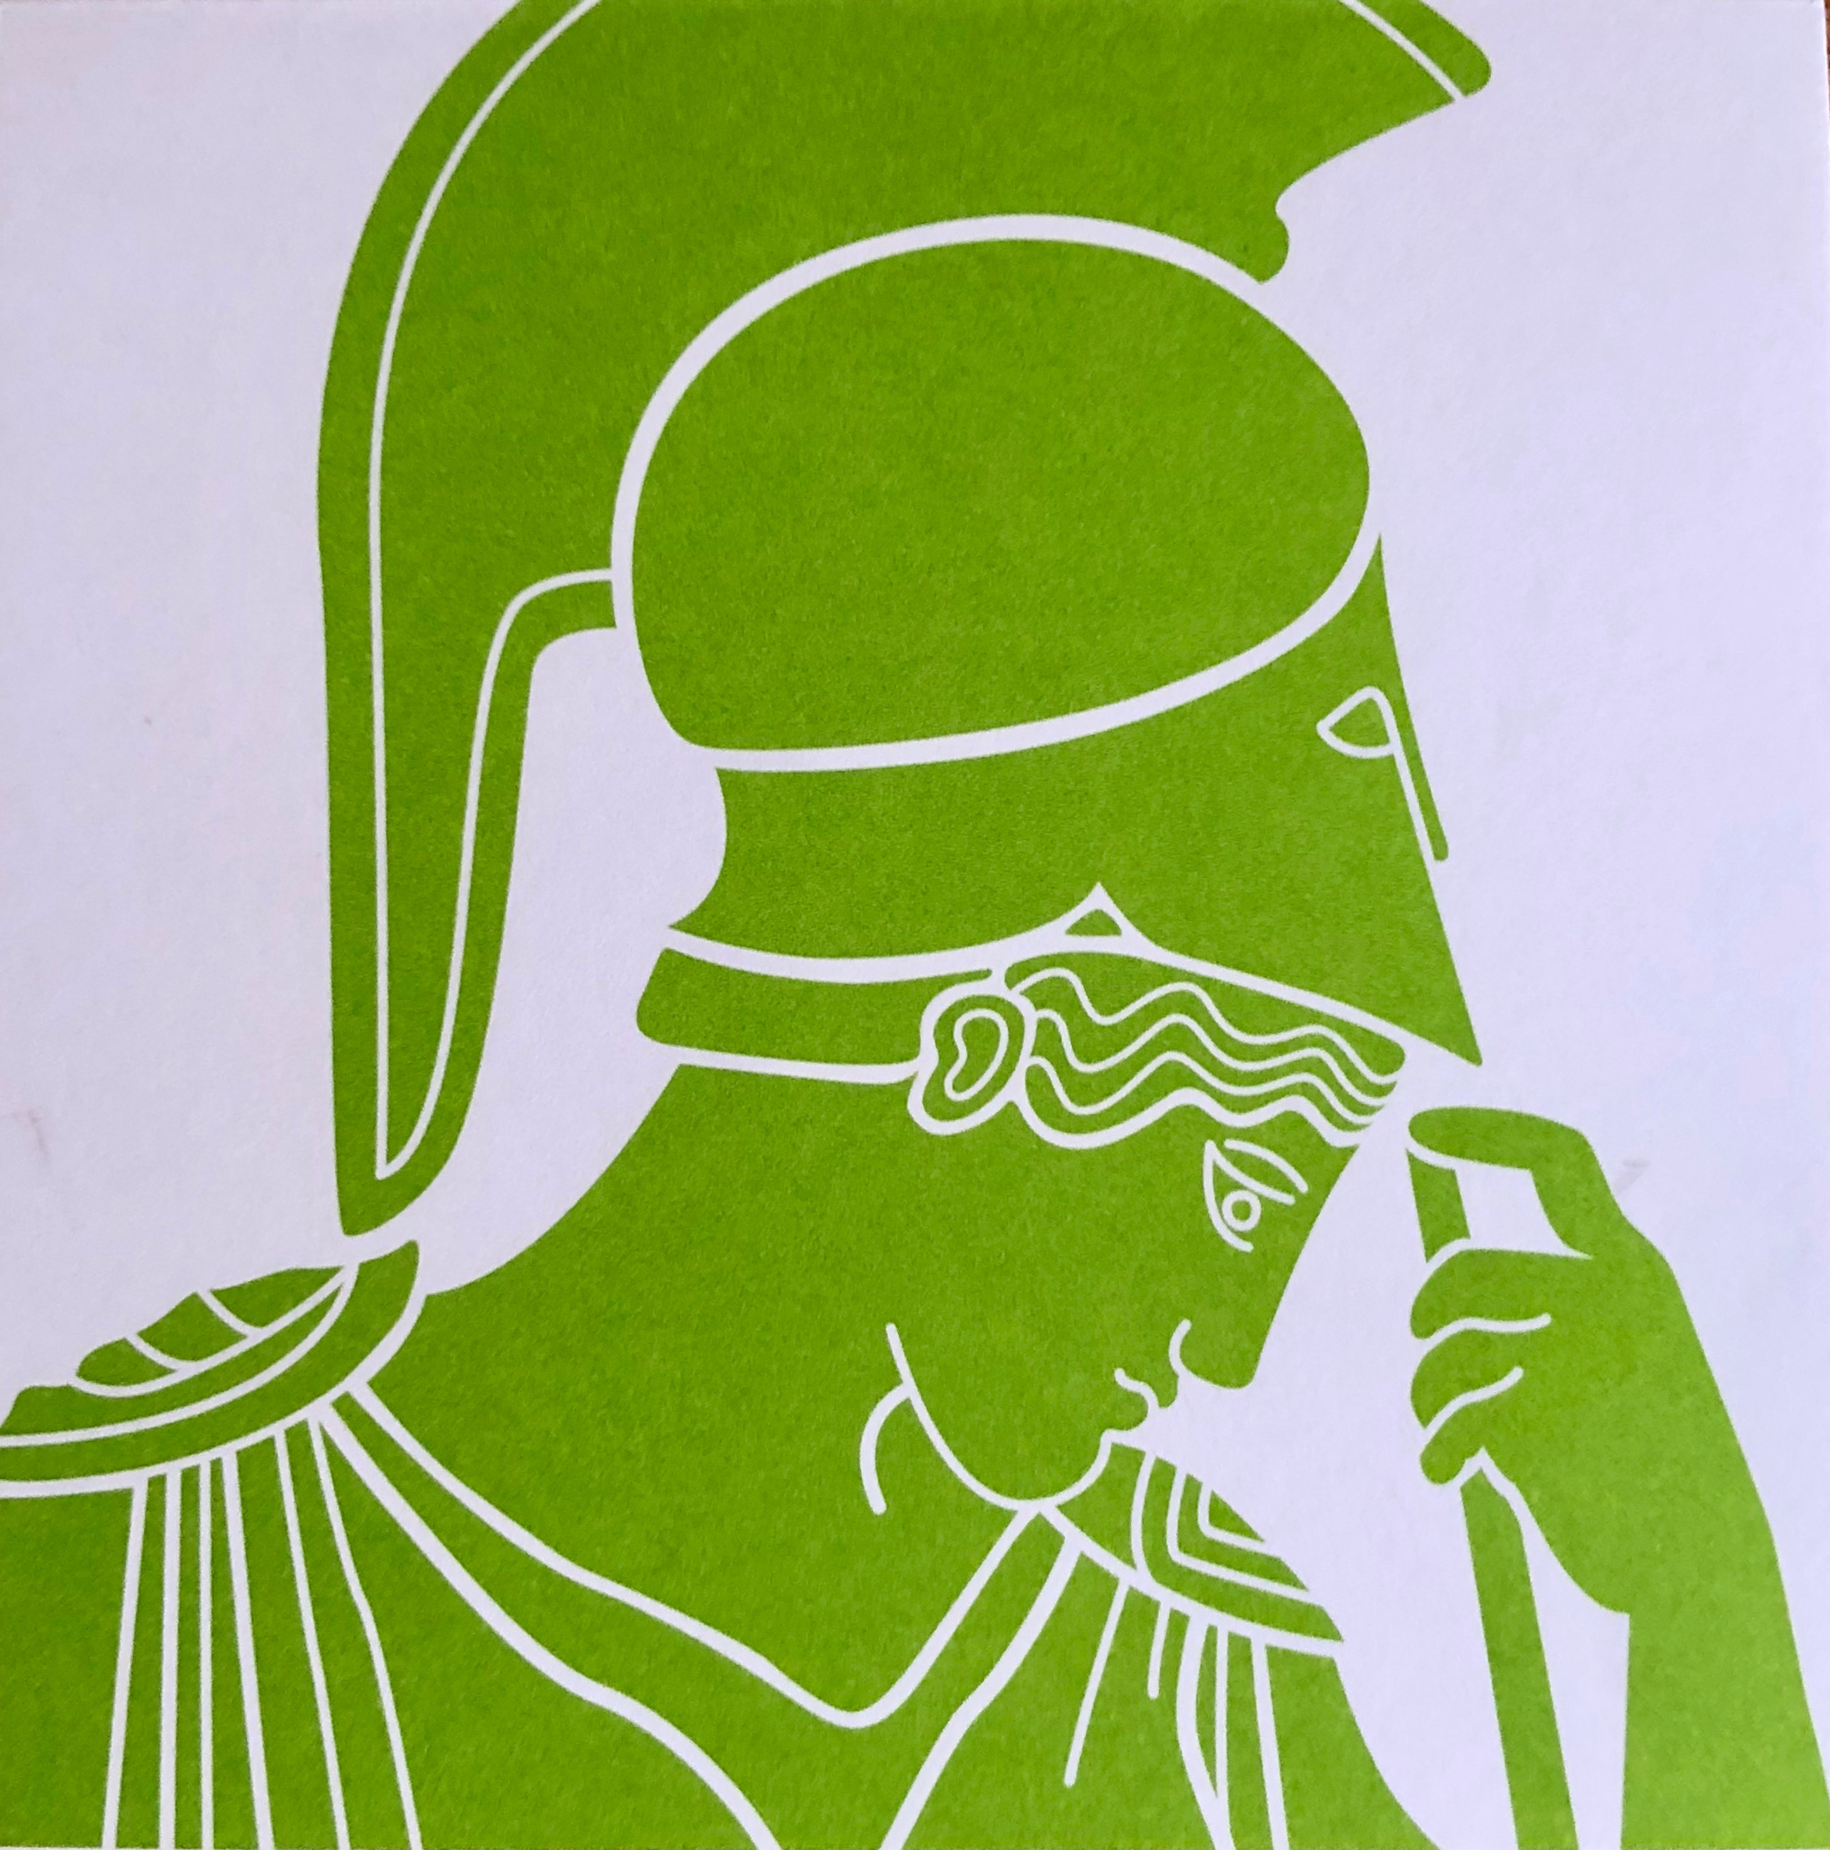
Athena was the First Mentor

Slide 4
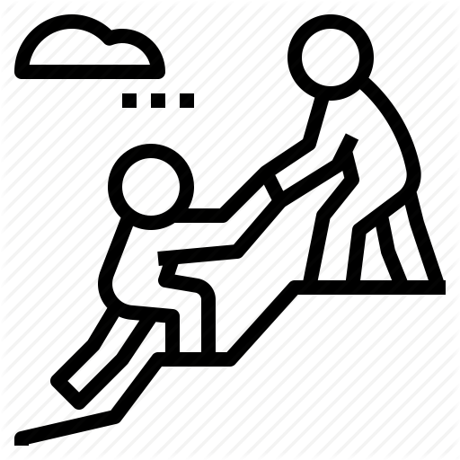


Why Mentoring?

Slide 5
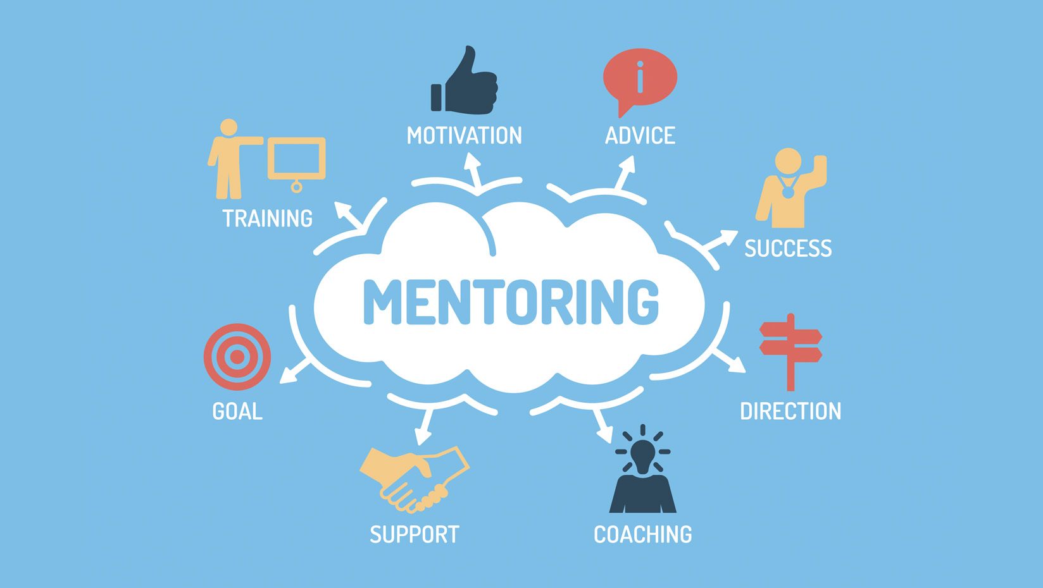

Slide 6
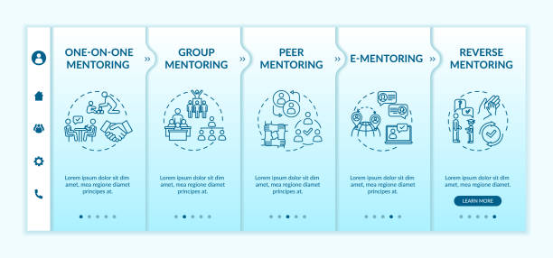
Mentoring Types

Slide 7
How Does Peer Mentoring matter?
Peer mentoring . . .
“preserves most of the benefits of traditional mentoring; while at the same time, it is in greater congruence with values-based transformational leadership and change, the values of librarianship, and the nature of a learning culture.”
(Source: Mary Ann Mavrinac, TRANSFORMATIONAL LEADERSHIP: PEER MENTORING AS A VALUES-BASED LEARNING PROCESS, portal: Libraries and the Academy, 2005 )
Notes:
PMP can fill the void between a FMP and IMP by offering opportunities for brainstorming, problem solving, reflection, and learning environment.
(source: K. Ross, Purposeful mentoring in Academic Libraries, 2013
PMP as a component of prof dev in libraries vs. FMP for tenure track librarians.
(source: A. Level, & M.Mach, Peer Mentoring Program, Library Management, V26, #6/7, 2005

Slide 8
Peer Mentorship
Mentoring, in a professional context, is characterized as an ongoing supportive developmental relationship between a more experienced professional and a less experienced newcomer.
Mentors can provide a variety of psychosocial (role modeling, and identity development) and career-related (org. socialization and professional advice) supports.
Through the transmission of tacit organizational knowledge and explicit practical advice, mentoring relationships enable newcomers to develop essential career competencies and socialize into their professional environments.
(source: Pethrick, H., Nowell, L., Oddone Paolucci, E. et al. Psychosocial and career outcomes of peer mentorship in medical resident education: a systematic review protocol. Syst Rev 6, 178 (2017) doi:10.1186/s13643-017-0571-y)

Slide 9
Characteristics of Effective Mentors/Mentees
Reciprocity,
Mutual respect,
Clear expectations,
Personal connection, and
Shared values.

Slide 10
Actions of Failed Mentorship
Failed mentoring relationships were characterized by
Poor communication,
Lack of commitment,
Personality differences,
Perceived (or real) competition,
Conflicts of interest, and
The mentor’s lack of experience

Slide 11
Peer Mentoring in Action
  Colorado State University Libraries
  Texas A&M's Libraries
  University of Idaho Libraries
  Penn State University Libraries
  Cornell University libraries
  Drexel University Libraries: Peer Mentoring in the Library Learning Terrace Adam Mizelle,
  Brock University. A mentorship in Academic Libraries: A universe of possibilities

Slide 12
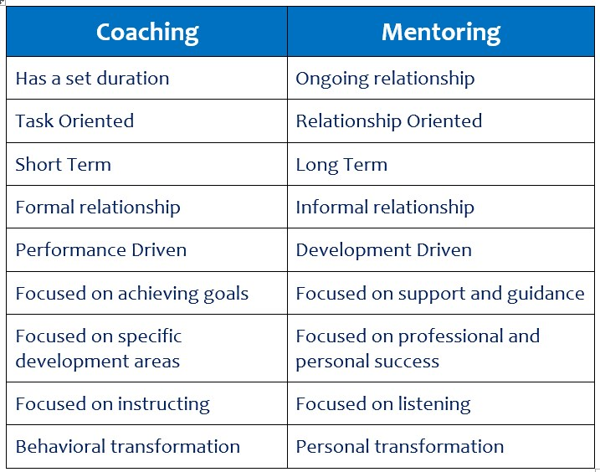
Mentoring vs. Coaching

Slide 13
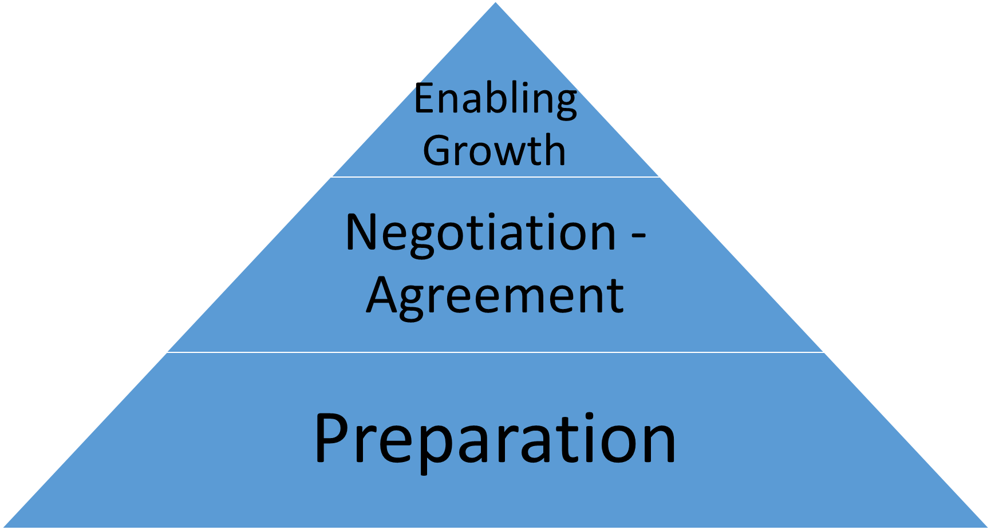
Four Phases of Mentorship
Preparation
Negotiation - agreement
Enabling Growth –
  strategies & 3 different questions to encourage and empower
Coming to Closure

Slide 14
Breakout Session
Discuss your mentoring experience: (positive, negative, or no experience.)
What was the outcome of the mentor relationship?
What was the most important takeaway from this discussion? Please use Chat to record one or two sentences.

Slide 15
Debriefing the Breakout Session

Slide 16



3 Takeaways on Peer Mentoring

Slide 17
Further Reading on Mentoring
Allen Darryl. “The dynamic mentoring primer: Exploring mentorship technology. Kettering: Mentorship Institute, Inc. 2012
Barrette-Ng, N., Nowell, L., Anderson, S.J., Arcellana-Panlilio, M., Brown, B., ... & Wilcox, G. The Mentorship Guide for Teaching and Learning. Calgary, AB: Taylor Institute for Teaching and Learning Guide Series. 2019
Beltman, S., & Schaeben, M. (2012). Institution-wide peer mentoring: Benefits for mentors. The International Journal of the First Year in Higher Education, 3(2), 33-44.​
CILIP. (2016). Mentoring for CILIP Professional Registration: Handbook to Support Mentors. https://libguides.exeter.ac.uk/ld.php?content_id=32480819
Owen, H., & Kogan Page. (2011). The complete guide to mentoring : How to design, implement and evaluate effective mentoring. London, England: Kogan Page Limited. TBA
TRIEC Mentorship Partnership. (2017). Tools for Mentors and Mentees. http://www.mentoringpartnership.ca/mentoring-tools/
University of Louisville (2020). Established Departmental Peer Mentoring Programs at U of L. http://louisville.edu/graduate/mentorcenter/Resources
Zachary, L. (2012). The mentor's guide: Facilitating effective learning relationships. San Francisco: Jossey-Bass.
Shin Freedman, Mentoring Experience of Academic Librarians: A Pilot Study of Mentorship in Academic Libraries , Journal of Library Leadership and Management, 35, no 2,2021

Slide 18
Q & A
Questions on peer mentoring, or want to talk about mentoring?
Email me: Shin Freedman sfreedman@Framingham.edu
Shin Freedman sfreedman@Framingham.edu Twitter@ShinFreedman
ORCID http://orcid.org/0000-0003-0710-0146
ResearchGate http://www.researchgate.net/profile/shin_freedman/?ev=hdcxprf
Member of Google Scholars http://scholar.google.com/citations?user=WTFQGkMAAAAJ
Member of Framingham State University Digital Repository http://works.bepress.com/shin_freedman/

