Slide 1

Mapping Out Your Research:
From Topic Selection to a Thesis Statement
Created by Lindsay LaChapelle & Alicia Vaandering
September 2019

Slide 2

Hello!
Lindsay LaChapelle
Writing Center Coordinator
Salve Regina University
You can find me at lindsay.lachapelle@salve.edu
Alicia Vaandering
Student Success Librarian
University of Rhode Island
You can find me at avaandering@uri.edu

Slide 3
Background
Taught to 300-level history class with primarily sophomore and junior history majors
Most students had previous experience with library and Writing Center instruction
Focus on topic development, drafting research question, and identifying next steps of research and writing
Goal: reinforcing concepts and skills

Slide 4
Objectives
To identify the issues and unique perspectives that are part of your research topic.
To draft a unique research question.
To articulate how to move from a research question to a working thesis and into the next steps of your research.

Slide 5
Overview
Topic speed dating: explore and focus your research topic
Developing a research question
Creating a research strategy
From research question to thesis statement

Slide 6

Topic Speed Dating
1-2 minutes | 1 person shares topic and potential directions
1-2 minutes | 2nd person responds with questions, feedback, and suggestions/general discussion of potential sources and keywords
Switch and repeat
1 minute | Write major takeaways on worksheet

Slide 7

Reflect
Consider the conversations you had with your peers and the feedback you received.
How did the way you explained your topic change from one conversation to the next?
How has talking about your topic helped you to focus the scope?
What keywords have you brainstormed after discussing your focused topic?
What questions do you still have?

Slide 8
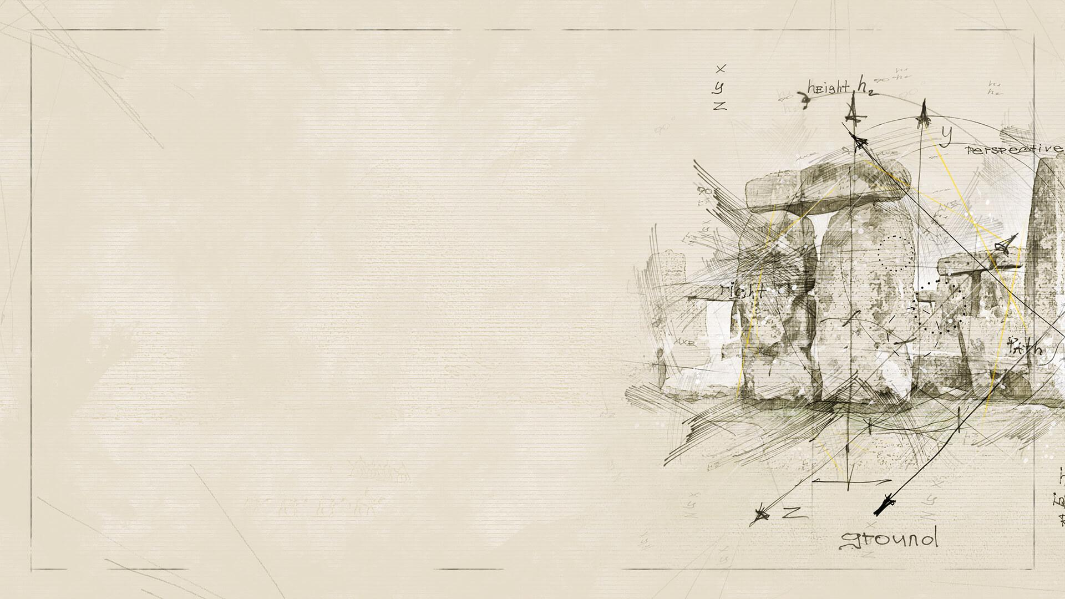
Getting Started with
Research Questions
Research questions should be:
    Open-ended
    Specific
Types of research questions
    Cause and effect questions: explore how one thing or event impacts another
    Comparison questions: explore the differences and/or similarities between two or more things
    Significance questions: explore the significance of something, an event, or a person

Slide 9
Examples:
“Why did Robert E. Lee surrender his Confederate army at Appomattox Court House?”
“How did the military service of Irish-American soldiers reduce nativism in the North during the war?”

Slide 10
Be Strategic and make a plan!
Ask yourself…
What information do you need?
  *think about the scope of your information need
What types of sources do you need to find your information?
What tools do you need to find your sources?
  Databases
  Library catalog
  Search engines
What terms should you use to search for sources?

Slide 11
What is a Thesis?
brief, succinct response to your research question
stance that demonstrates critical thought about a topic
specific, often complex, focus for the writing
idea that shows insight about a topic
statement that is supported by the body of the essay

Slide 12
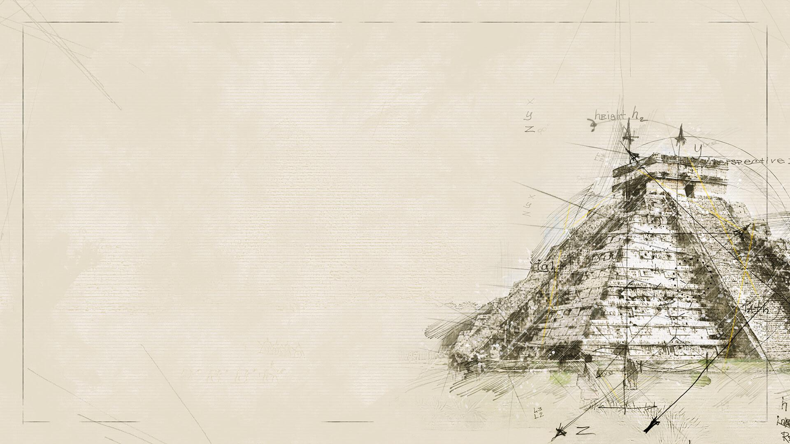
The thesis is the "so what" of your paper.
It may:
say why or how
say why we should care
make specific comparisons
make an evaluation
consider the consequences

Slide 13
Research & Thesis
Your research serves as evidence that backs up your thesis and subpoints in each body paragraph
Allow your research to guide your thesis
Your research will then help shape your argument and how you differentiate main ideas in each body paragraph
Your quotes and paraphrases must support your thesis
  If they don’t then, create a counterargument
  This helps to strengthen your points featured in the paper
A thesis is “working”-subject to changes
Patterns in your research may affect a specific idea, diction, and phrases used in your thesis

Slide 14

Thanks!
Any questions?
You can find us at:
lindsay.lachapelle@salve.edu
avaandering@uri.edu

Slide 15

Credits
Special thanks to all the people who made and released these awesome resources for free:
Presentation template and backgrounds by SlidesCarnival
Photographs by Unsplash

